Slide 1


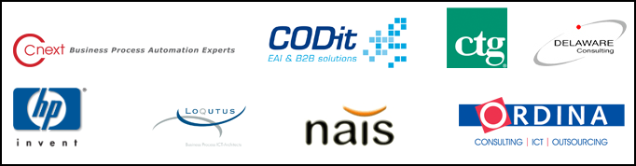
COUNCIL
APRIL 16, 17 2008

Slide 3
Real World SOA
Aligning Business and IT
Thomas Reimer
Enterprise Technology Strategist (CATM)
Microsoft Corporation

Slide 4
Agenda
SOA – Business Perspective
Aligning Business Agility and IT
Benefits of SOA and Dynamic IT
Microsoft Real World SOA
Business Value Approach
Microsoft SOA Platform
Analyst Perspective and Customer Momentum
Composite Application Demo
Getting Start with SOA
SOA Roadmap
4 Value Patterns

Slide 5
IT Brakes Growth
According to A.T. Kearney (2007 survey) companies lose 6% of their growth in sales per annum because their IT does not meet the current business requirements.

Slide 6

Business Structure Is Fleeting
Driven by Market Change, Competition, and M&A
75
Average company tenure in the S&P 500
65
55
45
35
25
15
5
-5
1938
1948
1958
1968
1978
1988
1998
2008
Source: Dick Foster, “Creative Destruction”
Notes:
What is the challenge for companies today … Business success is fleeting
“Why we are all here ....”
“clearly problem with agility – and now companies are starting to step up ... Look at SOA trend”
Business face unprecedented pressures to change
Competition (Neutalization)
Compliance / (Productivity
Innovation (Differentiation)
Dick Foster, author of Creative Destruction and managing partner/director @ Mckinsey and Co (now director at Innosight group)
“They need to innovate, reinvent, create new market opportunities” ie be AGILE
This all requires a business structure and organisation which can adapt and change
IT & Business together can provide innovation
Link together with new business and partners to create new services
Create greater efficiencies by driving out non-core business elements
Reconfiguration of organisation more easily
From vertically integrated to horizontally integrated agile processes & functions
This graph is one indicator of the business climate we all face today. It shows that the average tenure of companies in the S&P 500 has dropped from over 75 years to about 15 years. Companies come and go more quickly than ever before. The bottom line is - business success is fleeting.
So to remain successful why are businesses demanding this new era of innovation
[next slide]

Slide 7
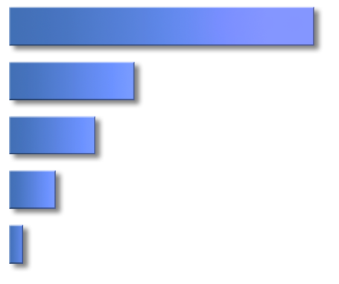
CEOs Demand Innovation for Growth
Ability to innovate
Ability to allocate the best talent
Ability to manage a global organization
Ability to allocate capital
Ability to manage increasing regulation costs
0
30
60
Source: March 2005 McKinsey Quarterly survey of 9,345 global executives
IT organizations overcome complex environments to deliver results.
Yet: With an increasing pace of markets change, only 1 in 10 CEOs believe their company has the ability to be very responsive.
Notes:
Therefore given business success is so fleeting, not surprising that the ability to innovate is a key priority for CEOs, as shown here from this McKinsey research.
One of the striking findings in this research is that only 1 in 10 CEOs thinks their organization can innovate today
So CEOs want to innovate, and want flexibility to allow strategic innovation
To remain competitive there are 3 key challenge areas business wants to be addressed:
Differentiation – Incremental advantage; develop unique value; or maybe price advantage. Investment determined by margin of improvement.
Neutralization – Catch up or overcome an advantage of a competitor. Investment good enough is enough – invest enough to achieve goal
Productivity – Realize cost reductions, efficiencies in process. Investment case-by-case driven.

Slide 8
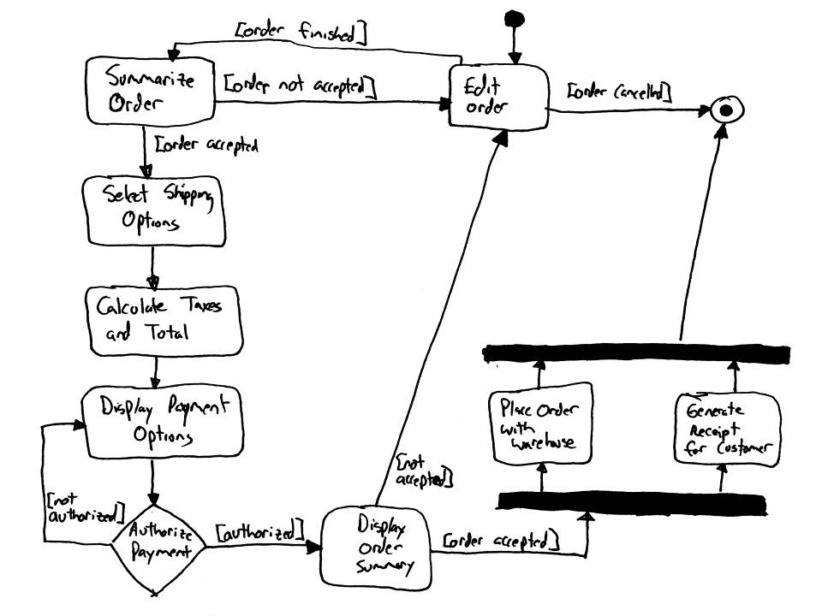
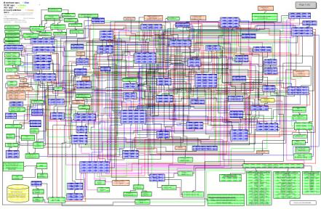

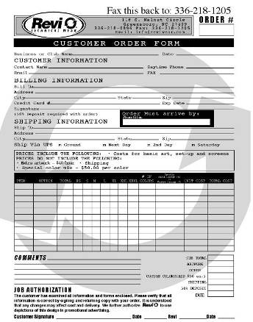

Obstacles To Overcome
Dynamic Processes
Static IT
Unstructured Content and Collaboration

Slide 9

Business Agility Depends on IT But IT Architectures were not Optimized for Flexibility
BUSINESS
Finance
Business siloed by IT
R&D
Focus on document exchange
Logistics
“Today’s IT architectures, arcane as they may be, are the biggest roadblocks most companies face when making strategic moves.” McKinsey “Flexible IT, Better Strategy”
Business model
Technology model
Solutions impose constraints
IIS
Siebel
Inward technology driven view
Tandem
AS400
TECHNOLOGY
Applications
Notes:
Business Agility Depends on IT Flexibility. But IT Architectures were optimized around prior needs for durability, security, and high quality around individual projects. Today flexibility across boundaries is also a key need, and an ability IT is building toward.
At the core of this is the need for a process that aligns business and IT. Before we describe what SOA offers, let’s briefly look at what we currently have. These diagrams, by the way, are from Arvindra Sehmi’s paper published in a recent edition of The Architects Journal.
Typically business needs have been conveyed largely by passing documents “over the wall” – all too often confusing requirements with solutions.
[Click]
This has made IT focus on meeting project needs, improving availability, security and productivity, but not spending too much time contemplating how it can drive radical business change.
[Click]
These IT solutions and platforms create technology silos that do an excellent job meeting current project needs, but also create constraints on the business model.
[Click]
As a result, business silos become reinforced by technology silos, which delivers great results within the silos but become less flexible.
[Click]
The process also has friction in it due to organizational boundaries, different vocabilaries, and models. Business and IT must work together to achieve common aims, and are looking forward to how to make this happen more smoothly.

Slide 10



SOA Reduces the Business & Technical Divide
BUSINESS
Requirements and solutions closely aligned
Focus on service
Processes
Business model
Service model
Soft boundaries (process & services)
Technology model
Focus on contract
Services
Outward business-driven view
TECHNOLOGY
Notes:
To achieve greater agility, the SOA vision seeks not just to remove the gap between business and IT, but also to blur the boundary between business processes and technology services.
[Click]
Essentially, SOA introduces a third element, a service model lying between the existing business models and the technology models.
You might think that adding an intervening layer moves these models further apart, but actually SOA acts as a lubrication layer that allows the two models to flex and work together in greater harmony.
[Click]
With an intervening service layer, the business can focus strongly on defining levels of service rather than how those services are delivered.
IT can in turn focus strongly on meeting contract obligations, choosing the best technologies and solutions for the circumstances, without unduly constraining the business process model.
[Click]
SOA naturally breaks down monolithic applications into finer-grained services which are more easily flexed and which can eliminate duplication. They are more easily aligned to business processes and help eradicate silo-based cycles.
As a result, IT has to develop a much more outward-looking view. Instead of being led by business projects, IT strategy is driven by and building business capability.
[Click]
The promise of SOA is that it will lubricate brittle and static relationships and allow an agile businesses to gain a strong competitive edge.

Slide 11
Services and Capabilities
Business Model
What ⇨ Capabilities SLE
How ⇨ Business Processes
Service Model
Service Contract
SLA
Orchestration
Technology Model
Service Interface
Service Implementation
Service Host/Management
Orchestration Engine

Slide 12
Example: Check Credit History Service

Slide 13


What is SOA?
A style of architecture, not a product
Leverages existing assets in a loosely-coupled manner
Standards are critical for success : WS-*, XML, RSS…
Web services makes service orientation practical and drives broad industry interoperability
Microsoft continues our commitment to delivering broad adoption of service orientation and interoperability through our investments in .NET
Primary benefit centers around business agility
SOA represents an enabler for faster process change, greater business insight and competitive advantage, and the creation of a new generation of dynamic applications.
Notes:
SOA is an enabler to achieve innovation / agility for business benefits
But SOA not a product, it is an architectural style. This approach is coming of age and enabled because:
Products which support development and management of services are more mature/available. This includes Governance technologies to make SOA successful (Microsoft provides this at a platform level with partners for solutions)
Standards (SOAP/HTTP/XML/XSD/WS-*) – particularly around web services have meant easier interoperability – opening up of platforms.
Microsoft has a long term commitment to .NET and our platform ensuring web-service support. This has been a long term bet for Microsoft. In addition, Microsoft has strong inter-operabilitiy across product sets through broad support for WS standards. SOA is an evolution from this.
So what kind of outcome can we expect from SOA, well we can start to think less of silo-ed functional applications and move towards more dynamic, composite applications that flexibly combine services together. [Next Slide]
Glossary:
RSS = Really Simply syndication

Slide 14


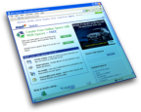








The Future – “Dynamic Applications”
Connected User Experiences
SOA Platform
Data Platform
Web Services 1
D2
F5
Web Services 4
Web Services 2
D2
Web Services 3
F5
D2
F5
IT Capabilities
Connecting Systems through SOA
Reducing development complexity
Optimizing Business Processes
Gaining BI at all levels
Centralized data that’s always on
Creating consistent, user-focused UX
Notes:
So what is a dynamic application / what are characteristics:
Rich UX, Ease to use
Colliding of 2 worlds (Web 2.0 mash-up & enterprise applications) – people are using w2.0 at home and are wanting similar experience from Enterprise apps (hence ‘Enterprise 2.0’)
Decades of investment in existing applications / transactional logic – that you cant ignore
Front end of composite app !
So it’s a focus on how do you re-purpose what you already have – combine in new and innovative ways
So that’s a great vision – but what are the proof points customers are doing this today ….
We are seeing many Microsoft customers start to realise greater agility through SOA

Slide 15

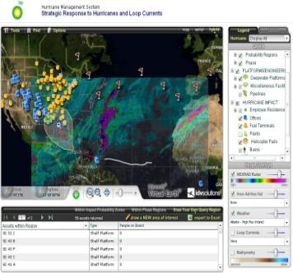







Composite App: BP's Solution Services consumption in an "Enterprise Mashup"
Data Visualization and ISV Partner
Internet Weather Service
Mapping Service
Development Platform & Tooling
Data Integration, Storage & Analysis
User Portal & Web Parts
Notes:
Here we see an example of a Enterprise SOA system that has real business impact. It is a great example of a composite application. This application aggregated and composed services and data from a variety of services, both internal and external, into the application.
British Petroleum (BP) has around 100,000 employees worldwide.
They wanted to create a system to better manage their efforts around managing weather systems (hurricanes etc) when it comes to knowing where their people are and which of their Oil drilling assets in the gulf were at risk.
They wanted a system that sped up their response times, and aggregated lots of data – typically this was done in a manual, “war room” way with maps and paper based information coming together in a non-automated way.
What they were able to get from their new system is real time insight and the ability to make decisions that can save lives and valuable assets in the event of a natural disaster.
Striking feature is how the User-Experience is becoming richer and Microsoft are strongly supporting this next generation of User Experiences or Rich-Internet-Applications (RIAs). The next slide shows our consumer Web 2.0 offering ‘Popfly’

Slide 16



IT Investment has a Strategic Impact
IT fuels profitable revenue growth.
Top 25% of IT capable firms grew revenue 6.8% faster per year.
Firms with better IT have more productive employees.
Top 25% of IT capable firms realize 23% higher revenue per employee.
IT gives managers more insight & control.
Managers in IT capable firms state they have significantly better insight & control over key dimensions of their business.
Source: Enterprise IT Capabilities and Business Performance, Marco Iansiti, David Sarnoff Professor of Business Administration, Harvard Business School George Favaloro, Principal, Keystone Strategy, Inc-March 2006
Notes:
IT can be a true differentiator for companies and how agile they can be. To understand the impact, a study by Harvard Business School and Keystone Strategy Inc. showed that companies in the top quartile of IT capability indeed had 6.8% faster growth per year, 23% higher revenue per employee, and significantly better managerial insight & control.
Let’s see how this has impacted real customers that have adopted Microsoft’s technology and SOA approach.

Slide 17
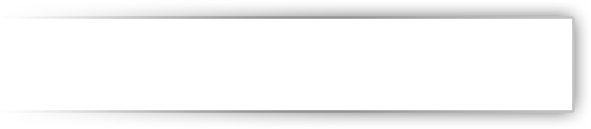









Successful Customers
Increased revenues by 20%
Reduced invoice generation time from 10 days to 20 seconds
Reduced time-to-market for new services by 40%
Reduced provisioning costs by 10-15%
Reduced help-desk costs by 10-15%
Improved customer service - more up-to-date, reliable info
Expected to cut development costs for its next project by $2.4M
CommSee: 30k users, 100+ apps
Primary branch experience
World-wide IT support for 400k+ users
Increases productivity, reduces deployment time by 83 percent
Notes:
4/15/2008 9:17 PM
© 2006 Microsoft Corporation. All rights reserved. Microsoft, Windows, Windows Vista and other product names are or may be registered trademarks and/or trademarks in the U.S. and/or other countries. The information herein is for informational purposes only and represents the current view of Microsoft Corporation as of the date of this presentation. Because Microsoft must respond to changing market conditions, it should not be interpreted to be a commitment on the part of Microsoft, and Microsoft cannot guarantee the accuracy of any information provided after the date of this presentation. MICROSOFT MAKES NO WARRANTIES, EXPRESS, IMPLIED OR STATUTORY, AS TO THE INFORMATION IN THIS PRESENTATION.
17
17
Here we highlight a few customers, who have seen such benefits as reduction in future development costs and reduced time-to-market. There is more detail in the value patterns section later in this presentation.
Vital
Based in Norway. New legislation laws around pension – created oppty to increase customers
Acquisitions – resulted in complex legacy environment
Vital wanted to boost the number of subscribers to its pension products
Needed to combine different transactions available through its disparate systems and present them as Web services in a single Web portal
Solution: SOA, application, BizTalk. which allowed it to interchange data from heterogeneous computer systems
What is common with all of these customers is very much the approach taken to SOA, which is an incremental step-wise delivery..
Significant dev cost reduction for second application
Commonwealth Bank Australia
Built an application CommSee (Customer Service Excellence), this leveraged the Microsoft SOA platform and provide a rich user-interface and agile service architecture, built on .NET, BizTalk, implemented in an SOA approach. More details and video case-studies available at MS.com/casestudies
CBA employees typically used handwritten notes to keep track of updated customer account information, they had to sift through stacks of paper each day. Also information about debit cards and other CBA products was not accessible through the bank’s system, CBA employees often were forced to call a customer’s original bank branch to order those items.
Services provided over the telephone were not recorded in a systematic way, customer service employees would have no knowledge of previous phone contacts with customers when those customers visited a branch in person. “Because of all these things, each individual customer interaction took way too much time,”
Serves 30,000 users
Pulls together all our existing data systems and provides a unified customer view complete with every transaction and holding for that customer
JSSI (Jet Support Services Inc)
Aircraft services provider improves supply chain efficiency and reduces costs
Manual financial processes were inefficient and hindering global growth
Finance and sales hampered by lack of system integration
Invoice generation took 10 days to complete
Solution:
Uses Microsoft BizTalk® Server 2006 and Microsoft Dynamics™ GP
Uses SharePoint® Portal Server and a service-oriented architecture (SOA)
Deutsche Telekom
Customer needed to reduce the time-to-market for new Internet services
Sought to make its provisioning system faster, more reliable, and more flexible
Wanted to reduce operating costs
Solution:
Customer rebuilt its provisioning system based on a service-oriented architecture and Microsoft® BizTalk® Server
Customer delivers its Internet services through XML-based Web services

Slide 18
Microsoft Real-World SOA Approach

Slide 19








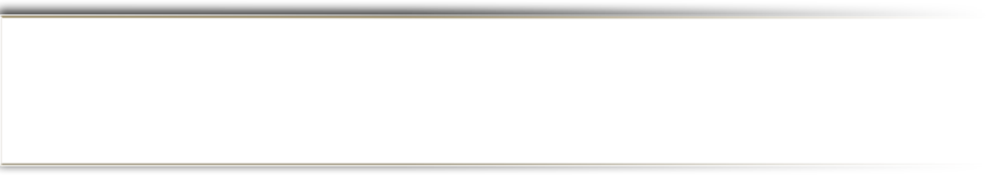

Microsoft "Real-World" SOA
Web Services
Business Value
Prioritized Success
Start with the business need
Not IT in isolation
Not exclusively reuse or data
Prioritize where you start
Build a capability roadmap
Don’t boil the ocean
- Iterate real successes
Notes:
Our approach to real-world SOA has been to begin with grounding in your business drivers, rather than a big bang approach. Many customers who viewed this as a big infrastructure investment project have put a lot of time and $$ into building layer after layer of the stack, meanwhile the business is changing more rapidly. Continuously changing business needs often get out of synch with long infrastructure efforts. The lack of Business and IT alignment can prevent SOA from delivering on it’s early promises.
In contrast, the customers we’ve seen be highly successful thru what we call a “real-world” approach, which departs from the industry norm of applying a high-risk, heavy, “top-down” strategy to SOA implementations that starts with major enterprise wide infrastructure investments that often fail to show results in a relevant timeframe or offer a compelling return on investment. Instead, the “real-world” approach to SOA advocated by Microsoft and practiced in successful customer SOA deployments relies on achieving rapid success around a focused business problem, which can result in broader SOA implementations.
Purely bottoms-up doesn’t work either – this can result in unmanaged chaos. Instead we see a successful model that we call “middle-out” – which begins with the business drivers and vision to set clear direction and priorities, but then takes multiple iterative steps to build out slices of end to end capability, with each iteration delivering a new dynamic app back to the business to drive business return.
To put this into action, we see three common steps to iterative SOA projects: Expose Systems using Services, Composing those services into processes or views, and then Consuming that in end applications or clients.

Slide 20










Microsoft Service SOA Offerings
Where to start SOA?
How to Decompose the Business?
What to Expose, Compose and Consume?
How to Measure the Business?
How to Expose, Compose and Consume?
How to deliver incrementally?

Slide 21










Application Platform For SOA
Consume
User Directed
Business Innovation
Value Justified
Compose
User Interaction
People using Content, Intelligence,
Collaboration and Communication
SOA as mechanism to Interact
Open Standards
connecting organizations
together
Compose
Business Transaction
Business Process Integration,
Process Automation, Optimization
SOA as mechanism to Transact
Compliance and Evolution
Cost Justified
CFO/CIO Driven
Expose
Existing Systems
Notes:
Let’s now look at Expose, Compose, Consume and see how that maps to platform capabilities.
Expose - Again, we see how important it is to be able to expose & re-use existing systems, particularly for cost-justification.
On the compose side, we see there are really two layers:
Compose on the Transactional Side: This is about services talking to each other or transacting data, including in EAI scenario, B2B scenarios, and automation scenarios – where processes are composed from other service elements. For instance, if multiple orders from multiple systems need to batched before sending out to another system. The key here is support for open standards and interoperability. The driving needs here can range from compliance to efficiency.
Compose on the Interaction Side: This focuses on how end-users collaborate in a workflow process or an application that is a composition of multiple services. It can involve for instance a portal that composes multiple services into one view, or human workflow that is system-to-human or human-to-human. Collaborative applications, portals, and workflow solutions that can compose services are key to enabling this. The driving needs here would focus on business innovation and value.
Consume – Finally, it is key that the end client is supported and enables a productive visualization and user experience. The key here is clients that are rich and configurable, and that can render services back into views and tools the user is familiar with.

Slide 22
Application Platform For SOA
Consume
User Directed
Security and Identity
Management and Governance
Design and Development
Compose
User Interaction
Presentation Services
(Portals, Web Parts, Office Client Extensions, Mobile Client)
Collaboration Services
(Real Time Communications, Online P2P Offline Collaboration)
Composition Services
(Workflow, Dashboards, KPIs, Doc Libraries, Business Data Catalog)
Business Process Services
(Orchestration, Rules, BAM, B2B)
Information Integration Services
(ETL, Federated Access, MDM)
Messaging
Services
(ESB, EAI, P2P, Queues)
Compose
Business Transaction
Connectivity Services
(Web Services & Adapters)
Expose
Existing Systems
Notes:
Taking this down more specific capabilities, we can see that within each of these layers there are sub-sets of capabilities:
For Composition on the Transaction Side, this includes Business Process Services like Rules, Information Integration Services like ETL, and Messaging Services like ESB. Across this are Connectivity Services.
On the User Interaction side, there is a layer of Presentation Services such as Client Extensions, Collaboration Services such as real-time communications, and Composition Services such as Workflow and BI
Across these are the essential capabilities of Security, Management and Governance, and Design / Development.
How Microsoft products fill these capabilities, is shown on the next slide ….

Slide 23
Application Platform For SOA
Consume
User Directed
Active Directory
System Center, Partners, MOF
Visual Studio, Patterns and Practices, MSF, SOM
Compose
User Interaction
SharePoint Server, .NET Compact Framework, Silverlight,Office System, ASP.NET, Windows Client
Live Communications Server, SharePoint Server
Workflow Foundation, SharePoint Server, CAB
BizTalk
Server
SQL Server
WCF
Windows
BizTalk Server
MSE
Compose
Business Transaction
WCF and BizTalk Server
Expose
Existing Systems
Notes:
This slide shows how Microsoft products map to the capability layers for SOA. We’d like to describe some beneficial properties:
First, certainly we recognize that Enterprise customers don’t have a single platform or technology – and that’s why interoperability is a key aspect of Microsoft products. It does help though if within a platform the mapping of products is clear and they work well together, which is a strength for Microsoft. Other SOA platforms are more fragmented and are the result of acquisitions that require more effort to integrate with each other.
Second, there is a more direct connection from the infrastructure to the business. Not only does this provide a rich ability for business to consume value, but does so in a faster way given how Microsoft products intra-operate from the infrastructure and to the client. Microsoft’s position is to have a platform that works well together and with other technologies, with last mile specialized/customized functionality coming from best of breed partners.

Slide 24



Agility
Experience
Single developer IDE across all lifecycle phases
Well factored and integrated stack
Focus on innovation not infrastructure
Self-Directed, Consumer-Focused
Rich Web AJAX Mash-Ups
Composite Application Office Business Applications
Mobile devices
Dynamics composite applications
Continued Application Platform investment and innovation
Spans both on-premise and cloud (Software + Services)
Dynamics Systems Initiative
Web services leader
Interoperability Executive Customer Council
Open XML and ISO Standardization
Mainframe, UNIX, data
Innovation
Interoperability

Slide 25
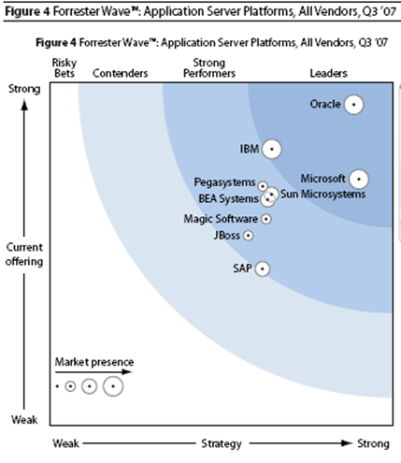
Application Platform Leader 2007
July 11, 2007 The Forrester Wave™: Application Server Platforms, Q3 2007
by John R. Rymer
Notes:
Application platform provides the strong underpinnings required by SOA
These recent Forrester report shows what a strong leader and large market presence Microsoft have
Oracle has a longer product line due to a series of non-integrated acquisitions. Microsoft believes in a strong unified platform, with best of breed solutions through partners – which provides the broadest and most extensive offering
July 11, 2007 The Forrester Wave™: Application Server Platforms, Q3 2007
by John R. Rymer for Application Development & Program Management Professionals

Slide 26
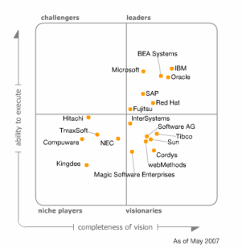
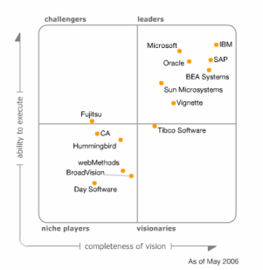
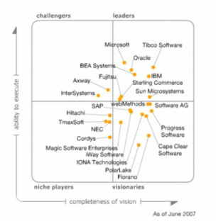
Analyst View – Gartner
Application
Infrastructure
Horizontal Portals
Back-End
Integration Projects
Notes:
Looking at a wider set of research done by the Gartner Analyst group, we see leadership across the Application Infrastructure, Portal, and Integration categories. Specifically this shows that Microsoft has
The strongest execution (y-axis) across all 3 categories
We provide to the customer what they need here and now
Partners enhance our offerings (for completeness of vision) – we give you the choice

Slide 27
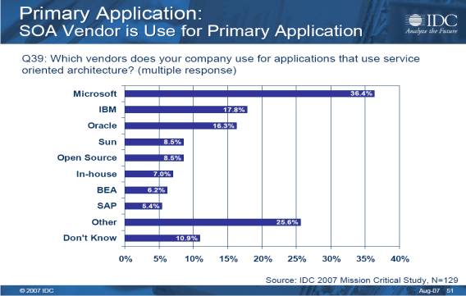
Customer View Microsoft a primary choice for SOA
IDC 2007 – Microsoft leads in vendor usage for SOA
Goldman Sachs research – companies view Microsoft as strategic partner for SOA
Notes:
This first graph here is based on a very recent survey by IDC:
IDC – the most respective for empirical research
Microsoft did not participate in respondent identification or selection
Double blind-survey
Shows Microsoft leads in vendor usage for SOA
Also Goldman Sachs research on who companies view as their strategic partner for SOA
Add Customer Momentum 27-28

Slide 28

















Customer Momentum
86%
6,500 BizTalk Customer s WW
Global 100 Penetration:
Notes:
Over 6,500 BizTalk customers world wide
Increased penetration to 86% of Global 100
1 of 7 ww share trades are made on BTS
57% of all deals coming from first time customers
SOA driving larger deployments with largest installations averaging over 56 processors per installation
Over 35,000 processors

Slide 29
Customer Momentum
Factoid | Source
12 of the 15 largest Retailers in the World run Microsoft BizTalk | Elsevier Food International, September 2006 (sourced from PlanetRetail database)
5 of 10 largest Hotel Chains in the World with over 2 Million rooms use Microsoft BizTalk | Hotels Magazine, July 2007
6 of the 8 largest U.S. Pharmacuetical Companies use Microsoft BizTalk | Fortune 1000 by Industry, April 30, 2007
4 of the 5 largest U.S. Electronics Parts Manufacturers use Microsoft BizTalk | Fortune 1000 by Industry, April 30, 2007
9 of 10 largest U.S. Telecommunications Companies use Microsoft BizTalk | Fortune 1000 by Industry, April 30, 2007
9 of the 10 largest Aerospace and Defense Companies in the U.S. run Microsoft BizTalk | Fortune 1000 by Industry, April 30, 2007
5 of the 8 largest U.S. Chemical Companies run Microsoft BizTalk | Fortune 1000 by Industry, April 30, 2007
4 of the 5 largest Railroads in the U.S. run Microsoft BizTalk | Fortune 1000 by Industry, April 30, 2007
9 of the 10 largest Insurance Companies in the World run Microsoft BizTalk | Insurance Information Institute (from Fortune Global 500 data)
23 of 27 EU member governments use Microsoft BizTalk to provide more efficient government services | European Union web site

Slide 30
SOA and BPM -Composite Application
demo
BizTalk Server 2006 R2
BizTalk Adapter Pack for SAP
Microsoft Office Visio 2007
Microsoft Office SharePoint Server 2007
Microsoft Office InfoPath 2007
Microsoft Windows Presentation Foundation and Expressions Blend
Microsoft Performance Point Server 2007

Slide 31
Getting Started with SOA
SOA Value Patterns

Slide 32
Getting Started Requires a Roadmap
Assess your current maturity, across multiple dimensions
Business
Methodology
Technical
Establish targets for where you want to be
Document important goals and metrics for transitions across the maturity dimensions
Recognize that aspects of the Roadmap may shift with experiences gained
The Microsoft APO approach – provides a roadmap
Notes:
Creation of roadmap to understand where you are currently and roadmap is critical
Provides incremental approach to reaching SOA
APO can help create that roadmap – so what is APO ?

Slide 33









Application Platform Optimization Your Guide to Enterprise SOA
Common enterprise service bus capabilities
Existing capabilities exposed as services
Consistent use of services across the organization
Cost reduction from (reuse) efficiency
Increase in business agility from contract based systems
Provider & Consumer
Organization
Secure, transactional services environment
Business processes reengineered as services
Services federated across business ecosystems
Monolithic systems reengineered as components
Real time data currency and business intelligence
Real time business services
Service is basis for virtualized resource management
Federated services management
Evaluating the beginnings of SOA and composite apps
Short term ROI on primarily technical solutions
Visioning, planning and communicating
Cost Center
More Efficient Cost Center
Business Enabler
Strategic Asset
Notes:
APO provides a framework to understand currently capabilities and provide roadmap
Enables a baseline to be established of where you are currently and then determine a roadmap to gradually increase level of maturity

Slide 34
SOA Maturity Model
Service Administration
Service Consumption
Service Implementation
Capability | Basic | Standardized | Advanced | Dynamic
 | Maturity Level
Basic security
Enterprise Security
Deployment Management
Scenario Impact Analysis
Basic Governance
Enterprise Governance
Provisioning Management
Business Analytics
Maintenance Efficiency
Organizational Alignment
Advanced Monitoring
Extensible Security
Explicit Contracts
Uniform Contracts
Semantic Services
Composable Policy
Service Identification
Service Discoverability
Self Service
Back Channel Messaging
Service Boundaries
Testing Support
Service Level Agreements
Extensible Service Channels
Service Adoption
Loosely-coupled Composition
Consumable Type System
Progressive Composition
Integration Efficiency
Design Patterns
Versioning Support
Rules Driven Policy
Development Process Efficiency
Common Entities
Executable Policy
Process Modeling Support

Slide 35

Select SOA Projects Move Incrementally towards Roadmap
The driving goal is business value – while component reuse is the next tier benefit
Select a project that addresses a well known business problem AND one that can benefit from SOA
Include LOB and IT objectives & well defined metrics
Prioritise where you start & Iterate – don’t boil the ocean
Requires achievable stretch beyond current capabilities to address gaps
Be something you put in production
Incorporate & Evolve Aspects of Governance
Leverage SOA Value Pattern
Notes:
Too many project plans justify SOA investments by promising future reuse and consequent reduction in IT costs. Reuse is too distant and too abstract to persuade businesses to invest. SOA must be justified by the increased business value that IT can deliver via fine-grained flexible services closely aligned to business processes.
The Microsoft approach to SOA – focuses on starting from business needs
MSBA can help understand business capabilities and needs – build service model
The business problem should be well understood or easily identifiable.
Pilot project should illustrate the potential for (relatively) immediate the benefits with SOA.
In depth business analysis such as a CBM effort will be used to help uncover the less obvious problems later in the adoption process.
It is important to design an overall SOA strategy; but it is not necessary to get the entire strategy funded right from the outset. Individual implementation projects can be small, tightly focused and carefully prioritised to give the business maximum benefit from its investment.
Start small and prioritise – to evolve the solution
It is important that the Pilot be real. Issues of deployment and management are very much a part of SOA and tend to be glossed over in POC efforts.
Governance is an issue at each stage of adoption. However the different adoption levels have different Governance concerns. In the initial stages, Governance will be more concerned with identifying and implementing technical best practices (XML Schema usage, WSDL best practices etc.). As the number of services grows the issues to address become more coarse grained such as Service Catalog Mgt.

Slide 36
SOA Value Patterns
SOA for Integration - Process & Information
JSSI increased revenues by 20% due to the end-to-end process integration
Global Crossing reduced operating expense by 40%
SOA for Modern Composite Applications
T-Mobile reduced Time-to-Market for new services by 40%
SOA for Consolidation
Zip lookup service consolidation resulted in saving of $30 million
SOA for Legacy Modernization
Vital cut development cost by $2.4 million
Notes:
SOA is not always the same foot-print for all organizations. SOA has a number of key patterns.
Microsoft has identified these key value patterns with example case studies from how our customers have implemented SOA
For example, Vital wanted to use a SOA Legacy Modernization value pattern to create a new pension application, which integrated data from a variety of applications. As a result, development time costs were cut by $2.4M
Driven by a need to respond to compliance, New pension laws in Norway provided an opportunity for Vital Forsikring ASA, a life and pension insurance company, to boost the number of subscribers to its products.
But after several mergers, Vital found itself with a myriad of mainframe systems running different applications.
The company decided to build a new pension application based on service-oriented architecture.
By using Microsoft® BizTalk® Server 2006, Vital has combined different transactions available through its disparate systems and presented them to employees and customers as Web services in a single Web portal.
Vital has improved customer service by ensuring that all transactions are completed successfully and by providing around-the-clock access to its pension products. Vital can also bring new products to market faster and expects to cut development costs for its next project by NOK16 million (U.S.$2.4 million).

Slide 37
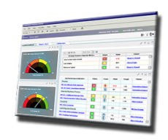
Value Pattern: Integration - Process Business Process Management for Continuous Innovation
Business Needs
Increasing need to tailor business processes on a per customer / per partner basis
Changing business processes takes too long
IT Needs
Increasing maintenance costs as applications continuously evolve
Inflexible systems can’t handle today's requirements
Business processes are highly flexible
Maintenance costs drop as changes in the processes can be effected in a managed environment
Business and IT benefits
Notes:
How to identify this pattern – business / IT needs
Increasing permutations/variations of business processes – tailor or customzse per customer/supplier etc
Modification of process takes too long
IT costs high, maintaining frequently changing applications – cost to deploy, manage etc
Systems unable to easily implement requirements
What are the benefits:
Flexible, expansive BPM – BPM in SOA has far more potential to be fulfilled
IT benefits of reduced maintenance costs as processes easier to modify
Lets look at an example – Jet Support Services Inc .. [next slide]

Slide 38

Idealized Business Process
Create
Lead
Qualified?
Create
Oppt’y
Create
Quote
Closed?
Complete
Sale
Create P.O.
Retire
Lead
Notes:
38

Slide 39



“Real World” Process
Estimate custom design
Get specs from customer
Validate specs with Tech Sales
Cost out the solution
Decide discount strategy
Assemble proposed response
Approve proposed response
Create
Oppt’y
Create
Quote
Notes:
39
39

Slide 40



Process Optimization Potential
With Business Process Management cycle times can be reduced by 40%
Typical Business Process
Idle period: 80%
Processing time: 20%
Processing time optimization
(Typical approach of ERP and CRM)
50% reduction of the processing time
10% reduction of the cylce time
Idle period reduction is
the main Focus of BPM
50% reduction of the idle period
40% reduction of the cycle time
Notes:
Add Real-world OBA Process 33-34

Slide 41
SOA and BPM
Business-driven
SOA
BPM
SOA
BPM
Build to
Change
Build to
Last
SOA
BPM
SOA
BPM
IT-driven

Slide 42













“With our new system, the time it takes to create invoices has gone from 10 days to 10 seconds.”
John LeBeau, Director, JSSI
Aircraft services provider improves supply chain efficiency and reduces costs
Manual financial processes were inefficient and hindering global growth
Finance and sales hampered by lack of system integration
Invoice generation took 10 days to complete
Engaged Microsoft® Solutions Provider LANAC Technology
Uses Microsoft BizTalk® Server 2006 and Microsoft Dynamics™ GP
Uses SharePoint® Portal Server and a service-oriented architecture (SOA)
Increased revenues by 20%
Expedited cash receipts by $2 million USD/month
Reduced invoice generation time from 10 days to 20 seconds
Notes:
JSSI (Jet Support Services Inc) http://www.microsoft.com/casestudies/casestudy.aspx?casestudyid=201335
Aircraft services provider improves supply chain efficiency and reduces costs
Manual financial processes were inefficient and hindering global growth
Finance and sales hampered by lack of system integration
Invoice generation took 10 days to complete
Solution:
Uses Microsoft BizTalk® Server 2006 and Microsoft Dynamics™ GP
Uses SharePoint® Portal Server and a service-oriented architecture (SOA)
Aircraft Services Provider
Jet Support Services Inc. (JSSI) wanted to expand its aircraft maintenance services business, but was hampered by labor-intensive and disjointed processes that were inefficient and prone to error.
Using a service-oriented architecture approach, JSSI created a sophisticated customer portal that connects customer-input data with an automated back-end solution built on BizTalk, Dynamics GP, SharePoint, and Dynamics CRM.
The integrated solution enabled JSSI to increase revenues and profits by dramatically improving its processes and reducing transaction time.
Detail
JSSI’s business model is unusual in the aviation industry, but designed to provide the ultimate in flexibility for its customers. Customers pay a fixed, monthly rate for regular servicing, and receive reduced rates for major operations. It also makes maintenance expenses more predictable.
But the process JSSI used to collect flight information from customers was inefficient and prone to error.
Customers submit a coupon by mail to JSSI’s bank with the number of hours flown (this is the metric used for aircraft maintenance). The bank would, in turn, send payment information to JSSI’s accounting department on a daily basis. JSSI staff would then manually enter the information, generate invoices, and apply the pre-paid funds to customer accounts.
Customers frequently erred in reporting the number of hours flown, however, necessitating a lot of back-and-forth dialogue. This customer-billing process required anywhere from 6 to 16 person-hours per day, according to John LeBeau, JSSI’s director of financial systems.
Another reason for the lengthy billing process was the disparate nature of JSSI’s technology infrastructure. Employees had to access three separate, non- integrated, applications-—a single-user accounting system, a database, and a hosted contact management system-—in order to complete a billing transaction.
Lack of integration hampered staff throughout the organization. “Sometimes an employee had to go to more than one application to get a true picture of the customers’ balance,” explains Sonya Taitt, a manager in the IT department and program director for the MyJSSI online portal.

Slide 43
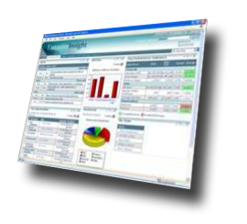

Value Pattern: Modern Composite Applications Intuitive & Adaptive User Experience & Interaction
Business Needs
IT Needs
Business processes span applications that don’t integrate well
Business applications are consistent and tailored to a given task/role
Business and IT benefits
No single sign-on, no role-based information/application delivery
Freedom to change IT resources without impact on the user experience
Freedom to incrementally
Multiple participants in business process need differing access
Too many applications required to complete a process
Notes:
Open up access to systems and get more flexibility around application;
focus on what you’re doing with the asset rather than the asset itself.
Business task.
Reusing and externalizing business tasks to drive revenue and improve customer support

Slide 44

“The new system enables T-Com to react in a fast, flexible, and cost-efficient way to changing market conditions for hosted, value-added services.”
Dirk Wöhning, Business Engineering Value Added Services, T-Com
Internet service provider reduces time-to-market for new services by 40 percent
Customer needed to reduce the time-to-market for new Internet services
Sought to make its provisioning system faster, more reliable, and more flexible
Wanted to reduce operating costs
Customer rebuilt its provisioning system based on a service-oriented architecture and Microsoft® BizTalk® Server 2004
Customer delivers its Internet services through XML-based Web services
Reduced time-to-market for new services by 40%
Improved system performance tenfold
Reduced provisioning costs by 10-15%
Reduced help-desk costs by 10-15%
Notes:
44
Deutsche Telekom
Customer needed to reduce the time-to-market for new Internet services
Sought to make its provisioning system faster, more reliable, and more flexible
Wanted to reduce operating costs
Solution:
Customer rebuilt its provisioning system based on a service-oriented architecture and Microsoft® BizTalk® Server
Customer delivers its Internet services through XML-based Web services

Slide 45
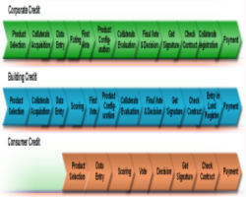
Value Pattern: Consolidation Create Flexible, Shared Services based Business Applications
Business Needs
IT Needs
Leverage existing IT investment
Unlock the value of existing IT assets
Business and IT benefits
Freedom to outsource without impact to existing applications
Turn proprietary systems into marketable business assets
Need to consolidate redundant systems
Eliminate the costs associated with
non-key functions
Notes:
Freedom to outsource with impact existing applications
Leverage existing
Eliminate cost of non-key functions
Zip – example of consolidation of how business was used post-code and geo-lookup services.

Slide 46


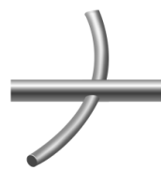


Value Pattern: Legacy Modernization Long Tail of the past IT investment
Business Needs
IT Needs
Manage all traffic to/from services consistently
Decoupling of service providers and consumers provides flexibility
Modernization of backend systems needs to be isolated from applications
Speed up new application development and integration
Flexibility to change service implementations
Consistent auditing, security, validation
Speed availability of existing systems by leveraging existing messaging backbones
Strengthen governance of service
Business and IT benefits

Slide 47
“Caseworkers can be more precise when they talk to customers on the phone—they can respond to requests more quickly, more easily, and with better quality information.”
Rolf Nergaard, Enterprise Architect, Vital Forsikring ASA
Pension insurance provider boosts worker productivity, improves customer service
Vital wanted to boost the number of subscribers to its pension products
Needed to combine different transactions available through its disparate systems and present them as Web services in a single Web portal
Developed a new pension application based on service-oriented architecture
Built its solution using Microsoft® BizTalk® Server 2006, which allowed it to interchange data from heterogeneous computer systems
Improved customer service by allowing caseworkers to provide customers with more up-to-date, reliable information
Expected to cut development costs for its next project by NOK16 million (U.S.$2.4 million)
Notes:
Vital (http://www.microsoft.com/casestudies/casestudy.aspx?casestudyid=200420)
Vital wanted to boost the number of subscribers to its pension products
Needed to combine different transactions available through its disparate systems and present them as Web services in a single Web portal
Solution:
Developed a new pension application based on service-oriented architecture
Built its solution using Microsoft® BizTalk® Server 2006, which allowed it to interchange data from heterogeneous computer systems
Basing its solution on BizTalk Server and SOA, Vital has enabled the use of modular systems that can be added and removed as needed.
Eliminated the point-to-point connections that once existed between its mainframe applications and the clients
Rather than rebuilding the Web portal interface every time it adds a new service, Vital can instead take a more plug-and-play approach in which each new service is added
Vital is able to respond more nimbly to changing market conditions by reducing the time-to-market for add-on products and services.
Allows the company to make quick updates to its pension application without disrupting consumers’ use of the existing solution.
“makes us more agile in that we can change the requirements as we add new business.”
Vital has already begun to reuse some of the services of its core pension system as it begins to develop a second pension application.
Vital estimates that reusable components from the original solution will save the company more than NOK16 million (U.S.$2.4 million) in development costs – incremental reuse benefit

Slide 48
Microsoft SOA Technologies
BizTalk Server and WCF

Slide 49
WCF Unifying Transport Protocols
One-stop-shop for services
Consistent object model
Adoption of WCF as IO layer
Inherit new capabilities as they are added to the platform :
WS-* Standards
Web 2.0
....
Focus on the functionality, WCF takes care of the plumbing
.NET Remoting
SOAP 1.1
ASMX
WSE
MSMQ
POX
WS-*
Windows
Communication
Foundation
Web 2.0 Technologies
RSS
REST
ATOM

Slide 50
BizTalk Server 2006 R2 Capabilities
Management and Operations
Business Rule Framework
Business to Business Integration
Business Activity Monitoring
Orchestration
Messaging
Tools
RFID Platform

Slide 51
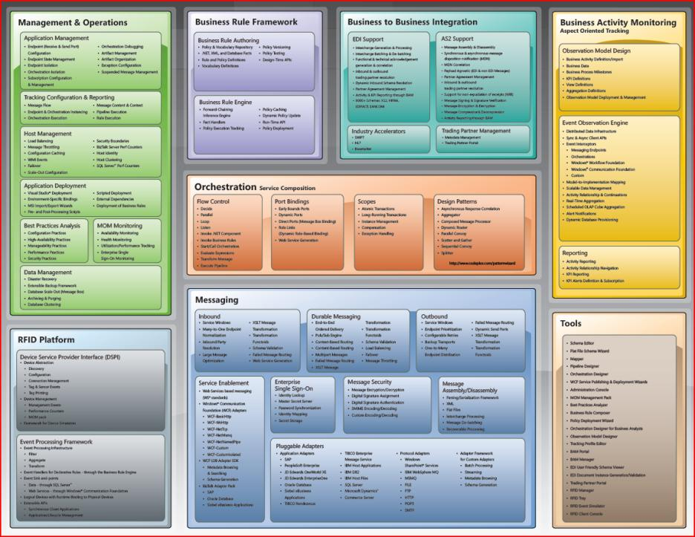
Notes:
Highlighted: New R2 Features

Slide 52
Extending The Service Bus
Service Bus
Naming
Messaging
Identity
Directory
Eventing
…
On-Premises
Cloud
Enterprise Service Bus
Internet Service Bus
BizTalk Server
On-premise SOA infrastructure for loosely-coupled communication based upon web service standards
Automation and management of business processes
Prescriptive guidance for ESB implementations available at www.codeplex.com/esb
BizTalk Services
“Firewall friendly” messaging, identity, and workflow services
Extend our server reach and capabilities for cross-organizational composite applications
CTP release of services are available today at http://labs.biztalk.net

Slide 53
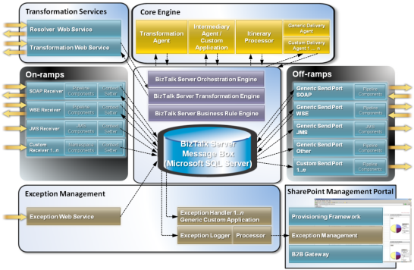




Microsoft ESB Guidance
Architectural guidance
Reusable components
Sample applications
Management portal
Available on www.codeplex.com/esb
Notes:
53

Slide 54
































SOA requires Identity and Access
User
provisioning
Access
management
Credential
management
Policy management
Identity Lifecycle Management
Automate identity and access management
Information Protection
Safeguard confidential data no matter where it goes
Smartcard authentication
Federated
identity
Encryption and signing
Directory Services
Simplify the management of users and devices
Secure wireless
Web
SSO
Live
integration
Full life-cycle management
Claims-based
access
Strong Authentication
Secure access beyond usernames and
passwords
Federated Identity/SSO
Collaborate securely across
organizational boundaries

Slide 55
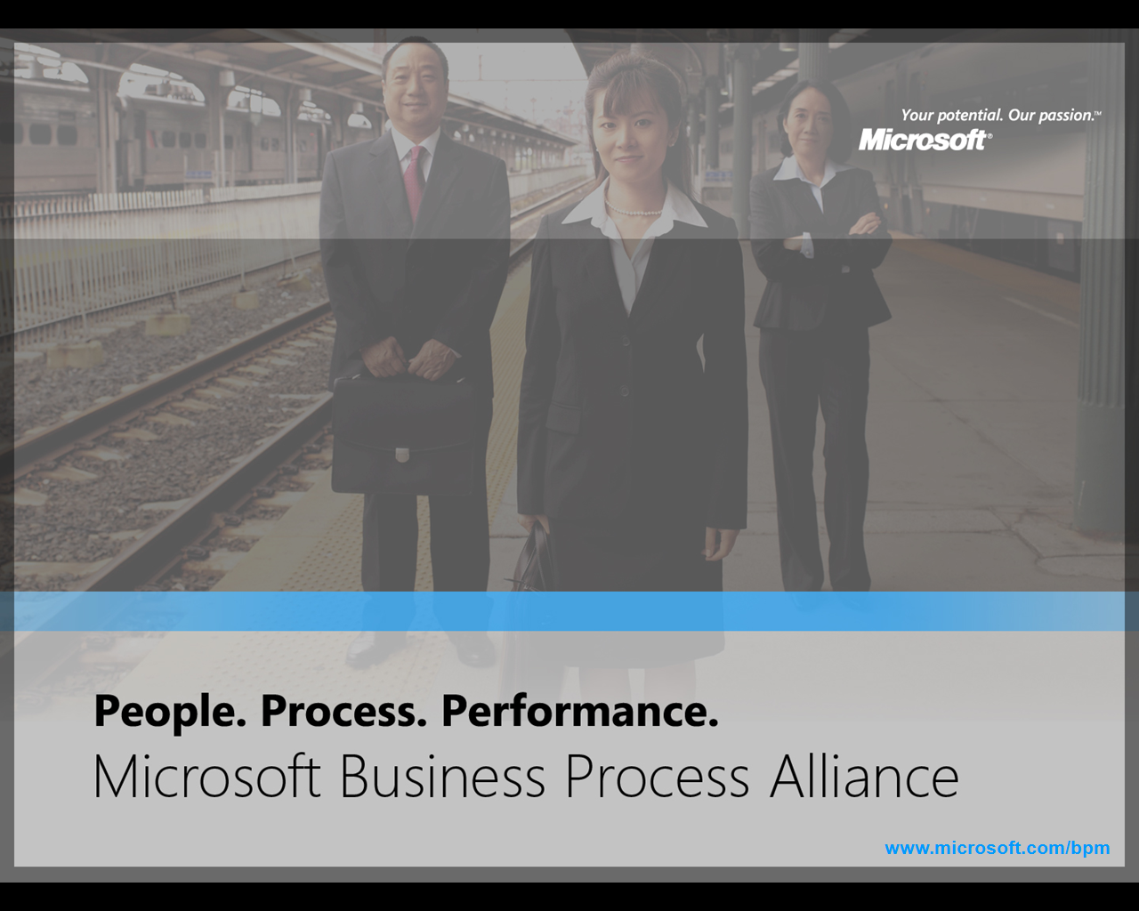









Rich, Diverse Partner Ecosystem The Microsoft Business Process Alliance
Set of strategic alliances to deliver greater customer choice of end-to-end SOA and BPM solutions on the Microsoft process platform
Includes joint marketing, sales, solution development
Kept intentionally focused (10 charter partners) to allow for deeper joint engagement model

Slide 56
Business Process Alliance Momentum – 2007
Announcement of the Business Process Alliance at the Gartner BPM Summit in February 2007. Since then…
350+ consulting and delivery partners
50+ solutions offered
6 partners appear in Gartner Magic Quadrants for their leadership in BPM and SOA solutions

Slide 57
Business Process Alliance Momentum - Industry Recognition
Ascentn
Gartner – “Cool Vendors in BPM 2007”
Microsoft – Technology of the Year in Innovation 2005
AmberPoint
InfoWorld’s Top 25 CTOs
Global 360
Coverage in Baseline magazine for Process360 9.5
Metastorm
START-IT magazine 125 in manufacturing
KMWorld magazine 100 companies that matter in knowledge management

Slide 58
Business Process Alliance Momentum – Product Releases
7 recent Product Releases
Ascentn: AgilePoint BPMS Suite 4.0
Global 360: Process360 9.5
InRule: InRule for Windows Workflow Foundation, InRule 2.9
K2: BlackPearl
Metastorm: Metastorm BPM 7.5
PNMSoft: Sequence BPM for Dynamics
… and more to come!

Slide 59
Business Process Alliance Momentum - Industries Served
Over 100 vertical templates and solutions for:
Banking & Financial Services
Government & Public Sector
Insurance
Healthcare & Life Sciences
Manufacturing
Media & Entertainment
Professional Services & Legal
Retail
Telecommunications
Transportation
Travel & Hospitality

Slide 60
Corporate Services : Scenario’s

Slide 61

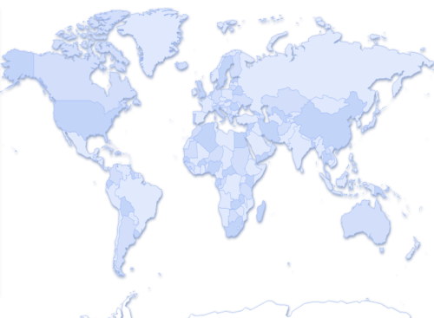



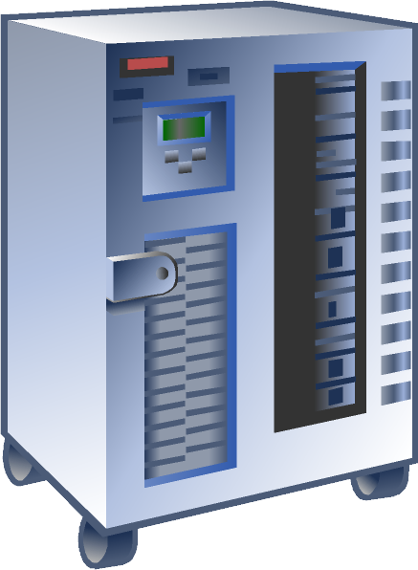
From Point-2-Point to ESB
BizTalk Server 2006 R2
Point-to-Point
EAI
ESB
Federated ESB
Unmanaged / Decentralized
Managed / Centralized
Managed / Decentralized
Managed / Distributed
Suitable for small configs
n² lines of connectivity
Supports lose coupling of systems
Message / Process Broker
n lines of connectivity
Centralized management
Limited scalability
Single point of failure
Common communication infrastructure
Common command infrastructure
n lines of connectivity
Proprietary communication protocols
Common communication infrastructure
Common command infrastructure
n lines of connectivity
Comminication protocol independent
Brokered Communication
EndPoint Metadata
Intelligent Routing
Transformation Services
Service Registry - Repository
Transaction Management
Service Mediation
Run-Time Governance
Exception Management
Business Rules
Workflow Orchestration
Web Standards Support

Slide 62
Corporate Services
CorporatePayments
Corporate
Treasury
E-Invoicing
Central International Hub
Federated ESB

Slide 63
Corporate E-Invoicing Hub
Group E-Invoicing Services
Certification
Authority
Service
Signing
Service
Validation
Service
CorporatePayments
Corporate
Treasury
E-Invoicing Process
Connectivity
Mapping
Checking
Signing
Connectivity
Central International Hub
Federated ESB
Notes:
Where does CPH sit within the corporate environment?

Slide 64
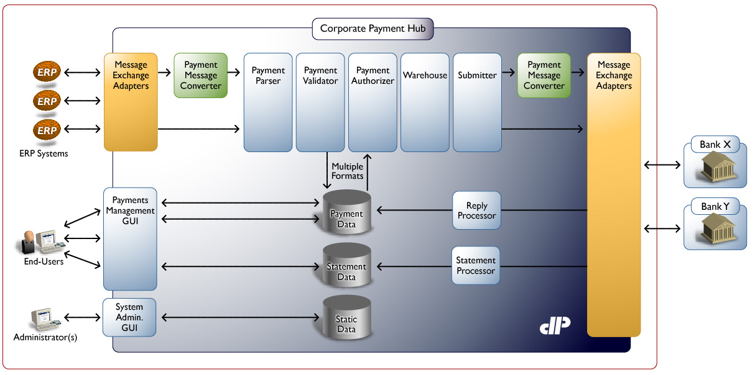





Corporate Payment Hub
Notes:
Where does CPH sit within the corporate environment?

Slide 65

Corporate Treasury Hub
Microsoft Treasury group’s responsibilities:
Allocating resources to subsidiaries
Reconciling transactions
Transferring money
Investing excess cash resources
Microsoft has 1,000+ bank accounts spread among 95 banks worldwide
Managing these accounts accurately maximizes revenue
Notes:
Where does CPH sit within the corporate environment?

Slide 66
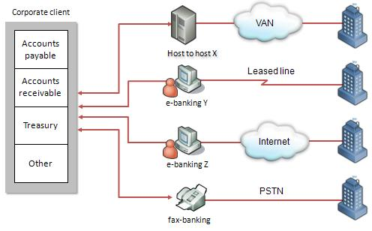
Business Challenge: Multiple Custom Connections
Notes:
Business Challenge: Multiple Custom Connections
Each bank that the Microsoft Treasury group works with uses different processes and systems to communicate with customers and banking partners. Previously, the Treasury group developed and maintained multiple custom point-to-point connections to communicate with its banks. As with all point-to-point solutions, this approach had inherent challenges.
The figure on this slide shows an example of the point-to-point connections between four different banks to a single corporate client. The example highlights connecting a back-end system (mainframe or host) from a corporate client to a bank’s host by using a Value Add Network (VAN). The “X” or “Y” after each connection name is a variable that implies that multiple connections of each type may exist. For example, the e-banking Y system connects with bank Y, and e-banking system Z connects to bank Z.
Aside from the cost and complexity of developing and managing several separate systems, implementing point-to-point connections provides unique challenges when the connections are mission critical, as they are for the Microsoft Treasury group. Characteristics like redundancy, reliability, and guaranteed delivery can be difficult to develop even within a single connection. Developing these characteristics as part of dozens—perhaps even hundreds—of custom connections is especially time-consuming and expensive.

Slide 67
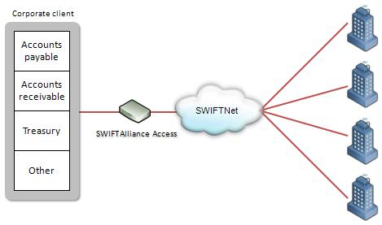
Integration Solution
Notes:
Integration Solution (continued)
The figure on this slide shows an example of communicating with several partner banks through SWIFTNet.

Slide 68
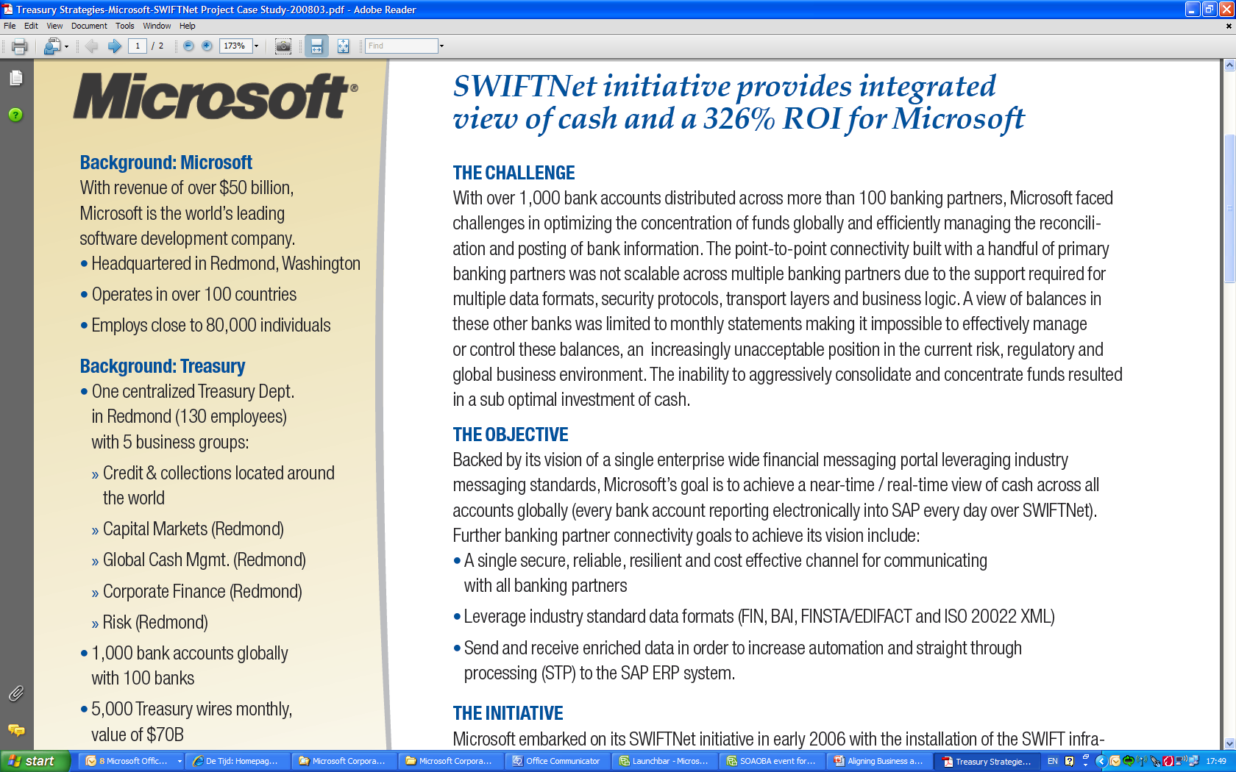
Corporate Treasury Hub
Notes:
Where does CPH sit within the corporate environment?

Slide 69

COUNCIL

