Slide 1
Introducing K2 [blackpearl] BPM
Architect Forum (Brussels, Belgium)
Shaun Leisegang | Presales Manager | shaun@k2.com

Slide 2

What is Business Process Management (“BPM”)

Slide 3
What is Business Process Management (“BPM”)
Defining BPM
“Business process management (“BPM”) is a field of knowledge at the intersection between management and information technology, encompassing methods, techniques and tools to design, enact, control, and analyze business processes involving humans, organizations, applications, documents and other sources of information”

Slide 4





What is Business Process Management (“BPM”)
Implementing BPM
Design
Assemble
Execute
Monitor
Optimize
Process Lifecycle: The ongoing, progressive activity, which aims to improve the efficiency of individual processes and the business as a whole

Slide 5
Introducing K2

Slide 6
Introducing K2
Our Customers
K2 enables business solutions for 1,500+ customers with over 1,000,000 users in over 43 countries
People in many different sectors and roles are already benefiting from K2 which allows them to respond rapidly to change both within the business and in the marketplace
We use our own platform to stay ahead of the market
http://www.k2.com/customers.aspx

Slide 7
Introducing K2
Our Company
First commercial software launch, 2000
K2.net 2003: award-winning .NET based Enterprise Workflow platform
Global presence; headquartered in Redmond, Washington
Deployed in 20% of the Fortune 100
Strong, global partner community
Over four years of triple-digit growth
2007: Release of K2 [blackpearl]

Slide 8

Introducing K2
K2 and
The only BPM vendor with a product built completely in .NET 3
Execute Windows Workflow Foundation
Consume or publish as Windows Communication Foundation
Deep integration into Office suite
Excellent relationships with the Microsoft product teams
The only Globally Managed, BPM, Independent Software Vendor (one of 32 ISVs)
Member of the Business Process
Alliance
The only Member of the Microsoft
Business Process Alliance to be
awarded the Innovation award

Slide 9
Introducing K2 blackpearl

Slide 10
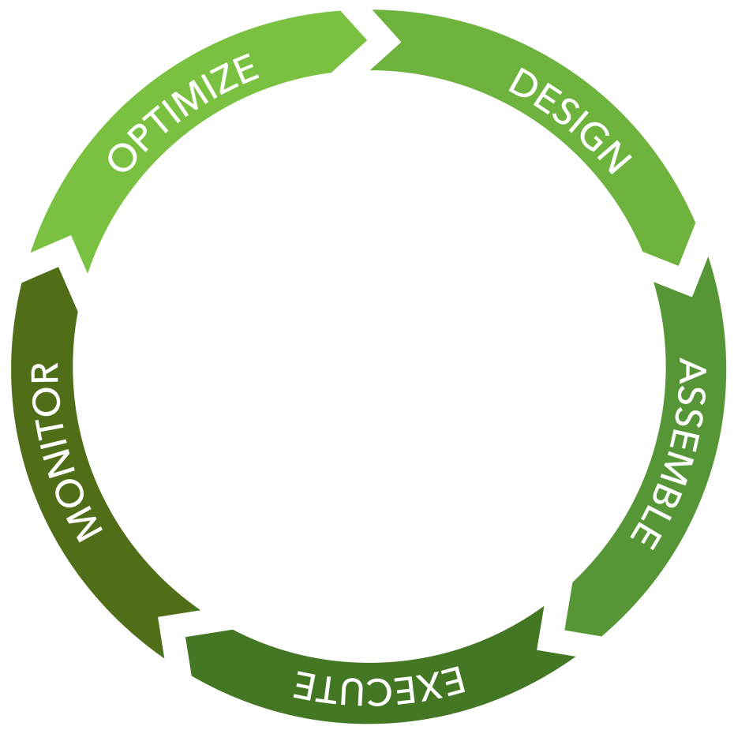
Introducing K2 [blackpearl]
Overview
Design
Graphical, intuitive design tools
Assemble
Powerful web based management
Execute
Secure, scalable and robust server architecture
Monitor
Standards based self service reports
Optimize
K2 [blackpearl] introduces a number of innovative features and technologies to facilitate building business process and dynamic applications for the enterprise

Slide 11
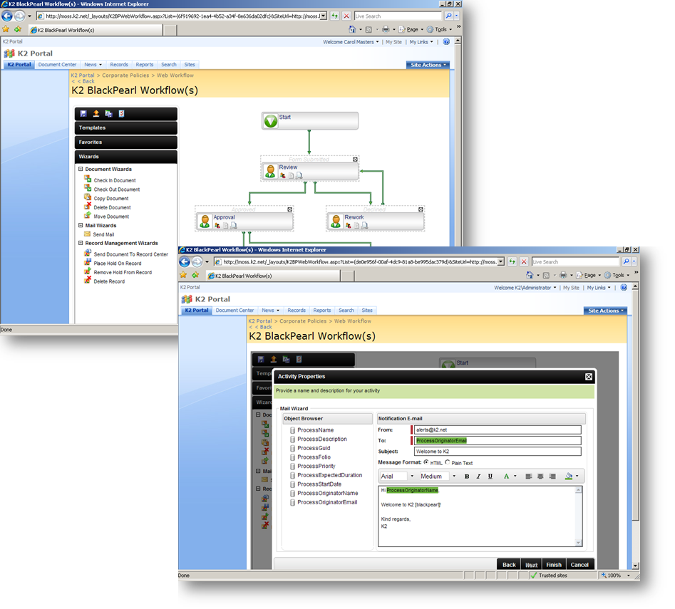
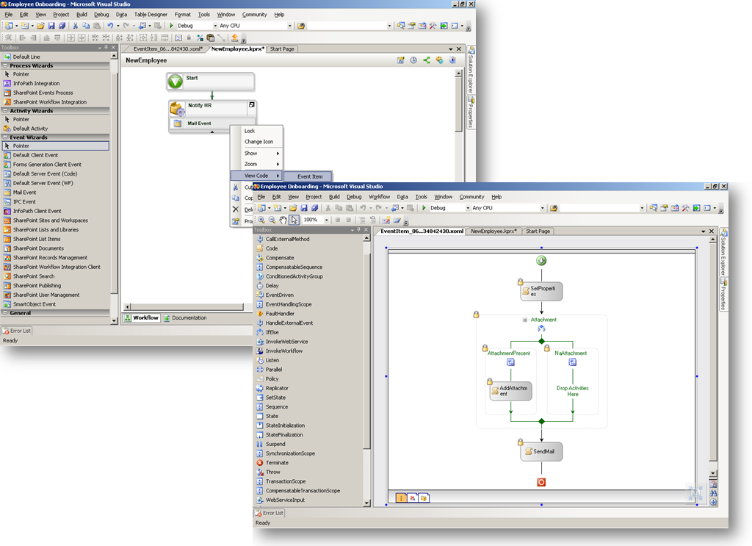
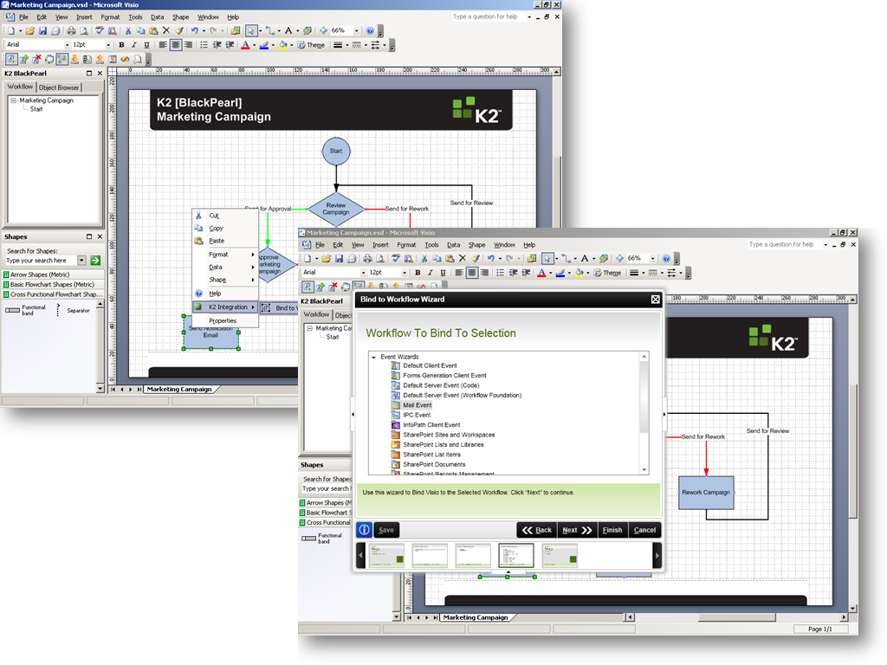
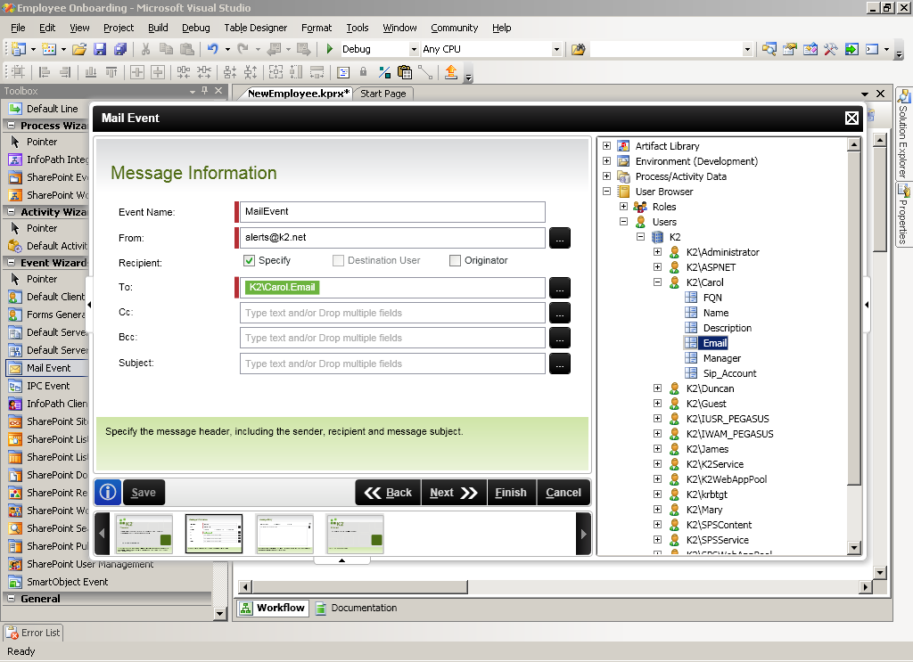
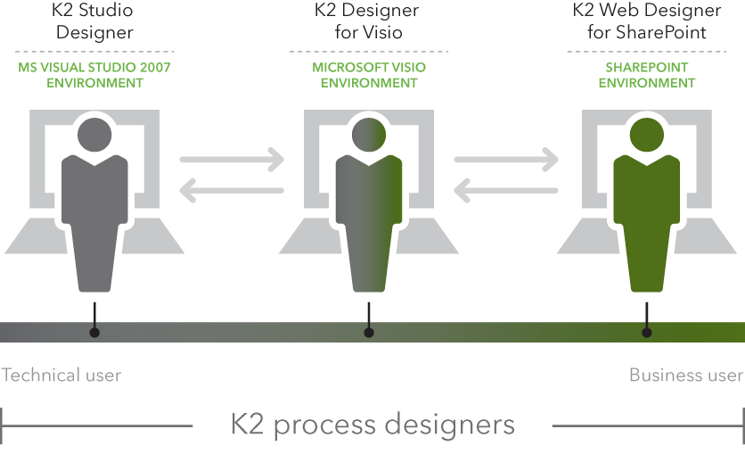
Introducing K2 [blackpearl]
Design
K2 Web Designer for SharePoint
For the End-User
Embedded in MOSS
K2 Designer for Visio
For the Power-User or Analyst
Stencil Agnostic
K2 Studio Designer
For the Developer
Graphical and allows access to WF and .NET code
Graphical, intuitive design tools

Slide 12
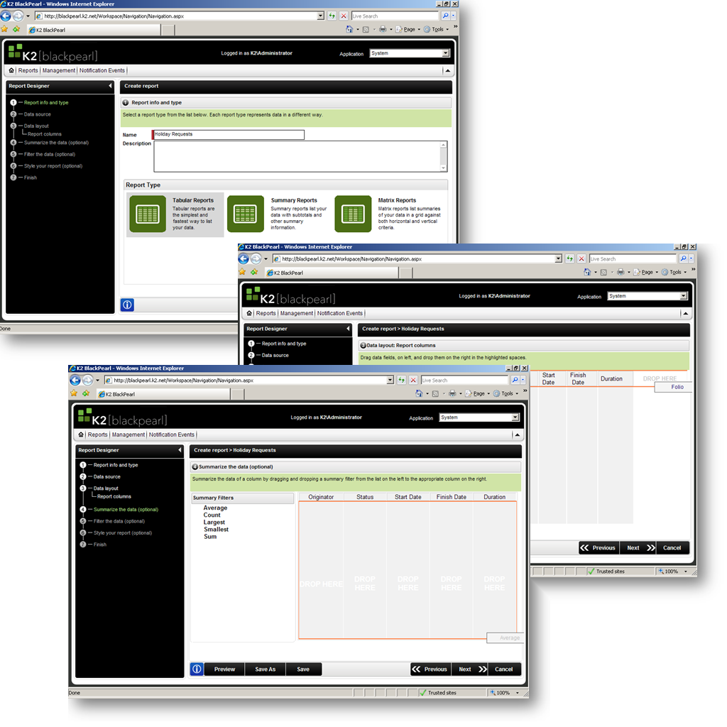
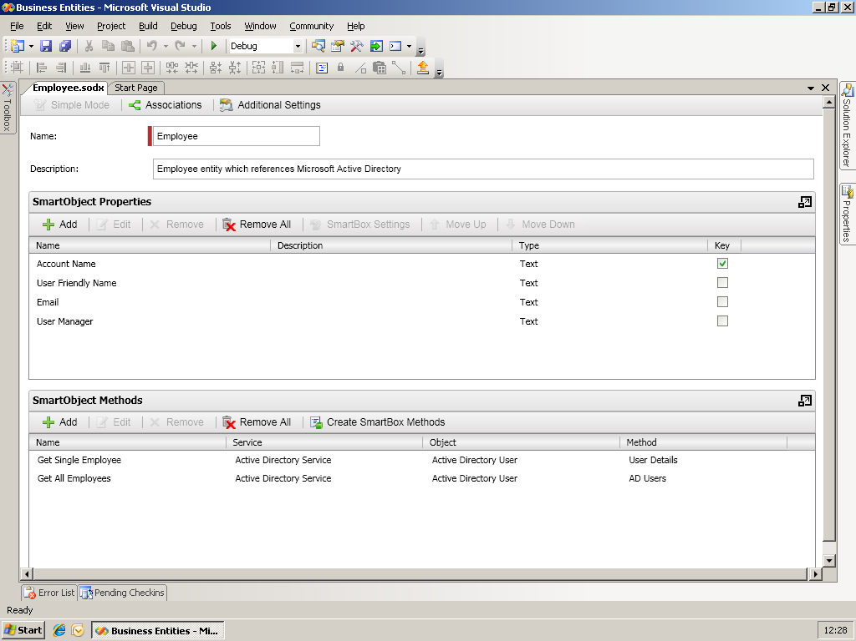
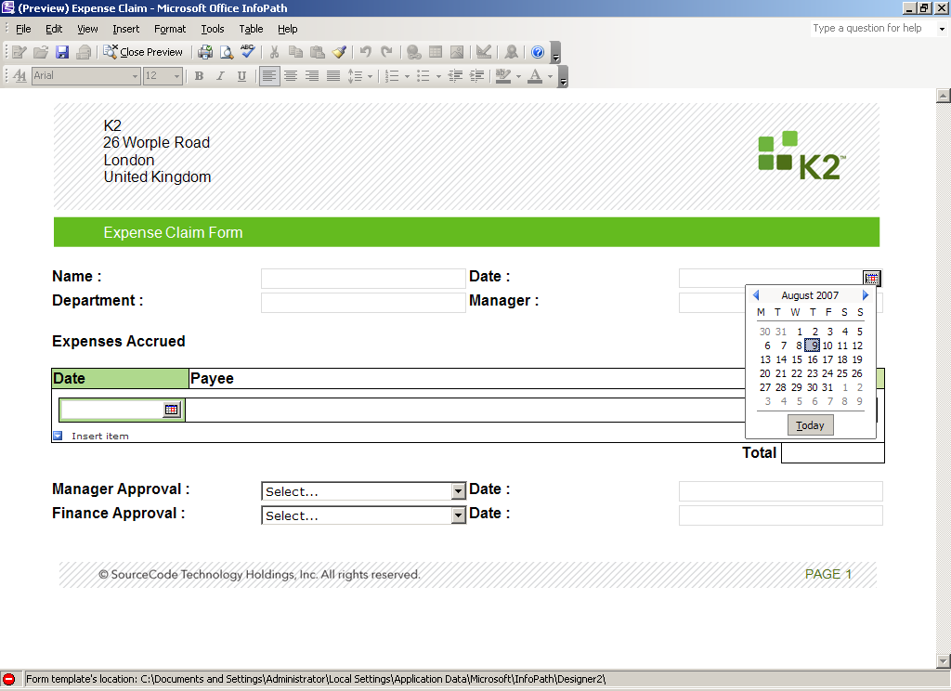
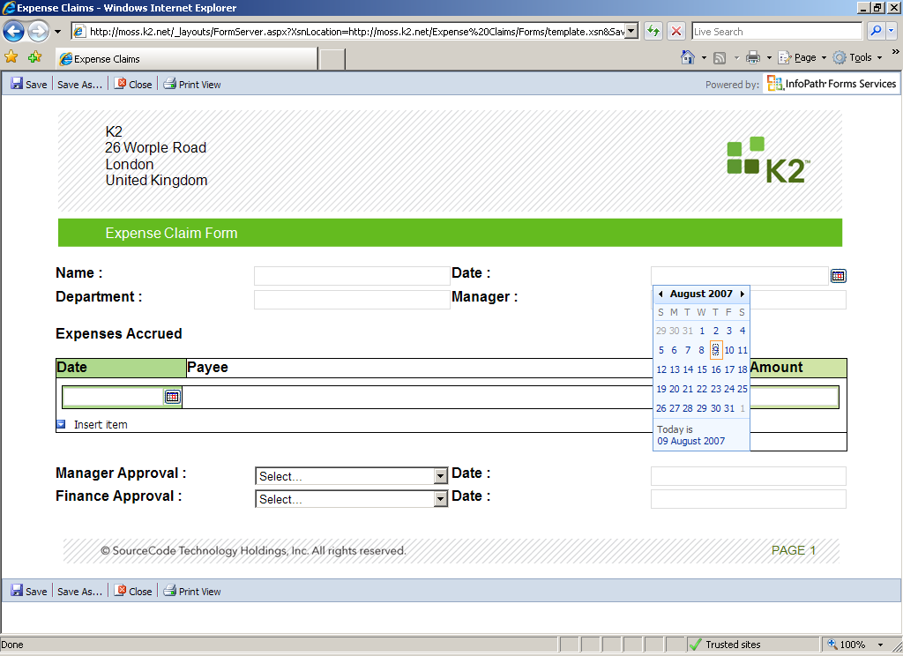
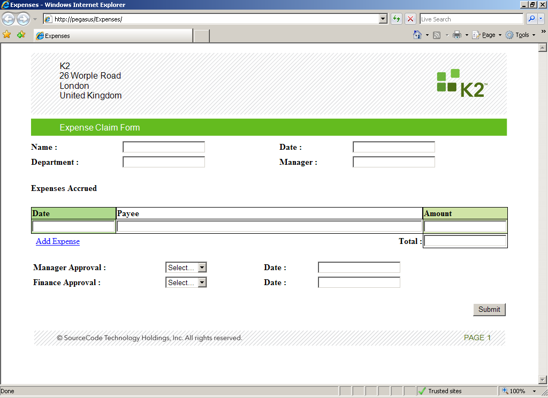
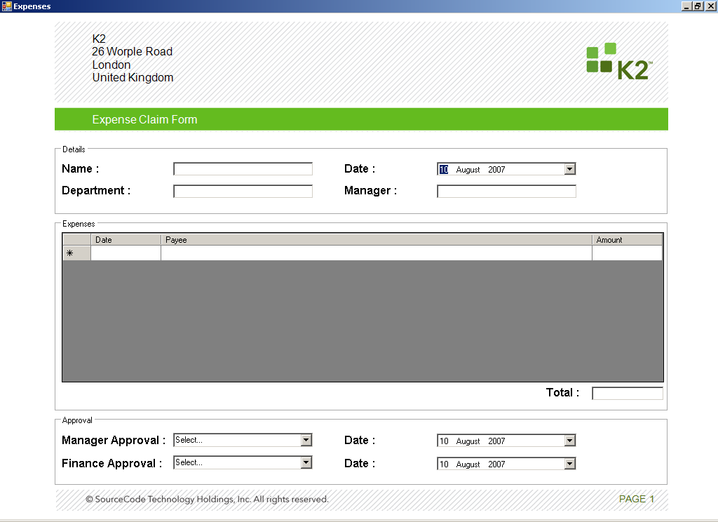

Introducing K2 [blackpearl]
Design
Business Entities
Design business entities which provision enterprise data
Forms
K2 SmartForms
Microsoft Forms Technologies
Policies
Localizable, natural language policies
Reports
Pre-configured and ad hoc reporting capability
Based on Microsoft SQL Server 2005 Reporting Services
Graphical, intuitive design tools

Slide 13
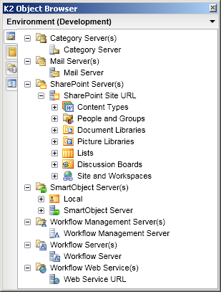
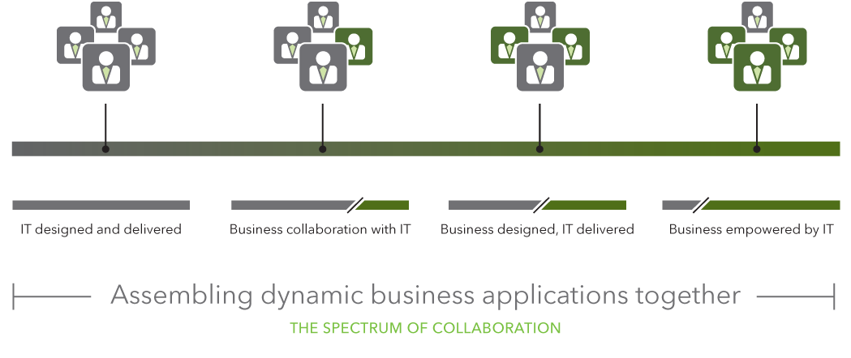
Introducing K2 [blackpearl]
Assemble
Artifact Library
Centrally create, manage and secure reusable artifacts
Process designers reuse preconfigured artifacts in their processes and applications
Environment Library
Centrally create, manage and secure multiple environments
Processes and applications execute against the selected environment
Assemble Dynamic Business Applications Collaboratively

Slide 14
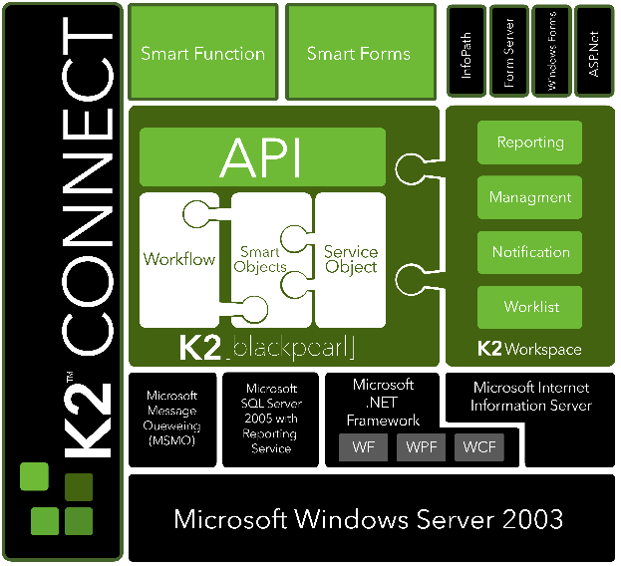
Introducing K2 [blackpearl]
Execute
K2 [blackpearl] Server
Scalable, secure and robust architecture
Built on Microsoft .NET 3.0
K2 Workspace
Localizable AJAX web application
Notification
Management
Reporting
Worklist
K2 [connect]
Integration with SAP
Model complex back end data structures and programs into consumable artifacts
Secure, scalable and robust architecture

Slide 15
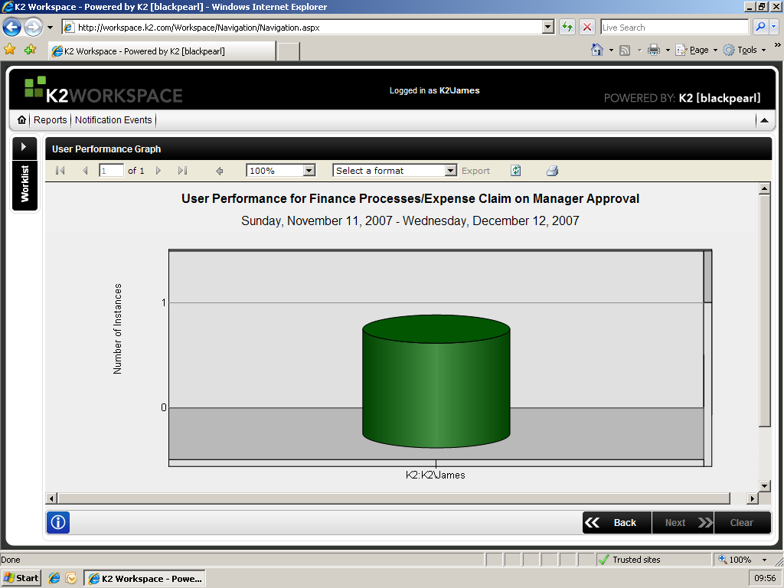
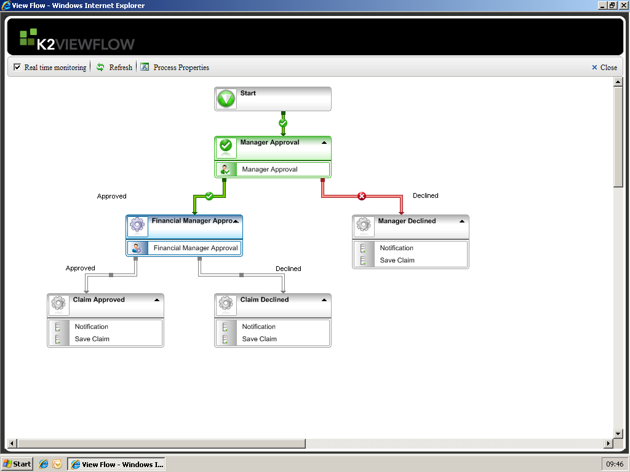
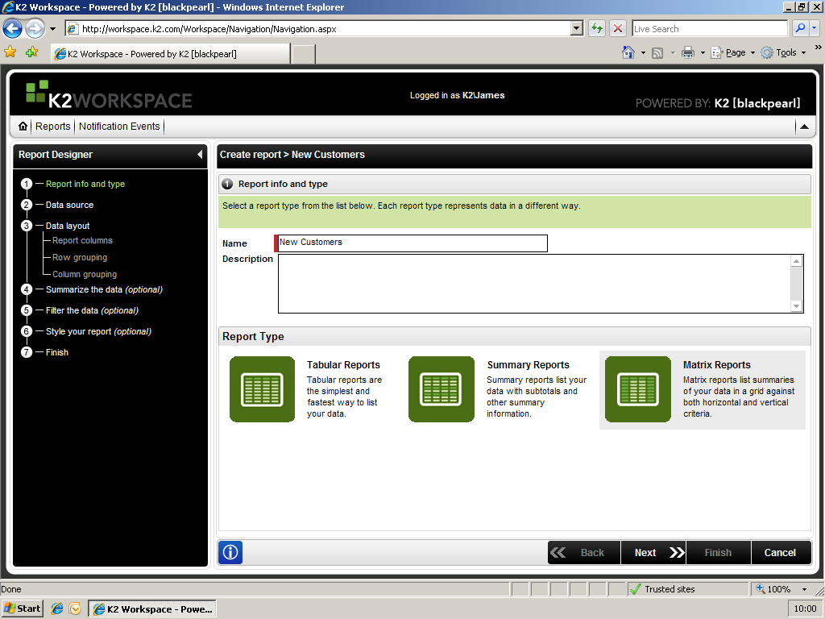
Introducing K2 [blackpearl]
Monitor
Real-Time Process Monitoring
View Flow
Standard Reports
Ad Hoc (Self Service) Reports
Standards based reporting, monitoring and analysis

Slide 16
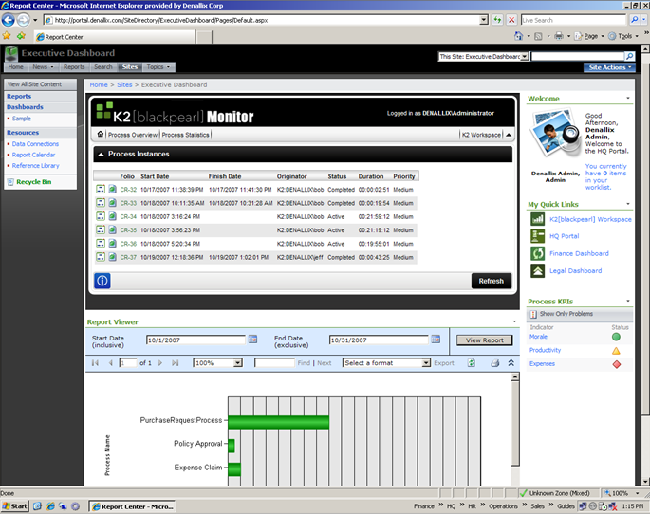
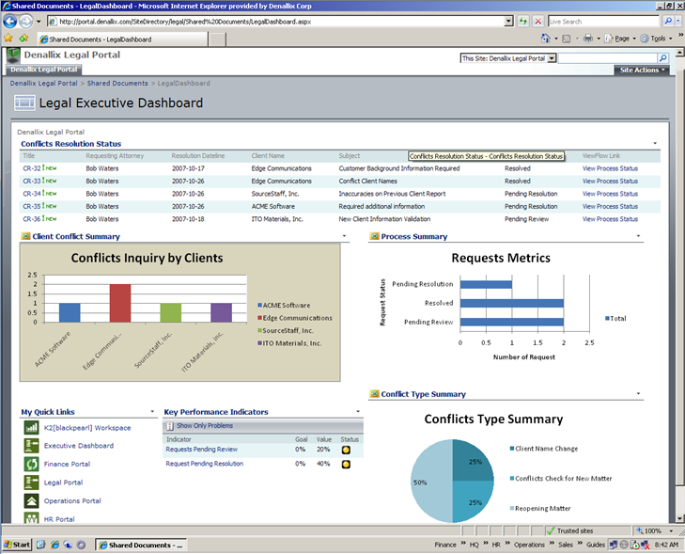
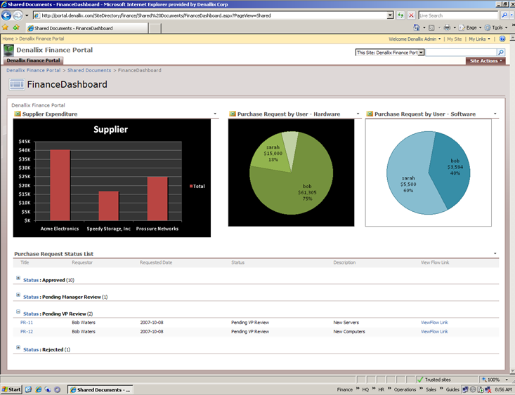
Introducing K2 [blackpearl]
Monitor
Integrated SharePoint Dashboards
Ability to assemble K2[blackpearl] Reporting Dashboard within MOSS delivering Process Metrics & Process Data
Ability to rapidly assemble Reports via K2 [blackpearl] Report Designer or SQL Reporting Designer
Standards based reporting, monitoring and analysis

Slide 17
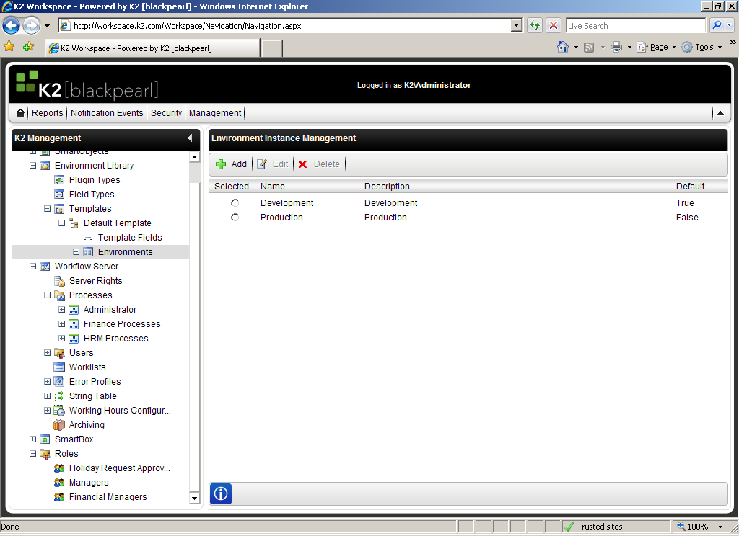
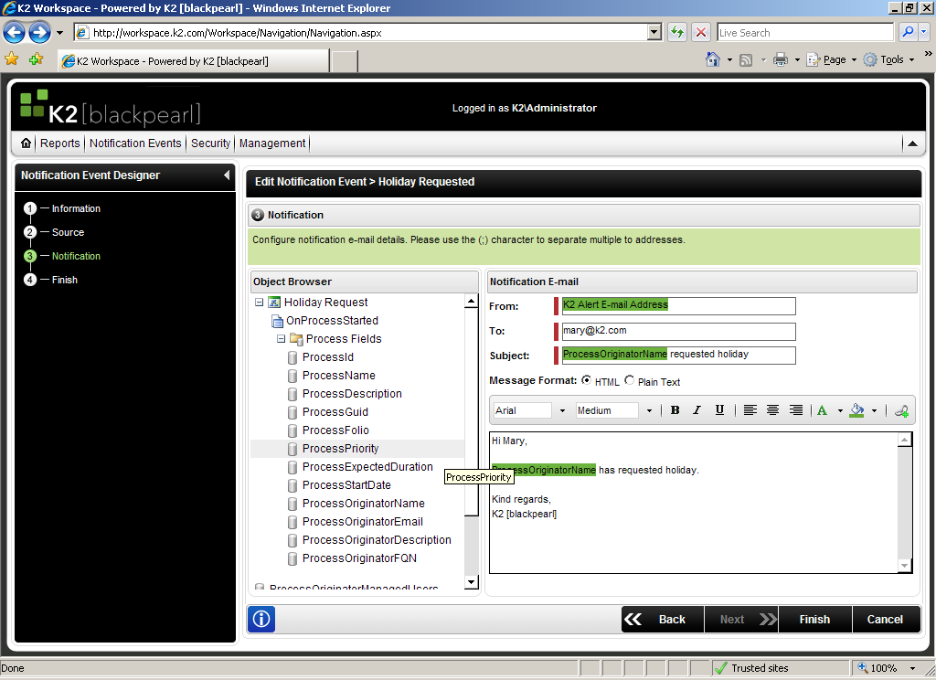
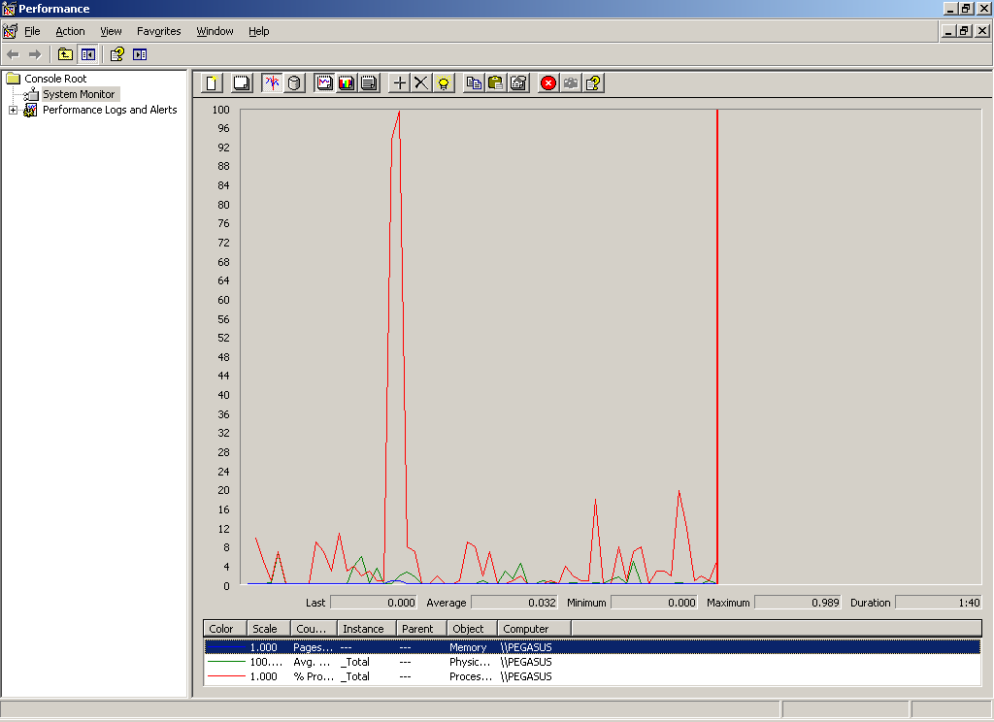
Introducing K2 [blackpearl]
Monitor
Notification
Fully configurable event notification for processes and applications
Performance
Standard counters for Microsoft Performance Monitor
Management
AJAX-enabled, localizable, web-based tooling
Standards based reporting, monitoring and analysis

Slide 18
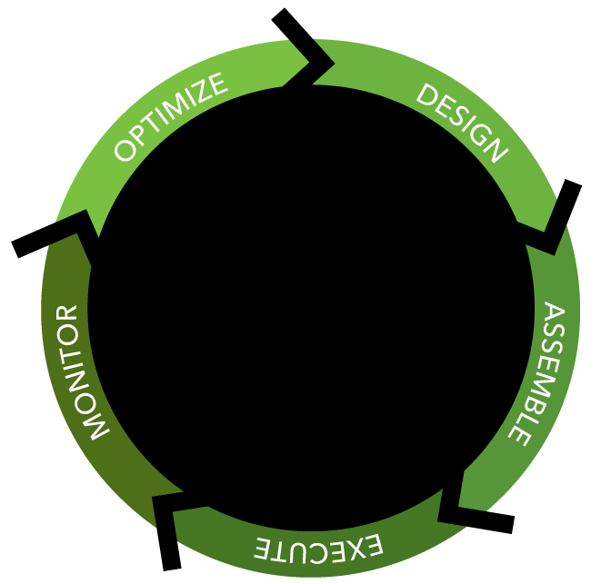
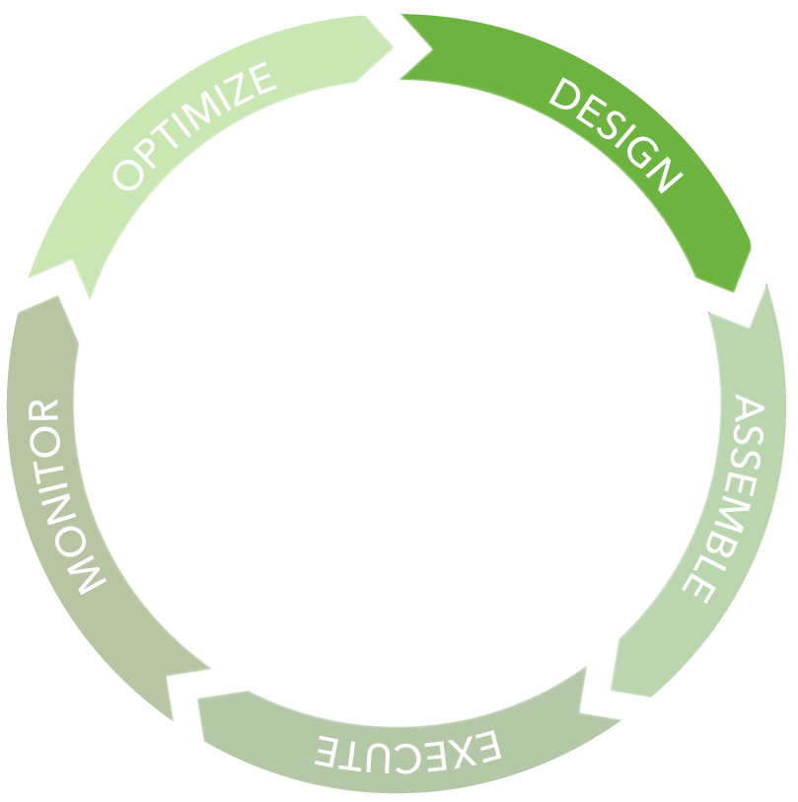
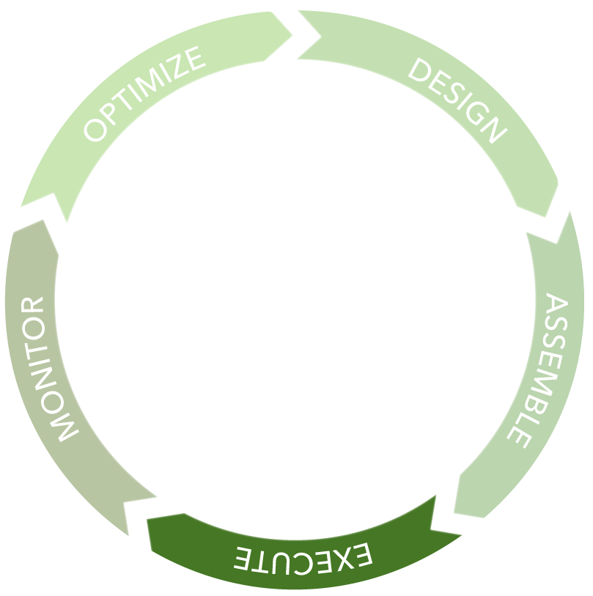
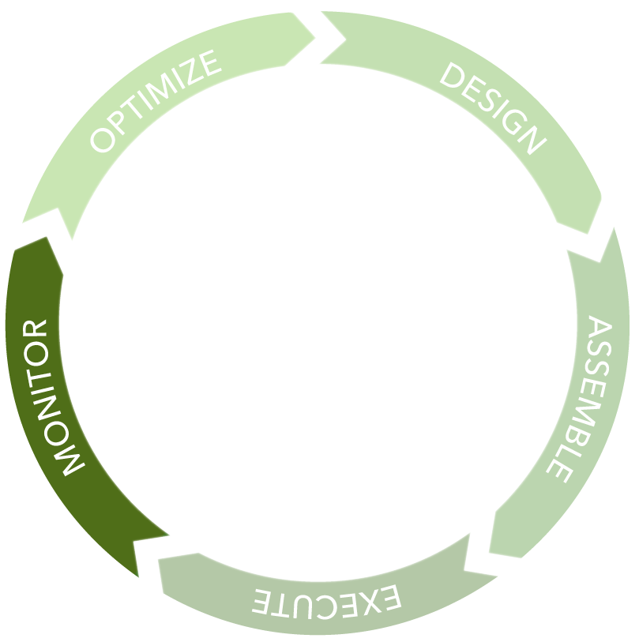
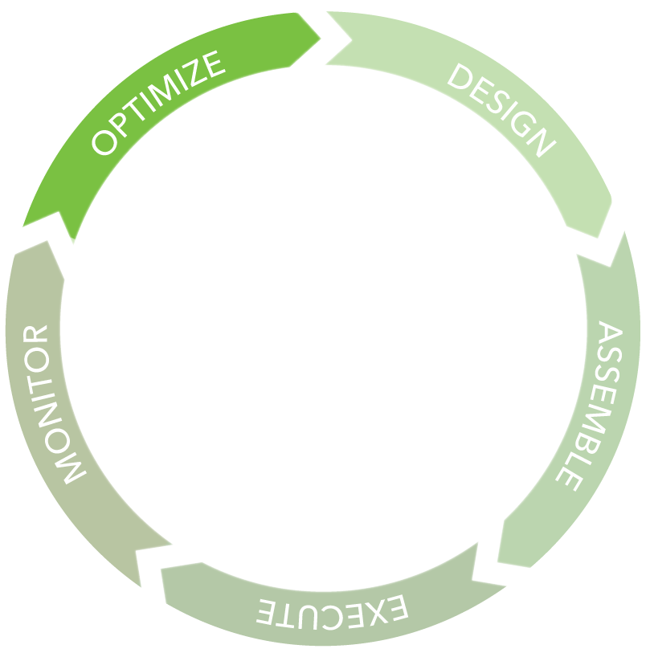
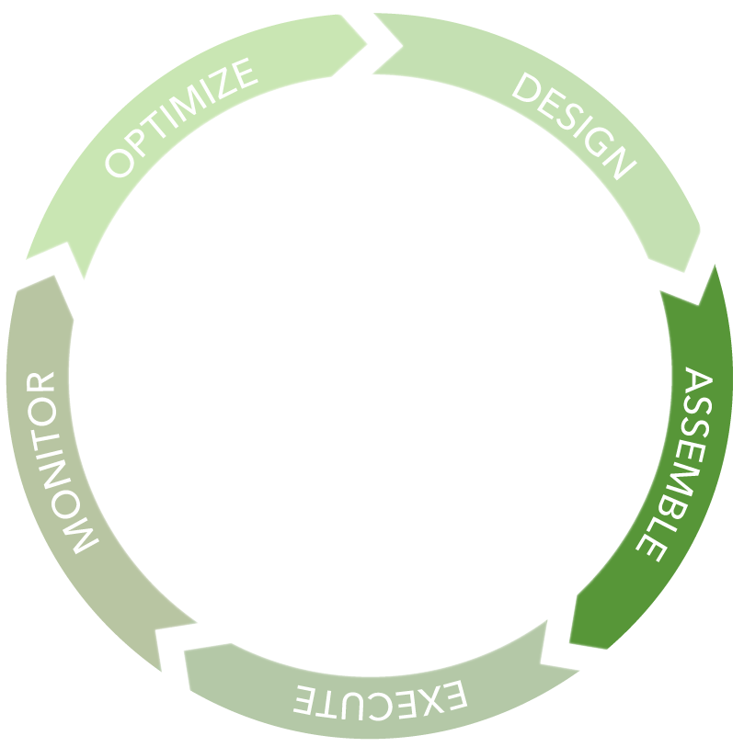

Summary
Web Designer, Visio,
K2 Studio, Visual Studio
Different designers for different users
Automatic documentation
In flight process changes
In flight policy changes
In flight data changes
Simulate
Out of the box reports
Custom reports
Real time process view
Task management
Create reusable components
Reuse components
Integrate LOB systems
Document management
Records management
Policies and rules
Server - Scalable, robust, cluster, Operational Info
Command line build
Environment library

Slide 19
K2 blackpearl Demonstration

Slide 20
K2 blackpearl Demonstration
How K2 Extends the Microsoft Stack
Business Process Modelling
Business Process Simulation
Integrated Human Workflow Management
User Roles
Workflow and Forms Integration
Escalation/Delegation Mechanisms
Universal Tasklist
Central Workflow Reporting and
Management
Standards Support
BPMN
XPDL, BPEL4P

Slide 21
K2 blackwatch

Slide 22
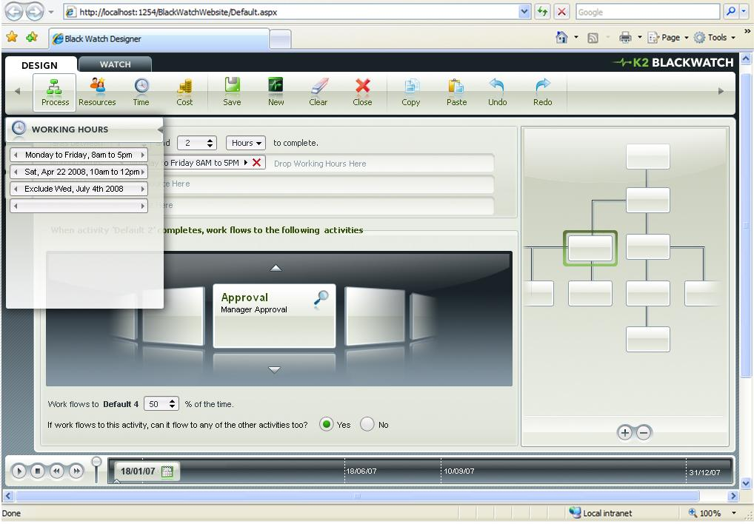
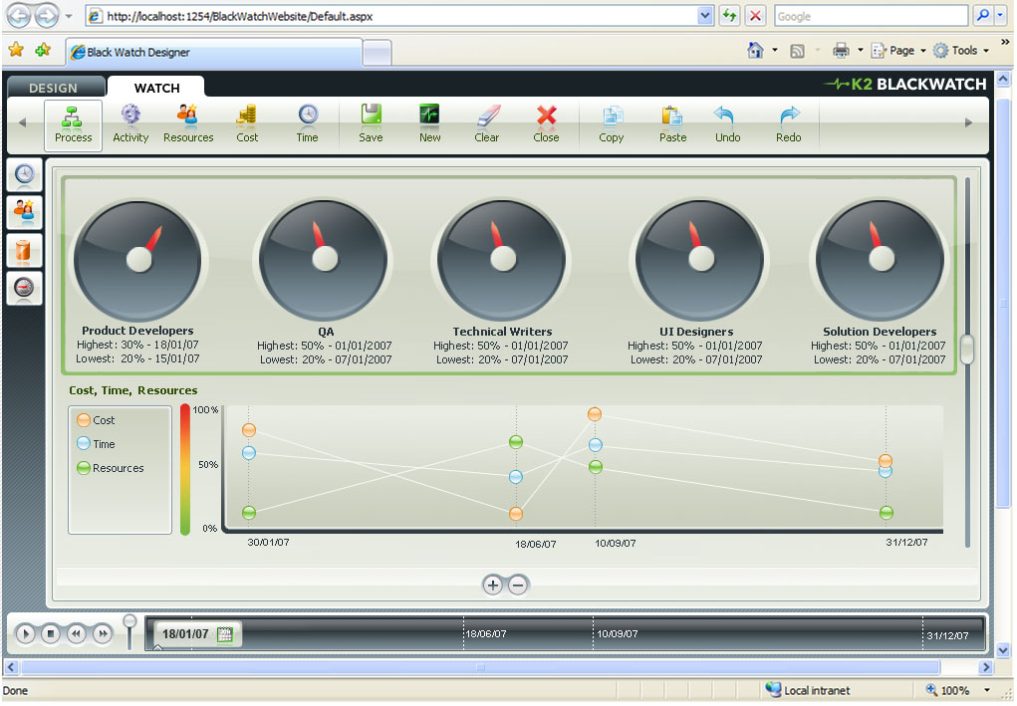

Slide 23
Case Study: BRFKredit (Copenhagen, Denmark)

Slide 24
BRFKredit
Business Needs
BRFKredit is an independent mortgage provider based in Denmark
It offers mortgage and securities services to thousands of customers worldwide
In 2005, BRFKredit began looking for a new platform on which to base its messaging and collaboration services
The company used Lotus Notes for messaging and content management, but found it increasingly difficult to manage these services cost efficiently and provide the flexibility employees needed
BRFKredit needed to:
Reduce operational costs
Give workers access to information
when out of the office
Help employees share information more
easily

Slide 25
BRFKredit
Solution
Migrated messaging and collaboration platform from an IBM operating system to Windows Server 2003
This supports the Microsoft Exchange Server 2003 messaging and collaboration solution.
Exchange Server 2003 delivers fast and secure messaging features through:
Microsoft Office Outlook 2003, which
helps employees manage their
e-mail and scheduling easily
Windows Mobile 5.0 running on
handheld devices, which provides a
mobile workforce
Microsoft Office SharePoint Server 2007
providing a repository from which employees
can quickly and securely access information
such as a colleagues’ e-mail folders and documents

Slide 26
BRFKredit
Software and Services
Microsoft Server Product Portfolio
Windows Server 2003
Microsoft Exchange Server 2003
Microsoft Office System
Microsoft Office SharePoint Server 2007
Microsoft Office Outlook 2003
Windows Mobile
Windows Mobile 5.0
SourceCode Technology Holdings, Inc
K2

Slide 27
BRFKredit
Benefits
Employees can search and share information with colleagues easily
Workers find e-mail messaging and scheduling easier and more reliable using Outlook 2003
Financial advisors and other employees are more flexible and can work productively when away from the office using mobile technology
The interoperable platform optimises current investments by integrating existing applications through SharePoint Server 2007
IT overheads are lowered through
The IT infrastructure is greatly simplified,
which reduces the routine maintenance
work required by employees
The company can expand business easily
because the environment is widely supported
and integrates with a range of third-party
applications

Slide 28
Call To Action

Slide 29
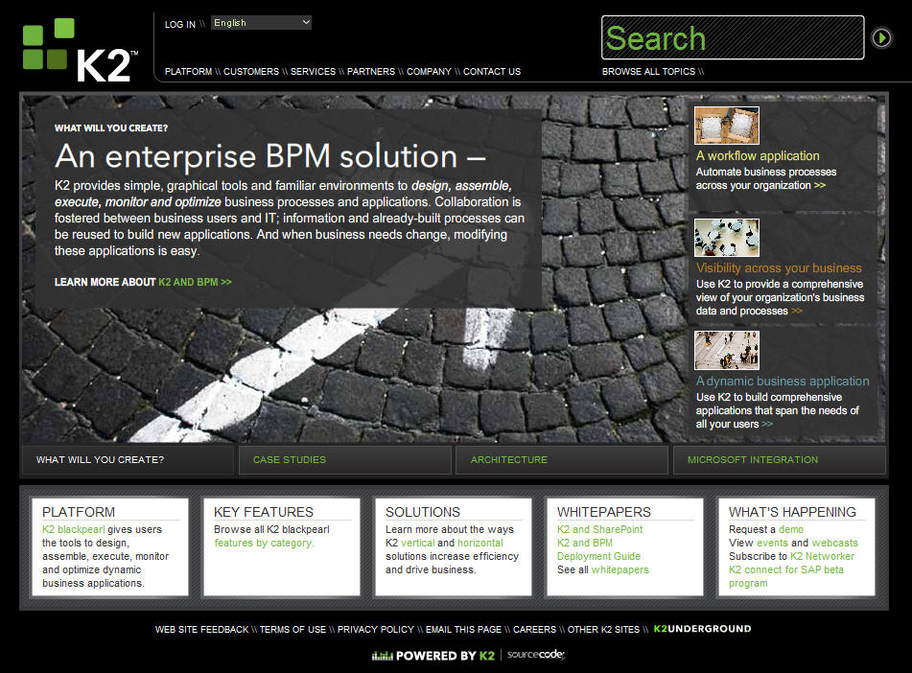
www.k2.com

Slide 30
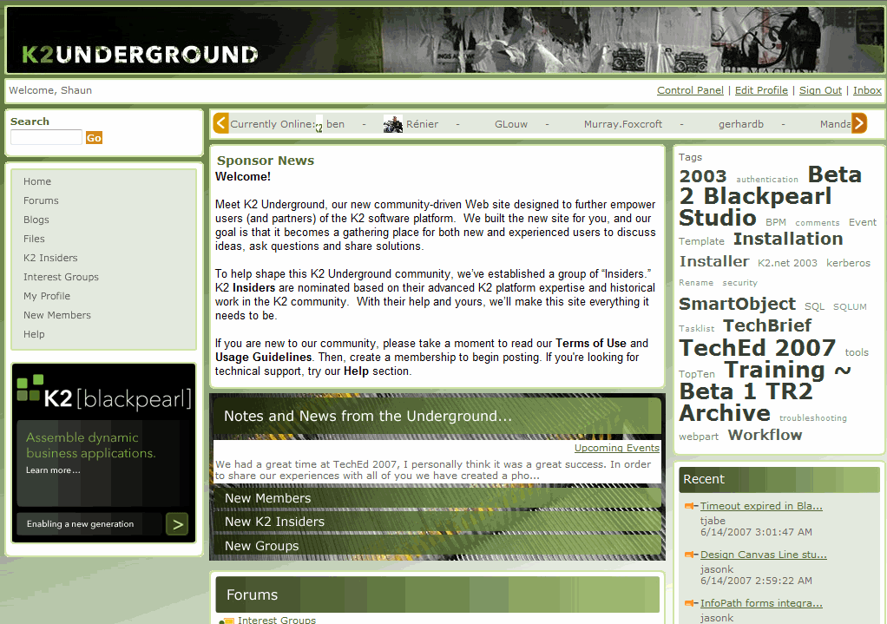
k2underground.com

Slide 31
Questions And Answers
Shaun Leisegang
Presales Manager
shaun@k2.com

