Slide 1


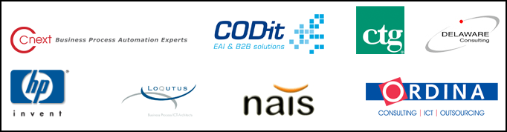
COUNCIL
APRIL 16, 17 2008

Slide 3
SOA Governance
Thomas Reimer
Enterprise Technology Strategist (CATM)
Microsoft Corporation

Slide 4
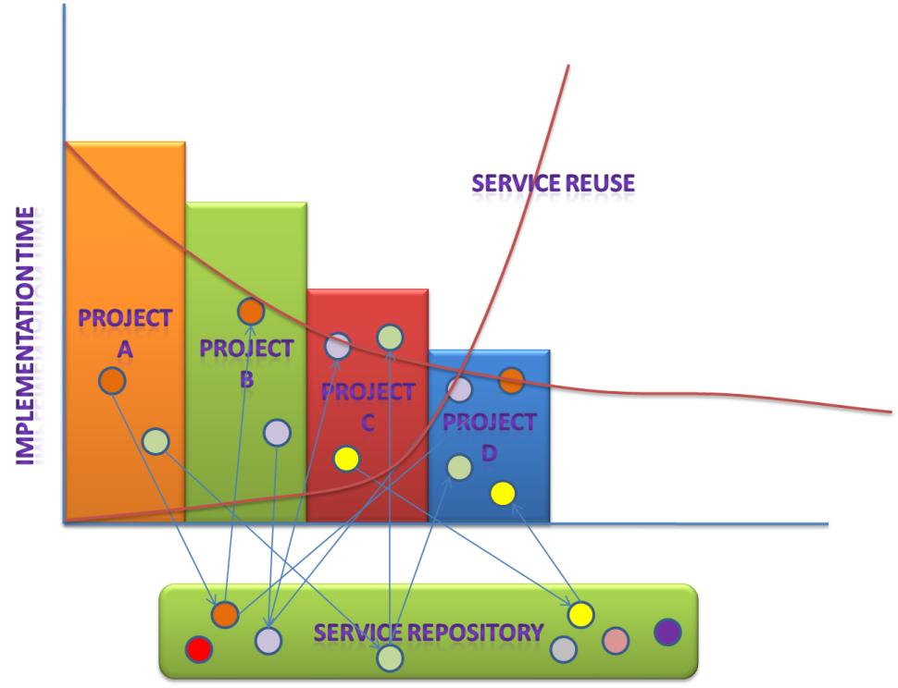
Benefits of SOA
SOA provides opportunity to leverage and reuse IT resources
Benefits can accrue quickly

Slide 5
Common SOA Scenarios
Abstracting back end systems from customers and clients
Automating mission-critical processes
Enabling new channels and business models
Providing visibility and governance across disparate heterogeneous systems
Notes:
Show of hands
Prompt Naveed & Chris to describe the situations

Slide 6
Typical SOA Governance Challenges
How can I ensure service developers can easily publish and discover services?
How can I guarantee existing SLAs when I add new consumers?
How can I ensure that services created are easily discovered and not re-invented?
Ensure that services created adhere to governance policies?
How can I manage services in a scalable way?

Slide 7



Service Versioning Challenge
Application Owner
Application Owner
Service A’
Operation 1
Operation 2 v1.5
Service A
Operation 1
Operation 2
Operation 3
Service A
Operation 1
Operation 2
Operation 3
UI
UI
Logic
Logic
Data
Data
Notes:
Service Versioning

Slide 8
Governance Types
IT Governance
Design time Governance
Runtime Governance
SOA
Governance
Corporate Governance
SOX
Enterprise Architecture
Codes of Business Conduct
Governance
IT Portfolio Management
Project Governance

Slide 9
Service Lifecycle
Envisioning
Service
Analysis
Planning
Service
Decommission
Service
Development
Developing
Management
Management
Governance
Service
Change
Management
Service
Testing
Stabilizing
Service
Consumption
Service
Provisioning
Service
Operation
Deploying

Slide 10
Microsoft Philosophy
End-to-End lifecycle approach is required

Slide 11
SOA Governance Capabilities
Envisioning
Project management
Programme Management
Planning
Service design
Developing & Stabilizing
Service development
Deploying
Management
Reporting
Portfolio Management
Event & Schema design
Capability Assessment
Policy / standards specification
Service testing
Service publishing
Dependency Analysis
SLA enforcement
Service discovery
Service Monitoring
Rogue Service discovery
Exception Management
Service taxonomy
Reporting
Notification Services
Provisioning
Stage Management
Service versioning
Build processes
Asset Management
Capability Repository
Service Repository
Design Time Governance
Runtime Governance

Slide 12
Design time / Runtime Governance Relationship
Service Creation
Service Validation
Service Publication
Runtime Service Discovery
Define & apply runtime policies
Runtime Service Monitoring
Service Discovery
Discover existing services – not reinvent
Create service in Registry
Validation Service Against Governance Policies
Publish validated Services for runtime consumption
Discovery dependencies on other services - dynamically
Define usages policies to control runtime access
Enforce policies and SLAs at runtime
Design Time Governance
Runtime Time Governance
Key

Slide 13
SOA Governance Applied
Envisioning
Project management
Programme Management
Planning
Service design
Developing & Stabilizing
Service development
Deployment
Management
Reporting
Portfolio Management
Event & Schema design
Capability Assessment
Policy / standards specification
Service testing
Service publishing
Dependency Analysis
SLA enforcement
Service discovery
Service Monitoring
Rogue Service discovery
Exception Management
Service taxonomy
Reporting
Notification Services
Provisioning
Stage Management
Service versioning
Build processes
Asset Management
Capability Repository
Service Repository
Design Time Governance
Runtime Governance
MOF
MSBA, SOM
MSF
Visual Studio Team System 2005
Windows Server Platform
SCOM 2007, MSE
.NET 3.0 (WCF)
Partners
Partners

Slide 14
SOA Design Time Governance

Slide 15
Design Time Governance Capabilities
Applies across Envisioning, Planning & Developing phases
Design Time Governance includes capabilities such as:
Service / Capability determination
Service Registry / Repository
Service Visibility
Service Trust
Change Management / Dependency Analysis
Policy Management / design time enforcement
Project Compliance

Slide 16
Microsoft Services Business Architecture (MSBA)
Business Architecture methodology tackles “how and where to start with SOA?”
Methodology is endorsed by the creators of Six Sigma, business process reengineering, and Zachman.
MSBA delivers:
Business Architecture
Project recommendations
Structure and focus for SOA decisions
No need to spend 6 –12 months on SOA analysis and paralysis.

Slide 17
What does MSBA provide?
Business case for initiating SOA projects.
Schematic language that is easily understood by business and IT stakeholders.
Industry templates and tools.
Exposes high-value business areas.
Risk mitigation approach for large SOA projects (typically 2 – 8 week projects).
Structured methodology to analyze governance and compliance.

Slide 18
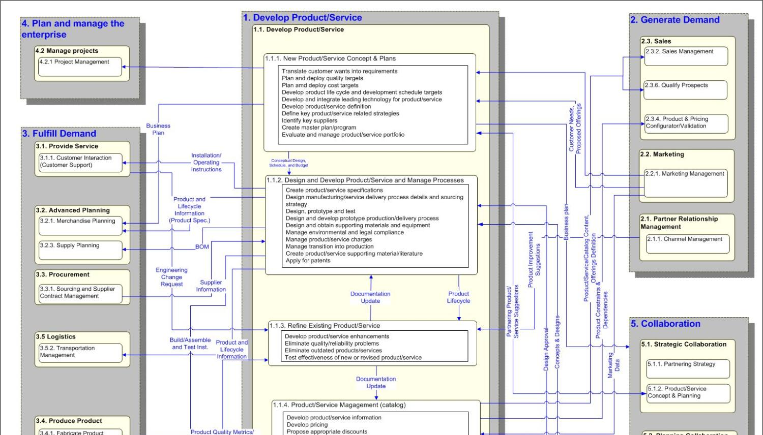
Detailed Capability Map

Slide 19
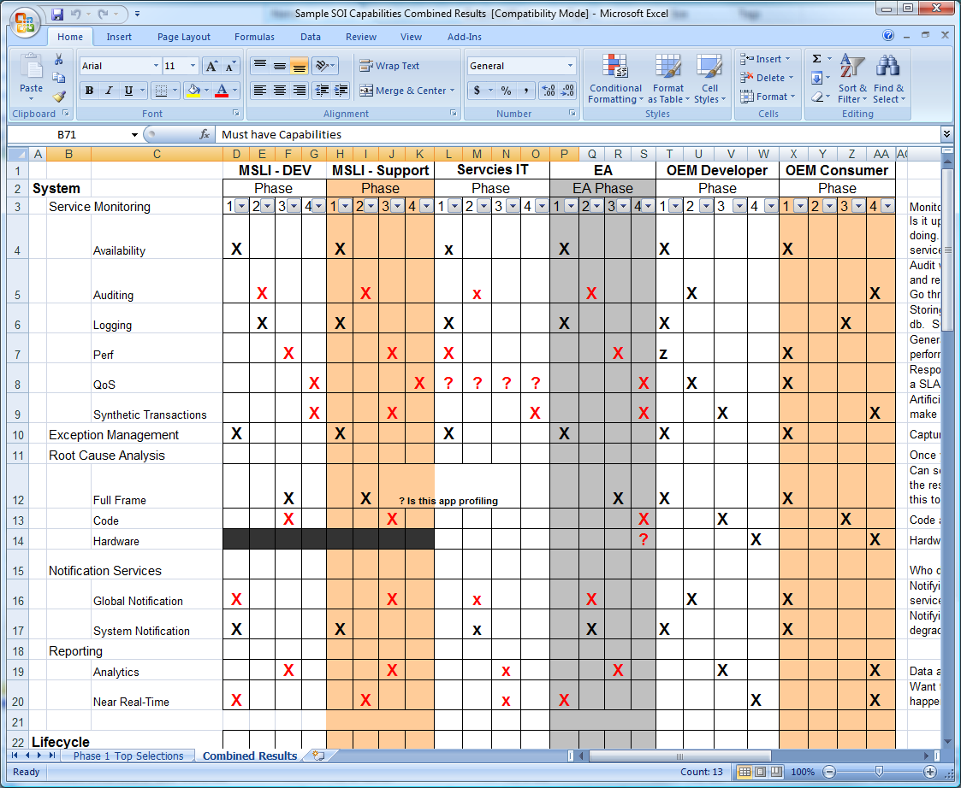
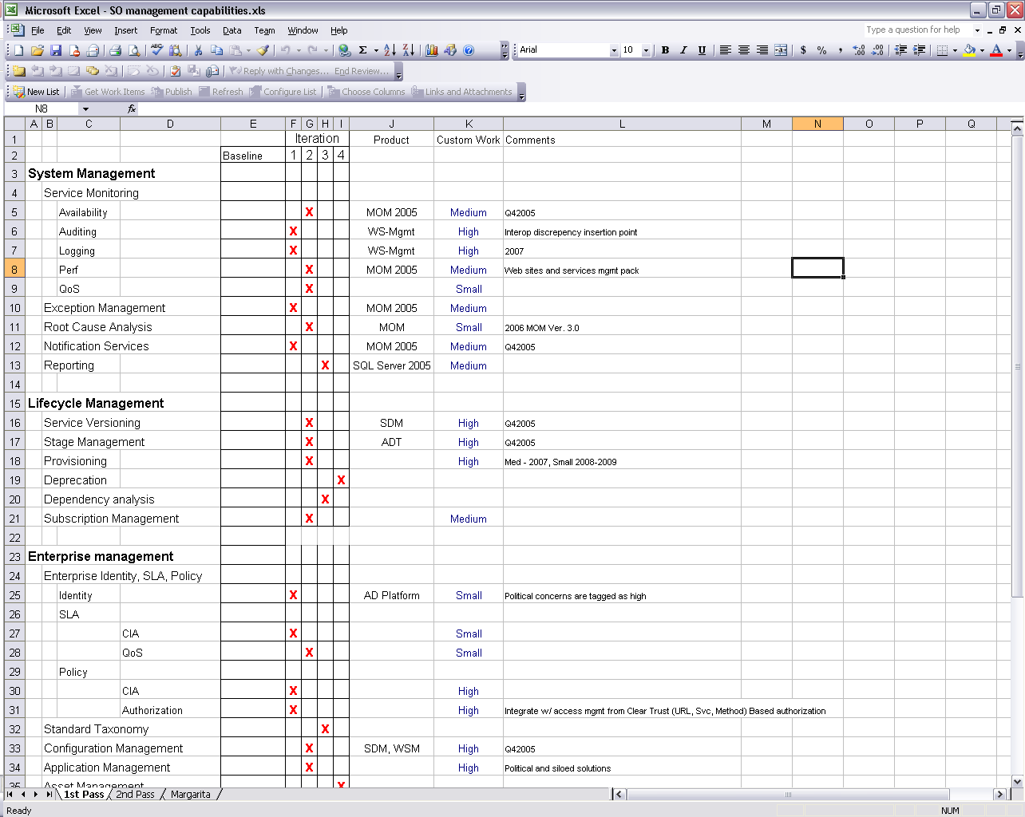
Prioritize Technical Capabilities

Slide 20


Service Oriented Modelling (SOM)
Where you really are
Where you want to be
Define Future
Business Architecture
Business Architecture
Microsoft Services
Service Oriented Modelling
Alignment
Alignment
Technology Architecture
Define Future
Technical Architecture

Slide 21
Understanding SOM
SOM is an Approach to bridge the gap between Business Architecture and Technology Architecture using connected models
SOM enables
Visibility
Visibility of Business Architecture through Capability Models and Heat Maps
Rapid Decision Making
Visibility enables business to focus doing the right thing
Agility
Agility comes from ability to react
Accountability
SOM ultimately provides accountability for chosen project
SOM provides a foundation for Incremental, Consistent and Repeatable Service Delivery through modelling:
Capability, Process, Service and Entity Models

Slide 22






Service Oriented Modelling
Where you really are
Where you want to be
Service Oriented Modelling
Capability
Models
Process
Models
Service
Models
Services
Capability Modelling
Process
Modelling
Service
Modelling
Implementation
Business Architects
Architects
Architects
Development Teams
Industry Templates
Templates
Templates
Templates
Backwards Traceability and Forward Engineering

Slide 23
Architecture Overview

Slide 24
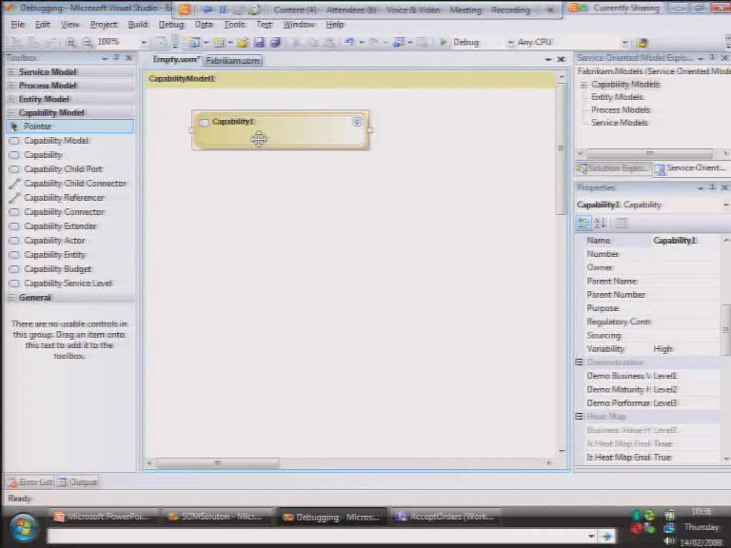

Slide 25
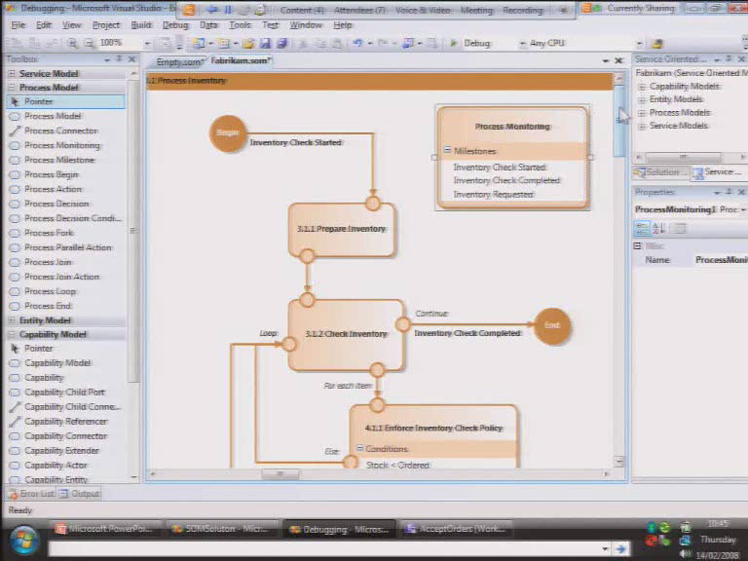

Slide 26
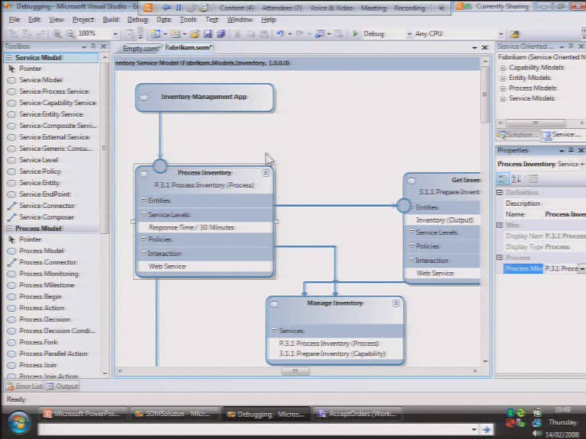

Slide 27
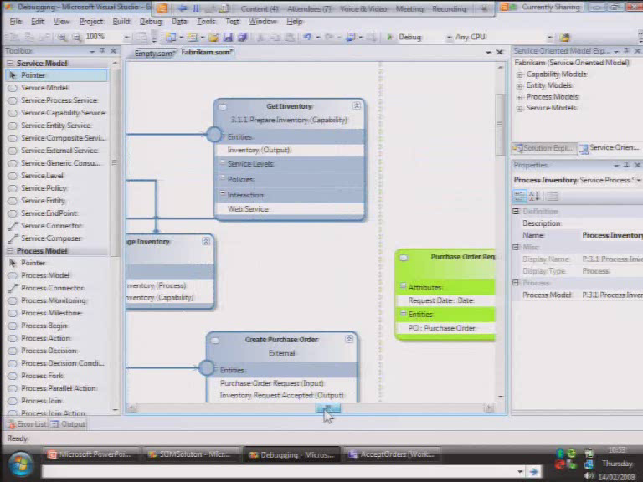

Slide 28
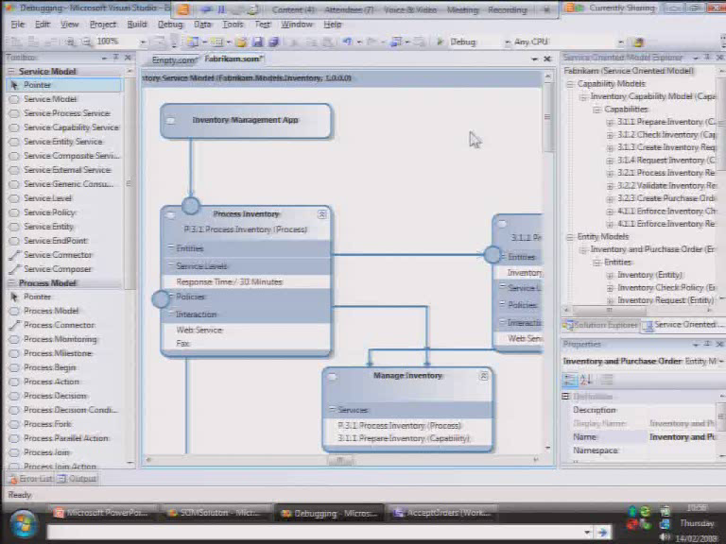

Slide 29

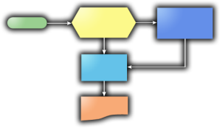
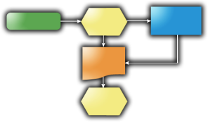
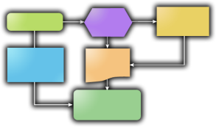

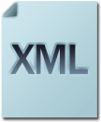
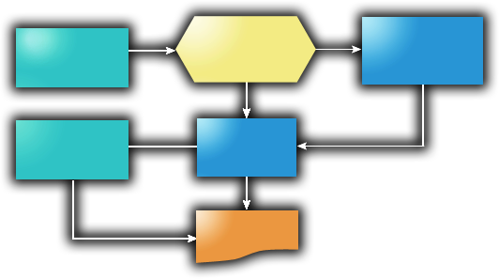

SOM Modellers in Action
Capability Models
Process Models
Entity Models
Consolidated
Information
Service Models
SOM Lead

Slide 30

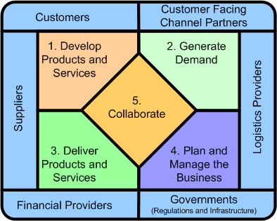



Microsoft
Server Platform
Microsoft Services
Business Architecture
BizTalk
BAM
WF
WCF
SQL
Etc.
Direct
Transformation
MSBA Drives
SOM Delivery
Microsoft
Development Platform
Source Code
Configuration
WCF Factory
EntLib
Etc.
Factory
Transformation
SOAMM Drives
SOM Customisation
Software Factories,
App Blocks and Guidance
Direct
Transformation
SharePoint (WF)
Office Docs
InfoPath
Etc.
SOA
Maturity Model
Microsoft
Office Platform
Notes:
Factory Transformation is generating another factory and partially-complete models/templates i.e WCF Service Factory Modelling Edition
Direct Transformation is generating environment/product/technology specific artefacts i.e.odx (XLANG), .XAML (WF), .DOCX, .CS (C#)
Although SOM is delivered top-down, customisation is bottom-up (starting from transformation templates to modelling framework)
In an ideal world there should be multiple software factories targeting different products and technologies. This personal comment, don’t hate me ☺

Slide 31
Service Development
Once services or capabilities have been identified – service development
Lots of challenges
Service versioning
Change management
Multiple roles engaged / collaboration
Transparency
Visual Studio Team System

Slide 32











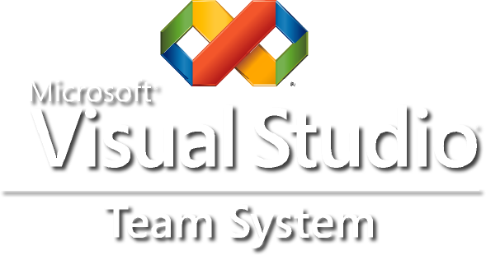
Visual Studio Team System Design time governance comprehensive support
Database Professional
Designer
Developer
Tester
Architect
Business
Analyst
Software
Quality
Project
transparency
IT / Project Manager
Change
Management
Planning
Project management
Programme Management
Architecture & Design
Service design
Construction
Service development
Deployment
Management
Reporting
Portfolio Management
Event & Schema design
Capability Assessment
Policy / standards specification
Service testing
Service publishing
Dependency Analysis
SLA enforcement
Service discovery
Service Monitoring
Rogue Service discovery
Exception Management
Service taxonomy
Reporting
Notification Services
Provisioning
Stage Management
Service versioning
Build processes
Asset Management
Capability Repository
Service Repository
Service
Versioning
Reporting
Visual Studio Team System
Team
Collaboration
Notes:
© 2006 Microsoft Corporation. All rights reserved. Microsoft, Windows, Windows Vista and other product names are or may be registered trademarks and/or trademarks in the U.S. and/or other countries. The information herein is for informational purposes only and represents the current view of Microsoft Corporation as of the date of this presentation. Because Microsoft must respond to changing market conditions, it should not be interpreted to be a commitment on the part of Microsoft, and Microsoft cannot guarantee the accuracy of any information provided after the date of this presentation. MICROSOFT MAKES NO WARRANTIES, EXPRESS, IMPLIED OR STATUTORY, AS TO THE INFORMATION IN THIS PRESENTATION.
32

Slide 33
MSF
Microsoft Solutions Framework
Software development processes, principles & proven practices
Methodology templates
MSF for Agile Software Development
MSF for CMMI® Process Improvement
Planning
Project management
Programme Management
Architecture & Design
Service design
Developing & Stabilizing
Service development
Deployment
Management
Reporting
Portfolio Management
Event & Schema design
Capability Assessment
Policy / standards specification
Service testing
Service publishing
Dependency Analysis
SLA enforcement
Service discovery
Service Monitoring
Rogue Service discovery
Exception Management
Service taxonomy
Reporting
Notification Services
Provisioning
Stage Management
Service versioning
Build processes
Asset Management
Capability Repository
Service Repository
Visual Studio 2005 Team System
enacts
Microsoft Solutions Framework
MSF
guides

Slide 34
Service Publish & Discovery
Shared Services published
During development – need to discover and consume
Microsoft Windows UDDI Server
Part of Windows Server 2003 platform
Publish and discover services
Enables client applications to programmatically interact
Supports UDDI version 2.0
Future support for v3.0
SDK for developers to publish and discover services

Slide 35
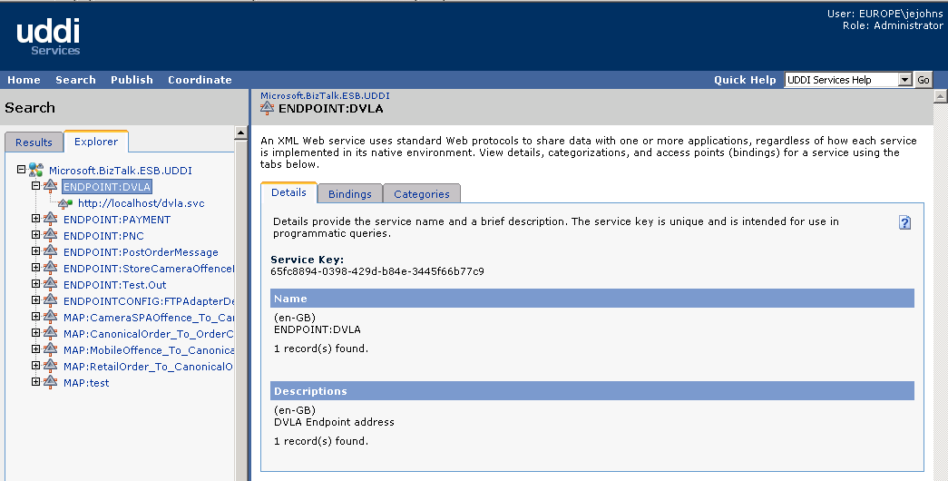
Service Registry
Windows UDDI server

Slide 36
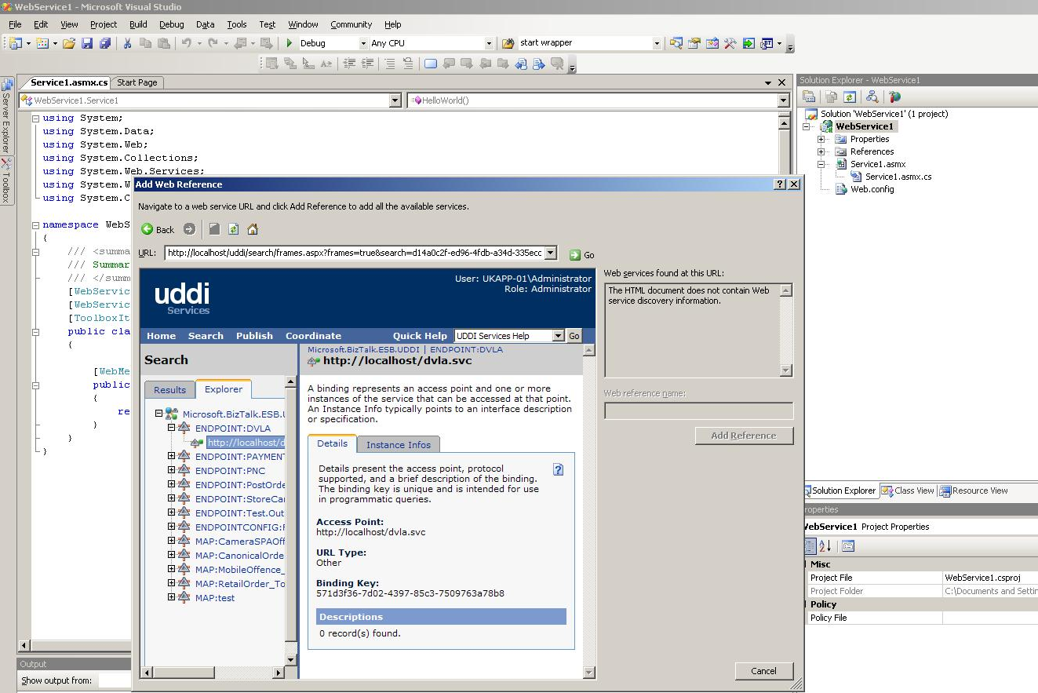
Design time discovery

Slide 37

Partner Interoperability
Microsoft SOA platform also interoperates with Service Registry/Repository vendors such as
HP Systinet
SOA Software
Visual Studio
Registries / Repositories

Slide 38
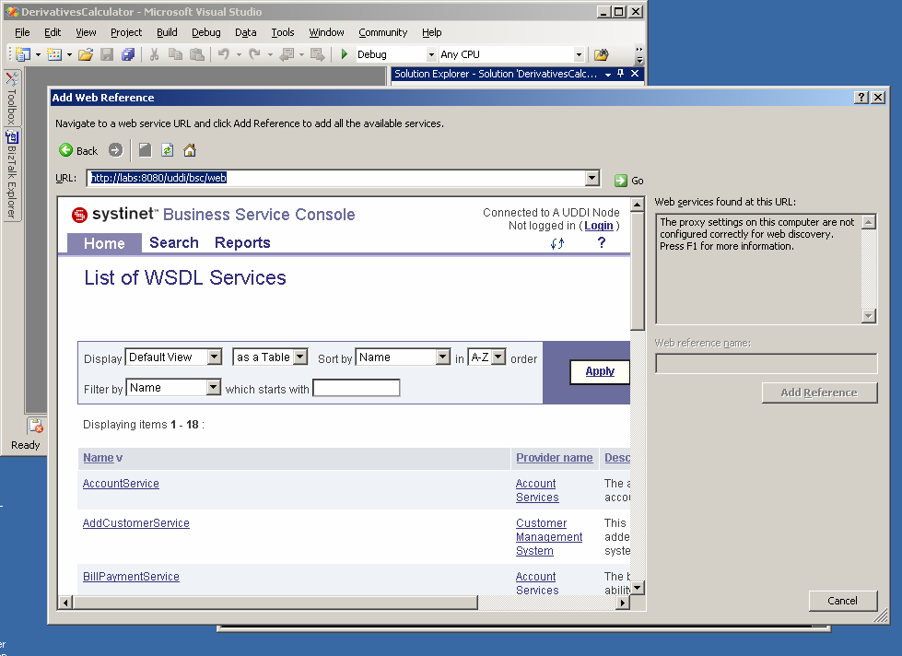
Design time discovery

Slide 39
SOA Runtime Governance

Slide 40
Runtime Governance Capabilities
Applies across Deployment, Management phases
Typical capabilities include:
Service Virtualization
Service Management
Service Monitoring
Service Discovery
Service Usage
Service Control
Planning
Project management
Programme Management
Architecture & Design
Service design
Developing & Stabilizing
Service development
Deployment
Management
Reporting
Portfolio Management
Event & Schema design
Capability Assessment
Policy / standards specification
Service testing
Service publishing
Dependency Analysis
SLA enforcement
Service discovery
Service Monitoring
Rogue Service discovery
Exception Management
Service taxonomy
Reporting
Notification Services
Provisioning
Stage Management
Service versioning
Build processes
Asset Management
Capability Repository
Service Repository
Runtime Governance

Slide 41
SOA Runtime Governance – Microsoft Approach
Managed Service Engine (MSE)
System Center Operations Manager 2007
Platform - WCF runtime discovery
Patterns & Practices:
Microsoft Operations Framework
Standards based approach
Partner Interoperability
Amberpoint Demo
Planning
Project management
Programme Management
Architecture & Design
Service design
Developing & Stabilization
Service development
Deployment
Management
Reporting
Portfolio Management
Event & Schema design
Capability Assessment
Policy / standards specification
Service testing
Service publishing
Dependency Analysis
SLA enforcement
Service discovery
Service Monitoring
Rogue Service discovery
Exception Management
Service taxonomy
Reporting
Notification Services
Provisioning
Stage Management
Service versioning
Build processes
Asset Management
Capability Repository
Service Repository
SCOM 07
MOF
DSI
SML
.NET 3.0

Slide 42
Service Virtualization
Host Service
Address
Virtual Service
Binding
Contract
Notes:
Abstraction
Translation
Visibility

Slide 43



Implementation Pattern
Messenger
A
C
B
Broker
A
C
B
Dispatcher
A
C
B
Service Intermediary
Address
Binding
Contract
Service Repository

Slide 44

Managed Services Architecture
Built on metadata and runtime messaging
Messenger
Message Normalization
Broker
Operation Selection
Policy Enforcement
Authentication
Authorization
Dispatcher
Operation Invocation
Message Translation
Decryption Encryption
Decryption Encryption
Authorization
Authentication
Service Catalog
(Meta Data Repository)
Client
Service Logic
(Service Runtime Engine)

Slide 45
Managed Services Engine (MSE)
The Managed Services Engine (MSE) is one approach to facilitating Enterprise SOA through service virtualization
Built upon the Windows Communication Foundation (WCF) and the Microsoft Server Platform (BizTalk Server, UDDI)
Developed by Microsoft Services to help customers address the challenges of SOA in the enterprise

Slide 46
Managed Services Engine (MSE)
Service virtualization through a Service Repository
Deploy services faster
Coordinate change management
Maximize the reuse of various service elements
Versioning
Abstraction
Service management
Routing, and runtime policy enforcement

Slide 47
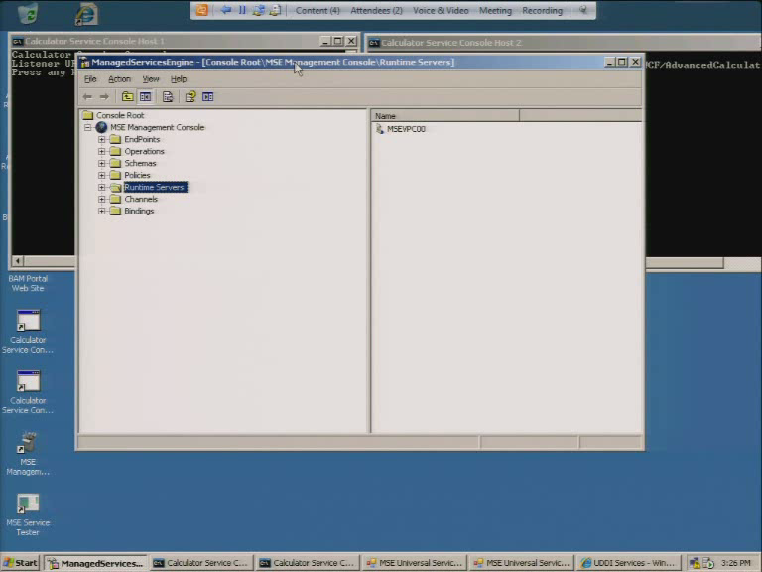

Slide 48
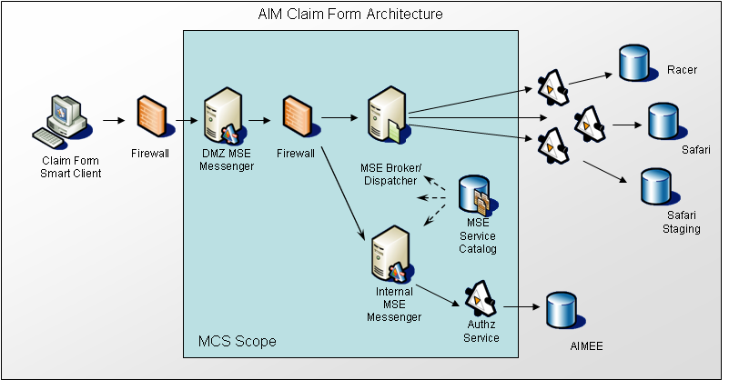
Customer Usage Scenarios
AIM Healthcare
Exposed SQL Server Stored Procs and Biztalk Orchestrations
Multiple consumer authentication models, AzMan for authorization

Slide 49














System Center Ops Mgr 2007
Proactive management of your IT services
Integrated monitoring of distributed applications, the end user perspective, and supporting infrastructure
End-to-End Service Management
Reduced problem resolution time
Management packs that include Microsoft expertise for applications, servers, and clients
Best of Breed for Windows
Simplifies managing your IT environment and improves time to value
Role based security, self monitoring infrastructure, and improved scalability
Increased Efficiency and Control

Slide 50





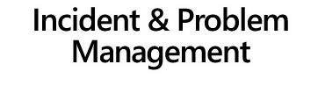













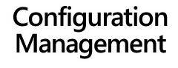





Notes:
50
© 2006 Microsoft Corporation. All rights reserved. Microsoft, Windows, Windows Vista and other product names are or may be registered trademarks and/or trademarks in the U.S. and/or other countries.
The information herein is for informational purposes only and represents the current view of Microsoft Corporation as of the date of this presentation. Because Microsoft must respond to changing market conditions, it should not be interpreted to be a commitment on the part of Microsoft, and Microsoft cannot guarantee the accuracy of any information provided after the date of this presentation. MICROSOFT MAKES NO WARRANTIES, EXPRESS, IMPLIED OR STATUTORY, AS TO THE INFORMATION IN THIS PRESENTATION.

Slide 51
System Center Capabilties
Envisioning
Project management
Programme Management
Planning
Service design
Developing & Stabilizing
Service development
Deploying
Management
Reporting
Portfolio Management
Event & Schema design
Capability Assessment
Policy / standards specification
Service testing
Service publishing
Dependency Analysis
SLA enforcement
Service discovery
Service Monitoring
Rogue Service discovery
Exception Management
Service taxonomy
Reporting
Notification Services
Provisioning
Stage Management
Service versioning
Build processes
Asset Management
Capability Repository
Service Repository
Design Time Governance
Runtime Governance

Slide 52
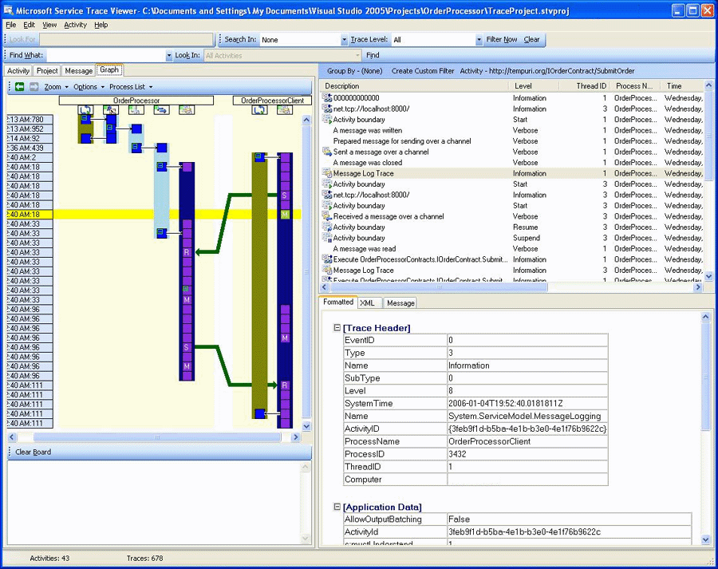
WCF Monitoring
Windows Communication Foundation (WCF) Service Trace Viewer Tool

Slide 53
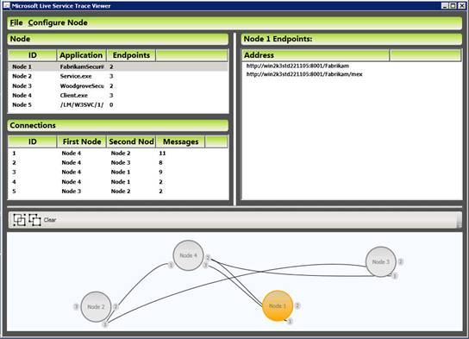
Runtime Discovery
WCF Live Service Trace Viewer
Service dependency analysis

Slide 54
Platform + Partner Solution
Envisioning
Project management
Programme Management
Planning
Service design
Developing & Stabilizing
Service development
Deploying
Management
Reporting
Portfolio Management
Event & Schema design
Capability Assessment
Policy / standards specification
Service testing
Service publishing
Dependency Analysis
SLA enforcement
Service discovery
Service Monitoring
Rogue Service discovery
Exception Management
Service taxonomy
Reporting
Notification Services
Provisioning
Stage Management
Service versioning
Build processes
Asset Management
Capability Repository
Service Repository
Design Time Governance
Runtime Governance

Slide 55
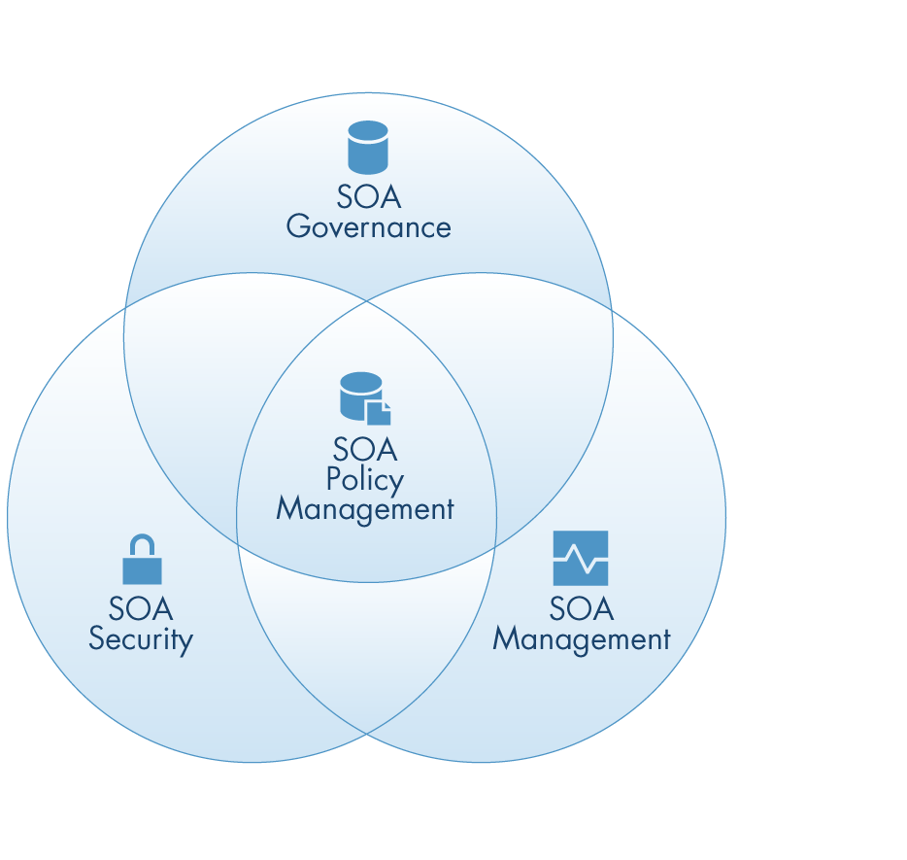

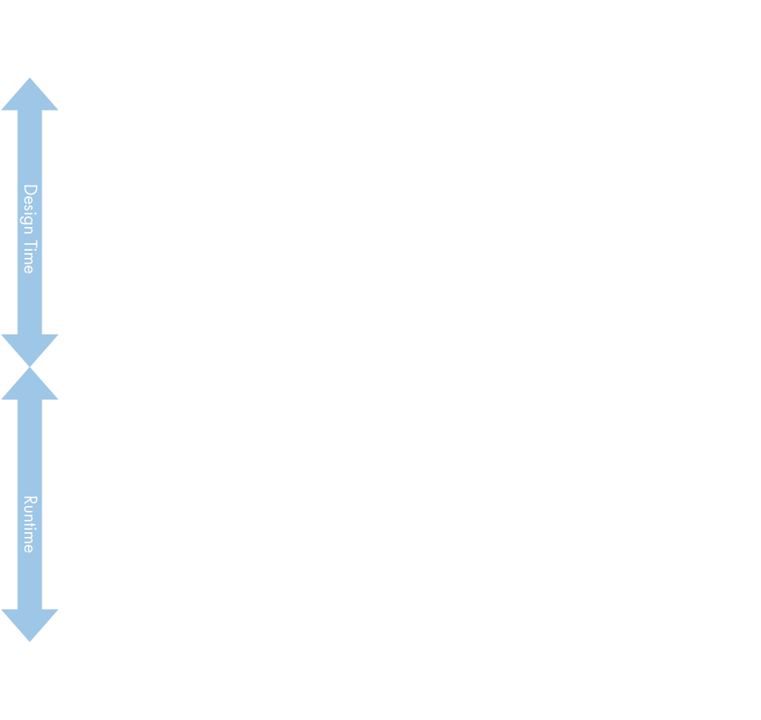
SOA Software
Governance Solutions
Compliance Checking
Policy Management
Service Discovery
Lifecycle Management
Exception Management
Reliability and performance management
Tolerance and mediation
Decoupling
Security Solutions
Trust enablement
SOA Policy Management
Policy management
Policy enforcement
Metric collection and analysis
Compliance management and reporting

Slide 56

COUNCIL

