Slide 1


Microsoft Dynamics NAV 2009 RoleTailored Client Terminology
May 2010

Slide 2

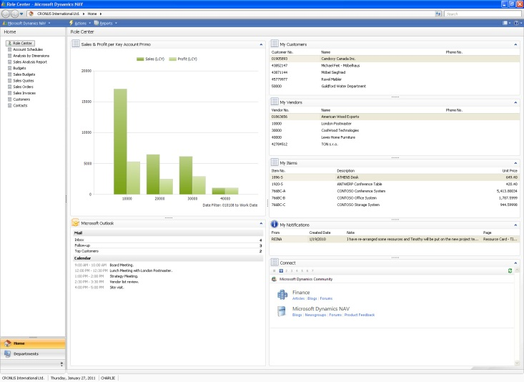
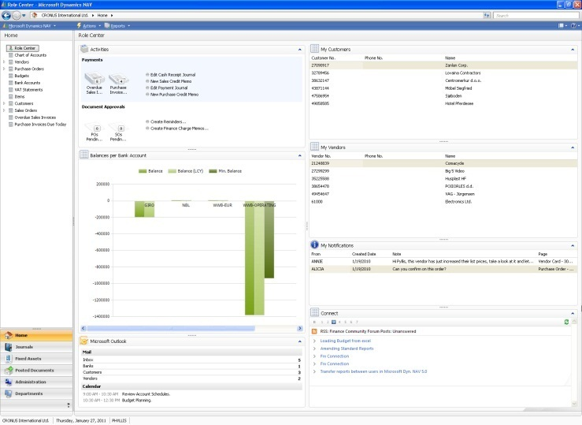
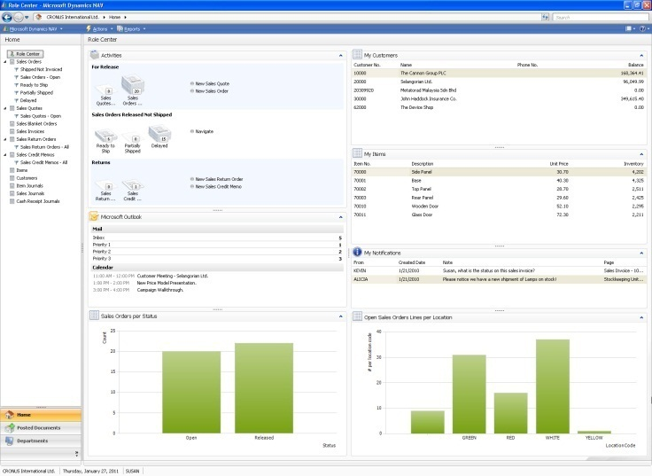



Getting to know the terminology of Microsoft Dynamics NAV 2009
To use Microsoft Dynamics NAV 2009, your employees log into a User Profile which provides a Role Center and links to relevant Places in your business management system. Whether it’s for a bookkeeper, a warehouse worker, or a purchaser, each User Profile has its own Role Center designed to help the user or users who do this job. Users will be able to take effective actions by easily finding and using the information they need. They will only see the data and tasks that they work with and the work that lies ahead of them. The Role Centers can be customized and personalized so that a user always feels at home; as a result, you’ll see increased user productivity.
Notes:
Introducing User Profiles.
There are two basic types of windows in Microsoft Dynamics NAV, navigation window and task window, and the page types and controls that can be used in each are different.
For that reason we must begin by understanding the two types of windows. (Next slide).

Slide 3
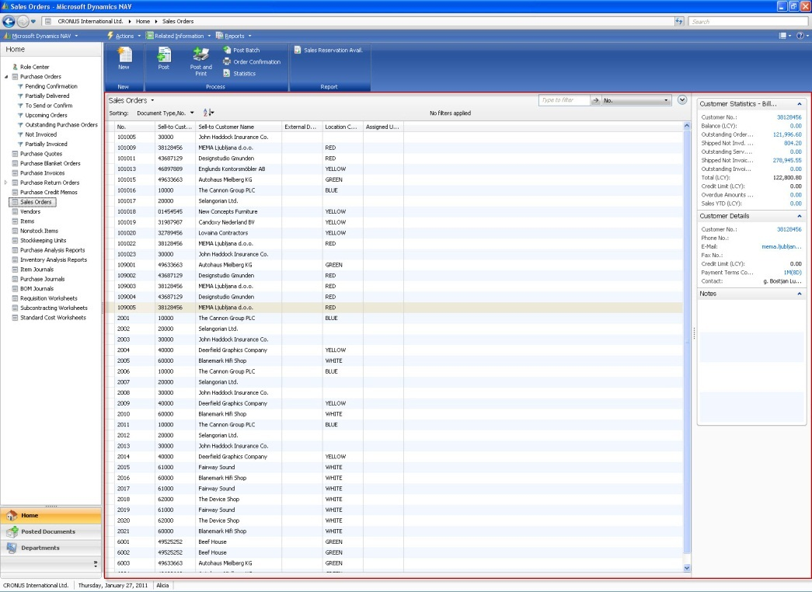
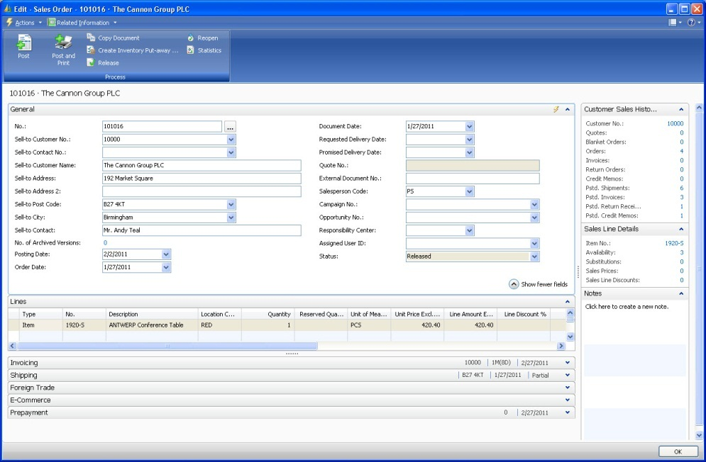
Two Window Types
Navigation Window
Task Window
Similar to Microsoft Office Outlook, there are two basic types of pages in Microsoft Dynamics NAV: Pages shown in the Navigation Window provide an overview and help users to find the data they need to work with. Pages in pop-up Task Windows show details about the record selected in the Navigation Window and help users to complete tasks with that record.
In Microsoft Dynamics NAV 2009, pages replace forms as the way to display and organize data. You can create pages to offer users a visual experience that is closely aligned with Microsoft Office and Windows Vista. There are different page types that you use for different situations. The page type you choose depends on the application task you want to support, the content you want to display, and how you want to display it.
Notes:
Introducing the Navigation Window and pop-up Task Windows.
Terms used in this slide:
Navigation Window
The Navigation window is the main window of the application. The types of pages displayed in this window are called Places, and as users navigate, one page replaces the other in the same window.
Task Window
Task windows are opened from the Navigation Window and from other Task windows. Each window only show one page and is closed when users are done working with that page.

Slide 4
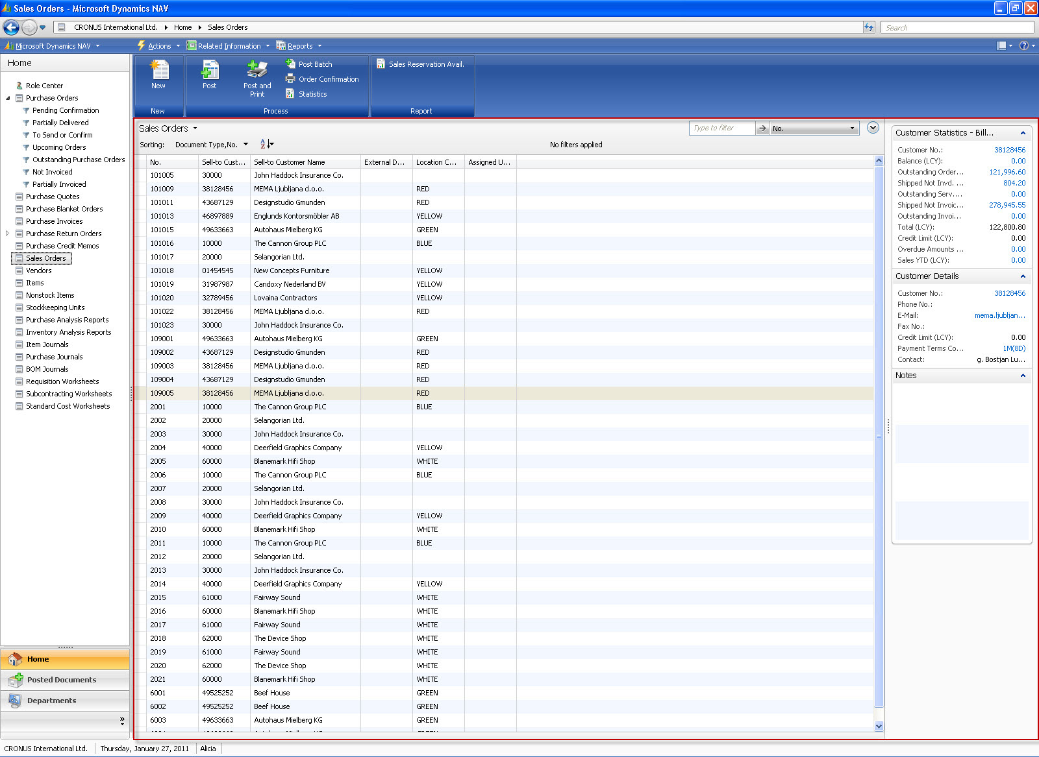
Navigation Window Controls
Travel Buttons
Address Bar
Action Pane
Filter Pane
Search box
Navigation Pane
Command bar
Fact Box
Fact Box Pane
Status bar
The RoleTailored client uses a number of windows to display information. Two of the key window types are the navigation window and the task page window. The navigation window (shown here) is the main window in which users find the information they need to work with. The navigation window is used for the Role Center, List Places, and Departments. A task page opens in a separate window when a user selects an action from the navigation window or from other task page windows. It is common for a user to have more than one task page window open at a time.
Notes:
Introducing the fixed User Interface Controls found in Navigation Windows.
Terms used in this slide:
Travel Buttons
Use them to go to back and forward within browsed pages.
Address Bar
The Address bar displays the location of the current page within the navigation hierarchy of the application. The Address bar updates when you navigate to a different page.
Search Box
Use the Search box to search and open any page in Microsoft Dynamics NAV.
Command Bar
The Command bar displays menus with actions that you can click to perform tasks or view information.
Action Pane
The Action pane is located under the Command bar and contains shortcuts to commonly used actions. (See later slide for details).
Navigation Pane
The Navigation pane displays a list of links to frequently used List places in the RoleTailored client. At the bottom of the navigation pane you can see Activity buttons. Click an Activity button to see the set of links, relevant to this button. You can add or delete Activity buttons and links to the List places from the Command bar or by right-clicking in the Navigation pane.
Filter Pane
The Filter pane is found on List pages and enables the user to filter and sort the items displayed in the list based on a given criteria. The Filter pane includes both the Quick filter and the Advanced filter. The Filter pane is automatically included on List pages and cannot be configured.
Fact Box Pane
The Fact Box pane is located on the right side of List Places and Task Pages and it is displayed by default if any Fact Boxes are added to it.
Fact Box
A Fact Box displays data related to information about an item on the page. For example, on the list page that shows sales orders, you can use a Fact Box to show additional fields of a selected sales order in the list.
Status Bar
The Status bar displays information about the current state of the RoleTailored client session. You can see the company you are working with, the work date and the name or ID of the logged-on user. Click the company name to choose another company from the list. Click the work date to select another date from the calendar.

Slide 5
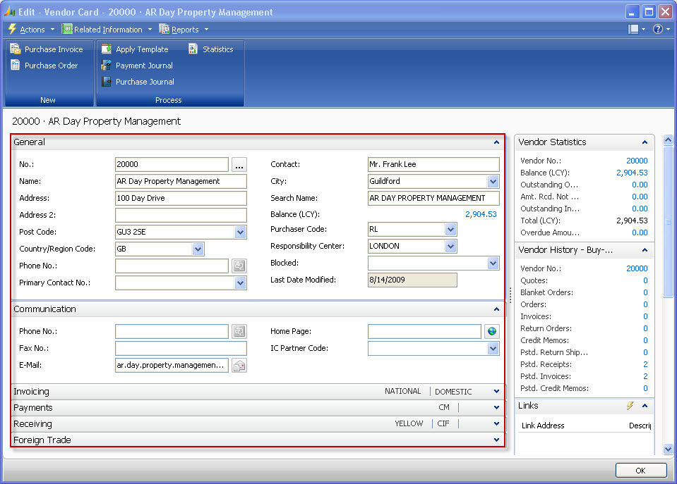
Task Page Controls
Expanded FastTab
Location of ”Show more fields” button when it is present
Collapsed FastTab
Promoted fields in FastTab
Page Footer
In Task Pages information is grouped in FastTabs if multiple groups exist. The header of the FastTab displays a name, such as "Payments“ or “General” on the Vendor Card as shown. Organizing data using FastTabs helps users to find key information more quickly, while providing an overview of the content of multiple FastTabs at the same time.
Notes:
Introducing the additional fixed User Interface Controls found in Task Pages.
Terms used in this slide:
FastTabs
FastTabs group data on a page, where each group has a header that expands and collapses the group when clicked.
Promoted Fields
You can configure or personalize fields in a FastTab to be Promoted: Promoting a field to the FastTab’s header enables you to present key information to the user when the FastTab is collapsed.
Additional Fields
You can configure or personalize fields in a FastTab to be Additional: Additional fields are not shown by default so the FastTab shrinks and leaves space for other FastTabs. When fields are set to Additional a link ”Show more fields” appears in the lower-right corner of the FastTab.
Page Footer
Task Pages have a Page footer which contains the buttons used to dismiss the page.

Slide 6
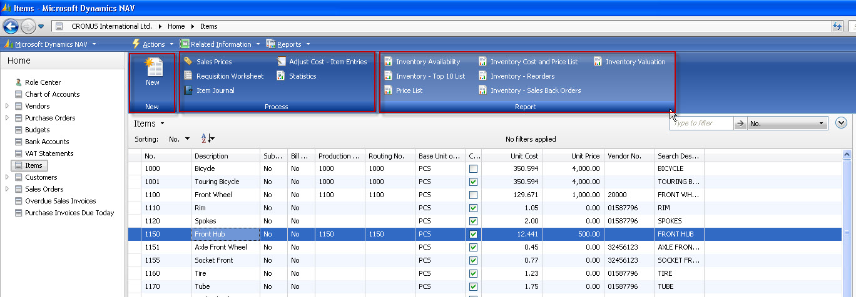
Details on Action Pane
Large icon size
Default Action Pane Groups
The Action pane is located under the Command bar on task pages and list places and contains shortcuts to commonly used actions. Actions display as icons plus text which the user can click to initiate a task or view information. To include an action in the Action pane, you use the Action Designer (available from the View menu when a Page Designer window is open) and promote the action. You should use the Action pane to display the tasks most frequently used by the user in the context of the page. For example, on an Items List Place, you should promote action to create more records and actions to process the selected record (or records). You should also include actions to display frequently accessed information related to the records such as statistics and reports.
Notes:
Introducing details about the User Interface Controls named Action Pane.
Terms used in this slide:
Action Pane
The Action pane is located under the Command bar on task pages and list places and contains shortcuts to commonly used actions. The full set of actions is available from the Command bar.
Action Pane Group
Action pane groups tie together related actions. Out-of-the-box there are three Action pane groups named New, Process and Reports. You may choose to create groups with the names of document states or process steps to better indicate to users which actions to use in which situations.
Large Icon Size
Actions can be shown with a large or small icon size. This can for example indicate to users if the action is used in every transaction or only in some situations.

Slide 7
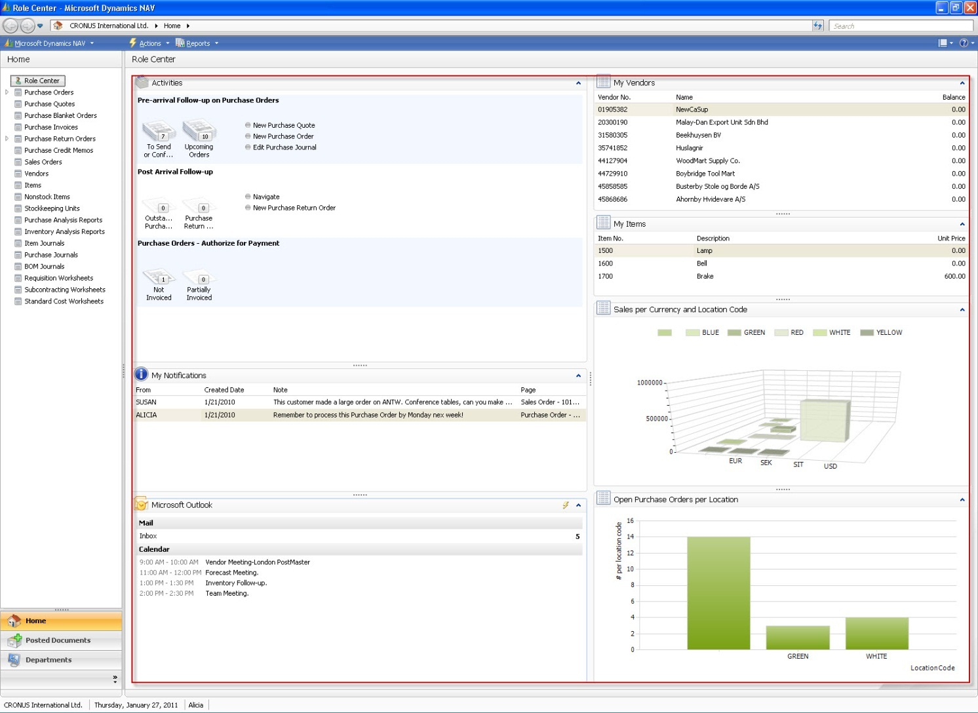
Role Center
Cues
Activities part
List Part - My Vendors
Role Center Page
List part - My Items
My Notifications part
Chart part
My Outlook part
The Role Center is the main page of the RoleTailored client. You can configure the Role Center for an individual user or a User Profile. The Role Center provides the user with an overview of the work of the day, where the user can quickly access information and tasks on which to focus for the day. The Role Center provides an overview of the work in front of you: The ordinary work (the stacks of paper) and the extraordinary tasks (the notifications). You also have single-click access to the frequently used List Places.
Notes:
Introducing the Role Center as a page in the Navigation window.
Terms used in this slide:
Activities Part
The Activities part contains stack of documents, called ”Cues”, click a Cue to open the corresponding list or journal.
Cue
A Cue is a shortcut to a filtered list, for example, Sales Orders - Open. A Cue icon represents a stack of papers with a number label. The height of the stack is proportional to the number of items in the underlying list, and the number label gives the precise count.
List Part
Your Role Center may contain one or more lists with customers, vendors or items. You decide which customers, vendors or items you include on the list. By double-clicking a line you can open that record without going through a List Place.
Chart Part
You can choose a chart to be displayed in your Role Center from a list of available chart definitions, including Balances per Bank Account, Sales and Profit per Key Account.
My Notifications Part
The My Notifications part allows you to view notifications which other users send to you. The notifications are generated from a Notes control on a task page.
My Outlook Part
The Outlook part provides an integration to Microsoft Outlook. From your Role Center you can get an overview of the e-mails, calendar, and tasks and then open the desired entity in Microsoft Outlook directly from Microsoft Dynamics NAV.

Slide 8
Navigation Window - List Place
Action Pane
Filter Pane
Quick Filter
Navigation Pane
FactBox
A List Place displays information from a table in a list format with rows and columns. Typical use of List Places include displaying sale orders or customers. Similar to the Role Center, List Places display in the navigation window. List Places only appear in the navigation window, but the same page definition is used to open a List Task Page in a separate window. To create a List Place, you create a page of the type List and then add an action to the relevant Role Center page using the Action Designer to create a link to it in the navigation pane.
Notes:
Introducing List Place as a page in the Navigation window.
Terms used in this slide:
Action Pane
The Action pane is located under the Command bar on task pages and list places, and contains shortcuts to frequently used actions.
Filter Pane
The Filter pane is found on List pages and enables the user to filter and sort the items displayed in the list based on a given criteria. The Filter pane includes both the Quick filter and the Advanced filter. The Filter pane is automatically included on List pages and cannot be configured.
Quick Filter
The Quick filter is found in the upper-right corner of the Filter pane. It is used to quickly filter on one of the columns shown in the list.
Advanced Filter
The Advanced filter is collapsed by default and can be shown at the bottom of the Filter pane by clicking the round button to the right of the Quick filter. The Advanced filter is used for building complex filter conditions that combine criterion for multiple columns.
FactBox
A FactBox is an area that is located on the right side of a page which displays data related to information about an item on the page. For example, on the list page that shows sales orders, you can use a FactBox to show additional fields of a selected sales order in the list.

Slide 9
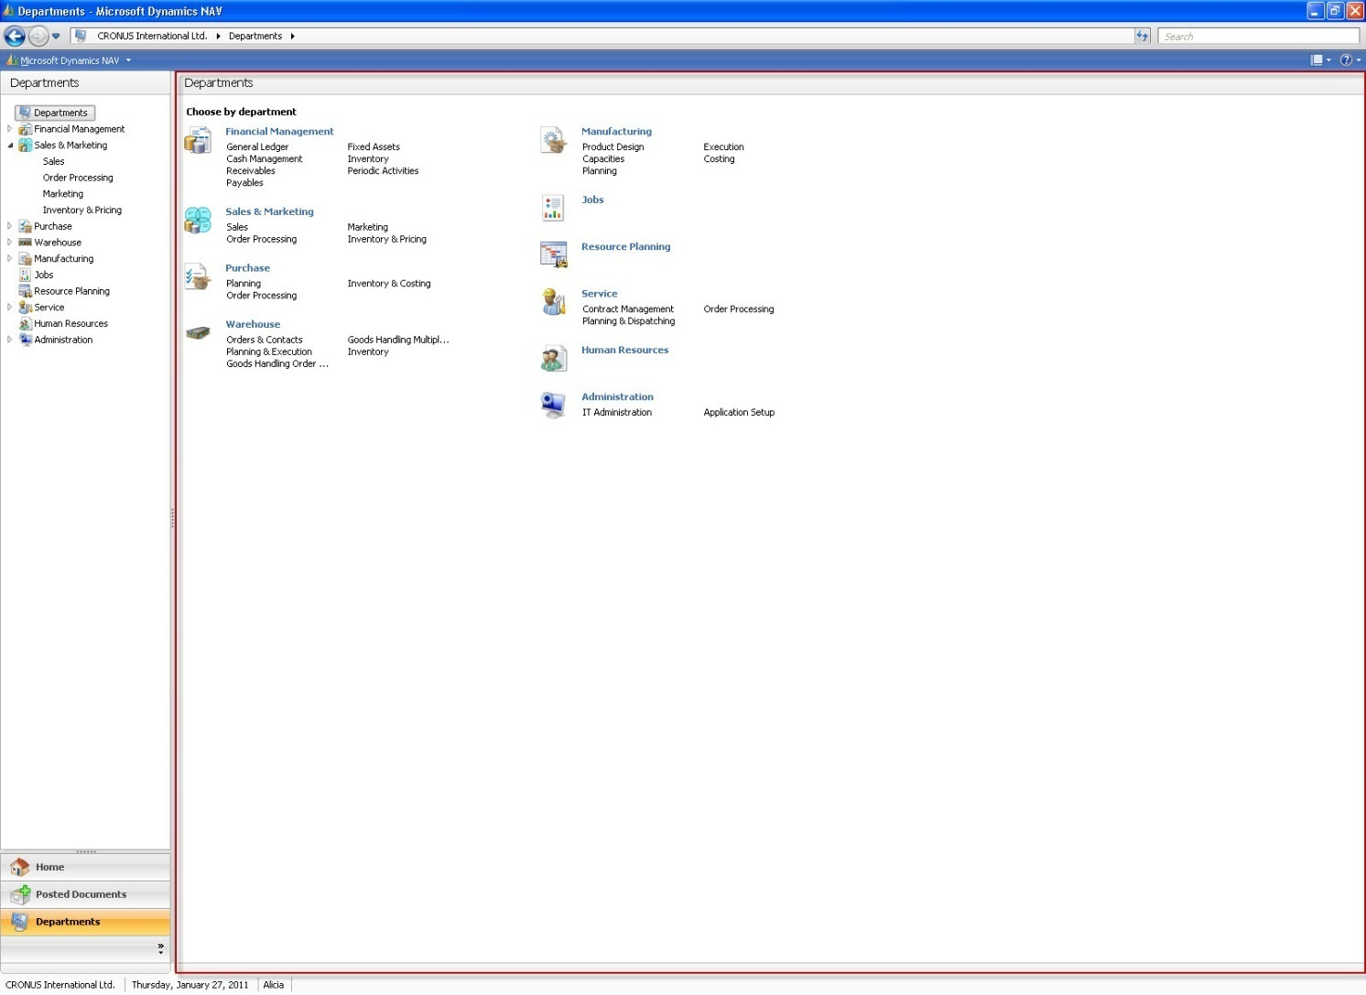
Navigation Window – Departments Place
Page Search
Navigation Pane
Content Area - Departments
Departments serve as the index of the book where users can go to find links to pages that they don’t use frequently and for that reason don’t want to clutter their Navigation Pane. Users click their way down through department names until they reach a bottom-level page which shows links to all the pages related to that department. Users can also filter the links by a category (such as lists, tasks or reports). If users find a link they want to use frequently they can right-click it and choose to add it to their Navigation Pane. The pages under Departments are generated automatically based on the menu suite of the RoleTailored client user.
Notes:
Introducing Departments as a page in the Navigation window.
Terms used in this slide:
Navigation Pane
When users select the Departments button then the Navigation Pane switches from showing links to List Places to showing a hierarchy of Departments. A highlight indicates which department is currently shown in the Content area.
Content Area
The Content area shows a top-, middle-, or bottom-level Departments page. The top- and middle-level pages show groupings of Department names and different levels of detail. The bottom-level pages show lists of links to all pages related to the currently selected Department.
Page Search
Note that the Page search field (which is available on all pages in the Navigation Window) is actually searching the Departments structure and can be used to navigate directly to a page based on part of its name.

Slide 10
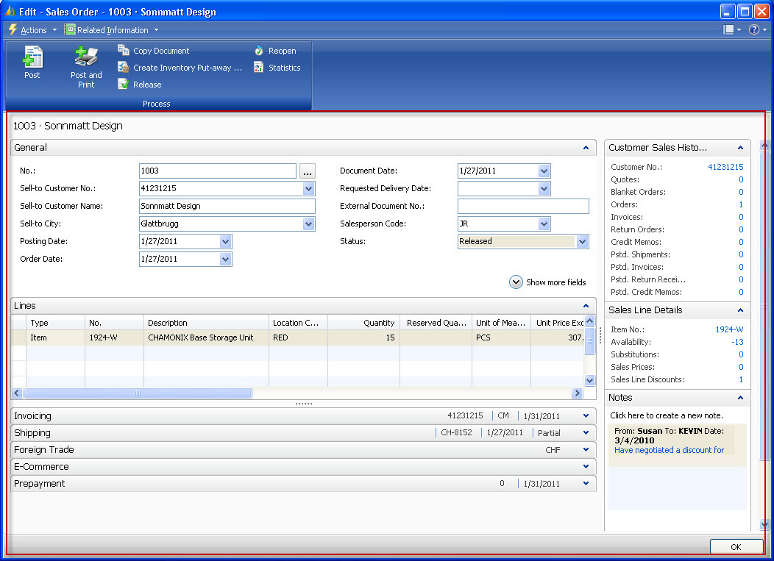
Task Window – Documents
Notes Fact Box
This is a “Sales Order” Task Page of the page type Document. Task pages are similar in concept to the pop-up windows in Microsoft Office Outlook that show an e-mail, contact, or a task. It is typical for users to have multiple task pages open at the same time. Similar to the Navigation window, a Task window includes a Command bar and Action pane. Unlike the Navigation window, it does not include the navigation pane or status bar. The user can work with more than one Task window open at a time. You create a Task window by creating a page and then linking the page to actions on other pages. The most common page types for Task windows are Document, Card and List (journal/worksheet).
Notes:
Introducing Document as a Task Window.
Terms used in this slide:
Task Window
A Task window is ideally designed so users can complete their task in a single window (by combining relevant data, Fact Boxes and actions into one page). In its basic form a Task window displays the details of one record or displays a list of records.
Document Page
A Document page contains a FastTab with header information, then a FastTab with document lines (a sub-page which is defined separately), and then optionally additional FastTabs with header information.
Notes Fact Box
The ”Notes” Fact box is a system Fact box that cannot be customized. If the Fact box is displayed in a List place in the Navigation window then it will be in view-mode. If the Fact box is displayed in a pop-up Task Page which is in edit-mode then the Notes Fact box will also be in edit mode and allow users to type in notes that attach to the record currently shown. Notes are targeted at named users. If a note is marked with ”Notify now” then it will also generate a Notification which is shown in the Notifications part on the Role Center of the receiving user.

Slide 11
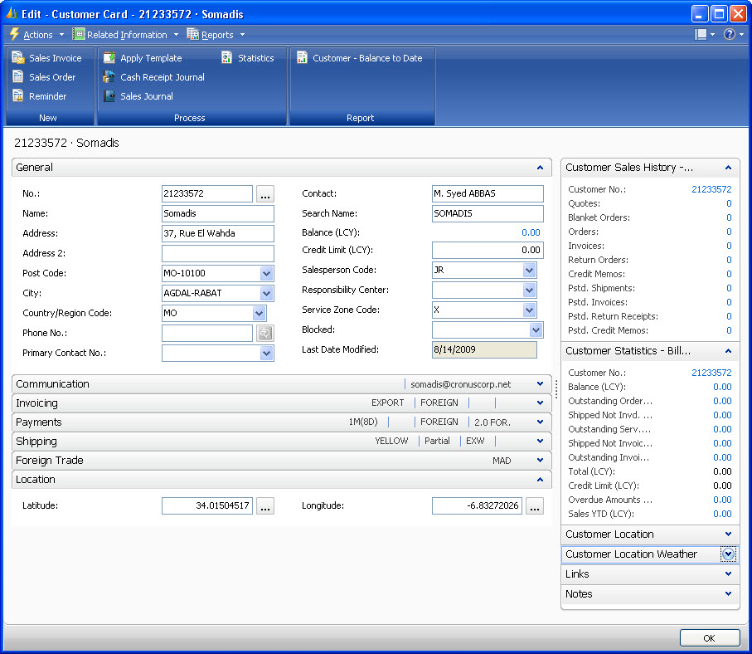
Task Window - Card
A Card page is used to view and edit one record or entity from a table. The Card page displays selected fields from the table. An example of using a Card page is for editing a customer.
Notes:
Introducing a Card as a Task Window.
Terms used in this slide:
Card Page
A Card page consists of one or more FastTabs with fields – no FastTabs with lines. (If only one FastTab exists, its frame is not shown).

Slide 12
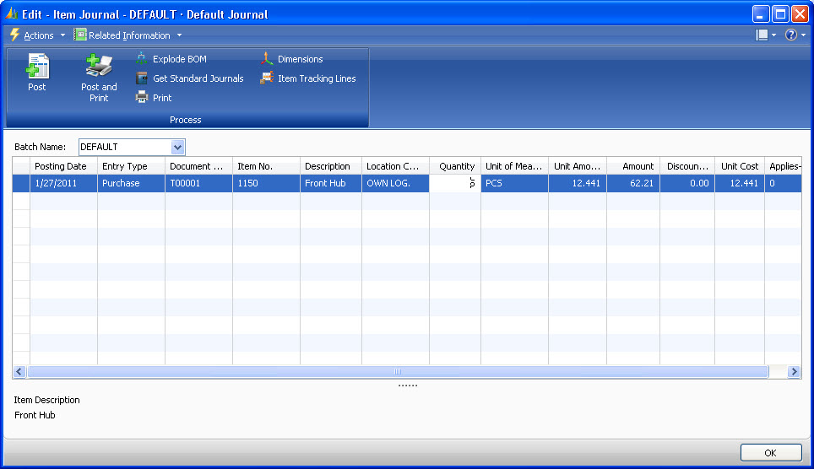
Task Window – Jounals/Worksheets
You use a Worksheet page type for creating worksheet or journal task pages. The Worksheet page consists of a single grid in the content area and a section at the bottom with details about the selected grid line or totals for the grid.
Notes:
Introducing Journal/Worksheet as a Task Window.
Terms used in this slide:
Journal/Worksheet Page
The page type for journals and worksheets contains only a list and then optionally related fields at the bottom of the page with descriptions of a selected line and/or calculations for the selected line or full list.

Slide 13
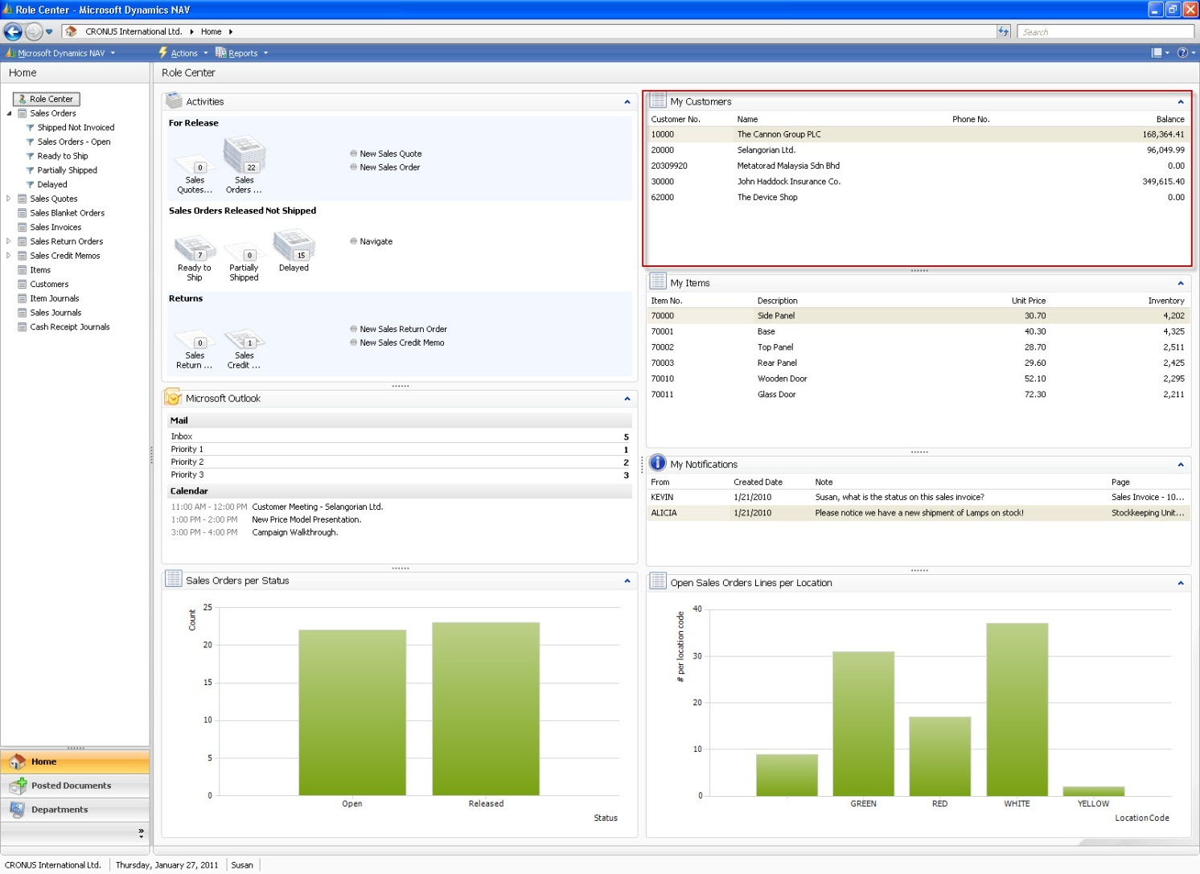
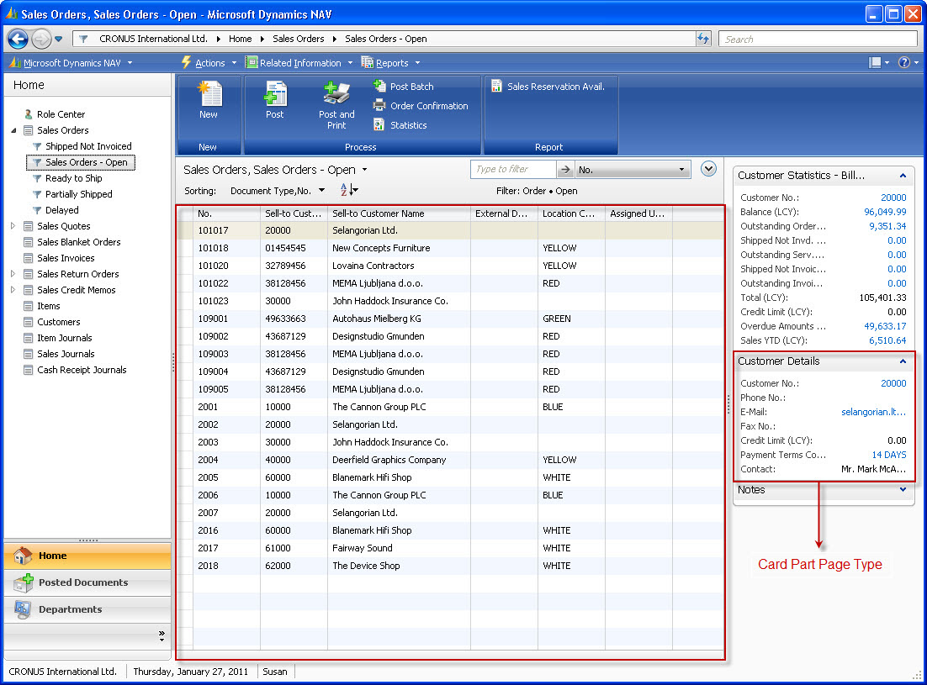
List Part & Card Part Pages
List Part Page Type
A Card Part page or List Part page are not intended to be launched in separate windows. Instead they are intended to be embedded in RoleCenters (in the Navigation Window only) or in Fact Box Panes (in List Places and in pop-up Task Windows). The parts are typically used in a FactBox to view the most important fields from a record related to the selected entity in the page. The illustration shows an example of a List Part page embedded in a Role Center. And then a Card Part page embedded in a List Place.
Notes:
Introducing List Part and Card Part as page types used inside other pages.
Terms used in this slide:
List Part
The List part page is used exclusively for showing a list of items.
Card Part
The Card part page is typically used for showing values for individual fields. It can also be used for a combination of individual fields and a list.

Slide 14
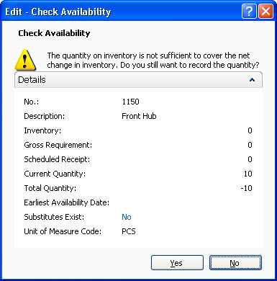
Confirmation Dialog
The NAV client uses the Confirmation Dialog page to display messages or prompt users with a confirmation before they continue with the task that they are working on. For example, when filling out a sales order, a user can select a quantity for an item. This quantity might exceed the item's availability. Using a Confirmation Dialog page, you can display a message that indicates this condition to the user. The user can then choose to continue or cancel filling out the sales order.
Notes:
Introducing Confirmation Dialog as a page type.
Terms used in this slide:
Confirmation Dialog
The Confirmation dialog is used for posing a question to the user which may require the user to look at more detailed information than would be appropriate for a simple message box. Confirmation dialogs can be used with simple yes/no buttons, or they can ask the user to select up to five parameters needed for processing.

Slide 15


