Slide 1
PLINQ
Parallelize Your .NET Applications with Parallel Extensions
Bijoy Singhal
Developer Evangelist | Microsoft India

Slide 2
Session Objectives
Understand why we need parallelism?
How PLINQ integrates parallelism into .NET?
How does PLINQ work?
What are Coordination Data Structures?
Demo: PLINQExamples
NOTE: This presentation is based on June 2008 CTP of parallel extensions. Things may change in future.

Slide 3
The Manycore Shift
“[A]fter decades of single core processors, the high volume processor industry has gone from single to dual to quad-core in just the last two years. Moore’s Law scaling should easily let us hit the 80-core mark in mainstream processors within the next ten years and quite possibly even less.”
-- Justin Ratner, CTO, Intel (February 2007)
“If you haven’t done so already, now is the time to take a hard look at the design of your application, determine what operations are CPU-sensitive now or are likely to become so soon, and identify how those places could benefit from concurrency.”
-- Herb Sutter, C++ Architect at Microsoft (March 2005)

Slide 4
What's the Problem?
Multithreaded programming is “hard” today
  Doable by only a subgroup of senior specialists
  Parallel patterns are not prevalent, well known, nor easy to implement
  So many potential problems
    Races, deadlocks, livelocks, lock convoys, cache coherency overheads, lost event notifications, broken serializability, priority inversion, and so on…
Businesses have little desire to “go deep”
  Best devs should focus on business value,
  not concurrency
  Need simple ways to allow all devs to write
  concurrent code

Slide 5
Example: “Baby Names”
  IEnumerable<BabyInfo> babies = ...;
  var results = new List<BabyInfo>();
  foreach (var baby in babies)
  {
  if (baby.Name == queryName &&
  baby.State == queryState &&
  baby.Year >= yearStart &&
  baby.Year <= yearEnd)
  {
  results.Add(baby);
  }
  }
  results.Sort((b1, b2) => b1.Year.CompareTo(b2.Year));

Slide 6

Manual Parallel Solution
Synchronization Knowledge
  IEnumerable<BabyInfo> babies = …;
  var results = new List<BabyInfo>();
  int partitionsCount = Environment.ProcessorCount * 2;
  int remainingCount = partitionsCount;
  var enumerator = babies.GetEnumerator();
  try {
  using (ManualResetEvent done = new ManualResetEvent(false)) {
  for (int i = 0; i < partitionsCount; i++) {
  ThreadPool.QueueUserWorkItem(delegate {
  var partialResults = new List<BabyInfo>();
  while(true) {
  BabyInfo baby;
  lock (enumerator) {
  if (!enumerator.MoveNext()) break;
  baby = enumerator.Current;
  }
  if (baby.Name == queryName && baby.State == queryState &&
  baby.Year >= yearStart && baby.Year <= yearEnd) {
  partialResults.Add(baby);
  }
  }
  lock (results) results.AddRange(partialResults);
  if (Interlocked.Decrement(ref remainingCount) == 0) done.Set();
  });
  }
  done.WaitOne();
  results.Sort((b1, b2) => b1.Year.CompareTo(b2.Year));
  }
  }
  finally { if (enumerator is Idisposable) ((Idisposable)enumerator).Dispose(); }
Inefficient locking
Lack of foreach simplicity
Manual aggregation
Tricks
Lack of thread reuse
Heavy synchronization
Non-parallel sort

Slide 7
LINQ Solution
.AsParallel()
  var results = from baby in babies
  where baby.Name == queryName &&
  baby.State == queryState &&
  baby.Year >= yearStart &&
  baby.Year <= yearEnd
  orderby baby.Year ascending
  select baby;

Slide 8
Example: Matrix Multiplication
void MultiplyMatrices(int size,
double[,] m1, double[,] m2, double[,] result)
{
for (int i = 0; i < size; i++) {
for (int j = 0; j < size; j++) {
result[i, j] = 0;
for (int k = 0; k < size; k++) {
result[i, j] += m1[i, k] * m2[k, j];
}
}
}
}

Slide 9
Manual Parallel Solution
Static Work Distribution
int N = size;
int P = 2 * Environment.ProcessorCount;
int Chunk = N / P;
ManualResetEvent signal = new ManualResetEvent(false);
int counter = P;
for (int c = 0; c < P; c++) {
ThreadPool.QueueUserWorkItem(o => {
int lc = (int)o;
for (int i = lc * Chunk;
i < (lc + 1 == P ? N : (lc + 1) * Chunk);
i++) {
// original loop body
for (int j = 0; j < size; j++) {
result[i, j] = 0;
for (int k = 0; k < size; k++) {
result[i, j] += m1[i, k] * m2[k, j];
}
}
}
if (Interlocked.Decrement(ref counter) == 0) {
signal.Set();
}
}, c);
}
signal.WaitOne();
Potential scalability bottleneck
Error Prone
Error Prone

Slide 10
Parallel Solution
void MultiplyMatrices(int size,
double[,] m1, double[,] m2, double[,] result)
{
Parallel.For(0, size, i => {
for (int j = 0; j < size; j++) {
result[i, j] = 0;
for (int k = 0; k < size; k++) {
result[i, j] += m1[i, k] * m2[k, j];
}
}
});
}

Slide 11
Parallel Extensions Architecture
.NET Program
PLINQ Execution Engine
Declarative
Queries
Parallel Algorithms
Query Analysis
Data Partitioning
Chunk
Range
Hash
Striped
Repartitioning
Operator Types
Map
Filter
Sort
Search
Reduction
Merging
Async (pipeline)
Synch
Order Preserving
ForAll
C# Compiler
VB Compiler
Task Parallel Library
Coordination Data Structures
C++ Compiler
PLINQ
Loop replacements
Imperative Task Parallelism
Scheduling
Thread-safe Collections
Synchronization Types
Coordination Types
F# Compiler
Other .NET Compiler
Threads + UMS
IL
TPL or CDS
Proc 1
…
Proc p

Slide 12
Parallel Extensions to the
.NET Framework
What is it?
  Library extensions to the .NET Framework
  Lightweight, user-mode runtime
  Supports imperative and declarative, data and task parallelism
  Common exception handling model
Why do we need it?
  Supports parallelism in any .NET language
  Delivers reduced concept count and complexity, better time to solution
  Begins to move parallelism capabilities from concurrency experts to domain experts

Slide 13
Parallel LINQ (PLINQ)
Enable LINQ developers to leverage
parallel hardware
  Supports all of the .NET Standard Query Operators
    Plus a few PLINQ-specific extensions methods
  Abstracts away parallelism details
    Partitions and merges data intelligently
    (“classic” data parallelism)
  Works for any IEnumerable<T>

Slide 14
Writing a PLINQ Query
Method 1: Comprehension syntax
  Syntax extensions to C# and Visual Basic
Method 2: Method syntax on the APIs:
  Used as extension methods on IParallelEnumerable<T>
  System.Linq.ParallelEnumerable class
API implementation does the actual work
  Compiler converts the former into the latter
var q = from x in Y.AsParallel() where p(x) orderby x.f1 select x.f2;
var q = Y.AsParallel().Where(x => p(x)).
OrderBy(x => x.f1).Select(x => x.f2);
var q = ParallelEnumerable.Select(
ParallelEnumerable.OrderBy(
ParallelEnumerable.Where(Y.AsParallel(), x => p(x)),
x => x.f1),
x => x.f2);

Slide 15
Partitioning
Input to a single operator is partitioned into p disjoint subsets
Operators are replicated across the partitions
Example
  (from x in D.AsParallel() where p(x) select x*x*x).Sum();
Each partition executes in (almost) complete isolation
… Task 1 …
D
where p(x)
select x³
Sum()
Sum()
… Task n …
where p(x)
select x³
Sum()

Slide 16
Partitioning, cont.
Types of partitioning
  Chunk
    Works with any IEnumerable<T>
    Single enumerator shared; chunks handed out on-demand
  Range
    Works only with IList<T>
    Input divided into contiguous regions, one per partition
  Striped
    Elements handed out round-robin to each partition
  Hash
    Works with any IEnumerable<T>
    Elements assigned to partition based on hash code
Repartitioning sometimes necessary

Slide 17


Merging
Pipelined: separate consumer thread
  Default for GetEnumerator()
    And hence foreach loops
  Access to data as its available
    But more synchronization overhead
Stop-and-go: consumer helps
  Minimizes context switches
    But higher latency, more memory
  Sorts, ToArray, ToList, etc.
Inverted: no merging needed
  ForAll extension method
  Most efficient by far
    But not always applicable
Thread 2
Thread 1
Thread 3
Thread 1
Thread 4
Thread 1
Thread 1
Thread 2
Thread 1
Thread 3
Thread 1
Thread 1
Thread 2
Thread 1
Thread 3

Slide 18

Coordination Data Structures
Thread-safe collections
  ConcurrentStack<T>
  ConcurrentQueue<T>
  ConcurrentLinkedList<T>
  ConcurrentSet<T>
  ConcurrentBag<T>
  …
Work exchange
  BlockingCollection<T>
  …
Phased operation
  CountdownEvent
  …
Locks
  ManualResetEventSlim
  SemaphoreSlim
  SpinLock
  SpinWait
  …
Initialization
  LazyInit<T>
  WriteOnce<T>
  …

Slide 19
PLINQExamples
DEMO

Slide 20
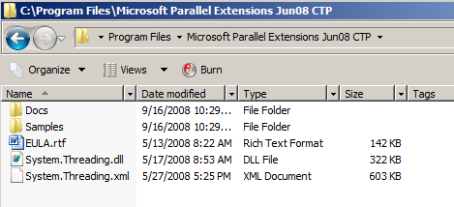
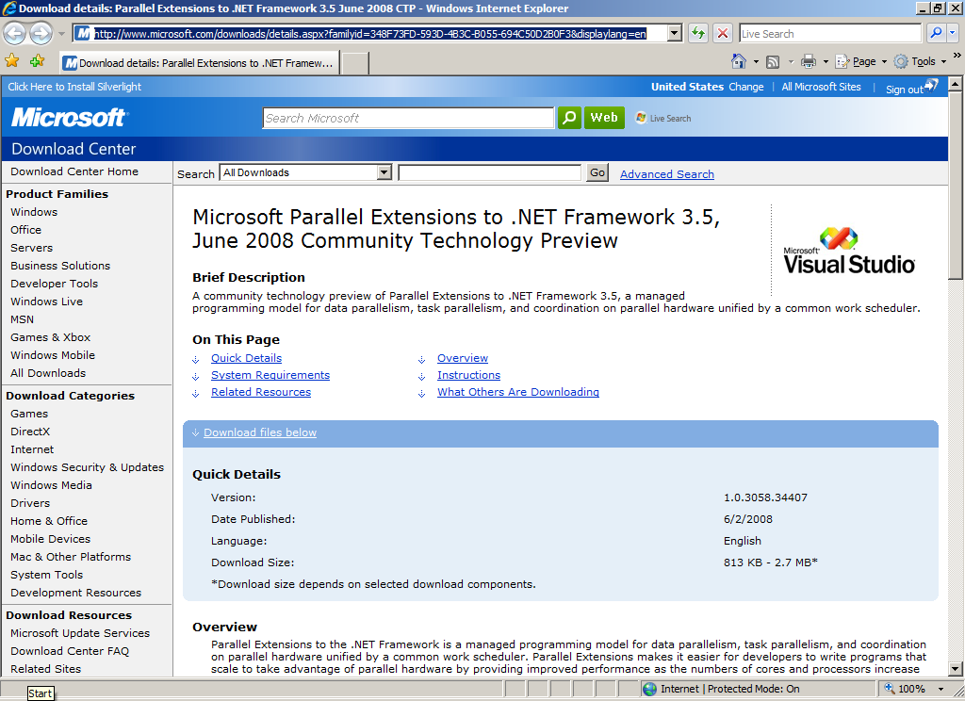
http://www.microsoft.com/downloads/details.aspx?familyid=348F73FD-593D-4B3C-B055-694C50D2B0F3&displaylang=en
SDK

Slide 21
References
Parallel Extensions Team Blog
http://blogs.msdn.com/pfxteam/
Parallel Extensions June 2008 CTP Help file

Slide 22
Feedback / QnA
Your Feedback is Important!
  Please take a few moments to fill out our online feedback form
  For detailed feedback, use the form at http://www.connectwithlife.co.in/vtd/helpdesk.aspx
  Or email us at vtd@microsoft.com
Use the Question Manager on LiveMeeting to ask your questions now!

Slide 23
Contact
Blog Address
blogs.msdn.com/bsinghal
Email Address
bsinghal@microsoft.com

