Slide 1
Performance Testing with VSTS
Cheryl Johnson
VSTS Solution Expert | Canarys Automations Pvt Ltd
vststeam@ecanarys.com

Slide 2
Agenda
Introduction to VSTS Test Edition
Web Tests
Performance Testing Concepts
Load Tests
Demo

Slide 3
VSTS Test Edition
Manual Tests
Unit Tests
Web Tests
Load Tests
Ordered Tests
Generic Tests
And, Database Testing in VSTS Database Edition

Slide 4
WEB TESTS
Built for non-programmers
  Can convert to a coded Web test
“HTTP” tests
  Send data over HTTP with
    HTTP headers
    Form post parameters
Validates server responses to queries

Slide 5
WEB TESTS
AJAX support
Extraction rules
Data-driven
Add a call to another Web Test
Web test Plug-ins

Slide 6
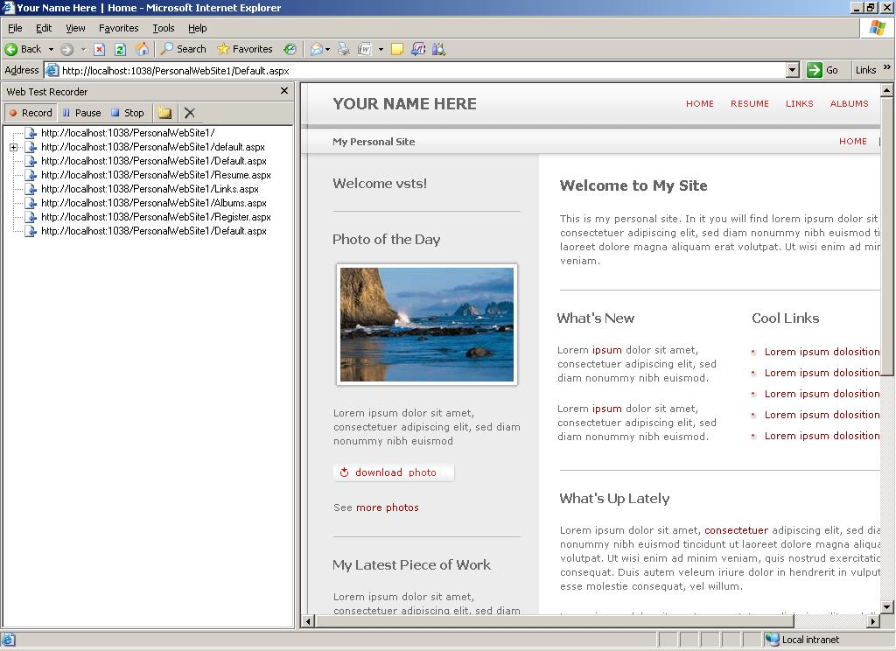
Web Recorder

Slide 7
Why Performance Testing?
The failure of a mission-critical application
can be costly
Assure performance and functionality under
real- world conditions
Locate potential problems before your
customers do

Slide 8
Why Performance Testing?
Reduce development time
Reduce infrastructure costs
Check your Application Readiness

Slide 9
Types of Performance Testing
Component Testing
Load Testing
Scalability Testing
Stress Testing
Volume Testing

Slide 10
Performance Test Objectives
Application response time
  How long does it take to complete a
  task?
Acceptance
  Is the system stable enough to go
  into production?
Regression
  Does the new version of the software
  adversely affect response time?
Reliability
  How reliable is the system under a
  heavy work load?
Capacity planning
  What is the hardware needed for
  an optimized performance ?
Bottleneck identification
  What is the cause of degradation in
  performance?

Slide 11

LOAD TEST
Executes Unit Tests and Web Tests
Simulates desired number of Virtual Users
Ideal for Performance and Stress Testing
Collects Performance Metrics on Client and Server
User Modeling

Slide 12
LOAD TEST
Paneled Graphs with smart grouping and zoom
Analysis Report
Export Performance counter data to CSV and Microsoft Office Excel
Manage results

Slide 13
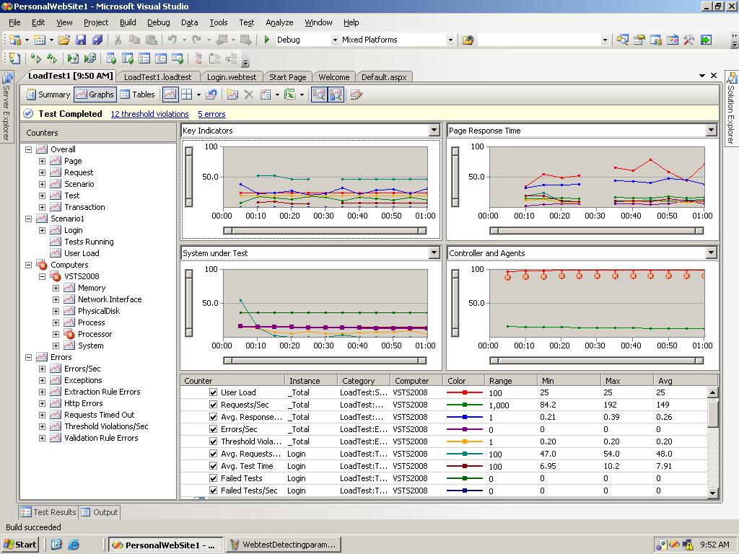
Multi-panel graph view
Automatically graphs key indicators

Slide 14
DEMO

Slide 15
References
Visual Studio Team System:
  http://msdn.microsoft.com/teamsystem
Microsoft Application Platform:
  http://msdn.microsoft.com/applicationplatform

Slide 16
Feedback / Q & A
Your Feedback is Important!
  Please take a few moments to fill out our online feedback form at:
  << Feedback URL – Ask your organizer for this in advance>>
  For detailed feedback, use the form at http://www.connectwithlife.co.in/vtd/helpdesk.aspx
  Or email us at vtd@microsoft.com
Use the Question Manager on LiveMeeting to ask your questions now!

