Slide 1

AGILE Patterns and PractiCEs
@ patterns & practices
Ade Miller ade.miller@microsoft.com http://www.ademiller.com/tech/
Notes:
Notes
The speaker notes for this deck ran off the slide in several places. This PDF includes additional blank slides that were not in the talk to allow you to read the notes.
I talked for over an hour so the notes in these slides cover the basics. I’ve also included links to numerous blog posts which expand on the topic covered in each slide.
OK… So here goes!
Ade Miller is the Development Manager at patterns & practices
p&p is a small group within Microsoft Developer Division who ship guidance on application development to Enterprise customers. Things like…
Enterprise Library
Software Factories
Books
We run several small (6-10 people) agile teams. These teams are often distributed and use a Scrum/XP based development approach.
This is why and how p&p delivers software the way it does not how the whole of Microsoft does it!

Slide 2

A glimpse into Santa’s workshop
Notes:
Lots of people tell us that they like the things that patterns & practices produces and want to know how we approach developing software.
This talk is really about how we think about software development. Hopefully you’ll come away with some cool ideas about how to think about your teams and helping them improve the way they develop.
We’ve been doing a mixture of Scrum and XP for some time. This isn’t a talk about the nuts and bolts of XP and Scrum – you can find that elsewhere – it’s an overview of how we think about development from first principles and some of the things we’ve learnt doing it.
Note… I didn’t say you’ll do exactly what we do. That’s not such a good idea and we’ll see why later.
---
Stock photo: http://www.sxc.hu/photo/920589

Slide 3

Values Principles Practices
Customer in room
Communication
Pair programming
Feedback
Refactoring
Courage
Coding standard
Simplicity
Integrate often
Respect
Test first
Notes:
Figuring out what works for you isn’t that easy
http://www.ademiller.com/blogs/tech/2008/05/choosing-an-agile-process-summary/
Values - Abstract, distinct ideals. For example XP’s values are; courage, communication, feedback, respect and simplicity (Extreme Programming Explained, edition 2 added respect).
Principles - Are values as applied to your problem domain or industry.
Practices - Practices are the principles applied to your team.
For example: Value -> Principle -> Practice(s)
Communication -> Whole Team -> Daily standup / shared workspace / collective ownership
Lots of people work backwards from the practices and evaluate their team based on practice adoption. While many of the agile practices are simply good engineering they need to align to your team’s values.
I wrote more on value alignment here:
http://www.ademiller.com/blogs/tech/2008/01/choosing-an-agile-process-part-3-evaluation/
---
Stock photo: http://www.sxc.hu/photo/1001265

Slide 4
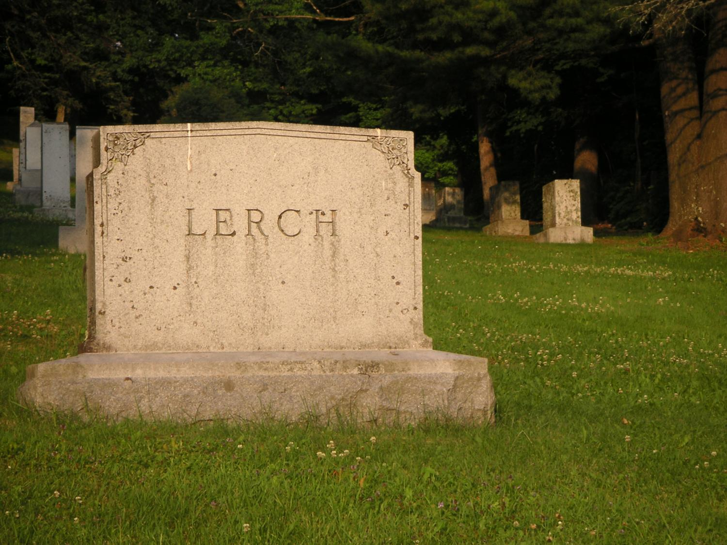
“People only change their values in light of a miracle or near death experience”
Notes:
Values are very core to people.
Unfortunately it often turns out that getting people to agree to a set of values is easy. This is largely because values are vague and lofty. For instance who’s going to say they don’t value communication (raise your hands)? That’s because “communication” is so vague that it’s easy to say yes and disagree on the definition later. Just as importantly communication sounds like a laudable goal and you’d feel like a bit of an idiot saying you don’t value it flat out!
Where things tend to break down is aligning those values to principles and practices. For example everyone can agree on communication but half the team refuse to turn up to standup meetings and want to report status by email once a week!
I wrote more on value alignment and what happens when your team’s values don’t align:
http://www.ademiller.com/blogs/tech/2008/01/choosing-an-agile-process-part-3-evaluation/
---
Stock photo: http://www.sxc.hu/photo/504217

Slide 5


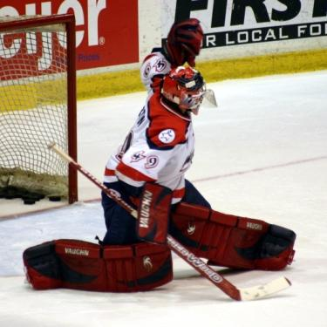
Practices…
Best principles
Notes:
Let’s take a step back from practices and try and think about principles. I’m not going to cover everything here. Largely because I want to focus on one that both you (in India) and I (in Redmond) probably have a lot of common interest in… distributed teams.
---
Stock photo: http://www.ademiller.com/climbing/
http://www.sxc.hu/photo/851553
http://www.sxc.hu/photo/535933

Slide 6

Hire Stars
Notes:
Hire the best people you can! I’m lucky in that my whole team are star developers who work well with others on a team. This is different from the solo hero or rock star who can do great things on their own and isn’t interested in working with other people.
http://www.ademiller.com/blogs/tech/2008/01/choosing-an-agile-process-part-5-heroes-and-villains/
During the talk someone asked me if agile will work with more junior people. The answer is yes if you have some senior people who are prepared to help them grow and value the team over their individual goals.
Martin Fowler has a blog post about the false economy of hiring lower quality people which is also worth a read…
http://www.ademiller.com/blogs/tech/2008/03/the-high-cost-of-talent/
---
Stock photo: http://www.sxc.hu/photo/930008

Slide 7

Focus on the team
Notes:
The team is more important than the people on it! France winning the Soccer World Cup in 1998 with a team of team players not a team of superstars. On several occasions I’ve seen the superstar developer leave a team and everyone predict it would fall apart and the project would fail. Only to have the team exceed expectations!
http://www.ademiller.com/blogs/tech/2007/05/does-agile-need-extremely-competent-people-in-order-to-work/
http://www.ademiller.com/blogs/tech/2006/05/software-development-is-a-team-sport/
---
Stock photo: http://www.sxc.hu/photo/825498

Slide 8

Deliver frequently… Or become irrelevant
Notes:
Teams at patterns & practices all deliver frequently! Most teams deliver working software to customers (you) every couple of weeks. This is the single biggest advantage that agile development gives to us… the ability to deliver frequent and adapt our thinking based on feedback on what we just delivered!
If you look at the most basic agile methodology – Crystal Clear – at it’s heart is stick a bunch of smart people in a room and let them have at it. But… make them show you working software frequently. Working software is what keeps everyone honest.
---
Stock photo: http://www.sxc.hu/photo/918252

Slide 9

Co-location?
Notes:
In the 2008 State of Agile Development survey 57% of respondents stated that their teams were distributed. Furthermore 41% of respondents said that they were currently using or plan to combine agile with outsourced development.
http://www.ademiller.com/blogs/tech/2008/09/who-moved-the-cheese-team-rooms-and-agile/
I’ve written so much about this subject it’s not even funny. You can find a whole series of blog posts on this at:
http://www.ademiller.com/blogs/tech/tag/distributed-teams/
---
Stock photo: http://www.sxc.hu/photo/967027

Slide 10
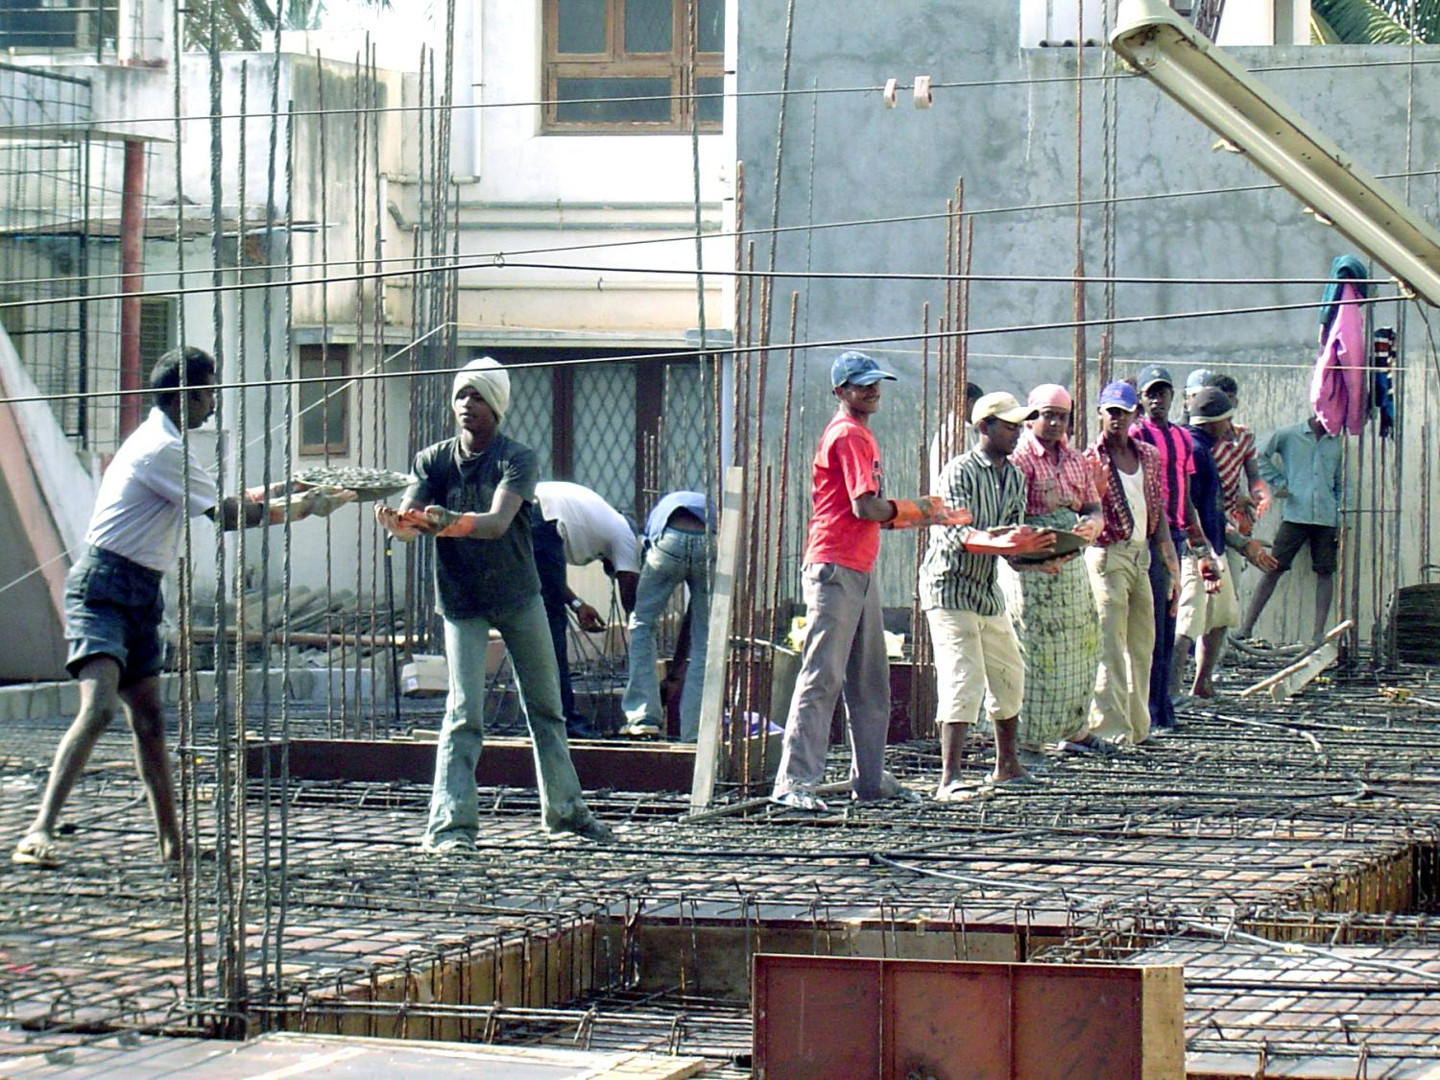
Agile Teams Work Together
Notes:
And this is a big problem! Agile teams like to work together on a problem; talking, discussing and white boarding designs and the like.
That’s much harder to do if we’re in separate offices or you are asleep when I’m awake (Did I mention that it’s midnight here).
---
Stock photo: http://www.sxc.hu/photo/789630

Slide 11

This card is a placeholder for a conversation
Notes:
In many cases agile teams replace artifacts with placeholders for conversations.
For example, rather than writing a ten page specification, an agile team would write a 3” x 4” story card. This approach relies on the team being able to ask the product owner questions about the feature/story described on the card. The team may also show the product owner work in progress.
---
Stock photo: http://www.sxc.hu/photo/

Slide 12

Distribution
Dislocation
Dissociation
Dysfunction
Notes:
Distributed teams are inherently less functional – more dysfunctional – than co-located teams.
---
Stock photo: http://www.sxc.hu/photo/656298

Slide 13

Focus on communication
Notes:
Maximizing the available communication bandwidth the key to successful distributed teamwork. There are many simple practices your team can implement to improve communication.
Conference phones
Instant messenger
Email (async & broadcast)
In some cases communication what would have been pull communication for a co-located team needs to be replaced by more formal push communication when distributed.
In other cases communication needs to become an explicit part of someone’s role on the team.
---
Stock photo: http://www.ademiller.com/climbing/

Slide 14

Plan to travel
Notes:
There’s no substitute for face to face communication. At the beginning of the project teams should try and co-locate for the first iteration or two. This allows team members to get to know each other and build rapport.
Distributed teams at patterns & practices typically plan to have site visits from remote developers both at the start of the project and for one to two weeks out of every six while the project is in flight.
Having the whole team in the room during the early stages of the project isn’t just about making key design decisions. It helps create personal bonds that will serve the team well later when they are no longer working in the same room.
---
Stock photo: http://www.ademiller.com/climbing/

Slide 15

Smart team distribution
Notes:
Distribution across time zones is far more impactful than geographical distribution alone. Significant time zone differences introduce communication blackouts into the team’s day during which part of the team is simply not available. A time zone distribution of three or four hours is workable with the whole team sharing either morning or afternoon hours with meetings taking place during these core hours.
Many patterns & practices teams use testers located offshore in India with a nine hour time difference. In this case they adopt the practice of having a team room representative for the offshore team. The representative replaces almost all direct interaction with the offshore team.
---
Stock photo: http://www.sxc.hu/photo/942884

Slide 16

Smart work distribution
Notes:
One of the challenges when the team distributes work is not to do so according to location. Doing this will have negative effects over time. The architecture will begin to reflect the team’s geographical distribution and different locations will become over specialized in particular components.
---
Stock photo: http://www.sxc.hu/photo/565912

Slide 17

Coach the team
Notes:
Distributed teams encounter more challenges and need more help to enable them to stick with the core practices employed by agile teams. Many distributed teams abandon key practices because they seem too hard. Having one person on the team who is committed to the coach role is vital in keeping a distributed team on the right path.
---
Stock photo: http://www.sxc.hu/photo/468653

Slide 18
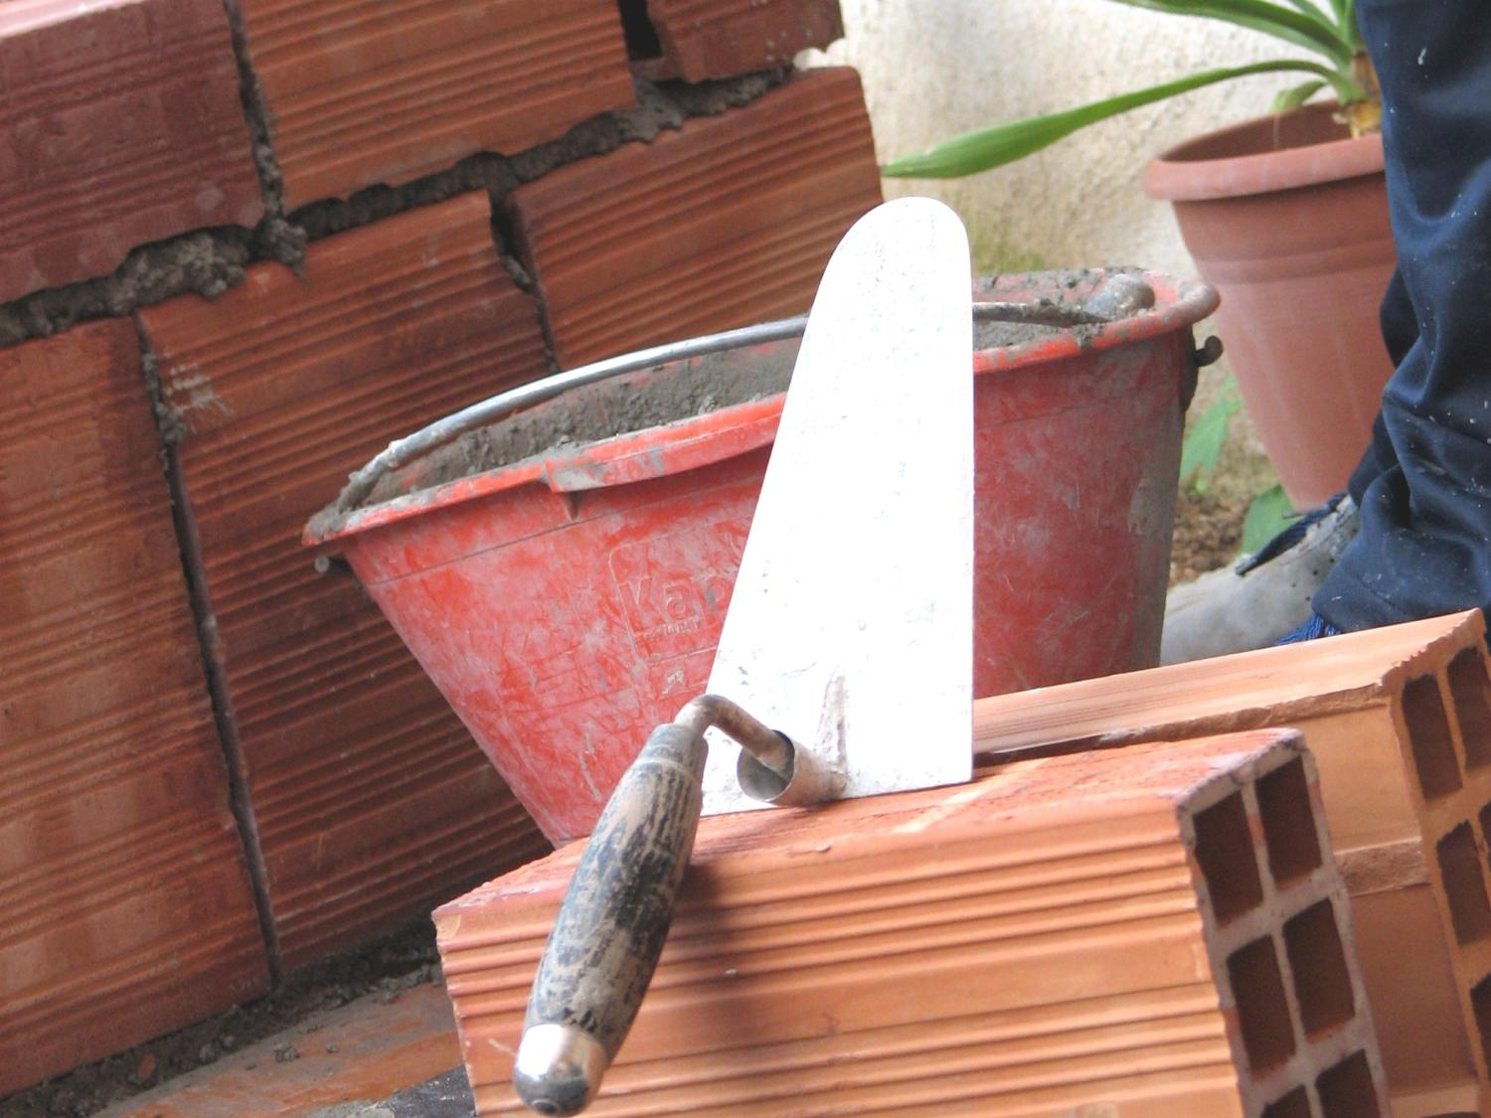
Build the team over time
Notes:
Good teams take time to form and work best if they stay together on multiple projects over long periods. One of the challenges of distributed teams is that this formation process is artificially extended by reduced communication.
As patterns & practices realized the significant effect of churn on agile teams and how much better long lived teams tended to perform we have tried to keep teams together over multiple projects.
---
Stock photo: http://www.sxc.hu/photo/680192

Slide 19

Provide the
right tools
Notes:
Visual Studio Team System – Sticky notes stuck to a wall lose their effectiveness in a distributed team. Team System helps the whole team see the current state of the iteration backlog and update individual tasks.
Scrum for Team System – Conchango’s Scrum for Team System is a free add-in for Team System that implements a Scrum task board and burndown charts to help with iteration planning and tracking.
Visual Studio Team Build – Continuous integration (CI) servers like Team Build and CruiseControl.NET play a key role on any agile team.
Microsoft SharedView - SharedView is an application that allows two uses to interact with a single desktop. Developers on patterns & practices teams use this for remote pairing in conjunction with a voice over IP service like Live Messenger, or Skype.
http://msdn.microsoft.com/vsts
http://www.scrumforteamsystem.com/
http://confluence.public.thoughtworks.org/display/CCNET/Welcome+to+CruiseControl.NET
---
Stock photo: http://www.sxc.hu/photo/959623

Slide 20

Beware of shiny objects
Notes:
In 1986 Fred Brooks said that there was no silver bullet. That’s still true today. So don’t think that any one practice, technology or tool is going to make all your problems go away. Especially when it comes to the actual activity of software development it’s more about the people than anything else. Don’t expect a tool to change the way people behave.
BTW: Fred Brooks also wrote the Mythical Man Month. This is one of the few books in software engineering that has truly stood the test of time (over thirty years). If you’ve not read it then you should.
http://en.wikipedia.org/wiki/The_Mythical_Man-Month
If we knew in 1985 that adding more people to a project doesn’t speed up delivery then why are we still doing it over thirty years later?
---
Stock photo: http://www.sxc.hu/photo/914361

Slide 21

Agile is NOT a religion
Notes:
(Joke) And neither is cricket… unless you’re English, or Indian
Seriously though… It’s very easy to become an “agile zealot”.
Someone asked me yesterday “How do I convince people to do Agile?”
My answer is “Don’t”. By that I mean I don’t think you should adopt Agile for Agile’s sake alone, that’s just “The means justify the ends”. It has to be solving some issues in your organization. Organizational change requires effort so you need to build a case for it.
What you should be asking is what are your biggest challenges?
If the answer is that everything is just fine but my developers don’t like the soda we provide then Agile isn’t going to solve the soda problem. If the response is more along the lines of shipping poor quality software, now that’s a problem agile can help with. Figure out their pain points, figure out where they want to be and then start applying some agile principles to help them get there.
Taken from the following blog post:
http://www.ademiller.com/blogs/tech/2008/02/choosing-an-agile-process-part-7-making-the-case/
---
Stock photo: http://www.sxc.hu/photo/737785

Slide 22

REFERENCES
Scrum and XP from the Trenches, Henrik Kniberg
Extreme Programming Explained, edition 2, Kent Beck
Ade Miller’s blog http://www.ademiller.com/tech/
Microsoft patterns & practices http://msdn.microsoft.com/practices
patterns & practices Lab video http://channel9.msdn.com/posts/Charles/Tour-Patterns-and-Practices-Lab/
Stock photos in this presentation http://www.sxc.hu/
Notes:
Some other useful links.
---
Stock photo: http://www.sxc.hu/photo/971068

Slide 23



QUESTIONS?
Notes:
I’m done!
---
Stock photo: http://www.sxc.hu/photo/728931
http://www.sxc.hu/photo/418215

