Slide 1
Microsoft Virtualization Delivers
More Capabilities, Better Value than VMware

Slide 2



Why Virtualize?
Drive Costs Down
Increase IT Efficiency
Enable Business Agility
Server Consolidation Energy & Space Reduction Application Compatibility
Rapid Provisioning High Availability
Business Continuity
Dynamic Datacenters & Desktops Accelerated Responsiveness
“Why is virtualization such a big deal? A lot of people understand, and they think it's about saving money, it's about saving power, it's about green IT, it's about space, and that's certainly true. But in our perspective, it's much, much bigger than that, and people are just now beginning to understand that. We think that there's a major transformation taking place in IT. This major transformation that's been taking place for years is starting to accelerate, and we believe that virtualization is a major enabler and catalyst of that transition that's taking place.”
- Tom Bittman, Gartner VP and Chief of Research of Infrastructure and Operations, at Microsoft’s Virtualization Launch Event
Notes:
Virtualization is so compelling because, when done right, it has the potential to transform IT, and your business, in substantive, tangible ways.
The benefit that’s top-of-mind for most organizations, especially in this economy, is that virtualization drives IT costs down. By consolidating servers you can lower capital costs for hardware and labor-related server management. Fewer servers also means you pay less for data center space, and less for power and cooling. Many companies also save money by using virtualization to ensure application compatibility, which eliminates the need for resource-intensive testing and installation processes. All of this adds up to significant cost savings.
Virtualization also helps make IT much more efficient. Servers, operating systems and applications can be provisioned in a fraction of the time previously required, so that end users can get the resources they need when they need them. High availability solutions help ensure that resources are always available and consistently reliable, which can result in drastic improvements in business continuity and, therefore, productivity.
This leads to the third major reason that organizations virtualize: to make their businesses much more agile. With dynamic data centers and desktops, IT can respond very quickly to evolving business, market and user needs.

Slide 3


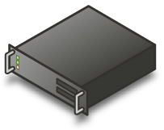

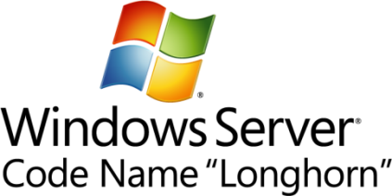
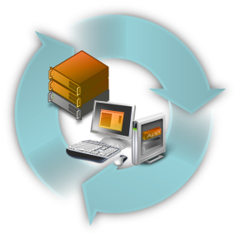




Why Customers are Excited about Microsoft Virtualization
It’s the Platform you know
Data center to desktop
End-to-End Management
Best TCO/ROI
1/6th the price upfront
Key feature of platform
Full range of products & solutions
Physical and Virtual & Cross-hypervisor
Significant Savings
Tools you know
Large partner eco-system
Interoperability
Lower ongoing costs
Notes:
Virtualization is about much more than simply consolidating physical servers and cutting data center costs. At Microsoft, virtualization means helping IT departments maximize ROI and cost savings across the enterprise. That’s why we created a portfolio of products that address all aspects of the physical and virtual infrastructure – servers, operating systems, applications and desktops – across multiple hypervisors, and that can be easily managed through a centralized console.
The Platform You Know: We make it easier for you to implement enterprise-wide virtualization by delivering technologies that not only are designed to work together, but that also integrate with your existing Windows infrastructure. Because our virtualization products are based on familiar Windows platform and interfaces and work with Windows-based technologies such as Active Directory, your IT staff can use the skills they already have. This means you can speed your on-ramp and will need less training, which will lower costs within your organization.
Data center to desktop: Microsoft provides a complete suite of technologies to enable an integrated, end-to-end virtualized infrastructure. Using products that span the desktop to the data center, you can bring capacities online in real-time as needed; streamline and provision applications, services and data on-demand; and accelerate backup and recovery and enhance availability so that your end users are protected against system failure and service interruptions.
End-to-end management: With Microsoft virtualization technologies, you can manage all of your physical and virtual infrastructures, across multiple operating systems and hypervisors, from the data center to the desktop.
Best TCO/ROI: Microsoft virtualization solutions are proven to save you more money and cost less (often up to one-third less) than competitive products. They help you dramatically lower total cost of ownership and realize the greatest ROI by streamlining many data center and desktop management tasks, and allowing you to take advantage of your existing Windows expertise.

Slide 4

The Microsoft Advantage Get More, Pay Less than VMware
Built-in virtualization
Extensive, unified management
Covers all the bases
Hard cost savings
Microsoft® technology breadth
Notes:
It’s clear that virtualization can help you save money and operate more efficiently. However, what may not always be so apparent is which virtualization approach makes the most sense.
VMware says it can reduce costs and improve flexibility. But a closer look reveals that its approach introduces more complexity and expense. Microsoft believes that, rather than undertaking a costly revolution, you should evolve your environment in a way that preserves and extends existing investments, strengthens your data center and desktop infrastructures, and reduces the burden on IT staff.
Microsoft virtualization solutions deliver the capabilities, savings, and simplicity you need to tackle today’s challenges and facilitate future growth. We offer significant advantages over VMware including:
Built-in virtualization
- Extensive, unified management
- Covering all the bases from desktop to data center
- Hard cost savings
- Technology breadth

Slide 5

Built-in Virtualization
Virtualization built into the operating system with Windows Server® 2008 R2 Hyper-V™ virtualization technology
Virtualization in the management platform with the Microsoft System Center suite of solutions
Three layers versus four
Microsoft (existing knowledge and skills) vs. VMware (more training, support, costs)
Why manage an extra layer and pay virtualization tax to get the functionality you require?
Notes:
To save your business time and money, we built virtualization directly into the operating system with Windows Server® 2008 Hyper-V™ R2 and into the management platform with Microsoft System Center.
With Microsoft, your virtualized infrastructure consists of the three computing layers you already have: hardware, OS and applications. Virtualization is simply a role within Windows. But with VMware you need a fourth layer just for virtualization: the VMware virtualization products, such as vSphere. If you use VMware, your IT staff must learn and support an extra virtualization level and vendor.
You should also bear in mind that upgrading from VMware ESX 3.5 to vSphere is a major undertaking: it is a significant change to customers’ environments. For instance, vSphere breaks compatibility with existing tools that work with VMware Infrastructure 3 (VI3) and, because vSphere virtual machines are not compatible with VI3, new virtual machines must be created to take advantage of many vSphere features. And at a cost of $3,495 per processor for vSphere Enterprise Plus, it can make a tremendous dent in your budget.
When you use Microsoft solutions, however, your IT team already has the knowledge and tools needed to administer a virtualized environment. And, you don’t need to manage an extra layer and pay a virtualization tax to get the functionality you require.

Slide 6

Extensive, Unified Management
Wide-spread virtualization requires comprehensive, seamless management
Only Microsoft System Center suite delivers
All integrated, all for one price
Physical and virtual machines (Hyper-V and VMware)
Host and in-guest management
Single pane of glass
No rip and replace for existing VMware customers
Notes:
The more you virtualize, the more complex your environment can become, and the more essential a comprehensive management system is to enabling a cost-effective, dynamic infrastructure.
With the Microsoft System Center suite, you get System Center Virtual Machine Manager, System Center Operations Manager, System Center Configuration Manager and System Center Data Protection Manager—all integrated and all for one price.
Don’t be confused by VMware’s comparison of our management solutions. It tends to group all of its products together and then pit them against System Center Virtual Machine Manager. But for a realistic assessment, you should compare them to the System Center suite. System Center gives you all the features of the disparate VMware products, and much more. It is the only solution that lets you easily manage physical machines, and provides both host and in-guest management of virtual machines—all through one pane of glass.
Even if you already use VMware, you can still take advantage of everything Microsoft has to offer, particularly as you move to virtualize more servers. You don’t have to rip and replace because, unlike VMware, Microsoft can manage your existing VMware virtual machines, as well as your Hyper-V virtual machines, through the same integrated system.

Slide 7

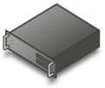










Microsoft Covers All the Bases From the Datacenter to the Desktop
Presentation
Virtualization
Server
Virtualization
Application
Virtualization
Desktop
Virtualization
“Having one vendor for the hypervisor, operating system, and much of our application software was very appealing to us from a support and cost perspective.”
Bert Van Pottelberghe,
Sales Director, Hostbasket
User State
Virtualization
Document redirection Offline files
Notes:
For virtualization to significantly impact your business, it has to span your enterprise. Because Microsoft is a platform company—not a niche vendor, like VMware—we have the broadest view of a virtualized infrastructure and the most extensive portfolio of proven virtualization solutions, including Windows Server 2008 with Hyper-V, Windows Virtual PC, Microsoft Enterprise Desktop Virtualization, Terminal Services, Microsoft Application Virtualization, and the Microsoft System Center family, which is the heart of the whole solution. Unlike VMware, we address all aspects of the infrastructure—servers, applications and desktops—and enable you to easily manage everything.
[NOTE: DO WE WANT TO BRIEFLY DESCRIBE EACH OF THE PRODUCTS LISTED?]

Slide 8

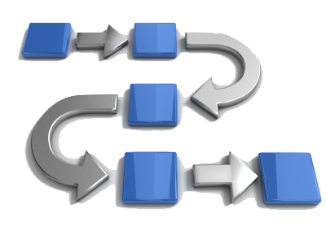
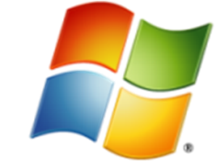
MS Virtualization: Best Choice for Server Applications
Microsoft Server Applications Built for Windows
Complete
Management Solution
Low Cost
Complete Solution
*Built-in Virtualization with One-stop Support
*Deep Application Knowledge
*A comparable solution can cost up to six times more†
*Large Partner Ecosystem
*Physical & Virtual Management
*Lower Ongoing Costs
Increased
Deployment Options
*Cross Platform and Hypervisor Support
Virtualization-friendly
Licensing
*Only available with Microsoft Virtualization
†Based on a comparison of Microsoft® System Center Server Management Suite Datacenter with VMware® vSphere Enterprise Plus with VMware vCenter Server.. Assumes a five host configuration, 2 processors on each host, 2 years support costs for both products, and no operating system costs included.. The Microsoft solution can use either the free Microsoft Hyper-V Server 2008 R2 hypervisor or an existing Windows Server 2008 R2 hypervisor. Based on Microsoft estimated retail prices and published VMware prices available at https://www.vmware.com/vmwarestore as of 08/04/2009 for purchases in the United States. Actual reseller prices may vary.
8
Notes:
Speaking Points:
To explain the 3 key reasons for choosing Microsoft virtualization (hyper-v + System Center). Highlights Microsoft Virtualization as the best choice when planning to virtualize Microsoft Server Applications.
The intention of this slide is that it can be used stand alone or as an overview slide to introduce the next 3 slides depending on presenter requirements. The following notes below give a very detailed breakdown of the 3 pillars the same information can also be found in the slide notes for slide 9-11.
1. Microsoft Server Applications Built for Windows
1-1 Built in Virtualization with One-stop Support:
Microsoft provides one-stop shopping and support across the entire virtualization stack―throughout the operating system, hypervisor, management tools, and server applications. The built-in architecture of Microsoft® Windows Server® 2008 with Hyper-V™ means there is no need for an additional hypervisor purchase. This means you can easily implement virtualization with your existing infrastructure and management tools. Since Hyper-V, Microsoft Application Servers, and System Center management tools are built on the “Windows you know”, you can use the in-house expertise you already have. In fact, if you know Windows, you know virtualization. Microsoft Windows Server 2008 with Hyper-V provides a simplified, reliable, and optimized virtualization solution, enabling improved server utilization with reduced costs.
1-2 Large Partner Ecosystem:
Microsoft virtualization is supported by a broad network of experienced partners who can rapidly respond to your business needs. Microsoft's extensive partner ecosystem of independent software, hardware and storage vendors complements and extends our virtualization toolset with products for servers, applications, storage, networks, and desktops. Together with our partners, we deliver robust, complete solutions for the virtualized infrastructure to our joint customers.
1-3 Increased Deployment Options
With Microsoft Virtualization plus Microsoft Server Applications’ native feature, you can effectively leverage additional virtualization features and capabilities including areas such as:
SQL Server® – Database Mirroring, Guest Clustering
Exchange – High Availability
SharePoint® – SharePoint Farm with virtual and physical environment
Microsoft also provides free Virtualization Solution Accelerators that provide end-to-end guidance, best practices, and automated tools to help you easily migrate to Windows Server 2008—so you can realize the cost savings and environmental benefits of Windows Server 2008’s built-in virtualization technologies.
2. Complete Management Solution
The more you virtualize, the more complex your environment can become—and the more critical management is to enabling a cost-effective, dynamic infrastructure.
2-1 Deep Application Knowledge:
It goes without saying that because of our deep knowledge of Microsoft applications, Microsoft virtualization is the best choice when virtualizing our products. It enables you to optimize your assets, centrally managing all of your physical and virtual resources across multiple hypervisors, down to the application level. Microsoft Virtualization provides an extensive level of monitoring and automated management capabilities, such as Performance and Resource Optimization (PRO) packs a feature of System Center Virtual Machine Manager and the extendable management capabilities of System Center Operations Manager.
2-2 Physical and Virtual Management:
Microsoft System Center Management Suite Enterprise (SMSE) gives you a wide variety of integrated management functionality for both your physical and virtual environments, and is the only solution that lets you manage Hyper-V and VMware®, all through one monitoring point (seamless physical and virtual management).
Microsoft lets you manage virtual and physical environments using common deployment, provisioning, monitoring, and backup methodologies across both. VMware’s answer to management is to use Virtual Infrastructure Enterprise and Virtual Center, but even this combination falls short: you still can’t manage multiple hypervisors, physical resources or applications―you can only do this with Microsoft virtualization.
2-3 Cross Platform & Hypervisor Support:
Microsoft virtualization technologies enable you to optimize your assets, centrally managing all of your physical and virtual resources across multiple hypervisors down to the application level.
Manages the entire lifecycle of the IT infrastructure from a single console
Integrates management of both physical and virtual systems, from the hardware to the workload
Allows IT Managers to dynamically create and optimize workloads for virtualization
3. Low Cost Complete Solution
3-1 VMware can cost up to six times more:
As Hyper-V is a built in feature of Windows Server, virtualizing your enterprise with Microsoft can cost less than competitive products and help you maximize the return on your virtualization investment. Microsoft conducted a cost comparison study based on a comparative offering from Vmware. When comparing like for like, it is possible to save up to 1/6th the upfront cost with Microsoft virtualization (no operating system was included in this calculation).
The Microsoft Virtualization Package Breakdown:
Microsoft Hyper-V Server 2008 R2 or Existing OS - $0 (not included for this calculation)
SMSD with 2yrs SA - $1504 x 5 servers = $7520
SCOM Server with 2yrs SA - $726
SCCM Server with 2 years SA - $726
SCDPM Server with 2 years SA - $726
TOTAL $9698
The VMware Virtualization Package Breakdown:
vSphere Enterprise Plus with 2 years SA- $10,241.28 x 5 servers = $51,206
vSphere Enterprise Plus - $0 (not included for this calculation)
vCenter Standard with 2 years SA - $7318
TOTAL $58,524
3-2 Lower Ongoing Cost:
Businesses have never been under more pressure to reduce costs and operate more efficiently. Virtualization is one of the most effective means for making this happen. It provides powerful, tangible ways to streamline many traditionally time-consuming processes and minimize the resources needed to deploy and manage IT resources. Microsoft customers are using virtualization technology to simplify their IT infrastructure, IT processes, and save money on an on-going bases by saving on space, power and resources. With virtualization built into the Microsoft platform, virtualization becomes a skill rather than a specialty. Now that you no longer need separate processes or IT teams to manage and support virtualization solutions, you can save time—and money—across the board. Customers agree that this is a crucial advantage.
3-3 Virtualization-Friendly Licensing:
Microsoft licensing is specifically designed to fit your virtualization needs with no additional licensing cost for your hypervisor and it also allows you to move virtualized applications to a different server whenever you require without licensing restrictions. Microsoft eliminated a licensing restriction that prevented customers from moving virtualized applications to a different server more than once every 90 days. That 90-day restriction was removed on Sept. 1 of 2008 for the most commonly used Microsoft server applications, including SQL Server 2008 Enterprise edition, Exchange Server 2007 Service Pack 1 Standard and Enterprise editions, Dynamics CRM 4.0 Enterprise and Professional editions, Office SharePoint Server® 2007, and Microsoft® System Center products. In all, 41 server applications are affected.
Source: http://www.microsoft.com/virtualization/why/overview/default.mspx

Slide 9

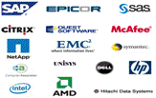

Microsoft Server Applications Built for Windows
Built-in Virtualization with One-stop Support
Hypervisor Feature of OS
“We liked the fact that Hyper-V™ was built into Windows Server® 2008…With Hyper-V, we don’t need separate drivers for the hypervisor, and we don’t pay additional licensing fees.”
Bart Roels, Operations Manager, Hostbasket
Large Partner Ecosystem
Broad Range of Partner Solutions and Services
Strong partner ecosystem and developer network
Hundreds of virtualization partners worldwide
Virtualization partner solution catalog with comprehensive solutions
Better Together: Microsoft Applications + Microsoft Virtualization
Microsoft ® SQL Server® – Database Mirroring, Guest Clustering
Microsoft ® Exchange – High Availability
Microsoft ® Office SharePoint® Server – SharePoint Farm with virtual and physical environment
Increased Deployment Options
9
Notes:
Speaking Points:
To explain in more detail why Microsoft Server Applications are built for Windows and Microsoft Virtualization
Built-in Virtualization with One-stop Support:
Microsoft believes virtualization is an integral part of your IT infrastructure, so we built Hyper-V™ into Windows Server® 2008, so there is no need to purchase an additional hypervisor. This means you can easily integrate it with your existing infrastructure and management tools. Since Hyper-V is the “Windows you know,” you can use the in-house expertise you already have. In fact, if you know Windows, you know virtualization. Microsoft Hyper-V Server 2008 provides a simplified, reliable, and optimized virtualization solution, enabling improved server utilization and reduced costs. Since Hyper-V Server is a dedicated stand-alone product, which contains only the Windows Hypervisor, Windows Server driver model and virtualization components, it provides a small footprint and minimal overhead. It easily plugs into customers’ existing IT environments, leveraging their existing patching, provisioning, management, support tools, processes, and skills.
Large Partner Ecosystem:
Microsoft virtualization solutions are based on the familiar Windows interfaces and work with all well-known Windows-based technologies, and because the solutions are Windows-based, they are supported by a broad network of experienced partners who can rapidly respond to your business needs. Microsoft's extensive partner ecosystem of independent software, hardware and storage vendors complements and extends our virtualization toolset with products for servers, applications, storage, networks and desktops. Together with our partners, we deliver robust, complete solutions for the virtualized infrastructure to our joint customers.
Increased Deployment Options
Microsoft Virtualization plus Microsoft Server Application means a wealth of enhanced deployment options including the following:
SQL Server® - Database Mirroring, Guest Clustering
Exchange - High Availability
SharePoint® – SharePoint Farm with virtual and physical environment
Microsoft also provides free Virtualization Solution Accelerators that provide end-to-end guidance, best practices, and automated tools to help you easily migrate to Windows Server 2008—so you can realize the cost savings and environmental benefits of Windows Server 2008’s built-in virtualization technologies.

Slide 10





Comprehensive Support for Business Critical Applications
Microsoft virtualization is the best choice for Microsoft Server Applications
Microsoft virtualization is supported by a diverse and growing list of industry leading business critical applications:
Enterprise Applications: including SAP®
Line of Business (LOB) Applications
Business Critical Applications
Enterprise Applications
LOB Customer
Applications
Management
Platform
Business Applications
ERP (SAP)
ERM
SCM
PLM
HR
Finance
Marketing
Microsoft
Server
Applications
Database
Collaboration
Communication
Virtualized Platform
Hyper-V™
Notes:
Speaking Notes:
Microsoft virtualization also provides seamless integration with a diverse and growing number of industry leading business critical applications; such as Enterprise applications like SAP® and Oracle®, Line of Business (LOB) Customer Applications and more than 30 of Microsoft's top applications (a full list of these applications can be found in the appendix of this deck)
Additional Information: Microsoft Virtualization and SAP
Businesses are under pressure to ease management and reduce costs while retaining and enhancing competitive advantages, such as flexibility, reliability, scalability, and security. Microsoft provides a complete suite of technologies to help enable an interoperable, end-to-end, virtualized infrastructure that can help IT departments maximize ROI and save costs across the enterprise. By consolidating application services on less hardware and simultaneously increasing flexibility and availability, you can lower the TCO of SAP infrastructures.
Windows Server® 2008 Hyper-V™ provides a low-cost, scalable and highly available platform for server consolidation of SAP solutions. Whether the solution comprises components of a SAP ERP system or middleware components such as SAP BW, SAP Enterprise Portal, SAP Process Infrastructure, SAP Master Data Management or SAP Mobile Infrastructure, the resource utilization of the SAP infrastructure’s physical servers can be optimized by moving the components into virtual environments. Microsoft solutions also improve availability, flexibility, and manageability of SAP applications in production, as well as test and development environments―with technologies such as clustering, Quick Migration and the end-to-end management capabilities of Microsoft® System Center products.

Slide 11
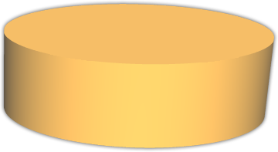



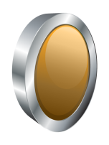
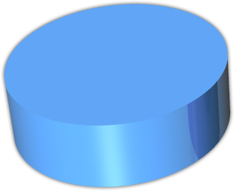



VMware
Hard Cost Savings: Feature & Cost Comparison Of Virtualizing 5 Hosts
$58.5K
VMware
Virtual Center
$7.3K
Multi-Hypervisor Management
x
App Management
x
x
vSphere 4 Enterprise Plus
$51.2K
Physical Management
Included
$9.7K
Virtual Management
System Center SMSD
$9.7K
Hypervisor
Cost comparisons assumes a five host configuration, 2 processors on each host, 2 years support costs for both products, and no operating system costs included.
Notes:
The savings that Microsoft virtualization solutions deliver over VMware are pretty straight forward: VMware typically costs three to five times more than Microsoft solutions. Plus with Microsoft, you get key capabilities like multi-hypervisor, application and physical management, which VMware doesn’t offer. But VMware has introduced creative pricing strategies that make these clear-cut advantages and savings harder to see.
VMware has been misleading the market about its costs by moving features from one product to another and pricing them separately. For instance, VMware says vSphere 4 Enterprise costs less than Virtual Infrastructure Enterprise did, but that’s only because it is now priced it for one processor instead of two. Many new vSphere features are available only with the vSphere Enterprise Plus SKU, which costs 18 percent more than vSphere Enterprise and five times more than the comparable Microsoft solution.
VMware’s pricing seems even more exorbitant when you consider that, with Microsoft Hyper-V Server 2008 R2, features such as clustering, high availability, and live migration are included at no extra charge. To get high availability and the newly announced 1TB memory, Cisco vSwitch and Host Profiles with VMware, you need vSphere Essentials Plus. Not only is this a cost upgrade for all current VMware customers, it is 12 times more expensive than the Microsoft solution for new purchases.
The bottom line is: VMware makes you pay more for less.

Slide 12

Enterprise vSphere vs. Windows Server 2008 R2/
Server Management Suite Datacenter Comparison
5 servers, 2 processor systems, with management server cost, 2 year maintenance, no operating system cost
vSphere Standard
vSphere Advanced
vSphere Enterprise
vSphere Enterprise Plus
Server Management Suite Datacenter
Price Hypervisor + Management
$13,958
+$7,318
$21,276
$32,885
+$7,318
$40,203
$42,124
+$7,318
$49,442
$51,207
+$7,318
$58,525
$0
+$9,698
$9,698
(Microsoft Hyper-V Server 2008 R2 or existing Windows Server 2008 R2)
Cost Difference
2.2x more
4.2x more
5,1x more
6xmore
vSMP Support
4-way
4-way
4-way
8-way
4-way
Physical Memory
256GB
256GB
256GB
1TB
1TB
VM/OS Updates
HA/Clustering
Vmotion/Live Migration
Backup/Recovery
Hot Add
Storage
Fault Tolerance
Storage VMotion
Quick
DRS/PRO
vNetwork/Host Profiles
Physical Mgmt
In-guest Monitoring
Cross Hypervisor

Slide 13
SMB vSphere vs. Hyper-V Server/VMM WGE/SCE Price Comparison
5 Servers, 2 Processors System, w/Mgmt Server Cost, 2 yr Maintenance, No OS Cost
 | vSphere Essentials | vSphere Essentials Plus | VMM Workgroup Edition (WGE) | vSphere Essentials Plus | VMM WGE + System Center Essentials (SCE)
Price | $1,098 x 2 = $2,196 | $4,388 x 2 = $8,776.28 | $757 + $0 (WS08R2 or HV R2) = $757 | $4,388 x 2 = $8,776.28 | $757 + $0 + $2,411 [SCE with 10 Server/ 50 Desktop CALs] = $3,168
Cost Difference | 2.9x more expensive | 11.59x more expensive |  | 2.77x more expensive
vSMP Support | 4-way | 4-way | 4-way | 4-way | 4-way
Physical Memory | 256GB | 256GB | 1TB | 256GB | 1TB
System Updates | (Host/OS only) | (Host/OS only) |  | (Host/OS only) | (HW/Host/OS/MS Apps/ 3rd Party Apps)
HA/Clustering
Live Migration
Backup/Recovery
Cross Hypervisor
Server & Desktop Management
In-guest Monitoring
DRS/PRO
HW/SW Inventory
SW Deployment

Slide 14
Free Hypervisor Feature Comparison
 | VMware ESXi 3 | VMware ESXi 4 | Hyper-V Server 2008 R2
Price | $0 | $0 | $0
Bare-metal Hypervisor | 32-bit | 64-bit | 64-bit
Boot from Flash
Host Processors | 32 Logical Processors | 64 Logical Processors | 64 Logical Processors
vSMP Support | 4-way | 4-way | 4-way
Host Physical Memory | 256GB | 1TB | 1TB
Virtual Machine Memory | 64GB | 255GB | 64GB
Free Remote Management Client
Live Migration
High Availability/Failover Clustering
Host based console for configuration and troubleshooting
Compatibility with Centralized Multi-host Management (vCenter/VMM) | (Only with per host upgrade to full VI3 license $2-4K) | (Only with per host upgrade to full vSphere license $2-4K) | (free with VMM server license, no per host cost)

Slide 15

Microsoft Technology Breadth
In-guest management and monitoring
Automated virtual machine optimization with in-guest knowledge
Interoperability
End-to-end management
Production scalability
Microsoft technical differentials
Notes:
With Microsoft, you get the same core features that VMware offers, plus key capabilities that make managing your infrastructure much easier and that enable you to operate with much greater effectiveness than VMware, including:
- In-guest management and monitoring
- Automated virtual machine optimization with in-guest knowledge
- Interoperability
- End-to-end management
- Production scalability
- Microsoft technical differentials

Slide 16
In-Guest Management and Monitoring
Integrate virtualization into existing tools, personnel, processes
Focus on applications, workloads running on virtual machines
Manage, monitor virtual machines just like physical machines
Microsoft System Center Virtual Machine Manager 2008 R2 integrated with System Center Operations Manager 2007 R2
Notes:
Having a single tool to manage the virtual infrastructure, with the familiar interface of System Center and Windows, enables IT organizations to integrate virtualization into existing tools, personnel, and most importantly, existing processes, thereby saving management, software, and training costs.
But there is much more to it than just managing virtual machines and virtual hardware. In the end, the applications and workloads that run on those virtual machines are what’s most importance. Because virtual machines are machines first, and virtual second, they must be managed and monitored just like physical machines, with additional features for virtualization management.
With Microsoft, this is easily accomplished through integrated physical and virtual management; specifically by integrating System Center Virtual Machine Manager 2008 R2 and System Center Operations Manager 2007 R2. Virtual Machine Manager includes a product connector for Operations Manager, which adds the virtualization-specific information from Virtual Machine Manager into the already rich monitoring database of Operations Manager.
Using Operations Manager, administrators can monitor the entire IT infrastructure, both the physical and virtual, and get a visual diagram view of the complete virtual infrastructure. You can drill down into the logical groupings of hosts, into virtual hosts, into virtual machines, and right into the actual Windows installation and all the applications running in the virtual machine. Real-time status of the systems, including the status of their applications and services, is visible at each level. In fact, it doesn’t really matter if the applications are running on a physical or a virtual machine.
What’s important is that you can manage the entire IT infrastructure from existing tools and touch both the physical and virtual systems. You eliminate costs associated with adding or expanding virtualization to the existing infrastructure by taking advantage of existing System Center investments. And you eradicate the cost and complexity of having two management infrastructures, one for physical and one for virtual.

Slide 17

Automated Virtual Machine Optimization with In-Guest Knowledge
Only Microsoft provides host and in-guest management of all virtual machines
Not available with VMware: focused on virtual machine not workload
Lack of in-guest affects VMware memory overcommit
As scale virtual machines per server, capital cost benefits with Microsoft increase, VMware benefits decrease
Notes:
Only Microsoft provides both host and in-guest management of all virtual machines. The combination of Hyper-V and System Center delivers critical insights into the virtual infrastructure at the application and service levels, and tools to leverage that knowledge. One of the features that enables this is Performance Resource Optimization (PRO) in Virtual Machine Manager. It allows optimization at both host and application levels. This is critical because managing virtual machines from an application perspective is needed to ensure a reliable, high-performing environment.
VMware does not offer this capability, as it is focused on the virtual machine rather than the workload. VMware’s lack of in-guest management also affects its memory overcommit feature, which enables allocating more memory to virtual machines than they actually have. However, not only can over-allocating memory to a virtual machine result in under-utilization of resources on the host system, which goes against one of the driving factors for using virtualization for server consolidation, when disk swapping occurs the virtual machines will suffer significantly and the applications will bear the brunt of the problems. In essence, the initiation point of issues moves from the virtual machine to the application. Because VMware does not have in-guest application and service monitoring, there is no way to get insights into problems within the virtual machine. While an administrator may see some metric indications of memory and disk usage, an understanding of the impact on the actual application is missing.
VMware has a Distributed Resource Scheduler (DRS) feature for performing post-placement optimization, but unlike PRO, DRS can only monitor CPU and memory utilization and cannot react automatically to application issues. VMware customers who do not have System Center would need to purchase and implement additional third-party applications for in-guest management, such as backup and software distribution. Many of these third-party applications are charged on a per-virtual machine basis. By contrast, the System Center suite is licensed at the host level. This means that, as organizations scale more virtual machines per server, the capital cost benefits with Microsoft increase while the benefits associated with VMware decrease.

Slide 18

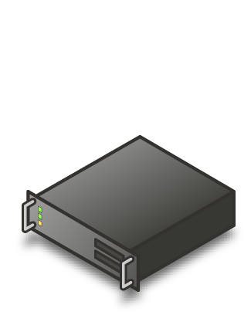
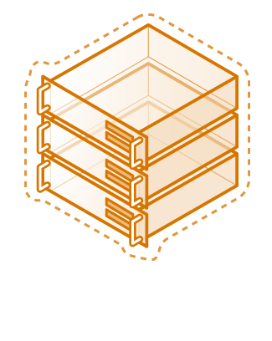



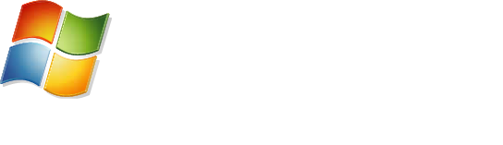

Virtualized Workloads
Microsoft fully supports our key server applications in a virtualized environment
Microsoft has updated server workload licensing to enable virtualization mobility
Management of the workloads is key, not just the virtual machine
“Maxol runs Exchange Server 2007, SQL Server 2005, Terminal Services, and file and print servers as key workloads in its virtual environment. Going forward, nearly every business application at Maxol will be a candidate for virtualization.”
- Maxol Case Study
“We’ve seen first-hand that we can virtualize everything from file, print, and web servers to database servers running SQL Server and Oracle, and actually have the virtual machine run *faster* than what it ran on our original physical box.”
- Janssen Jones, Indiana University

Slide 19
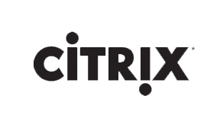
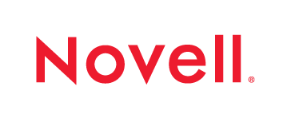

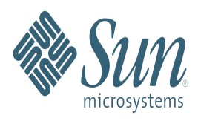
Interoperability
Interoperability agreements with Novell, Citrix (Xen), and Red Hat to support Linux on Hyper-V
SVVP (Server Virtualization Validation Program) to certify non-Microsoft Hypervisors for Microsoft Support
System Center Operations Manager supports monitoring of non-Windows, including Linux
System Center Virtual Machine Manager manages VMware ESX servers
VMware
“DHMC runs both Windows Server 2008 and Windows Server 2003 as guest operating systems under Hyper-V, as well as Linux. To date, DHMC has virtualized Web servers, sites on Microsoft Office SharePoint® Server 2007, reporting servers, medical applications, domain controllers, file and print servers, Citrix servers, and more.”
Dartmouth Hitchcock Medical Center Case Study

Slide 20


End-to-End Management
Microsoft application-level knowledge and support equals much greater integration with virtualization
Comprehensive System Center capabilities
Notes:
By providing both application-level knowledge and support, Microsoft enables much greater integration with virtualization than VMware does. And with the comprehensive capabilities within the System Center suite, you can easily have seamless, end-to-end management, which is not possible with VMware. Microsoft provides integrated software distribution and patch management (including virtualized applications with Microsoft Application Virtualization), compliance monitoring, system, applications, and service level monitoring, full backup and recovery of hosts, virtual machines and the applications inside the virtual machines, and integrated virtual and physical machine management.

Slide 21
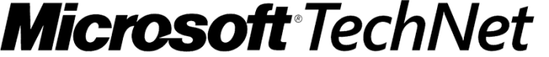
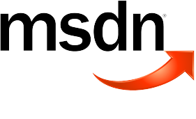
Production Scalability
Hyper-V Powering Microsoft Internet Properties
TechNet: 100% Hyper-V
http://technet.microsoft.com
~1 million hits a DAY
MSDN®: 100% Hyper-V
http://msdn.microsoft.com
~3 million hits a DAY
Microsoft.com: ~50% Hyper-V and growing
http://www.microsoft.com
>1 billion hits a month
Notes:
VMware claims superior scalability for its hypervisor, however the tremendous scalability and reliability of Hyper-V is pretty clear. The popular Microsoft TechNet site, which gets more than one million hits a day, and MSDN, which exceeds three million hits daily, both run 100 percent on Hyper-V. Even www.microsoft.com, which averages more than one billion hits a month, is a largely Hyper-V site.

Slide 22
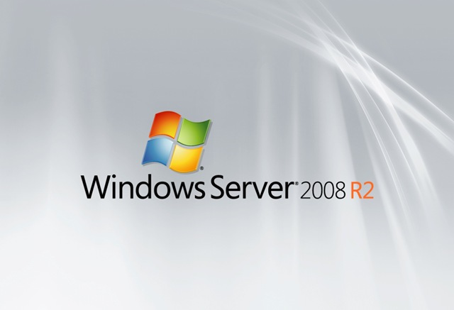


Microsoft Technical Differentials
Integrated live migration and failover clustering; no cost in standalone
VMware vCenter Server support
Large memory support
64-bit hypervisor
Notes:
Microsoft virtualization solutions have key technical differentials, which VMware tends to gloss over and ignore. Some of the more notable examples include:
Integrated live migration and failover clustering
Windows Server 2008 R2 with Hyper-V
No cost in standalone hypervisor, Microsoft Hyper-V Server 2008 R2, free download www.microsoft.com
VMware Advanced SKU with vMotion is the comparable solution, and that costs thousands of dollars per server
Large memory support
Windows Server 2008 Hyper-V: 1TB RAM on hosts
VMware ESX: 256GB
vSphere/ESX 4.0: 512GB RAM in most expensive SKU
64-bit hypervisor
Hyper-V already fully 64-bit
VMware just introducing with vSphere 4.0
VMware vCenter Server support
Virtual Machine Manager 2008 manages VMware hosts through vCenter integration; manages and integrates multiple vCenter servers to give an overall view of your VMware infrastructure
VMware just adding this level of support to vSphere 4.0

Slide 23

The VMware Reality
No critical insights into applications inside virtual machines
Cannot manage physical machines
“Per-app” pricing scheme does not reflect real-life usage or costs
Upgrading to vSphere is complex, time-intensive, expensive
Typically costs four to six times more than Microsoft
VMware not needed to virtualize
Requires extra virtualization layer, unnecessary virtualization tax
Notes:
VMware does not have the key capabilities and price advantage that Microsoft has, and which customers say are critical to a sound virtualization strategy:
- VMware is focused on the VM not on the workload; but managing virtual machines from an application perspective is needed to ensure a reliable, high-performing environment.
VMware has no solution for managing physical machines, and since physical machines will remain a critical aspect of your infrastructure, this is a major hole in VMware offerings and adds additional complications for you.
VMware tries to influences buyers to look at price-per-application rather than price-per-host. However, both VMware and Microsoft base pricing on the physical box, so this doesn’t add up. VMware does not base its pricing story on how customers actually pay for and use its products.
Upgrading to vSphere from VMware ESX 3.5 is major undertaking; it’s very time- and resource-consuming. It requires a significant change to customers’ environments. For instance, vSphere breaks compatibility with existing tools that work with VMware Infrastructure 3 (VI3) and, because vSphere virtual machines are not compatible with VI3, new virtual machines must be created to take advantage of many vSphere features.
VMware tries to assert that the costs for its solutions and Microsoft solutions are about the same. But all the price comparisons consistently show that VMware solutions cost three to five times more than comparable Microsoft solutions.
VMware tries to make you believe that you need its solutions in order to effectively virtualization your environment. As we’ve shown today, it’s simply not true.
VMware virtualization requires an additional layer, over and above what you need with Microsoft. That’s 4 layers instead of 3, and much more money and effort. You’re essentially paying a tax—an unnecessary tax—just to get virtualization capabilities.

Slide 24

Microsoft: The Better Value
Virtualization built into Windows Server 2008 R2 and the System Center suite of solutions
Free Hyper-V hypervisor with Microsoft Hyper-V Server 2008 R2
Only solution for in-guest management
System Center delivers unified end-to-end management of physical and virtual machines, including VMware
Complete portfolio of desktop to data center products
No extra virtualization layer
No virtualization tax
Why pay more and get less with VMware, when Microsoft virtualization delivers all the capabilities you need?
Notes:
Microsoft virtualization is clearly a better value than VMware. With virtualization built into the Windows environment, and the free Hyper-V hypervisor, you don’t need to support an extra layer or pay a virtualization tax. With the Microsoft System Center suite of integrated solutions, including the only solution for in-guest management, there’s no added complexity when it comes to end-to-end management and you get critical insights that just aren’t possible with VMware. And with the breadth of Microsoft desktop to data center products, you can create the virtualized environment that best suits your business.
Is it worth the extra line item on the invoice, the extra line in the budget, to use VMware virtualization when virtualization is built into Microsoft Windows Server 2008 R2?
The bottom line is this…there is no need to pay more and get less with VMware, when you can get all the capabilities you need with Microsoft virtualization solutions.

Slide 25

Take the Next Step
Learn more about why Microsoft virtualization is a better all-around value than VMware
Read the white paper comparing Microsoft and VMware at www.microsoft.com/virtualization/compare/vmware-comparison.mspx
Download a trial of Windows Server 2008 R2 with Hyper-V virtualization built-in at www.microsoft.com/windowsserver2008/en/us/default.aspx
Download the free Microsoft Hyper-V Server 2008 R2 bare metal hypervisor at www.microsoft.com/hyper-v-server/en/us/r2.aspx
Watch the Top 10 VMware Myths video at www.microsoft.com/vmwarecompare
This material is provided for informational purposes only. Microsoft makes no warranties, express or implied. ©2009 Microsoft Corporation.
Notes:
I hope you’ll take the next step to learn more about why Microsoft virtualization solutions are a better value than VMware solutions. Check out these links to a white paper comparing Microsoft and VMware, and a video giving the real deal behind myths VMware is promoting about Microsoft virtualization. I also encourage you to a download a trial of Windows Server 2008 R2 with Hyper-V, and our free Hyper-V Server 2008 R2 bare metal hypervisor.

