Slide 2
Aligning License Acquisition to IT strategy
Patrick Viaene
Volume License Program Manager

Slide 3
Topics
Microsoft Licensing options
Software Assurance
Product Licensing
Food for thought

Slide 4
Microsoft Licensing in 10 minutes

Slide 5
License types
OEM: sold with PC (or server)
Limited rights: no downgrade, no imaging, no hardware transfer, no language-switch, no MS support, not usable on Terminal Server.
Cheaper (?)
Retail
Limited rights: no downgrade, no imaging, no language-switch, not usable on Terminal Server. But transferrable
Expensive (?)
Volume license:
Many rights: downgrade, imaging, language-switch, transfer.
Extra: spread payment possible, simple management, maintenance (Software Assurance)

Slide 6
License types
OEM: sold with PC (or server)
Limited rights: no downgrade, no imaging, no hardware transfer, no language-switch, no MS support, not usable on Terminal Server.
Cheaper (?)
Retail
Limited rights: no downgrade, no imaging, no language-switch, not usable on Terminal Server. But transferrable
Expensive (?)
Volume license:
Many rights: downgrade, imaging, language-switch, transfer.
Extra: spread payment possible, simple management, maintenance (Software Assurance)
‘…You may not rent, lease or host the software…’

Slide 7
Volume Licensing high-level options
 | 1. Buy Licenses | 2. Buy Licenses over 3y | 3. Rent Licenses over 3y
SMB (<250 PC’s) | Open License | Open Value | Open Value Subscription
Enterprise (>250 PC’s) | Select Agreement | Enterprise Agreement | Enterprise Agreement Subscription
Characteristics | SA optional ‘A la carte’ choice Upfront payment of total cost Cost = investment, CAPEX | SA included Customer chooses standard desktop Spread payment of License + SA Cost = investment, CAPEX | SA included Customer chooses standard desktop Annual payment of rental fee (buy-out optional) Cost = cost, OPEX

Slide 8
1. Open License (Select)
“Buy software when you need it”
2 year contract (Select: 3)
One-time payment of total cost
Software Assurance optional
As of 5 licenses
Per legal entity

Slide 9
2. Open Value (EA)
“Buy software per standard PC”
Practically
Choose standard PC:
Windows upgrade
Office Small Business, Pro Plus or Enterprise
SBS CAL, EBS CAL, Core CAL or Entreprise CAL Suite
If company-wide: extra discount
3 year contract
Spread payment of total cost
Software Assurance incl
As of 5 PC’s
Additional products available
Possible for ‘group of’ companies
Discount if all 3

Slide 10
3. Open Value Subscription (EA Subscription)
“Rent software per standard PC”
Practically
Always company-wide
Choose standard PC:
Windows upgrade
Office Small Business, Pro Plus or Enterprise
SBS CAL, EBS CAL, Core CAL or Entreprise CAL Suite
3 year contract
Spread payment of rental cost
Software Assurance incl
As of 5 PC’s, yearly count can go up or down
Additional products available
Possible for ‘group of’ companies
Discount if all 3

Slide 11
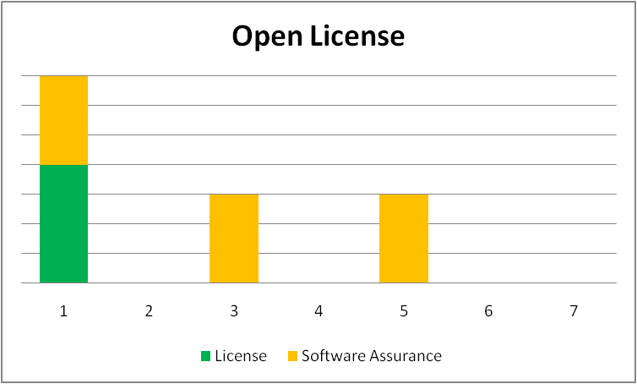
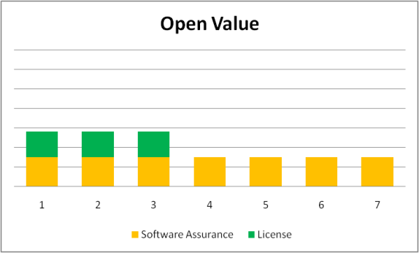
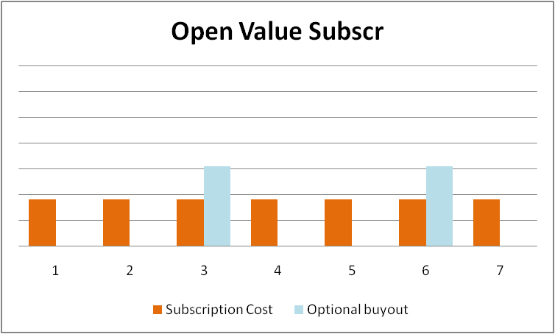
Summary
Open/Select:
SA optional
Simplicity: buy NOW, buy what/when you use
Difficult management
Open Value/EA:
SA included
Spread over 3 year
Discount for standardization
Simple management
Open Value Subscription/EAS
SA included
Spread over 3 year
Discount for standardization
Simplest management, evolves with company size
Cheapest solution first 5.x years

Slide 12
New in Enterprise Agreement
EAP – Enrollmen for Apllication Platform
ECI – Enrollment for Core Infrastructure

Slide 13
Software Assurance
Upgrade rights to new version
Office Multilingual, incl proofing tools
Predictable cost, easy budgetting
Office Home Use Program
Forefront Client Security Home Use Program
e-Learning
Training Vouchers
Employee Purchase program (EPP)
Windows Pre-installation Environment (WinPE)
Problem resolution support
TechNet Plus subscription
Cold back-up server
Access to Step-Up SKU’s
Access to Desktop Optimization Pack (incl App-V aka Softgrid)
Simple management
Exclusive version: Windows Enterprise

Slide 14
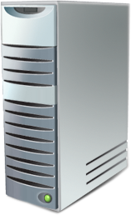
The story on CAL’s
‘Server + CAL’ model
‘Per CPU’ model
External connector option
Device CAL’s versus User CAL’s

Slide 15
Core CAL – Enterprise CAL
“Enterprise” CAL (addititive)
“Base” CAL
Core CAL Suite
Windows Server CAL
Exchange Server Std CAL
Exchange Enterprise CAL
Office SharePoint Server Std CAL
SharePoint Server Enterprise CAL
System Center Config Mgr Client ML
Office Communications Server Std CAL
Office Communications Server Ent CAL
System Center Operations Mgr Client ML
Windows Rights Mgmt Services CAL
Forefront Security Suite

Slide 16
Windows Server 2008 R2
Upgrade to ‘R2’ is not free, except for SA customers ☺
CALs remain the same
Virtualisation rights remain the same
Enterprise: 4 VMs
Datacenter: unlimited number of VMs
Downgraderights remain the same
Rights to LIPs (Language Interface Pack) remain the same
So, for Windows Server 2008 R2 licensewise much remains the same, except …

Slide 17
Terminal Server
Terminal Services
With release of Windows Server 2008 R2, a few changes:
Terminal Services renamed RDS – Remote Desktop Services
RDS CAL now includes “App-V for TS” ➔ “App-V for RDS”
Price increase of 5% for TS CALs
Price promo of 5% till end of calendar year ☺
What does not change
No increase for current SA customers untill SA renewal
License model per user or per device
What does App-V for RDS addition mean?
All App-V technical advantages (remember: App-V was Softgrid, from Softricity)
Possible license optimisation for the applications published on the TS

Slide 18
Product Licensing
“Microsoft Licensing is difficult to understand”
Licensing – “How can a professional organisation acquire its software licenses” – is relatively simple
Product Licensing – ‘What can I do with the software for which I have a license?’ or ‘What licenses do I need to put together this infrastructure’ is more difficult and evolves quickly.
Sources of information:
Volume License Briefs At www.microsoft.com/licensing/resources/volbrief.mspx
‘How to Buy’ pages

Slide 19
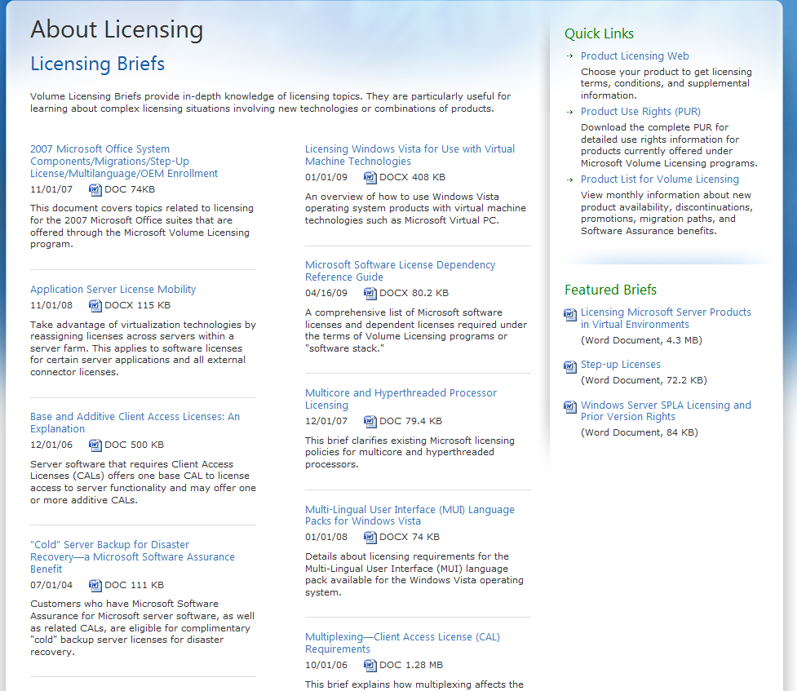

Slide 20
VDI:

Slide 21
Food for thought
Transpose your Microsoft desktop reality to an agreement.
Is your core infrastructure Microsoft?
Think Enterprise CAL for your clients
Think ECI – Enrollment for Core Infra – for your servers
Is your Application infrastructure Microsoft?
Think Enterprise Desktop for your clients
Think EAP – Enrollment for Application Platform – for your servers
Evaluate the financial treatment of your license acquisitions

