Slide 1
Windows TV Architecture And Roadmap
Mike Morrison
Program Manager
Microsoft Corporation

Slide 2
Agenda
Windows TV Goals and Growth
Windows Vista TV Enhancements
Windows Logo Program for Broadcast Receivers
Protected Broadcast Driver Architecture (PBDA) Overview
Windows TV Platform Updates
Windows TV Futures

Slide 3
Windows TV Goals
Enable TV standards
Support all analog and the vast majority of digital TV households worldwide to watch TV natively on Windows Media Center
Easy to find the TV you want
Personalized yet easy way to search, discover and get more information on TV content you want to view on broadcast, via on-demand or over the Internet
Provide great TV everywhere
Provide a rich, personalized recording and viewing experience anywhere in your home or on the road and on any device

Slide 4
Windows TV Growth
Windows
XP MCE
MCE
2004
MCE
2005
MCE 2005
Rollup 2
Windows
Vista
Analog
NTSC
A/V Capture
PAL / SECAM
Digital
DVB-T
ATSC
Digital Cable
Shipped in Windows Vista Worldwide

Slide 5
Windows Vista TV Enhancements

Slide 6
TV Enhancements In Windows Vista
US Digital Cable Support
Exhaustive TV Channel Autoscanning
TV now supported in all Windows countries
Existing Standards (NTSC, PAL, SECAM, DVB-T, ATSC)
In-Box Drivers
EPG available in 25 countries
Migration to Microsoft Decoder, EVR and WDDM
Recorded TV Gallery View (with thumbnails)
64-Bit TV Support

Slide 7
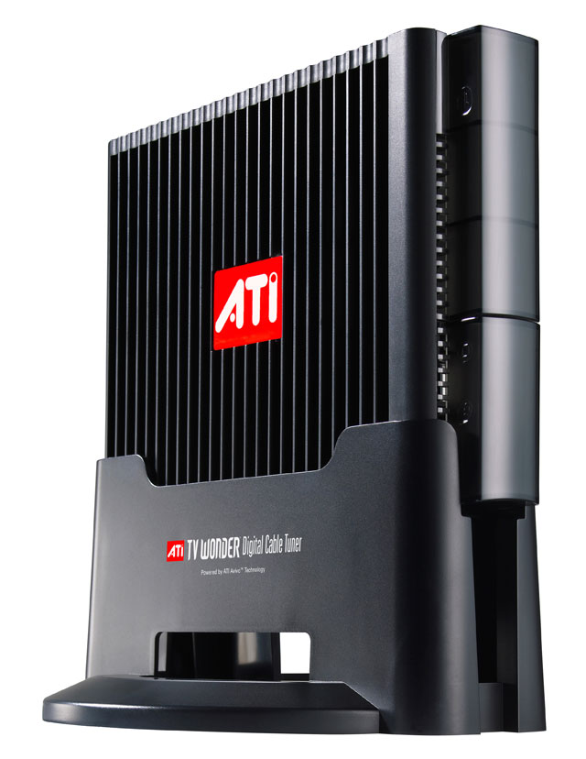
US Digital Cable Ready – Today!
Native support for SD and HD digital cable channels with OpenCable(t) Unidirectional Receiver (OCUR)
View premium digital cable content on the PC
Watch and record HD Digital Cable
Support for non-CableCARD HD (Local HD)
Simplified Configuration experience
No more Digital Cable Set-Top-Box slaving!
Easy Connectivity (Cables) and Setup (First Run)
Built-in support for CableCARD Pairing and Diagnostics
First dynamic hybrid tuner for Media Center (analog + digital)

Slide 8
Exhaustive Scanning
Automated mechanism to do a complete scanning of broadcast frequencies
Brings parity with CE devices
Works on current hardware, 60% coverage
Test Results from Europe
Scanning in Netherlands (results)
Exhaustive Scanning
Legacy Scanning
Scanning time 13min
Total found 43
Valid channels 43
Noise 0
Duplicates 0
Scanning time 21min
Total found 120
Valid channels 43
Noise 47
Duplicates 30
versus

Slide 9
Raising The Quality Bar For Broadcast Recievers
New Windows Logo Kit…
Vista WDK
DfMCE Logo
XP Broadcast Receiver Category
Migrated to Windows Vista WDK
Robust could not be ran outside Microsoft
First Official Broadcast Receiver Test Suite
Only Driver Reliability Tests
No BDA or Tuner Specific tests
DTM Support

Slide 10
Windows Logo Program For Broadcast Recievers
The Broadcast Receiver Category in the Windows Logo Program and Kit will be broken into new subcategories focusing on Broadcast Standards
Insures each logo requirement is applicable to the specific hardware and target market
Allows us to remove many of the manual steps in the existing logo test suite reducing the overhead in running the logo tests
New Logo Program “Broadcast Receiver” Categories
NTSC, ATSC, DVB_T, PAL, ISDB-T*, NTSC_M_J, Etc…
* For unsupported Broadcast Standards, only the Driver Reliability Tests under the Unclassified program will be required.z

Slide 11
Moving Forward With The Windows TV Ecosystem

Slide 12
The Worldwide Move To Digital
Analog content sources are still relevant
Digital TV is increasingly important
Content
Larger quantity and variety of digital services
Premium content (HBO, Showtime, etc.)
High definition audio and video
Analog switch-off
Motivated by better use of limited bandwidth
Transition schedules are set for many countries
Full deployment already underway in some places
We have made progress with ATSC and DVB-T, but there’s more to do…

Slide 13
Challenges For Digital TV On The PC
End to end content protection and Digital Rights Management is becoming the requirement:
U.S. Digital Cable (Bi-directional and Multi-stream)
Japan ARIB ISDB-T/S
Conditional Access (CA) protected content
U.S. ATSC Broadcast Flag equivalents
Developing a common API and cryptography solution
Simplifies hardware development
Simplifies software integration
Enables worldwide solutions

Slide 14
Protected Broadcast Driver Architecture (PBDA)
Features
Extends Broadcast Driver Architecture (BDA)
Protects content from the TV tuner to the operating system
Standardizes crypto APIs
Worldwide solution
Broadcast standard and CA independent
Uses industry-approved Windows Media DRM
Device support
Internal devices through Kernel Streaming (PCI/e)
External devices through Internet Protocol (USB/TCP-IP)

Slide 15
Windows TV Driver Model
BDA
WDM
PBDA
Windows TV Interfaces
Clear Analog
Clear Digital
Protected Digital
Tuner Device

Slide 16

PBDA Implementations
Enables secure delivery of premium content to Windows
Common chip-level hardware requirements (crypto)
Supports host or device screening (including bulk mode)
Worldwide solution (broadcast standard and CA independent)
PBDA KS
Primary design consideration: regional regulatory constraints (e.g., ISDB, Broadcast Flag)
Local/integrated devices
Extends BDA devices
Form factor: Highly integrated
Dedicated device (serves single PC)
Mini-driver must support new API
PBDA IP
Primary design consideration: network operator constraints (e.g., CableLabs, Premium Satellite)
Network based devices
Extends network devices (UPnP, WSDL)
Form factor: External, detachable
Shareable device (serves multiple PCs)
Class Driver: No driver required

Slide 17
Windows TV Driver Model
BDA
WDM
PBDA
Windows TV Interfaces
BDA Proxy Plug-in
Class Driver
KSTVTune
KSXBar
KSProxy
UPnP Framework
Kernel Streaming
Winsock
AVStream
TCP/IP
Mini Drivers
Tuner Device

Slide 18
End-To-End PBDA Content Protection
Digital Receiver
Windows Vista
CCI States
WMDRM License
Rendering
Copy Freely
Copy Once
Copy Never
CF
CF
COPP
MV
HDCP
CO
CO
CN
CN
CA
HDMI
DVI
Component
WMDRM
SBE
WMDRM
Applies to both PBDA-KS and PBDA-IP

Slide 19
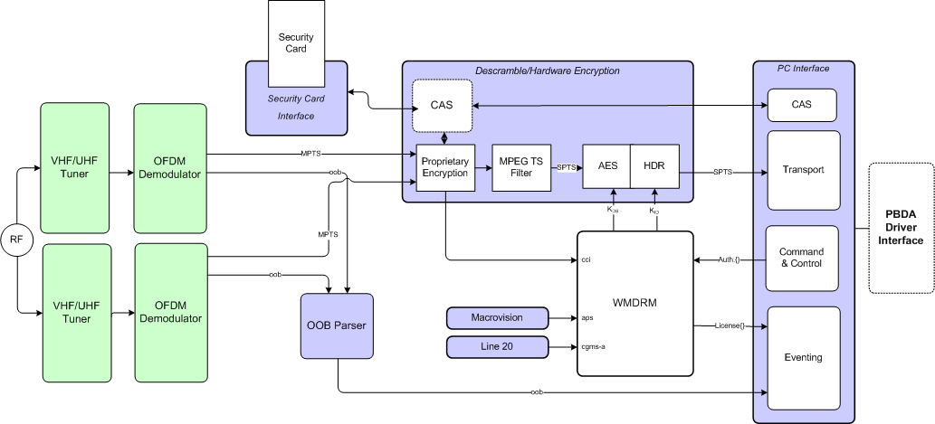
Sample PBDA Tuner

Slide 20
TV Platform Updates

Slide 21
ISDB-T Platform Update
PBDA tuners for ISDB
Premium content with B-CAS support
Live and recorded HD/SD TV
Interactive TV (BML)
In-band guide (SI/EPG)
Protected content pipeline
Video, audio, and data
ARIB TR-B14/B15 compliance

Slide 22
DVB-S Platform Update
DVB-S Platform improvements
Full DiSEqC support for Version 1.0
Generic Send/Receive functions to implement DiSEqC 1.x and 2.x
No active plan for native DVB-CI support
Current CI solutions will no be blocked, but also will not supported by Microsoft
Consider PBDA solution

Slide 23
Building Quality Tuners

Slide 24
Potential Issues Caused By Poor Analog Drivers
TV startup is too slow
Channel changes are too slow or glitch
Lip sync is bad
Closed captions do not appear
Closed captions out of sync with the audio and video
Picture loses detail
TV just stops after long periods of viewing
Seeking and trick mode playback do not work well
PC does not wake up and record shows

Slide 25




Consider The Whole Pipeline
Demod/ Decoder
Tuner
Encoder
Driver
Quality loss is permanent
Maintain quality throughout pipeline
Carefully select components
Develop high quality and reliable drivers

Slide 26
Recommendations
Analog Tuners
Separate Inputs for
Antenna (Terrestrial and FM reception), Cable, Clustered S-Video, composite video, audio
USB tuners should support USB 2.0
Clearly label tuner inputs
Encoding
Use hardware based encoders to insure scalability to multi-tuner and slower CPU PCs
Provide at least 9 MBs VBR encoding
Digital Tuners
Capture chips must support full transport stream bitrates for the desired medium (HD up to 19 MBs)
Detect and report signal presence and strength even if signal
is not yet locked

Slide 27
Supporting Multiple Tuners
Each tuner should be a different device instance
A separate graph will be built for each tuner instance
Each instance should maintain its state independently from other instances
Each instance must function fully and independently from other instances
There should be separate DirectShow filter entries for each instance (Tuner, Crossbar, Capture, etc.)
Each instance must have its own unique hardware pin mediums
Instances that share physical connectors must be able to independently select their input via the crossbar filter

Slide 28
Windows TV Futures

Slide 29
Windows TV Futures
Windows
XP MCE
MCE
2004
MCE
2005
MCE 2005
Rollup 2
Windows
Vista
Analog
NTSC
A/V Capture
PAL / SECAM
Digital
DVB-T
ATSC
Digital Cable
The move to digital is on

Slide 30
Many Up And Coming Standards
Digital
Satellite
Bi-Directional / Multi-stream Digital Cable
ISDB (T, S, C)
DVB (Full T, S, S2)
IPTV
Digital Mobile Standards
DTTB
A lot remains…

Slide 31
Call To Action
Move to Digital TV formats
Strive for a high quality pipeline
Ensure that your device and driver work on ALL 64-bit enabled Windows operating systems
We're making a big bet on PBDA. Join us!
Contact us tvpbda @ microsoft.com
Decide which version is right for you (KS/IP)
Engage now to be ready for the next release

Slide 32
Additional Resources
Microsoft TV technologies on MSDN
http://msdn.microsoft.com/library/default.asp?url=/library/en-us/directshow/htm/introductiontodirectshow.asp
Related Sessions
CLN-T355: PCTV Tuner Technology Directions
For E-mail addresses
hdtv @ microsoft.com
tvhybrid @ microsoft.com
tvpbda @ microsoft.com

Slide 33

© 2007 Microsoft Corporation. All rights reserved. Microsoft, Windows, Windows Vista and other product names are or may be registered trademarks and/or trademarks in the U.S. and/or other countries.
The information herein is for informational purposes only and represents the current view of Microsoft Corporation as of the date of this presentation. Because Microsoft must respond to changing market conditions, it should not be interpreted to be a commitment on the part of Microsoft, and Microsoft cannot guarantee the accuracy of any information provided after the date of this presentation. MICROSOFT MAKES NO WARRANTIES, EXPRESS, IMPLIED OR STATUTORY, AS TO THE INFORMATION IN THIS PRESENTATION.

