Slide 1
Next-Generation Testing For NICs – Best Practices
Rade Trimceski
Program Manager
Microsoft Corporation
Mitesh Desai
Software Design Engineer
Microsoft Corporation

Slide 2
Key Takeaways
Introduce new approach to testing network drivers
Introduce new tools for next-generation NIC testing

Slide 3
Agenda
How we test drivers today
How we will complement this testing in the future
Multi-Path Exerciser (MPE)
Static Driver Verifier for NDIS Miniports (SDV)

Slide 4
Current Tools
NDISTest
Functional testing of the network driver
Limited stress and performance testing
Driver Verifier
Detects violations at runtime
Bus specific tests
Functional testing of the network driver as it relates to the specific bus
Prefast for Drivers (PFD)
Compile-time static verification tool

Slide 5
NDISTest
Send/
receive
Tests interact with the user mode library
User-mode component, NDISTest Script Library, issues commands to ndprot.sys
The NDISTest protocol driver (ndprot.sys) is bound to the miniport
Tests run sequentially
OID
request
X-sum
offload
NDISTest
Library
user
kernel
NDISTest
Protocol
NDIS.SYS
3rd Party Miniport Driver
Networking Card Hardware

Slide 6

Test Tools Design Space
Run Time
Tools
Static Code Analysis
Tools
No binary changes required
Benefits from code annotation
Doesn’t require any code changes
NDISTest
PFD
SDV
Bus specific tests
Driver Verifier
MPE

Slide 7
Multi-Path Excerciser
Send/
receive
X-sum
offload
MPE is seamlessly integrated into the NDISTest
Appears as an NDISTest job
MPE exercises multiple driver code paths simultaneously
Targets synchronization issues that manifest as
Bugchecks
Non-transient soft failures
OID
request
NDISTest
Library
user
kernel
NDISTest
Protocol
NDIS.SYS
3rd Party Miniport Driver
Networking Card Hardware

Slide 8

MPE In Action
demo

Slide 9
SDV For NDIS Miniports
library.c
Rules for NDIS Miniports
more_code.c
ü
Verification Engine
driver.c
Model of NDIS
Driver Source
Static Driver Verifier
Verified Driver

Slide 10
SDV For NDIS Miniports
We are enabling SDV for NDIS Miniports by developing the NDIS model and rules
Rules validate the contract between NDIS and the miniport
When SDV for NDIS Miniports is released it will be part of the existing SDV tool
SDV for WDM drivers ships in the Windows Driver Kit today

Slide 11
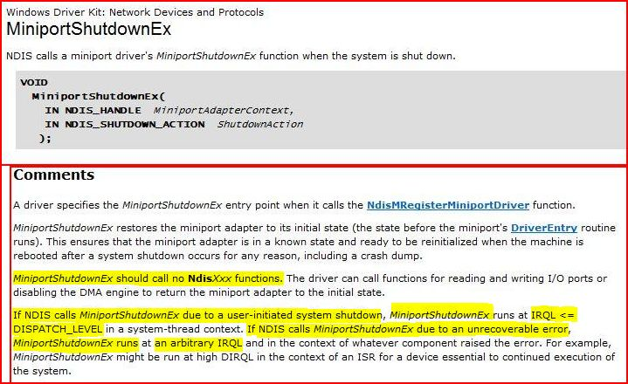
SDV Rule Example
From the MSDN documentation on MiniportShutdownEx(…)

Slide 12
SDV For NDIS Miniports
demo

Slide 13
Release Timeline
MPE will be part of NDISTest for logo
Beta preview planned for 2007
MPE will be integrated in the DTM
SDV for NDIS Miniports release plans to be announced

Slide 14
Call To Action
Download MPE from the NDISTest Connect website
Run MPE on all your drivers
Read “How to debug MPE exposed driver bugs” which is part of the package
Provide feedback on MPE and the documentation by sending e-mail to ndiststr @ microsoft.com
When released integrate SDV in your early development cycle

Slide 15
Additional Resources
Web Resources
Connect website: http://connect.microsoft.com/default.aspx
Connect site for NDIS test tools (NDISTest, MPE, SDV for NDIS Miniports)
Use Invitation ID NTst-CY36-J9MX
Connect site for NDIS specifications and documentation
Use Invitation ID NDIS-B4JF-H9C9
Whitepapers: http://www.microsoft.com/whdc/device/network/ndis/default.mspx
Related Sessions
DVR-T381: Static Analysis and Verification of Drivers
Contact us
Tools questions:
NDIS related questions:
Ndiststr @ microsoft.com
Ndis6fb @ microsoft.com

Slide 16

© 2007 Microsoft Corporation. All rights reserved. Microsoft, Windows, Windows Vista and other product names are or may be registered trademarks and/or trademarks in the U.S. and/or other countries.
The information herein is for informational purposes only and represents the current view of Microsoft Corporation as of the date of this presentation. Because Microsoft must respond to changing market conditions, it should not be interpreted to be a commitment on the part of Microsoft, and Microsoft cannot guarantee the accuracy of any information provided after the date of this presentation. MICROSOFT MAKES NO WARRANTIES, EXPRESS, IMPLIED OR STATUTORY, AS TO THE INFORMATION IN THIS PRESENTATION.

