Slide 1
Capacity Planning For Microsoft Office Communications Server 2007 Deployments
Francois Doremieux
Senior Program Manager
Microsoft Corporation

Slide 2
Key Takeaways
Capacity planning is critical to the success of an OCS deployment
Take the time upfront to plan in detail (including regional topologies)
Use Planning tool

Slide 3
Agenda
Capacity Planning process (30 min)
OCS Planner tool demo (15 min)
Questions and Feedback (15 min)

Slide 4
The Planning Process
Key Considerations
Verify model assumptions
Run model
Confirm output topology
Prepare for Deployment
Start Deployment
Fill-out Capacity model
Topology Selection

Slide 5
Key Considerations
Functional Requirements
Will you deploy Voice?
Will you deploy Video?
Will you deploy Conferencing?
Do you need this to work outside the corporate firewall?
Do you have compliance requirements for IM and conferencing?
Site Analysis
How many sites do you have?
What is the bandwidth available at each site?
How many users at each site?
What are the availability requirements for each site?
Deployment Path
Are you migrating from LCS 2005?
Is this a greenfield deployment?
Is this a proof-of-concept deployment?

Slide 6
Topology Selection
HA?
> 5K users
Small Branch or
Proof of Concept
No
No
Standard
Edition
Yes
Yes
> 30K users
No
Enterprise
Edition:
Consolidated
Regional
Datacenter
Yes
Enterprise
Edition:
Expanded
Central
Datacenter

Slide 7
Topology Selection Global or regional?
Enterprise Edition Expanded can scale globally
However,
Mediation Server needs to be close to IP-PSTN gateway
Front-Ends and conferencing servers cannot be geographically distributed within a pool
Network delay between user and pool should be less than 150 ms
Therefore
You may need to deploy regional datacenters for audio/video or data conferencing

Slide 8
High Availability
Scale is not only consideration for server count; redundancy is important as well for
IIS server
Conferencing servers
A/V servers
Edge servers
Redundancy means N+1 servers plus hardware load balancer

Slide 9
Capacity Planning Model assumptions
How many users are Enterprise voice enabled? (10%)
How many users work remotely (externally)? (5%)
How many meeting participants outside your firewall? (50% )
How many users are in a meeting at any point in time (5%)
Average of contacts per user (50)
Users/minute login rate (800+)
How many users are archived? (100%)
Archiving & CDRs are being captured (Yes)
Ratio of new to old clients (70/30)

Slide 10
Capacity Planning Important factors
Presence, Application Sharing, and A/V consume the most resources
IM and voice signaling is negligible
Front-Ends can be added to a pool up to a limit; that limit is determined by the backend hardware and is not “hard-coded”
Conferencing Servers can be added as needed for additional scale for conferencing
Number of users per pool is bounded by presence and the backend SQL server

Slide 11
Capacity Planning Meeting size and MCU scaling
https://ucforums.microsoft.com/ShowPost.aspx?PostID=12802
Not hard-coded
Test up to 250 participants in a single meeting
Test up to 210 meetings on a single server
Scalability is limited by hardware capacity
Larger meetings should use the Live Meeting Service instead

Slide 12
Capacity Planning Edge servers scaling
Recommend separate A/V Edge Server, co-located web conferencing and Access Edge Server
This configuration would support
Up to 1500 A/V sessions per server
Up to 5000 SIP sessions per server
Up to 1500 Web Conferencing sessions per server
VPN clients would not count against these numbers

Slide 13
Network Considerations
Disable IPSec for Audio/Video
150 ms maximum end-to-end delay for Audio/Video
Silence during calls saves bandwidth
BW dynamically changes based on network usage
Media | Bandwidth (on the wire)
Audio | 50 Kbps per media stream (one-way)
RTAudio (8kHz) | 32.6 Kbps
RTAudio (16kHz) | 49.8 Kbps
Siren | 40.4Kbps
Video | 300 Kbps per media stream (one-way)
Data Collaboration | 112 Kbps (full desktop sharing) Negligible for slide presentations, etc

Slide 14
Simple Model For 2 Party Call
50% of time User A talks
50 kbps sent from SF to NY
50% of time User B talks
50 kbps sent from NY to SF
Average this out for N concurrent calls
Total BW SF to NY = N X 25 kbps
Total BW NY to SF = N X 25 kbps
SF
NY
User A
User B

Slide 15

Planning A Phased Deployment
100% users fully UC enabled busiest hour
Use Population
SF Office (OCS Pool) | 750
NY Office (WAN link) | 250
Bandwidth Requirements (BHCA) – 2 Party Calls
BHCA SF-NY | 25
Calls Answered | 22.5
Audio (Mbps in each direction) | 0.55
Video BW (Mbps in each direction) | 1.37
User Model
Answered Calls: Total Calls | 0.9
Audio: Audio + Video Calls | 0.75
Bandwidth Requirements – Conferencing
Conference Audio SF -> NY (Mbps) | 0.49
Conference Audio NY -> SF (Mbps) | 0.60
Conference Video SF-> NY (Mbps) | 1.53
Conference Video NY -> SF (Mbps) | 0.38
Conference Model
Peak Concurrent Conference Users | 50
Avg. Meeting Size | 8
Audio : Audio + Video Confs | 0.5
Peak Bandwidth Requirements –Total
Total SF -> NY (Mbps) | 3.94
Total NY -> SF (Mbps) | 2.36

Slide 16
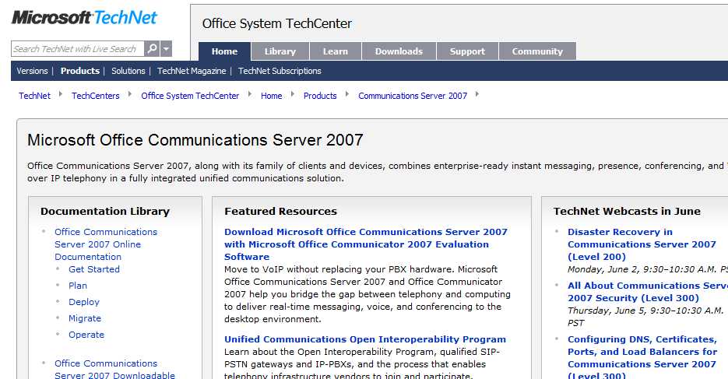
Want To Be An Expert?
Get in depth and up to date technical resources from TechNet
Leverage the variety of Webcasts and Virtual Labs available
Be part of the OCS Product Dialogue
Join the OCS Community
http://technet.microsoft.com/office/ocs/

Slide 17

© 2008 Microsoft Corporation. All rights reserved. Microsoft, Windows, Windows Vista and other product names are or may be registered trademarks and/or trademarks in the U.S. and/or other countries.
The information herein is for informational purposes only and represents the current view of Microsoft Corporation as of the date of this presentation. Because Microsoft must respond to changing market conditions, it should not be interpreted to be a commitment on the part of Microsoft, and Microsoft cannot guarantee the accuracy of any information provided after the date of this presentation. MICROSOFT MAKES NO WARRANTIES, EXPRESS, IMPLIED OR STATUTORY, AS TO THE INFORMATION IN THIS PRESENTATION.

