Slide 1



.NET Framework 4
and
Visual Studio 2010
Pandurang Nayak Harish Ranganathan
Client Platform Evangelist Web Platform Evangelist
Microsoft Corporation India Microsoft Corporation India

Slide 2
.NET Framework 4.0

Slide 3
.NET Framework Current "Layer Cake"
.NET Framework 3.5 + SP1
MVC
Dynamic Data
Entity Framework
Data Services
.NET Framework 3.5
LINQ
WF & WCF Enhancements
Add-in
Framework
Additional Enhancements
.NET Framework 3.0 + SP1
Windows Presentation Foundation
Windows Communication Foundation
Windows Workflow Foundation
Windows CardSpace
.NET Framework 2.0 + SP1

Slide 4
.NET Framework 4.0
User Interface
Services
Data Access
ASP.NET
(WebForms, MVC, Dynamic Data)
Windows Presentation Foundation
Data Services
Windows Communication Foundation
ADO.NET
Entity Framework
WinForms
“Velocity”
Windows Workflow Foundation
LINQ to SQL
Core
Parallel Extensions
Managed Extensibility Framework
LINQ
Languages
Dynamic Language Runtime
Base Class Library
Common Language Runtime

Slide 5
Base Class Library Improvements
Managed Extensibility Framework
Easy declaration/consumption of extensibility points
Monitoring for new runtime extensions
Watching a specific directory for new extensions
Additional core data structures
Numerics (BigInteger & ComplexNumber)
Tuple, SortedSet
I/O Improvements
Memory-Mapped Files
Unified Cancellation model

Slide 6
Parallel Computing
Task Parallel Library (TPL)
Imperative Task Parallelism
Work-Stealing Algorithm for maximum efficiency
Higher-level abstraction (no more Thread knowledge necessary)
Parallel Linq (PLINQ)
Declarative Data Parallelism (focus on the *what*, not the *how*)
Simple Parallelism via Linq-To-Objects
Coordination Data Structures (CDS)
Common structures to help with parallelism tasks

Slide 7
Parallel Extensions for .NET
demo

Slide 8
.NET Framework 4.0: Client
Windows Presentation Foundation
Client Profile
Business focused controls
Silverlight Synergy
Windows 7 Advances
Touch Computing

Slide 9
Windows 7 Touch
video

Slide 10
ADO.NET 4.0
Entity Framework v2
Persistent Ignorance
Code-First Development
TDD-Support
Foreign-Key Support
Lazy Loading

Slide 11
ASP.NET 4.0
ASP.NET MVC
Separation of Concerns, Testability
High control over market up
ASP.NET Dynamic Data support for MVC
Easily Create Custom controls and views based on data base
ASP.NET better CSS and ID

Slide 12
Project “Velocity”
Distributed Caching for .NET
Session State Provider for ASP.NET
Flexible, Several Different Caching Models
Partitioned
Replicated
Local

Slide 13
Distributed Applications
Windows Communication Foundation
RESTful enhancements
Messaging enhancements
Correlation enhancements
Seemless integration with Workflow Services
Windows Workflow Foundation
Significant improvements in performance and scalability
New workflow flow-control models and pre-built activities
Enhancements in workflow modeling
Updated visual designer
Notes:
Messaging enhancements
• Transports - UDP, MQ, Local in-process
• Protocols - SOAP over UDP, WS-Discovery, WS-BusinessActivity, WS-I BP 1.2
• Duplex durable messaging
Manageability: Better control throttling, end-to-end tracing, and out-of-box “services for managing services”

Slide 14
More Web Goodies…
ADO.NET Data Services
REST based exposure of relational data
Ability to go “offline”
ASP.NET AJAX
JavaScript UI Templates and Data-binding
AJAX Control Toolkit Enhancements
Client-side controls
DOM selection, manipulation and animation
Addition of jQuery

Slide 15
Visual Studio 2010

Slide 16
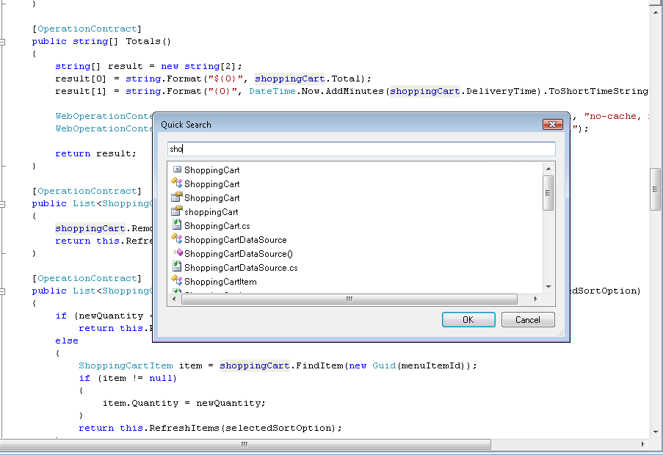
New IDE Improvements
Visual Studio Environment
WPF-based Editor
Better Multi-Monitor Support
Navigation
Quick Search
Highlight references
Project System
100% source code compatible
Multi-Targeting

Slide 17
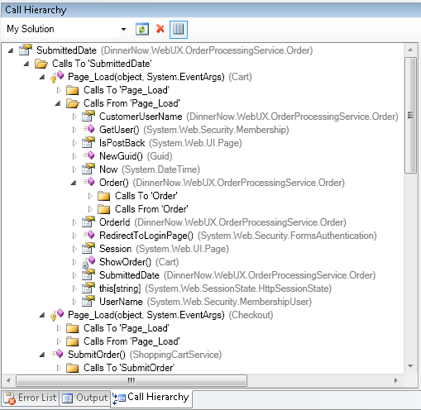
Code Focused Development
Consume First, Declare Later
Generate from usage
Code insight
Call hierarchy
Inline call tree
Layers
Rich formatting of code
Overlays of contextual information
Document Map Margin

Slide 18
Visual Studio 2010: New Features
demo

Slide 19
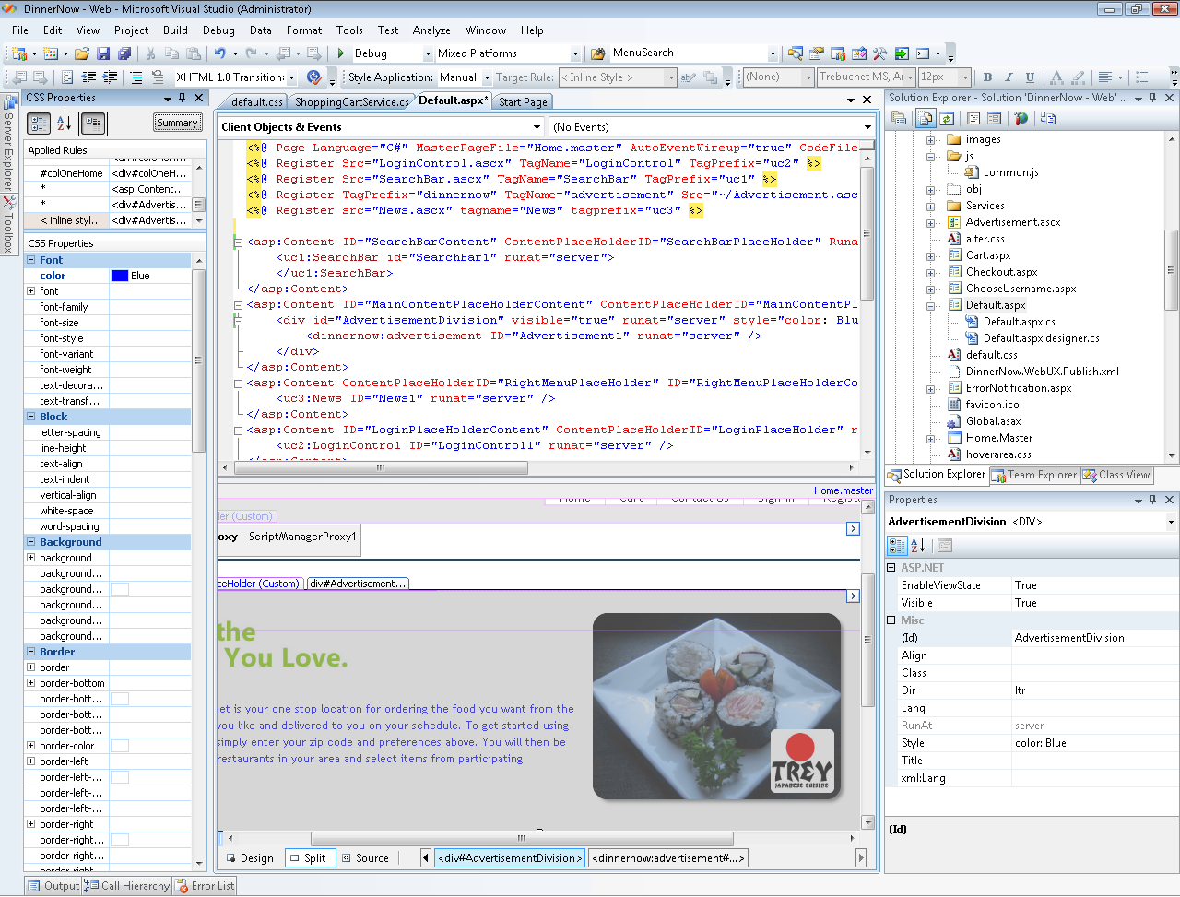
Web Development
Enhanced JavaScript tooling
HTML snippets
New MVC and Dynamic Data tooling
Integrated Web Deployment

Slide 20
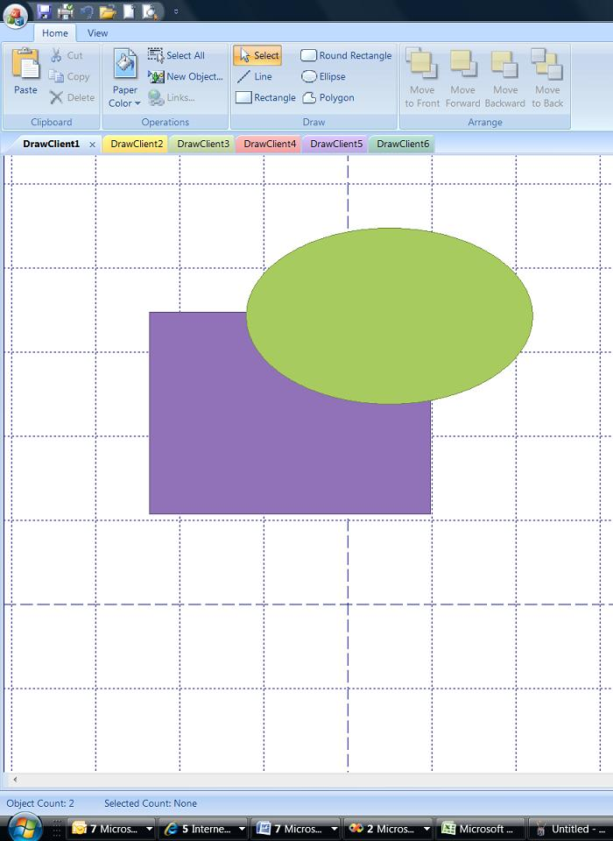
Native C++ Development
Amazing IDE Experience
Scale smoothly
Better navigation of large source bases
Multi-targeting
MFC Class Wizard
Parallel computing support
Light up on Windows 7
Updated MFC Look-and-Feel

Slide 21
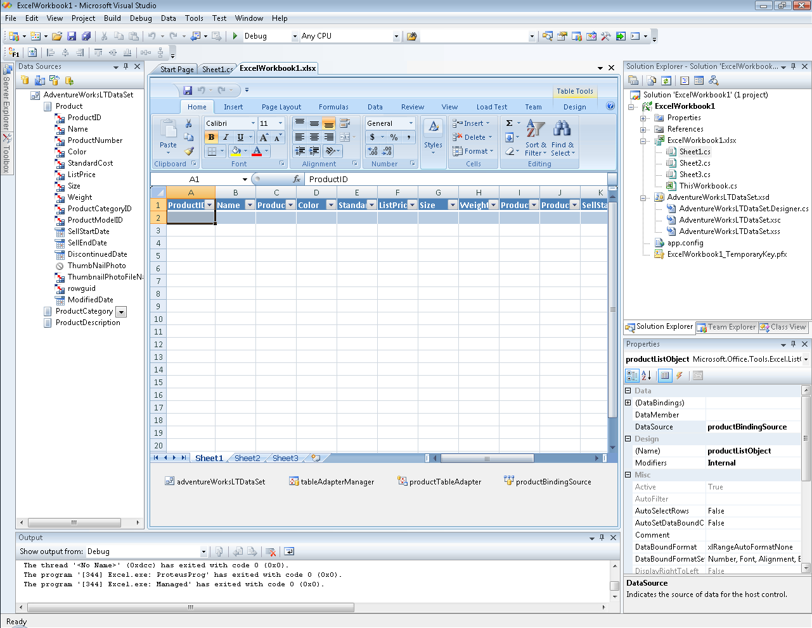
Office Development
ClickOnce Enhancements for Office
Create solutions with multiple addins and documents
Ability to deploy and update custom actions
Improved document and template deployment
Publish Office client customizations to SharePoint

Slide 22
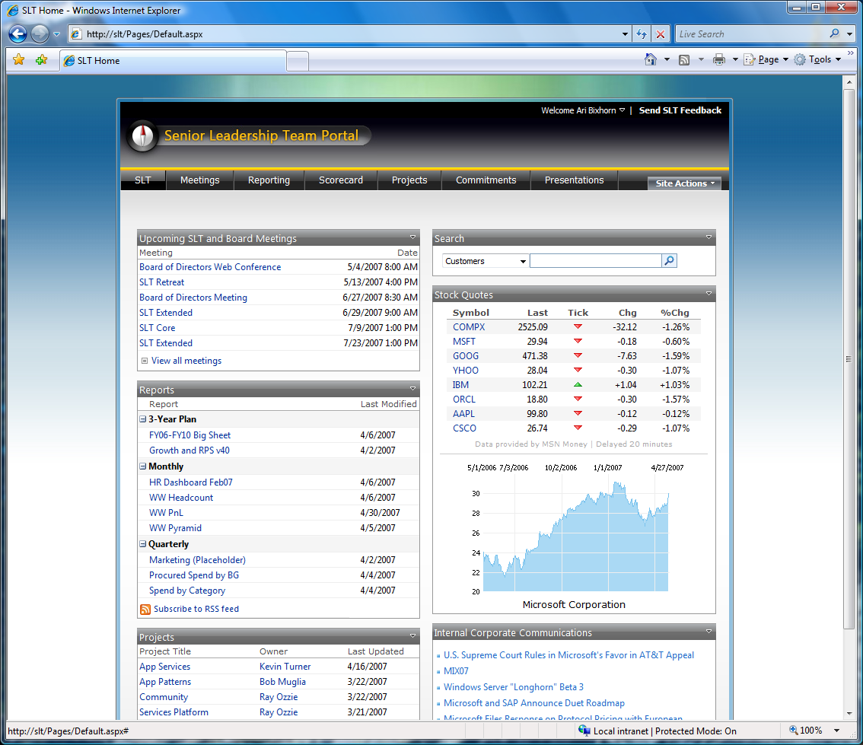
SharePoint Development
SharePoint tooling for common customizations
Great experiences inside Visual Studio – coding->debug->deploy
Extensible infrastructure allowing 3rd parties and ISVs to create additional SharePoint tooling
Workflow Content Types List Definitions Site Definitions Web parts (+ Visual Designer) | Application pages Master pages Server controls Modules Fields

Slide 23
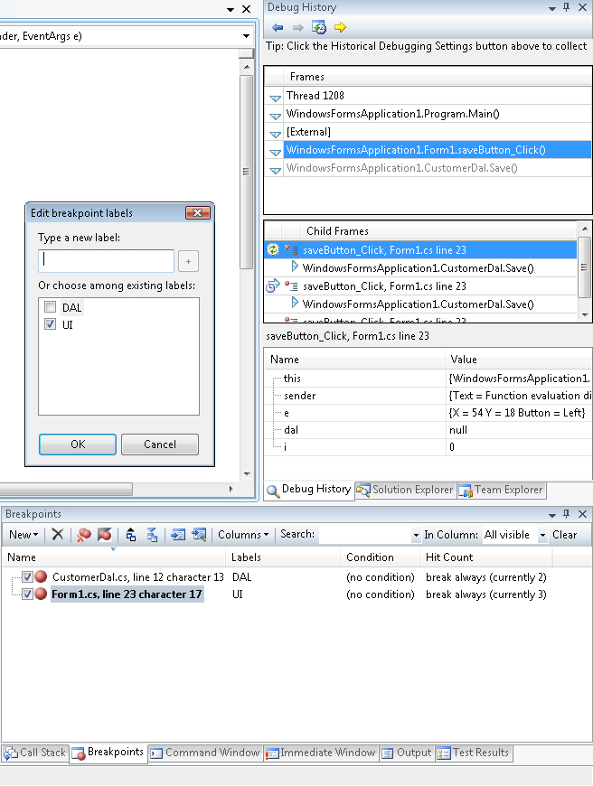
Debugger
Richer platform support
64-bit mixed-mode debugging
Minidump debugging support for managed and mixed-mode
WPF Visualizer
Breakpoint improvements
Grouping and labeling
Import/export
Historical Debugger
Record & playback application execution

Slide 24
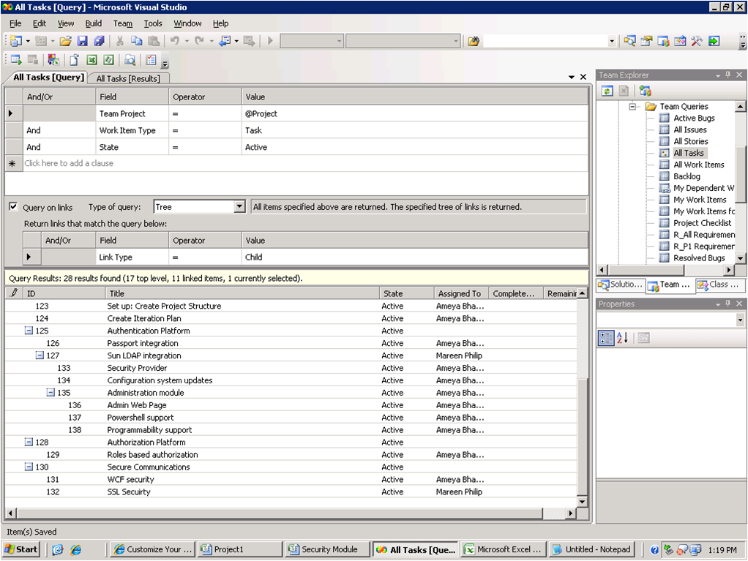
Team System: Business Alignment
Project Management
Project Server
Client Integration
Lightweight Project Planning Tools
Requirements Traceability
Reports
Individual Dashboards
Process Customization
Wider variety of examples from Microsoft and community

Slide 25
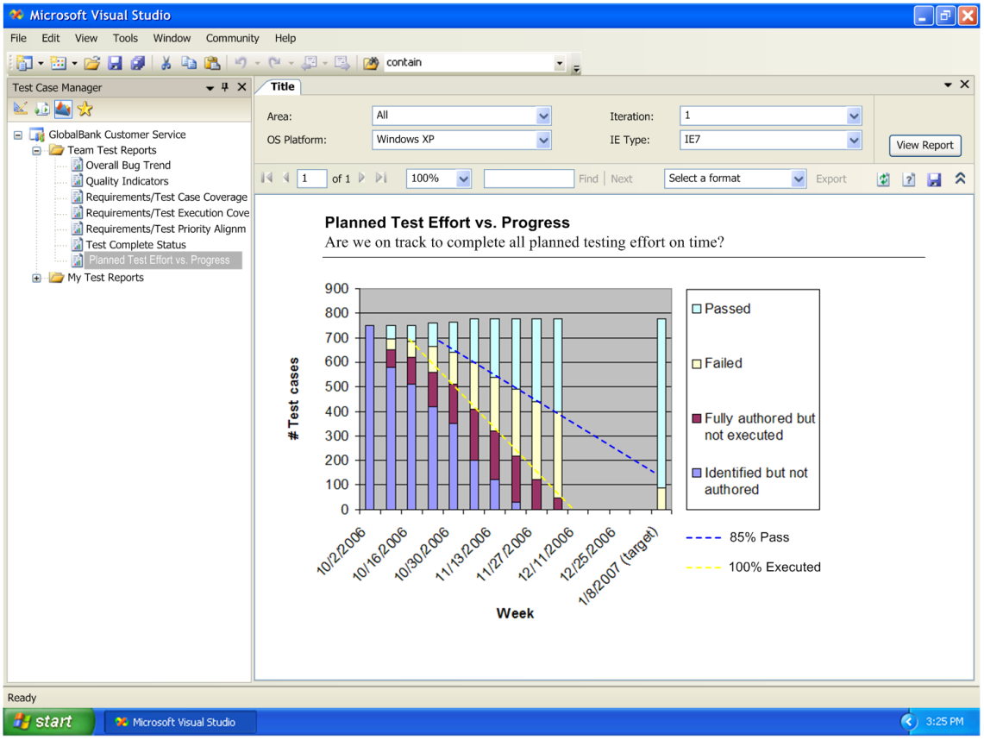
Team System: Quality & Testing
Visual structure and behavior in UML and DSL models
Eliminate the “no repro” problem
Gated checkin
T-SQL Quality Tools
Testing improvements
Test prioritization
Manual Testing
Functional Testing
Test Case Management

Slide 26

2006 Microsoft Corporation. All rights reserved. Microsoft, Windows, Windows Vista and other product names are or may be registered trademarks and/or trademarks in the U.S. and/or other countries. The information herein is for informational purposes only and represents the current view of Microsoft Corporation as of the date of this presentation. Because Microsoft must respond to changing market conditions, it should not be interpreted to be a commitment on the part of Microsoft, and Microsoft cannot guarantee the accuracy of any information provided after the date of this presentation. MICROSOFT MAKES NO WARRANTIES, EXPRESS, IMPLIED OR STATUTORY, AS TO THE INFORMATION IN THIS PRESENTATION.

