Slide 1



Slide 2
Changing the world with
Software + Services
Luc Van de Velde
Director Developer and Platform Group
Microsoft Belux

Slide 3
Agenda
S+S: What, Why, Who and Where
The Microsoft S+S platform today
Microsoft SaaS platform
Live & Online
End-toEnd S+S sample: LitwareHR
The Microsoft S+S platform tomorrow
Catch the next wave in Olso!

Slide 4
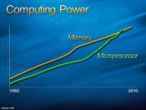
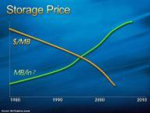


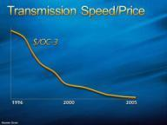


Two strong drivers for change
The revolution of “fast and cheep”
The race for “a free long tail”
Technology
Business
LPIA
LPIA
DRAM
DRAM
DRAM
DRAM
LPIA
LPIA
x86
x86
ctlr
ctlr
ctlr
ctlr
x86
x86
LPIA
LPIA
1 MB
1 MB
1 MB
1 MB
LPIA
LPIA
x86
x86
cache
cache
cache
cache
x86
x86
LPIA
LPIA
1 MB
1 MB
1 MB
1 MB
LPIA
LPIA
x86
x86
cache
cache
cache
cache
x86
x86
LPIA
LPIA
1 MB
1 MB
1 MB
1 MB
LPIA
LPIA
x86
x86
cache
cache
cache
cache
x86
x86
PCIe
NoC
NoC
NoC
NoC
NoC
NoC
PCIe
ctlr
ctlr
LPIA
LPIA
1 MB
1 MB
1 MB
1 MB
LPIA
LPIA
x86
x86
cache
cache
cache
cache
x86
x86
LPIA
LPIA
1 MB
1 MB
1 MB
1 MB
LPIA
LPIA
x86
x86
cache
cache
cache
cache
x86
x86
LPIA
LPIA
1 MB
1 MB
1 MB
1 MB
LPIA
LPIA
x86
x86
cache
cache
cache
cache
x86
x86
LPIA
LPIA
Custom acceleration
LPIA
LPIA
x86
x86
x86
x86

Slide 5



The Industry Debate
Software
Service

Slide 6











The Industry Debate
Enterprise Software Gets a Face-Lift
SaaS Emerges as Long-Term Rival to Packaged Software
Is the Enterprise Ready for 2.0?
SaaS Will Grow At a 21% CAGR During the Next Three Years Reaching $10.7B in 2009
The Rich Client Strikes Back
SaaS in 2007: It’s about services, doh!

Slide 7
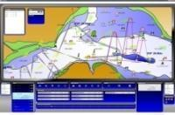
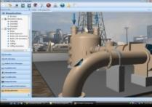





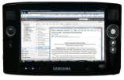
The Industry Debate: rationalized
Control
Flexibility
Pricing
Trial
Operations
Customization
Extensibility
Integration
Richness
Security
…
Software
Services

Slide 8
Our Strategy
+
Software
Services

Slide 9
Our Strategy
+
Software
Services
Experience: Consistent across multiple clients
Deployment: On-premise and hosted
Development: Extending tools and platform to cloud
Business Models: Expanded monetization opps

Slide 10











The Industry Move is On
Software
Software
+
Services
Service
Software

Slide 11














Software Plus Service Pillars
Delivery
Composition
Software
+
Services
Experience
Federation
Monetization

Slide 12




Delivery Capabilities
Software, services & support offerings specifically designed for one-to-many delivery over the Internet
Software as a Service
Packaged software customized, deployed & managed by provider
Hosted Outsourced IT
Software Delivery
How is the end-to-end experience delivered?
Today’s packaged software deployed on-premise
Traditional Software
Customer Managed
Co-Managed
Provider Managed
Application Management
Who manages the app software experience, SLA?

Slide 13


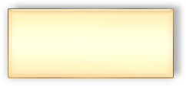
Delivery Capabilities
Software as a Service
Attached Services
Finished Services
Building Blocks
Hosted Outsourced IT
Co-Location Services
Hosted Infra & Applications
Software Delivery
How is the end-to-end experience delivered?
Today’s
In-House IT
Outsourced IT,
On-site Contractors,
Asset Transfer, etc
Traditional Software
Customer Managed
Co-Managed
Provider Managed
Application Management
Who manages the app software experience, SLA?

Slide 14














Service Types
Software as a Service
Attached Services
Finished Services
Building Blocks
Hosted Outsourced IT
Platform
Software Delivery
Traditional Software
Streaming
Customer Managed
Co-Managed
Provider Managed
Application Management
Services

Slide 15
Agenda
S+S: What, Why, Who and Where
The Microsoft S+S platform today
Microsoft SaaS platform
End-toEnd S+S sample: LitwareHR v2
The Microsoft S+S platform tomorrow
Catch the next wave in Oslo!

Slide 16








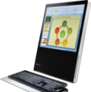


Developer Platform in the Cloud
APPLICATIONS & SOLUTIONS
Live Services
Online Services
3rd Party
Apps & Solutions
BUILDING BLOCK SERVICES
ID AND ACCESS
COMMUNI-CATIONS
SEARCH
SERVICE DELIVERY
Building Block Services
DATA SERVICES
BUSINESS LOGIC
CORE SERVICES
…
GLOBAL FOUNDATION
Datacenters
Computers
Networks

Slide 17
SQL Server Data Services
Microsoft® SQL Server® Data Services (SSDS) is an internet facing, highly scalable and cost effective pay as you grow data storage and processing utility
Application Agility
Simple, flexible data model
REST and SOAP protocols support
Scales without Limits
Storage and processing scales without restrictions
Businesses pay only for the resources consumed
Business Ready SLA
Built using robust Microsoft SQL Server technology
SLA for business continuity
Highly available, reliable and secure

Slide 18





Microsoft Online Services
Enterprise class software delivered as subscription service hosted by Microsoft and sold with partners
Starting with…
Business Productivity Online Suite

Slide 19
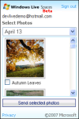





















The Windows Live Platform
Client-side SDKs & APIs
IM Activity SDK
IM Add-In SDK
Writer Add-In SDK
Live ID Client SDK
Additional SDKs & APIs
Silverlight
Agents SDK
Alerts SDK
Web Controls for Mashups
19
Service APIs
REST
XML-RPC
REST
SOAP
SOAP
HTTP/SOAP
Silverlight Streaming
Spaces
Live
Contacts
Virtual
Earth
Live
Search
Live ID
Development Tools
Visual Studio
Expression Studio
Popfly
SharePoint Designer

Slide 20
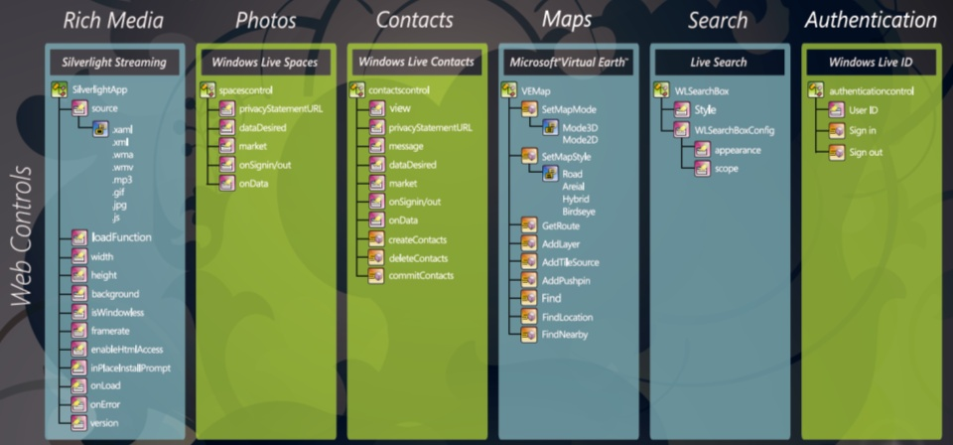
Windows Live Web Controls APIs

Slide 21
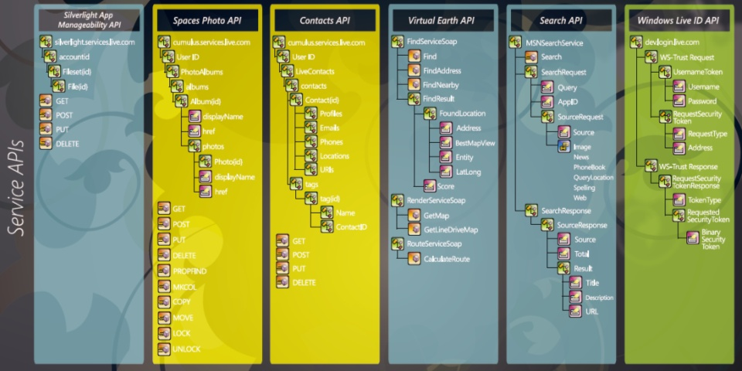
Windows Live Web Services APIs

Slide 22
Resource WL
WL Platform
http://Dev.live.com
Samples
http://Get.live.com
Simple business sample
http://extra.msn.be/specials/hyundai/fr.asp

Slide 23
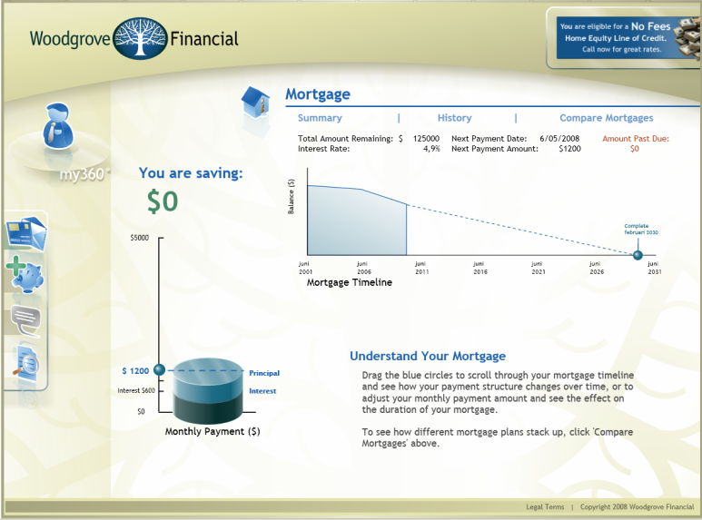
Woodgrove Bank Online

Slide 24
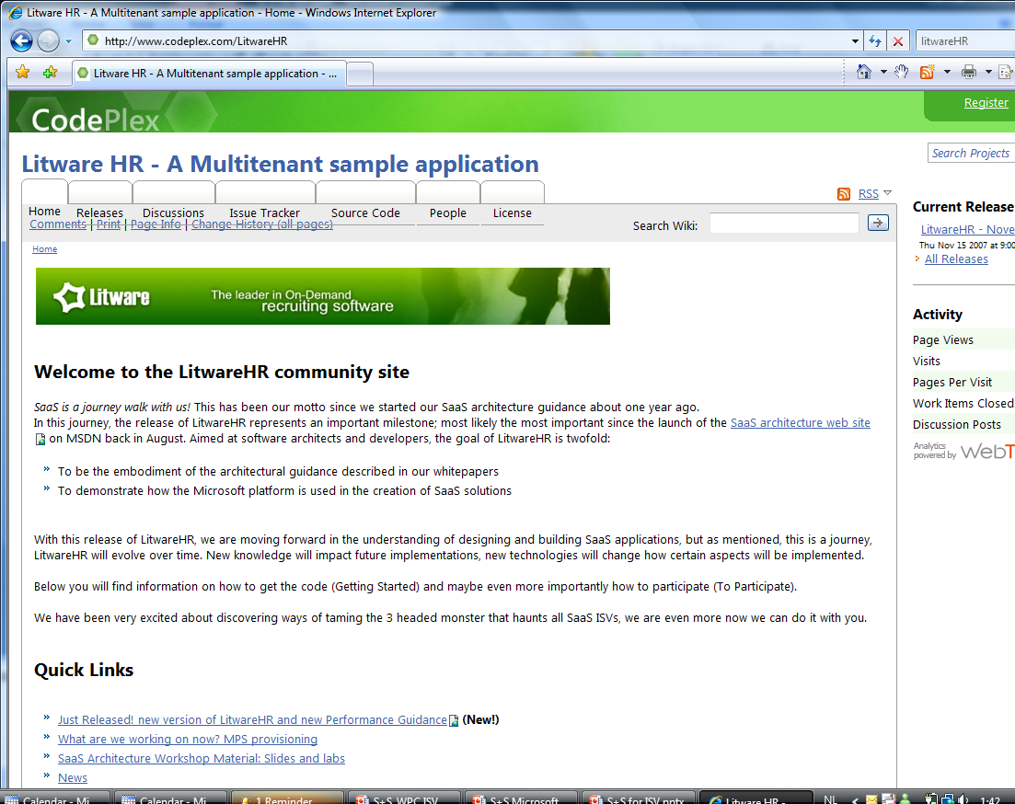
S+S Sample Application: LitwareHR

Slide 25


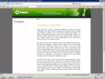


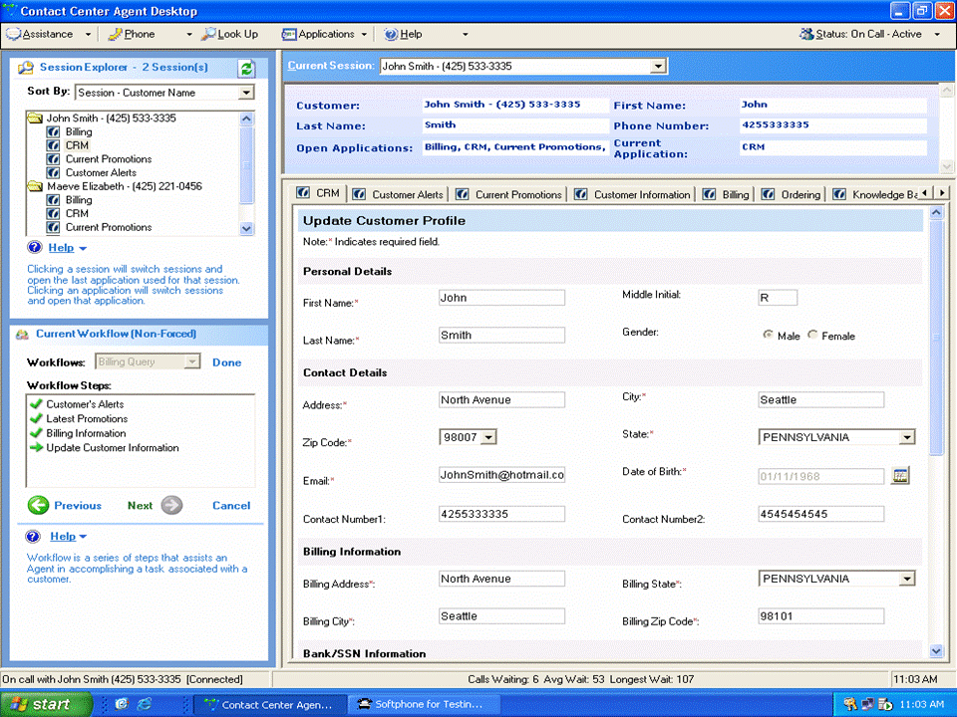




LitwareHR – Reference Application
Private
Website
Functional
Services
Web Client
SQL Server
Multi-Tenant Data Access
Network
Public
Website
Metadata
Services
SQL Server
Data Services
Smart Client
WCF / WF
REST/
SOAP APIs

Slide 26
Agenda
S+S: What, Why, Who and Where
S+S: How - build them now!
End-toEnd S+S sample: LitwareHR v2
Windows Life as a development platform
S+S: how - catch the next wave in Oslo!

Slide 27
Software and Services: VNext
An emerging platform for
“in the cloud”
composite applications
Internet Services Bus
Many enabling trends (HW/SW/changing business models)
Will become the next “Win 32” ecosystem
Rapid, ad hoc, just-in-time solutions (Long Tail)
Delivery model for packaged applications and useful business services
Driven by and drives SW transformation within enterprises
Model driven development
BPM
ESB

Slide 28



Our Approach
SERVICES
Client
Server
Cloud

Slide 29




Our Approach
APPLICATIONS
SERVICES
MODELS
Oslo
Productivity
Agility
TCO

Slide 30
Model Driven Development
SOA and Web Services
All components “look” the same from the outside
Contracts
Channels
Enables
High level, intuitive tools for structural composition
More dynamic connections
HW Performance trends enable higher-level application abstractions
Workflows, Rule sets, etc
Closer, simpler and higher fidelity “catcher” for elements of the business modeling.
Eliminates the “miracle happens here transformation.”
High level abstraction enables recipes, patterns and templates.

Slide 31



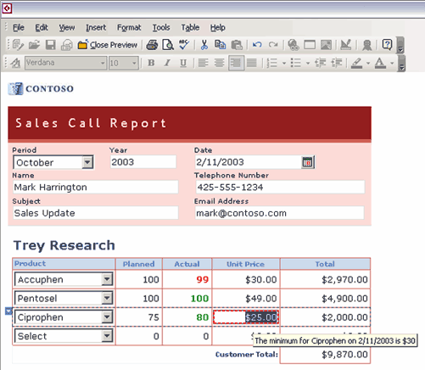







Our Approach
Site Creator
APPLICATIONS
BUIT Developer
SERVICES
MODELS
End-User
Oslo
Business Analyst
Operations
Database Administrator
Architect
Developer
Test / QA

Slide 32





Getting Out of Silos
Requirements
Process
Design
Contracts
Workflow
Rules
Deployment
Health
…
We need a way to bring these models together

Slide 33






Repository
Database to store and share models
Modeling Language
An approachable, mainstream, textual modeling language for describing both data (e.g. requirements) and behavior (e.g.workflow)
Process Server
A full featured execution environment for workflow, rules, and any .NET service.
Modeling Tools
Create, edit, and browse models
Bus Analyst
Arch
Dev
IT Pro
Cloud Services
A set of Microsoft hosted services including a service bus and a process server
Service Bus
Allows services to discover and communicate with each other
Modeling Tools
Modeling Language
Model Repository
Process Server
Service Bus
Cloud Services

Slide 34





Delivering the Vision
APPLICATIONS
SERVICES
“6”
Services “1”
“10”
“5”
“4”
MODELS
Oslo
A New Way to Build Applications

Slide 35

Oslo in a Nutshell
Services Extending services from the client to the cloud
Models Making models a mainstream part of development
Detailed Announcement @ PDC in October
APPLICATIONS
SERVICES
MODELS
Oslo

Slide 36
The Software Plus Service World
Software + Service will beat just software or just service
Must focus on cost and value
More choices, but more responsibilities
Platforms will help and Microsoft will be there
5 pillars for web platform - MS present on 5 pillars
Will become the next “Win 32” platform & ecosystem
Web OS
Microsoft 2.0 ☺

Slide 37


