Slide 2
Microsoft’s Web Conferencing Solutions
Name Title Microsoft Corporation

Slide 3
Session Objectives After this session, you will understand
Microsoft’s Web Conferencing offerings
Capabilities of Microsoft’s Web Conferencing products
On-premise, hosted, and hybrid deployments
Conferencing system requirements

Slide 4

Today’s Business Environment What customers are telling us
Distributed workers need to collaborate remotely, train and conduct events
Reduce cost of travel and proprietary audio and video conferencing
Meet needs of both new and advanced users
Connect Organizations
Make remote meetings as effective as face-to-face meetings
Incorporate rich media and video to engage attendees
Have two-way audio and breakout rooms for more interactivity
Engage Attendees
Software + Service
Choice
Service for quick deployment across the organization
Software for information control and unified implementation
Software and Service solutions that work together
Notes:
For businesses today the key challenge is really connecting the disconnected. It is estimated that over two thirds of information workers today are collaborating with colleagues in different regions of the country and world. At the same time as business is being conducted in a more distributed manner, the costs of travel –be it transportation costs, time to meetings, environmental impact of air and automobiles – and of audio/video conferencing remains high. While earlier versions of web conferencing helped to partially address this new world of work, it is clear that there is still a ways to go. End-users particularly request an easy-to-use tool that provides a great experience to both novice and advanced users.
If the first set of requirements are around the “what” of web conferencing, the second set of requirements are around the “how”. This is to more deeply engaging attendees to have more effective meetings with integrated audio, video and media.
Lastly, customers want to have a choice when deploying web conferencing. They want software to control the information flow and when deploying the complete UC application suite. They want the service is they want to free up their IT for other strategic projects.

Slide 5
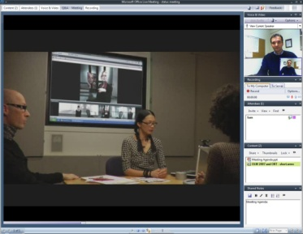




Microsoft’s Web Conferencing Solutions
Common user experience
+
Choice of server or service
On-Premise Server
Hosted Service
Notes:
With the 2007 releases of Office Communications Server and the Live Meeting service, Organizations will have a choice of web conferencing technologies from Microsoft.
2. However, regardless of whether end users are using one or the other on the backend for a web conference, there is a single web conferencing client that works with both, insuring a single common end user experience. This simplifies learning and support for people new to web conferencing and lets power users be maximally efficient no matter what’s powering their web conference.
3. When an organization is deciding whether to use the on-premise server solution of the hosted service solution, it fundamentally comes down to a customer choice about how they want to manage, deploy and control the technology.
- Customers will see value in a service if they want to free up their IT resources to focus on other important projects
- Customers will see value in a server if they want to take control of the information and delivery of the solution – the simplest case being a customer that has a corporate or industry compliance requirement for keeping data and meeting information inside their firewall
4. One other high level factor to consider is for customers interested in using an on-premise solution that need to use some of the features that are not currently offered with OCS. For these customers it may make sense to extend their OCS solution with some licenses for users that need to conduct trainings or events.

Slide 6




Microsoft’s Web Conferencing Solutions Feature Highlights
New client with improved user experience
Advanced testing and breakout rooms
New event registration
Connected Organizations
Rich media presentations
Panoramic video and active speaker switching
Two-way VoIP audio
Engaged Attendees
Flexibility with single user experience
Unified implementation with OCS 2007
Extending to training and events with service
Software + Service
Choice
Notes:
9/6/2007 8:27 AM
© 2004 Microsoft Corporation. All rights reserved.
This presentation is for informational purposes only. Microsoft makes no warranties, express or implied, in this summary.
6
Microsoft’s 2007 releases of OCS and OLM have been in the works for over two years now with improvements and enhancements that touch on all customer needs. But if you look at the big investments we’ve made in these 3 areas, they include:
Connected Organizations
A redesigned Windows client and web client to simplify the experience for new users and help advanced users be more efficient
Broader support for using Live Meeting for online trainings and events through advanced testing/grading, breakout rooms and event registration
Engaged Attendees
Ability to share multimedia clips
Improvements in video, including native support of webcams and of Microsoft RoundTable
Two-way VoIP audio
Software + Service Choice
Single client that works with OCS and OLM back-ends adds flexibility in usage and deployment, simplifies training
Outlook Add-in can be used to schedule meeting on both server and service

Slide 7
Connected Organizations

Slide 8
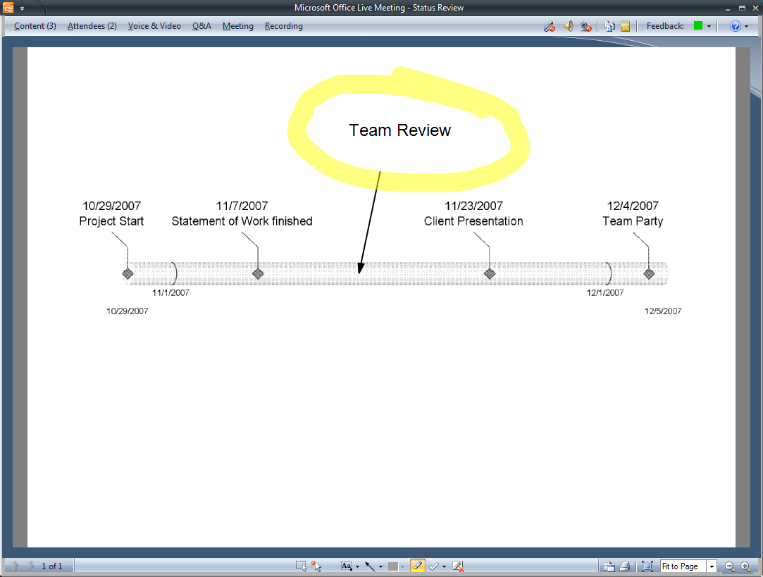
Collaborative Meetings
Connected
Organizations
Hold collaborative meetings easily and cost effectively
Connected Organizations
Key Features
Scheduling Add-in for Office Outlook
MeetNow from Office Communicator
Redesigned user experience
Choice of VoIP or PSTN audio
Whiteboard with new annotation tools
Always-on shared notes pane
^{IMPROVED}
^{NEW}
^{NEW}
^{NEW}
Redesigned client with larger content viewing area
Notes:
LM2007 Collaborative Meetings Scenario:
Jim’s company is deploying Microsoft's UC suite and he set up a meeting to discuss the network architecture our rollout plans with his team mates.
He uses the Scheduling Add-in for Outlook to schedule the meeting and send invitations to his team members. Alternatively, he could have used the MeetNow menu in Communicator to invite them on an ad-hoc basis, but the meeting is not until tomorrow and Jim wants to put this meeting on their calendars.
The new user experience is enhanced with a streamlined interface without any panes exposed initially. A large area for viewing shared documents focuses attendees on content.
Jim has a choice of PSTN and two-way VoIP audio to conduct the audio portion of his remote meeting.
Several attendees use the interactive whiteboard and annotation tools to brainstorm new design ideas. (new annotation tools include rich text, shapes and flowcharts)
Jim keeps track of customer inputs in the new always-on Shared Notes pane (new). From time to time, meeting attendees jump in and clarify some of the more subtle points by co-editing the action items. By the end of the conference a new action plan is agreed upon and attendees exit the call satisfied with the efficiency of their collaborative meeting

Slide 9
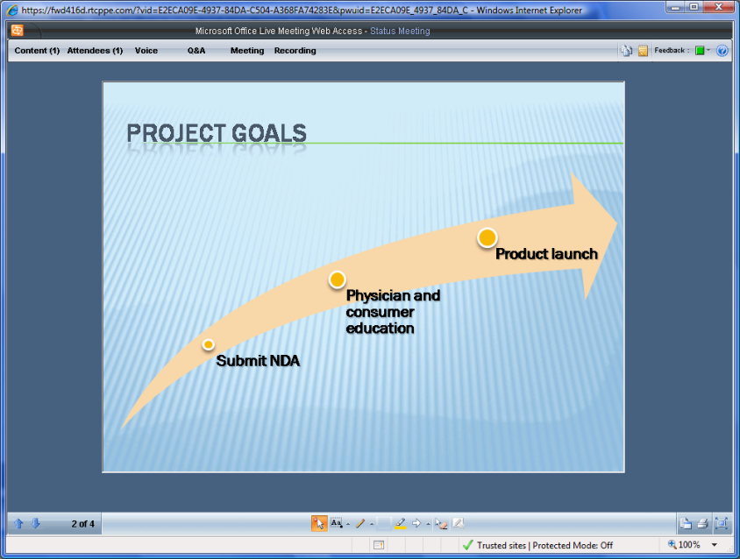
Training And Events
Connected
Organizations
Train distributed employees and partners Conduct events that support large audiences
Connected Organizations
Connected Organizations
Key Features
Event and class registration *
Surveys and public events page *
Advanced testing and grading *
Virtual breakout rooms *
Live Meeting Web Access *
^{IMPROVED}
^{NEW}
^{NEW}
^{NEW}
^{IMPROVED}
* Advanced capabilities available with Office Live Meeting 2007
Live Meeting Web Access interface
Notes:
Training and Events and events with LM2007 scenario:
Sam, a marketing manager responsible for training the sales field on new company products and campaigns, organizes an internal training event for the 500-strong sales force (max. meeting size is 1250 attendees) using LiveMeeting.
Sam sets up a public events page (new) and defines an attendee survey (new) covering the attendee preferences for training sessions. He sends an email to an internal email alias and includes the URL of the registration page . One by one, sales representatives sign up for the training event. Each attendee receives a confirmation email and an Outlook calendar item. Sam tracks registrations using the registration dashboard and reports (new). When Sam has to change the date of the event, all registered attendees receive an update email with new information (improved).
A sizable portion of attendees join the training event using the web client (improved: UI design follows the windows client’s design) – staffers with locked-down PCs, and several MacOS users.
Sam divides the attendees into two groups to discuss sub-topics and launches Virtual Breakouts (new). Each group gains its own environment for whiteboarding and sharing content, including a dedicated PSTN audio sub-conference (new) At the end of the breakouts Sam brings everybody back to the main room.

Slide 10
Connected Organizations
demo

Slide 11
Engaged Attendees

Slide 12
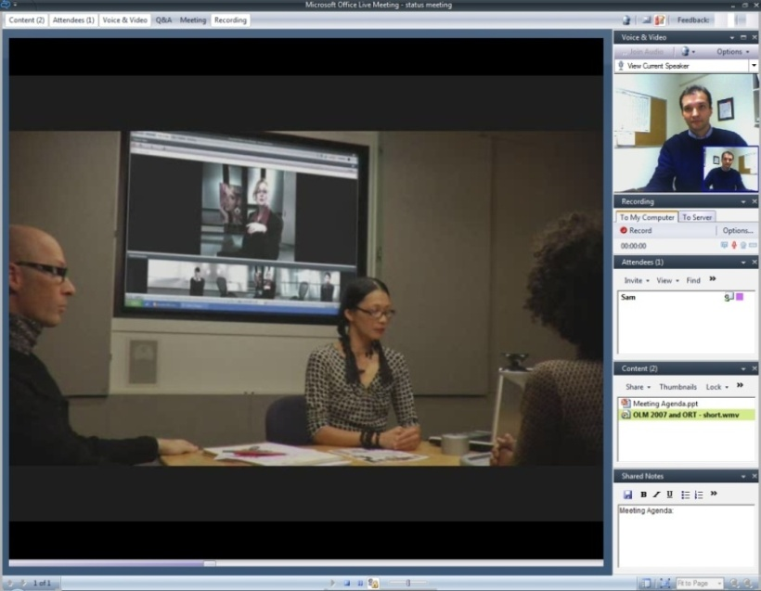
Integrated Media
Engaged
Attendees
Enable immersive remote conferencing
Engaged Attendees
Key Features
Rich media (Flash, movies)
Webcam and RoundTable video
VoIP audio and ACP call controls
PSTN and VoIP bridging *
Handouts in native format
High-fidelity recordings
^{NEW}
^{NEW}
^{NEW}
^{NEW}
^{IMPROVED}
^{IMPROVED}
* PSTN & VoIP Bridging available with Office Live Meeting 2007
Rich media, Webcam video, and VoIP integration
Notes:
Integrated Media with LiveMeeting 2007 Scenario:
Donna, an architect working on designs for a new condominium, invites several representatives of the property owner and the construction company to discuss the latest changes to building’s exterior. To speed up approvals, Donna uses Live Meeting to connect with the remote representatives.
While on location, Donna recorded a short video clip with her camera phone, which she shares with her attendees using Live Meeting (new: Rich media).
She also distributes new building plans in their native CAD format, a revised location map and costing estimate spreadsheet (new: Handouts in native format)
Everyone on the call is using a web camera (new: Webcam and RoundTable video), making the distance between the attendees seem smaller.
Most attendees use VoIP computer audio for their audio experience (new: VoIP Audio), but to accommodate the two colleagues who are stuck at an airport waiting for their plane, Danny provides a PSTN telephone number to call in. Live Meeting supports mixing of PSTN and VoIP audio in the same meeting (new: PSTN and VoIP bridging)
Sam asks the trainers-presenters to record their Live Meeting sessions. These high-fidelity recordings (new: new multimedia content types are now supported in recordings; recording quality is improved) will be available after the event for reference and to scale the training effort to subsidiaries and new employees.

Slide 13
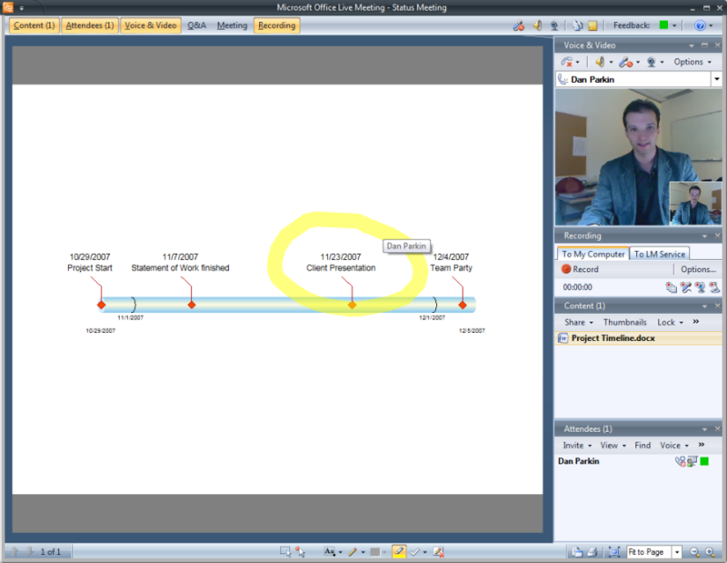
More Interactive Meetings
Engaged
Attendees
Two-way, multi-party video and audio experience
Engaged Attendees
Key Features
Application and desktop sharing
Two-way multi-party VoIP audio
Multi-party video
Active speaker video switching
Interactive whiteboard
Polls and mood indicators
^{NEW}
^{NEW}
^{NEW}
^{IMPROVED}
Whiteboard and webcam video
Notes:
More Interactive Meetings with LiveMeeting 2007 Scenario:
Paul is conducting a review session with his team and shares the Customer Proposal document with everyone online. He opens the document in Word and uses Application Sharing to stream the image of his desktop to all meeting participants.
Paul set up two-way multi-party VoIP as his audio choice for the meeting. Everyone is using webcams for multi-party video experience.
Paul wants to keep attendees engaged while making sure that he’s still in control of his meeting – the structured feedback tools provided by Live Meeting are giving him just that. Attendees send in their questions in background using the Q&A tool, or “raise their hands” to request permission to interrupt the presenter with a verbal question (new).

Slide 14
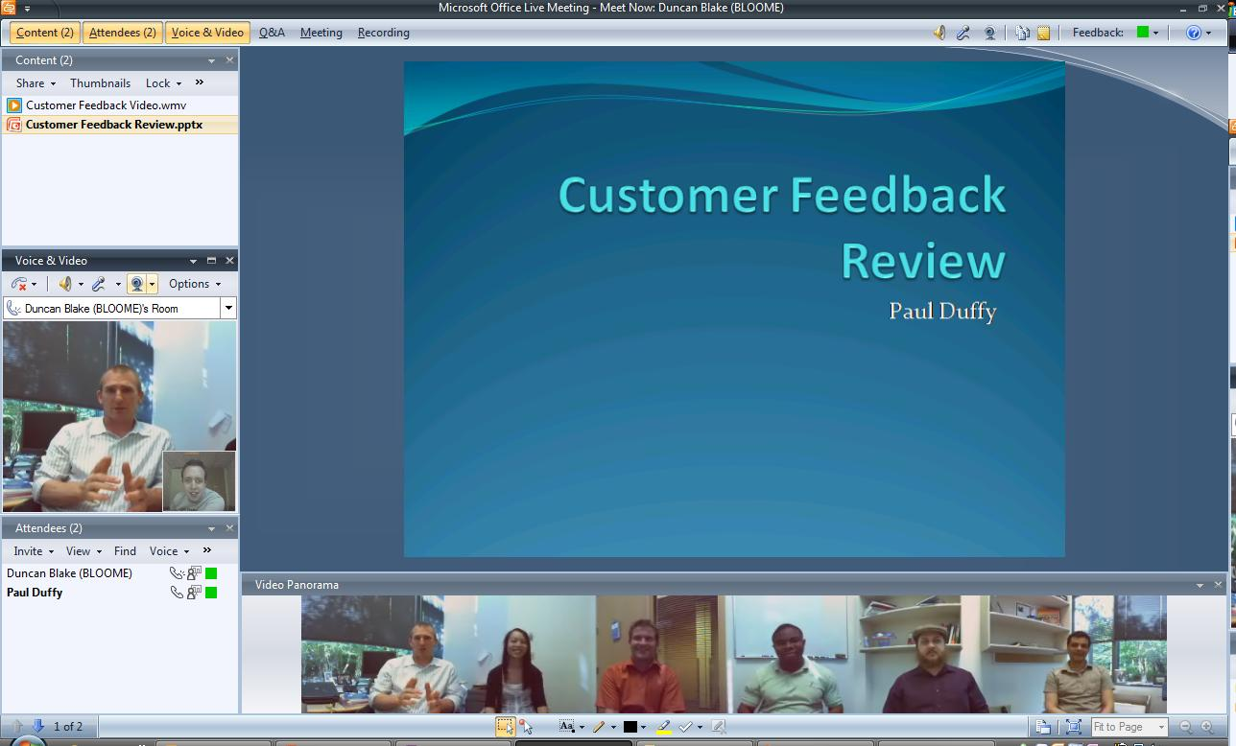

Microsoft RoundTable Panoramic Video
Engaged
Attendees
Enable immersive remote conferencing
Engaged Attendees
Key Features
360-degree panoramic video
Active speaker video switching
Quality of experience
Easy to use
PSTN speakerphone
Integrated with Live Meeting client
Key Features
^{NEW}
360-degree panoramic video
Active speaker video switching
Quality of experience
Easy to use
PSTN speakerphone
Integrated with Live Meeting client
Panoramic video by RoundTable
Notes:
RoundTable Panoramic Video
Danny, an engineering lead at a mid-size manufacturing firm, holds a standing Friday status meeting for his 30-person distributed team. The company has invested in Microsoft conferencing technology, including the RoundTable conferencing device (new).
At the appointed time several remote teams assemble in RoundTable-enabled conference rooms.
RoundTable is easy to setup and connect. It's plug-and-play, with no external drivers required, and it's fully integrated with the Live Meeting 2007 client. To set up the RoundTable, Danny just needs to plug it in the USB port of her laptop. The customer project owner does the same on his end.
Because of the 360-degree panoramic video delivered by RoundTable both teams can now see each other and benefit from a more immersive virtual meeting experience, including visual cues and body language which previously got lost in audio-conferencing conferences.
Because of the size of the team, the active-speaker video switching (new) comes very handy – only one person is shown at a time, saving screen real estate for the content that is being presented and causing less distraction (Note: active-speaker switching involves only attendees who use VoIP audio).
To deliver the quality of experience RoundTable incorporates echo cancellation and automatic gain control. RoundTable can also work as a traditional PSTN speakerphone.

Slide 15
Engaged Attendees
demo

Slide 16
Conferencing Software + Service Choice

Slide 17



Conferencing Choice with 2007 Releases Choice of server or service with a common user experience
Scenarios
Training
Events
Extend with Live Meeting for training and events
Collaborative Meetings
Control information flow and solution delivery
Free up IT resources
Notes:
It fundamentally comes down to a customer choice about how they want to use our software
- Customers see value in a service if they want to free up their IT resources to focus on other important projects
- Customers see value in a server if they want to take control of the information and delivery of the solution – the simplest case being a customer that has a corporate or industry compliance requirement for keeping data and meeting information inside their firewall
2. The one other high level factor to consider is for customers interested in using an on-premise solution that need to use some of the features that are not currently offered with OCS. For these customers it may make sense to extend their OCS solution with some licenses for users that need to conduct trainings or events.
The next slide will give you a better sense of the feature breakdown
In terms of other meeting products from MSFT:
NetMeeting: NetMeeting has not shipped as an independent feature since 2000. There will be no future versions of NetMeeting and Microsoft does not recommend that customers invest in new deployments of NetMeeting.
Windows Meeting Space: Optimized for the Face to Face collaboration experience (the hotel lobby or team meeting ) on LAN and ad-hoc Wi-Fi networks. Allows groups to form a shared, common session for up to 10 people in the same room.
****************
Primary is OCS, support with LiveMeeting
- Feature need. Server is primary conferencing platform but need additional features in the service (see feature chart)
- Gradual rollout to server. Start with a service and over time have a controlled rollout based on your schedule and when your IT skilled
Flexible meeting capacity. Server is primary conferencing platform but augment with a hosted service to quickly scale to meet demands of larger meetings
Meeting configurations with external attendees. Use service to provide for meetings that include both internal and external attendees to eliminate need for setting up server inside DMZ.
Primary is LiveMeeting, support with OCS
Compliance requirements. Service is primary conferencing platform, but use server conferencing for meetings where it’s important to control content for company and industry regulations

Slide 18
Conferencing Features
Conferencing
Choice
 | OCS 2007 | Live Meeting 2007
Editions | Enterprise | Standard | Professional
Meeting Attendee Capacity | 250 | 15 | 1250
Storage Days |  | 90 | 365
Pre-meeting Handouts NEW |  |  | √
Advanced Testing/Grading NEW |  |  | √
Virtual Breakout Rooms NEW |  |  | √
Registration IMPROVED |  |  | √
Shared Recordings IMPROVED |  |  | √
Live Meeting Web Access IMPROVED |  | √ | √
End user support |  | √ | √
Account Management (LM Manager) |  | √ | √
Reporting | Some | √ | √
Client (Windows-based) IMPROVED | √ | √ | √
Two-way VoIP audio NEW | √ | √ | √
Audio bridge integration | √ | √ | √
Video (Webcam & Roundtable) NEW | √ | √ | √
Application Sharing | √ | √ | √
In-meeting File Transfer NEW | √ | √ | √
Rich Media Presentations NEW | √ | √ | √
Scheduling Add-In for Outlook | √ | √ | √
Enable Personal Recordings NEW | √ | √ | √
Training
Events
Collaborative Meetings
Notes:
Key feature differences between Office Communication Server 2007 and Live Meeting 2007 to point out
Meeting size – LM allows bigger
Storage – LM has
Shared recordings, registration, virtual breakout rooms, testing/grading, pre-meeting handouts, account management, reporting
Web client – LM has
Support – LM provides in-meeting support
Audio bridge – LM comes with 4 ACP partners

Slide 19
Choosing The Right Mix
Conferencing
Choice
Decision Criteria | Best Solution
 | OCS 2007 | OLM 2007
Information Control Have corporate requirements to keep data behind the firewall? | √
Unified Implementation Are already implementing OCS 2007 for IM, Presence, Voice? | √
Established IT department Have an established IT department to deploy and operate? | √
Meeting size Need to support meetings with more than 250 attendees? |  | √
Training and event needs Need to conduct training or events? |  | √
External Attendees Do not want to deploy a secure extranet? IT department does not want to support external attendees? |  | √
+
Control information flow and solution delivery with OCS 2007
Extend with OLM 2007 service for training and events
Notes:
Primary is OCS, support with LiveMeeting
- Feature need. Server is primary conferencing platform but need additional features in the service (see feature chart)
- Gradual rollout to server. Start with a service and over time have a controlled rollout based on your schedule and when your IT skilled
Flexible meeting capacity. Server is primary conferencing platform but augment with a hosted service to quickly scale to meet demands of larger meetings
Meeting configurations with external attendees. Use service to provide for meetings that include both internal and external attendees to eliminate need for setting up server inside DMZ.
Primary is LiveMeeting, support with OCS
Compliance requirements. Service is primary conferencing platform, but use server conferencing for meetings where it’s important to control content for company and industry regulations

Slide 20

Live Meeting And OCS 2007 Requirements
Conferencing
Choice
Client
Deploy client and Office Outlook Add-In to all users
External users auto-install the client from microsoft.com
2005 and 2007 clients can co-exist on user PCs
Deploy pool of Web Conferencing and Audio and Video MCUs
Deploy Edge Servers to enable external access
Enable firewall ports 443, 444, 8057 for external access
Configure Live Meeting service meeting option defaults
Deploy Service Portal to enable Active Directory authentication

Slide 21













Deployment Topology
Conferencing
Choice
PSTN
Live Meeting Data Centers
Virginia | California | Singapore | UK
Up-to 1,250 Attendees
LM Web Access
Mac, UNIX, Windows
PSTN
Gateway
Recordings
Meeting
Content
Conferencing Servers (“MCUs”)
Internet
Virus Scanning
Corporate Data Center
Bandwidth (kbps)
Slides | 56
App. Sharing | 120
Voip | 80
Webcam | 350
RoundTable | 350
Office Communications Server
Up-to 250 Attendees
Active Directory
Edge Servers
Meeting
Content
Windows-based client
Conferencing Servers (“MCUs”)

Slide 22
RoundTable Requirements
Conferencing
Choice
Room
Maximum room size of 25 ft. x 15 ft. x 10 ft.
Connect to analog phone line for PSTN bridging
Connect to PC with Ethernet cable
Acoustics and Lighting
Use satellite microphones on tables larger than 15 x10 ft.
Use indirect fluorescent or ambient lighting
Use neutral wall coloring
Management
For configuration and software updates use
OCS 2007 Software Update Service for remote devices
RoundTable Device Management Tool for local devices
Notes:
Management:
Two options for managing RoundTable devices
OCS 2007 Software Update Service: an Add-on to OCS 2007; Has a Web-based configuration UI
RT Device Management Tool: a command-line tool with an Office InfoPath form UI
-

Slide 23
Key Takeaways In this session you learned about…
Microsoft’s Web Conferencing offerings
Capabilities of Microsoft’s Web Conferencing products
Evaluation criteria for on-premise, hosted, or hybrid deployments
Conferencing system requirements

Slide 24
Q&A

Slide 25
Resources
Sign up for Office Live Meeting Trial
www.livemeeting.com/trial/
View Office Live Meeting demo videos
http://www.microsoft.com/uc/products/livehosted.mspx
Visit the OCS 2007 Tech Center
http://technet.microsoft.com
Notes:
9/6/2007 8:27 AM
© 2005 Microsoft Corporation. All rights reserved.
This presentation is for informational purposes only. Microsoft makes no warranties, express or implied, in this summary.
25

Slide 26
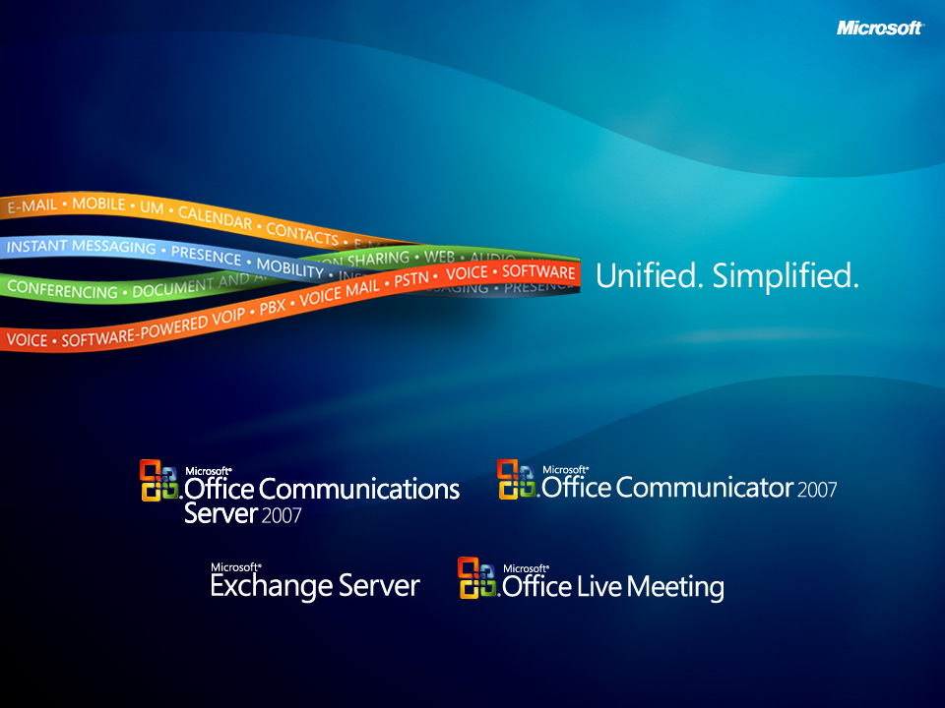

Slide 27

© 2007 Microsoft Corporation. All rights reserved. Microsoft, Windows, Windows Vista and other product names are or may be registered trademarks and/or trademarks in the U.S. and/or other countries.
The information herein is for informational purposes only and represents the current view of Microsoft Corporation as of the date of this presentation. Because Microsoft must respond to changing market conditions, it should not be interpreted to be a commitment on the part of Microsoft, and Microsoft cannot guarantee the accuracy of any information provided after the date of this presentation. MICROSOFT MAKES NO WARRANTIES, EXPRESS, IMPLIED OR STATUTORY, AS TO THE INFORMATION IN THIS PRESENTATION. This document may contain information related to pre-release software, which may be substantially modified before its first commercial release. Accordingly, the information may not accurately describe or reflect the software product when first commercially released.

