Slide 2
Integrating the Database into the Application Lifecycle Using
Microsoft Visual Studio Team System for Database Professionals
DEV301
Duncan Davenport

Slide 3
Session Objectives and Agenda
Microsoft Visual Studio Team System
Visual Studio Team Edition for Database Professionals
Microsoft Solutions Framework
New Roles
  Database Developer
  Database Administrator
Offline Database Development
New Workstreams
  DB Admin: Create a Database Project
  DB Dev: Implement a Database Development Task
  DB Admin: Deploy a Database Project
Process Guidance Customization

Slide 4


















Visual Studio Team System
CIO
PMO
Team Edition for Database Professionals
Expand to database teams
Manage database change
Extend team productivity and collaboration
Integrated quality
Architect
Tester
Developer
DB Pro
Project
Manager
Designer
Business
Analyst
Application
Support
Operations
4
Notes:
4
6/8/2007 7:42 AM
4
© 2005 Microsoft Corporation. All rights reserved.
This presentation is for informational purposes only. Microsoft makes no warranties, express or implied, in this summary.

Slide 5

Incorporate the Database Professional into the software lifecycle and provide them with a foundation for change management and process integration.
Change Management
  Project-Based Development
    Project Model that represents schema as objects providing a “personal sandbox” for
    offline development that lives within a Visual Studio Solution
    Team Collaboration with Work Item and Process Integration with Team Foundation Server
  Automated Change Support
    Rename Refactoring with the ability to preview pending changes prior to execution
    Comparison Tools (Schema & Data Compare) allow comparisons & synchronization
    of schema and data with design/test/production databases
    Version Control of all database objects with the ability to reverse engineer a database
    to bring it under Source Control
  Database Unit Testing
    Database Unit Testing ensures iterative changes don’t break existing functionality
    Data Generator provides Repetitive Dataset Generation for tests based on saved settings
Build / Deployment
  MSBuild Integration for Database Deployments/Builds based on Projects
  Either Create a new Database at the target location or Update an Existing Schema
5
Notes:
5
5

Slide 6

Microsoft Solutions Framework (MSF)
A highly customizable, scalable, fully integrated set of software development processes,
principles, and proven practices
Designed to deliver the type of guidance desired by the user when and where it is needed
Seamless experience with
Visual Studio 2005 Team System
for process automation and guidance

Slide 7

Process Guidance Templates
Components
Prescriptive Guidance
  Roles
  Workstreams
  Activities
  Work products
Process Enactment
  Work items
  Queries
  Reports
  Check-in policies

Slide 8
Process Guidance Templates
MSF Agile/MSF for CMMI
MSF Agile
  MSF for Agile Software Development is a scenario-driven, context-based, agile software development process that utilizes many of the ideas embodied
  in Visual Studio Team System
  9 roles, 17 workstreams, 5 work item types
MSF for CMMI
  MSF for CMMI Process Improvement provides
  rich connections to the CMMI process to help organizations quickly implement mature
  software development practices
  20 roles, 26 workstreams, 7 work item types

Slide 9








WorkItems and WorkFlow
Bugs
Quality of
Service Reqs
Test
Scenarios
Tasks
Business
Analyst
Dev Team
Change
Requests
Project
Manager
Production
Errors
Work Items are the units of
communications within the
development team
Operations

Slide 10

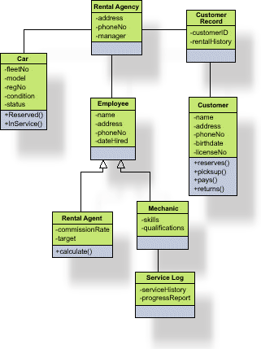

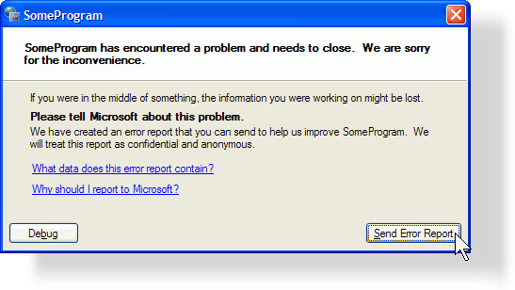
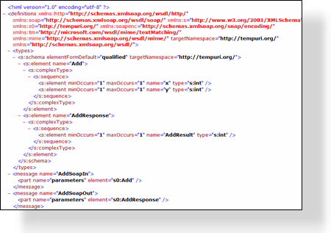




What is in a Work Item?
Proposed
Title
Description
Current State
Active
Active
Attachments
Scenario
Tasks
Bugs
Resolved
Who it is assigned to
Resolved
Links to other Work Items
Full Auditable history
Closed
Closed
Anything else you want …

Slide 11



MSF Agile: Team Model
Project Manager
Architect
Program Management
Archtecture
Business
Analyst
Developer
Product Management
Development
Team
of Peers
Database Developer
User Experience
Test
Business Analyst
Tester
Release Operations
Database Administrator
Release Manager

Slide 12
New Roles
Database Developer
  Implement all database development tasks within the
  planned time frame
  Cost estimation, supervision of feature implementation, and providing database expertise to the other developers on the team
  Participates in the iterative database development lifecycle,
  along with the database administrator and the application development team members
Database Administrator
  For database development, support the…
    Creation of database projects
    Deployment of database project changes to production
  In addition to the database administrator’s traditional role of performing day-to-day administration and maintenance
  of database servers

Slide 13
New Work Streams
Create a Database Project
Implement a Database Development Task
Deploy a Database Project

Slide 14

MSF Agile:
Exploring the Process Guidance
demo

Slide 15




Conceptual Overview
Production Database
Management Studio
Difficult to manage
change to the schema
Production database
is “one version of
the truth” for data
and schema”
DBA doesn’t have
access to changes until he/she has
deploy or reject choice
Changes often made to production database
and not rolled back into test
Tuning
Monitoring
Schema Changes
Schema
“One Version of the Truth” for Data and Schema
15
Notes:
15

Slide 16





Conceptual Overview
Production Database
Management Studio
Schema change now managed in
Visual Studio Team System
and Team Foundation Server
Production Database is now
“one version of the truth” only for data
DBA does have access to changes
before he/she has deploy or reject choice
“One version of the truth” for schema
is under source control
Tuning
Monitoring
“One Version of the Truth” for Data
“One Version of the Truth” for Schema
Changes can be rolled out in a scheduled & managed way
Scripts allow administrators to manage change updates
Offline
Under Source Control
Schema
Schema Changes
16
Notes:
16

Slide 17



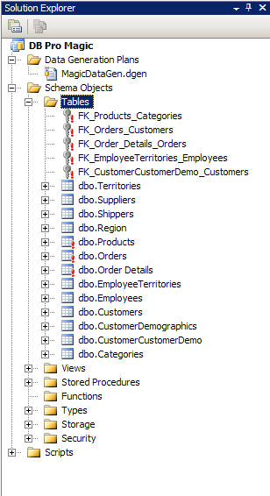


Offline Development
Production Database
Create table AUCTION
( id int not null,
title varchar(25) not null,
startDate DateTime not null,
length in not null)
Test Database

Slide 18

Create a Database Project
Key activities
Create Database Project
Import Existing Database
Configure Build & Deploy Settings
Modify Generated Pre\Post Deployment Scripts
Verify Database Project
Add Database Project to Source Control

Slide 19


Create a Database Project
Database Administrator
SCM
Check in to
Source Control
DB Dev
DB Admin
Database
Project
Production
Database
Import schema

Slide 20
Create a Database Project
Database Project Wizard
Microsoft SQL Server 2000 & SQL Server 2005 Database Project Wizards
Guide you through the entire database project creation workstream
Ease initial project setup

Slide 21
DBAdmin:
Create a Database Project
demo

Slide 22

Implement a Database Development Task
Key activities
Cost a Database Development Task
Update Local Project Environment
    Build \ Deploy to local sandbox server
Write Code for a Database Development Task
    Build \ Deploy…
Perform a Database Unit Test
Refactor Database Code
    Build \ Deploy \ Run tests…
Review Database Code
    Build \ Deploy \ Run tests…
Integrate Database Code Changes
    Build \ Deploy \ Run tests…

Slide 23


Isolated Iterative Development
Sync
Check-out
Edit/Refactor
Test
Check-in
Sand
box
Sand
box
SCM
Work is being driven and
tracked
via work items
Sand
box
Sand
box
DB Dev
DB Admin
Production
Database

Slide 24
DB Dev:
Implement a DB Development Task
demo

Slide 25

Deploy a Database Project
Key activities
Synchronize Database Project
Verify Build
Perform Database Unit Tests
Analyze Changes
Create Build Script
Back Up Target Database
Deploy Database to Staging Server (Optional)
Deploy Database

Slide 26

Conceptual Overview
SCM
Sync from Label
DBDev
DBA
Verify
Staging
Database
Build
SQL
Deploy
Script
Refine deploy script
Database
Project
Deploy
Production
Database

Slide 27
DBAdmin:
Deploy a Database Project
demo

Slide 28

Process Guidance Customization
Prescriptive Guidance
Extend or create new process guidance
  Customize Process Guidance for
  a specific methodology
    MSF Agile, MSF for CMMI
    Scrum
    SOX, ISO9000, PRINCE2
    Iterative Agile DB Development
  Customize roles, workstreams, activities, work products
Download Process Guidance Template from http://msdn.microsoft.com/msf
Many partners have built templates already
Notes:
6/8/2007 7:42 AM
28
©2005 Microsoft Corporation. All rights reserved.
This presentation is for informational purposes only. Microsoft makes no warranties, express or implied, in this summary.

Slide 29
Process Guidance Customization
Prescriptive Guidance
Download Process Guidance From MSF
Modify Process Guidance using InfoPath
Compile Process Guidance with MSFWinBuild
Upload new Process Guidance to Team Server
Notes:
6/8/2007 7:42 AM
29
©2005 Microsoft Corporation. All rights reserved.
This presentation is for informational purposes only. Microsoft makes no warranties, express or implied, in this summary.

Slide 30
Process Template Customization
Work Items \ Queries \ Reports
Process Template can be downloaded from MSF site, or downloaded from Team Foundation Server
Work Items
  Introduce new work items types or add database-specific fields into existing work items types
Queries
  Generate specific queries for database
  professionals utilizing new work items \ fields
Reports
  Generate trend reports useful for
  database professionals
Notes:
6/8/2007 7:42 AM
30
©2005 Microsoft Corporation. All rights reserved.
This presentation is for informational purposes only. Microsoft makes no warranties, express or implied, in this summary.

Slide 31
Process Template Customization
Work Items \ Queries \ Reports
Download Process Template from MSF
Download Process Template from Team Server
Modify Process Template with XML Editor
Modify Process Template with Team System Process Editor
Upload changes to Team Server
Notes:
6/8/2007 7:42 AM
31
©2005 Microsoft Corporation. All rights reserved.
This presentation is for informational purposes only. Microsoft makes no warranties, express or implied, in this summary.

Slide 32
Database Development Lifecycle
Wrap-up
Database development lifecycle
is enabled through
  Enhanced database development tools
    Visual Studio Team Edition for Database Professionals
  Improved process guidance incorporating
  the database professional
    Updated MSF Agile \ CMMI Process Guidance Templates
Isolated offline database development is
the key enabler of iterative development
and risk mitigation

Slide 33
Availability
MSF Process Guidance \ Visual Studio Team System Database Edition
MSF Process Guidance
  Process Templates ship with Visual Studio
  Team Foundation Server
  Updated process guidance – Web download
Visual Studio Team System Database Edition
  Download and Add to VSTS 2005
  Included in Visual Studio 2008 Team Suite
33
Notes:
33

Slide 34
Related Content
DAT317 Database Schema Versioning: How to Use Microsoft Visual Studio Team System for Database Professionals and Team Foundation Server to Version and Deploy Your Databases
Monday, June 4 10:30 AM - 11:45 AM, S310 E
DEV301 Integrating the Database into the Application Lifecycle Using Microsoft Visual Studio Team System for Database Professionals
Friday, June 8 2:45 PM - 4:00 PM, S210 E
  DEV04-HOL – Getting Started with Microsoft Visual Studio Team Edition for Database Professionals
  DEV05-HOL – Integrating the Software Development Lifecycle with Microsoft Visual Studio Team Edition for Database Professionals
  DEV06-HOL – Comparing Database Schemas and Deploying Changes with Microsoft Visual Studio Team Edition for Database Professionals
  DEV07-HOL – Managing Change with Microsoft Visual Studio Team Edition for Database Professionals
Notes:
6/8/2007 7:42 AM
© 2005 Microsoft Corporation. All rights reserved.
This presentation is for informational purposes only. Microsoft makes no warranties, express or implied, in this summary.
34

Slide 35
Resources
Product Website
http://msdn.microsoft.com/vstudio/teamsystem/products/dbpro/default.aspx
Microsoft Solutions Framework
http://www.microsoft.com/msf
Team Foundation Server Power Tools
http://go.microsoft.com/?linkid=542249
Product MSDN Forums http://forums.microsoft.com/MSDN/ShowForum.aspx?ForumID=725&SiteID=1
Blogs
http://blogs.msdn.com/gertd
http:// blogs.msdn.com/duncand

Slide 36
Resources
Technical Communities, Webcasts, Blogs, Chats & User Groups
http://www.microsoft.com/communities/default.mspx
Microsoft Learning and Certification
http://www.microsoft.com/learning/default.mspx
Microsoft Developer Network (MSDN) & TechNet
http://microsoft.com/msdn
http://microsoft.com/technet
Trial Software and Virtual Labs
http://www.microsoft.com/technet/downloads/trials/default.mspx

Slide 37
Q&A

Slide 38
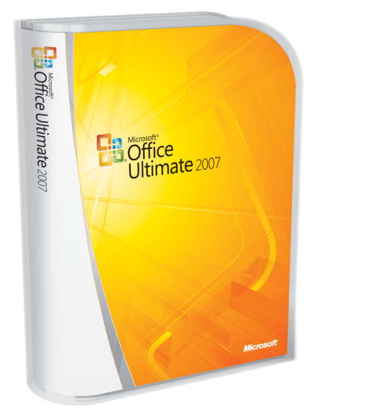





Complete an evaluation on CommNet and
enter to win!

Slide 39

Resources
Monday
A Lap Around Microsoft Visual Studio 2008 (Session repeats on 6/8) 10:30
Overview of Microsoft Visual Studio 2008 for Devices and .NET Compact Framework 3.5 4:45
Tuesday
The .NET Language Integrated Query (LINQ) Framework 8:30
LINQ and XML for the Microsoft Visual Basic Developer 10:15
Building Smart Client Applications in Microsoft Visual Studio 2008 10:15
Building a Complete Web Application Using ASP.NET "Orcas" and Microsoft Visual Studio 2008 (Two parts) 10:15 and 1
Microsoft Visual C#: Tips and Tricks for the Microsoft Visual Studio 2008 IDE 1:00
Microsoft Visual Basic: Tips and Tricks for the Microsoft Visual Studio 2008 IDE 2:45
Building Microsoft Windows Presentation Foundation Applications with Microsoft Visual Studio 2008 and
Microsoft Expression Blend 4:30
Wednesday
Building Microsoft Windows Communication Foundation and Windows Workflow Foundation Applications with
Microsoft Visual Studio 2008 5:30
Thursday
Microsoft Visual C# Under the Covers: An In-Depth Look at C# 3.0 8:00
Friday
Using the .NET Language Integrated Query (LINQ) Framework with Relational Data 9:00
A Lap Around Microsoft Visual Studio 2008 (Repeated from 6/4) 1:00
What's New in Microsoft Visual Studio Team System for Testers, New Features in Visual Studio 2008 and Best Practices for Testing AJAX, SharePoint, and Reporting Services 1:00

Slide 40

Resources
Monday:
A Lap Around Silverlight 4:45
Thursday:
Enhancing ASP.NET AJAX Applications with Silverlight 8:00
Silverlight Tips and Tricks 4:30
Friday:
Creating and Delivering Rich Media and Video on the Web with Silverlight, Expression Studio, and
Windows Server 2008 9:00
Building Rich Internet Applications with Silverlight 1:00
Building Interactive Media Experiences with Silverlight 2:45
Links:
Scott Guthrie on Channel 9 - http://channel9.msdn.com/showpost.aspx?postid=304508
Silverlight Developer Center - http://msdn2.microsoft.com/en-us/silverlight/default.aspx
Silverlight Alpha 1.1 SDK - http://msdn.microsoft.com/vstudio/eula.aspx?id=c8bf88e7-841c-43fd-c63d-379943617f36

