Slide 1

2008
Overview

Slide 2








The Complexity Challenge
“In our company, each department has produced their own systems.”
“Complexity is just natural,
a characteristic of IT — it’s complicated.
And complicated is not necessarily bad.”
“We're a large company, and we have everything. Sun environments, Unix, Microsoft servers, and IBM mainframes.”
“…hardware, software, systems,
and databases. They all have
to cooperate together.”
“We want to control costs and create a seamless environment, so we're trying to align the processes and systems.”
“You cannot reduce IT complexity, you can only make it more manageable.
IT is complex.”

Slide 3



Visual Studio 2008
Improves
Developer
Productivity
Better
Collaboration
Across the
Lifecycle
Employ the
Latest
Technologies

Slide 4


Rejuvenating the Developer
LINQ with data
Service-oriented-Architect (SOA )Services
Web Workflow
Developer Challenges
Improved Productivity
Decreased Complexity
Better Application Quality
Deliver Workflow
Consume Services
Simplify Mobility
Better Deployment
Client Services
Enhanced Quality

Slide 5







Employ the latest technologies

Slide 6



Integrate Graphic Designers
Design compelling UI
Build great application
functionality

Slide 7






















Slide 8


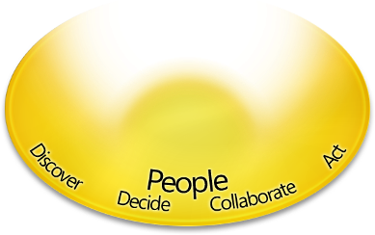








Deliver Lifecycle Collaboration
TS Data
Test Management
VSTESA
Extensions
Enterprise
Load Testing
Full Lifecycle
Management
Real-time
Project Reporting
Predictable , Visible,
Controlled Development Process

Slide 9




















Visual Studio Team System
Real Time Visibility
Team
Collaboration
Integrated Quality
Support
Guidance
Performance and Analysis Tools
Secure Applications
PAG
MSF
AJAX Web
SOA Support

Slide 10






Roadmap
Visual Studio
’10’
Visual Studio
‘Rosario’
Visual Studio 2008
RTM
1H 08
Orcas Beta
Mid 07

