Slide 1

Visual Studio 2010 和 .NET Framework 4 培训研讨会

Slide 2
演示文稿概述（隐藏幻灯片）：
技术水平：300
目标受众：开发人员和架构师
目标 （您希望受众得到哪些收获）：
理解为什么以及在什么地方使用 MEF
理解如何使用 MEF
演示文稿概述：
什么是可扩展性？
MEF 满足哪些地方？
MEF 基本内容（导入/导出/容器/目录）
MEF 中级主题
生命周期
范围

Slide 3

托管扩展性框架之旅
姓名
职务
组织
电子邮件
Notes:
ESTIMATED TIME:
60 minutes
DEMO CODE:
Use demo “IntroToMef” for all demos. There are “begin” and “end” projects for each individual demo.

Slide 4

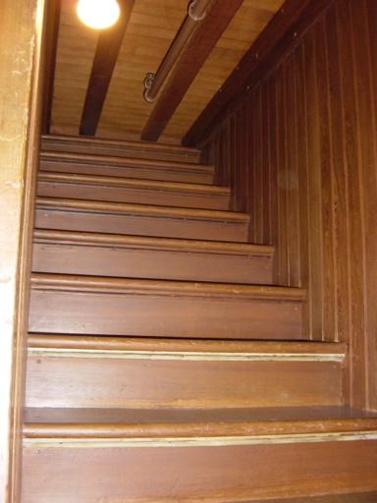

Slide 5
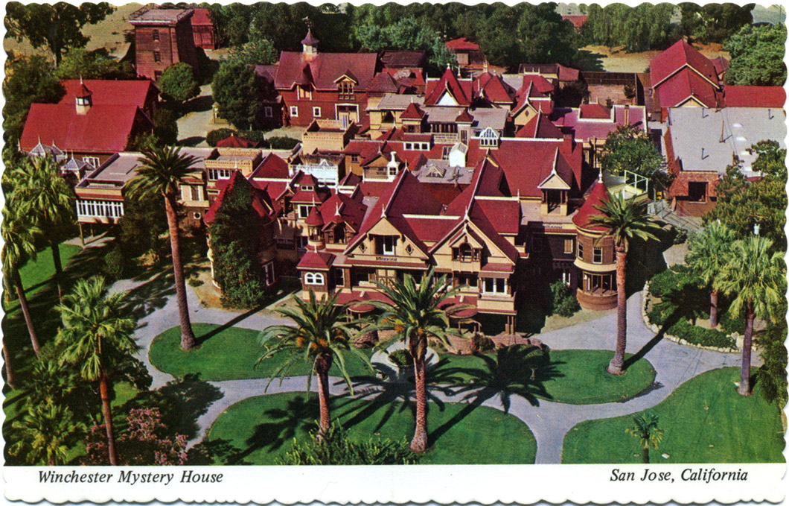
Notes:
Deeply saddened by the deaths of her daughter Annie in 1866 and her young husband in 1881, and seeking solace, Winchester consulted a medium on the advice of a psychic. According to popular history, the medium, who has become known colloquially as the "Boston Medium," told Winchester that she believed there to be a curse upon the Winchester family because the guns they made had taken so many lives. The psychic told Winchester that "thousands of people have died because of it and their spirits are now seeking deep vengeance."
Although this is disputed, popular belief holds that the Boston Medium told Winchester that she had to leave her home in New Haven and travel West, where she must "build a home for yourself and for the spirits who have fallen from this terrible weapon, too. You must never stop building the house. If you continue building, you will live forever. But if you stop, then you will die too."
Under Winchester's day-to-day guidance, its "from-the-ground-up" construction proceeded around-the-clock, without interruption, from 1884 until her death on September 5, 1922, at which time work immediately ceased.[2] The cost for such constant building has been estimated at about US $5.5 million[3] (if paid in 1922, this would be equivalent to almost $70 million in 2008 dollars).[4]

Slide 6
目标
理解可扩展性对软件的重要性
理解何时以及如何使用 MEF
与其他现有技术的关系
您的反馈

Slide 7
问题……
软件维护
原软件开发
Notes:
Nearly 80% of software development costs is in the maintenance of software.

Slide 8
托管扩展性框架？
托管扩展性框架（Managed Extensibility Framework，MEF） 是 .NET Framework 中的一个新库，支持更好的重用应用程序和组件。使用 MEF、.NET 应用程序可以从静态编译转变为动态组合
Notes:
MESSAGING:
New Library = just an assembly, a normal .dll, used by any .NET language
Dynamically Composed = composition takes place at runtime and composition behavior differs depending on how it is configured.

Slide 9

com·pose [ kəm pṓz ]
2) 将各种组件结合起来形成一个整体
MSN Encarta

Slide 10
开放/封闭原则
软件实体应该
对扩展开放，
但是对修改封闭。

Slide 11
已知
vs.
未知
Notes:
MESSAGING:
Due to it’s declarative-based and discovery-enabled approach, MEF becomes very powerful to use in an application where it is being used to put together a bunch of potentially unknown parts into a working application. You might also think about this as a 3rd party extending your application. When you are compiling your application (long before you ship), you have absolutely no idea on what sorts of extensions might be built for your application into the future. That’s the power of extensible applications, they can be extended and used in ways the original authors perhaps didn’t expect, or didn’t have the time to do themselves.
If you are concerned strictly with the “known” part of the equation (composing different software entities together that are all known at compile time), there are other solutions that are available today that are very powerful for this scenario: namely IoC containers (IoC = Inversion of Control). The Managed Extensibility Framework was designed primarily with the unknown aspect of extension in mind.

Slide 12
MEF 基本内容……
一个应用程序包含很多部件。

Slide 13
MEF 基本内容……
导出。
导入。
组合。

Slide 14
部件，进入下半场……
public class SimpleMortgageCalculator : IMortgageCalculator
{
public ILogger Logger { get; set; }
public float Calculate()
{
Logger.Log("Calculating Mortgage");
return ...;
}
}
部件
A
Notes:
MESSAGING:
So, if a MEF-aware application is built of parts, parts can be thought of as the “heart” of a MEF-aware application. Let’s take a look at a simple Part. In this case, it is a class called SimpleMortgageCalculator that has one dependency it needs satisfied, an ILogger. Let’s see how we would use MEF to declare the needs this part has in order to be composed.

Slide 15
导出……
[Export(typeof(IMortgageCalculator))]
public class SimpleMortgageCalculator : IMortgageCalculator
{
public ILogger Logger { get; set; }
public float Calculate()
{
Logger.Log("Calculating Mortgage");
return ...;
}
}
部件
A
Notes:
MESSAGING:
So, if a MEF-aware application is built of parts, parts can be thought of as the “heart” of a MEF-aware application. Let’s take a look at a simple Part. In this case, it is a class called SimpleMortgageCalculator that has one dependency it needs satisfied, an ILogger. Let’s see how we would use MEF to declare the needs this part has in order to be composed.

Slide 16
导入……
[Export(typeof(IMortgageCalculator))]
public class SimpleMortgageCalculator : IMortgageCalculator
{
[Import(typeof(ILogger))]
public ILogger Logger { get; set; }
public float Calculate()
{
Logger.Log("Calculating Mortgage");
return ...;
}
}
部件
A
Notes:
MESSAGING:
So, if a MEF-aware application is built of parts, parts can be thought of as the “heart” of a MEF-aware application. Let’s take a look at a simple Part. In this case, it is a class called SimpleMortgageCalculator that has one dependency it needs satisfied, an ILogger. Let’s see how we would use MEF to declare the needs this part has in order to be composed.

Slide 17
组合。
目录提供部件。
目录

Slide 18
组合。
容器是撮合者。
目录
Notes:
MESSAGING:
Now that we’ve declared all our Imports and Exports, how are they all matched up together? This is the job of the container. The container is the “match maker” if you will. An application will ask the configured container for an object of a given type, then the container will take care of building up the entire object graph and returning the necessary object. All of this matching is handled by the container itself, the user doesn’t have to think about it at all.

Slide 19


组合。
AggregatingCatalog
容器是撮合者。
DirectoryCatalog
目录
AssemblyCatalog
TypeCatalog

Slide 20


第 1 步 – MEF 基本内容
Notes:
DEMO:
Use “IntroToMef” Demo, _1_Begin (_1_End contains finished demo)

Slide 21
不要忘记元数据……
[Export(typeof(IMortgageCalculator))]
[ExportMetadata(“Calculation”, “Simple”)]
[ExportMetadata(“Tax Aware”, null)]
public class SimpleMortgageCalculator : IMortgageCalculator
{
public ILogger Logger { get; set; }
public float Calculate()
{
Logger.Log("Calculating Mortgage");
return ...;
}
}
部件
A

Slide 22
部件可能会延迟（Lazy）……
[Import(typeof(ILogger))]
public ILogger Logger { get; set; }
部件
A
部件
B
Notes:
MESSAGING:
Sometimes though, you may not want to import the part itself (let’s say you may only need to use it in specific situations and hence don’t want to create it in every situation, or you might want to programatically determine whether it should be imported or not). This can be done in MEF through lazy imports.
To lazily import a part, rather than having the property imported to be the type of the import directly, you can import Export<T> (where T is the type you are importing). Once you have a reference to the Export, you have direct access to information like the contract for that Export as well as any Metadata for that Export (which can then be used to query against to determine whether the import should be used or not).

Slide 23
部件可能会延迟……
[Import(typeof(ILogger))]
public ILogger Lazy<ILogger> Logger { get; set; }
部件
A
延迟
<B>
Notes:
MESSAGING:
Sometimes though, you may not want to import the part itself (let’s say you may only need to use it in specific situations and hence don’t want to create it in every situation, or you might want to programatically determine whether it should be imported or not). This can be done in MEF through lazy imports.
To lazily import a part, rather than having the property imported to be the type of the import directly, you can import Export<T> (where T is the type you are importing). Once you have a reference to the Export, you have direct access to information like the contract for that Export as well as any Metadata for that Export (which can then be used to query against to determine whether the import should be used or not).

Slide 24
第 2 步– 元数据和延迟评估
Notes:
DEMO:
Use “IntroToMef” Demo, _2_Begin (_2_End contains finished demo)

Slide 25
灾难性后果……
[Export(typeof(IMortgageCalculator))]
[ExportMetadata(“Calculation”, “Simple”)]
[ExportMetadata(“Tax Aware”, null)]
[ExportMetadata(“This”, “foo”)]
[ExportMetadata(“That”, “bar”)]
部件
A

Slide 26
灾难性后果…… 得到了解决
[Export(typeof(IMortgageCalculator))]
[ExportMetadata(“Calculation”, “Simple”)]
[ExportMetadata(“Tax Aware”, null)]
[ExportMetadata(“This”, “foo”)]
[ExportMetadata(“That”, “bar”)]
[Export(typeof(IMortgageCalculator))]
[CalcCapabilities(
Mode=Complexity.Simple,
TaxAware=true,
This=“foo”,
That=“bar”)]
部件
A

Slide 27
第 3 步 – 强类型元数据
Notes:
DEMO:
Use “IntroToMef” Demo, _3_Begin (_3_End contains finished demo)

Slide 28
上下文的重要性！

Slide 29
第 4 步 – 上下文感知
Notes:
DEMO:
Use “IntroToMef” Demo, _4_Begin (_4_End contains finished demo)

Slide 30
生命周期
共享
非共享
容器
容器
部件 A
部件B
部件B
部件B
Notes:
MESSAGING:
MEF also provides parts the capability of specifying what their lifetime behavior should be (like whether one instance of a part should be used everywhere, or whether a new instance should be created for each new request for that part). Among other things, this is enables scenarios like using MEF in a web server scenario or in a scenario where you might require a part to be isolated from other instances of the same part.
This can be specified very easily using the PartCreationPolicy attribute.

Slide 31
第 5 步 – 生命周期
Notes:
DEMO:
Use “IntroToMef” Demo, _5_

Slide 32
但是………
所谓的外部依赖关系在哪里？

Slide 33
.\Extensions
CompositionContainer

Slide 34
第 6 步 – 外部依赖关系
Notes:
DEMO:
Use “IntroToMef” Demo, _6_Begin (_6_End contains finished demo)

Slide 35
声明性的力量
什么 vs. 如何

Slide 36
System.AddIn 怎么样？
Notes:
** SCRIPT **
You’ll hear a lot in this talk about “Essence versus Ceremony.” It’s a phrase used in several language circles. What Essence versus Ceremony really boils down to is having the syntax and compiler of a language get out of your way. We’re all familiar with those moments we run into where we seemingly have to jump through hoops to express the true intentions of our code. You know, that phase where you translate what you truly mean into a form that the compiler is happy with.
Well, we want to remove those hoops, and there’s a bunch of features in both C# 4.0 and VB 10 that do just this. I’ll be emphasizing this discussion a lot throughout this talk because I feel it is a topic that developers care a lot about. And anything we can do to break down the amount of ambiguity that is introduced between the developer’s solution and the written code is A Good Thing.
So what have we done in C# 4.0 and VB 10 and why does it make developers’ lives easier?

Slide 37
IoC Containers 怎么样？
Notes:
** SCRIPT **
You’ll hear a lot in this talk about “Essence versus Ceremony.” It’s a phrase used in several language circles. What Essence versus Ceremony really boils down to is having the syntax and compiler of a language get out of your way. We’re all familiar with those moments we run into where we seemingly have to jump through hoops to express the true intentions of our code. You know, that phase where you translate what you truly mean into a form that the compiler is happy with.
Well, we want to remove those hoops, and there’s a bunch of features in both C# 4.0 and VB 10 that do just this. I’ll be emphasizing this discussion a lot throughout this talk because I feel it is a topic that developers care a lot about. And anything we can do to break down the amount of ambiguity that is introduced between the developer’s solution and the written code is A Good Thing.
So what have we done in C# 4.0 and VB 10 and why does it make developers’ lives easier?

Slide 38
Hand-Rolled Plugins 怎么样？
Notes:
** SCRIPT **
You’ll hear a lot in this talk about “Essence versus Ceremony.” It’s a phrase used in several language circles. What Essence versus Ceremony really boils down to is having the syntax and compiler of a language get out of your way. We’re all familiar with those moments we run into where we seemingly have to jump through hoops to express the true intentions of our code. You know, that phase where you translate what you truly mean into a form that the compiler is happy with.
Well, we want to remove those hoops, and there’s a bunch of features in both C# 4.0 and VB 10 that do just this. I’ll be emphasizing this discussion a lot throughout this talk because I feel it is a topic that developers care a lot about. And anything we can do to break down the amount of ambiguity that is introduced between the developer’s solution and the written code is A Good Thing.
So what have we done in C# 4.0 and VB 10 and why does it make developers’ lives easier?

Slide 39
问题……
软件维护
原软件开发
Notes:
Nearly 80% of software development costs is in the maintenance of software.

Slide 40
解决方案……
软件维护
原软件开发
Notes:
Nearly 80% of software development costs is in the maintenance of software.

Slide 41
资源
http://mef.codeplex.com
Clean Code，Robert C. Martin
Working Effectively with Legacy Code，
Michael Feathers
Refactoring，Martin Fowler

Slide 42
Notes:
Questions?

