Slide 2
Microsoft + SAP：基于商务智能的互联与集成
BAP202

Slide 3
议程
Microsoft和SAP合作历史
产品技术互联与集成
商务智能产品的互联和在Microsoft-IT的实施方案

Slide 4

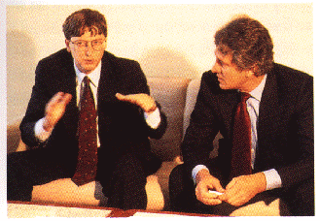

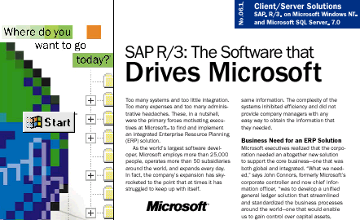



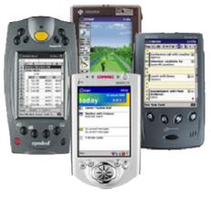






Microsoft和SAP伙伴关系
Apr 93
Apr 94
Jul 95
Aug 95
Jan 97
Oct 97
Agreement between Bill Gates and Hasso Plattner
First R/3 Release on Windows NT
Microsoft selects SAP for its global finance implementations
Microsoft SQL Server Support
Microsoft Exchange integration with R/3 3.1
Availability of the SAP DCOM Connector
Oct 99 / Feb 00
Mar 00
Feb 02
Apr 03
May 04
Oct 04- Now
Microsoft and SAP partner for mySAP.com and Windows 2000 launch
mySAP.com solutions on Pocket PC
First Customer on 64-Bit Windows
Support for Windows 2003
(32- & 64-bit)
Interoperability Agreement Announced
First Deliverables on Agreement

Slide 5



Microsoft和SAP伙伴关系
“More than any other company we work with, SAP has strong influence on our product development, and we see that growing in the future.”
– Bill Gates
“This relationship consists to 95% of partnership and 5% of competition.”
– Henning Kagermann
Microsoft公司运行SAP产品: ERP (FI, HCM), SCM, BW, APO, GTS
SAP公司运行Microsoft产品

Slide 6













SAP平台的推荐选择
% of new SAP installations on Windows and SQL Server
75%
: 60,000+ SAP Deployments
: 30,000+ SAP Deployments
50%
25%
1994
1998
2002
2008

Slide 7






Microsoft让SAP易用
通过熟悉的前端环境提高工作效率
(Duet, OBA)
驱动业务绩效 (SAP and Microsoft 商务智能)
延伸度
优化SAP后端支撑 (Windows and SQL Server)
延伸SAP解决方案 (.NET 应用)
互联互通
高效连接客户和商务流程
灵活性

Slide 8

Microsoft连接SAP和用户
依赖于超级用户
所有员工都成为SAP用户
SAP
SAP

Slide 9











MS-IT设施SAP的战略
简化管理
标准化业务流程
定义通用业务政策
标准化报表和命名规则
简化和合并系统和应用
单一SAP生产系统（Production Instance）战略
提高效率
基于Office的解决方案
自动化流程
消除纸张
和供应商电子连接
向员工提供实时数据

Slide 10
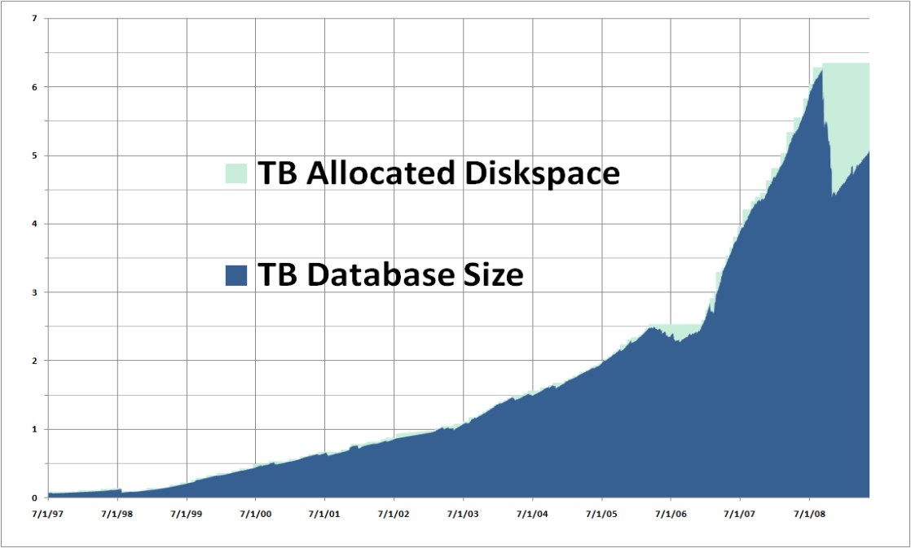
MSIT SAP ERP数据容量增长趋势

Slide 11
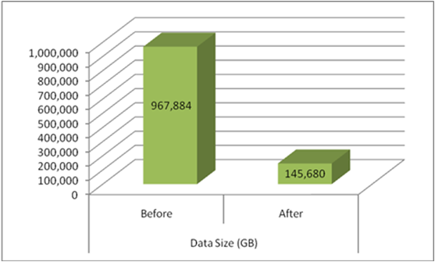
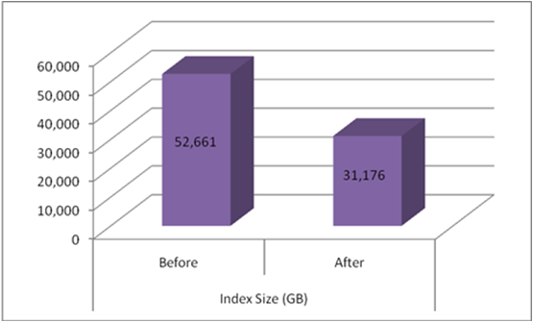
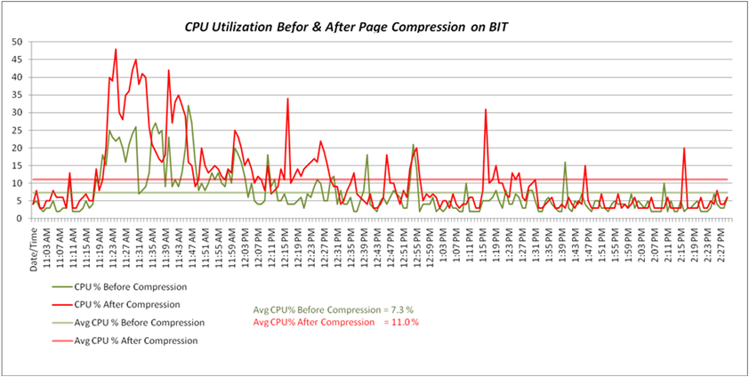
SAP BW后端的SQL Server 2008
页面级压缩

Slide 12
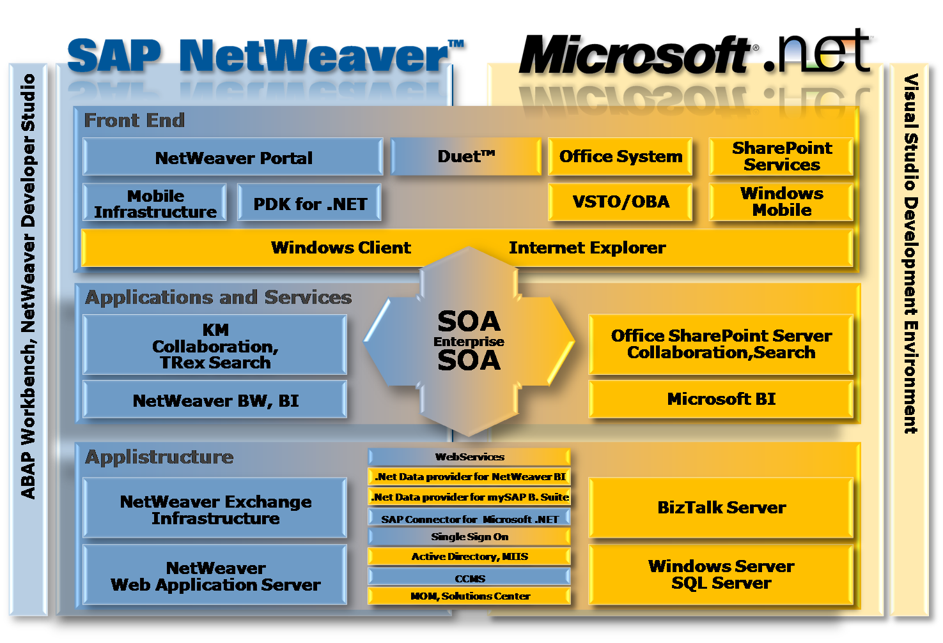




Microsoft和SAP互联
流程
员工

Slide 13

MS-SAP BI 产品互联一览
SQL Server Reporting Services
Excel
BizTalk
SQL Server Integration Services
SAP BW
Duet

Slide 14





SAP BW在MSIT的价值
和SAP ERP最佳集成和丰富的Business Content
SAP增量数据管理
完备的平台方案
ETL批处理
SAP安全管理
以配置为实施重心
全面的Unicode支持
增强ETL （通过Data Transfer Process实现）
增强的Open Hub界面
实时数据抽取（Real-time Data Acquisition）
7.0 新功能

Slide 15


BI解决方案架构
ODBO
SAP ERP
SAP BW
Excel
SharePoint Portal Server
PerformancePoint Server
Microsoft .Net Provider for SAP NetWeaver BI
SQL 2008
Reporting Services
XML/A
Open Hub
Microsoft Connector for SAP BI
SQL 2008
DW
SQL 2008
Analysis
Services
BizTalk Adapter 3.0 for mySAP Business Suite
SQL Server Integration Services
ORACLE

Slide 16

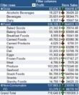

SSRS + SAP BW
.NET Data Provider for SAP BI
BW Data Store
XML/A
SSRS
特点
非执行级别的报表
接近实时的查询
特定报表
SAP认证

Slide 17









SSIS + SAP BW
SAP BW 7.0
SSIS
Open Hub
Microsoft Connector for SAP BI
SQL Server DB
SSAS
SAP BI Source
特点
构建针对SAP数据的SQL Server企业数据仓库的重要工具
SAP认证
免费：包含于SQL Server2008 Feature Pack

Slide 18
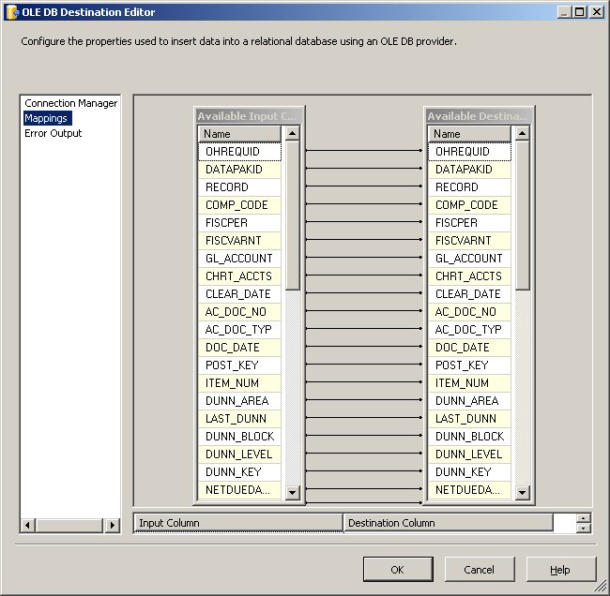
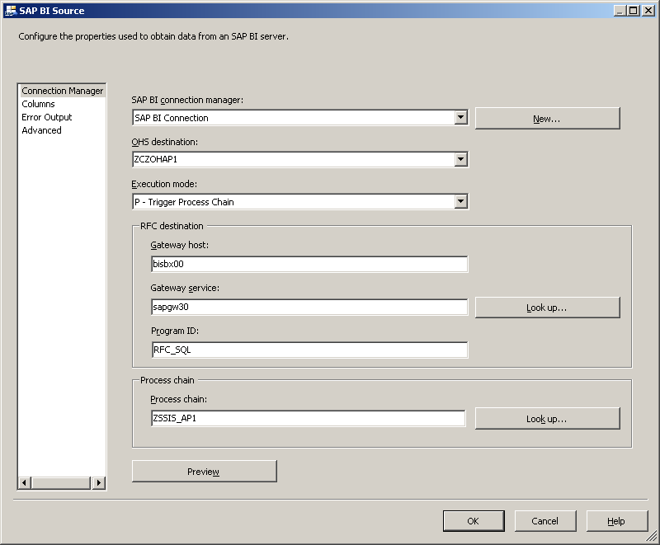
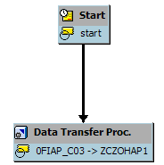
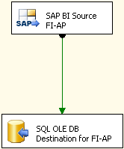
SSIS+SAP BW: 配置Connector
SAP BI Process Chain
SSIS Data Flow

Slide 19



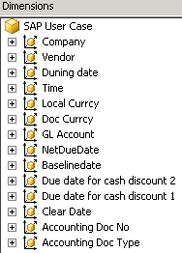
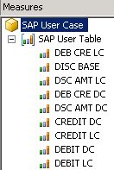
SSIS + SAP BW应用案例
SAP BI Cube
Open Hub
Microsoft Connector for SAP BI
SQL Staging Table
Dimension Processing
SSAS Cube

Slide 20

Excel + SAP BW
SAP BW OLE DB Provider
SAP BI
MDX

Slide 21

BizTalk + SAP BW
SAP BW系统信息表
案例
实时跟踪BW ETL状态信息
BizTalk SAP Adapter

Slide 22
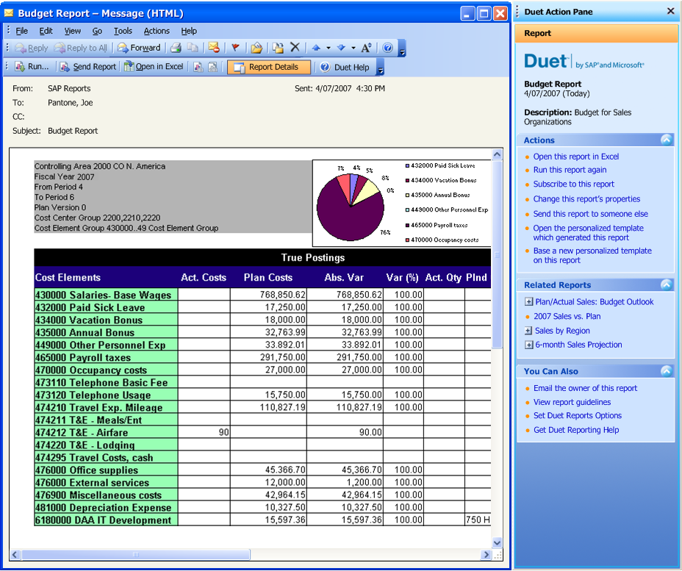



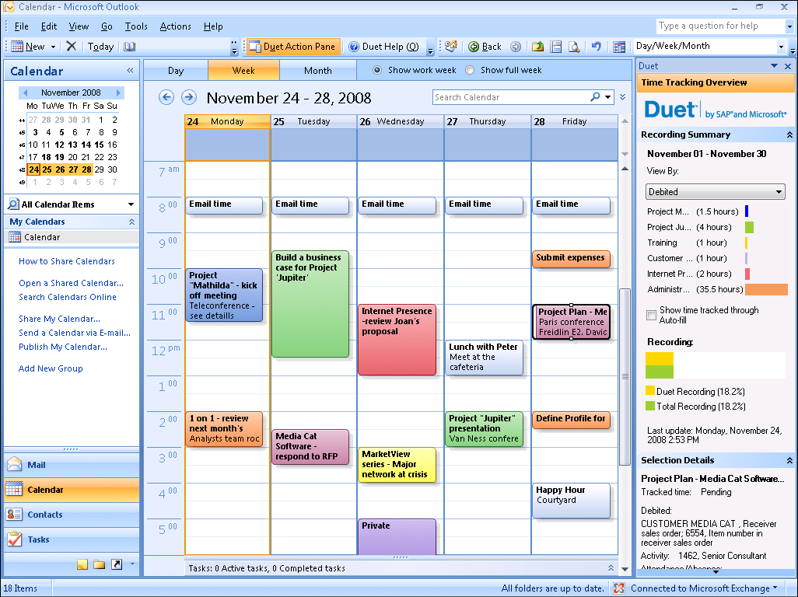








Duet + SAP BW
Budget
Monitoring
Sales
Management
Travel
Management
Leave
Management
Team
Management
Workflow
Approval
Time
Management
Reports
Analytics
Recruitment
Management
Purchasing
Management
Demand
Planning

Slide 23

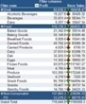









MSIT应用1: 企业数据仓库
EDW
SQL Server DB
SSRS
SSAS
Open Hub Services
Master Data
DTP
Transformation
InfoProvider
Finance
Controlling
Consolidation
Purchasing
Treasury
Data Transfer Process
Transformation
DataSource/PSA
SAP BW
InfoPackage
InfoPackage
SAP ERP

Slide 24





MSIT应用2: 企业数据集散
Business
SAP ERP
SAP BW
Staging
Accumulate
Distribution
Business
Feedstore
Business

Slide 25








MS-IT应用3: 实时报表
EDW
SSRS
Open Hub Services
DSO
Virtual Provider
PSA
SAP BW/BI 7.0
SAP ERP
Delta Queue
R/3 Data Source
R/3 Data Source

Slide 26





















总结
SAP Unicode
Simplicity
SAP
BI Unicode
SQL
用户
体验

Slide 27
参考资源
http://www.microsoft.com/sap
https://www.sdn.sap.com/irj/sdn/dotnet
https://www.sdn.sap.com/irj/sdn/windows
http://msdn.microsoft.com/en-us/library/dd299430.aspx
http://msdn.microsoft.com/en-us/library/cc974473.aspx

Slide 28
疑问和解答

