Slide 2
SQL Server 2008 虚拟化和最佳实践
DAT221

Slide 3
议程
SQL Server的整合及虚拟化
SQL Server Consolidation today
Virtualization and Hyper-V
High Availability
Live Migration
Managing consolidated environments
Upcoming SQL Server consolidation features
SQL Server在虚拟环境下的性能评估
Understanding the Overhead
Cost of Running SQL workloads in Hyper-V Environment
Consolidation Scenarios
Best practices and recommendations
A Case Study
总结

Slide 4
系统整合的趋势和因素
硬件使用率
Datacenter deployment efficiency
Power Utilization
Often hardware standardization coincides
管理效率
Fewer servers to manage and maintain
Centralized management of multiple/many servers
系统设施的灵动性
Load Balancing
降低费用，提高可用性

Slide 5
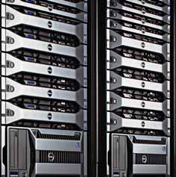
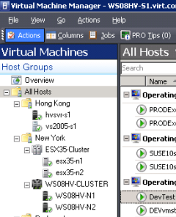

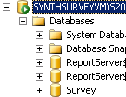
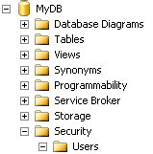
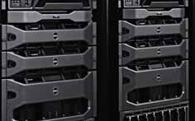


SQL Server的整合现状
多种整合策略存在并被使用
通常分离度越高，密度降低，费用增高
Virtual
Machines
Instances
Databases
Schemas
MyServer
Higher Isolation, Higher Costs
Higher Density, Lower Costs
IT Managed
Environment
Sales_1
Consolidate_1
Marketing_1
Online_Sales
ERP_10
DB_1
DB_2
ERP_10
DB_3

Slide 6
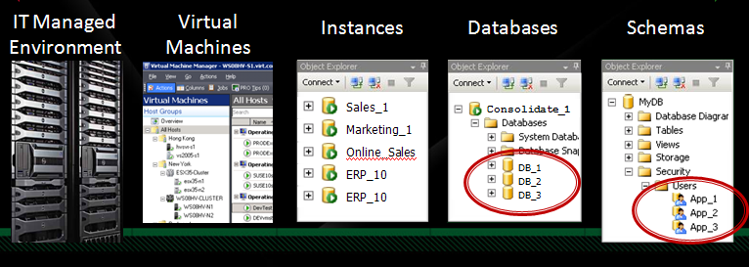
SQL Server的整合现状
Schema 层次的整合
多个数据库整合到一个数据库
Forces common security model on all applications
Typically requires changes to application and scripts
Many opportunities for subtle cross interactions
Namespace collisions and conflicts
Unexpected dependencies / performance contentions
Higher Isolation, Higher Costs
Higher Density, Lower Costs

Slide 7
SQL Server的整合现状
数据库层次的整合
多个数据库共存在同一SQL实例
Common security, manageability and compatibility models required
Might require changes to existing applications and scripts
Lower manageability costs
Better resource isolation and allocation capabilities through Resource Governor
Higher Isolation, Higher Costs
Higher Density, Lower Costs

Slide 8
SQL Server的整合现状
实例层次的整合
多个实例共享同一系统
Full schema and security isolation
Partial system resource and management isolation
Potential conflicts in namespace, resources and system roles
System Memory and CPU are typical density limiters
Higher Isolation, Higher Costs
Higher Density, Lower Costs

Slide 9
SQL Server的整合现状
虚拟机的整合
Strong isolation between applications
Ease of capturing and moving execution loads
Out of the box High Availability configuration
Flexible storage management
Fewer systems, but just as many OS images to manage
Increased resource usage
Higher Isolation, Higher Costs
Higher Density, Lower Costs

Slide 10





什么是虚拟化?
Multiple operating systems images supporting separate independent applications running simultaneously on the same computer system
Strong hardware enforced isolation between the VMs
1个物理机
Child Partition
Child Partition
Server
Child Partition
Root Partition
Server
Server
SP2 RC
Hypervisor
Devices
Processors
Memory
Hardware

Slide 11
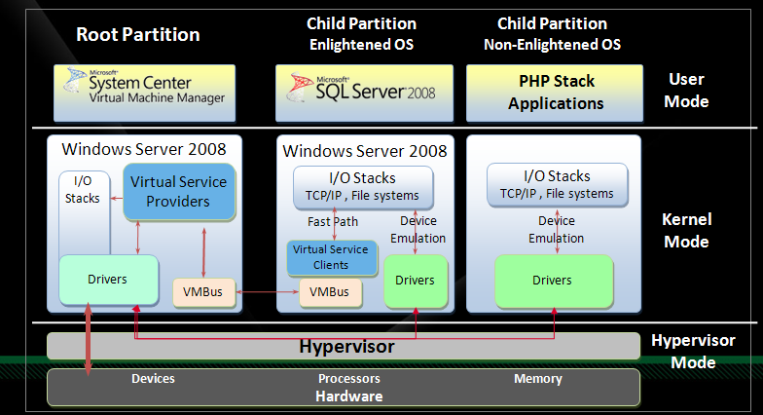
Hyper-V架构概览
The Hypervisor runs directly on the hardware
2nd generation virtualization technology in Intel VT-x with EPT and AMD –V with NPT chips accelerate VM performance
Operating systems and applications run in partitions on top of the Hypervisor
Enlightenment provides fast path which avoids device emulation
Integration services provides VSCs, VSPs and VMBus

Slide 12
SQL Server在虚拟环境的高可用性
整合对系统高度可用性有更高要求
Consolidation serves to increase cost for a single system failure
Increasing focus on planned outages vs. unplanned outages
Utilization focus increasingly puts passive HADR hardware in negative light
共享存储环境 - SANs, iSCSI, NAS,
Windows Fail-Over Clustering
Host based Clustering
Child partition based Clustering
无共享存储环境
SQL Server Mirroring
Transactional and Peer-to-Peer replication
Log Shipping
资源分离
SCVMM
SQL Server Resource Manager

Slide 13
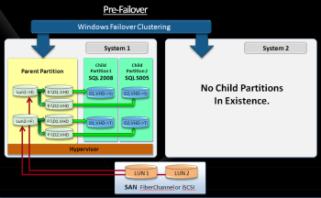
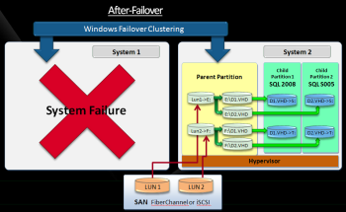
SQL Server在虚拟环境的高可用性
Windows 故障转移群集 – 宿主机故障转移群集
One complete system fails over to another system
All VMs on the source system fail over
Each VM can target different physical systems for fail-over
Each VM is re-started on fail-over target system
WFC migrates LUNs to target system(s)
Enables Live Migration in Windows 2008 R2

Slide 14
SQL Server用Hyper-V达到高可用性
宿主故障转移群集 - Partition movement, Drive routings
Pre-Failover
Windows Failover Clustering
System 1
System 2
Child
Partition 1
SQL 2008
Child
Partition 2
SQL S005
Parent Partition
No Child Partitions
In Existence.
Lun1->E:
E:\D1.VHD
D1.VHD->S:
D2.VHD->S:
E:\D2.VHD
Lun2->F:
F:\D1.VHD
D1.VHD->T:
D2.VHD->T:
F:\D2.VHD
Hypervisor
LUN 1
LUN 2
SAN FiberChannel or iSCSI

Slide 15
SQL Server用Hyper-V达到高可用性
宿主故障转移群集 - Partition movement, Drive routings
After-Failover
Windows Failover Clustering
System 1
System 2
Child
Partition 1
SQL 2008
Child
Partition 2
SQL S005
Parent Partition
Lun1->E:
E:\D1.VHD
D1.VHD->S:
D2.VHD->S:
System Failure
E:\D2.VHD
Lun2->F:
F:\D1.VHD
D1.VHD->T:
D2.VHD->T:
F:\D2.VHD
Hypervisor
LUN 1
LUN 2
SAN FiberChannel or iSCSI

Slide 16
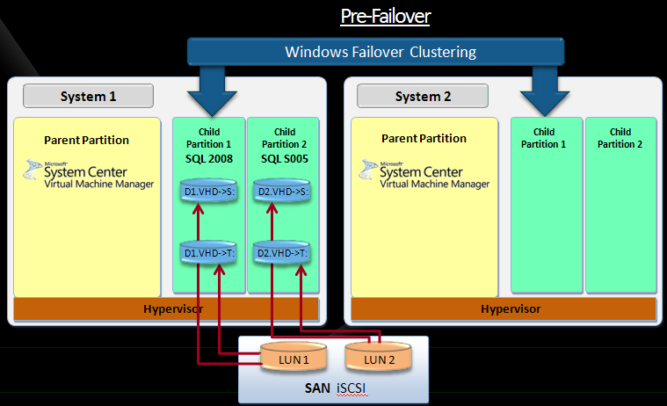
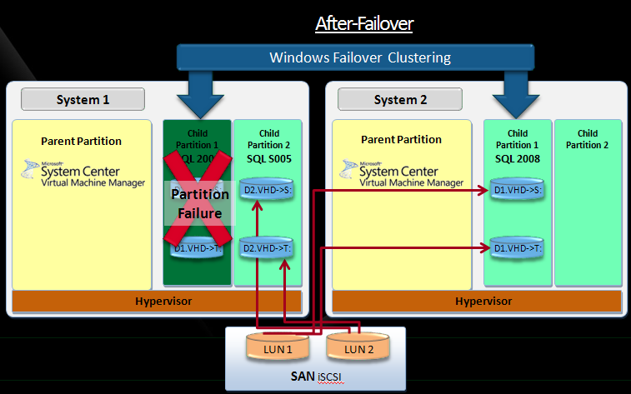
SQL Server在虚拟环境的高可用性
Windows 故障转移群集 - Guest Level Clustering
Clustering applied at the individual VM level
A single VM on the source system fails over to another VM
Each VM can target different physical systems for fail-over
WFC does not migrate LUNs to target system(s)
iSCSI typically required
Not currently supported for SQL Server

Slide 17
SQL Server用Hyper-V达到高可用性
虚拟机故障转移群集 - Partition movement, Drive routings
Pre-Failover
Windows Failover Clustering
System 1
System 2
Parent Partition
Child
Partition 1
SQL 2008
Child
Partition 2
SQL S005
Parent Partition
Child
Partition 1
Child
Partition 2
D1.VHD->S:
D2.VHD->S:
D1.VHD->T:
D2.VHD->T:
Hypervisor
Hypervisor
LUN 1
LUN 2
SAN iSCSI

Slide 18
SQL Server用Hyper-V达到高可用性
虚拟机故障转移群集- Partition movement, Drive routings
After-Failover
Windows Failover Clustering
System 1
System 2
Parent Partition
Child
Partition 1
SQL 2008
Child
Partition 2
SQL S005
Parent Partition
Child
Partition 1
SQL 2008
Child
Partition 2
Partition
Failure
D1.VHD->S:
D2.VHD->S:
D1.VHD->S:
D1.VHD->T:
D2.VHD->T:
D1.VHD->T:
Hypervisor
Hypervisor
LUN 1
LUN 2
SAN iSCSI

Slide 19
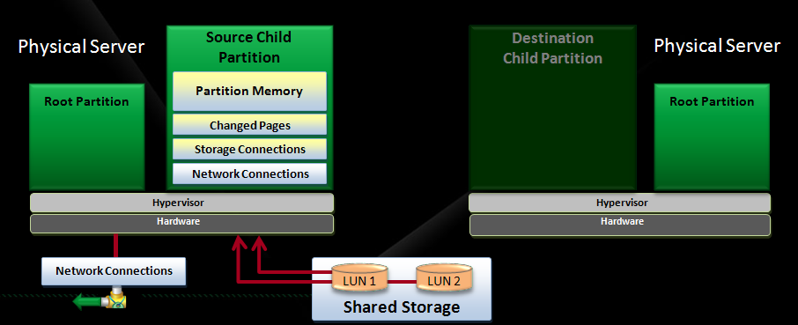
Hyper-V Live Migration
Windows 2008 R2新功能
Migrates a running VM with essentially zero down time
Actually, several seconds of downtime, but connections are maintained
Allows essentially zero down time:
Hardware maintenance
Patching and servicing of host OS
Currently does not allow zero down time;
Patching and servicing of guest OS
Patching and servicing of applications within guest VMs

Slide 20

Hyper-V Live Migration
工作机制详解
Step 1: Snapshot VM memory
Copy partition memory from source VM to Destination
Physical Server
Source Child Partition
Destination Child Partition
Physical Server
Partition Memory
Partition Memory
Root Partition
Root Partition
Changed Pages
Storage Connections
Network Connections
Hypervisor
Hypervisor
Hardware
Hardware
Network Connections
LUN 1
LUN 2
Shared Storage

Slide 21
Hyper-V Live Migration
工作机制详解
Step 2: Copy changed pages from source VM to destination
Physical Server
Source Child Partition
Destination Child Partition
Physical Server
Partition Memory
Partition Memory
Root Partition
Root Partition
Changed Pages
Changed Pages
Storage Connections
Network Connections
Hypervisor
Hypervisor
Hardware
Hardware
Network Connections
LUN 1
LUN 2
Shared Storage

Slide 22
Hyper-V Live Migration
工作机制详解
Step 3: Storage connections are migrated from the source VM to the destination VM
Physical Server
Source Child Partition
Destination Child Partition
Physical Server
Partition Memory
Partition Memory
Root Partition
Root Partition
Changed Pages
Changed Pages
Storage Connections
Storage Connections
Network Connections
Hypervisor
Hypervisor
Hardware
Hardware
Network Connections
LUN 1
LUN 2
Shared Storage

Slide 23
Hyper-V Live Migration
工作机制详解
Step 4: Network connections are migrated from source VM to destination VM
Physical Server
Source Child Partition
Destination Child Partition
Physical Server
Partition Memory
Partition Memory
Root Partition
Root Partition
Changed Pages
Changed Pages
Storage Connections
Storage Connections
Network Connections
Network Connections
Hypervisor
Hypervisor
Hardware
Hardware
LUN 1
LUN 2
Network Connections
Shared Storage

Slide 24
Hyper-V Live Migration
工作机制详解
Step 5: Destination VM is brought online,
Source VM is taken off line
Physical Server
Source Child Partition
Destination Child Partition
Physical Server
Partition Memory
Root Partition
Root Partition
Changed Pages
Storage Connections
Network Connections
Hypervisor
Hypervisor
Hardware
Hardware
LUN 1
LUN 2
Network Connections
Shared Storage

Slide 25
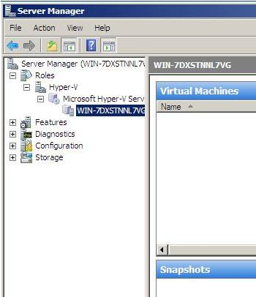
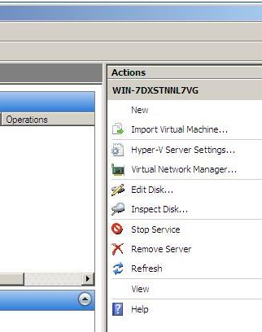
创制和管理虚拟机
Hyper-V Role in Windows 2008 Server Manager
Centralized management of Virtual Machine creation, configuration and provisioning
Provides wizards for creation and provisioning of VMs and devices
Provides tools for creation and provisioning of Virtual Hard Drives (VHDs)
Limited import capabilities

Slide 26
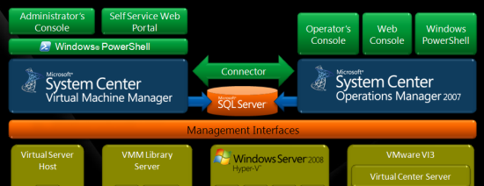
System Center VM Manager 2008
Physical-to-Virtual and Virtual-to-Virtual image creation
In place physical systems can be provisioned to VMs
VMWare VMs can be translated to Hyper-V
Rapid Virtual Machine Provisioning
Virtual Machine library
Multi-machine management across system and VMs
PRO - Performance and Resource Optimization and automation

Slide 27
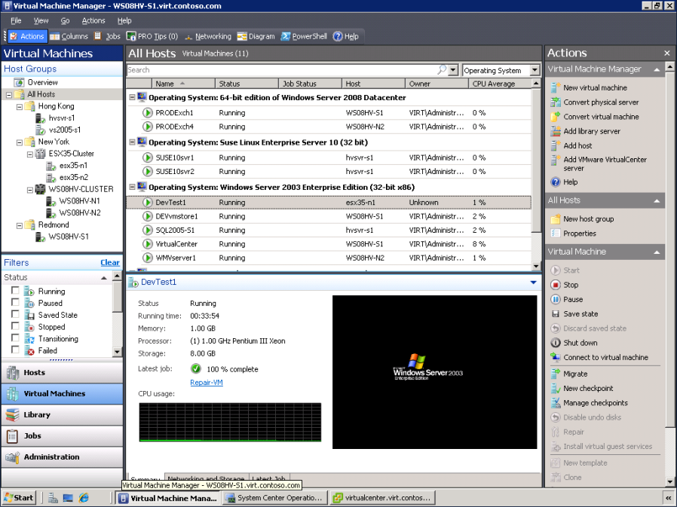
System Center VM Manager 2008
System Center VMM Monitoring Interface

Slide 28
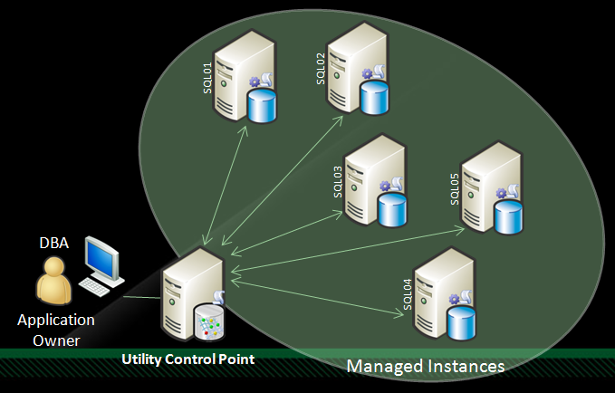
部署和管理SQL Utility
SQL Server 2008 R2的重点投资
SQL Server Fabric
Centralized deployment and management of SQL Instances and database application data
Utility Control Point (UCP)
Centralized management console
Resource utilization monitoring
Deployment of Data Tier Application Components
Data Tier Application Component (DAC)
Deployment container for database objects and policies for an application
Connection Virtualization
Decouples application from physical instance

Slide 29
SQL Server的整合
SQL Server 2008 R2的另一投资
Greater than 64 Core Support
Sysprep for SQL Server
VM Guest failover support for SQL Server
VM Live Migration support for SQL Server

Slide 30
议程
SQL Server的整合及虚拟化
SQL Server Consolidation today
Virtualization and Hyper-V
High Availability
Live Migration
Managing consolidated environments
Upcoming SQL Server consolidation features
SQL Server在虚拟环境下的性能评估
Understanding the Overhead
Cost of Running SQL workloads in Hyper-V Environment
Consolidation Scenarios
Best practices and recommendations
A Case Study
总结

Slide 31
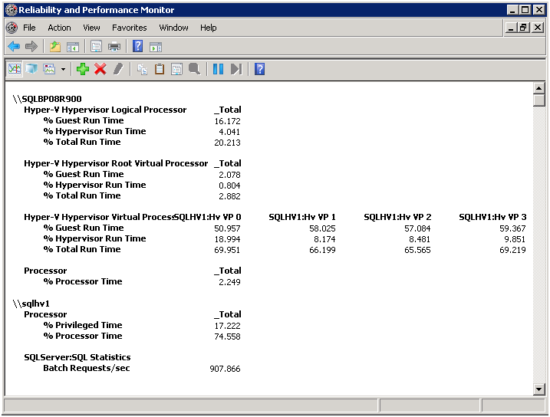
性能监控: CPU
术语
Logical Processor: One logical computing engine in the OS, application and driver view
Virtual Processor: Virtual logical processor (up 1:8 over commit of LP)
传统的 % Processor Time counters在虚拟机和宿主机可能不准确
Hyper-V Processor Counters是CPU 使用率的最好指标
Hyper-V Logical Processor: Total CPU time across entire server
Hyper-V Virtual Processor: CPU time for each guest virtual processor

Slide 32
性能监控: 存储
术语
Passthrough Disk: Disk Offline at Root Partition
VHD (Virtual Hard Disk)
Fixed Size VHD : Space allocated statically
Dynamic VHD : Expand on demand
Configuration | Considerations
Guest VM w/ Passthrough Disks | Use Physical disk counters within root partition to monitor I/O of passthrough disks
Guest VM w/ VHD | Use Logical or physical disk counters within guest VM to monitor IO rates of a VHD Disk counters at the root partition provide aggregate IO of all VHDs hosted on the underlying partition/volume
Either configuration | Very little difference in the values reported by the counters from the root partition with those within guest VM Slightly higher latency values (Avg. Disk/sec Read and Write) observed within the guest VM

Slide 33



关系性OLTP Workload
OLTP workload测试环境
3 different load levels
4 种配置比较
(DELL R900 16core)
Workload Level | Target CPU
Low | 20-30%
Medium | 50-60%
High | 80%
4 Logical Processors
Hyper- V Disabled (bcdedit)
4 Logical Processors
Hyper- V Role and Service Enabled
Native
Root
4 Virtual Processors
Passthrough Disks (Synthetic Device)
4 Virtual Processors
Fixed Size VHD (Synthetic Device)
VM1
VM2

Slide 34
存储配置 (HDS AMS1000)
Dedicated per VM using passthrough disks:
Disk Configuration per VM/Root
SQL Data – 2 LUNs
150GB LUNs using RAID 1+0 (4+4) Sets
SQL Log – 1 LUN
50GB LUN using RAID 1+0 (2+2) Set
Shared using static VHDs (single logical volume at Root level) :
Single Pool of Disks for data files and single pool for logs
F: Data files
Two 150 GB VHDs per VM
G: Log files
One 30GB LUN VHD per VM

Slide 35
性能比较
可以达到同样处理速度
however there is more CPU overhead with hyper-v enabled or when running within a VM
Some overhead observed with Hyper-V just being enabled
测量标准
Throughput = Batch Requests / sec
Relative Throughput = Batch Requests / sec / %CPU

Slide 36
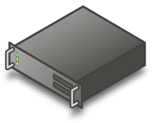





整合场景
同样 OLTP Workload
Low workload level to simulate typical consolidation scenario
Multi-Instance (4)
配置
Native Instance
Affinity mask = 0
Max memory = 12GB
Virtual Instance:
4 VPs, 14 GB memory, 12 GB for SQL
Fixed size VHD on shared volumes
Virtualization (4)
测试环境
NUMPROC 16
Concurrent native instances scale from 1 to 4
Concurrent VMs scale from 1 to 4 (without overcommit CPU)
NUMPROC 8
Concurrent native instances scale from 1 to 4
Concurrent VMs scale from 1 to 4 (CPU overcommit running >2 concurrent VMs)

Slide 37
实例的扩展性- 16 CPU Core Root
物理实例和虚拟实例具有类似的性能和扩展性
Default CPU affinity settings for comparison, no CPU over commit for VMs
Targeting same application workload throughput per instance
Virtual instances throughput is stable on non-NUMA machine as density increases

Slide 38
实例的扩展性 - 8 CPU Core Root
物理实例和虚拟实例具有类似的性能和扩展性
Default CPU affinity settings, CPU over commit for 3 and 4 concurrent VMs
Targeting same application workload throughput per instance
Observe higher system latency in over commit cases

Slide 39

VM的扩展性: 新芯片的构架
SLAT (second level address translation):
AMD Nested Page Table, Intel Extended Page Table
Avoid software overhead, Hardware GPA->SPA
Windows 2008 R2 Hyper-V性能和扩展性都有提高
AMD
Shanghai
HP DL585, 16 core
HP EVA8000
VM Configuration:
4VP
7GB RAM
Low workload level
Relative Throughput
Batch Req/sec/%CPU

Slide 40
WS08 R2 Hyper-V 亮点
Virtualization Feature | WS08 Hyper-V RTM | WS08 Hyper-V SP2 | Windows Server 2008 R2 Hyper-V (aka Win7 HyperV)
Logical Processor Support | 16 | 24 | 64
Address Space Management | Software Only | Software Only | Hardware (SLAT Processors)
Core Parking / Deeper Sleep States (C3) | No – Limited C states | No – Limited C states | Yes
IPv6 offloads | No | No | Yes
Chimney | No | No | Yes – Off by default in RC
Jumbo Frames | No | No | Yes
Virtual NIC interrupts | VP0 | VP0 | VP0 receive / distributed for send
IO Sizes (Virtual SCSI) | 64KB | 64KB | 8MBytes
VHD Block Size | 512KB | 512KB | 2MB
Hot add of storage | No | No | Yes

Slide 41


BI 方面的虚拟化
SQL Server Analysis Service Workloads
3个真实Workload测试
ICE
Information Security Consolidated Event Management System
Cube Size – 78 GB
Query Characteristics – storage engine intensive queries
WebTrends
Web statistics
Cube Size – 100 GB
Query Characteristics – storage engine intensive, with complex queries formula engine calculations
Excel Testing
Software test tracking
Cube Size – 10 GB
Query Characteristics – formula engine intensive, complex queries
硬件配置
Host: Dell R900 16 core, 64GB
Storage: HDS AMS1000
Native (NUMPROC=4)
(4LP, 32GB))
Native Environment
VM (Root NUMPROC=4)
(4VP, 32GB))

Slide 42
Analysis Service Workload Overhead
查询性能比物理实例多10%
Both for storage engine and formula engine intensive workloads
复杂的MDX queries需要更多CPU时间

Slide 43




BI 方面的虚拟化 SQL Server Reporting Services Workload
On Demand (Live) and Cached (Session) workload
3 Different Renderings (HTML, Excel, PDF)
2 Report Definition Type (Graphic report and Table Report)
Force TCP Between RS FE and Data Source in Native
Private Network between VMs
NUMPROC=8, CPU Affinity on Native Instances
Native Environment

Slide 44
Live Session Reports: Native vs. VM
Comparable relative throughput
Higher latency most due to virtual network latency
Table (HTML)

Slide 45
案例分析 – MSIT SQL整合
Current State
~2,700 Applications in MSIT Portfolio
~4797 SQL Server Instances
~100,000 databases
~20% end-of-life hosts/year
~10% CPU utilization across hosts
Consolidation Approach
Microsoft IT selected host consolidation to reduce risks such as SLA conflicts and shared resources
WSRM vs. Hyper-V
Approach to resource management is an important decision
Microsoft IT evaluated WSRM and Hyper-V & ultimately chose Hyper-V
Microsoft IT uses Hyper-V to manage processor and memory use on host and guest partitions

Slide 46





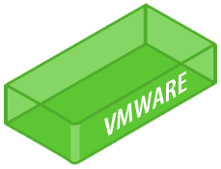





Hyper-V
Hyper-V
Hyper-V
Leverage Hyper-V to optimize:
Allows multi-core Virtual Machines
Allows an oversubscription of the physical processor to gain even greater efficiencies
Additional power efficiencies from using Hyper-V with blade chassis
“Green MSIT” design leverages SAN, Hyper-V, and blade technology together to maximize efficiency and utilization
Potential for $4-5M savings extended across the Enterprise

Slide 47
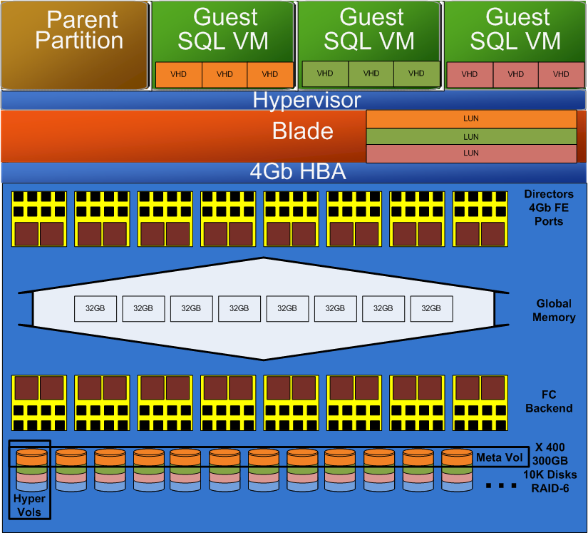
Service Offerings
Offering | Processors | RAM (SQL Server + OS)
SQL VM - small | 1 | 2 GB or 4 GB
SQL VM - medium | 2 | 4 GB or 8 GB
SQL VM - large | 4 | 16 GB

Slide 48
整合后回报

Slide 49
不同整合方案的比较 Multi-Instance SQL vs. Hyper-V VMs
 | Multiple SQL Instances | Multiple VM’s
Isolation | Shared Windows instance | Dedicated Windows instance
CPU Resources | Number of CPUs visible to Windows instance | Up to 4 virtual CPUs
Memory | Server Limit Flexible (max server memory) | Statically allocated to VM Offline changes only No ability to “over commit” memory resources 64GB limit per VM 2 TB Limit per Host
Storage | SQL Data Files with standard storage options | SQL Data Files using Passthrough or Virtual Hard Disks exposed to VM
Resource Management | WSRM (process level) SQL Server Resource Governor | Hyper-V guest VM SQL Server Resource Governor
Number of instances | 50 | Practical limit determined by physical resources
Support | Normal Rules Apply | SQL 2008 , SQL 2005
High Availability | Normal Rules Apply | DBM, Log Shipping (supported - limited field experience so far) Guest clustering

Slide 50
总结 Best Practices and Recommendations
Running SQL Server workloads within Hyper-V guest VM’s is a viable option for production environment
When compared against native the same throughput can be achieved within a guest VM at a cost of slightly increased CPU utilization
Assuming limitations of Guest VM meet requirements of the workload.
Proper hardware sizing is critical to SQL Server performance
Test/Monitor your workloads
“Enlightenments”
Better IO performance
Reduce memory access overhead, Optimizations related to CPU efficiency, scalability of multi-processor VMs
CPU Resources Over Commit on case by case basis for Higher Density
Total number of guest virtual CPUs > the number of physical CPU cores
May introduce significant performance overhead when all workloads are busy

Slide 51
总结 Best Practices and Recommendations
Passthrough and Fixed Size VHD for Better I/O performance
IO Performance Impact is minimal
SQL IO performance and sizing recommendations apply
Dynamic VHD not recommended for SQL Server deployments
In over commit CPU resource scenarios
We have observed more CPU overhead to manage the additional logical CPU’s.
Proper sizing of memory capacity
Memory is allocated for VMs in a static fashion and can only be modified when a guest is offline
CPU Affinity
Not supported by Hyper-V
SQL CPU Affinity has no practical effect on virtual instance
Lower Network Latency with IPv6
Private Network and IPv6 between VMs
Jumbo Frames

Slide 52
疑问和解答

Slide 53
参考资源
SQL Server China R&D Group: http://blogs.msdn.com/sqlcrd
SQL Server China Forum: http://social.microsoft.com/forums/zh-CN/sqlserverzhchs/threads/

Slide 54
参考资源
Running SQL 2008 in Hyper-V Environment
http://sqlcat.com/whitepapers/archive/2008/10/03/running-sql-server-2008-in-a-hyper-v-environment-best-practices-and-performance-recommendations.aspx
Green IT in Practices: SQL Server Consolidation in Microsoft IT
http://www.msarchitecturejournal.com/pdf/Journal18.pdfhttp://msdn.microsoft.com/en-us/architecture/dd393309.aspx
Support Policies of SQL Server in virtualized environments.
http://support.microsoft.com/?id=956893
http://blogs.msdn.com/psssql/archive/2008/10/08/sql-server-support-in-a-hardware-virtualization-environment.aspx
Windows Virtualization Validation Program
http://windowsservercatalog.com/svvp.aspx?svvppage=svvp.htm
Windows Server Hyper-V site
http://www.microsoft.com/windowsserver2008/en/us/virtualization-consolidation.aspx
Hyper-V Technet center
http://technet2.microsoft.com/windowsserver2008/en/servermanager/virtualization.mspx
SQL Server 2008 Business Value Calculator: www.moresqlserver.com

