Slide 2
Inside Windows Server 2008 R2 Virtualization
VIR211

Slide 3
Agenda
Live Migration
Clustered Shared Volumes
Performance and scaling improvements
  Network Virtual Machine Queues
  Second Level Address Translation
  Distributed Timer Execution
Power Efficiency
  Core Parking
  Timer Coalescing

Slide 4
Live Migration
Live Migration migrates a running VM with minimal disruption of the VMs services
  Goal is that open TCP/IP connections do
  not timeout
Live Migration steps:
  Establish connection between source and
  target computer
  Transfer VM configuration and device information
  Transfer VM memory
  Suspend source VM and transfer state
  Resume target VM

Slide 5
Live Migration Operation
time
Source
Computer
Target
Computer
Migration
Setup
Memory
Transfer
State
Transfer
VM Running

Slide 6
Live Migration Internals
Virtual machine on source computer creates “dirty bitmap” of memory pages
  Iterates over pages, sending them to target
  virtual machine
  Registers for modify-notifications on pages to detect subsequent changes
    Source VM still active and can be modifying memory
  Repeats over newly modified pages
Stops iterating when one of the following:
  All pages sent
  Makes 5 passes

Slide 7
Live Migration Operation
Memory
Configuration
Configuration
State
State
Server 1
Server 2

Slide 8
Demo
Live Migration

Slide 9
Agenda
Live Migration
Clustered Shared Volumes
Performance and scaling improvements
  Network Virtual Machine Queues
  Second Level Address Translation
  Distributed Timer Execution
Power Efficiency
  Core Parking
  Timer Coalescing

Slide 10
High Available Storage and Virtualization
Traditional HA storage is ‘shared nothing’ where one node exclusively owns a LUN
Shared nothing has major disadvantages for virtualization management and high availability
  One VM per LUN requirement causes LUN explosion
    Management headache
  Disruptive delays when LUN ownership changes
    Physical disk resource must fail over
    Old owner must dismount and new owner must mount volume
    Not suitable for Live Migration

Slide 11
Clustered Shared Volumes
Clustered Shared Volumes (CSV) implements hybrid sharing for LUNs
  One node owns the storage namespace (e.g. directory structure)
  and metadata
  Other nodes can own the storage backing an individual file’s
  data (e.g. VHD)
Benefits of CSV:
  Can store all VM VHDs on one LUN
  High-performance access to VHDs from owning nodes
    All nodes have read/write access to file data
  Seamless VM movement between nodes
    Any node can read from VHD, so no need to change LUN ownership
  Seamless LUN ownership transition
    Persistent handles allow cluster to move LUN without interruption to
    VM operation

Slide 12
Clustered Shared Volume Implementation
CSV filter driver forwards all namespace operations (e.g. create file, delete file, resize file) to LUN owner
  These operations are relatively rare
  Uses SMB2
VM hosting node opens VHD for
exclusive access
  VHD read and write is frequent
  CSV filter obtains raw LUN sector map of file
  Reads and writes directly to underlying volume

Slide 13


Clustered Shared Volumes Architecture
CreateFile
VM
File Server Service
CSV I/O Filter Driver
CSV I/O Filter Driver
Redirector FSD
NTFS
NetFT
NetFT
Storage Drivers
Storage Drivers
LUN
LUN Owner
VHD

Slide 14
Clustered Shared Volumes Architecture
Read/WriteFile
VM
File Server Service
CSV I/O Filter Driver
CSV I/O Filter Driver
Redirector FSD
NTFS
NetFT
NetFT
Storage Drivers
Storage Drivers
LUN
LUN Owner
VHD

Slide 15
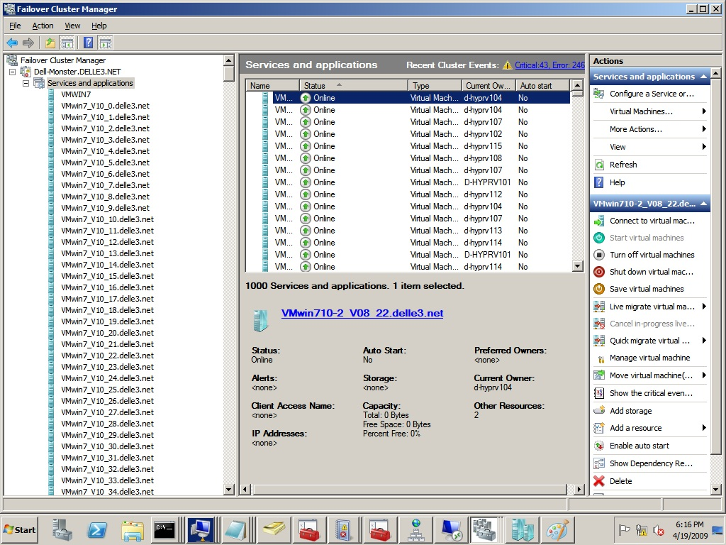
CSV Scalability
1000 VMs running on a 16-node cluster with 16.5 TB shared storage:

Slide 16
Agenda
Live Migration
Clustered Shared Volumes
Performance and scaling improvements
  Network Virtual Machine Queues
  Second Level Address Translation
  Distributed Timer Execution
Power Efficiency
  Core Parking
  Timer Coalescing

Slide 17
Overview of Server 2008 R2 Hyper-V
Scaling Improvements:
Virtualization Feature | WS08 Hyper-V RTM | WS08 Hyper-V SP2 | Windows Server 2008 R2 Hyper-V
Logical Processor Support | 16 | 32 | 64
Total number of powered on VM’s | 128 | 192 | 384
Total Virtual Processors Supported | 128 | 192 | 512
Guest Virtual Processor Support | 4 (WS08 only) | 4 (WS08 only) | 4 (Win7/WS08)
Many performance and scalability improvements
  Lock free algorithms
  Distributed data structures

Slide 18
Overview of Storage Improvements
Virtualization Feature | WS08 Hyper-V RTM | WS08 Hyper-V SP2 | Windows Server 2008 R2 Hyper-V
Diff Disk Scaling Performance | 1x | 1x | 4x – 5x
IO Sizes (Virtual SCSI) | 64KB | 64KB | 8MBytes
IO Size (Virtual IDE) | 64KB | 64KB | 64KB
VHD Block Size | 512KB | 512KB | 2MB
Fixed VHD Creation Speed | 1x | 1x | 3x – 4x
Hot add of storage | No | No | Yes
SCSI Command Pass-through | No | No | Yes

Slide 19
Overview of Networking Improvements
Virtualization Feature | WS08 Hyper-V RTM | WS08 Hyper-V SP2 | Windows Server 2008 R2 Hyper-V
IPv6 offloads | No | No | Yes
LSOv2 | Limited (LSOv1 from VM) | Limited (LSOv1 from VM) | Supported
Guest to guest throughput | Good | Good | Better
VMQ | No | No | Yes (off by default)
Chimney | No | No | Yes (off by default)
Jumbo Frames | No | No | Yes
Virtual Switch MAC learning | Good | Good | Better (every packet)
Virtual NIC interrupts | VP0 | VP0 | VP0 receive / distributed for send

Slide 20
Agenda
Live Migration
Clustered Shared Volumes
Performance and scaling improvements
  Network Virtual Machine Queues
  Second Level Address Translation
  Distributed Timer Execution
Power Efficiency
  Core Parking
  Timer Coalescing

Slide 21
Performance Overhead of Traditional VM Network I/O
Receive path processing:
  VM Switch in Parent partition classifies packet based on destination MAC address
  Performs MAC address look up and VLAN ID validation
  Copies data to child partition
  Context switch to child to process received data
Send path processing:
  Child partition copies data to memory shared with parent
  VM Switch performs MAC address lookup and VLAN ID validation
  Simulates task offload in software for VM to VM traffic
  Extra copy for VM to VM traffic

Slide 22
Virtualized Network I/O Data Path
Parent Partition
VM1
VM2
Virtual Machine Switch
Ethernet
Routing
VLAN Filtering
Data Copy
TCP/IP
TCP/IP
Port 2
Port 1
VM NIC 1
VM NIC 2
Miniport
Driver
NIC
VM BUS

Slide 23
Networking Virtual Machine Queues
Hyper-V uses virtual machine queue (VMQ) support in new NICs to offload processing
to hardware
VMQ operation:
  Each VM is assigned a hardware-managed
  receive queue
  Hardware performs MAC address lookup and VLAN ID validation
  Places receive packets in appropriate queue
  Queues are mapped into VM address space to avoid copy operations

Slide 24
Network I/O Data Path With VMQ
Parent Partition
VM1
VM2
Virtual Machine Switch
Routing
VLAN filtering
Data Copy
Ethernet
TCP/IP
TCP/IP
Port 2
Port 1
VM NIC 1
VM NIC 2
Miniport
Driver
Default
Queue
Q1
Q2
VM BUS
Switch/Routing unit
NIC

Slide 25
VMQ Performance

Slide 26
Agenda
Live Migration
Clustered Shared Volumes
Performance and scaling improvements
  Network Virtual Machine Queues
  Second Level Address Translation
  Distributed Timer Execution
Power Efficiency
  Core Parking
  Timer Coalescing

Slide 27
VM Memory Management
Today, processors provide one level of address translation, but hypervisor needs to manage two
Shadow page tables combine these mappings because the processor knows how to perform only one level of translation
Physical Computer
Virtual Machine
Guest Virtual Address
Guest Virtual Address
Guest OS defines GVA-to-GPA mappings
Guest Physical Address
Hypervisor defines GPA-to-SPA mappings
System Physical Address
System Physical Address

Slide 28
Shadow Page Tables
Hypervisor maintains a Shadow Page Table
  Combines two layers of translation into a single page table
  Demand-filled when Child OS touches a page
  Flushed any time the Child OS modifies its
  page tables
Shadow Page Table overhead:
  Fills and flushes invoke the hypervisor
  Can account for up to 10% of total CPU time
  Typically consumes 10-30 MB of memory per VM

Slide 29
Second Level Address Translation (SLAT)
Goes by several names:
  Intel calls it Extended Page Tables (EPT)
  AMD calls it Nested Page Tables (NPT) or Rapid Virtualization Indexing (RVI)
Processor provides two levels of translation
  Walks the guest OS page tables directly
  No need to maintain Shadow Page Table
  No hypervisor code for demand-fill or flush operations
Resource savings:
  Hypervisor CPU time drops to 2%
  10-30 MB of memory saved per VM

Slide 30
Agenda
Live Migration
Clustered Shared Volumes
Performance and scaling improvements
  Network Virtual Machine Queues
  Second Level Address Translation
  Distributed Timer Execution
Power Efficiency
  Core Parking
  Timer Coalescing

Slide 31
Distributed Timer Execution
Before, all timer expiration (deferred procedure calls – DPCs) executed on CPU 0
DPCs allow low-level components to queue non-critical, but non-preemptable work
Relying on one CPU for DPC timer expiration can cause bottleneck on Hyper-V servers with many guests:
  Root timers execute on CPU 0 and the more guests, the more timers
  CPU 0 can also execute guest virtual processors, reducing time it can execute timers
  Worse, overload of CPU 0 could result in DPC timeouts and delayed timers
CPU 0
CPU 1
CPU 2
CPU 3
Global
Timer
Queue

Slide 32
Distributed Timer Execution (Cont)
Now, timers execute on the processor on which they are inserted
  Spreads timer DPC load across CPUs
  No global timer lock
  Major scalability benefit
    Benefits non-Hyper-V systems as well
  Note: old behavior on client
CPU 0
CPU 1
CPU 2
CPU 3
Per-CPU
Timer
Queues

Slide 33
Agenda
Live Migration
Clustered Shared Volumes
Performance and scaling improvements
  Network Virtual Machine Queues
  Second Level Address Translation
  Distributed Timer Execution
Power Efficiency
  Core Parking
  Timer Coalescing

Slide 34
Hyper-V Power Management
Low power requires CPUs to stay idle so that they can enter deep sleep states (C-states)
  Sleep time has to offset cost of transitioning into and
  out of sleep
Windows 7 includes two significant
power enhancements:
  Core parking: avoiding use of cores on a socket to allow them to go into deep C-states
  Timer coalescing: sending multiple timer notifications at once to allow longer idle periods
Hyper-V integrates these concepts into
VM management

Slide 35
Agenda
Live Migration
Clustered Shared Volumes
Performance and scaling improvements
  Network Virtual Machine Queues
  Second Level Address Translation
  Distributed Timer Execution
Power Efficiency
  Core Parking
  Timer Coalescing

Slide 36
Core Parking
Kernel in parent performs core-parking control
  Actually parks entire processors. This only works on multi-processor systems.
Hypervisor maps processor usage data into
the parent
  Updates every 100ms
Parent tells hypervisor which cores to park
  Hypervisor lets processors finish work, but stops including them in scheduling decisions
  Will use them if necessary to meet child
  CPU guarantees

Slide 37
Core Parking Operation
Core 0
Core 1
Core 0
Core 0
Core 0
Core 1
Core 1
Core 1
Socket 0
Socket 1
Workload

Slide 38
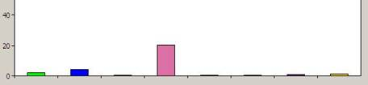
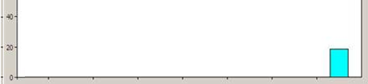
Core Parking in Action
CPU utilization of 8 idle child partitions without core parking:
With core parking:

Slide 39
Agenda
Live Migration
Clustered Shared Volumes
Performance and scaling improvements
  Network Virtual Machine Queues
  Second Level Address Translation
  Distributed Timer Execution
Power Efficiency
  Core Parking
  Timer Coalescing

Slide 40
Timer Coalescing
When child partition timers fire:
  External timer interrupt into hypervisor
  Hypervisor must schedule child partition
  Injects timer and child responds
Problem: multiple timers per child causes:
  Many external timer interrupts
  Hypervisor CPU overhead
  Child VM execution
Solution: coalesce timer expiration across
child VMs

Slide 41
Timer Coalescing Implementation
Coalescing is based on a combination of techniques:
  If a device interrupt occurs within half a period of a timer expiration, timer is expired
  Alignment of child timer expirations to multiple of natural timer frequency
Un-coalesced Timer Events
15.6ms
15.6ms
15.6ms
Coalesced Timer Events
VM 1 Timer Delivery
VM 2 Timer Delivery
VM3 Timer Delivery

Slide 42
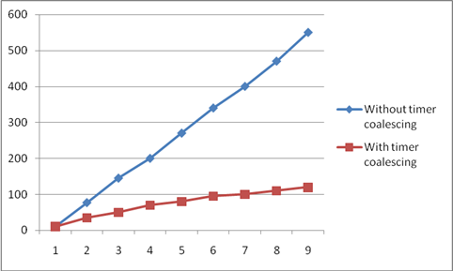
Timer Interrupt Reduction
Timer Interrupts Per Child
 | No Coalescing | Timer coalescing | % Reduction
Timer interrupts/sec | 560 | 56 | 90%
CPU utilization | 3.2% | 1.9% | 41%
CPU Utilization for 8 idle Server 2003 child partitions

Slide 43
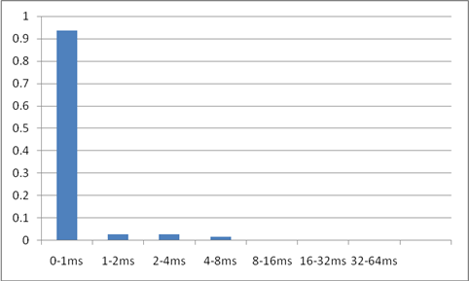
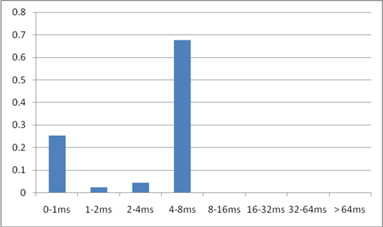
Time Spent in CPU Sleep
Un-coalesced
Coalesced
4-8ms allows the computer to enter the deepest sleep state for the most power savings

Slide 44
Q & A

Slide 45
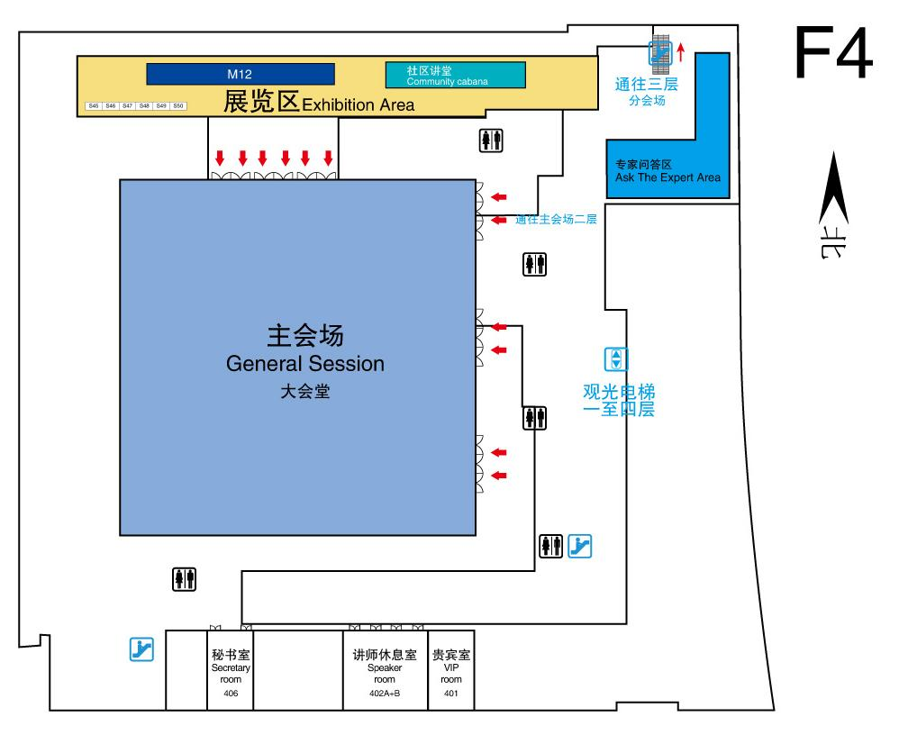
Ask the Expert (F4)
In next 70 minutes, I will be available at the “Ask the Expert” area to answer your questions

