Slide 1
Microsoft Office PerformancePoint TM Server 2007

Slide 2
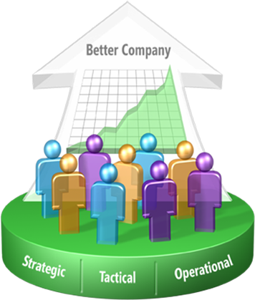

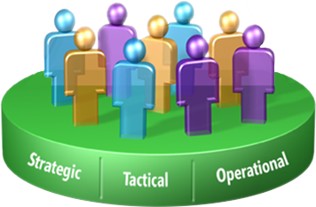
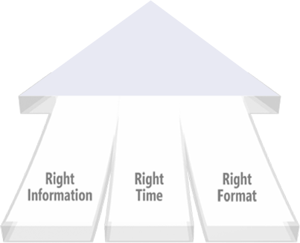

Microsoft Vision
Improving organizations by providing business insights to all employees leading to better, faster, more relevant decisions
Complete and integrated performance management offering.
Pervasive delivery of intelligence through Microsoft Office.
Enterprise grade and affordable.
2
Notes:
2

Slide 3



Microsoft Business Intelligence
Performance
Management
Applications
Business Scorecard Manager 2005
PerformancePoint Server 2007
ProClarity Analytics 6
Office SharePoint Server 2007
Office Excel 2007
SQL Server 2005 Integration Services
SQL Server 2005 Analysis Services
SQL Server 2005 Reporting Services
BI
Platform
SQL Server 2005
Notes:
3/27/2007 11:10 AM
3
© 2005 Microsoft Corporation. All rights reserved.
This presentation is for informational purposes only. Microsoft makes no warranties, express or implied, in this summary.

Slide 4
Performance Management according to Gartner
Combination of management methodologies, metrics, and IT (applications, tools and infrastructure) that enables users to define, monitor, and optimize results and outcomes to personal or departmental objectives while enabling alignment with strategic objectives across multiple organizational levels (personal, process, group, departmental, corporate or business ecosystem”
Gartner - October 2006
“Understand Performance Management to Better Manage Your Business”

Slide 5
Performance Management and BI according to Gartner
Business Intelligence
Performance Management
Pervasive: Agility with change and innovation.
Scope:
Integrated corporate performance experience.
Communicate actions about ‘one version of the truth’.
Strategic
Strategic: integrated business execution and management.
Scope:
Scorecards, Analytics
Corporate Portal
Inter-departments
Operational: improve business effectiveness
Scope:
Dashboards
Interactive query
Intra-department
Tactical
Focused: process efficiency or cost reduction
Scope:
Excel
Department
Opportunistic
Measure
Optimize
Decide and Manage
Lead and Innovate
Increasing business value
Gartner (March 2006) – How to justify cost and value of BI investments
Notes:
5
Tactical Guideline: Define business benefits and BI vision, and plan according to the type of organization and stage/rate of BI adoption.

Slide 6

Better Execute on Strategy
Monitor
What happened?
What is happening?
Analyze
Why?
Strategy
Plan
What will happen?
What do I want to happen?
Continuous business improvement, not just an annual exercise
6
Notes:
6

Slide 7
PM Today Effective PM Has Not Been Realized
Fragmented
Average $B+ firm has 10 GLs, 12 budget, 13 report systems.
Only 26% have integrated planning and reporting processes
Slow and inflexible
Only 20% of firms update budgets within the fiscal cycle.
Average firms wait 11 days from month end to get reports.
Labor intensive
Average time for annual budget process is 4-5 months.
Budgeting process takes up 20-30% of managers time
Finance staffs spend 79% of time on “low-value” activities
Costly and ineffective
Cost to budget is 23,000+ person days per $B in revenue.
60% of firms fail to align actions & strategy.
* Best Practices in Planning and Management Reporting by David A. J. Axson.

Slide 8
Methodologies Alone are Not Effective
Economic Value Add (EVA)
ABC Modeling
Balanced Scorecard
Beyond Budgeting
Lean Manufacturing
A Methodology without a PM process leads to failure…
Planning &
Budgeting
Scorecards
Dashboards
Analysis &
Discovery
Management Reporting
Forecasting
A PM Process with disparate applications leads to extra time & cost…

Slide 9
Limited Tools & Information
Financial
Management
Dashboards
Scorecards
Planning
Budgeting
Profitability
Project
Portfolio
Analysis
Forecasting
Analytics
Reporting
Incomplete set of functionality leads to limited usefulness and inability to act on information.
Inconsistent business definitions and business rules leads to “Spreadsheet integration”
Time
Product
Location
Revenue
Expenses
Margins
Service
Calls
Employee
Hires
Customers

Slide 10
Limited Participation & Usage
Products Designed For Power Users, Too Hard For Information Workers To Use
Performance
Management
Applications
Products do not Provide For Collaboration or Personalization
Products Are Too Expensive To Give To Large Numbers Of Employees

Slide 11
PM Protagonists
Business Executives
CFO, CEO, COO.
Controller, Finance Executive.
General Manager, Line of Business Manager.
Information Workers
Power Users, Business Analysts, Modelers.
Contributors.
IT Managers
BUIT
Corporate IT

Slide 12

Executives care about driving performance
Accelerate the decision making process.
Flexibility to handle changing business conditions.
Aligned, accountable and secure PM.
They can’t accomplish this because
“6 months for planning,
5 months for budgeting,
2 weeks to develop a forecast”*
* Best Practices in Planning and Management Reporting by David A. J. Axson.

Slide 13

Information Workers want to contribute to performance
Need a user-friendly and flexible environment.
Collaborate as part of the performance management process.
Define, modify and maintain business rules without IT.
They can’t accomplish this because
“Half their time
collecting and validating data
rather than
analyzing and planning”*.
* Best Practices in Planning and Management Reporting by David A. J. Axson.

Slide 14

IT Managers want to enable business users
Reduce the complexity, maintenance and cost of the performance management infrastructure.
Empower the business to improve performance.
Provide access to information
while supporting the compliance process.
They can’t accomplish this because
“10 general ledger systems,
12 different budgeting systems
13 different reporting systems”*.
* Best Practices in Planning and Management Reporting by David A. J. Axson.

Slide 15






How PM is addressed today
Business Analysts
Executives
Many moving parts
Manual consolidation
Linked Spreadsheets
Error-prone
Slow
Is any of this still relevant?
Information Workers

Slide 16
While the IT managers ask
Who should have access to this information?
Who should be even driving change?
Can any of this be audited?
What’s the cost of an error?
Many companies face this issue
“Only 26% of companies rely
on integrated
planning and reporting processes”*.
* Best Practices in Planning and Management Reporting by David A. J. Axson.

Slide 17


How PM can be addressed
Scorecard & Dashboard
Reporting
What, Why, How, Who, When?
Analytics
Forecasting
Planning
Flexible, Secure, Auditable.
“Build and modify within compliance”
Aligned, Actionable, Accountable.
“Information that I can trust and act on”
Collaborative, User-friendly, Contextual.
“Information that is relevant to me”

Slide 18
PM: Capabilities Required
What is happening?
Scorecard & Dashboard
What happened?
Reporting
Analytics
Single Data Model
Why?
What will happen?
Forecasting
What do I want to happen?
Planning, Budgeting, Consolidation
Process requires past information, present conditions and future outcomes
18
Notes:
18

Slide 19
PerformancePoint Approach
Business Driven
Functionality
Value
People
Business users define, modify and maintain logic and rules.
Plan, budget, forecast, scorecard, dashboard, management reporting and consolidation.
Workflow driven templates and forms.
Pre-built and ad-hoc rules and calculations.
Single data model & definitions.
Bring all users into PM process.
Personalized scorecards, plans.
Powerful visualization and annotations.
Support collaborative PM.
Active alerting and notifications.
Familiarity of Office and Excel.
Self service for business users.
Centralized application management.
Improved control over spreadsheets.
Integration with data sources.
Priced for broad deployment.
Extends existing investments in Office & SQL.
Auditable & secure.
Provides visibility and transparency.
Spans across the enterprise.
Aligns and supports PM process.
Flexible and model driven.

Slide 20
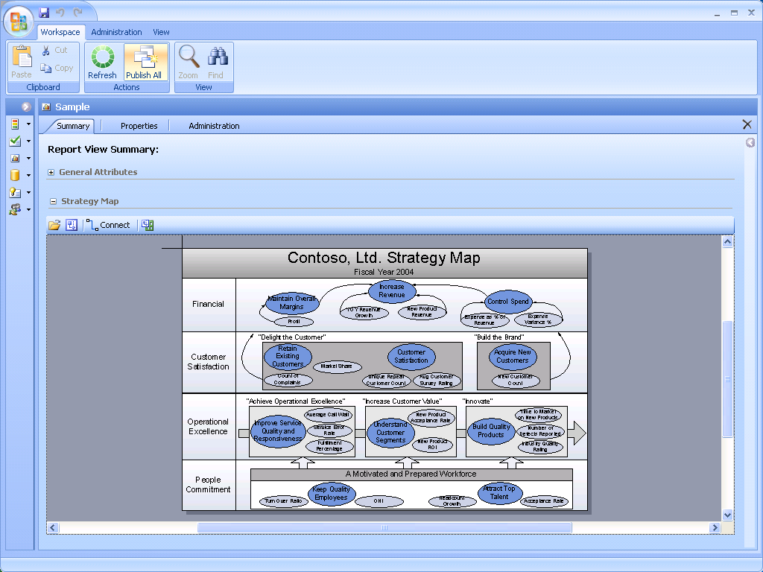
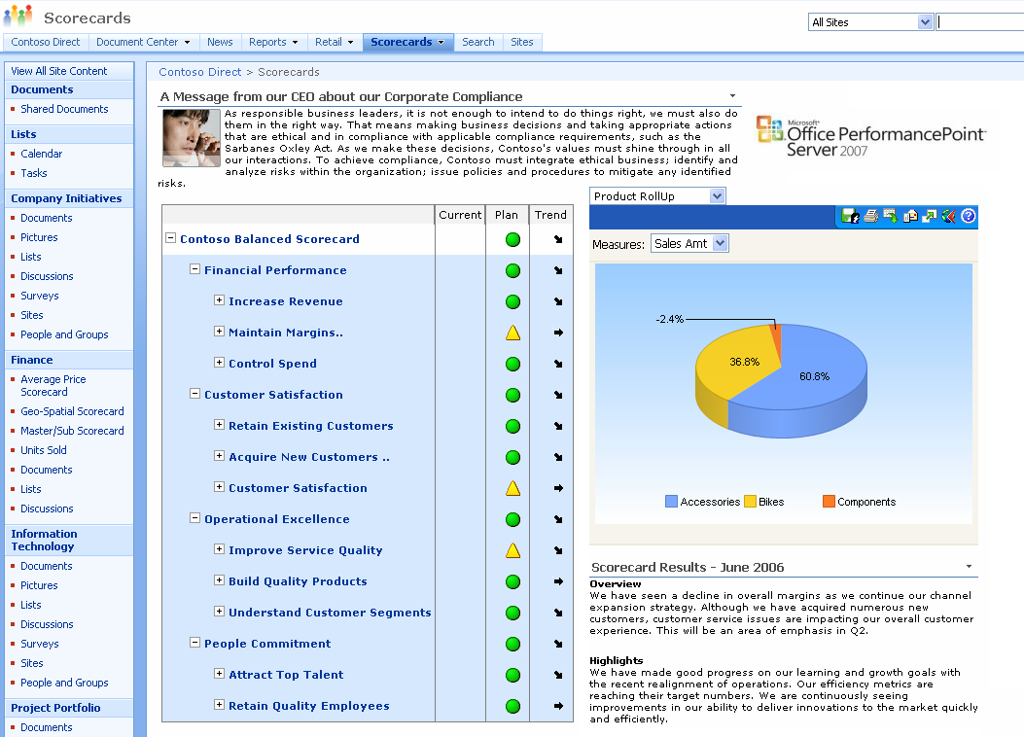
Monitoring
Business-Driven
Business users can build performance dashboards easily through an integrated design experience across monitoring and analytics.
People
All users have visibility into organizational performance. They can monitor and take action in a familiar and collaborative environment.
Personalized performance views are delivered to all users, all types of use (Office, SharePoint, Reporting Services).
Functionality and Value
Certified by Balanced Scorecard Collaborative.
Spans from personal performance dashboards to formal methodology-based and cascading scorecards.
Web-based and offline functionality provides wide and secure scorecarding reach (internal and external).
Contextual KPIs and reports reflect changes of planning, budgeting and forecasting data in real-time.
Rich capabilities can be deployed quickly and cost-effectively (Strategy Maps, Office integration, alerts and notifications).
Built-in templates and wizards allows users to quickly build and share scorecards .
Access a wide variety of structured and unstructured data-sources enable a complete scorecarding experience.

Slide 21
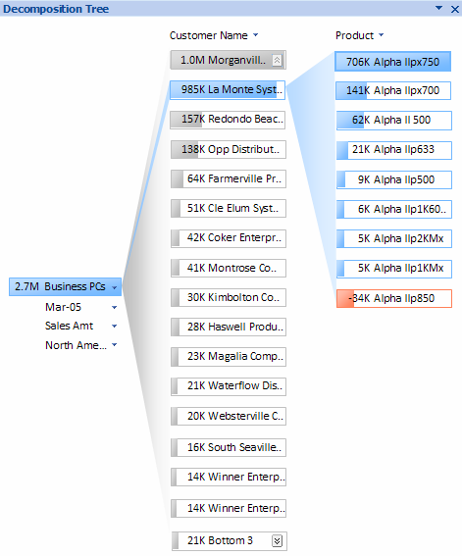
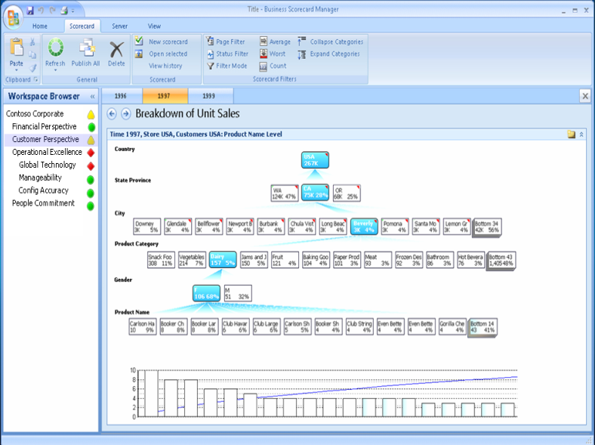
Analytics
Business-Driven
Business users capture and share analytical best practices using an intuitive and collaborative environment.
People
Advanced visualization and analytics make it easy for users understand complex information faster, spot highlights, trends and opportunities.
Rich analytical functionality reach is extended all users, all types of use out of the box (Excel, SharePoint, Reporting Services).
Functionality and Value
Web-based and offline analysis, providing secure access to information to the right people at the right time.
Analytics span from multidimensional slice and dice in Office to rich capabilities like decomposition trees, drill-across, server business logic definitions, root-cause analysis and prediction.
Users can build, share and manage their analysis with no coding.
They can build and combine local and server-side data calculations, actions, annotations, scorecards as well as planning, budgeting and forecasting KPIs and metrics.
Analytical views can be shared and managed in the SQL Server Report Manager, SharePoint Server Report Center or output to PDF, HTML, XML.

Slide 22
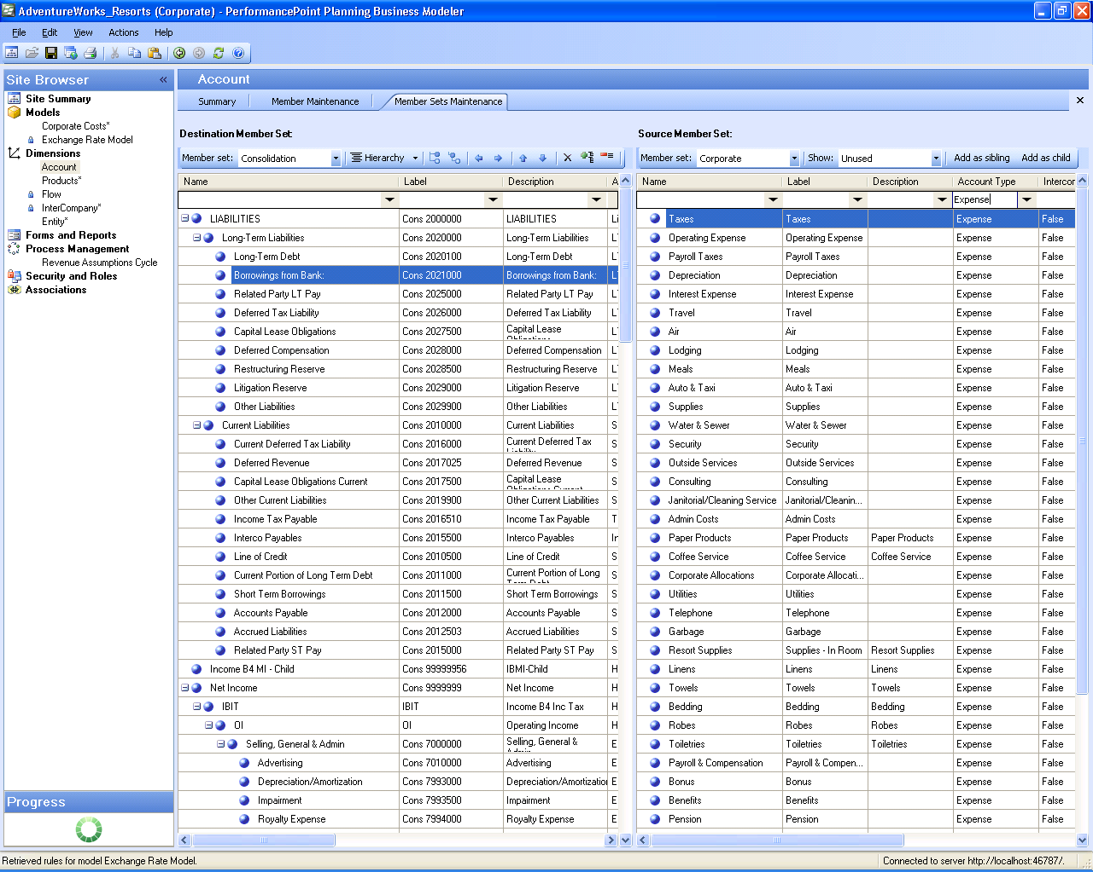
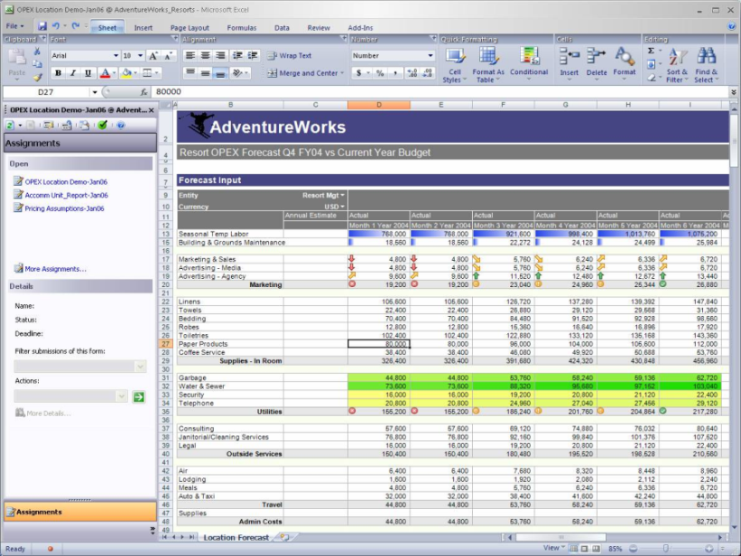
Planning, Budgeting, Forecasting
Business-Driven
Business users can define, modify and maintain logical business models integrated with business rules, workflows and enterprise data.
People
Information workers can interact with and continuously contribute to the business processes of planning, budgeting and forecasting in the familiar and easy to use Excel Environment.
Functionality and Value
Business users design models the way they think about their business. They can integrate and maintain business rules, calculations and assumptions with no coding.
Spans from single model deployments to enterprise scenarios utilizing model-to-model mapping functionality.
Top-down and bottom-up planning functionality supports deployments requiring users to set top-level targets, test scenarios, perform detailed analysis online and offline.
Process management enables users to manage the forecasting progress through forms, workflows, submissions, approvals, reports, notifications and annotations.
Ability to connect to information contained in external systems and data sources. Transformation and business logic can be applied to both PerformancePoint Server and external data sources and systems.

Slide 23
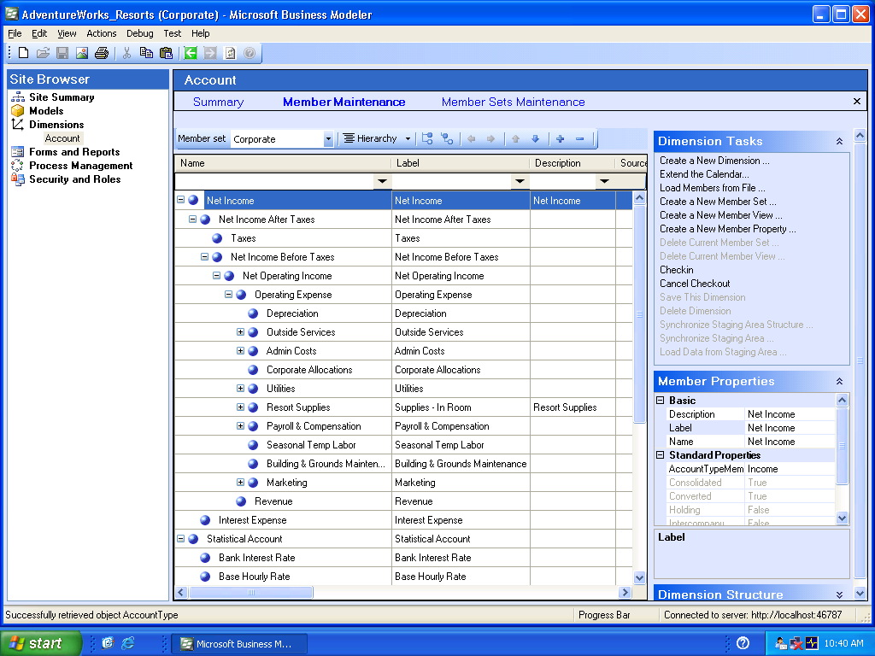
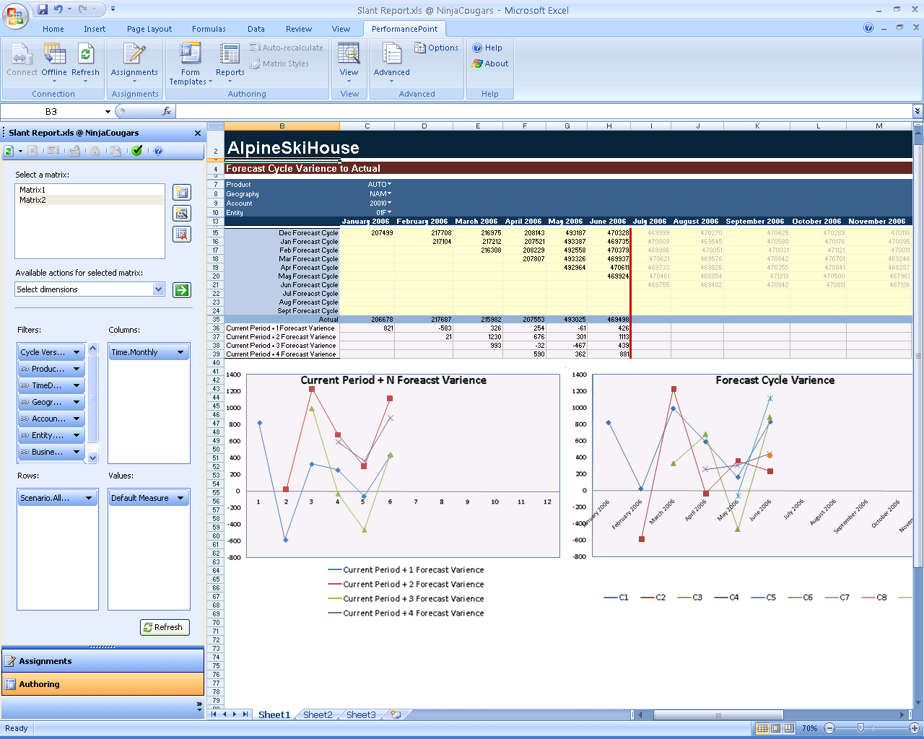
Reporting and Consolidation
Business-Driven
Business-users can define their own view of the business and distribute templates and forms in a timely fashion with greater accuracy.
People
All users can combine operational data and financial data into one report rather than reconsolidating data through error-prone and time consuming manual efforts.
Information workers can build, customize and share production quality reports from Excel while being connected to a secure and centrally managed server.
Functionality and Value
Financial Intelligence functionality allows business users to perform sensitivity and variance analysis (Price/quantity/customer/product mix and timing).
Manage financial consolidation process with multiple currency conversions, inter-company eliminations and reconciliations, multi-tier allocations and support for GAAP and IFRS.
Widely distribute dynamic and standard reports including financial statements, management reports and ad-hoc analysis.
Report filters passed from Excel to Reporting Services guarantee consistency of experience for report consumers.
Reports can be managed and accessed in SQL Server Report Manager and the SharePoint Server Report Center.

Slide 24
PPS Migration/Upgrade Policy
Customers current on Microsoft SA or ProClarity Maintenance
BSM customers get 1 Server and 1 CAL license for each BSM Server/CAL license.
PC customers get 1 Server and 1 CAL license for each Server/Desktop/Pro/Web license.
Rights for PC 6.3 and BSM 2005 provided.
Customer not current on ProClarity Maintenance
Must renew maintenance with Microsoft by April 1 to qualify

Slide 25



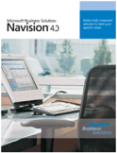
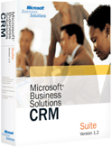


















What is PerformancePoint Server?
Build
Consume
Server
Monitor
Scorecards
Dashboards
SharePoint
Application Metadata
Analyze
Ad-hoc, root-cause analysis
Analytics
SQL Server
Business Logic
Online/Offline SQL reports
Security
Process
Plan
Budgeting, Forecasting
Financial Intelligence
Office applications
Spreadsheets
KPI lists
Unstructured data sources

Slide 26
Product Demonstration

Slide 27

AdventureWorks
AdventureWorks designs and markets bicycles, frames, components and accessories for mountain, road and touring cycling.
Contoso is considering PerformancePoint for integrated monitoring, analytics and planning.
Jennifer, AdventureWorks’ CFO.
Business challenge: margin issues across some product categories.

Slide 28
Demo Flow
Monitoring
Driving accountability
Q&A
Demo scenario
Collaboration
More than just numbers
END
Planning
Integrated experience
Integration
Delivery in Office
Analytics
Asking questions

Slide 29
External Resources

Slide 30
Training
Monitor | Analyze
Introduction to Business Scorecard Manager BSM for business decision makers BSM Builder Fundamentals BSM Builder Advanced Report Views Scorecard Views Deploying Scorecards to SQL Reporting Services Deploying Scorecards to SharePoint BSM Server & Security Extensibility | ProClarity Professional Client End User Training Part 1 ProClarity Professional Client End User Training Part 2 ProClarity Web Standard Client End User Training ProClarity Business Logic Server Training PAS Environment and Authoring Training ProClarity Dashboard End User Training ProClarity Dashboard Administrator Training What's New in 6.1 ProClarity for SharePoint Portal Server Training

Slide 31
PPS Product Dependencies
Recommend Office SharePoint Server 2007, support Windows SharePoint Services 3.0.
Recommend Excel 2007 for Planning, Support Excel 2003.
SQL Server 2005 Standard for Monitoring and Analysis.
SQL Server 2005 Enterprise Edition for Planning.

Slide 32

© 2006 Microsoft Corporation. All rights reserved. Microsoft, Windows, Windows Vista and other product names are or may be registered trademarks and/or trademarks in the U.S. and/or other countries.
The information herein is for informational purposes only and represents the current view of Microsoft Corporation as of the date of this presentation. Because Microsoft must respond to changing market conditions, it should not be interpreted to be a commitment on the part of Microsoft, and Microsoft cannot guarantee the accuracy of any information provided after the date of this presentation. MICROSOFT MAKES NO WARRANTIES, EXPRESS, IMPLIED OR STATUTORY, AS TO THE INFORMATION IN THIS PRESENTATION.

Slide 33











Slide 34
Price List Timing
ProClarity 6.3
First version of ProClarity available through Microsoft
Need to synchronize with PerformancePoint pricing
On price list Feb 1 at $195 CAL/ $20,000 server/$30,000 External Connector
Business Scorecard Manager 2005
Need to synchronize with PerformancePoint pricing
Updated April 1 at $195 CAL/ $20,000 server/$30,000 External Connector
PerformancePoint Server 2007
Price list availability base on actual RTM date
Details announced at CTP 2 release

Slide 35
Appendix

Slide 36
Microsoft Business Intelligence
Applications
PerformancePoint Server 2007
End-user tools
SharePoint Server 2007
Excel 2007
BI Platform
SQL Server 2005
Notes:
3/27/2007 11:10 AM
36
© 2005 Microsoft Corporation. All rights reserved.
This presentation is for informational purposes only. Microsoft makes no warranties, express or implied, in this summary.

Slide 37
BSM, ProClarity, and PPS
Available Today
March 2007
ProClarity Analytics 6.2
ProClarity Analytics 6.3
Business Scorecard Manager
PerformancePoint Server 2007
v1
PerformancePoint Server 2007
v2
Available Today
RTM - Sept 2007
Office 14

