Slide 1

Windows LiveTalk Webcast
Sharing Deployment Tips from Early Adopters
Elan Ellinger Takis Petropoulos Chris Minaugh
Senior Product Manager Manager Systems Engineer
Microsoft Corporation User Centric Solutions and Systems Management Tools Dell Inc.
Dell Inc.

Slide 2
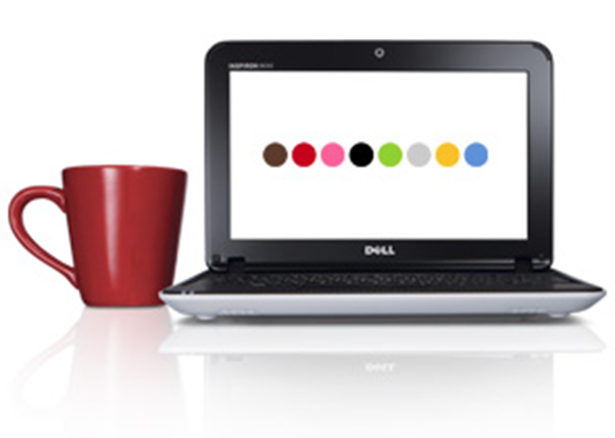
Agenda
Interview with Dell IT Organization
Live Q&A
Evaluation and Free Giveaway
Wrap Up
Notes:
Host to lay out objectives:
Learn from early adopters (Microsoft customers/partners) on how best to plan for and execute a successful pilot project for Windows 7 deployments in their organizations.
Gain a deeper understanding on how to resolve critical areas such as application compatibility, image engineering, deployment infrastructure and more.
Get your questions answered so you can start rolling out your Windows 7 pilot programs in your organization.

Slide 3









Windows Optimized Desktop
Supporting Ultimate Flexibility with Windows 7, Desktop Virtualization, and System Center
  Anywhere Access for Users
  Security and Data Protection
Data & User Settings
User State Virtualization
Applications
Application Virtualization
On the PC
BitLocker
On Portable Drives
BitLocker To Go
Online & Offline
Data & Applications cached locally
Protecting Local Systems
AppLocker
  Business Continuity
Helpdesk Tools & Disaster Recovery
Desktop Error Monitoring, Diagnostic & Recovery Toolset
  End-to-End Management
System Center
Notes:
Delivering on the Essential Capabilities: Supporting Ultimate Flexibility with Windows 7, Desktop Virtualization and System Center
Essential Points to Land:
Questions 1-8
Windows XP has been in the market for over 10 years now, and with the availability of Windows 7 organizations are planning their migration. And although you are looking at your desktop from a migration perspective, this is actually a good time to think of your overall desktop strategy. With the increasing pressure to cut cost but at the same time allow user flexibility to be more productive, there are 4 capabilities essential capabilities a holistic Optimized Desktop strategy enables:
Access from anywhere – with the increasing number of mobile workers , you need to ensure these users are productive regardless of where they are. This capability is provided by a set of technologies that help IT both manage and give access to Data (Folder Redirection/Offline Files), Applications (Application Virtualization), and User Settings (Roaming User Profiles).
Security and Data Protection is non negotiable – companies have a lot to lose from data loss or security breaches both financially and in customer trust. This is provided by BitLocker on the PC and extended to portable drives by BitLocker To Go. It is protected in transit with DirectAccess, which leverages the security advances of IP v6 and IPSec to ensure data protection.
Business Continuity is the ability to maintain the business as usual status regardless of different disruptive circumstances. Whether your users need to work from remote locations or just need helpdesk support – this is achieved using the helpdesk and disaster recovery tools, providing users their Active Directory credentials and their data, applications, and computing environment that can be provisioned to them on demand.
With the different trends in Virtualization where you can decide what you would like to install locally, on prem or make available through the cloud, you need to have the tools to manage all of these from one single console. All of this is managed end-to-end from physical to virtual and desktop to datacenter with System Center.

Slide 4

Deployment Spotlight
  Technical Challenges
  New Improvements
  Deployment Approach
Compatibility challenges
Hardware, Software and Browser
Training
User, Admin, Help Desk
User Acceptance
  Security enhancement
  Manageability
  Performance
  User Experience
  Management of hardware compatibility
  Built infrastructure first then made Windows 7 available for early adoption
  Integration of Microsoft components to Windows 7 deployment
Notes:
Questions: 9-13

Slide 5
Dell Best Practice
Understand the current state of your environment
Determine compatibility issues
Build a strategy to move to your desired state

Slide 6
Q&A

Slide 7
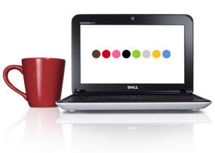
Win a Dell Mini!
We have a Dell Mini netbook to give away today.
To be eligible, you must complete the webcast evaluation.
We will draw the winner at random after the event is completed (not on the live stream today).
The winner will be notified via e-mail.
Dell Mini Inspiron 10 (1012) Netbook®
Atom® Processor N450 (1.66GHz, 512K)
Genuine Windows® 7 Starter
for Small Notebook PCs, 32bit, English
10.1" Widescreen Display (1366x768)
Integrated 1.3M Pixel
250G, 2.5inch, 5400RPM SATA Hard Drive and Webcam
NO PURCHASE NECESSARY.
Open only to legal residents of the 50 US or DC. Sweepstakes ends 1:30 pm, Central time, on April 29, 2010.
For full rules, please e-mail : v-jatho@microsoft.com

Slide 8
Deployment Resources
Start driving Proof of Concept Projects in your org!
  Use Self-Service Proof of Concept Jumpstart Kit:
    http://technet.microsoft.com/en-us/windows/ff603537.aspx
  Find Microsoft Partners/Microsoft Consultants to assist you:
    http://www.microsoft.com/deploynow
  Learn more on deployment tools and guidance from Springboard:
    http://www.microsoft.com/springboard
  Send this webcast link to your colleagues:
    http://go.microsoft.com/?linkid=9725330

Slide 9

© 2010 Microsoft Corporation. All rights reserved. Microsoft, Windows, Windows Vista and other product names are or may be registered trademarks and/or trademarks in the U.S. and/or other countries.
The information herein is for informational purposes only and represents the current view of Microsoft Corporation as of the date of this presentation. Because Microsoft must respond to changing market conditions, it should not be interpreted to be a commitment on the part of Microsoft, and Microsoft cannot guarantee the accuracy of any information provided after the date of this presentation. MICROSOFT MAKES NO WARRANTIES, EXPRESS, IMPLIED OR STATUTORY, AS TO THE INFORMATION IN THIS PRESENTATION.

