Slide 1

FOREFRONT TMG VPN Juan Luis García Rambla MVP Windows Security jlrambla@informatica64.com

Slide 2
Agenda
Introducción.
Servicio de VPN.
Notificación del proceso de inspección.

Slide 3
Introducción

Slide 4
Introducción
VPN define una “Virtual Private Network” o Red Privada Virtual.
Básicamente una VPN establece una conexión segura a través de un medio inseguro como pueda ser Internet.
Cualquier red que utilice conexiones IP puede considerarse una VPN.

Slide 5
VPN en Forefront TMG
TMG ofrece soporte de arquitectura VPN para dos casuísticas:
Clientes VPN.
Branch Office.

Slide 6
Cliente VPN
Adicionalmente a las arquitecturas tradicionales de ISA Server 2006 para conexiones PPTP y L2TP, TMG ofrece conexión mediante SSL.
A través de la conexión SSTP un cliente puede establecer una conexión VPN a través de puerto 443.

Slide 7
Servicio de VPN

Slide 8
Características de las VPN
Se requiere de un encapsulado capaz de proveernos de:
Autenticación.
Usuario.
Equipo.
Datos.
Compresión de datos.
Cifrado de datos.
Direccionamiento dinámico.
Resolución de nombres.
Gestión de claves.
Soporte Multiprotocolo (IP, IPX, etc…).

Slide 9
Encapsulado
Poner un paquete dentro de otro.
Se encapsulan o envuelven los datos con otra cabecera con información de enrutamiento para que puedan atravesar una red publica hasta su destino.
Puede encapsularse trafico a dos niveles del modelo OSI.
Nivel 2: encapsulan tramas al nivel de conexión.
PPTP.
L2F.
L2TP.
Nivel 3: encapsulan paquetes al nivel de red.
IPSEC.

Slide 10
SSTP
Las conexiones SSTP establecen conectividad TCP a través de HTTPS.
SSL a través de los certificados validan la conexión con el servidor.
Una vez validada la conexión SSL se procede a la fase de negociación y autenticación PPP.
El encapsulamiento de los paquetes PPP se realiza sobre la sesión HTTPS.

Slide 11
Protocolos de túnel
PPTP.
Desarrollado por Microsoft, es un estándar de facto.
Esta ampliamente implementado y existen varias implementaciones compatibles.
Suficientemente seguro para casi todas las aplicaciones.
L2TP.
Estándar de la “Internet Engineering Task Force” (IETF) .
Unión.
Algunos problemas de interoperabilidad.
Tanto PPTP, L2TP y SSTP utilizan PPP por debajo, lo que les proporciona gran parte de los requerimientos necesarios.
Notes:
PPTP is a Microsoft-developed protocol that has become the de facto industry standard due to its wide deployment in Windows; PPTP clients ship with all versions of Windows since Microsoft® Windows® 95, with Mac OS X, and with most Linux distributions. PPTP supports a variety of authentication methods, which we’ll discuss later, and it encrypts connections in both directions using a randomly generated, and periodically changed, symmetric key. You may have heard from customers that PPTP is insecure; in fact, there were some vulnerabilities discovered in the NT 4.0 timeframe, but Microsoft moved quickly to fix them. A few non-Microsoft PPTP implementations on Linux still have a number of implementation flaws.
Unlike PPTP, the Layer 2 Tunneling Protocol (L2TP) is a pure tunneling protocol. It doesn’t incorporate any authentication or encryption, which makes it unsuitable for use on its own. L2TP is almost always combined with the IPsec extensions for VPN functionality: this combination provides strong encryption and authentication, plus tunneling that can be used either to link two remote networks or a single remote client to a network (we’ll discuss these two modes in the IPsec module). For the remainder of this course, we’ll treat the L2TP+IPsec combination as though it were a single protocol.

Slide 12
Autenticación
PPTP
Autenticación a nivel de Usuario proporcionada por PPP.
L2TP/IPSec
Autenticación a nivel de Usuario proporcionada por PPP.
Autenticación a nivel de máquina proporcionada por IPSec.
Claves preestablecidas.
Certificados Digitales de máquina.
SSTP
Validación de la confianza a nivel TCP proporcionado por certificados.
Autenticación a nivel de Usuario proporcionada por PPP.

Slide 13
Metodos de Autenticación
Password Authentication Protocol (PAP).
Envía la password en texto claro.
Shiva Password Authentication Protocol (SPAP).
Utiliza cifrado reversible.
Challenge Handshake Authentication Protocol (CHAP).
Utiliza MD5 para proporcionar autenticación mediante desafío-respuesta.
Requiere almacenar las contraseñas con cifrado reversible en el servidor (DC).
MS-CHAP.
Existen debilidades conocidas.
Notes:
For backward compatibility, the Windows 2000 and Windows 2003 RRAS services include support for a number of authentication methods that nonetheless shouldn’t be used in production networks. While these protocols may sometimes be turned on to support legacy systems, you should be careful to point out the security implications of doing so to your customers.
PAP sends the user name and password in cleartext.
CHAP uses MD5 to provide challenge-response authentication. It is broadly supported, but it requires you to configure AD to allow storage of reversibly encrypted passwords. Doing so means that an attacker who can compromise a domain controller can obtain passwords for all users, so this is a really, really bad idea, especially since you normally have to force a password change so that users get their passwords changed.
MS-CHAP is a Microsoft-developed variant of CHAP that provides a similar MD5-based challenge-response protocol but that doesn’t depend on reversible encryption of users’ passwords. This makes it a better choice than CHAP; however, the original protocol has a number of design weaknesses that have been known for several years. Accordingly, its use is not recommended.
By default, the Windows Server 2003 family implementation of MS-CHAP v1 does not support LAN Manager authentication. If you want to allow the use of LAN Manager authentication with MS-CHAP v1 for older operating systems such as Microsoft® Windows NT® 3.5 and Windows 95, you must set the HKLM\System\CurrentControlSet\Services\RemoteAccess\Policy\Allow LM Authentication value to 1 on the authenticating server. Microsoft® Windows® 2000 Server supports LAN Manager authentication by default. Upgrading a computer running Windows 2000 Server to a member of the Windows Server 2003 family preserves the existing Allow LM Authentication setting.

Slide 14
Metodos de Autenticación
MS-CHAP v2.
Versión mejorada de MS-CHAP.
Usada frecuentemente.
Desde el punto de vista del cifrado es mas fuerte que PAP, CHAP, MS-CHAP.
Recomendada cuando no es posible implementar EAP-TLS.
Notes:
MS-CHAP version 2 (v2) addresses several weakness in the original MS-CHAP protocol:
MS-CHAP allows LAN Manager encoding for responses, and that’s cryptographically weak. MS-CHAPv2 doesn’t use LAN Manager encoding for anything, including password changes.
MS-CHAP provides one-way authentication: the server can authenticate the client, but there’s no way for the client to authenticate the server’s identity. MS-CHAPv2 provides two-way mutual authentication.
MS-CHAP uses a key generation process that results in using the same key each time a user with the same password connects. MS-CHAPv2 adds random data to the password generation process so that cryptographic keys aren’t ever reused.
MS-CHAP uses a single key for transmitting and receiving data. MS-CHAPv2 uses two separate cryptographic keys.

Slide 15
Metodos de Autenticación
EAP
Extensible Authentication Protocol
Soporta varios tipos de Autenticación
EAP-MD5: Desafió/Respuesta. No muy seguro.
EAP-TLS: Basado en cerificados; requiere pertenencia a un dominio; diseñado para ser utilizado con Smart Cards
EAP-RADIUS: Mecanismo proxy de reenvió de datos en un formato EAP especifico a un servidor RADIUS
El tipo a utilizar se puede especificar en el servidor o mediante políticas a un grupo especifico de usuarios.
Notes:
With the Extensible Authentication Protocol (EAP), an arbitrary authentication mechanism authenticates a remote access connection. The exact authentication scheme to be used is negotiated by the remote access client and the authenticator (either the remote access server or the RADIUS server). Routing and Remote Access includes support for EAP-TLS and MD5-Challenge by default. You can plug in other EAP modules to the server running Routing and Remote Access to provide other EAP methods.EAP allows for an open-ended conversation between the remote access client and the authenticator. The conversation consists of authenticator requests for authentication information and the responses by the remote access client. For example, when EAP is used with security token cards, the authenticator can separately query the remote access client for a name, PIN, and card token value. As each query is asked and answered, the remote access client passes through another level of authentication. When all questions have been answered satisfactorily, the remote access client is authenticated.A specific EAP authentication scheme is known as an EAP type. Both the remote access client and the authenticator must support the same EAP type for successful authentication to occur.
Windows 2000 and 2003 support several EAP types:
EAP-MD5 is used for challenge-response authentication between servers; it shouldn’t be used for user authentication, and Windows RRAS doesn’t let you choose it for such. However, third-party products that request EAP-MD5 challenges for RADIUS traffic will work.
EAP-TLS uses digital certificates to exchange keys that are then used to establish a secure connection for authentication. This is the most secure EAP type supported by Windows 2000 (Windows 2003 supports PEAP, covered in the next slide). However, it requires clients to have client certificates, so it is mostly used with deployments that include smartcards or tokens that can hold the necessary certificates.
EAP-RADIUS is a proxy pass-through mechanism that allows an RRAS server to accept data in a specified EAP type and pass it to a RADIUS proxy. It can’t be used for direct authentication.
The specific EAP types used on a server can be set on a per-server basis; in addition, you can use remote access policies to determine which types may or must be used for specific groups of users.

Slide 16
Metodos de Autenticación
PEAP: Protected EAP
Proteje las negociaciones EAP envolviéndolas con TLS.
Se usa solo para conexiones wireless 802.11.
Soporta reconexiones rpáidas para entornos grandes con roaming.
Puede usar PEAP plus
EAP-MS-CHAPv2: añade autenticación mutua; requiere que el cliente confíe en los certificados del servidor; fácil de implementar.
EAP-TLS: muy seguro; requiere una infraestructura PKI.
Notes:
Protected Extensible Authentication Protocol (PEAP) is a new member of the family of EAP types. PEAP uses Transport Level Security (TLS) to create an encrypted link between an authenticating PEAP client, such as a wireless computer, and a PEAP authenticator, usually an IAS server. PEAP itself does not specify an authentication method, but provides additional security for other EAP authentication protocols, such as EAP-MSCHAPv2, that can operate through the TLS-protected channel provided by PEAP. PEAP is used as an authentication method for 802.11 wireless client computers, but is not currently supported for VPNs or other remote access clients.To enhance both the EAP protocols and network security, PEAP provides:
Protection for the EAP method negotiation that occurs between client and server through a TLS channel. This helps prevent an attacker from injecting packets between the client and the RRAS server to cause the negotiation of a less secure EAP method. The encrypted TLS channel also helps prevent denial of service attacks against the IAS server.
Support for the fragmentation and reassembly of messages, allowing the use of EAP types that do not provide this.
A way for wireless clients to authenticate the IAS or RADIUS server. Because the server also authenticates the client, mutual authentication occurs.
Protection against the deployment of an unauthorized wireless access point (WAP) when the EAP client authenticates the certificate provided by the IAS server. In addition, the TLS master secret created by the PEAP authenticator and client is not shared with the access point. Because of this, the access point cannot decrypt the messages protected by PEAP.
PEAP fast reconnect, which reduces the delay in time between an authentication request by a client and the response by the IAS or RADIUS server, and allows wireless clients to move between access points without repeated requests for authentication. This reduces resource requirements for both client and server.
You can deploy PEAP for 802.11 wireless access in two methods:
PEAP with EAP-MS-CHAPv2 (PEAP-EAP-MS-CHAPv2) is easier to deploy than EAP-TLS because user authentication is accomplished with password-based credentials (user name and password) instead of certificates or smart cards--only the IAS or RADIUS server is required to have a certificate. PEAP-EAP-MS-CHAPv2 provides improved security over MS-CHAPv2 by using mutual authentication, preventing an unauthorized server from negotiating the least secure authentication method, and providing key generation with TLS. PEAP-EAP-MS-CHAPv2 requires that the client trust certificates provided by the server.Additionally, the server certificate can be issued by a public CA. that is trusted by the client computer (that is, the public CA certificate already exists in the Trusted Root Certification Authority folder on the client computer certificate store. In this case, the server certificate is not downloaded and added to the client trusted root certificate store, and the user is not prompted to make a decision about whether to trust the server.
PEAP with EAP-TLS provide a much stronger authentication method than those that use password-based credentials. PEAP with EAP-TLS (PEAP-EAP-TLS) uses certificates for server authentication and either certificates or smart cards for user and client computer authentication. To use PEAP-EAP-TLS, you must deploy a PKI because the client has to have a certificate issued by the same CA that the server's using.

Slide 17
Branch Office

Slide 18
Necesidades de conexión
Un problema frecuente de las empresas consiste en el envío de datos críticos para una organización a través de un medio inseguro como Internet.
La soluciones de comunicaciones deben permitir una integración en las infraestructuras, minimizando el impacto administrativo y el esfuerzo de los usuarios.
Ante un elevado número de usuarios, los clientes VPN, deben dar paso a conexiones entre sitios.

Slide 19
Conexión de Sitios mediante VPN
Establece una conexión entre dos sedes mediante una conexión VPN.
La conexión puede establecerse mediante:
PPTP.
L2TP/IPSEC.
SSTP
Túnel IPSEC.
TMG admite los mismos sistemas de autenticación para clientes VPN que para conexiones de sitios remotos.

Slide 20
Características de la conexión
Para realizar una conexión de VPN Site to Site son necesarias una serie de condiciones:
Tener una cuenta de usuario con permisos de marcado.
El nombre de la red de conexión Sitio a Sitio deberá tener el mismo nombre de la cuenta con permisos de marcado.
Deberá establecerse un direccionamiento IP diferente para cada lado del túnel y diferente de todas las redes IP conocidas por los servidores involucrados en la conexión.

Slide 21
Sitios remotos y clientes VPN
Determinadas configuraciones de VPN son compartidas por las dos soluciones ofrecidas por TMG.
Direcciones IP asignables.
Mecanismos de autenticación.
Definición de servidores Radius para la autenticación.
Habrá que prever por lo tanto la necesidad de utilizar estas funciones compartidas en un único servidor o utilizar dos servidores diferenciados para configuraciones independientes.

Slide 22
DEMO

Slide 23
Contacto
Juan Luis García Rambla
jlrambla@informatica64.com
Informática64
www.informatica64.com

Slide 24
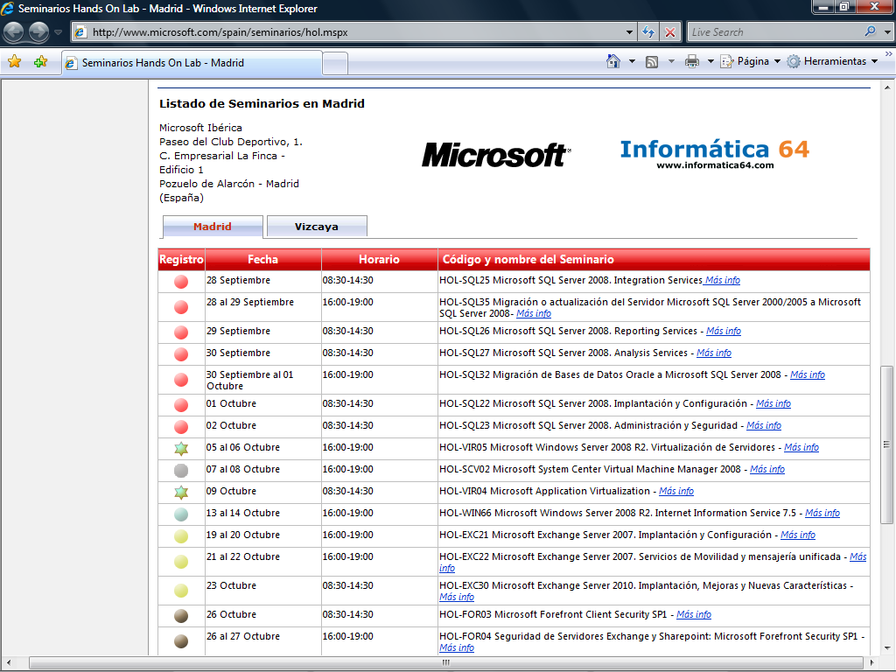
Campaña Hand On Lab
http://www.microsoft.com/spain/seminarios/hol.mspx
Semana del 26 al 30 de Octubre – HOL Forefront

Slide 25
Más acciones desde TechNet
Para ver los webcast grabados sobre éste tema y otros temas, diríjase a:
http://www.microsoft.es/technet/jornadas/webcasts/webcasts_ant.asp
Para información y registro de Futuros Webcast de éste y otros temas diríjase a:
http://www.microsoft.es/technet/jornadas/webcasts/default.asp
Para mantenerse informado sobre todos los Eventos, Seminarios y webcast suscríbase a nuestro boletín TechNet Flash en ésta dirección:
http://www.microsoft.es/technet/boletines/default.mspx
Descubra los mejores vídeos para TI gratis y a un solo clic:
http://www.microsoft.es/technet/itsshowtime/default.aspx
Para acceder a toda la información, betas, actualizaciones, recursos, puede suscribirse a Nuestra Suscripción TechNet en:
http://www.microsoft.es/technet/recursos/cd/default.mspx

