Slide 1
Biztalk in the field
CODit Collaborative integration
Platform
Ahlers
Danny Buysse, Product Manager and Lead architect CODit

Slide 2
Agenda
About CODit
About Ahlers
About The Project

Slide 3
About CODIT

Slide 4
Company mission statement
Help enterprises to integrate their different application domains (EAI) and connect their business with external partners (B2B) with more flexible processes
Focus on Integration and Microsoft technology
  BizTalk Server & Host Integration Server
  SQL Server SSIS (ETL)
  .NET 3.5 and 4.0
  WCF : Communication Foundation (web services)
  WF: Workflow Foundation (AppFabric)
  Business process Automation/Modeling
  .NET Development
  SharePoint Workflow Development (MOSS)

Slide 5
Business Units
CODit Projects & Consultancy (Services)
CODit Managed Services (Support Desk)
  Biggest Dedicated BizTalk Support center in Europe!!
  From support availability to full outsourcing
CODit Products
  Collaborative Integration Platform
  BizTalk Implementation Framework
  SOA Dashboard

Slide 6
About AHLERS

Slide 7

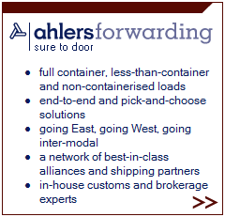
Ahlers Logistic and Maritime Services is an international logistic and maritime service provider with a network of own offices in Europe, Asia and CIS/Baltic.

Slide 8
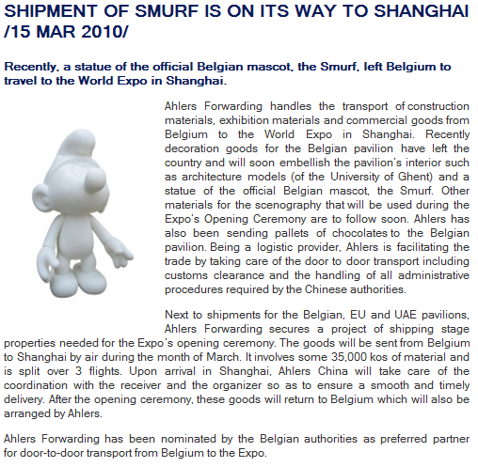
http://www.ahlers.com/en/news/articles/2010/Smurf/

Slide 9
THE PROJECT
To improve her performance in the field of information management, Ahlers initiated a project known as the “1-file concept”.

Slide 10
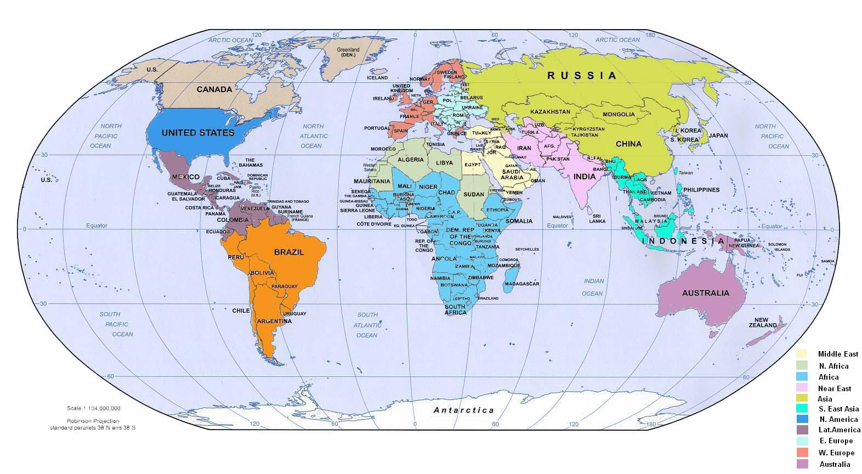
Ahlers counts over 700 employees in 16 countries in Europe, CIS and Asia.
ERP Sint Petersburg
ERP Rotterdam
ERP Antwerp
ERP China
x
One File Concept – Enterprise Application Integration
ERP India
x
ERP Indonesia
x

Slide 11
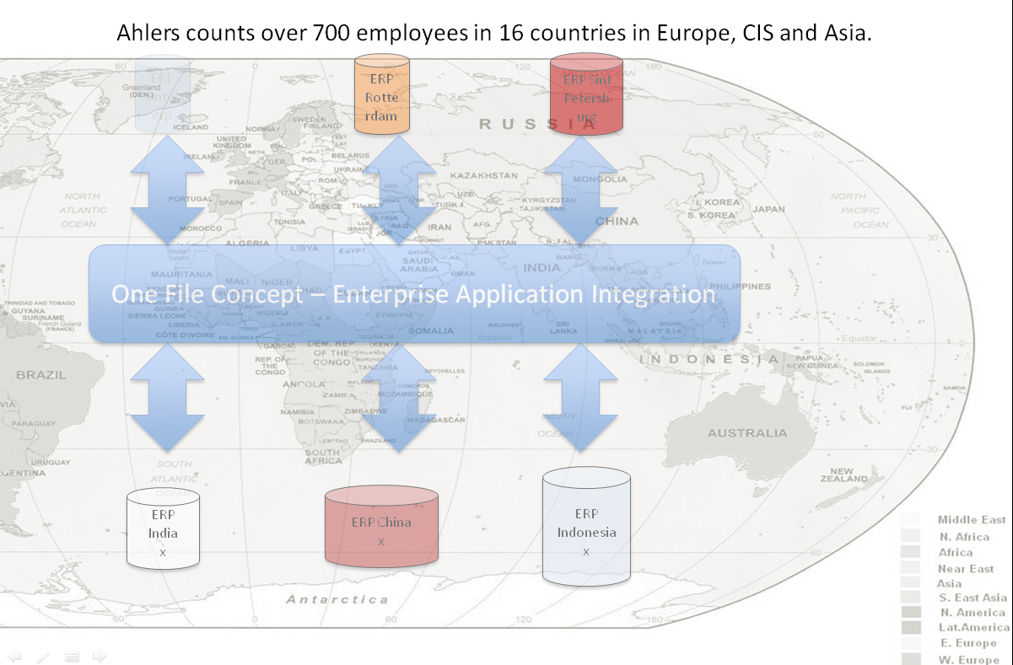
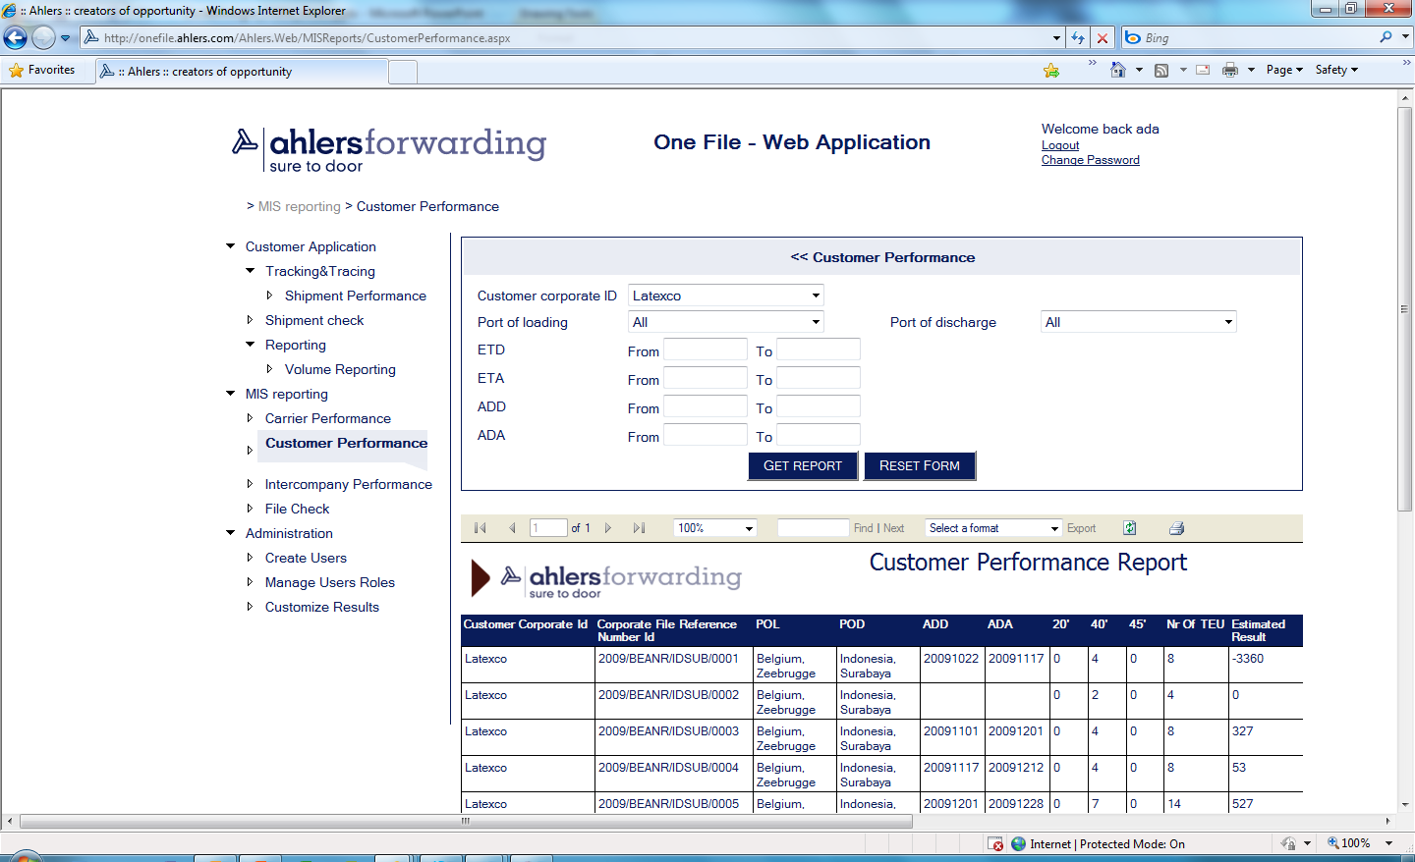
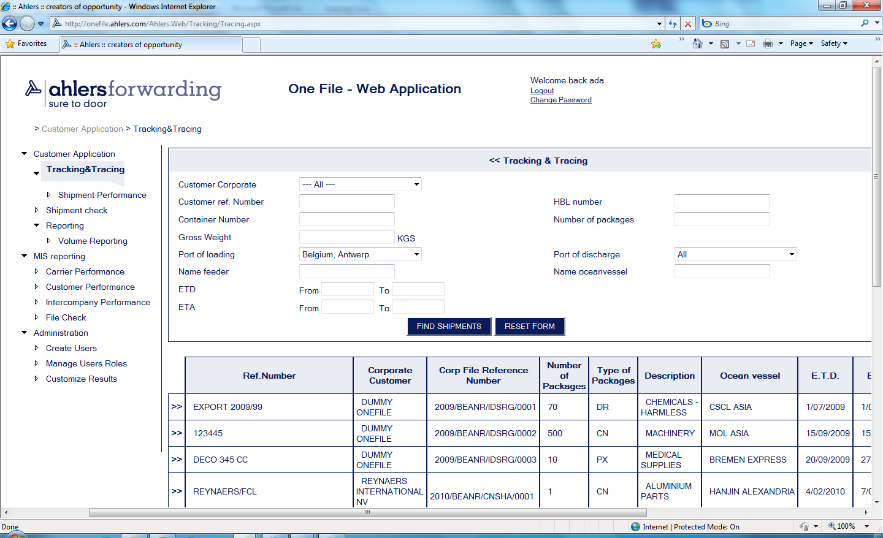
Functionalities for business users
Exchange of operational data, related to a ‘file’, between connected offices or between a connected office and the corporate server
Customer tracking and tracing application, accessible via a web portal
MIS-reporting on Ahlers corporate level

Slide 12
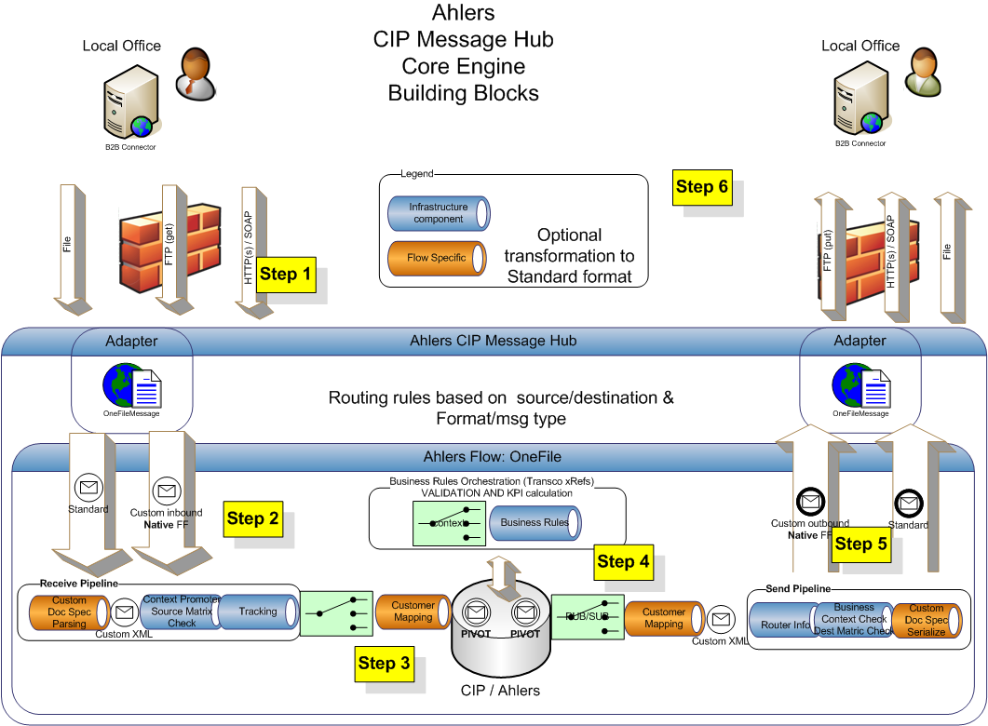
Technical solution

Slide 13
BizTalk Functionalities used
Rich Adapter Set
Validation of content
Mapping capabilities in messaging layer
Tracking
Routing functionalites based on context properties
Web Service integration for Business rules
Configuration
Orchestration for business user notifications
Generic Exception handling pattern

Slide 14
Technologies used
Microsoft BizTalk Server
SQL Server
ASP.NET
Linq2SQL
CODit Implementation Framework
WCF Services

Slide 15
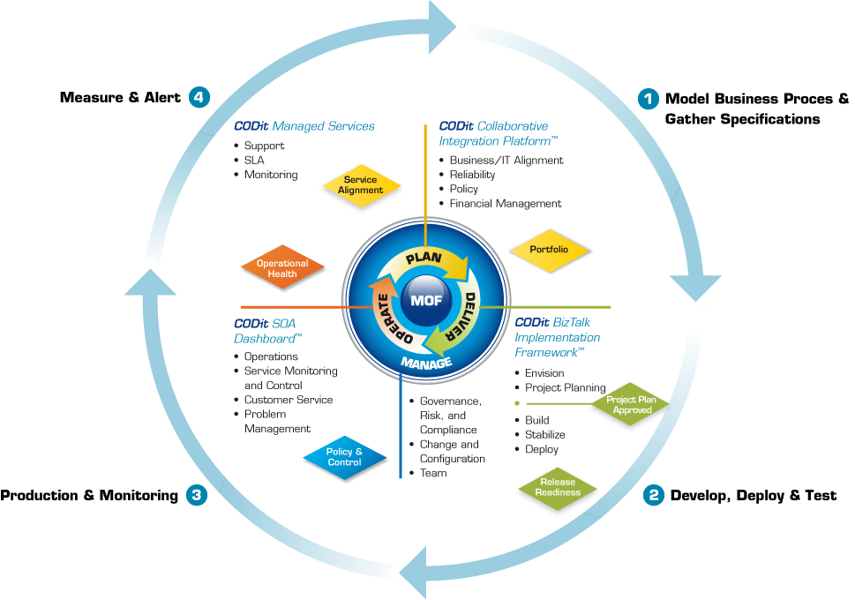
Integration Lifecycle

Slide 16
Q&A
Contact details: danny.buysse@codit.eu

