Slide 2
Microsoft FAST Technologies for the most demanding Enterprise Search
Guest speaker:
Marc Van de Woestijne from JobAt
Dirk Fierens Solution Advisor Microsoft

Slide 3
Agenda
Introduction to Microsoft Search
The different flavors of FAST
Demonstration of some live sites
Testimonial of JobAt solution based on FAST
Conclusion and Q&A

Slide 4




Vision
Enterprise search will change the way people interact with information
Search
will be
everywhere
Search will
enable unique
user experiences
Search will
change the way people do business

Slide 5



Microsoft’s Enterprise Search Today
Entry-level
Solution
Infrastructure
Solution
High-end
Solution
Enterprise search tightly integrated with a business productivity infrastructure
Best-in-class
enterprise search for the most demanding applications
Enterprise search available as a free download

Slide 6
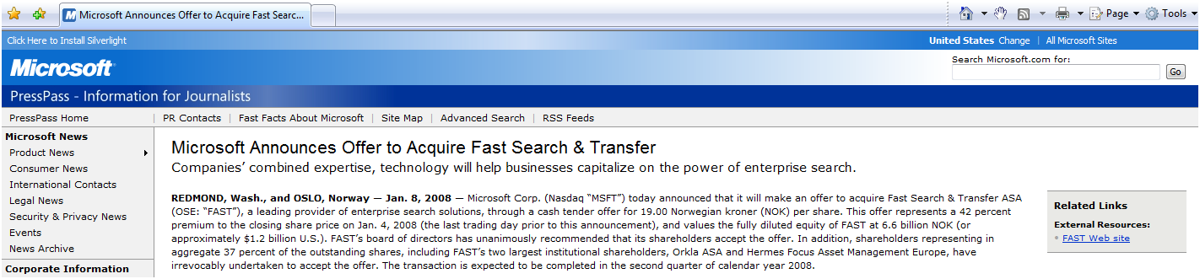
Acquisition of FAST

Slide 7
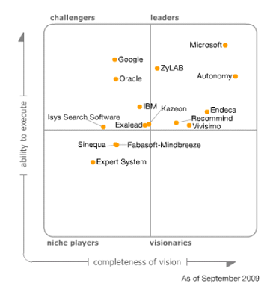


Microsoft is in the Leaders Quadrant
Gartner Magic Quadrant for Information Access Technology, 2009
The Magic Quadrant is copyrighted September 2009 by Gartner, Inc. and is reused with permission. The Magic Quadrant is a graphical representation of a marketplace at and for a specific time period. It depicts Gartner's analysis of how certain vendors measure against criteria for that marketplace, as defined by Gartner. Gartner does not endorse any vendor, product or service depicted in the Magic Quadrant, and does not advise technology users to select only those vendors placed in the "Leaders" quadrant. The Magic Quadrant is intended solely as a research tool, and is not meant to be a specific guide to action. Gartner disclaims all warranties, express or implied, with respect to this research, including any warranties of merchantability or fitness for a particular purpose. This Magic Quadrant graphic was published by Gartner, Inc. as part of a larger research note and should be evaluated in the context of the entire report. The Gartner report is available upon request from Microsoft.
SOURCE: Gartner, Inc., “Magic Quadrant for Information Access Technology”

Slide 8
Agenda
Introduction to Microsoft Search
The different flavors of FAST
Demonstration of some live sites
Testimonial of JobAt solution based on FAST
Conclusion and Q&A

Slide 9
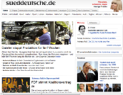
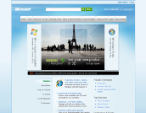
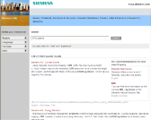
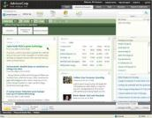


Search… to drive your Business
Connecting people to information, driving better outcomes
On a company website
On a corporate network
  [Screenshot]
  Increasing Revenue
  Quality business decisions
  Production time
  Cutting
  Costs
  Production time
  High end Search foundation
    Search helps your customers
    get what they want.
Search helps your employees
get their jobs done.

Slide 10
Enterprise Search Product Portfolio in Wave 2010
Products to Meet Every Customer Need
Solutions for
Internet Business
Solutions for
Business Productivity
FAST Search
for SharePoint Internet Sites
FAST Search
for SharePoint
FAST Integrated
with
SharePoint
SharePoint Server for Internet Sites
SharePoint Server
FAST Search
For Internet Business
FAST Search
for Internal Applications
FAST Stand-alone
Entry-Level
Solutions
Search Server
Express

Slide 11
FAST Search for SharePoint
Business Productivity Proposition

Slide 12


Microsoft Enterprise Search- Productivity
Products for Every Customer Need
Complete intranet search
High end search delivered through SharePoint
Common across the product line
Common UI Framework
Social search features and integration
SharePoint platform integration
End user and site administrator enablement
Common Connector Framework (BDC)
APIs and developer Experience
Admin & deployment capabilities
Operations advantages (SCOM, scripting)

Slide 13



FAST Search Extends SharePoint Server
Superset of capabilities; common base functionality and platform
Best High-End Content Search based on FAST ESP
Common query and federation APIs
Common connectors and content APIs
FAST Search
for SharePoint
Content search
SharePoint Server
2010
End
Users
People search
Content +
Profiles
Unique Social Search
from SharePoint Server 2010
Common IT Pro and developer experience

Slide 14
FAST Search for SharePoint
Summary of architectural elements
Site Collection Level Admin UI
- Keyword Management
- User Context Management
- Site Promotion/Demotion
PowerShell
Schema configuration
Admin configuration
Deployment configuration
Central Administration UI
Property mapping
Property extraction
Spell-checking
Administration and Schema Object Model
SharePoint
Front-end
Security
Access
Module
Indexing
Content
Processing
And
Linguistics
Connectors:
- SharePoint
- File Traverser
- Web
- BDC
- Exchange
- Notes
- Documentum
Content
Content
Custom
front-end
Query Object Model
Query Web Service
Query and
Result
Processing
Search
Connectors:
- Web Crawler
JDBC
Content
Federation
Object Model
Monitoring Services
OpenSearch or other Sources
People Search
Microsoft System Center Operations Manager
!
!
SharePoint Server 2010
FAST Search for SharePoint
Other

Slide 15
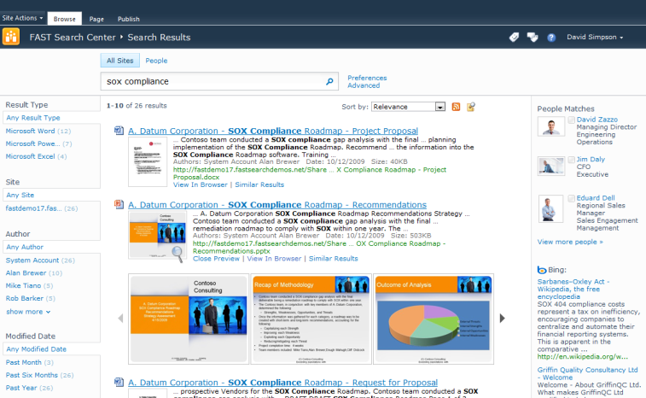
FAST Search for SharePoint User Interface
Visual and conversational interaction with precise control
Deep Federation
Sorting
Thumbnails
Similar Results
Previews
Built on SharePoint Search Center
Leverages all of innovations in SharePoint
Open Web Parts, Federation, query suggestions, related queries, Did you mean?
Visual results connects users with content
Thumbnails for Word and PowerPoint
Visual Best Bets highlight premium content
Preview in browser without leaving the results

Slide 16
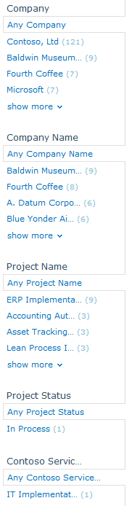

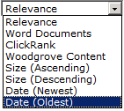
Deep Refinement and Sorting
Enables precise control of results
Out of the Box
Enables conversational experience across all of the results
  You will never miss any content
  Enabling better findability and exploration
  Discover non-obvious relationships across the entire result set
Exact counts shows relative weight
  Provides analytic view of your results
  Indicates priority and importance
  The right lever to slice and dice your content
Sort on any field
  Empower the user to use the relevance model that best fits their needs
  Rearrange the result set to meet specific criteria
  Alphabetical, numeric, and date
Sorting Options
Exact Counts

Slide 17
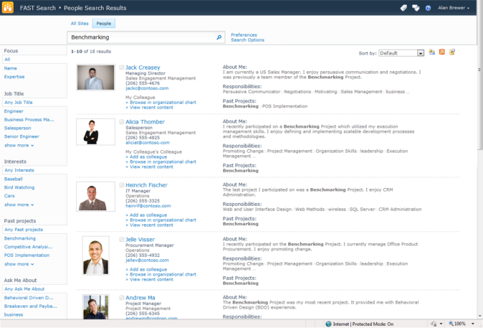
Connect with people and expertise
and streamline how you find and collaborate with others
Filter by title, expertise & other attributes
Phonetic name lookup
Expertise matching
Real-time
presence
Org browsing
Find recent content
Find people
with address book search that matches names phonetically & lets you browse organizations
Discover expertise
based on terms matched from
mined Outlook inbox data and
SharePoint MySite profiles
Use MySite profile pages
that recognize and track your colleagues and make it easier to share your work with others

Slide 18


Eliminate Compromise
IT Pro perspective
 | Enterprise class search system integrated with SharePoint | Highly capable and easy to manage
Industrial strength scale-out and performance | Enterprise Scale-out (to 100M docs) Full Fault Tolerance Native 64 bit; Hyper-V support | Same capabilities, plus: Extreme scale-out
Easy deployment | Wizard - driven installation | Same capabilities
Enterprise-class manageability | PowerShell support; SCOM support Consolidated search dashboard Graphical Search admin reports | Same capabilities, plus: Extended SCOM support
Secure, broad connectivity | Full set of connectors OOB Easy to add new sources via BDC Strong security | Same capabilities, plus: Enterprise Web Crawler
Advanced content processing OOB |  | Content Processing pipeline Metadata Extraction
Easy to configure high-end user experiences |  | Easy setup of User Context, Visual Best Bets, Promotion Give end users control over sorting, ranking, navigation

Slide 19
Demo
FAST Search on Microsoft’s intranet

Slide 20
FSIS Overview
FAST Search Server 2010 for Internet Sites

Slide 21

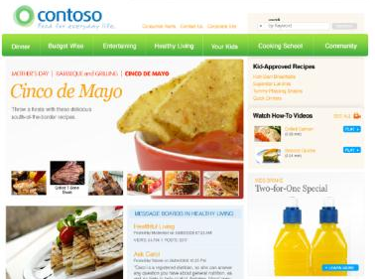
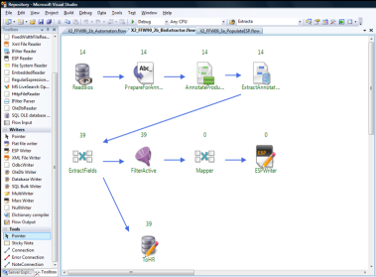
FAST Search for Internet Sites
A platform for creating search-driven experiences that …
Connect
people with
what they want
[Screenshot of
Web Experience]
[Screenshot of
Design Interface]
Adapt
as content, community &
customer interests change
Guide
customers to actions
that drive revenue

Slide 22














Engaging Experiences—Made Easier
FAST Search for Internet Sites is an enabling technology
Connect
Federated
Off-site Content
Search-generated
Topic Pages
Interactive Product
Experiences
Blended User-
generated Content
Adapt
Recommendations
& Personalization
Dynamic, Visual
Navigation
Location-based &
Mobile Search, Content
Social Ranking
& Tagging
Guide
Promotions and
Cross-sell
Targeted
Lead Generation
One-stop
Account Servicing
Interactive
Customer Support

Slide 23
FSIS vision pillars
Deliver engaging information experiences that drive revenue
Content fusion
Orchestrate enriched experiences
Interactive application development and tuning
Protect existing investments, show the future

Slide 24
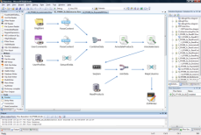


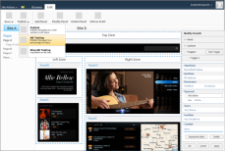
FSIS Overview
FAST Search Designer
for Developers
Visually develop, debug, and
profile flows
Engine
IMS
ESP 5.3 SP3
CTS
UI Toolkit
Engine
Engine
Index
Engine
Engine
Content
Engine
…
Engine
…
User Experience
FAST Search Business Manager
for IT and Business Managers
Deploy, start/stop, and monitor flows
Set triggers that govern which IMS flows
to use on different parts of a page
Integrated A/B testing

Slide 25
Agenda
Introduction to Microsoft Search
The different flavors of FAST
Demonstration of some live sites
Testimonial of JobAt solution based on FAST
Conclusion and Q&A

Slide 26
Agenda
Introduction to Microsoft Search
The different flavors of FAST
Demonstration of some live sites
Testimonial of JobAt solution based on FAST
Conclusion and Q&A

Slide 27
Agenda
Introduction to Microsoft Search
The different flavors of FAST
Demonstration of some live sites
Testimonial of JobAt solution based on FAST
Conclusion and Q&A

Slide 28





Turn information into business outcomes through engaging experiences.
Social
Connect and collaborate to apply your talent more effectively
Conversational
Change how you
interact with information, giving you better answers
Visual
Help you identify patterns and discover new insights
Contextual
Tailored to your
role, task, and perspective, making you more productive

Slide 29
Enterprise Search Content
More information:
  Search info on Technet
    http://technet.microsoft.com/en-us/enterprisesearch/default.aspx
  Enterprise resource center on MSDN
    http://msdn.microsoft.com/en-us/office/bb335345.aspx
  Search areas on Sharepoint.microsoft.com
    http://sharepoint2010.microsoft.com/product/capabilities/search/Pages/default.aspx
  Enterprise Search solutions
    http://www.microsoft.com/enterprisesearch/en/us/Solutions.aspx

