Slide 1
Microsoft Business Intelligence – One platform for delivering enterprise wide analysis and reporting
Raheel Retiwalla – Business Intelligence Specialist
Jim Healey – Office Business Applications
Bruce Alpert – Office Business Applications Specialist

Slide 2

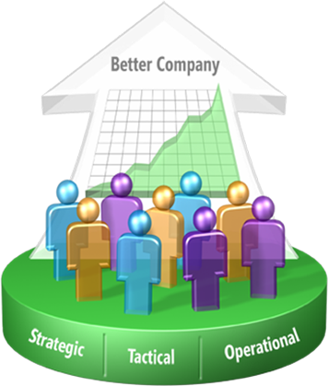


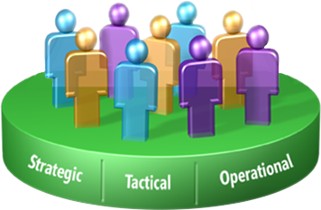
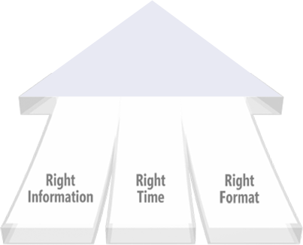

Improving organizations by providing business insights to all employees leading to better, faster, more relevant decisions
Advanced Analytics
Self Service Reporting
End-User Analysis
Business Performance Management
Operational Applications
Embedded Analytics

Slide 3


Analytic Applications
(Office Business Applications)
End-user Tools
(Office)
BI Platform
(SQL)

Slide 4










Complete and Integrated
Office
SQL
Analytic
Applications
Business Scorecarding, Planning, and Analytics
Portal
(Office Server)
End-user
Tools
End-user Analysis
Integrate
(SSIS)
Analyze
(SSAS)
Report
(SSRS)
BI
Platform
Data Warehouse
(SQL Server 2005)
Notes:
4

Slide 5


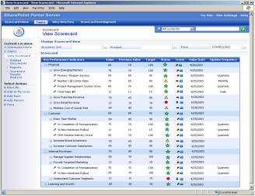







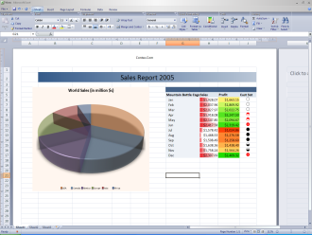
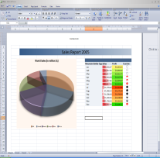


GOE Data Warehouse Solution Architecture
JDE, Artemis
Historian
Unified Model for all analysis and reporting
Data Warehouse
SSIS
Dashboard
Other existing data
UDM
Analysis Services
Reporting Services
External Sources
Excel
Excel

Slide 6


Business Intelligence end-user experience

