Slide 1
Tutorial on Microsoft SOA Technologies Part1
Klaus Rohe
Developer Platform & Strategy Group
Microsoft Deutschland GmbH
klrohe@microsoft.com

Slide 2
Agenda
Fundamentals
Architecture of Smart Clients (Windows Presentation Foundation WPF)
WS* compliant services (Windows Communication Foundation WCF)
Workflow (Windows Workflow Foundation WF)
Additional technologies and perspectives

Slide 3
Microsoft Platform Architecture
Microsoft Windows Operating System
(Windows Server 2003 / 2008)
.NET 3.X (Application Programming Model)
Internet Information Services 6.0/7.0 (IIS 6.0/7.0)
Management
Message Queuing (MSMQ)
Transactions (COM+)
Active Directory
UDDI
Application server (Middleware)
Recovery
Networking
Storage

Slide 4
Microsoft .NET 2.0 Framework
Browser
App
Web Service
App
Local
Apps
Distr.
Apps
C#
C++
VB.NET
IronPython
Perl
…
Common Type System /
Common Language Specification
ASP.NET
Web Forms
Web Parts
Web Services
ADO.NET
DB-Access
XML
Windows
Forms
Enterprise
Services
.NET Base Class Library
Common Language Runtime (CLR)
Windows Operating System

Slide 5
Microsoft .NET 3.0 Framework
.NET 3.0
Windows
Presenation
Foundation
(WPF)
Windows
Communication
Foundation
(WCF)
Windows
Workflow
Foundation
(WF)
Windows
Cardspace
.NET Framework 2.0

Slide 6
Microsoft .NET 3.5 Framework
.NET 3.5
Windows
Presenation
Foundation
(WPF)
Windows
Communication
Foundation
(WCF)
Windows
Workflow
Foundation
(WF)
Windows
Cardspace
LINQ
ADO.NET Entity Framework
.NET Framework 2.0

Slide 7
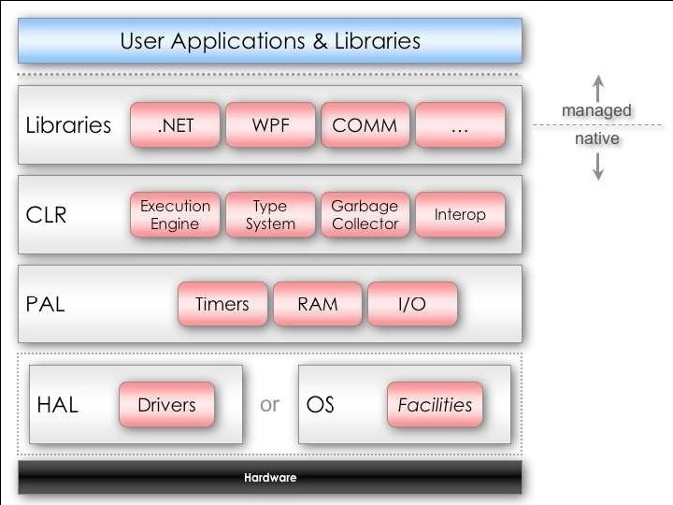
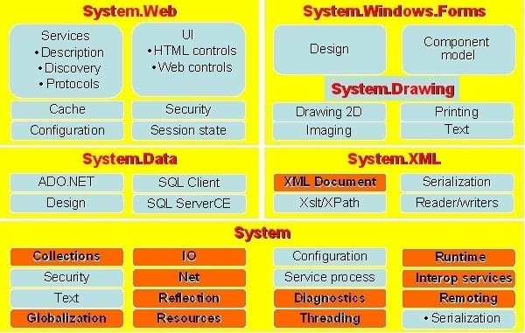
.NET Compact Framework .NET Micro Framework
Compact Framework for mobile devices (Windows Mobile)
Micro Framework for „Embedded“, no operating system necessary:
http://www.elektronikpraxis.vogel.de/themen/embeddedsoftwareengineering/implementierung/articles/92518/
.NET Micro Framework

Slide 8
Supported platform
Windows Vista
Windows XP SP2
Windows Server 2003 SP1
Windws Server 2008
.NET 3.X Software Development Kit, free download at:
http://www.microsoft.com/downloads/details.aspx?FamilyId=C2B1E300-F358-4523-B479-F53D234CDCCF&displaylang=en
Comes with command line tools, compilers, …

Slide 9
Agenda
Fundamentals
Architecture of Smart Clients (Windows Presentation Foundation WPF)
WS* compliant services (Windows Communication Foundation WCF)
Workflow (Windows Workflow Foundation WF)
Additional technologies and perspectives

Slide 10
Smart Client Architecture
Client
Server
CAS Sandbox
Deployment
Smart Client
Components
Smart Client Application
User interface
Web Service interface
Business logic
Business logic
Data
Locale
data store
Offline support
Notes:
Smart-Clients:
Make use of local resources
Make use of network resources
Support occasionally connected users
Provide intelligent installation and update
Provide client device flexibility

Slide 11
Smart-Client Technologies
Windows Forms
Since .NET 1.0, .NET Wrapper for Windows API
Windows Presentation Foundation (WPF)
New GUI technology, part of .NET 3.X for development of innovative user interfaces
Vector graphics, 3D, animations
Separation of layout and programming logic
Office (Word, Excel, Outlook…) as a Smart Client
Office programms as a basis for client development (No VBA programming)

Slide 12
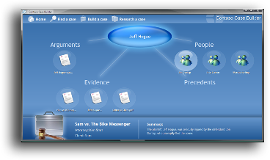
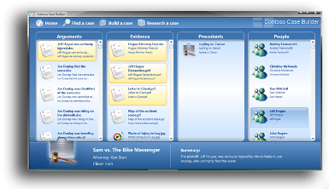
Windows Presentation Foundation (WPF)
Unified programming model for UIs, media and documents
Vector based graphics
Utilisation of the graphics subsystem of modern PCs
Support of declarative Programming
XAML eXtensible Application Markup Language
Better collaboration of graphic designers and programmers
Simplified Deployment
.NET deployment modell
Application starting from the browser
Notes:
Context: These are the four goals of WPF – next few slides drill down further on each of them.
Building UI, graphics, documents and media into a single environment: providing a richer experience by unifying these together, allowing them to be integrated in a far deeper way than before, and reducing the number of APIs developers have to track by putting things into a single managed object-orientated interface.
Rich graphics processors woefully underused by modern applications. 128MB memory, rich 3D capabilities. Avalon takes advantage of these capabilities using a DirectX-based model. Vector- rather than bitmap-based, supports high-dpi, double buffering.
Declarative and procedural programming supported for designers and developers to do what they want to do.
Need to make it as easy as “clicking on a link” to deploy an Avalon application: either via a browser or via a standalone app.

Slide 13
Three types of development for WPF applications
XAML
<Button Name="btnOk">
<Button.Background>
RadialGradient White Blue
</Button.Background>
OK
</Button>
XAML Only
XAML + C# Code (VB.NET, …)
Abstraction:
Separation of layout and progarmming logic
Visual Studio 2008
C# code only
C#
Button btnOk = new Button();
btnOk.Background = new RadialGradientBrush(
Colors.White, Colors.Blue);
btnOk.Content = "Ok";

Slide 14
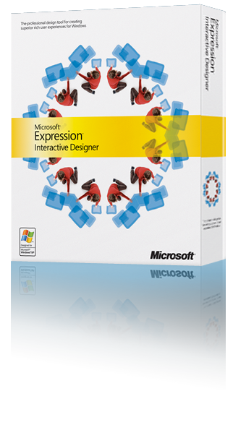


Better collaboration of designer & software developer
Designer
Softwareentwickler
Microsoft Expression
XAML
Microsoft Visual Studio 2005
Electricrain ZAM 3D
…

Slide 15
WPF in the web browser
XAML Browser Applikation
Nur Windows und IE, .NET 3.X Framework muss installiert sein
Silverlight 2.0:
Portable, subset of WPF,
Cross Browser and cross platform
IE 5.5+, Mozilla 1+, Firefox 1+, Opera 7+, Safari 1+
Mac OS, Linux
Supports JavaScript, C# , VB.Net, Python and Ruby
Beta: http://msdn2.microsoft.com/en-us/asp.net/bb187358.aspx

Slide 16
Agenda
Fundamentals
Architecture of Smart Clients (Windows Presentation Foundation WPF)
WS* compliant services (Windows Communication Foundation WCF)
Workflow (Windows Workflow Foundation WF)
Additional technologies and perspectives

Slide 17
SOA and Web Services
SOA
Web
Services
CORBA
…
WSDL
SOAP
…
IDL
IIOP
…
From: Evaluating a Service-Oriented Architecture, CMU/SEI-2007-TR-015
http://www.sei.cmu.edu/publications/documents/07.reports/07tr015.html

Slide 18
WS*
WS* is a shortcut for the web service specifications and standards:
WS-Security
WS-Addressing
WS-ReliableMessaging
WS-AtomicTransaction
WS-Policy
…
Web services are a technology to implement services in a platform and vendor agnostic way
Broad industry support:
Microsoft, IBM, Oracle, SAP
SOA != Web-Services, but …

Slide 19
Windows Communication Foundation (WCF)
Unified programming for distributed service oriented programming
Message oriented communication
Support of web service standards (WS*)
Considerable simplification of distributed programming
Meta data driven
WCF
(Indigo)
Web- Services (WSE)
Message
Queuing
Enterprise
services
Remoting

Slide 20
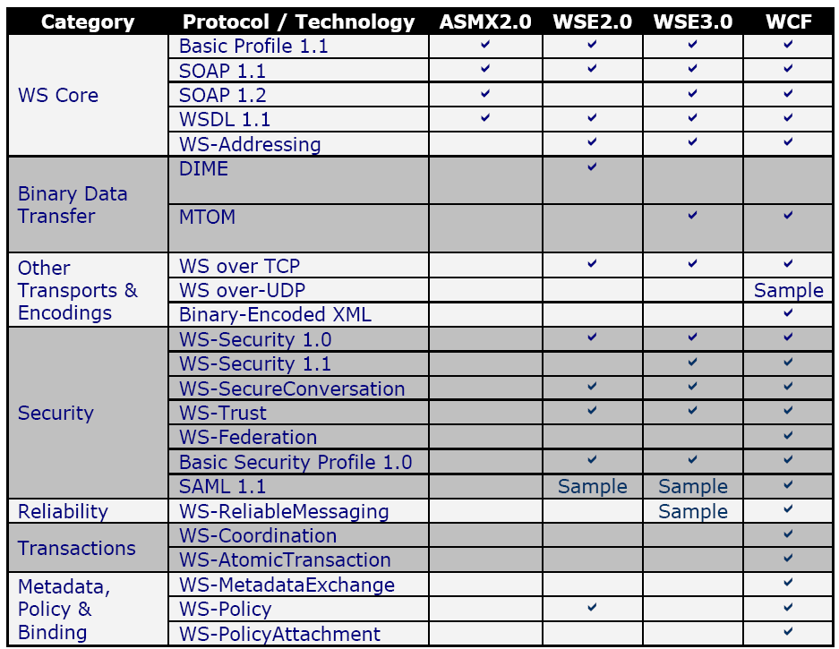
WS*-Protocolls supported in WCF

Slide 21
Windows Communication Foundation Endpoints
A
B
Service
Provider
(Host process)
Service
Consumer
C
C
B
A
End point
Message
A
B
C
End point
End point = Address + Binding + Contract
Address: URI
net.tcp://localhost:9000
net.pipe://mymachinename
http://localhost:8000
net.msmq://localhost
Binding: Communication properties
Contract: Operation contract & Data contract, public interface

Slide 22
Windows Communication Foundation Bindings
Flow Protocol
(e.g. WS-AtomicTransaction)
Binding:
Defines the communication properties (Security, data format, tranport protocol) of the communication
Bindings can be defined by configuration or in the code
10 standard bindings available
Reliability Protocol
(WS-ReliableMessaging)
Security Protocol
(WS-Security and related)
Binding
Encoder
(Text/XML, MTOM, Binary)
Transport
(Http, Tcp, Named Pipe, Queued)
Notes:
A binding defines how an endpoint communicates to the world. It is constructed of a set of components called binding elements that "stack" one on top of the other to create the communication infrastructure. At the very least, a binding defines the transport (such as HTTP or TCP) and the encoding being used (such as text or binary). A binding can contain binding elements that specify details like the security mechanisms used to secure messages, or the message pattern used by an endpoint.

Slide 23
WCF Communication architecture
Client
Service
Object
Proxy
Dispatcher
Transaction protocol
Transaction protocol
XML
Reliable Messaging
Protocols
Reliable Messaging
Protocols
Channel Stack
(Binding)
XML
Security protocol
Security protocol
Message Encoder
Message Encoder
1101011001
Transport
Transport

Slide 24
WCF Standard Bindings
Binding | Interop | Security | Session | TX | Duplex
BasicHttpBinding | Basic Profile 1.1 | N, T | N | N | n/a
WSHttpBinding | WS | M, T, X | N, T, RS | N, Yes | n/a
WSDualHttpBinding | WS | M | RS | N, Yes | Yes
WSFederationBinding | Federation | M | N, RS | N, Yes | No
NetTcpBinding | .NET | T, M | T ,RS | N, Yes | Yes
NetNamedPipeBinding | .NET | T | T, N | N, Yes | Yes
NetPeerTcpBinding | Peer | T | N | N | Yes
NetMsmqBinding | .NET | T, M, X | N | N, Yes | No
MsmqIntegrationBinding | MSMQ | T | N | N, Yes | n/a
poxBinding | (pox = plain old xml) = REST, neu im .NET Framework 3.5
N = None | T = Transport | M = Message | B = Both | RS = Reliable Session
Notes:
BasicHttpBinding
BasicHttpBinding nutzt Http-Transport, um SOAP 1.1 Nachrichten zu verschicken.
Alle Einstellungen sind WS-I Basic Profile 1.1 konform.
Sicherheit ist per Default ausgeschaltet kann aber auf Nachrichten- oder Transportebene
angeschaltet werden. Standardmäßig wird ein Text(UTF-8)-Encoding verwendet.
WSHttpBinding
WSHttpBinding ergänzt das BasicHttpBinding um erweiterte WS-Spezifikationen wie WSAddressing,
WS-ReliableMessaging und Transaktionen.
WSDualHttpBinding
WSDualHttpBinding baut auf WSHttpBinding auf, unterstützt jedoch Duplex Contracts für
asynchrone Kommunikation.
WSFederationHttpBinding
WSFederationHttpBinding implementiert die WSFederation-
Spezifikation, welche eine sichere und interoperable Kommunikation innerhalb
föderierter Unternehmen garantiert.
NetTcpBinding
Mit NetTcpBinding können binär-codierte Nachrichten über TCP versendet werden.
NetNamedPipeBinding Das NetNamedPipeBinding wird für lokale Kommunikation innerhalb einer Maschine
verwendet.
NetMsmqBinding
NetMsmqBinding unterstützt Microsoft Message Queuing (MSMQ) als Transport

Slide 25
WCF Bindings are very flexible
Binding of a WCF service can be changed without nay chnages to the source code:
Changes of the binding are done by editing the application configuration file (app.config)
Example:
Client PC
Application or parts of it should provide offline capability
Laptop for field staff
WCF Client
WCF Client
config
config
NetNamed-PipeBinding
NetTcpBinding
WCF Services
Server
WCF Services
config
DB
config
DB

Slide 26
netMSMQBinding
Dispatcher
Service
MSMQ
Queue
Client
Proxy
MSMQ
Channel
Listener
Dispatcher
Service

Slide 27
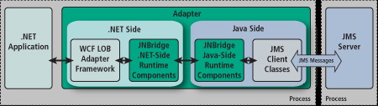
Reliable Messaging Bindings Integration
Custom Channel for IBM WebSphereMQ for Windows Communication Foundation
JNBridge JMS Adapter for .NET

Slide 28
WCF Contracts
A WCF contract describes the external public view on the service
Operation contracts
Defines the exposed operations
Data contracts
Describe the data which are send to or received from service operations
Message contracts
Describe a SOAP message
Message contracts support direct access to the SOAP header and SOAP body of a message

Slide 29
WCF Contract Example (1)
[DataContract]
public struct CalculatorMessage
{
[DataMember]
public string Expression;
[DataMember]
public string Result;
[DataMember]
public double ComuptationTime;
}
[ServiceContract()]
public interface ICalculatorService
{
[OperationContract]
string Calculate(string Expression);
[OperationContract]
void CalculateWithTiming(ref CalculatorMessage CalcMsg);
}

Slide 30
WCF Contract Example (2)
[ServiceContract()]
public interface IBankService
{
[OperationContract]
[TransactionFlow(TransactionFlowOption.Mandatory)]
bool TransferFromCA2SA(int aid, double amount);
[OperationContract]
AccountMessage GetAccountInfo(int aid);
}

Slide 31
WCF Service Behavior
Behaviors describe the behavior of the class, which implements the service interface
Operation behaviors define the behavior of operations (methods)
Example: Behavior concerning transactional context
Behavior | Description
Instancing | Controlls how instances are created: Singe (singleton) Per call Per session
Concurrency | Defines wether a service is single- or multi-threaded .
Throttling | Determines the maximum number of: simultaneous requests, Connections Number of service instances pending operations
Error Handling | Defines how exceptions are handled

Slide 32
Hosting WCF Services
Service must live in a process:
WCF services can be hosted in any .NET program (self-hosting)
.EXE, COM+, NT Service, WPF, IIS
IIS 7 supports http, tcp, named pipes and MSMQ as transport protocols.
Windows Activation Service (WAS)
Common service of WCF and IIS 7 which activates services on demand.
It supports process monitoring („Health Monitoring“), process recycling and configuration

Slide 33
WCF Activation Architecture
WAS
AppPools (w3wp.exe)
Process Manager
Configuration
Worker
(AppDomain)
Worker
(AppDomain)
Worker
(AppDomain)
Worker
(AppDomain)
Worker
(AppDomain)
Worker
(AppDomain)
Worker
(AppDomain)
Process Host
Worker
(AppDomain)
Process Host
Worker
(AppDomain)
Process Host
Protocol-specific Listener Adapters
http
net.tcp
net.pipe
net.msmq
Response
Request

Slide 34
WAS versus Self-Hosting
Self-host hast to be started explicitly (manually), Was doesn’t
System service (NT-Service)
In addition to system services WAS offers:
Idle time management
Identity management
Application pooling
Isolation
For self-hosting all the above features have to be implemented!

Slide 35
New in Visual Studio 2008 for WCF
New project templates for WCF
Generic WCF service host
WcfSvcHost.exe
Generic WCF test client
WcfTestClient.exe

Slide 36
Agenda
Fundamentals
Architecture of Smart Clients (Windows Presentation Foundation WPF)
WS* compliant services (Windows Communication Foundation WCF)
Workflow (Windows Workflow Foundation WF)
Additional technologies and perspectives

Slide 37
What is Windows Workflow Foundation?
Windows Workflow Foundation (WF) is a Framework for developing workflow based Windows application
Windows Workflow Foundation is not a server product but:
WF is targeted at software developers not buisness process designers:
WF simplifies the development of certain types of applications (long running processes…)
Tool to compose applications from existing services: Interplay of WF and WCF
Building flexible applications

Slide 38
Windows Workflow Foundation (WF) Workflow model
Sequential
workflow
State machine
workflow
A Workflow is a sequence of activities.
An activity in WF can be:
A block of code
Antoher WF workflow
A call to a (WS) service
A human interaction
Three types of workflow:
Sequential workflows (like a „flow diagram“)
State machine Workflows („Finite State Machine“)
Rue based workflow („Rule Engine“)
Rule based workflow
Rule1
…
Activity 1
Rule n
Activity n

Slide 39
Windows Workflow Foundation Architecture
Base technology:
A Workflow is a set of activities.
Workflow is executed by a host process.
Developer can implement domain specific activities
Components:
Base Activity Library: predefined, general activities, basis for domain specific activities
Runtime Engine: executes a workflow and provides runtime services. Has to be hostet in a .NET application.
Runtime Services: service provided for inter workflow communication, persistence, tracking …
Visual Designer: graphical editor to construct workflows in Visual Studio. Can be embedded into applications
Visual Designer
(Visual Studio 2008)
A workflow
Custom Activity Library
Windows
Workflow Foundation
Base Activity Library
Runtime Engine
Runtime Services

Slide 40
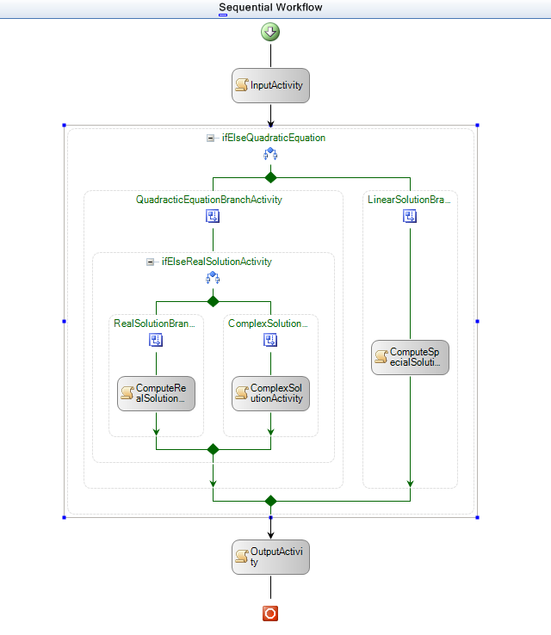
Supported design types in WF
Markup Only
(XOML)
Markup + Code
(XOML + C# / VB)
(Visual Designer)
Code Only
(C# / VB)
(Visual Designer)
Workflow Designer in Visual Studio
Workflow compiler
(wfc.exe)
Markup Only
(XOML)
C# / VB compiler
Workflow runtime
.NET assembly
Workflow
instance
Workflow
instance
Workflow
instance

Slide 41
Typical application scenarios for WF (Some examples)
Implementation of traceable business logic
WF visualizes the business logic and makes it traceable (Tracking Service!)
Implementation of long running and recoverable program logic
The WF persistence service provides transactional serialization and restart capability
Implementation of flexible components
WF provides the change of program logic without recompiling. Separation of logic from implementation, using domain specific activities to implement business logic
Implementation of program logic which can be described by rules
WF provides a rule engine with the capability to separate the rules into external rule file or database table.

Slide 42
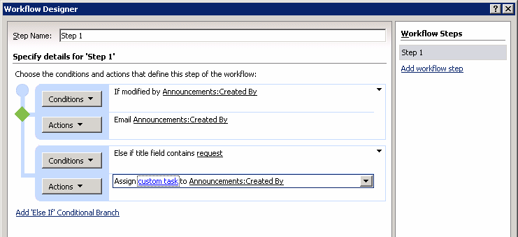
Microsofts Workflow Strategy
All Microsoft products which are some how related to workflow or include workflow related tasks will be build upon Windows Workflow Foundation.
Microsoft Office 2007 and Office SharePoint Server 2007 provide document centric workflows and workflow designers which are implemented with Windows Workflow Foundation.
The next version of Microsoft BizTalk server will be based on Windows Workflow Foundation.
(SharePoint Designer)

Slide 43
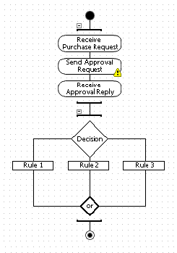
Microsoft BizTalk Server (Message and integration broker)
Orchestration
Rule engine
XML, Flat File, Binary, EDI, iDoc
XML, Flat File, Binary, EDI, iDoc
Receive Location
Send Port
Receive
Adapter
Send Adapter
Decrypt
Parse
Resolve
Party
Serialize
Sign
Encrypt
Receive Pipeline
XML-Msg.
Send Pipeline
Tracking Database
MessageBox Database
Config Database
Notes:
Bi

Slide 44
Workflow and BizTalk Server
BizTalk Server
Premium BPM server
Distinct server product
Use in B2B, EAI, BPM scenarios
Deployable solutions
Manageability, scale-out
Design
Tools
Accelerators
Business
Activity
Monitor
and
Admin
Tools
Orchestration
Workflow
Messaging
Transformation
Future version will migrate to Windows Workflow Foundation for orchestration
Adapters
Workflow framework
Exposed via .NET 3.x
Broad set of scenarios
Used to build solutions
Enables manageability
and scale-out in solutions
Use for building workflow into apps or workflow-enabled servers
Visual Studio Designer
.NET 3.x
Windows Workflow
Foundation

Slide 45
J2EE application architecture
External
HTML Browser
HTTP
Firewall
Web Server
(Servlets, JSPs)
HTTP
Internal
HTML Browser
Middle Tier
Application Server
(EJBs)
Java App.
(Swing, Applet)
RMI / IIOP
JDBC
Database

Slide 46
.NET application architecture
External
HTML Browser
HTTP
Firewall
Web Server IIS
(ASP.NET, Webparts)
HTTP
Internal
HTML Browser
Middle Tier
Application Server IIS mit WAS
(WCF Services)
.NET Smart Client / Office
SOAP / TCP
ADO.NET
Database

Slide 47
Service orientieted software on the
Microsoft Platform
Browser
Smart Client
WPF
WinForms
Office Client
Word, Excel, …
Clients
Client Tier
Dynamic
HTML Pages
.
.NET Framework 3.X
ASP.NET
WebParts
Web Tier, Portal
IIS
Application server
(Business logic)
WCF
Services
WCF
Services
WF
Workflow
Business Tier
ADO.NET, DLINQ
Datenbankserver
Datenbank
Datenbank
EIS Tier
WPF: Windows Presentation Foundation,
WCF: Windows Communication Foundation,
WF: Windows Workflow Foundation

Slide 48
Agenda
Fundamentals
Architecture of Smart Clients (Windows Presentation Foundation WPF)
WS* compliant services (Windows Communication Foundation WCF)
Workflow (Windows Workflow Foundation WF)
Additional technologies and perspectives

Slide 49

Identity in the Internet
Today's Problems:
Authentication and identification with username and password
Different usernames and passwords for different sides
Boring, repetitive registration process

Slide 50

CardSpace
Based on Web Services Protocol Stack
WS-Security, WS-Trust, WS-SecurityPolicy, WS-MetadataExchange
Works with every identity management system which supports the above protocols
User is in control of his digital identity:
User decides which information about his self he reveals.
Use centric
Simple to use
Uses metaphor of a wallet with identity cards

Slide 51
CardSpace Identity Metasystem Architecture
ID Provider
Relying Party
ID Provider
Relying Party
Kerberos
SAML
X.509
…
Security Token
Server
WS-SecurityPolicy
Security Token
Server
WS-SecurityPolicy
WS-Trust, WS-MetadataExchange
Identity Selector
Subject
CardSpace

Slide 52




Language INtegrated Query (LINQ)
VB
C#
Others…
.NET Language-Integrated Query
LINQ enabled data sources
LINQ enabled ADO.NET
LINQ
To Objects
LINQ
To Datasets
LINQ
To SQL
LINQ
To Entities
LINQ
To XML
<book>
<title/>
<author/>
<price/>
</book>
Objects
Relational
XML
LINQ provides one programming model for all types of data (objects, SQL, XML, DataSets)

Slide 53
LINQ example
using System;
using System.Query;
using System.Collections.Generic;
class app
{
static void Main()
{
string[] names = { "Burke", "Connor",
"Frank", "Everett", "Albert", "George",
"Harris", "David"};
IEnumerable<string> expr = from s in names
where s.Length == 5
orderby s
select s.ToUpper();
foreach (string item in expr)
{
Console.WriteLine(item);
}
}
}

Slide 54
Parallel programming and multicore CPUs
(Task Parallel Library)

Slide 55
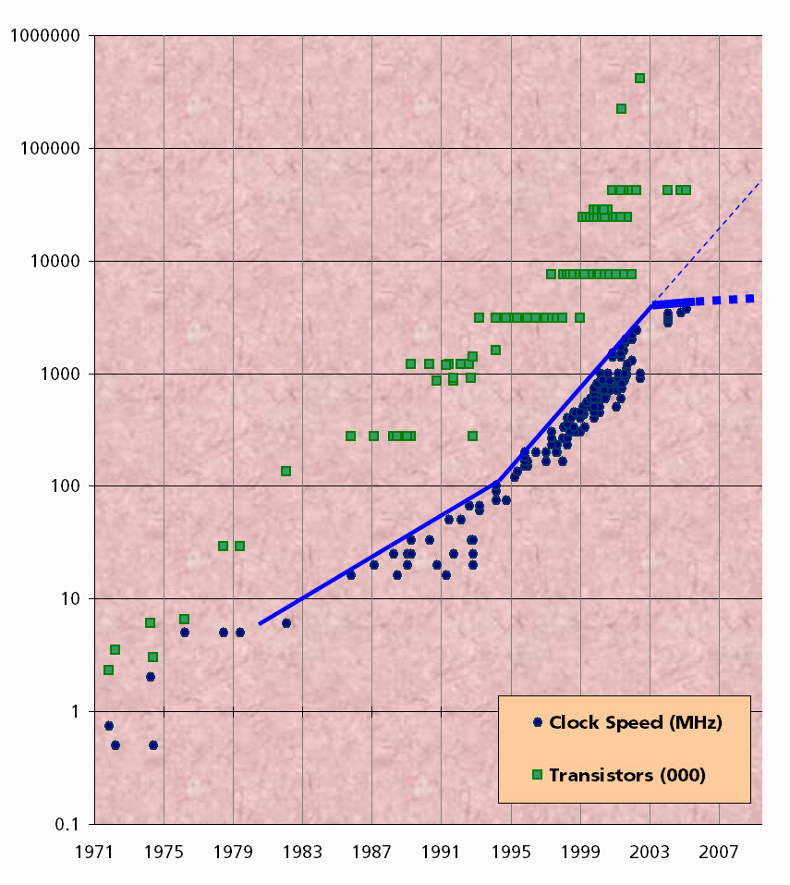
Intel CPU clock speed
Only very slow linear increase CPU clock speed since 2003
The Free Lunch Is Over A Fundamental Turn Toward Concurrency in Software
By Herb Sutter
http://www.gotw.ca/publications/concurrency-ddj.htm
Quelle: http://www.gotw.ca/publications/concurrency-ddj.htm

Slide 56
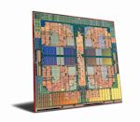
The Free Lunch is Over (Multicore CPUs)
Slow apps will no longer get magically faster next year
Ordinary desktop and laptop machines will be multi core
Single threaded apps will just be too slow
You have to be able to write threaded apps
But hand locking and hand protecting shared memory is just too hard

Slide 57
Task Parallel Library Simplifying Multi Threaded Programming
Task Parallel Library (TPL) design goals:
Simplifying the development of multi threaded .Net applications
Raising the abstraction level for multi threaded programming
TPL is developed in collaboration of Microsoft® Research, and the Microsoft CLR team (Common Language Runtime) (http://msdn2.microsoft.com/en-us/concurrency/default.aspx ).
TPL is a major component of the Parallel FX Library
Parallel FX Community Tech Preview (CTP) can be downloaded from: http://www.microsoft.com/downloads/details.aspx?FamilyID=e848dc1d-5be3-4941-8705-024bc7f180ba&displaylang=en

Slide 58
Microsoft Parallel Extensions to .NET Framework 3.5
.NET 3.5
Windows
Presenation
Foundation
(WPF)
Windows
Communication
Foundation
(WCF)
Windows
Workflow
Foundation
(WF)
Windows
Cardspace
Microsoft Parallel Extensions to .NET Framework 3.5 (PLINQ, TPL)
LINQ
ADO.NET Entity Framework
.NET Framework 2.0
Common Language Runtime 3.0

Slide 59
TPL example
// Ohne TPL
void SeqMatrixMult(int size, double[,] m1, double[,] m2, double[,] result)
{
for (int i = 0; i < size; i++) {
for (int j = 0; j < size; j++) {
result[i, j] = 0;
for (int k = 0; k < size; k++) {
result[i, j] += m1[i, k] * m2[k, j];
}
}
}
}
// Mit TPL
using System.Concurrency;
void ParMatrixMult(int size, double[,] m1, double[,] m2, double[,] result)
{
Parallel.For( 0, size, delegate(int i) {
for (int j = 0; j < size; j++) {
result[i, j] = 0;
for (int k = 0; k < size; k++) {
result[i, j] += m1[i, k] * m2[k, j];
}
}
});
}

Slide 60


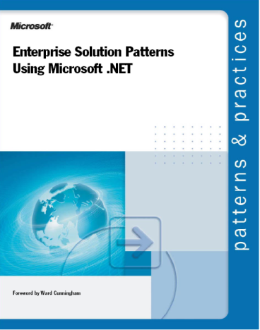

Microsoft ressources for architects
Architecture Guidance Documents
http://www.microsoft.com/practices
The Architecture Journal
Four issues a year
Authors:
User of Microsoft technology
Microsoft employees
Registration: ww.ArchitectureJournal.net
Hardcopy via mail or pdf download

Slide 61
Additional information (1):
.NET Framework 3.5:
http://wpf.netfx3.com/
C# Lecture Cornell University:
http://www.cs.cornell.edu/courses/cs215/2008sp/
Windows Presentation Foundation:
http://msdn.microsoft.com/windowsvista/building/presentation/default.aspx?pull=/library/en-us/dnlong/html/wpf101.as
Windows Communication Foundation:
http://www.davidchappell.com/IntroducingWCFv1.2.1.pdf
Windows Workflow Foundation:
http://msdn.microsoft.com/library/default.asp?url=/library/en-us/dnlong/html/wfintro.asp
Windows CardSpace:
http://msdn.microsoft.com/windowsvista/default.aspx?pull=/library/en-us/dnlong/html/IntroInfoCard.asp

Slide 62
Additional information (2):
Smart Clients:
http://msdn2.microsoft.com/en-us/library/aa905318.aspx
http://msdn2.microsoft.com/en-us/architecture/bb288452.aspx#userinter_topic4
http://silverlight.net/default.aspx
OSLO
http://www.microsoft.com/soa/
http://www.microsoft.com/soa/products/oslo.aspx
http://msdn.microsoft.com/en-us/arcjournal/bb906065.aspx
Astoria
http://msdn.microsoft.com/en-us/arcjournal/bb906063.aspx

