Slide 1
Volume License Basics

Slide 2
Volume Activation Key Management

Slide 3
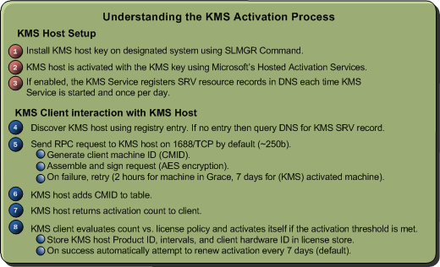
Key Management Service (KMS)

Slide 4
Multiple Activation Key (MAK)

Slide 5
Volume Activation Timeline

Slide 6
Volume Activation License States

Slide 7
Planning for Activation

Slide 8
Volume Activation Resources

Slide 9
Monitoring and Management Tools

Slide 10
Volume Activation Image Management

