Slide 2
Using the Client Object Model and REST to Access SharePoint 2010
Name
Title
Company

Slide 3
Agenda
Introduction to Client Object Model
.NET Client Object Model
Silverlight and Client Object Model
JavaScript and Client Object Model
REST & WCF Data Services

Slide 4
Introduction to Client Object Model
What is all about and how does it work?

Slide 5
Accessing Data in SharePoint 2007
SharePoint Data
Server
Application
SharePoint API
Web Service
Client Application

Slide 6
How can this be improved
Web Services can be complicated
Difficult to call from JavaScript
Often custom wrapper services are created
Customers solve the same problem over and over again

Slide 7
Client Object Model
Simple and easy to use API to Add, Retrieve, Update and Manage Data in SharePoint.
SharePoint Data
Consistent
Efficient
Client Application
.Net CLR
Silverlight
JavaScript

Slide 8
Accessing Data with Client OM
Content database
SharePoint Data
Server
Application
SharePoint API
Web Service
Client.svc
JSON
XML
Client Application
Client OM
WPF/WinForm/Office
Silverlight
JavaScript
Client Application

Slide 9
Equivalent Objects
Server (Microsoft .SharePoint) | .NET Managed (Microsoft.SharePoint .Client) | Silverlight (Microsoft.SharePoint .Client.Silverlight) | JavaScript (SP.js)
SPContext | ClientContext | ClientContext | ClientContext
SPSite | Site | Site | Site
SPWeb | Web | Web | Web
SPList | List | List | List
SPListItem | ListItem | ListItem | ListItem
SPField | Field | Field | Field
Member names mostly the same from server to client (e. g., SPWeb.QuickLaunchEnabled = Web.QuickLaunchEnabled)

Slide 10
Major Objects in Client Object Model
Site
Web
ContentType
Change
List
Navigation
Form
NavigationNode
View
UserCustomAction
Field
RoleDefinition
ListItem
User Interface
RoleAssignment
Data and Schema
Folder
WorkflowAssociation
Logic
File
WorkflowTemplate
Security
WebPart

Slide 11
Getting Started: 3 things to know
1. ClientContext is the central object
2. Before you read a property, you have to ask for it
3. All requests must be committed in a batch
clientContext = new ClientContext(“http://mysite”);
clientContext.Load(list);
clientContext.ExecuteQuery();

Slide 12
High level handling of commands
Client Application
Server
Sequence of commands:
Client.svc
command 1;
command 2;
command 3;
Execute commands
in the batch:
XML
context.ExecuteQuery();
command 1;
command 2;
command 3;
JSON
Process results
Send results back

Slide 13
Client Object Model Limitations
You still need to handle synch/update semantics (change log could help)
No elevation of privilege capabilities
Requests are throttled
.net CLR has sync method; Silverlight CLR and Jscript are async

Slide 14
.NET Client object model
How do I utilize client object model in my windows apps?

Slide 15
.Net CLR Client OM
Provides easy access from remote .NET clients to manipulate SharePoint data
Can be utilized from managed code – also from office clients etc.
Assemblies
Microsoft.SharePoint.Client.dll (281kb)
Microsoft.SharePoint.Client.Runtime.dll (145kb)
To Compare: Microsoft.SharePoint.dll – 15.3MB

Slide 16
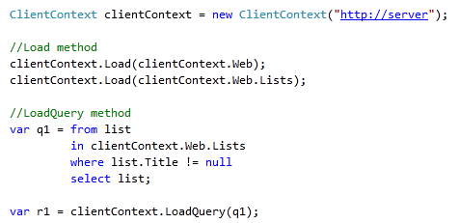
.NET Client OM

Slide 17
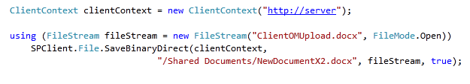
Uploading file example
In 2007 version submitting files to SharePoint was suprisingly difficult – in 2010, using client object model, we can accomplish this extremely easily.

Slide 18
Hello, Client OM
demo

Slide 19
Silverlight and client object model

Slide 20
Silverlight in SharePoint 2010
Can use Silverlight in separate ASPX page or in Web Part
The web part can contain custom properties that are sent to Silverlight via the InitParams property
The XAP file can be deployed to LAYOUTS or content database and loaded at run time
The Silverlight application can then make use of the Client OM

Slide 21
Integrating with SharePoint
Web Services
More coverage
Client Object Model
Site, navigation
security services
Very flexible and straight forward
REST
Easiest to use
For fixed list schema
Web Services
Advanced Operations
SharePoint Server Operations
Client OM
Advanced List Operations
Site Operations
Security
REST
Working with list data,
fixed schema

Slide 22
Silverlight CLR Client OM
C:\Program Files\Common Files\Microsoft Shared\Web Server Extensions \14\TEMPLATE\LAYOUTS\ClientBin
Microsoft.SharePoint.Client.Silverlight
262KB
Microsoft.SharePoint.Client.Silverlight.Runtime
138KB
Redistributable planned for the assemblies
Also XAP file that can be dynamically included to Silverlight application

Slide 23
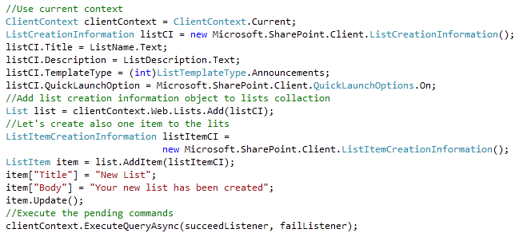
Silverlight Client OM

Slide 24
Building and Deploying Silverlight
Built in support in Visual Studio 2010
Sandboxed and Farm Solutions support
F5 deploy and debug experience
SharePoint WSP
Visual Studio builds WSP package on F5
Silverlight XAP
Deploy as SharePoint Farm or Sandboxed Solution

Slide 25
Custom Silverlight Web Part with client OM
demo

Slide 26
The JavaScript Client Object Model

Slide 27
JavaScript Client OM
JavaScript Client OM is easily added to a SharePoint ASPX page - reference:
_layouts/sp.js
Add this using <SharePoint:ScriptLink>
All libraries crunched for performance
Use un-crunched *.debug.js files with debug mode
Method signatures can be different compared to .NET and Silverlight
Different data value types

Slide 28
JavaScript Client OM
C:\Program Files\Common Files\Microsoft Shared\Web Server Extensions\14\TEMPLATE\LAYOUTS
SP.js (SP.debug.js)
380KB (559KB)
SP.Core.js (SP.Core.debug.js)
13KB (20KB)
SP.Runtime.js (SP.Runtime.debug.js)
68KB (108KB)

Slide 29
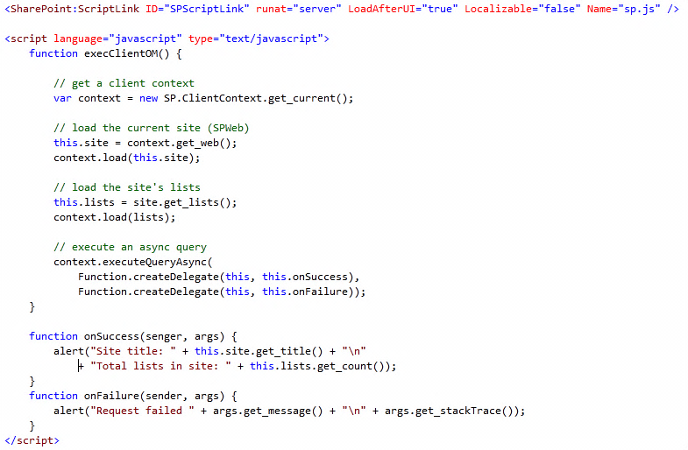
JavaScript Client OM

Slide 30
JavaScript Client OM
demo

Slide 31
REST & WCF Data Services
REST access to SharePoint data

Slide 32
Why a RESTful Interface for SP?
Why REST
It is a natural fit for SharePoint data
Item == resource
Uniform interface and addressing scheme
Low barrier of entry, interoperability
Why WCF Data Services
RESTful conventions & frameworks for data
Builds on top of standard AtomPub
Exactly the sort of convention we needed
Consistent tools and client libraries

Slide 33
A RESTful Interface for Data
Just HTTP
Items as resources, HTTP methods (GET, PUT, …) to act
Leverage proxies, authentication, ETags, …
Uniform URL convention
Every piece of information is addressable
Predictable and flexible URL syntax
Multiple representations
Use regular HTTP content-type negotiation
JSON and Atom (full AtomPub support)

Slide 34
Accessing data using REST
Content database
SharePoint Data
SharePoint API
ListData.svc
Atom
JSON
Post, Put, Get
Client Application
Any application or platform - .NET, Java,
Flash, Silverlight

Slide 35
Operations
Operations map to HTTP verbs
Retrieve items/lists → GET
Create new item → POST
Update an item → PUT or MERGE
Delete an item → DELETE
These apply to links (lookups) as well
SharePoint rules apply during updates
Validation, access control, etc.

Slide 36


URL Conventions
Addressing lists and items
List of lists | …/_vti_bin/listdata.svc/
List | listdata.svc/Employees
Item | listdata.svc/Employees(123)
Single column | listdata.svc/Employees(123)/Fullname
Lookup traversal | listdata.svc/Employees(123)/Project
Raw value access | listdata.svc/Employees(123)/Project/Title/$value
Presentation options
Sorting | listdata.svc/Employees?$orderby=Fullname
Filtering | listdata.svc/Employees?$filter=JobTitle eq 'SDE'
Projection | listdata.svc/Employees?$select=Fullname,JobTitle
Paging | listdata.svc/Employees?$top=10&$skip=30
Inline expansion | listdata.svc/Employees?$expand=Project

Slide 37
Visual Studio 2010 support
Integrated support for Data Services
Client library for .NET and Silverlight
IDE integration, “Add Service Reference”
Data service visualizer to explore site structure
Feature rich client library for .NET
Typed experience through code-gen
LINQ support
Change tracking, batching, blobs, all supported
Requires installation of WCF data services 1.5 to server side

Slide 38
REST & WCF Data Services
demo

Slide 39
Summary
Introduction to Client Object Model
.NET Client Object Model
Silverlight and Client Object Model
JavaScript and Client Object Model
REST & WCF Data Services

Slide 40


Slide 41

© 2010 Microsoft Corporation. All rights reserved. Microsoft, Windows, Windows Vista and other product names are or may be registered trademarks and/or trademarks in the U.S. and/or other countries.
The information herein is for informational purposes only and represents the current view of Microsoft Corporation as of the date of this presentation. Because Microsoft must respond to changing market conditions, it should not be interpreted to be a commitment on the part of Microsoft, and Microsoft cannot guarantee the accuracy of any information provided after the date of this presentation. MICROSOFT MAKES NO WARRANTIES, EXPRESS, IMPLIED OR STATUTORY, AS TO THE INFORMATION IN THIS PRESENTATION.

