Slide 2
Accessing SharePoint 2010 Lists Using LINQ to SharePoint
Name
Title
Company

Slide 3
Agenda
Motivation for LINQ
LINQ Syntax
LINQ to SharePoint

Slide 4
Motivation for LINQ

Slide 5
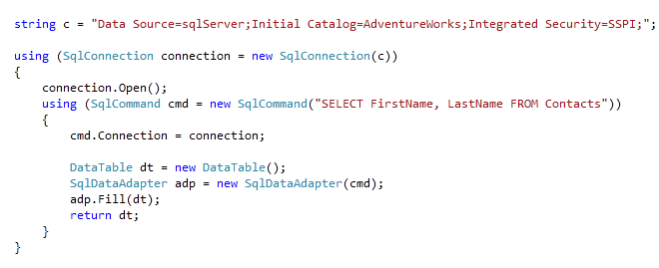
SQL Query

Slide 6
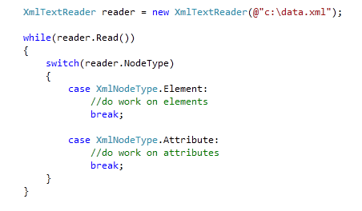
XML Query

Slide 7
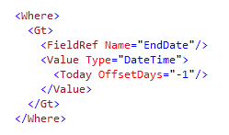
2007-Style CAML Query

Slide 8
What is LINQ?
Language Integrated Query
Simplified, object-oriented way to query
Bridges OOP and relational data
Compile-time checked queries
Provides IntelliSense inside Visual Studio
Unified syntax for querying any data source

Slide 9
Hello, LINQ! WebPart
demo

Slide 10
LINQ Syntax

Slide 11
Enhancements for LINQ
IEnumerable<T>, IQueryable<T>
Automatic Properties
Object and Collection Initializers
Extension Methods
Lambda Expressions
Query Syntax
Anonymous Types

Slide 12
IEnumerable<T>, IQueryable<T>
Contained in System.Collections.Generic
Implemented by the query provider
Supports a simple iteration or a query against that type
This is what allows LINQ to query

Slide 13
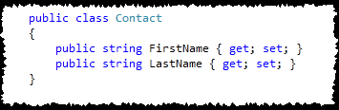
Automatic Properties
Allows short-hand property declarations
Compiler emits getters and setters
Used in LINQ to surface properties

Slide 14
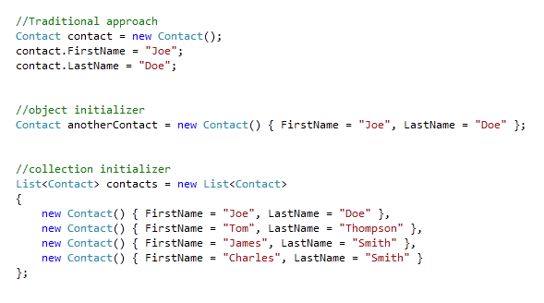
Object and Collection Initializers

Slide 15
Extension Methods
Allow you to add methods to an object without sub-classing
LINQ has extension Methods for IEnumerable and IQueryable

Slide 16
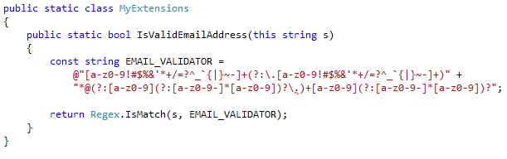
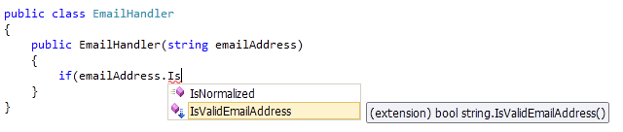
Extension Methods (cont.)

Slide 17
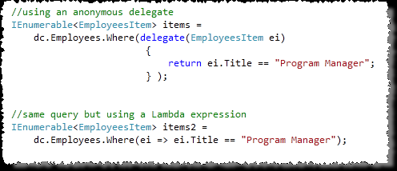
Lambda Expressions
Compact way to write anonymous functions

Slide 18
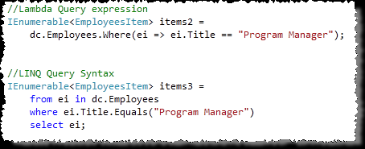
Query Syntax
Offers a readable alternative to Method syntax

Slide 19
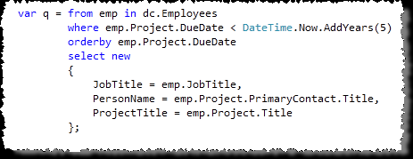
Anonymous Types
Allows developers to use variables without declaring the type.
Still strongly typed, but inferred

Slide 20
Available LINQ Providers
LINQ to SQL
LINQ to XML
LINQ to Entities
LINQ to SharePoint

Slide 21
LINQ to SharePoint

Slide 22
LINQ to SharePoint
No CAML Required (Does not replace CAML)
Entity classes form Business Layer
Strongly-typed queries and types
Intellisense support helps query construction
Microsoft.SharePoint.Linq.dll
Encapsulates the SharePoint object model queries based on the created entity classes
Server-side only, client-side LINQ experience is provided by SP REST interface (listdata.svc)

Slide 23
Using LINQ to SharePoint
Create Entity Classes
Create DataContext
Write Queries

Slide 24
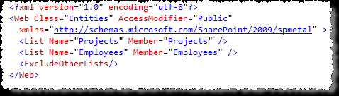
Creating Entity Classes
Create Entity Classes
Automatic generation using SPMetal.exe
spmetal /web:<url> /code:Projects.cs
Defaults to creating Entity classes for every list, use the parameters xml file to limit scope
Auto-generated class using multiple or single list
Creates strongly-typed DataContext

Slide 25
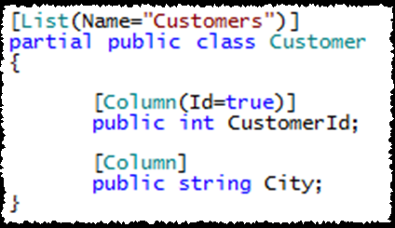
Creating Entity Classes cont.
Create Entity Classes
Add Reference to Microsoft.SharePoint.Linq
Add Entity Source File to Visual Studio Project

Slide 26
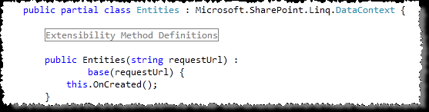

Create DataContext
Create DataContext
Use Entity class in your code
DataContext class allows access to list data

Slide 27
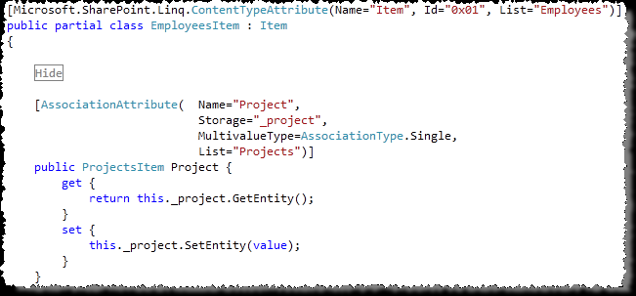
List Relationships
Write Queries
Query across multiple lists with relationships
Association attribute declares relationship

Slide 28
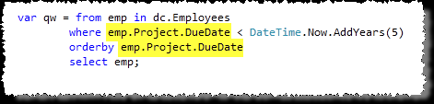
Write Queries
List Relationships (cont.)
Cross-List Queries use strongly typed members
Example: Employee List and the Project List have a relationship

Slide 29
Modifying List Data
Write Queries
Changes to entity objects are tracked by LINQ provider
Changes submitted SubmitChanges() method is called

Slide 30
LINQ to SharePoint
demo

Slide 31
Summary
Motivation for LINQ
LINQ Syntax
LINQ to SharePoint

Slide 32


Slide 33

© 2009 Microsoft Corporation. All rights reserved. Microsoft, Windows, Windows Vista and other product names are or may be registered trademarks and/or trademarks in the U.S. and/or other countries.
The information herein is for informational purposes only and represents the current view of Microsoft Corporation as of the date of this presentation. Because Microsoft must respond to changing market conditions, it should not be interpreted to be a commitment on the part of Microsoft, and Microsoft cannot guarantee the accuracy of any information provided after the date of this presentation. MICROSOFT MAKES NO WARRANTIES, EXPRESS, IMPLIED OR STATUTORY, AS TO THE INFORMATION IN THIS PRESENTATION.

