Slide 2
Exposing Business Intelligence with SharePoint 2010
Name
Title
Company

Slide 3
Agenda
Business Intelligence (BI) Primer
BI Tools in SharePoint 2010
Visio Services
Excel Services
PerformancePoint Services

Slide 4
Business Intelligence (BI) Primer

Slide 5
Business Intelligence
What is Business Intelligence?
Analytics
OLAP
Data Mining
Benchmarking
Reporting
What information do decision makers need in order to make effective business critical decisions?

Slide 6
BI Tools in SharePoint 2010

Slide 7
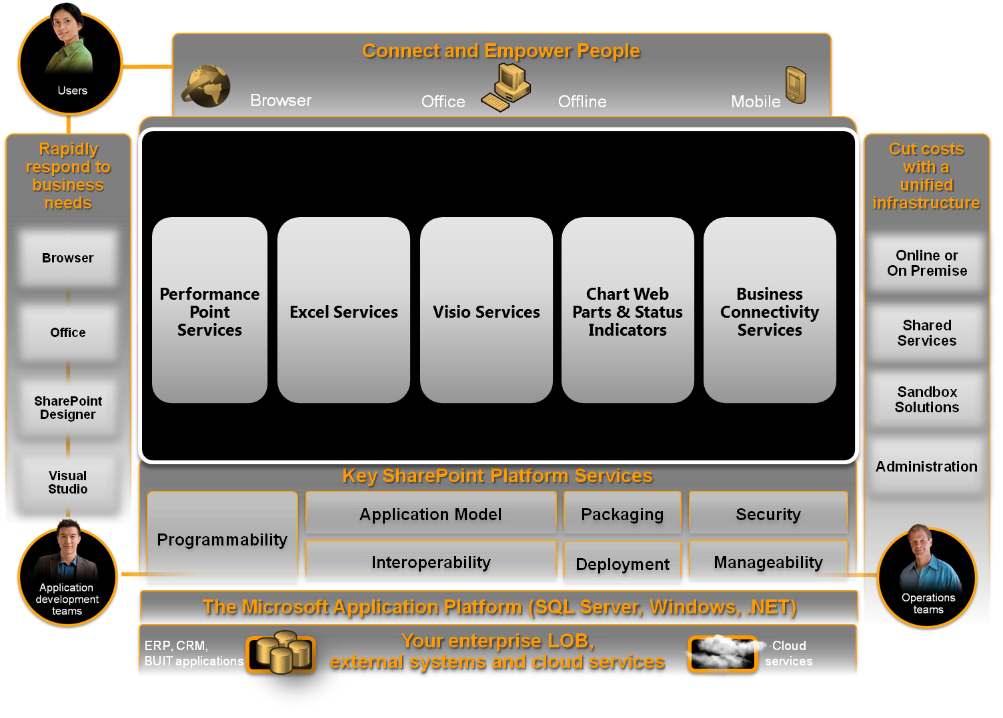
Microsoft SharePoint 2010 The business collaboration platform for the enterprise and the web

Slide 8



Microsoft Business Intelligence
Get more out of the products you own
Business User Experience
Familiar User Experience
Self-Service access & insight
Data exploration & analysis
Predictive analysis
Data visualization
Contextual visualization
Business Collaboration Platform
Dashboards & Scorecards
Excel Services
Web based forms & workflow
Collaboration
Search
Content Management
LOB data integration
Business Collaboration Platform
Data Infrastructure and BI Platform
Analysis Services
Reporting Services
Integration Services
Master Data Services
Data Mining
Data Warehousing
Data Infrastructure & BI Platform

Slide 9
SQL Server 2008 R2 Reporting Services & PowerPivot
Reporting services
Does not ship with SharePoint 2010
Reporting Services Web Parts can be installed as add-on to SharePoint
Used to create professional reports for BI apps
Includes reports builder for modifying reports
PowerPivot
Used either for client or server side excel files
Makes it possible to work with an extremely large scale of data from multiple, heterogeneous data sources at one time

Slide 10
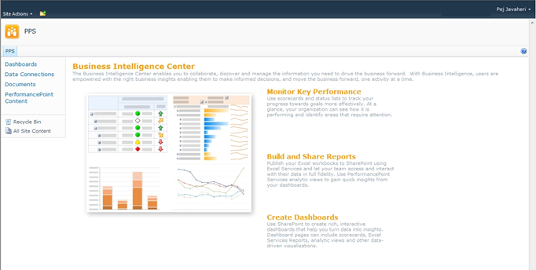
BI Center Site Template
Evolution of the Reporting Center template
Predefined lists for PPS, Excel Services
Starting point for BI
BI functionalities can be also used in other sites as well

Slide 11
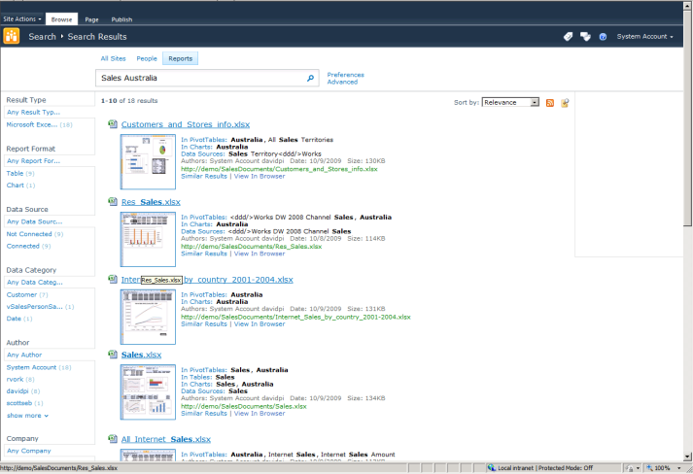
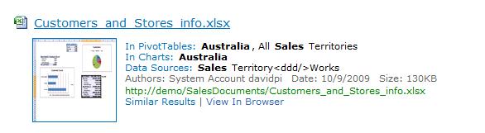
BI Indexing Connector
Add-in to FAST Search Server for SharePoint
Query and Crawl XLSX/XSLM and RDL reports (2005 and higher)
Improve relevance and search across all documents
Dedicated Reports tab

Slide 12
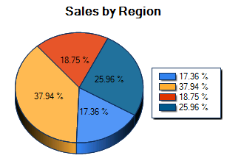
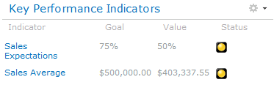
SharePoint 2010 BI Web Parts
Simple web parts that provide visualization
Quick summary of data
Can access multiple data sources
Fixed Values
Lists and External Lists
Excel Services
SQL Analysis Services
Other Web Parts
Lists and External Lists
Excel Services

Slide 13
Chart Web Part & Status Indicators
demo

Slide 14
Visio services

Slide 15
Visio Services Key Features
Share Diagrams in SharePoint
Connect Diagrams to Data
Build Dashboards
Full Fidelity rendering with Silverlight, or PNG
Diagrams can be connected to various Data sources
Diagrams can be viewed without having Visio client installed
Use Web Part Connections to integrate with other SharePoint web parts
Use the Mashup API to fully customize your dashboards and manipulate data
Visualize your business intelligence with Visio diagrams
Use data graphics to build front ends for your real-time business intelligence solutions

Slide 16
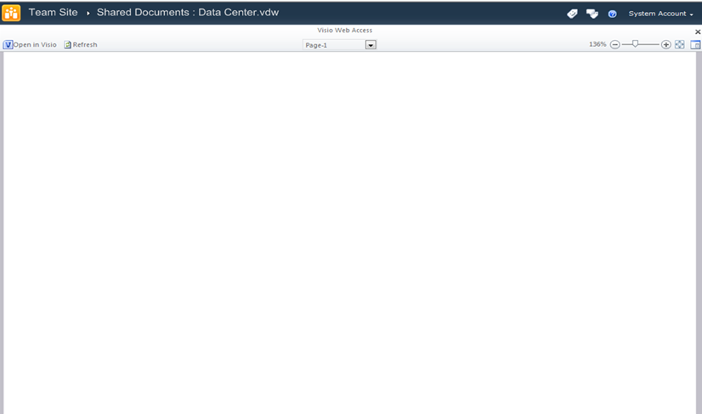
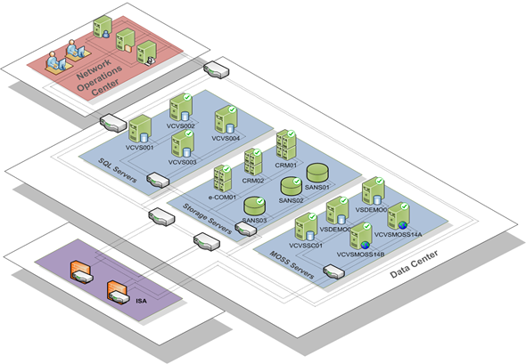
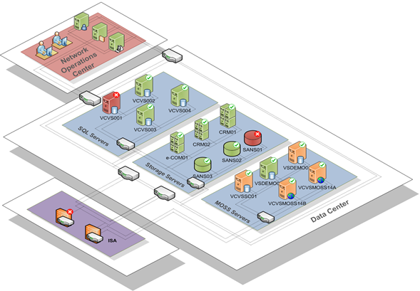
Visio Services, At a Glance “Data-Driven Diagrams in SharePoint”
1 hour later…
Top Features:
Diagrams all live in SharePoint
Diagrams viewable in the browser
Diagrams created once only
Diagrams containing data graphics are refreshable
Diagrams give data context and improve insights into the state of a system
Data Source

Slide 17




Visio Services features
Rendering
Browser-agnostic
Full Fidelity rendering using
Down-level experience in PNG
Visual Refresh of Data Diagrams
Refresh data connected diagrams to:
Supports Kerberos, SSO & Unattended Auth.
Automatic refresh
SQL
Excel
SP Lists
OLEDB
ODBC

Slide 18
Visio Services extensibility
Visio Services JavaScript Object Model
Custom Data Providers
Enables refresh from non-native data sources.
Custom Data Graphics
Enables diagrams to participate in mash-up applications.
Enables the refresh of non-native data graphic shapes.
Web part connections
Consume and provide information between Visio services and web parts

Slide 19
Visio Services
demo

Slide 20
Excel Services

Slide 21
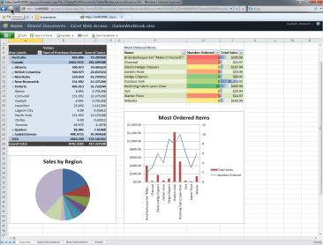
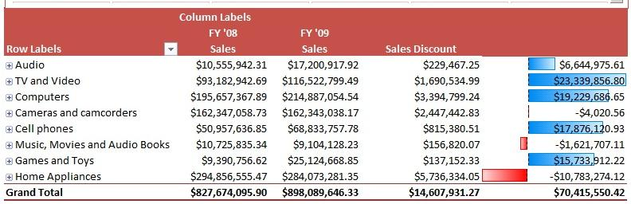
What is Excel Services?
Real-time, interactive, end-user BI reporting tool
Displays all or targeted elements of Excel workbooks through the browser
Extends Excel capabilities such as external data connectivity and Excel based modeling to the browser
Application Development platform for building data-centric applications
Automate workbooks via Web Services API
Provide highly interactive application via JSOM
Easily distribute Excel content via REST

Slide 22
Excel Services Architecture
W E B F R O N T E N D
Excel Web Access
Excel Web Services
REST API
JSOM
Excel Proxy
A P P L I C A T I O N S E R V E R
User-Defined Functions
Excel Calculation Service
External Data Sources
SharePoint Content Database
XLSX / b / m

Slide 23
Exposing Excel Content
Excel Web Access (EWA) Web part
Displays entire workbook, specific sheets, or specific items *”Publish” allows content owner fine control over what gets displayed
Programmatically
REST Services
Web Services
JavaScript Object Model
Server-based User Defined Functions

Slide 24
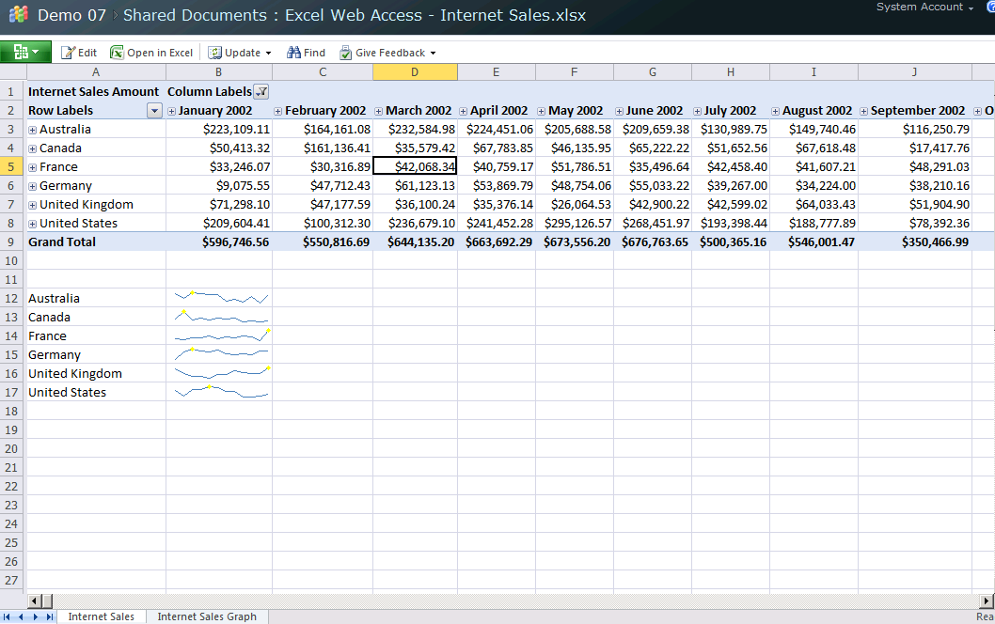
Excel Workbooks in the Browser
Provides a browser based view of Excel
Allows interaction within the Excel Workbook
Expand / collapse Pivot Table, Sorting, Filtering, Parameters
EWA integration with SharePoint filters enable Excel based dashboards
Excel Web App

Slide 25
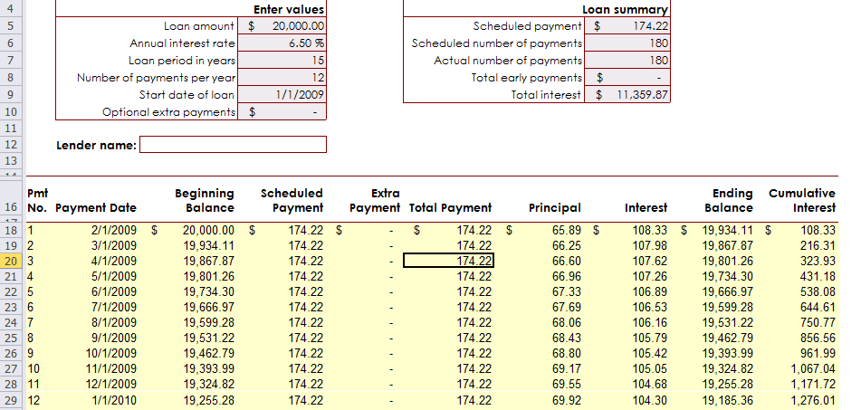
Leveraging Existing Excel Solutions
Share existing Excel applications, analysis, and models by publishing to SharePoint

Slide 26
Programmability
Web Services (updated for 2010): Increase Developers ability to automate & manipulate Excel work books
New methods to supports discovery & retrieval of more workbook objects
Ability for a web service based application to participate in a collaborative editing session.
JavaScript OM (New for 2010): Enable new application scenarios for professional developer
Enable Dev to catch and react to user’s actions w/in a displayed web
Project workbook data via mash up
REST (New for 2010):
No-Code access to Excel workbook content
Enables “live” projection of Excel content
Server based User Defined Functions

Slide 27
Excel Web Services
Expanded and enhanced from previous versions
Supports editing and saving workbook programatically
Can be used to:
Automate workbook level operations
Leverage existing Excel models
Provide easily maintainable calculation engine for business applications

Slide 28
Excel REST API
Exposes Excel content via simple URL
Access charts, tables, PivotTables or ranges
Returned formats include: image, html, and xml (atom)
Enables end users to:
Embed dynamic data and charts where-ever a URL can be evaluated (web page, office apps, etc.)
Create mashups by using simple references to Excel content
<advanced> leverage existing Excel models by passing in values via the URL, and retrieving results as part of the same URL.
No need to write/deploy custom code
SharePoint security enforced

Slide 29
REST Syntax
http://server/_vti_bin/ExcelRest.aspx/Shared%20Documents/File.xlsx/Model/Ranges(‘Sheet!A1’)
Handler – the ASPX that handles all Excel Services REST requests
Name of the file as you would access it in SharePoint
Path inside the workbook.
Resource Name | Allows access to…
/Model | The workbook (the binary or the available feeds)
/Model/Ranges | List of named ranges in a workbook (some of them)
/Model/Ranges(‘RangeName’) | Specific range.
/Model/Charts | List of charts
/Model/Charts(‘ChartName’) | Specific Chart
/Model/Tables | List of tables (Lists)
/Model/Tables(‘TableName’) | Specific table
/Model/PivotTables | List of PivotTables
/Model/PivotTables(‘PivotName’) | Specific PivotTable

Slide 30
JavaScript Object Model (JSOM)
Add JavaScript code on a Web Part page to programmatically interact with Excel Web Access Web Parts
Functionality includes
JSOM events that are raised when users edit a cell, change the active selection or active cell, and when the workbook has finished rendering
Use JSOM to set/get values and to drive the UI (scroll to a range, switch between named items or sheets)

Slide 31
Excel Services
Demo

Slide 32
PerformancePoint Services

Slide 33
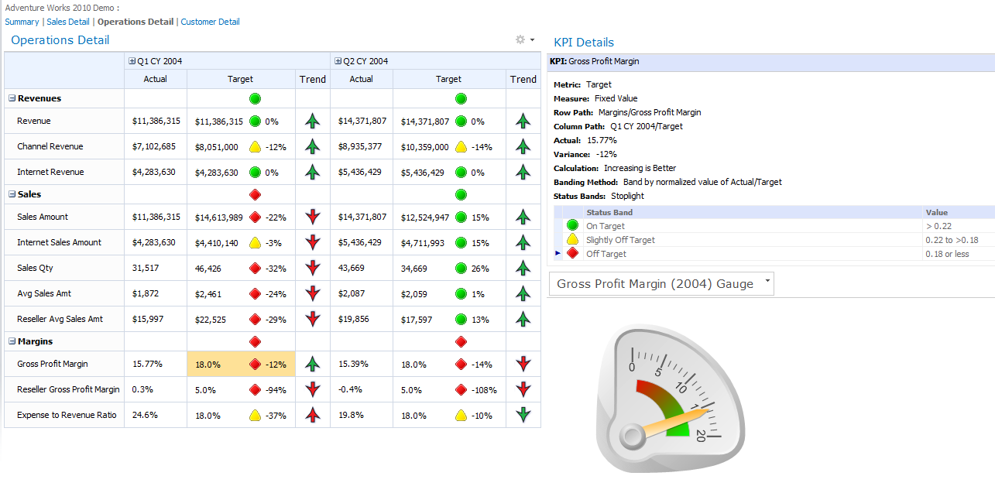
PerformancePoint Services
Context-driven dashboards across systems
Provides transparency and accountability
Interactive access using browser
Can be created/updated by power-users/professionals

Slide 34
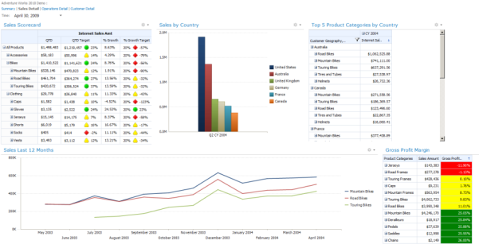

What are Dashboards?
Visual displays of information needed to achieve one or more objectives*
Single-Screen display of information to keep in touch with…
Should answer fundamental questions
Alert the user to issues or problems
Operational, Performance, Personal

Slide 35
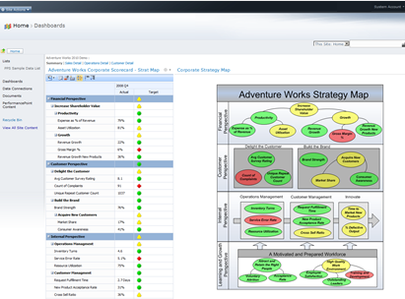
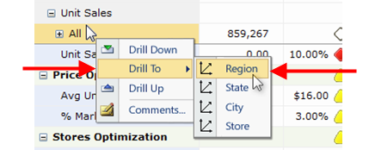
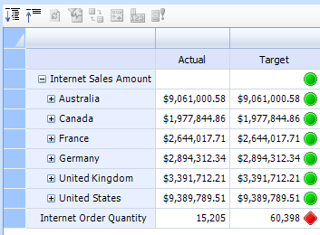
What are Scorecards?
Elements of a dashboard
Align strategies and organizational goals
Measure and manage Key Performance Indicators (KPI)
Modeled after the business, not the data

Slide 36
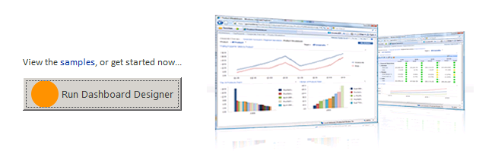
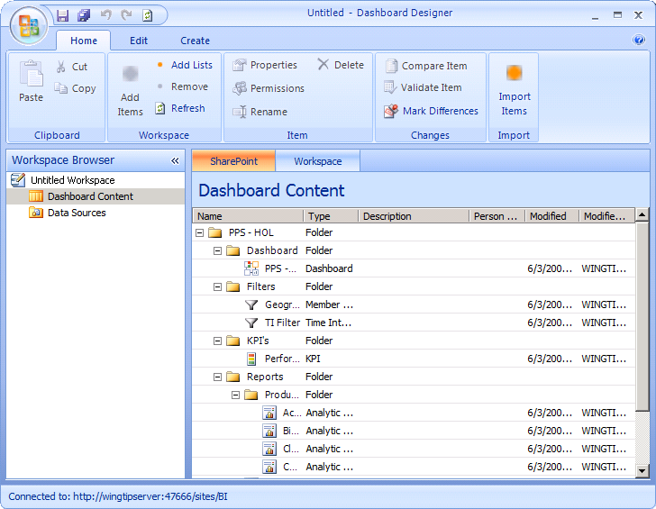
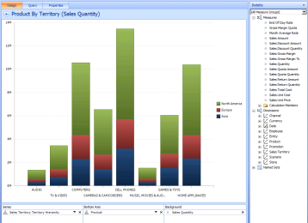
Designing PPS Applications
Dashboard designer used to create content
ClickOnce application launched from browser
Manages content directly in SharePoint
Lists for content, data sources, dashboards

Slide 37
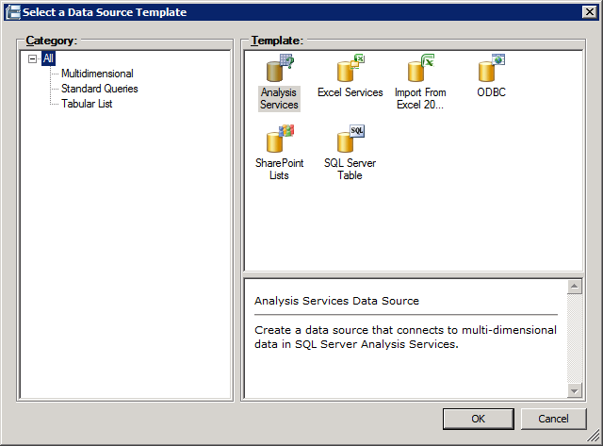
Aggregating Data Sources
Data access is managed with Data Sources
Data is accessible from multiple sources
Analysis Services, SQL Server, Excel Services, PowerPivot and SharePoint lists
Accessed with service account or current user
Stored in list as an XML file (*.ppsdc)

Slide 38
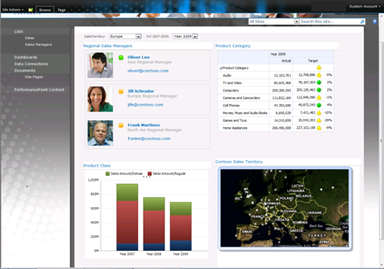
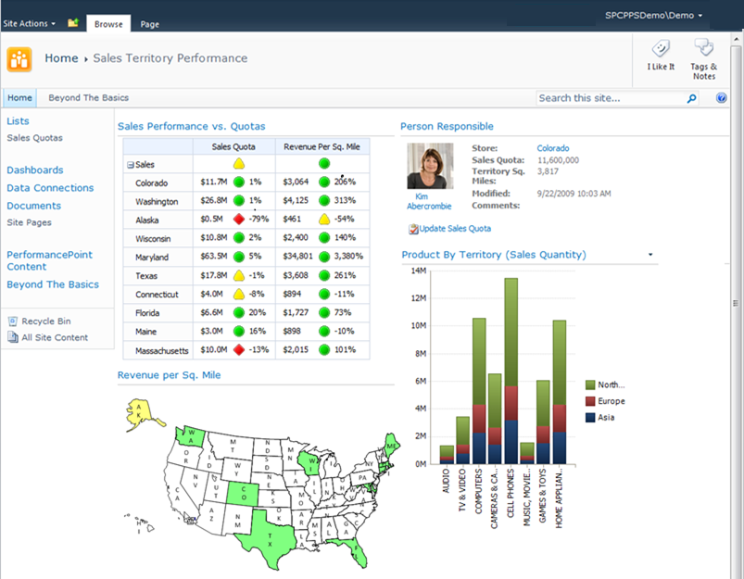
PPS Content in the Browser
Business users view content in the browser
Stored as Web Part pages
Web Part connections used to relate content
Ex. Item choice in a scorecard updates reports

Slide 39
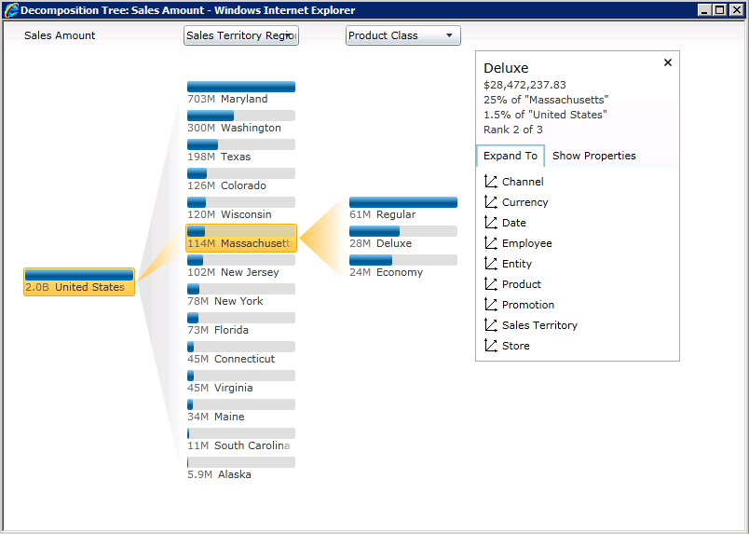
Visual Data Exploration
Decomposition trees allow data exploration
New in SharePoint 2010
Available by right clicking data in browser
Analyze -> Decomposition Tree
Allows filtering\expanding across dimensions
Allows faster and more relevant visualization of data

Slide 40
Development Scenarios
Create Report, Filter, and Tabular Data Source Extensions
Report extensions, Filter extensions, data source extension, editor customizations
Create Scorecard Transforms
Change the appearance, contents, or functionality of scorecards

Slide 41
PerformancePoint Services
demo

Slide 42
Summary
Business Intelligence (BI) Primer
BI Tools in SharePoint 2010
Visio Services
Excel Services
PerformancePoint Services

Slide 43


Slide 44

© 2010 Microsoft Corporation. All rights reserved. Microsoft, Windows, Windows Vista and other product names are or may be registered trademarks and/or trademarks in the U.S. and/or other countries.
The information herein is for informational purposes only and represents the current view of Microsoft Corporation as of the date of this presentation. Because Microsoft must respond to changing market conditions, it should not be interpreted to be a commitment on the part of Microsoft, and Microsoft cannot guarantee the accuracy of any information provided after the date of this presentation. MICROSOFT MAKES NO WARRANTIES, EXPRESS, IMPLIED OR STATUTORY, AS TO THE INFORMATION IN THIS PRESENTATION.

