Slide 2
Developing Custom Search Solutions with SharePoint 2010
Name
Title
Company

Slide 3
Agenda
Search Extensibility Overview
Extending Search WebParts
Query Syntax Improvements
The Connector Framework
Customizing Refiners
Custom Ranking Models Overview

Slide 4
Search Extensibility Overview

Slide 5
Search Extensibility Challenges in 2007
Some search Web Parts were sealed
CoreResultsWebPart used hidden and sealed types for query processing
Most scenarios required writing a new WebPart(s)
Limited customizations
Custom XSLT
Custom search properties and advanced search

Slide 6
2010 Search Extensibility
Query Extensibility
Search Web Parts
Best Bets
Visual Best Bets
Core Results WebPart
Related Queries
Search Action Links
Query Suggestions
Search Box
Federated Results
More…
Query & Federation OM
Query Web Service
Custom Ranking models
User Context Custom Properties
Search Refinements
Indexing Extensibility
Custom Connector
BCS Content Sources
Custom Entity Extractor
Custom IFilter

Slide 7
Extending Search web parts

Slide 8
SharePoint 2010 Search Extensibility Improvements Search Web Parts
Virtually all search Web Parts are now public
Over 50 Web Parts and classes
CoreResultsWebPart
SearchBox
Related Queries Web Part
Best Bets Web Part
Refinements Web Parts
FAST Search Web Parts are extensions of WebParts in SharePoint Search

Slide 9
Working with Search WebParts
CoreResultsWebPart
Add additional controls
Override Render() to modify HTML
Customize rendering of results with xmlResponseDoc
Add custom properties and editor parts
Modify user’s query, create dynamic query, etc
QueryManager
Modify user’s query
CoreResultsDatasource
Create custom Datasource views
CoreResultsDatasourceView
Override AddSortOrder() to modify query

Slide 10
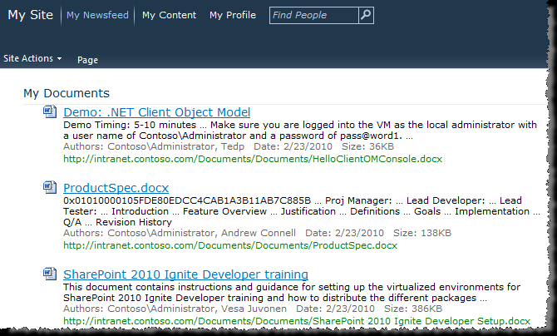
My Documents Walkthrough
Scenario – Create a WebPart for MySites that displays documents which that user authored

Slide 11
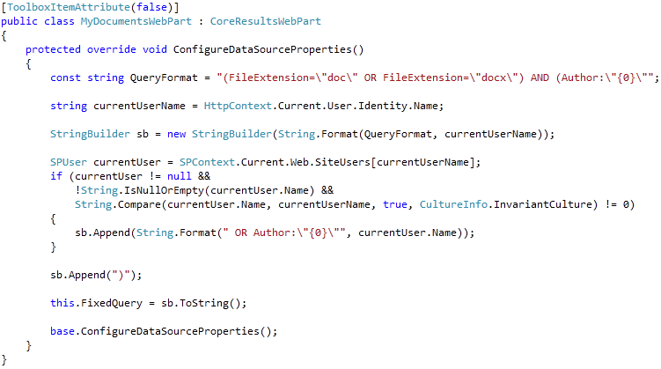
My Documents Walkthrough (cont.)

Slide 12
Customization Pattern Parts based on CoreResultsWebPart
There are different ways in which results can be customized in a custom part
For example, override ConfigureDataSourceProperties
This pattern should work for virtually any customization scenario
Our scenario: a Web part that can sort on any number of managed properties

Slide 13
Customization Pattern Step 1: New WebPart Class
Create a new Web part that inherits from the CoreResultsWebPart class
Override CreateChildControls to add any controls necessary for your interface
Override CreateDataSource
This is where you get access to the “guts” of the query
In the override, create an instance of a custom data source class you will build

Slide 14
Customization Pattern Step 2: New CoreResultsDatasource Class
In the override for CreateDataSource, set the DataSource property to a new class that inherits from CoreResultsDataSource
In the CoreResultsDataSource constructor, create an instance of a custom data source view class you will build
No other overrides are necessary

Slide 15
Customization Pattern Step 3: New CoreResultsDatasourceView Class
Set the View property for your CoreResultsDatasource to a new class that inherits from CoreResultsDatasourceView
In the CoreResultsDatasourceView constructor:
Get a reference to the CoreResultsDatasource so you can reference back to the Web part
Set the QueryManager property to the shared query manager used in the page

Slide 16
Sorted Search Results
demo

Slide 17
Query Syntax Improvements

Slide 18
SharePoint 2010 Search Improvements Keyword Query Syntax
Support for Boolean operators
(“SharePoint” OR “FAST”) AND (Title:”Customizing Search”)
Prefix matching for keywords and properties
Micro* author:Bill*
Improved operator support
= > >= < <=

Slide 19
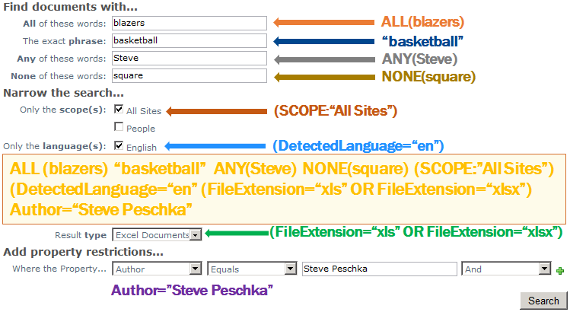
New Keyword Query Syntax Creating custom queries
You can now use the same features of Advanced Search with KeywordQuery

Slide 20
The Connector Framework

Slide 21
The Connector Framework
SharePoint 2007 Indexing
Protocol Handlers
Business Data Catalog IDEnumerators
SharePoint 2010 Connectors
Exchange
Notes
Custom .NET Connector

Slide 22

The Connector Framework
App Server
Search Engine
BCS Profile Page
BCS Connector
BCS Runtime
MD Cache
App Server
External Data Source
MD Service
SSO Service
SQL
LOB App
DB Server
MetaData
SSO

Slide 23
BCS Based Connector New Features for Search in Model Files
Support for attachments
Item-level security
Crawl across entity associations
Control the resulting display URL
Managed with PowerShell
Get | Remove | Create-SPEnterpriseSearchCrawlCustomConnector

Slide 24

Twitter Connector
demo

Slide 25
Customizing Refiners

Slide 26
Search Refinement
Shallow results refinement
Available in all SKUs except SP Foundation
Uses associated metadata from top results to further refine results
Deep results refinement
Only available in FAST Search Server
Uses associated metadata from all results to further refine results

Slide 27
Search Refinement (cont.)
Implemented as RefinementWebPart
Uses XML to define Filter Categories
Categories Include
Title
Description
Type
Mapped Property

Slide 28
Search Refinement (cont.)
OOTB Filter Generators
ManagedPropertyFilterGenerator
TaxonomyFilterGenerator
RankingModelFilterGenerator
Or…Write your own
Derive from RefinementFilterGenerator

Slide 29
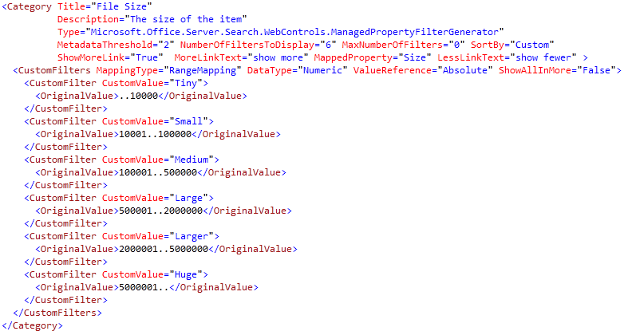
Adding a New Category Scenario – Add a File Size Refiner

Slide 30
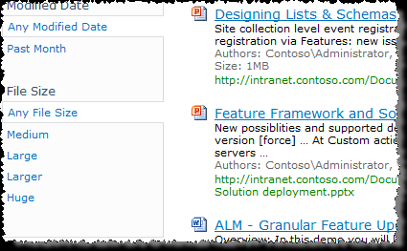
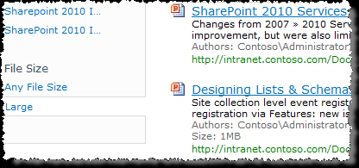
Using the New Refiner Scenario – Add a File Size Refiner

Slide 31
Custom Ranking Model Overview

Slide 32
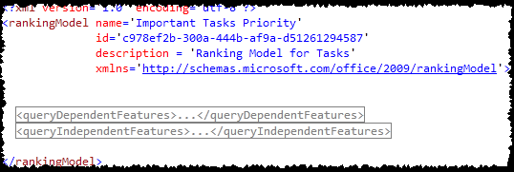
Custom Ranking Models Overview
Admins use XML files to describe new Ranking Models
Custom ranking models rank using a weighted-average of the features in the XML descriptor
Manage Ranking Models using PowerShell
Use Custom Ranking Model with CR Web Part Property DefaultRankingModelID

Slide 33
Summary
Search Extensibility Overview
Extending Search WebParts
Query Syntax Improvements
The Connector Framework
Customizing Refiners
Custom Ranking Models Overview

Slide 34


Slide 35

© 2010 Microsoft Corporation. All rights reserved. Microsoft, Windows, Windows Vista and other product names are or may be registered trademarks and/or trademarks in the U.S. and/or other countries.
The information herein is for informational purposes only and represents the current view of Microsoft Corporation as of the date of this presentation. Because Microsoft must respond to changing market conditions, it should not be interpreted to be a commitment on the part of Microsoft, and Microsoft cannot guarantee the accuracy of any information provided after the date of this presentation. MICROSOFT MAKES NO WARRANTIES, EXPRESS, IMPLIED OR STATUTORY, AS TO THE INFORMATION IN THIS PRESENTATION.

