Slide 1
Windows 7 Logo Program Results to Date
David Edfeldt
Senior Program Manager Lead
Windows Logo Program

Slide 2
Overview
Why we care about the logo (and are thankful you do too)
Impact of the logo program on launching Windows Vista and Windows 7
Logo program and partnership going forward

Slide 3
History
Windows Logo Program started in 1995 to improve customer experience with Windows 95
Evolved from a Microsoft manual testing program into a well defined set of standards backed with partner self testing
Approximately 20,000 products tested each year, from over 1,000 companies

Slide 4




A Long Legacy (Total submissions per OS logo program)
1998
?
2001
123,263
2006
49,694
Today
9,771 +
Logo programs still active for Windows XP and Windows Vista
31,022 submissions in the last year – all OSes
Data current Nov/2009

Slide 5
Windows 7 Launch --Thank you!
At general availability, 3x more devices/systems were logo-qualified than for Windows XP

Slide 6
What the Logo Means in 2009
The Windows Logo Program
Provides market confidence in the Windows experience
Through active partner engagement
In a carefully structured process of defining requirements
Validating compliance via testing
Documenting certification online
And providing on-going online services
To assure quality after the product goes to market

Slide 7
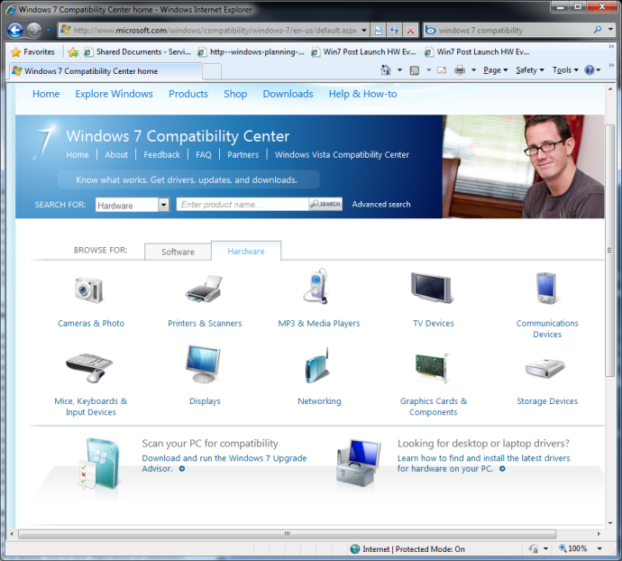
Market Confidence
Retailers expect the logo on systems
Consumers look for logo-qualified products
Most consumers look for the logo in making PC-related purchases¹
Consumers aware of logo, use as indicator of Windows compatibility ²
Businesses look for logo-qualified products
“I require the Logo. I need to know that it’s compatible”- IT Director, Enterprise
IT Professionals: Logo an important factor in their purchase decision and would recommend it to others²
^{Common bid spec}
Microsoft helps you market your logo-qualified product
Easily identified logo artwork
Windows 7 compatibility center (1 million unique visitors per month)
Sources: 1. Microsoft CMG, Logo Survey Compilation, 12/08,
2. Market Decisions Corporation, Windows Vista Logo Program: Awareness, Perception, and Purchase Intent, 12/06

Slide 8
Partner Value in That Market Confidence
The China experience
2009 survey of partners
“Why do you Logo?”

Slide 9
… in the Windows Experience…
Building OS features that take advantage of the new technology
Addressing compelling scenarios
Providing quality end-to-end experience of customers
Supporting a breadth of devices and systems on a dependable extensible platform
How does the logo program help with this?

Slide 10


Logo & Windows Vista
Problem: How to move the industry/ consumers off 7 year–old thinking
Impact:
95% Premium adoption within a year
High x64 adoption by 2009

Slide 11
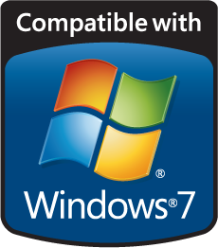
Logo & Windows 7
Problem: Nail the fundamentals
“It Just Works”
Server
Client
High
Availability
Fault
Tolerance
Dynamic Partitioning
Power Management
Device
Stage
Windows
Touch
Windows
Media Center
Device-specific functionality
Storage
Imaging
Graphics
Audio
Printers
Network
Bus
Display
Modem
…
Connectivity
Impact:
Scenario-based requirements
Work on the fundamentals
e.g., 1394, PCI, BT, USB …
Reliability

Slide 12






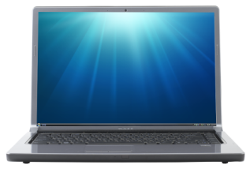
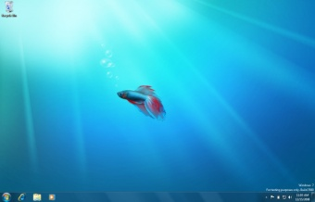
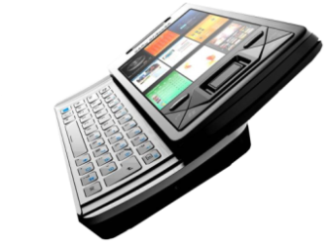

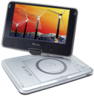
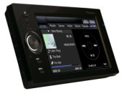
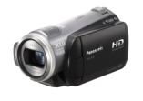







Works The Way You Want
“Great with Devices”

Slide 13
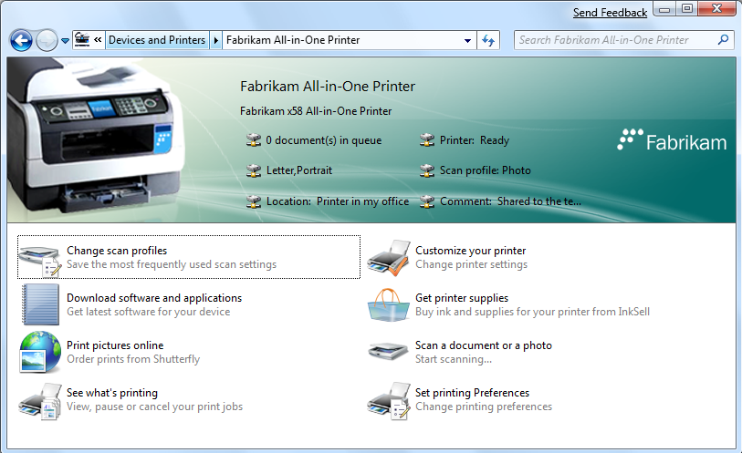
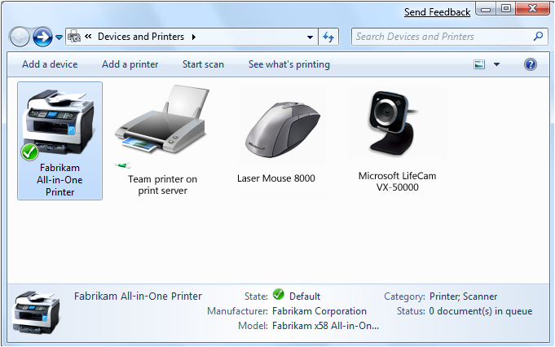
The Connected Device Story
Simple requirements across USB and protocols → good experience
Removable flag used and set correctly
GetObjectPropList length 256 bytes
Metadata delivery to end users on partner’s schedule

Slide 14
Partner Engagement and the Logo Program Cycle Creating a predictable onramp
Requirement proposed
Requirement locked
Partner feedback
Requirement enforced
Preview test released
Type of requirement | Time to enforcement
Silicon change | 18 Months +
Firmware/ hardware | 12 Months
Software | 6 Months

Slide 15
Windows 7 Onramp and Logo Program
Requirements communication improved
Posting earlier
Downloadable docs from Winqual
More mature test harness
Well attended Logofests internationally
Strong preview in advance of RC
Partner bug database through Connect
Internationally supported
Outstanding partner participation!

Slide 16
Windows 7 Partner Support Effort
Time: Jan 25th, 2009 – Aug 21st, 2009
Goal:
Getting logo submission ready for Win 7 Launch
Fix test bugs and OS bugs
Rapid partner fixes
Results – 1,446 Partner contacts

Slide 17
Launch was International Partner Effort
Time: Jan 25th, 2009 – Aug 21st, 2009
Goal:
Getting logo submission ready for Win 7 Launch
Fix test bugs and OS bugs
Rapid partner fixes
Results – 1,446 Partner contacts

Slide 18
Partners Across all Device Areas
Time: Jan 25, 2009 – Aug 21, 2009
Goal:
Getting logo submission ready for Win 7 launch
Fix test bugs and OS bugs
Rapid partner fixes
Results – 1,446 partner contacts

Slide 19
Ready at Windows 7 Launch
At GA, 36% more partner logos than Windows Vista, 200% more than Windows XP

Slide 20
Metadata Adoption
526 Devices and Printers folder devices
1493 Device Stage devices
443 WPD baseline experiences devices
5000+ Baseline printer experience devices
Thank you!

Slide 21
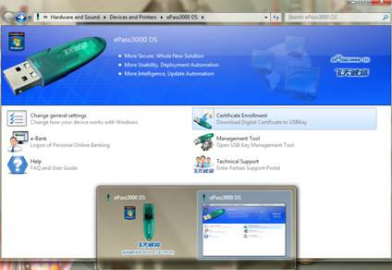
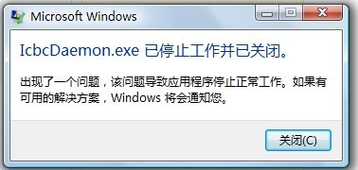
Making a More Responsive Logo Program
The China banking story

Slide 22
Together We Can…
HW innovation
Customer scenarios
Requirements
Validate
Marketplace
Windows 7 –
I WE made it

Slide 23
Together We Can…
HW innovation
Customer
scenarios
Requirements
Validate
Marketplace
Windows 7 –
I WE made it

Slide 24
Together We Can…
HW innovation
Customer
scenarios
Requirements
Validate
Marketplace
Windows 7 –
I WE made it

Slide 25
Together We Can…
HW innovation
Customer
scenarios
Validate
Marketplace
Windows 7 –
I WE made it

Slide 26
Together We Can…
Customer
scenarios
Validate
Marketplace
HW innovation
Requirements
Windows 7 –
I WE made it

Slide 27
Together We Can…
Windows 7 –
I WE made it

Slide 28
Add value by integrating into the complete device lifecycle
Provide customer telemetry
Help update devices in the market
Plan
Design
Develop
Deploy
Support
Help solve critical bugs in the market
Introduce expectations for requirements early
Explain which technologies Microsoft will be evangelizing
Continue marketing even after an OS release
Help articulate which requirements are applicable
Help with distribution of driver/software
Provide dependable tests free of most bugs
Understand the lead times required for manufacturing
Provide high quality code examples and tools to help with coding
Inform how to best leverage MS marketing
Provide support & don’t overburden/randomize
Data: Windows 7 Launch Postmortem

Slide 29
Together We Will…
Thank you for your passion, your effort,
your partnership

Slide 30
Additional Resources
Web Resources
Windows Logo Program
http://www.microsoft.com/whdc/winlogo/
Windows Quality Online Services (Winqual)
https://winqual.microsoft.com/
Newsletter
WHQL Weekly Newsletter http://www.microsoft.com/whdc/newsreq.mspx

Slide 31

© 2009 Microsoft Corporation. All rights reserved. Microsoft, Windows, Windows Vista and other product names are or may be registered trademarks and/or trademarks in the U.S. and/or other countries.
The information herein is for informational purposes only and represents the current view of Microsoft Corporation as of the date of this presentation. Because Microsoft must respond to changing market conditions, it should not be interpreted to be a commitment on the part of Microsoft, and Microsoft cannot guarantee the accuracy of any information provided after the date of this presentation. MICROSOFT MAKES NO WARRANTIES, EXPRESS, IMPLIED OR STATUTORY, AS TO THE INFORMATION IN THIS PRESENTATION.

