Slide 1
ENTERPRISE Overview
Microsoft Dynamics CRM
Presenter Name
Presenter Title
Presenter Date

Slide 2

Long Term CRM Success
“To get better CRM projects, the company must view CRM as more than just an IT project or a business project. Instead, business users and IT users must work together to implement a strategy.“
Gartner Group September 2007
Notes:
CRM projects in the past have often been a point of contention between business and IT. Both groups have worked hard to make the projects successful, but the inherent product designs did not make it easy to meet user needs, business (management) needs, and IT needs.
User needs: a tool that helps them do their job, give them complete and accurate customer visibility that’s easy to get to, and minimize data entry
Management needs: users to use the system (input and update) reliably so business processes are consistent and customer info is complete and accurate
IT needs: a solution that fits with their infrastructure, that leverages existing investments and skillsets, easy to configure, customize, upgrade, and provides low TCO
Much of the root causes for lack of deployment success grew from poor user adoption and inability to adapt and change the solution quickly enough.
Background Info:
Siebel, SAP, Oracle more aligned to IT end of spectrum – users hated using the application and refused to use it.
Salesforce.com and other SaaS-only CRM aligned to user end of spectrum – targeted users frustrated with IT deployment/change times; fragments IT infrastructure plans by giving up control and flexibility of data and security.

Slide 3
Typical Challenges in Enterprise CRM
Achieve reliable user adoption
Attain 360 degree view of customers
Adapt quickly to business changes
Align business and IT needs
Accelerate project delivery and returns
Notes:
Users:
The previous generation of CRM (SAP, Siebel, Oracle) was crammed down users’ throats – why? Because these applications had hundreds of features that in name, should have met current or future user needs. The reality was that the applications were installed to meet management needs for control, visibility, reporting. Users disliked the tools and often viewed them as a “big brother” watching over their shoulder. Once users shunned the system and resisted entering data, leading to numerous deployments that didn’t meet expectations. Companies now are more focused on enabling users rather than controlling them, coaching and providing best practices. Most vendors are moving towards this – SAP Duet, Siebel Outlook plugin, Salesforce.com Outlook plugin, SugarCRM Outlook plugin. They are all trying to expose small pieces of their functionality through applications that people are already using. They are still tied to their backend applications.
Change:
The previous generation of CRM was designed more for brute force than agility. One of our customers, a large European telco, told us they had a team of coders writing 500,000 lines of code every 6 months to maintain their last-generation CRM system [system was Siebel]
Enterprises are inherently complex.
Change breaks custom build
Largest deal in Microsoft history was a public sector deal for the DoD. In our previous CRM system (Siebel) 12 activities related to closing the deal were recorded. We then analyzed the sales rep’s laptop to see if there were other interactions that had not been captured. Guess how many activites/interactions we found? 2200, sitting in Outlook, Excel, Word – bascially Microsoft Office.
Other Topics
Expanding deployment choices
Evaluating and balancing on-premise and on-demand options
Buy over build
Preference for packaged applications

Slide 4

Industry Views
“End-user benefits must remain at the center of CRM process and application enhancements. Attention must be given to the application user interface and workflows to ensure that they are well aligned with the working practices of day-to-day users.”
Forrester Research June 2007
“A CRM system must be flexible to adjust as a company's business model and processes change. CRM solutions that only address the first level or two of a company's sales process or cannot adapt to change will have limited effectiveness.”
CRM June 2007
“Our senior leaders gave me the time and resources to do the job right. They saw value in getting users actively involved and encouraged me to take this approach. I concentrated on delivering ‘quick wins' to sustain their enthusiasm.”
Customer –CRM Magazine, September 2007
Notes:
Other (backup) Quotes:
“Software as a service (SaaS) falsely appears as a panacea for the problems associated with CRM projects because SaaS offers low initial capital expenses and quick integration capabilities. However, after five years, costs often are the same as traditional software and, so far, SaaS has had difficulty supporting complex processes.”
“SaaS really is suitable only for departmental initiatives (such as sales), not for cross-departmental or enterprise solutions. Integration may be just as expensive as on-premises software during the long term. “
"Our senior leaders gave me the time and resources to do the job right. They saw value in getting users actively involved and encouraged me to take this approach. I concentrated on delivering ‘quick wins' to sustain their enthusiasm.“
“Nothing succeeds like success, so you need to get off to a fast start.”
“This meant that companies and their salespeople were required to adhere to what software providers deemed industry standards, rather than offer their customers solutions that leveraged and improved upon the specific and successful sales practices they had been engaging in for years.”

Slide 5



Change the Game in Enterprise CRM
Enable Users to focus on Customers,
Not CRM
Adapt Quickly to Business Changes
Deliver Quick Wins Across Business and IT
Notes:
Focus on Customers, Not CRM
Help users do their jobs better
Reduce chore activities and increase core productivity
Adapt Quickly with CRM
Use technology as a tool to embrace change
Empower business and elevate IT
Deliver Wins Across the Enterprise
Foster IT and business partnership for long-term success
Deliver customer wins for CEO, TCO wins for CFO, and project wins for CIO
Not using CRM would put users at a competitive disadvantage.
Business agility in large global enterprises – like elephants dancing.
Whether you use software as a service, deployed on premise, or a combination, empower business
CRM is something everyone can agree on.
TCO, Risk mitigation

Slide 6
SOLUTION

Slide 7
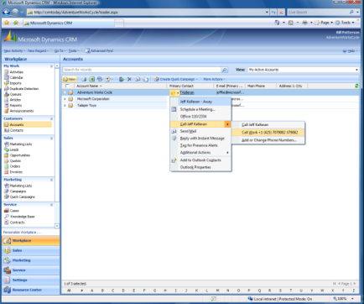
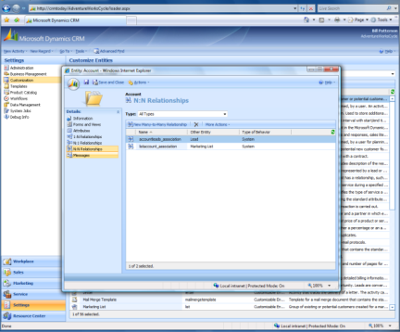
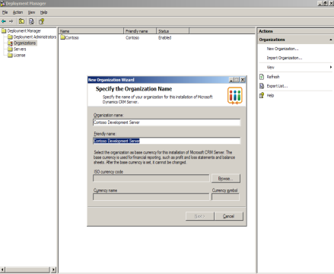



Microsoft Dynamics CRM in the Enterprise
Usability
Flexibility
Manageability
“We need a solution that helps make our jobs easier – not harder.”
“We need a solution that adapts to fit our unique business needs.”
“We need a solution that is easily managed by our already constrained IT resources.”
Actionable Analytics
Performance and Scalability
Notes:
Core pillars of Microsoft Dynamics CRM for enterprises.
Three key pillars built upon a foundation of analytics and performance.

Slide 8
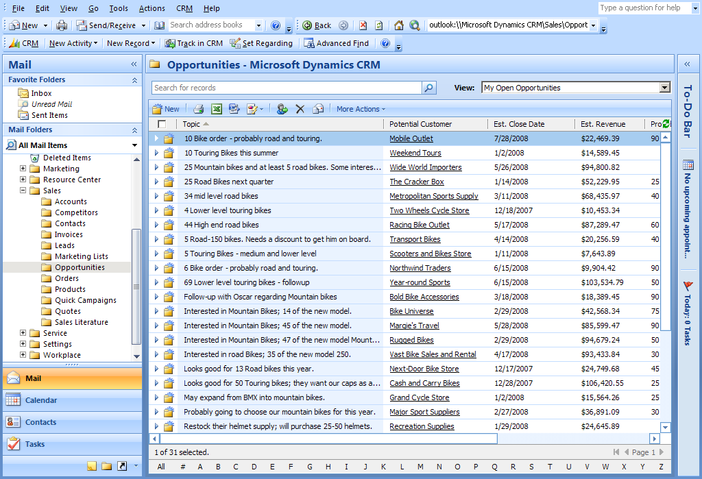

Everyday Usability
Provide users with relevant role-based information through contextual visibility into the applications that they use daily.
Everyday Usability Components
Native Microsoft Office interface
Connected and disconnected clients
Web and mobile access
Composite applications
Microsoft Advantage
Achieve high user adoption by making CRM a natural extension of user habits
Improve productivity by consolidating customer information to a single location
Reduce training and transition costs with easy-to-learn applications
Notes:
Works the way people work – improve productivity, reduce data entry. Give them relevant info in a single interface. Increase user adoption to get more complete, accurate customer view. It’s a virtuous cycle.
Composite applications pulls information from sources outside of CRM into a single application so users get the information they need in one location. This information can be structured or unstructured, and can come from ERP, legacy, industry vertical, Web, or other sources.
Information examples:
Inventory
Billing
Shipping
Mapping
Financial – Hoovers, Factiva

Slide 9
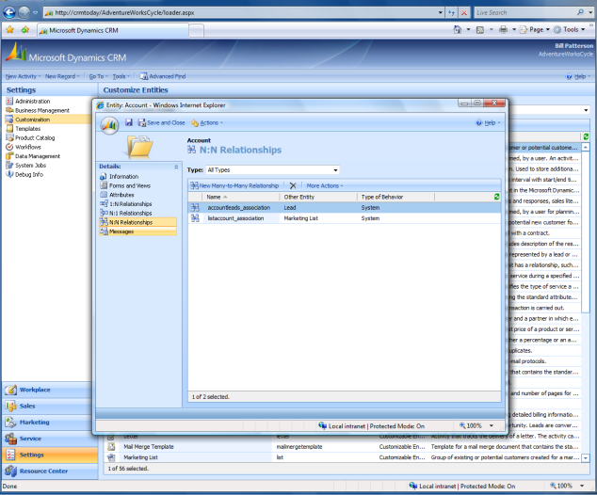

Enterprise Flexibility
Enterprise Flexibility Components
Quick point and click customization
Visual workflow
Powerful programm- ability and extensibility
Enable business units to adapt quickly to the changing business environment
Relationship management platform
Deployment choice
Enterprise multitenant CRM
Microsoft Advantage
Change quickly with visual customization at business analyst level
Change deeply with powerful customizability in standard tools
Change completely to accelerate custom development projects
Notes:
3 levels of flexibility:
Individual business units can quickly configure and reconfigure the application at the business analyst level
IT can modify the application quickly through the SDK that uses industry-standard .NET programmability. Changes are upgradable
The application can be customized to handle non-CRM needs, but that still require managing relationships and orchestration of processes and workflows. We call this xRM, where the x can represent any kind of relationship – citizens, candidates, constituents, donors, partners, troops, even convicts in one case.
Manage changes – architecture of the application stores all changes (in metadata) to help you track and manage changes over time. Use of SDK allows changes to be upgraded.

Slide 10


Efficient Manageability
Deliver quick return on investment and low total cost of ownership with deployment choice, streamlined installation and simplified administration
Efficient Manageability Components
Native services oriented architecture
Deployment choice
Portable application model
Systems Center Essentials
Office client diagnostics
Monitoring and diagnostic tools
Automated deployment tools
Enterprise Multitenant CRM
Microsoft Advantage
Integrates tightly with other Microsoft tools and technologies
Fits heterogeneous environments with standard interoperability
Common codebase and data model across deployment methods
Delivers fast on-demand deployments with full data and security control
Mix and change deployment models at any time
Notes:
Features make it easy for IT to deploy and manage the application.

Slide 11
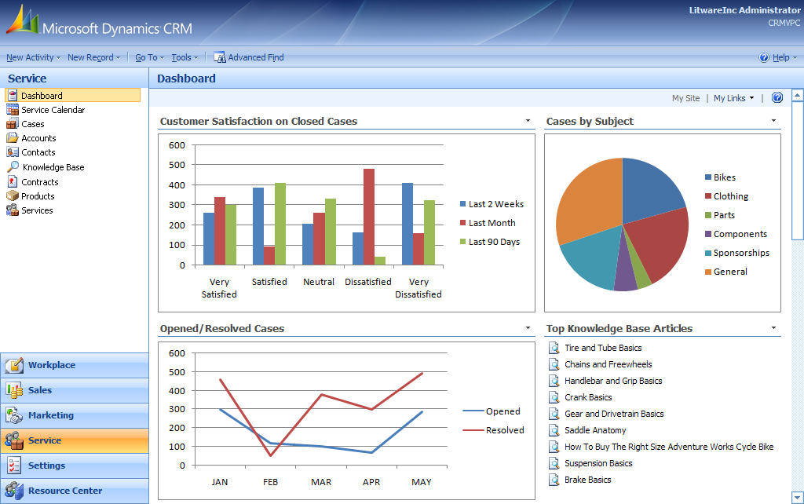

Actionable Analytics
Empower everyday CRM users with easy reporting and actionable analytics
Actionable Analytics Components
Microsoft Excel integration
Report Wizard
Windows Workflow Foundation
Predictive analytics
Microsoft Office Performance Point
SQL Server Analysis Services
SQL Server Reporting Services
Microsoft Advantage
Combine analytics with workflow for actionable intelligence
Minimize costs by leveraging existing Microsoft technology investments
Deliver business insight through familiar productivity tools
Bring analytics to the masses
Notes:
Most of the analytics technologies are included in the products that customers already own.

Slide 12
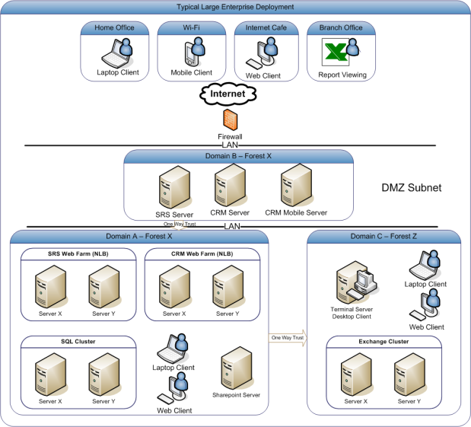
Performance and Scalability
Performance and Scalability Components
Service grid architecture
Deployment choice
WAN performance optimization
Load balance clustering
Scale flexibly and efficiently across local or global enterprise deployments
Web farm clustering
Exchange clustering
SQL Server clustering
SQL mirroring
Microsoft Advantage
Leverage optimization throughout the .NET, Windows, SQL and Exchange platform
Configure to meet user experience, bandwidth and hardware requirements across wide area networks
Scale flexibly up and out across application and data tiers
Notes:
Scales to tens of thousands of users on a single instance, with sub-second response – details in white paper to be released Feb 27/08
- Easy to optimize and to maintain that performance over time - use standard SQL Server tools to tune the app, not highly specialized, expensive resources. Toolkit provided at no additional charge.
- As an example of how easy it was to tune – our last benchmark running tens of thousands of concurrent users was executed with a team of 3 people over 1 week. By comparison, another enterprise CRM vendor (Siebel) took 6 months and a team of people performing highly specialized tuning operations to do similar tests.
Tested to over 1 billion records in the database, with sub-second response
- Again, minimal tuning involved, and using standard hardware
Highly performant and highly configurable for optimal user experience over WAN environments.
- In some cases, up to 95% reductions in roundtrips and page sizes from version 3.0

Slide 13
Enterprise CRM Scenarios
Multinational Deployments
Single Contextual UI
Multitenant CRM
Surround Deployments
xRM
Support business units across the globe in different languages and currencies
Aggregate and analyze data from diverse sources into a single customer view
Benefit from the best of the on-demand and on-premise deployment models
Increase user adoption of legacy CRM and migrate over time
Reach beyond the traditional
boundaries of CRM

Slide 14
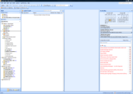




Powered by Microsoft Dynamics CRM
Tight Microsoft Office Integration
Native Outlook client
Seamless integration with MS Office
Robust Workflow Capabilities
Geared for the business user, guided UI
The inherent flexibility to use across groups/systems
Seamless Remote Capabilities
Robust Offline solution
Multitude of mobile device access options
Ease of Customization and Integration
Web-Services based, Open API for easy integration
Architected for easy customization and configuration
Flexible Delivery Options
Single code base across on-premise, on-demand, hybrid
Host it internally for ultimate flexibility and control

Slide 15
BENEFITS

Slide 16







Key Benefits of Microsoft Dynamics CRM
360° Customer View
Higher
Productivity
Business Agility
Project Successes
Achieve 360° visibility across the entire organization
Enable users to do their jobs better by allowing them to focus on customers
Use technology as an enabler for business change
Reach project goals with on-time under-budget CRM deployments that deliver quick returns on investment

Slide 17



Key Benefits for Business
VP of Division
Achieve clear view of business
Leverage agility for competitive advantage
Partner with IT for long term success
Reach high user adoption
Develop consistent customer processes
Leverage reporting and analytics
Business
Manager
Customer Facing Employees
Use familiar Microsoft Office tools
View role-tailored customer information
Minimize data entry

Slide 18



Key Benefits for IT
Chief Information Officer
Rapid time to value
Low total cost of ownership (TCO)
Consistent with IT architecture & standards
High user adoption
Low training time and cost
Quick project wins
IT Project Team
Business
Analyst
Quick and easy customization
Create and modify cross-team workflow
Painless report building
Notes:
CIOs care about driving down their costs, providing agility to the business and generally keeping to consistent architecture. CIOs are in the business of risk mitigation and providing service. If MS is a standard in their business, building their contact center with MS CRM is a great opportunity.
IT Project team can win by providing the users with ability to meet the exact specifications that users provide.
Business Analysts will often report to the business-side of the house but be more IT-oriented. Focus on workflow and reporting. The key to winning them over is to focus on the fact that they can design workflows & business processes in Titan easily and effectively. Secondarily, with Titan, the business analyst can use canned reports, build sophisticated customer reports or even use advanced analytics to measure the business performance.

Slide 19
EVIDENCE

Slide 20
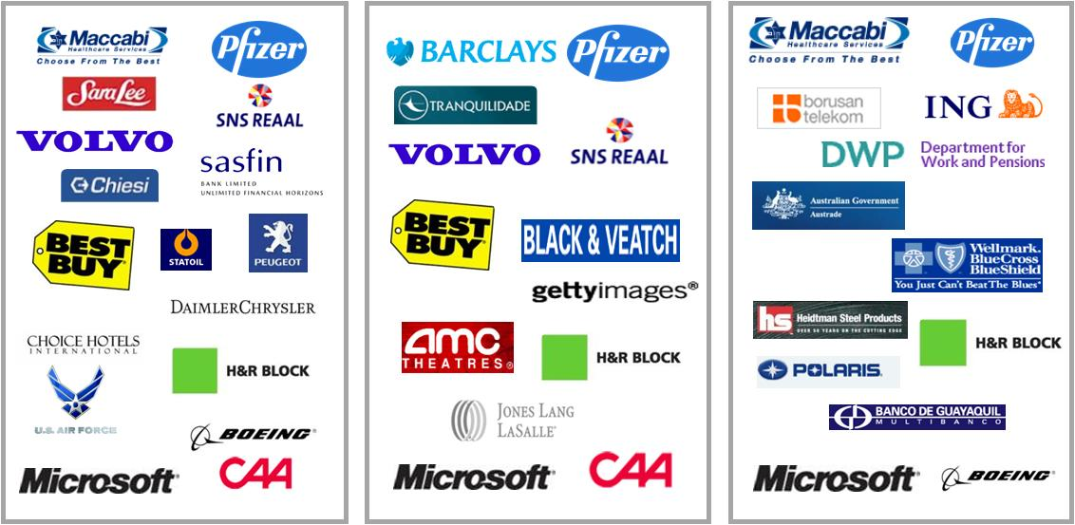
Global Successes in Enterprises
Sales
Marketing
Service
Notes:
Pfizer (Around 30 users)
Implementing MS CRM Sales & Marketing Module in Pfizer KSA including all the customization needed to fit the data model of Pfizer & data migration from their legacy system
Daimler Chrysler (Around 15 Users)
Implementing MS CRM Sales & Marketing part inside Daimler Chrysler to help DC Egypt communicating with their customers & track all the 2 ways communications history also the project includes development of Mobile sms add-on in order to help DC Egypt sending bulk sms to their customers from the CRM grid similar to sending bulk email feature of MS CRM

Slide 21


Customers in Action
ING
US Dept. Agriculture
Price Waterhouse Coopers
Financial Services
4,000 users
ING uses CRM as a relationship management platform for procurement, and as an IT-hosted multitenant solution for accelerated delivery of CRM to multiple divisions.
Public Sector
16,000 users
The USDA supports over 6 million farmers by using Microsoft Dynamics CRM as a business application platform to manage business processes and workflows across its 27,00 field offices.
Professional Services
6,000 users
PwC Canada uses CRM as part of the Company Dashboard to provide staff, leadership, and partners with a single view of its customers across a dozen different applications and repositories.
Notes:
ING
ING has adopted MS CRM in several business units around the world with almost 4,000 CRM user licenses. The most important examples are:
ING Private Banking in Singapore: 200 users in Hong Kong and the Philippines; deployed
ING Insurance in Malaysia: 400-500 users (and growing); deployed
ING Real Estate (Development) in The Netherlands: 200 users are now live and additional users in 8 different European countries will follow shortly. Microsoft is also discussing implementing MS CRM at Real Estate Investment Management and Finance. deployed
ING Insurance in Central Europe: 400 users are now live in Czech Republic and Romania. MS CRM is tagged as preferred CRM solution in this region and discussions are there with ING Hungary, ING Spain, ING Poland and ING Greece to also implement the solution. Interesting aspect there is that in the end, the MS CRM solution implemented will be the same in each country and hosted for the region. Microsoft is starting up conversations about its role and the possibility the host this service for ING Central Europe. The final solution will be based on our Titan release. Partly deployed
ING Retail Bank in The Netherlands: proof of concept that allows Call Center employees to directly create appointments in the agent’s calendar. To be deployed soon
ING Procurement / Vendor Management. Initial implementation has started, focusing on contact management first which will be expanded into other functional areas, depending on the ERP solution that will be selected by ING. This implementation is accepted by the Titan Showcase program, for which ING would like to be an external reference.
ING in Mexico is about to sign for MS CRM. This is a win-back over SAP
PriceWaterhouseCoopers:
PricewaterhouseCoopers Canada (PwC) has more than 5,600 partners and staff in 23 locations from St. John's, Newfoundland to Vancouver, British Columbia. Now celebrating 100 years of excellence in Canada, PwC provides industry-focused assurance, advisory and tax services for public, private and government clients in four areas: corporate accountability, risk management, structuring and mergers and acquisitions, and performance and process improvement. As part of a larger network of over 142,000 people in 149 countries, PwC Canada works to provide clients with the best of their collective thinking, experience and solutions to build public trust and enhance value for their clients and their stakeholders.
The Portal contains PwC Canada’s CRM toolset which has as its main access point the Company Dashboard. This single aggregation point displays contextual information about a client or target company from a dozen different applications/repositories (some being external to the Firm). The main goals of the toolset are: 1) to empower PwC Canada partners / staff to better serve clients and build relationships thorough enhanced collaboration / knowledge sharing that also facilitates a cultural change; and 2) to present the leadership and partners with valuable information that allows them to run the business without requiring a large amount of administrative work associated with keeping the information up-to-date. This is accomplished by using existing information as much as possible, ensuring that all input forms are easy to use, and focusing on capturing only the most relevant information. By initially focusing on creating an open, holistic and flexible CRM platform, it has allowed the team to easily expand the toolset to meet the needs of the business.

Slide 22

Customer Perspectives
“Because Microsoft is readily accepted by my sales staff, the choice of Microsoft CRM was a rather quick and natural one.”
Hans Wilkes,
Commercial Director, REAAL Verzekeringen
“Microsoft Dynamics CRM brings business process automation to an otherwise complex, multi- step process.”
John Thompson,
AVP H&R Block
“Connecting to a transparent, global platform gives us quick and easy access to the current data we need.”
Jack Minter,
Managing Director, Jones Lang LaSalle

Slide 23


Customer Return On Investment (ROI)
Replacing 70 applications,
Reducing application development staff from 20 contractors to 8 contractors,
Reduced enrollment process from 30-40 days to 2-3 days
Connects H&R employees, employers, hospitals, and schools with state agencies
Expecting 125% productivity increase
Projected 200 hours/month savings for total of $3M
Public Sector Customer

Slide 24










Partnering for Success
Software and Services Enterprise Partner Examples

Slide 25
DISCUSSION

Slide 26
APPENDIX

Slide 27
Enterprise CRM Trends
Focus on the users
Shift from applications that dictate, to tools that enable
Engineer for change
Plan for inevitable change that accompanies large complex organizations and disparate systems
Information is everywhere
Disparate data still pervasive; new sources of rich data in Web 2.0, structured & unstructured data
Notes:
Users:
The previous generation of CRM (SAP, Siebel, Oracle) was crammed down users’ throats – why? Because these applications had hundreds of features that in name, should have met current or future user needs. The reality was that the applications were installed to meet management needs for control, visibility, reporting. Users disliked the tools and often viewed them as a “big brother” watching over their shoulder. Once users shunned the system and resisted entering data, leading to numerous deployments that didn’t meet expectations. Companies now are more focused on enabling users rather than controlling them, coaching and providing best practices. Most vendors are moving towards this – SAP Duet, Siebel Outlook plugin, Salesforce.com Outlook plugin, SugarCRM Outlook plugin. They are all trying to expose small pieces of their functionality through applications that people are already using. They are still tied to their backend applications.
Change:
The previous generation of CRM was designed more for brute force than agility. One of our customers, a large European telco, told us they had a team of coders writing 500,000 lines of code every 6 months to maintain their last-generation CRM system [system was Siebel]
Enterprises are inherently complex.
Change breaks custom build
Largest deal in Microsoft history was a public sector deal for the DoD. In our previous CRM system (Siebel) 12 activities related to closing the deal were recorded. We then analyzed the sales rep’s laptop to see if there were other interactions that had not been captured. Guess how many activites/interactions we found? 2200, sitting in Outlook, Excel, Word – bascially Microsoft Office.
Other Topics
Expanding deployment choices
Evaluating and balancing on-premise and on-demand options
Buy over build
Preference for packaged applications

Slide 28



Scalability And Availability
Stateless Message Based Connection
Allow for failure during transaction
Efficiency allows for fewer server per user
Serviced by large web farms
Exchange Cluster
NLB
App Tier Scale Out
Leverages Standard IIS technologies with NLB
Code optimized for scale out deployment
Web Services are Load Balanced as well
CRM Application Server Web Farm
Support for Standard SQL Server Failover
Support for Log shipping
Index Wizard Support
SQL Server Cluster
Active-Passive
Notes:
Main Points:
Stateless message based connections allow for high availability and scalability within the user context
App tier is engineered for scale out
Database supports index tuning and standard failover
In the enterprise performance, scalability and failover are very important architecture features. You cannot rely on the brute force of just adding more resources to a server or more servers. You must approach the engineering task from a model of efficiency and resilience. We created the application to have a stateless message based operation through out the stack. This provides for the ultimate scalability as you can have multiple servers acting as one and if a server fails the user will not be interrupted or asked to log in again. As each process is treated as a discrete amount of work you achieve a loosely coupled experience with regards to scale out scenarios. This also means much less memory at the database server for user session. Other applications require lots of connections to be open at the server which drives up the memory usage even if the transaction load is small. This ultimately puts a top end on the number of users that you can support. To gain more room at the database server connection pooling is often used which brings with it other problems of blocking transactions.
Our application server is housed in the context of IIS. This shortens the path of servers between logic and presentation. We do not have to publish logic results from an application server to another web server that then renders the UI for delivery to the client. This operation is all handled within a single machine offering efficiencies of low latency. This also allows us to leverage low cost and high performance network load balance solutions. There are many mission critical solutions in the market today that provide this functionality. We can take advantage of this because we put no external demands on IIS or Windows Server that would not allow us to use the default scalability solutions. The web service interface also gets load balanced with this approach allowing for highly scalable integration interface scenarios. The load balancing applies to the UI generation as well as the business logic with a single solution that lowers management effort.
We take advantage of all the native features of SQL Server that apply to our application. This means that our application works with standard active/passive clustering of the SQL server. In addition to redundancy we have architected for performance. Our database does not contain the security descriptors from AD reducing the incremental traffic during authentication. When a custom entity is created we automatically generate indexes based on relationships and saved queries which result in a highly optimized scheme. Further performance measure can be made to separate the SQL Server Reporting Services on a different machine which will further spread the load and allow for greater performance. The techniques employed to manage and tune the database environment along with the tools are provided with SQL Server. These tools include the database tuning wizard which can be applied to the CRM database for optimization.

Slide 29
100+ Enterprise Enhancements in Titan
Multi – tenant/language/currency
Many to many relationships
End user productivity and experience enhancements
Customizable SmartNav
Advanced Reporting Wizard
Email smart-matching
Outlook background sync
Offline experience + offline reporting
Mobile experience
Significant performance, scalability, availability enhancements
WAN performance (fewer Http round trips, smaller pages)
Clustering for: web farm, Exchange Server, Reporting Service,
SQL mirroring
Advanced data management
Intelligent data import tools
Intelligent data migration tools
Deduplication
Intelligent deployment and administration tools
Internet facing deployments
Deployment diagnostics and automation
Improved tracing, logging, monitoring (incl. tighter System Center integration)
Authentication key management
Citrix support
Powerful customization environment and application platform
Windows Workflow Foundation
Offline SDK
Significant eventing framework improvements
Metadata API
Notes:
Intelligent deployment and administration tools to accelerate time to value and minimize IT burden
Multi – tenant/language/currency to support multinational deployments while minimizing IT costs
Next generation Power of Choice allows enterprises to self-provision SaaS CRM to divisions or geographies (SaaS inside the firewall)
Support for many to many relationships address complex horizontal and vertical needs
Significant performance, scalability, reliability enhancements for large deployments
Advanced data management to ensure data quality
End user productivity and experience enhancements improve adoption and overall ROI
Powerful customization environment and application platform for flexibility and agility

Slide 30
# 1 – “We are global” Multinational Enterprise Deployments
Customer Requirements
Multinational corporations often need to manage customers and transactions across countries, currencies, and languages
Business Value
Single view of the customer
Efficient use of IT resources
World class performance and scalability
Key Functionality in 4.0
Single instance multi-currency
User selectable multi-language
WAN performance optimization
SQL Server mirroring and clustering
Web farm, Exchange, and load balance clustering
Parallel inbox processing
Citrix support
Notes:
Multinationals such as Nestle need to sell and support in multiple areas of the world in local language and currency. Sales and service employees can now select their preferred UI language on the fly, and perform transactions in local currency. All this is enabled from a single centralized deployment, regardless of base location, currency or language.

Slide 31
# 2 – “The best of both worlds” Enterprise IT-Provisioned CRM
Customer Requirements
Speed: enterprises need to be able to support and enable numerous diverse business units quickly and flexibly.
Control: IT needs to retain control and ownership over application and data security.
Business Value
Unprecedented combination of speed, flexibility, and control for enterprise CRM across divisions, organizations, and geographies
Key Functionality in 4.0
Single instance multitenant CRM
Portable application platform
Multicurrency, multilanguage
Notes:
CRM in the past was often too expensive, took too long to deploy, and was too difficult to maintain and change. Then along came CRM offered as a hosted service (SaaS CRM), which promised quick installations but gave up control of data, control of application security, and often created additional silos of information.
For the first time, customers can get the best of both worlds with Microsoft Dynamics CRM hosted by enterprise IT

Slide 32
# 3 – “My customer is my partner is my supplier” Complex Business Models
Customer Requirements
Manage complex business relationships across customers, partners, vendors, brokers.
This is critical in many B2B and B2B2C verticals such as financial services, real estate, and government
Business Value
Allows businesses greater flexibility to manage customer relationships and interactions
CRM users can easily enter, track, and view complex relationships, fostering higher user adoption and greater data quality
IT saves time and money on customization work
Key Functionality in 4.0
Portable Application data model support for many to many relationships
Notes:
Enterprises often have business relationships that span beyond a single company selling a good or service to multiple customers. Often, their customers are also their partners, and sometimes their supplier, and sometimes even a competitor…this may exist locally, regionally, globally, and may even be a separate division within the same global enterprise!
Complex relationships such as these are common in the financial services industry. Wholesalers such as Merryl Lynch, Goldman Sachs and Pimco sell to brokerage houses like Raymond James, Charles Schwab, and TD Waterhouse, which in turn sell the products to end consumers such as institutional and private investors. The wholesalers sell to multiple brokerage houses, who also buy products from multiple wholesalers. Companies along the entire value chain need to be able to sell and provide service to their customers through a complex web of intermediaries.
It is imperative that CRM users be able to accurately enter and track the full extent of these complexities in the CRM system so that data in the system reflects the full reality of the business relationship. What’s more, the system must allow this to be done easily and quickly, without complex programming as extensive delays can cause users to become disenchanted with the CRM system, resulting in user adoption and data quality challenges.
While it was possible to model many to many relationships in Dynamics CRM 3.0, the architecture changes in 4.0 allow the data model to natively handle complex relationships. This will result in lower IT overhead for deployment and maintenance, as well as faster time to value and change response.

Slide 33
# 4 – “Enterprise CRM on time and under budget” Streamlined Installation, Simplified Administration
Customer Requirement:
Focus on the business, not on deploying and maintaining CRM
Utilization of IT resources as a strategic business advantage, not buried in systems maintenance and change management
Business Value
Fast deployment time to value
Low total cost of ownership
Rapid change management
Key Functionality in 4.0
System Center Essentials integration, SMS Deployment, Roaming Profiles, Self-healing Installer, Automated Outlook Diagnostic tool, Email Router Easy Configuration, Add Users Wizard, Portable Role Based Setup, Improved Administration Panel, Environmental Diagnostics, Deployment Administrator and Manager, System Tracing Logging & Monitoring, No-VPN Remote Access
Notes:
System Center Essentials & MOM:
Get and stay secure
Update management for Windows, Dynamics CRM
and other applications
Keep environment up and running
Complete monitoring, with knowledge for servers,
desktops, network devices and hardware
Serve and support end users
Diagnostics tasks, reporting and deploy
end user software
Keep track of what I have
Hardware and software asset inventory and reporting

Slide 34
# 5 “We do things differently around here” Flexibility and Extensibility
Customer Requirements
Company DNA is a key strategic advantage in the industry
Unique business processes
Atypical CRM needs
Business Value
Match the technology to the business, not the other way around
Minimize change management of people, the hardest part
Key Functionality in 4.0
Customizable Workflow Orchestration, Extensible Workflow Library, Visual Workflow Designer, Offline plugins, Plug-in Authentication, Metadata APIs, Asynchronous Event Processing, Dynamic Entity Objects for Images Access, Dynamic Plugin Registration, Exceptions from Post Stage, Default CRM Proxy

