Slide 1



Expedia Tips for a Smooth Trip to Windows 7
Upgrading desktop infrastructure with Windows 7 to drive productivity, efficiency & data security

Slide 2
Today’s webcast
Joe Maglitta (Moderator)
Editorial Director and Market Expert, Ziff Davis Enterprise
Michael Peterson
Manager End User Technology, Expedia
William Weigle
Systems Engineer, Expedia

Slide 3

Agenda
Company Background
Business Objectives, Current Challenges
Technology initiatives: Windows 7 & App-V
Lessons Learned & Best Practices

Slide 4
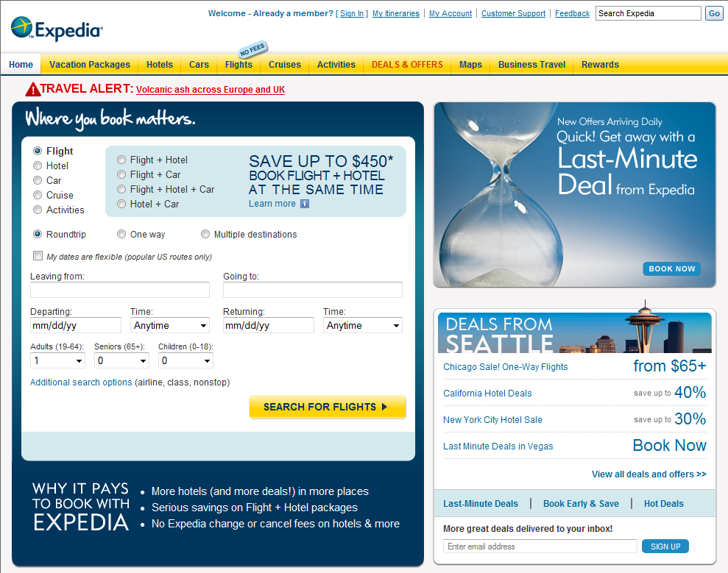
Company Background
Founded 1996, based in Bellevue, WA
World’s largest online travel services provider
19 Expedia.com sites, affiliated services including Hotels.com, Hotwire.com, Egencia
Approximately 7,000 employees worldwide
2009 Annual revenue $3 billion

Slide 5


Business Objectives
Desktop Infrastructure: Investment Goals
“Create a seamless computing experience for our people wherever they happen to be working, ensure a thoroughly secure environment to protect corporate data”
Boost organizational flexibility
Empower greater employee productivity
Strengthen enterprise security

Slide 6
Current IT Infrastructure
98% Windows XP with images maintained across 11 field sites
Non-standard deployment processes, image configuration
SCCM R2 SP2 deployed and managing all client workstations for patching and targeted software deployments
Manual software approval workflows and installation
Server 2003 SP2 corporate domain

Slide 7
Current Challenges
Reduce PC Images: IT supports up to 10 unique images, with multiple HW platforms
Standardize Processes: Four management tools currently in use
Streamline Provisioning: 98% of business applications installed manually
Improve PCI compliance: Needs more robust security & control over sensitive customer data

Slide 8
Technology Initiatives
In Pilot:
Windows 7
Application Virtualization (App-V)
Microsoft Deployment Toolkit (MDT)
In Evaluation:
MED-V Desktop Virtualization
DirectAccess
…And now for Expedia’s Journey

Slide 9
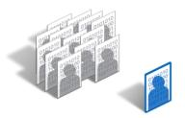
PC Image Management & Deployment

Slide 10




Application Provisioning

Slide 11

Green IT Initiative & Power Management

Slide 12


Security & PCI compliance

Slide 13

Benefits
Rapid provisioning & centralized maintenance
Better control over power consumption
Enhanced data security and better PCI compliance
More Flexible, Manageable and Secure PC environment

Slide 14
Lessons Learned, Best Practices
Windows 7 & App-V at Expedia
Application testing was key with MS ACT as a first validation
Focus education on what’s new with Windows 7 to see the productivity gains; Snap, Connect to projector
Leverage the Microsoft tools; MDT 2010 and MDOP to make the desktop transition

Slide 15
Q & A

Slide 16
Top Resources
Windows 7: www.Windows.com/Enterprise
Windows Optimized Desktop: www.Microsoft.com/OptimizeDesktop
Windows 7 for IT Pros: www.Microsoft.com/Springboard
Microsoft Desktop Optimization Pack: www.Microsoft.com/MDOP
Windows End of Support for Windows XP SP2 and Vista RTM: http://www.microsoft.com/windows/enterprise/products/windows-7/end-of-support.aspx
Interested in more webcasts? Visit http://www.microsoft.com/windows/enterprise/products/windows-7/webcasts.aspx
And for your next travel booking: www.Expedia.com

Slide 17
Thanks
KOMO TV
And especially to you for joining us!

