Slide 1
SQL Server 2008 R2
Manageability

Slide 2
SQL Server 2008 R2
Challenges facing database administrators today:
Proactively monitoring and tuning system health
Scaling management to multiple data centers
Gaining insight into historical trends and real-time activities
Managing complex and high-value tasks
Notes:
These challenges facing database administrators and operators today include:
Managing complex and high-value tasks
Proactively monitoring and tuning system health
Scaling management to multiple data centers
Gaining insight into historical trends and real-time activities

Slide 3
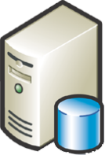













SQL Server 2008 R2 Manageability Productive Administration
Monitor
Troubleshoot
Configure
Tune
Scale
Audit
Report
Manage by Intent
Monitor with Insight
Scale with Ease
Notes:
At the core of all innovation in relation to Microsoft products are the people who use those products. It is our goal to develop a synergistic and symbiotic relationship between what you do want to do, how you do it, and how we can support those goals with innovative technology.
Our commitment is to deliver value and innovation across the entire IT lifecycle by enabling solutions that make administration easier and more productive. SQL Server 2008 R2:
Provides tools to ease development, deployment & configuration
Helps system maintenance with proactive administration through visual tools and reports
Provides great instrumentation to support alert monitoring & tuning
Enables scalable administration : Amplifying the impact of your people

Slide 4







SQL Server 2008 R2 Manageability
Manage at Scale
Automate Tasks
Streamline Troubleshooting
Gain insight into historical trends
Scale for any business size
Monitor system health and optimize performance
Perform interactive administration
Conform and comply with system configuration policies
Notes:
SQL Server 2008 R2 enables you to manage at scale, automate administrative tasks, and streamline troubleshooting with a range of innovative and effective features.
SQL Server 2008 R2 addresses manageability challenges by providing the ability to:
Conform and comply with system configuration policies
Scale for any business size
Monitor system health and optimize performance
Leverage interactive administration
gain insight into historical trends

Slide 5






Manage Efficiently at Scale
Centralized Management through a Single Management Console
Scalable Management with Systems Center Operations Manager
Streamlined Application and Multi-Instance Management
Notes:
SQL Server Management Studio delivers a portfolio of tools through a single console to centrally manage SQL Server instances, applications, and all SQL Server services, allowing administrators to more efficiently manage at scale.

Slide 6
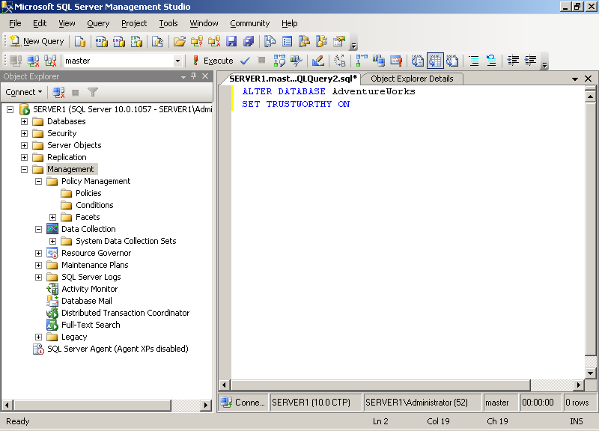
Single, Central Management Console
SQL Server Management Studio
Centralized management of all SQL Server instances and services
Intellisense for productive management
PowerShell integration
Notes:
Today’s organizations need to store and manage ever-increasing volumes of data, and support a growing number of software applications and services that access that data. This trend has led to data services solutions that span the enterprise, which dramatically increases the workload for database administrators and other operational support personnel.
SQL Server 2008 R2 provides centralized data services administration with SQL Server Management Studio and Integrated Configuration options with SQL Server Configuration Manager.
Centralized Data Services Administration
SQL Server Management Studio is a comprehensive, centralized management tool that enables you to manage all of your SQL Server instances through a single interface. Use SQL Server Management Studio to manage all SQL Server instances and services including relational databases, Reporting Services, Analysis Services, Integration Services, and SQL Server Compact databases. Using a single, consistent management interface reduces training requirements and makes it easier to manage data services across the enterprise.
Integrated Configuration
SQL Server Configuration Manager enables system administrators to manage SQL Server services and network libraries from a single location. You can add the SQL Server Configuration Tool as a snap-in to the Microsoft Management Console (MMC). By creating a custom management console that is specifically designed to support their job functions, system administrators can save time by not having to open multiple tools. Additionally, the SQL Server configuration tool helps system administrators to manage portions of the services that relate to their functions, which relieves the database administrator to manage databases and database performance.

Slide 7
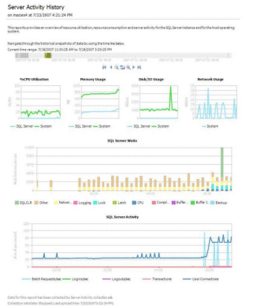
Gain Management Insight
SQL Server Management Studio includes:
Standard Reports
Custom Reports
Performance Dashboards
Notes:
SQL Server Management Studio includes a number of standard administrative reports that you can use to view information about your SQL Server instances, databases, and other objects.
Additionally, you can create custom reports and integrate them into the SQL Server Management Studio interface.
Performance Studio provides a number of custom reports based on data collection sets that have been collected from SQL Server instances and stored in the management data warehouse. You can use these reports as performance dashboards to help you gain insight into the historical performance and health of your SQL Server instances across the enterprise.

Slide 8
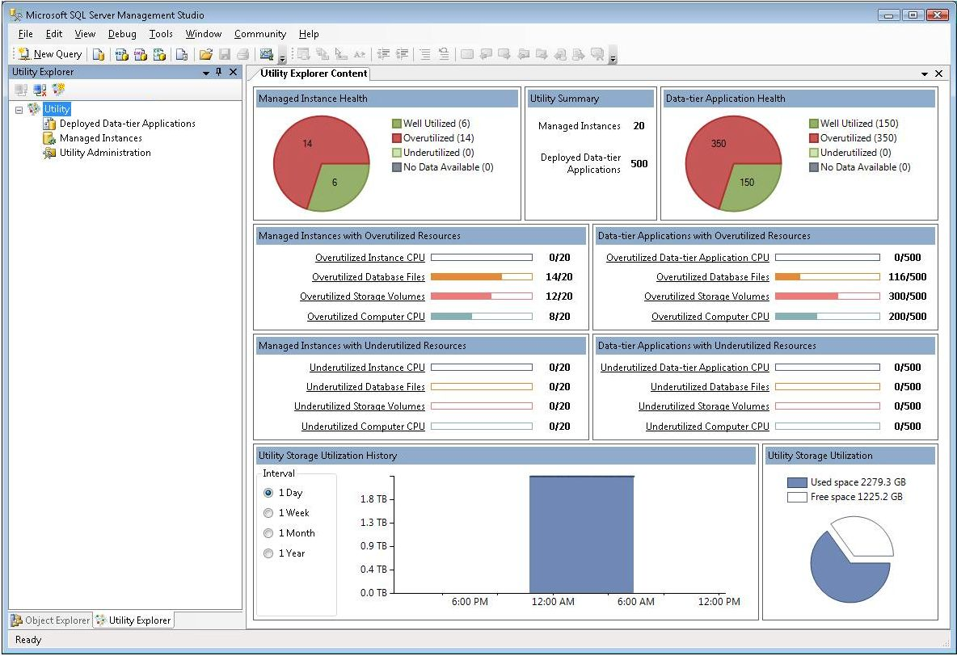
Multi-Instance Management
Control server sprawl with a Utility Control Point
Enroll hundreds of instances into central management
Define global resource utilization policies
Easy-to-use management interface with dashboard view
Fast and easy setup, no install DVDs
Accelerate consolidation projects
Notes:
Utility Control Point
SQL Server 2008 R2 delivers a new way to monitor and manage the utilization of multiple SQL Server instances and data-tier applications by introducing a centralized utility control point and enrolling SQL Server instances and applications from across your enterprise. Default policies evaluate the resource utilization levels of the enrolled instances and assess violations of these policies to give an overall, enterprise-wide view of database server utilization.
Setting up a UCP
Setting up a Control Point is very straightforward. A new wizard in SQL Server Management Studio guides you through a simple five-step process of creating the Control Point on your chosen SQL Server 2008 R2 instance, and additional wizards enable you to enroll instances and register data-tier applications to be managed by the Control Point . With SQL Server 2008 R2, you have the flexibility to enroll instances one at a time or batch-enroll using PowerShell integration.
Data-Tier Applications
Control Point also supports management of data-tier applications. A data-tier application is a container that defines and bundles the database schema, reference data, and deployment requirements of an application together so you can manage them as a single entity. You can manage data-tier applications through the Control Point and evaluate resource utilization just as you can for SQL Server instances.
Utility Explorer
To manage the Control Point and enrolled instances and registered data-tier applications, SQL Server 2008 R2 Management Studio has a new feature called Utility Explorer. A sister feature to Object Explorer that helps you manage individual databases, Utility Explorer is the management interface for multi-instance management. Utility Explorer allows you to access each Control Point, and it displays summary and detail information about enrolled instances and registered data-tier applications, including database file utilization, storage volume utilization, and Control Point utilization. From the Utility Explorer you can also adjust policies and security settings for the Control Point. It features an intuitive dashboard view with color-coded charts that enable administrators to see at a glance which SQL Server instances and data-tier applications are overutilized or underutilized, helping them to make informed, proactive decisions about server consolidation or expansion to optimize hardware resource utilization.
Utilization Policies
You can use Utility Explorer to adjust global policies that specify thresholds for underutilization and overutilization of resources. For example, you can specify that 80 percent represents the point at which instance processor utilization is overutilized, and 20 percent as the point where it is underutilized. Performance figures collected from enrolled instances are compared to these values, and any instances that exceed or fall below these figures will be immediately obvious in the dashboard view in Utility Explorer.
After you have identified an overutilized or underutilized instance, you can drill down from the summary information offered in the dashboard view to a more detailed breakdown for that instance by selecting the instance under the Managed Instances node in the Utility Explorer.
Utility Policies can define maximum and minimum thresholds for:
Instance processor utilization
Computer processor utilization
File space utilization for database and log files
Computer volume space utilization
As well as setting global policies, you can also define individual policy settings for individual instances, giving you greater flexibility in your management of multiple SQL Server instances. Any policies defined individually in this way will override the global settings where configured thresholds differ.

Slide 9
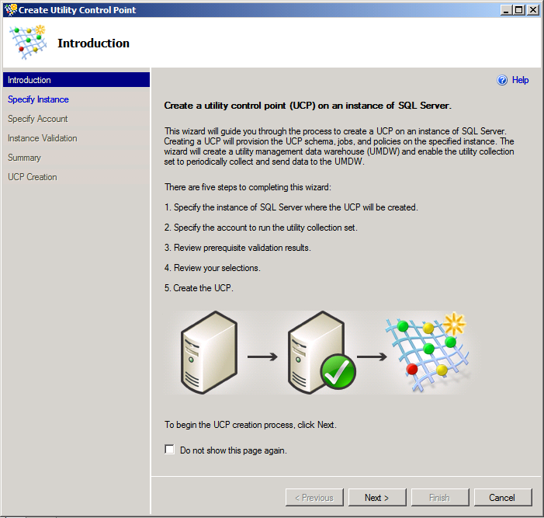

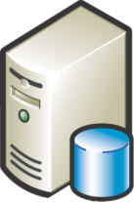


SQL Server Control Point
New wizards in SQL Server Management Studio
Wizards for fast and easy setup
Create a Control Point
Enroll instances
Insights refreshed every 15 minutes
Database
Administrator
SQL Server
Control Point
Managed Server Group
Notes:
SQL Server Control Point
DBA teams will gain more visibility and control over their environment through new extensions in SQL Server Management Studio.
New wizards allow database administrators (DBAs) to quickly designate a SQL Server instance as a SQL Server Control Point and then enroll instances into centralized multi-server management. This enables DBAs to gain visibility into relevant information, such as SQL Server versions, and helps them to control the sprawl of unsanctioned and non-standard instances and applications. Within about 15 minutes from setup, DBAs will have insights into database utilization, enabling them to make decisions about consolidation candidates or proactively address applications and instances that are overutilized. Dashboard views provide easy-to-understand information.

Slide 10

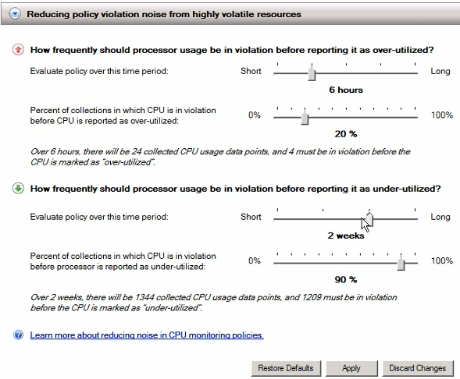
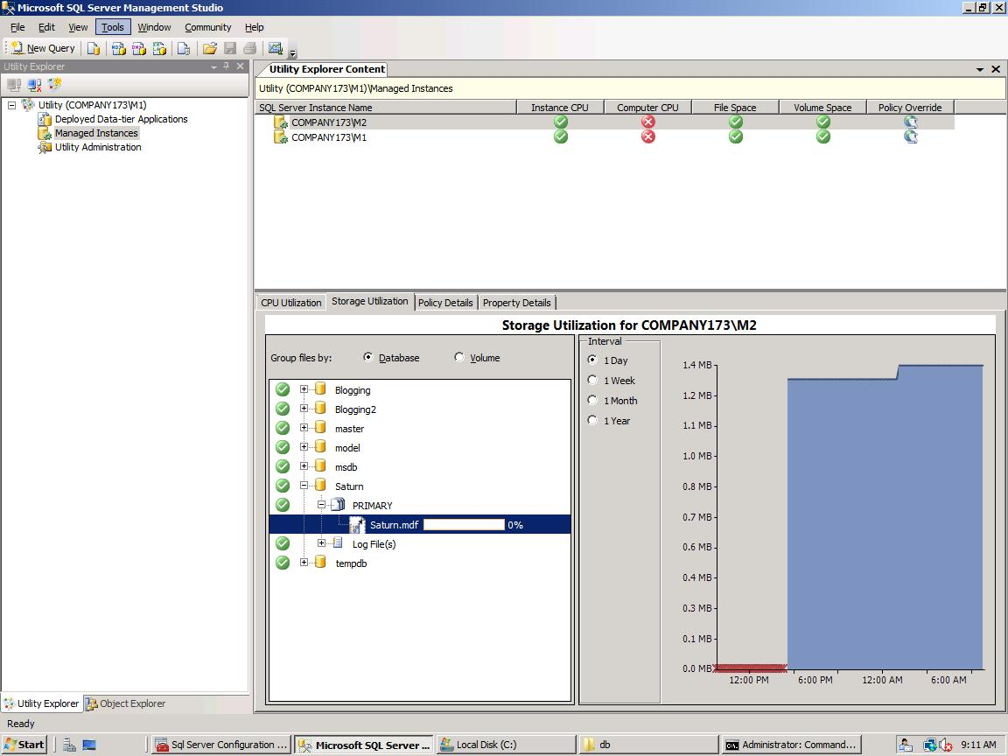
Insight into Utilization and Policy Violations
At-a-glance views for insights
ID consolidation opportunities or potential issues
Quickly drill down to detailed views
Simple UI for policy adjustments
Notes:
Insight into Utilization and Policy Violations
After instances are enrolled, at-a-glance dashboard viewpoints provide insights into application and database utilization and capacity policy violations to help identify consolidation opportunities, maximize investments, and ultimately maintain healthy systems.
DBAs can use simple UI tools to adjust default policies to define desired utilization thresholds across database instances or applications in the SQL Server Control Point.

Slide 11







Single Unit of Deployment—Data-Tier Application
Deployment without DAC
Deployment with DAC
Data-Tier Application Package
Packages data-tier objects
Integrated with Visual Studio 2010
Encapsulates deployment requirements
Reduces manual tasks, improves quality
Increase deployment and upgrade efficiencies
Notes:
Data-Tier Application
A key challenge for many database developers and administrators is deploying new applications or upgrading or migrating database applications from one server instance to another—for example, from a staging server to a production server, from one SQL Server instance to another in a server consolidation scenario, or from an older instance of SQL Server to SQL Server 2008 R2. Moving an application from the development environment to a test server and ultimately to the production environment can be problematic for a variety of reasons. For example, the newly deployed database may use a different storage configuration from the development database, or it may rely on dependent server-level objects such as logins that must also be created on the production server for the application to function correctly.
To address these problems, and to help make deployments go more smoothly, SQL Server 2008 R2 introduces the concept of the data-tier application. The data tier of an application includes the logical database structure, physical data objects, and dependent server-level objects, such as logins and database and log files. A data-tier application encapsulates these elements into a single unit of deployment called a data-tier application package. Developers can add deployment requirement policies to the data-tier application package as they create or modify it. For example, deployment requirements can be as basic as “VersionMajor is greater than or equal to 10.” These built-in requirements help reduce the loss of information during transition from development to IT. Developers and administrators can create these packages by using SQL Server Management Studio and Microsoft Visual Studio® 2010.
Create and Manage in SQL Server Management Studio and Visual Studio 2010
In SQL Server Management Studio, you can use the Extract Data-tier Application wizard to extract information from existing databases to build a package, which can be redeployed elsewhere. If you need to modify the database application before redeployment, you can do so by opening the extracted package in Visual Studio 2010, where you can create new objects such as tables, logins, and users, or add other new deployment requirements. You can also use Visual Studio 2010 to create new data-tier application packages from scratch. Packages that developers create or update by using Visual Studio 2010 can then be passed to database administrators for deployment.
You can deploy new or updated data application component packages by using the Deploy Data-tier Application wizard in SQL Server Management Studio. This easy-to-use interface greatly simplifies the deployment and migration of database applications, reducing the time and effort administrators need to spend on this task. You can also create scripts to deploy packages by using Microsoft Powershell™, which can be useful if you need to deploy the same application multiple times.
Simplify Upgrades
applications from older platforms, including SQL Server 2000, SQL Server 2005, and SQL Server 2008, to the SQL Server 2008 R2 platform. You can use the Extract Data-tier Application wizard in SQL Server 2008 R2 Management Studio to capture the required information from the database on the older platform into a data-tier application package, and then redeploy it onto a SQL Server 2008 R2 instance as previously described.

Slide 12

Scalable Management
SQL Server Management Pack For Microsoft System Center Operations Manager
Improved troubleshooting and planning
System administration that is scalable across your enterprise
End to end service management of line-of-business (LOB) applications
Rich, easy-to-customize reports bring additional insight
Notes:
SQL Server Management Pack
The SQL Server Management Pack for Microsoft System Center Operations Manager monitors the availability and performance of SQL Server 2008 R2, and can issue alerts for configuration problems. The Management Pack collects Event Log alerts and provides associated knowledge articles that provide additional user details, possible causes, and suggested resolutions.
Use the SQL Server Management Pack to enable broader system administration that is scalable across your enterprise. Implement end to end service management of line-of-business (LOB) applications for greater visibility. Use rich, reports and an easy-to-customize reporting environment to bring additional insight when troubleshooting and planning.

Slide 13


Effective Automation
Manage Configuration and Security with Policies
Schedule Tasks and Workflows
Automate Administration and Deployment
Notes:
With highly productive features like Policy-Based Management, SQL Server significantly helps reduce the burden on database administrators, enabling them to focus on high-value activities and help ensure compliance.

Slide 14
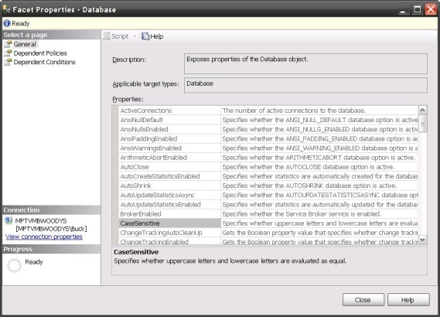
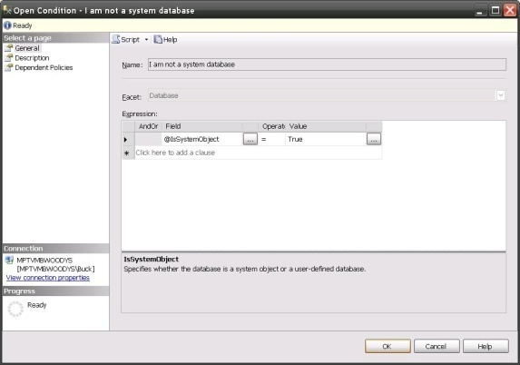
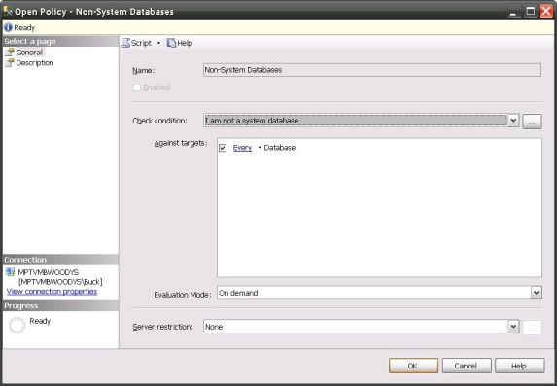

Policy-Based Management Defining Policies
Facets
Conditions
Policies
Targets
Categories
Notes:
The DMF uses the following objects when configuring policy management:
Facets. Contain properties that expose options related to an area of policy management. For example, the Surface Area includes properties that relate to specific SQL Server features, such as Database Mail Enabled and CLR Integration Enabled.
Conditions. Express the state of a facet. are based on a single facet, and can be used in one or more policies. For example, you could create a condition named Minimal Surface Area in which all of the properties in the Surface Area facet are assigned the value False.
Policies. Contain a single condition that is enforced for one or more targets. For example, you could create a policy named Locked Down Server that assigns the Minimal Surface Area condition to the server.
Categories. Contain one or more policies. Database owners can subscribe a database to one or more category. For example, you could create a category named Corporate DB Policies that contains a policy to enforce database object naming conventions and another policy to enforce a specific database compatibility level, and subscribe line of business databases to the category. By default, all databases implicitly subscribe to the default category. Additionally, categories can be marked as Active or Inactive at the server or database level, which enables administrators to control policy enforcement.
Targets. Are entities, such as servers, databases, logins, tables, or other database objects to which policies are assigned. All targets in a SQL Server instance form a target hierarchy. Within a policy, a target set is defined when a set of filters are applied to the target hierarchy. For example, a target set can include all of the indexes owned by the Production schema.
Each DMF facet represents an aspect of SQL Server management in which one or more related configuration options is defined. SQL Server 2008 R2 includes a number of pre-defined facets, which you can use to define policies that enforce specific configuration option values. For example, SQL Server 2008 R2 includes the Surface Area facet.
You can create conditions to define a desired configuration that is based on the settings in a facet
Finally, to define a policy, you simply specify the condition that you want to enforce
SQL Server 2008 R2 provides a comprehensive set of facets that you can use to specify configuration settings and rules for your SQL Server 2008 R2 implementation. Some examples of ways in which you can use the provided facets to define policies include:
Using the Server facet to enforce specific server configuration settings such as the login authentication mode.
Using the Surface Area facet to control which features are enabled, and reduce the surface area of the server.
Using the Database facet to enforce specific database settings such as the compatibility level.
Using the Multipart Name facet to enforce naming conventions for tables views, and other schema-bound database objects.
Using a range of facets to enforce known best practices for your database solution, such as ensuring that data files are stored on a separate drive from log files.
Distributing Policies Across the Enterprise
The DMF provides the capability to publish policy categories to additional SQL Servers in your environment. You can define policies on a SQL Server instance (known as the configuration server) and then replicate those policies to other servers (known as configuration targets). Any changes made to the policies or the categories on the configuration server (such as marking a particular category as inactive) are automatically propagated to all of the configuration targets, which significantly reduces the overhead that is associated with enforcing configuration policy compliance across the enterprise. In addition to the distribution of policies, you can execute queries against the set of configuration targets by using the Query Editor.

Slide 15


Manage by Intent Policy checking and governance
Facets
Define aspects of system configuration
Physical properties that relate to settings
Logical properties that encapsulate business rules
Conditions
Capture the declarative intent (desired state)
Simplify compliance enforcement
Notes:
Manage by Intent: the ability to declaratively define the desired configuration of a particular facet of the system. In DMF this maps to the facets and conditions. The power of facets is that they’re not bound to physical properties - they can encapsulate business logic and create new logical properties on objects. The condition is what captures the declarative intent (the desired state). Is it easier to alter a trigger and get the code correct or make a simple change to a condition (in some respect the condition represents the ‘IF’ part of your trigger (If schema != ‘dbo’))? Probably depends on the user and/or the specific shop.

Slide 16
Intelligent Monitoring
On Demand
On Schedule, log out-of-compliance
Changes are attempted, prevent out-of-compliance
Changes are attempted, log out-of-compliance
Manual checking by administrator
SQL Server Agent job checks periodically and logs non-compliance
DDL trigger rolls back non-compliant changes
Event notification logs non-compliant changes
Notes:
When you define a policy, you select an execution mode for the policy, which will determine whether the policy is enforced proactively, on a scheduled basis, or manually through administrative intervention. The following four execution mode options are in the policy properties:
On Demand. An administrator manually invokes policy checking.
On Schedule, log out-of-compliance. A SQL Server Agent job periodically executes the policy and records any configuration settings that do not comply with active policies.
Changes are attempted, prevent out-of-compliance. DDL triggers roll-back transactions that do not comply with active policies.
Changes are attempted, log out-of-compliance. Event notification evaluates a policy when a relevant change occurs and records any configuration settings that do not comply with active policies.
The policy defines which objects should conform to the desired state (condition) and when and how they should be checked (when changed – prevent out of compliance, when changed – log out of compliance, and on schedule – log out of compliance). You could do all this on your own but you’ll end up with a very complex implementation that will be difficult to maintain. DMF does all of the hard work (trigger maintenance, service broker queue maintenance, and Agent job maintenance) for you. All you have to worry about is does the condition reflect your management intent and is the policy configured to behave as you desire.

Slide 17

Scale with Policies
Automate policy enforcement across the enterprise
Define policies centrally
Notes:
There are two main elements: the ability to manually run policies against groups of servers and the ability to automate policies against groups of servers. This capability provides a central definition of policies and ‘pushes’ the policy out to the desired servers. The policy is then automated on the remote server and returns health state on a periodic basis. This prevents you from having to jump from server to server and maintain your triggers, etc. Once again, DMF is doing the work for you. Your mental picture here should be something like group policy. Integration with System Center is also a critical component of this.

Slide 18


Automate Administration and Deployment
SQLCMD
Create batch files
Automate multiple scripts
SQL Server Management Objects (SMO)
Create custom .NET management tools
PowerShell 2.0 Support
Build robust administrative scripts
Manage across multiple Microsoft products
PS C:\Users\Admin.
C:\>sqlcmd –I Insert..
Notes:
You can customize and extend your management capabilities by creating applications and scripts to perform common administrative tasks. This approach can significantly simplify the operation and management of your data services by delegating management tasks to less experienced administrators and providing a simple utility that contains only the functionality that is required for those tasks.
PowerShell 2.0
Use the PowerShell language to build more robust administrator scripts and manage across multiple Microsoft products. Use the SQL Server provider to quickly navigate paths to locate objects within your servers. Use the set of cmdlets to take actions against the system such as running scripts containing T-SQL or XQuery statements.
SQLCMD
To facilitate multi-script automation through batch files, SQL Server 2008 includes SQLCMD. SQLCMD is a comprehensive command-line tool that you can use to run parameterized and multi-server scripts that perform administrative tasks. By incorporating SQLCMD operations in a batch file or script, you can achieve a high level of administrative automation without requiring operators to use complex management interfaces.
Server Management Objects
Server Management Objects (SMO) is an enhanced Application Programming Interface (API) that exposes the full management environment of SQL Server to developers. You can use SMO to build powerful custom applications to manage SQL Server–based solutions.

Slide 19
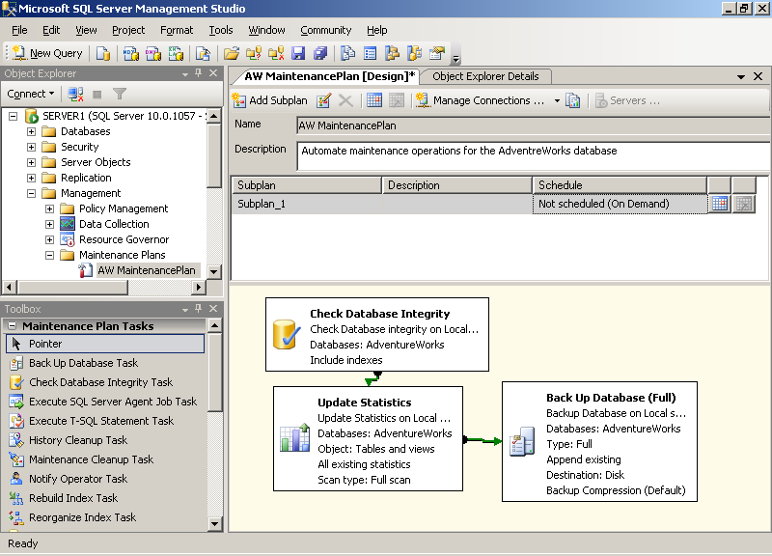
Schedule Tasks and Workflows
SQL Server Agent
Jobs, operators, and alerts
Maintenance plans
Central configuration of jobs for multiple servers
Notes:
Automated Maintenance
Through the SQL Server Agent service, SQL Server 2008 gives administrators the flexibility to provide an automated and proactive management and maintenance strategy for their database environment. The SQL Server Agent provides the following components to configure your automated environment:
Jobs. A series of one or more steps to be completed. These steps can consist of Transact SQL statements, SQL Server Integration Services package, or command-line statements.
Alerts. Preconfigured messages that are generated automatically when a particular event occurs on a SQL Server.
Operators. Users defined with additional contact information that may include an e-mail address, pager number, or net send address. Alerts are sent to these operators when preconfigured events occur, or to notify them of success, failure, or completion of a job or job step.
Schedules. Specifies when a job runs. A job can be associated with more than one schedule.
Multi-server jobs can be maintained at a centralized server and used to manage SQL Server instances across your organization.
Maintenance Plans
Maintenance plans enable administrators to quickly configure standard maintenance policies, such as regular database and transaction log backups, and index maintenance to be implemented on SQL Server instances. The Maintenance Plan Wizard provides a quick and user-friendly way to define maintenance plans for one or more databases. Similarly to jobs, multi-server maintenance plans can be managed from a centralized server in a master server/target server configuration. In addition to the Maintenance Plan Wizard, SQL Server Management Studio provides an extensive design surface with which you can define an enhanced workflow for maintenance plan tasks.

Slide 20



Streamline Troubleshooting
Gain Resource Insights
Perform Real-Time Diagnosis
Streamline Server Tuning
Notes:
Accelerate impact analysis and pinpoint problems through Performance Data Collector, SQL Server Profiler, and Database Engine Tuning Advisor.

Slide 21


Gain Resource Insights
Performance Data Collector
Low overhead data collection
Centralized data storage
Comprehensive reporting
SQL Trace
Performance Counters
Transact-SQL
Management Data Warehouse
Data providers:
Notes:
SQL Server 2008 R2 provides Performance Studio, which is an integrated framework that you can use to collect, analyze, troubleshoot, and store SQL Server diagnostics information. Performance Studio provides an end-to-end solution for performance monitoring that includes low overhead collection, centralized storage, and analytical reporting of performance data. You can use SQL Server Management Studio to manage collection tasks, such as enabling the data collector, starting a collection set, and viewing system collection set reports as a performance dashboard. You can also use system stored procedures and the Performance Studio application programming interface (API) to build your own performance management utilities based on Performance Studio.
Performance Studio provides a unified data collection infrastructure that consists of a data collector in each SQL Server instance you want to monitor. The data collector is flexible and provides the ability to manage the scope of data collection to fit development, test, and production environments. You can easily collect both performance and general diagnostic data with the data collection framework.
The data collector infrastructure introduces the following new concepts and definitions:
Data Provider. Sources of performance or diagnostic information that can include SQL Trace, performance counters, and Transact-SQL queries (for example, to retrieve data from Distributed Management Views).
Collector Type. A logical wrapper that provides the mechanism for collecting the data from the data provider.
Collection Item. An instance of a collector type. When you create a collection item, you define the input properties and collection frequency for the item. A collection item cannot exist on its own.
Collection Set. The basic unit of data collection. A collection set is a group of collection items that are defined and deployed on a SQL Server instance. Collection sets can run independently of each other.
Collection Mode. The manner in which the data in a collection set is collected and stored. The collection mode can be set to cached or non-cached. The collection mode affects the type of jobs and schedules that exist for the collection set.
The data collector is extensible and supports the addition of new data providers.
When the data collector is configured, a relational database with the default name MDW is created as a management data warehouse in which to store the collected data. This database can reside on the same system as the data collector, or on a separate server. Objects in the management data warehouse are grouped into the following three preconfigured schemas, each of which has a different purpose:
The Core schema includes tables and stored procedures for organizing and identifying the collected date.
The Snapshot schema includes data tables, views, and other objects to support the data collected from the standard collector types.
The Custom Snapshot schema enables the creation of new data tables to support user-defined collection sets that are created from standard and extended collector types.
Performance Studio provides a robust set of preconfigured system collection sets, including Server Activity, Query Statistics and Disk Usage, to help you to quickly analyze your collected data. You usually start your monitoring and troubleshooting with the Server Activity system collection set. A set of reports associated with each system collection set is published in SQL Server Management Studio, and you can use these reports as a performance dashboard to help you to analyze the performance of your database systems.

Slide 22

Perform Real Time Diagnostics
SQL Server Profiler
Capture SQL Server activity
View and play back captured workloads
Correlate with System Monitor
Notes:
Use SQL Server Profiler to capture server events for real-time diagnosis. Correlate traces with performance counters to analyze events and diagnose issues. Plus monitor the health of server instances, diagnose problems, and tune performance with Dynamic Management Views (DMV) and functions that relay server state information
SQL Server Profiler
SQL Server Profiler shows how SQL Server internally resolves queries by providing a graphical interface for the functionality provided through SQL Trace. With SQL Server Profiler, you can capture the activity generated by a workload on a SQL Server instance. The events that are captured and displayed can be defined by using predefined templates, and you can modify the system provided templates to create your own templates. You can save the captured workload to a table or to a file for future evaluation. You can immediately start a new trace from SQL Server Management Studio based on your connection context. For example, if you want to trace statement execution for a particular Query Editor session, the new Trace Query in SQL

Slide 23

Streamline Server Tuning
Database Tuning Advisor
Gain insight into indexing and partitions structures of your databases
Optimize indexes and partitions for your workload
Notes:
Database Engine Tuning Advisor
You can use the Database Engine Tuning Advisor (DTA) to gain insight into the existing indexing and partitioning structure of your databases, and to get recommendations for how to improve database performance by creating appropriate indexing and partitioning structures. In addition to optimizing your indexing structure, DTA can recommend new physical data structures, including partitioning. DTA also offers you the ability to tune across multiple servers and limit the amount of time the tuning algorithms run. DTA is available as both a command-line and graphical utility. The command-line utility enables you to take advantage of advanced scripting options.

Slide 24

© 2009 Microsoft Corporation. All rights reserved.
This presentation is for informational purposes only. Microsoft makes no warranties, express or implied, in this summary.

