Slide 1
Håkan Lagerström TSP hakanl@microsoft.com +46773 91 92 75

Slide 2



We’ve Magnified Our Strengths
Microsoft offers market-leading search solutions from a trusted partner
Best-in-class Technology
The most powerful and market-leading enterprise search platform
Simplicity & Consistency
A single vendor that meets all your business needs and integrates with your existing infrastructure
Commitment to Innovation
The largest team of engineers and researchers in the world dedicated to enterprise search

Slide 3



Strategy Microsoft offers a comprehensive portfolio of search solutions.
Entry-level Search
Infrastructure Search
High-end Search
Enterprise search available as a free download
Enterprise search tightly integrated with a business productivity infrastructure
Best-in-class enterprise search for the most demanding applications

Slide 4
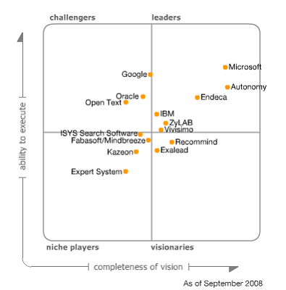


Microsoft Is in the Leaders Quadrant
Gartner Magic Quadrant for Information Access Technology, 2008
The Magic Quadrant is copyrighted September 2008 by Gartner, Inc. and is reused with permission. The Magic Quadrant is a graphical representation of a marketplace at and for a specific time period. It depicts Gartner's analysis of how certain vendors measure against criteria for that marketplace, as defined by Gartner. Gartner does not endorse any vendor, product or service depicted in the Magic Quadrant, and does not advise technology users to select only those vendors placed in the "Leaders" quadrant. The Magic Quadrant is intended solely as a research tool, and is not meant to be a specific guide to action. Gartner disclaims all warranties, express or implied, with respect to this research, including any warranties of merchantability or fitness for a particular purpose. This Magic Quadrant graphic was published by Gartner, Inc. as part of a larger research note and should be evaluated in the context of the entire report. The Gartner report is available upon request from Microsoft.
SOURCE: Gartner, Inc., “Magic Quadrant for Information Access Technology” by Whit Andrews & Rita Knox, September 30, 2008

Slide 5
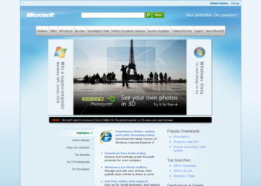
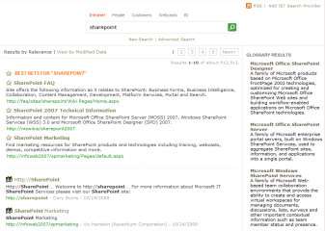
Enterprise Search is Transforming Business
Connecting people to information, driving better outcomes
On a company website
On a corporate network
[Screenshot]
[Screenshot]
search helps your customers get what they want
search helps your employees get their jobs done
increasing revenue
cutting costs

Slide 6
Microsoft’s Enterprise Search Strategy
Builds on the FAST ESP platform to create innovative products
Solutions for Internet Business
Solutions for Business Productivity
Bring the power of high-end search to everyone
Make search the anchor for monetizing assets online
FAST ESP becomes the foundation
for all enterprise search products

Slide 7


Licensing Predictability and Simplicity
Upcoming products will be made available through Microsoft Licensing
Solutions for Internet Business
Solutions for Business Productivity
Licensing
Queries per second,
Data volume, &
Permitted purpose
SharePoint Server eCAL & FAST Search for SharePoint Server License
Operating Systems
Windows Server, UNIX, or Linux
Windows Server

Slide 8
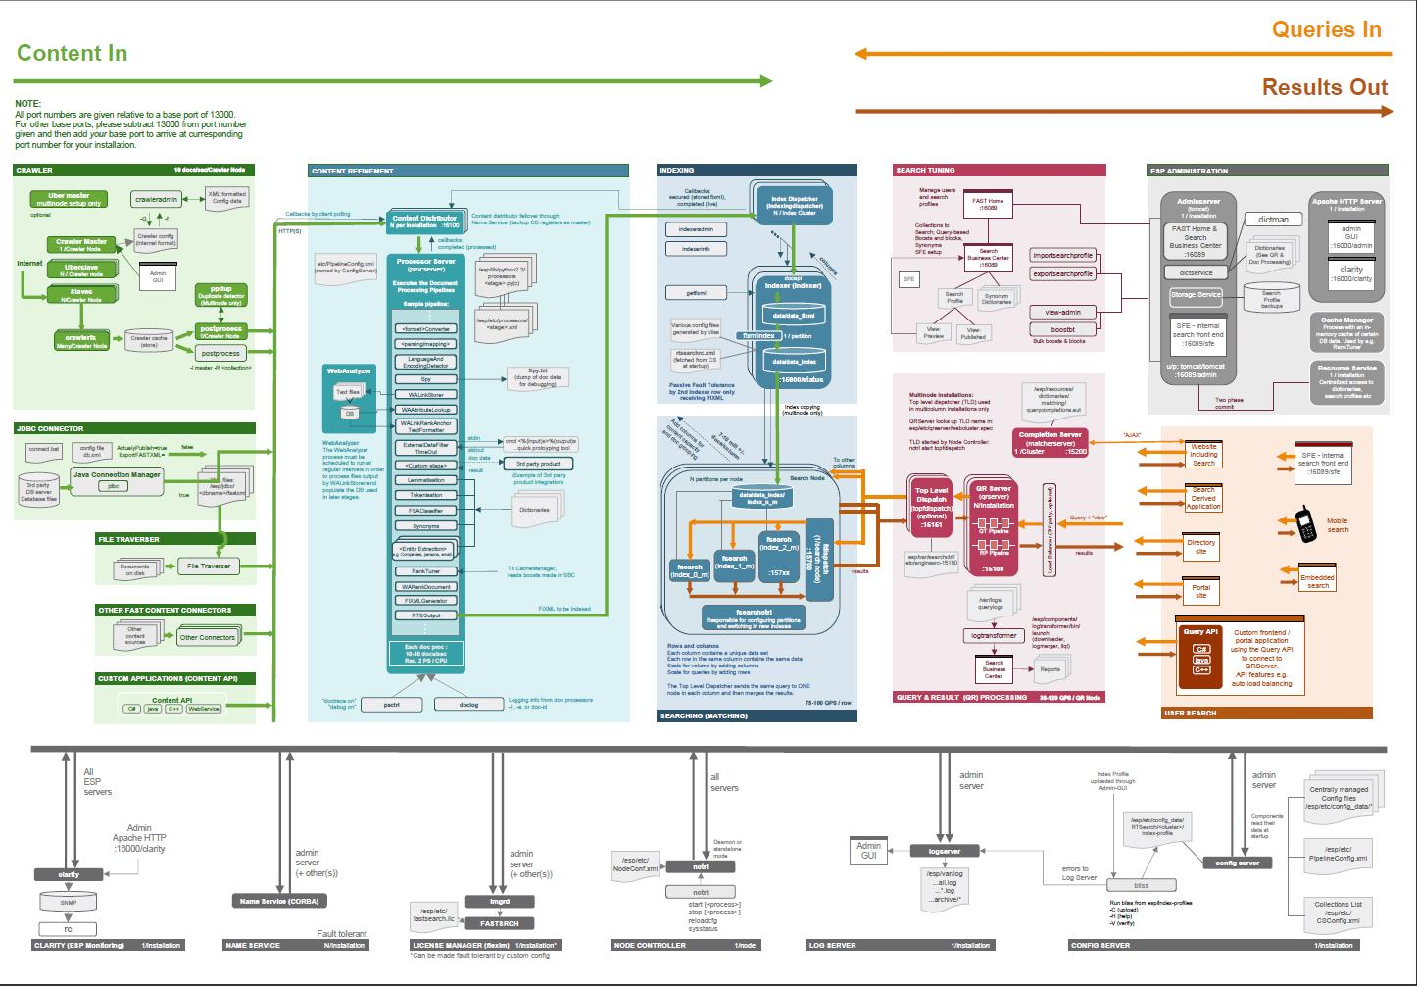
ESP Architecture (easy version)

Slide 9
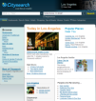









FAST ESP Software Architecture
Content Analytics
Contextual Matching
Interaction Management
Data & Content
Information
Insight
Decisions
Content Collections
Views
Search
index
Query analysis
Document processing
…
Content API
.
.
.
.
.
Query API
Result analysis
…
Structured & unstructured
SoA Services Layer
Deployment Studio
Business Studio

Slide 10



The Data processing Pipeline; Content Refinement
Tenses : To Run / Ran / Running
Forms : Man / Men vs Girl / Girls
Morph : Happy / Happier / Happiest
Inclinations : the table / a table
Format Conversion
Language Detection
Linguistic
Normalization
Entities
Taxonomy
Clustering
Custom
Plug-in
Ontology
NEWS
PARIS (Reuters) - Venus Williams raced into the second round of the $11.25 million French Open Monday, brushing aside Bianka Lamade, 6-3, 6-3, in 65 minutes.
The Wimbledon and U.S. Open champion, seeded second, breezed past the German on a blustery center court to become the first seed to advance at Roland Garros. "I love being here, I love the French Open and more than anything I'd love to do well here," the American said.
A first round loser last year, Williams is hoping to progress beyond the quarter-finals for the first time in her career.
→Search
→Alert

Slide 11

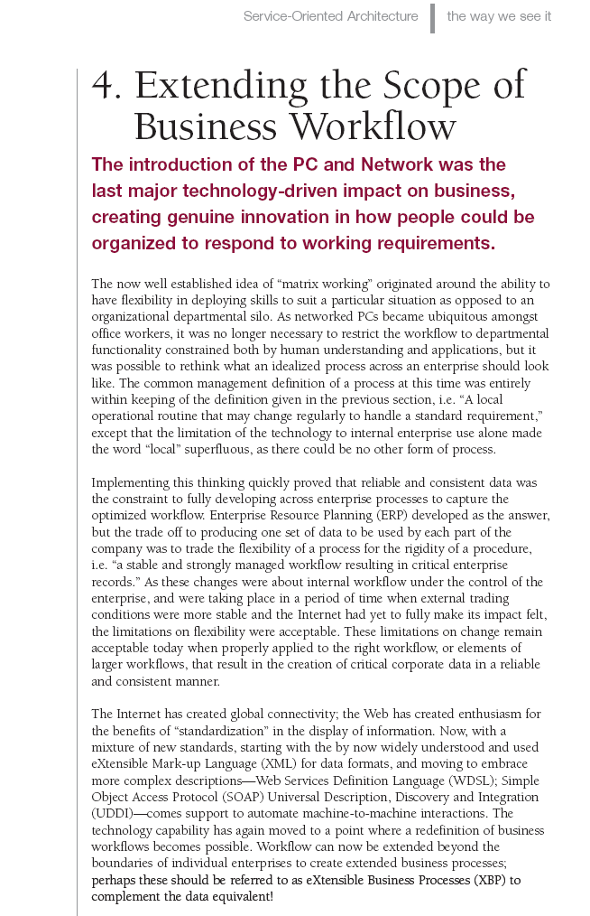

Basic Entity Extraction in Action
Notes:
11

Slide 12
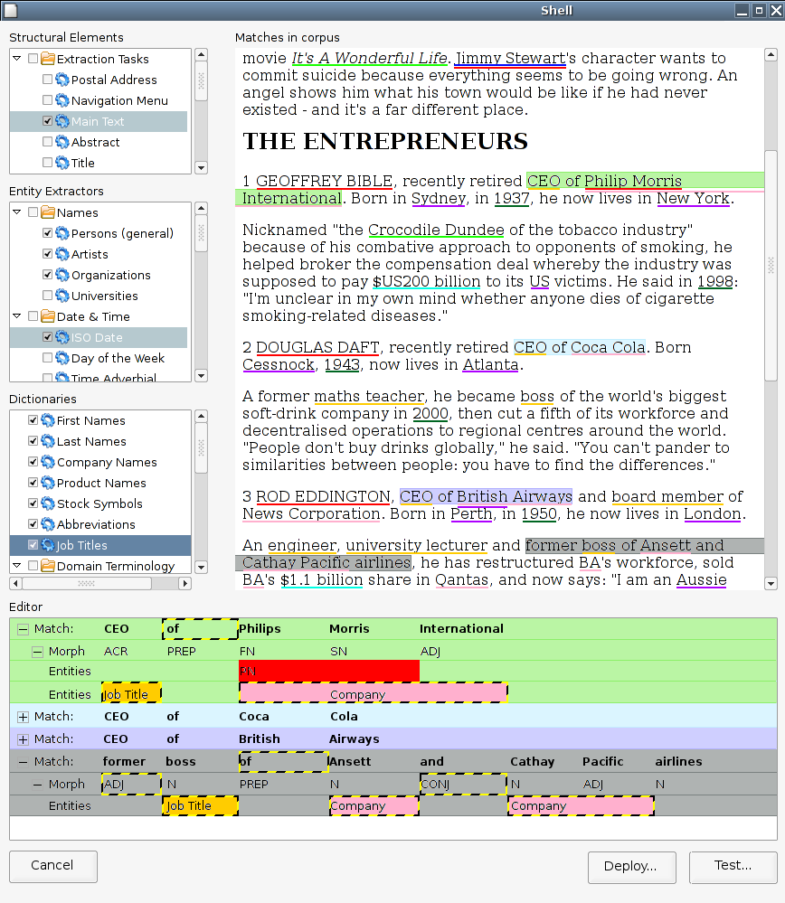
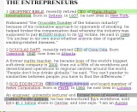
Contextual insight
COLLECTION
DOCUMENT
SUB-DOCUMENT
ENTITY
Title:
Body:
<sentence>
1 GEOFFREY BIBLE, recently retired CEO of Philip Morris International. Born in Sydney in 1937, he now lives in New York.
</sentence>
<person>
GEOFFREY BIBLE
</person>
Out-of-the-box Completeness
Person, Company, Location, Date, Quote, Price, Measure, Upper, Acronym, Airline, Car, Email, Filename, ISBN, University, URL, Newspaper, Phone, Zip, Ticker, Jobtitle, Time, ++
Author:
John Smith, George Johnsen
Creation date:
13th of January, 2006

Slide 13





Microsoft’s Vision for Enterprise Search
Turn information into business outcomes through engaging experiences.
Conversational
Change how you interact with information, giving you better answers
Visual
Help you identify patterns and discover new insights
Actionable Allow you to rapidly turn answers into outcomes

Slide 14






Make the Most of Your Content Understanding content and user intent
Improve understanding of user intent
What is the user asking?
Get rid of noise
Where are they asking from?
Understand user context
Make content findable and usable
Use entity extraction
Provide better structure
Enhance user experience through richer navigation
Take advantage of structure
User
Content
Unstructured Data
Match
Structured Data
Rich Media

Slide 15
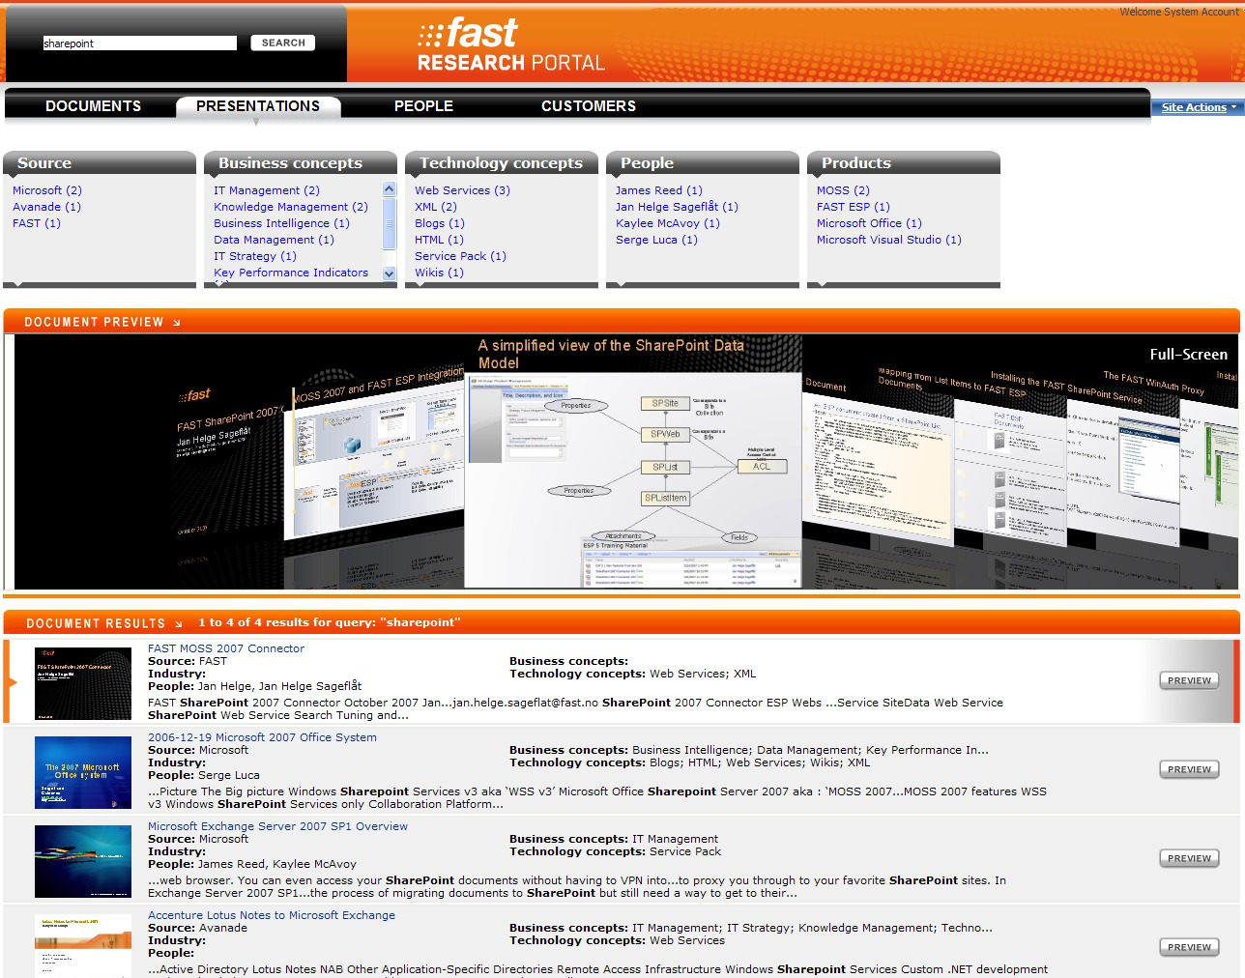
Engage Your User with Visual Search
Visual navigation options for intuitive search
Document previews and thumbnails
Exact Navigator Counts
Federated Results
Identify content without downloading
Disparate result sets are unified with federation
Document Thumbnails
Sharepoint demo

Slide 16
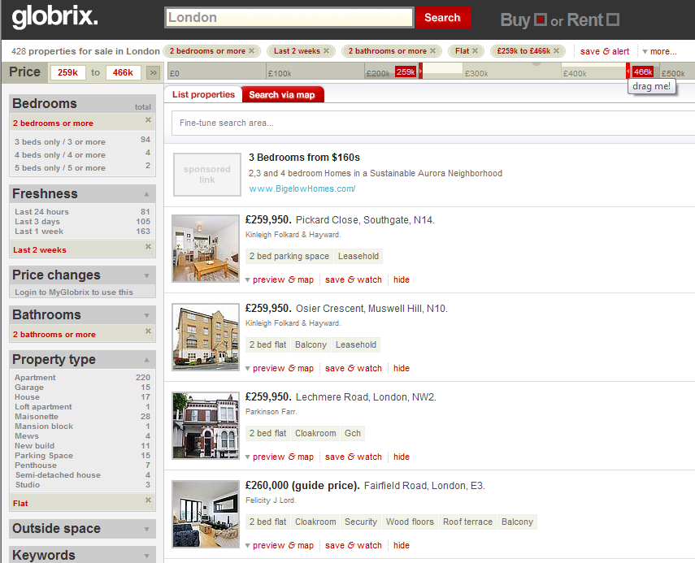
Promote Interactive Search with Navigation
Allow users to easily specify queries with sliding scales
Navigation Breadcrumbs
Advanced Filtering
Support rapid query refinement with navigation
Sliding Scales
Unsupervised Clustering
Dynamically generate navigators and categories with entity extraction
Globrix.com

Slide 17
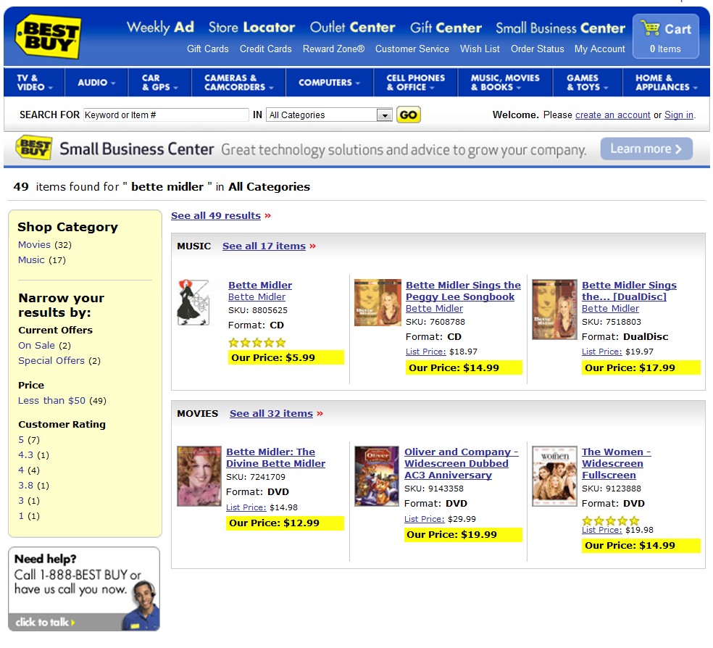
Enrich Content to Better Match to User Intent
Aggregates 20M listings across 80,000 data stores
Automated entity extraction, tagging, and classification
Result sorted in categories
Anti-spam and scoring algorithms
Entities used in navigation and filtering
Bestseller in each category
Bestbuy.com

Slide 18
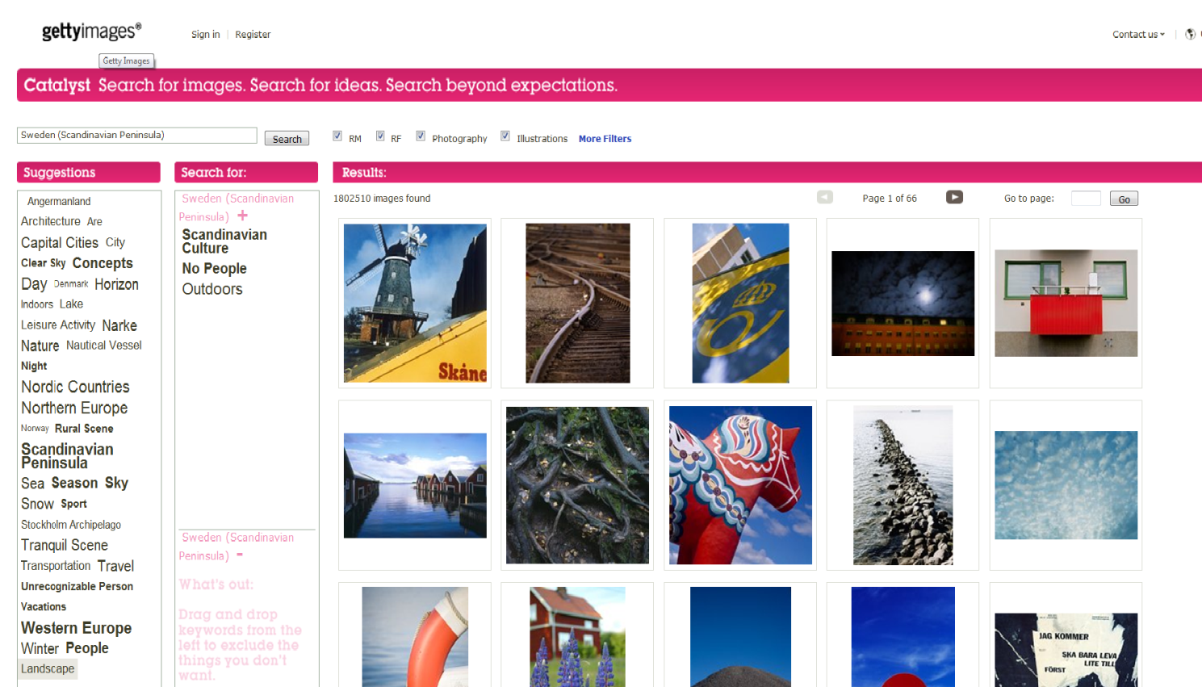
Advanced Visual tools
Query completion
Tag clouds
Advanced query language
User tuned relevance
Gettyimages

Slide 19
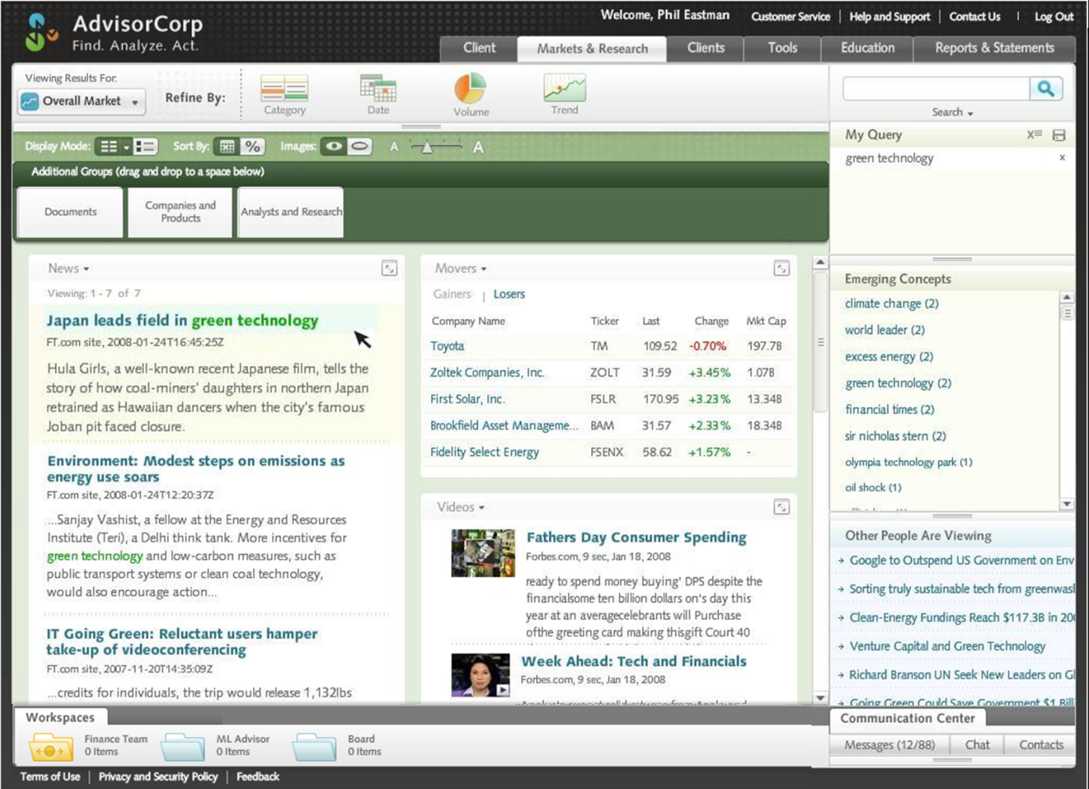
Configure for Your Users’ Needs
Content refinement performs analysis, extracts entities, and tags by category and subject
Structured Data
A variety of data asset types can be leveraged for more complete insight
Concept Extraction
Rich experience improves content “findability”
Advisor Corps demo

Slide 20
Demo Examples
Dagens nyheter
Bestbuy
Gettyimages
Sharepoint Demo (intranet)
Research Portal (Intranet)
Contoso rocks (intranet)
Conversational
Change how you interact with information, giving you better answers
Visual
Help you identify patterns and discover new insights
Actionable Allow you to rapidly turn answers into outcomes

Slide 21
Summary
Microsoft is committed to the enterprise search space and is well positioned to lead
FAST Search for SharePoint offers a new choice for productivity search
You can buy FAST ESP today, confident your investment will carry into the future

Slide 22

© 2008 Microsoft Corporation. All rights reserved. Microsoft, Windows, Windows Vista and other product names are or may be registered trademarks and/or trademarks in the U.S. and/or other countries.
The information herein is for informational purposes only and represents the current view of Microsoft Corporation as of the date of this presentation. Because Microsoft must respond to changing market conditions, it should not be interpreted to be a commitment on the part of Microsoft, and Microsoft cannot guarantee the accuracy of any information provided after the date of this presentation. MICROSOFT MAKES NO WARRANTIES, EXPRESS, IMPLIED OR STATUTORY, AS TO THE INFORMATION IN THIS PRESENTATION.

