Slide 1

Standards Compliant Web Sites
John-Daniel Trask
Mindscape

Slide 2
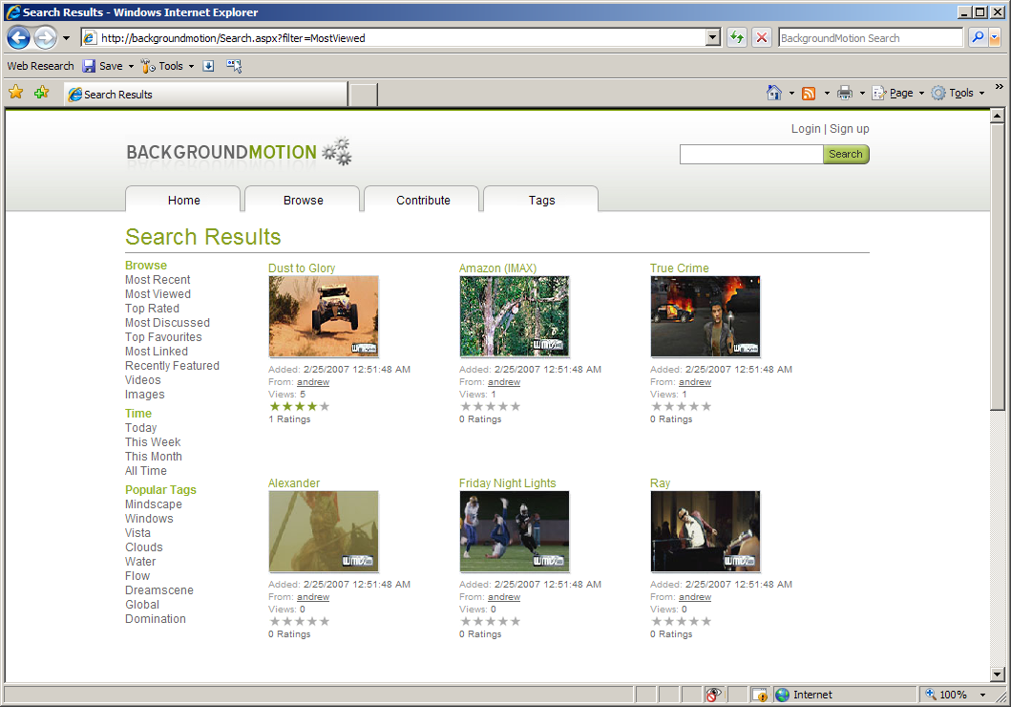
BackgroundMotion
Lightweight build: 3 weeks
Consumes resources from
  Flickr, Soapbox, GeoTagIt
Also publishes services and data

Slide 3


Standard?
Agreed upon protocols
Three types
      De-facto
      Industry
      Government
D
I
G

Slide 4
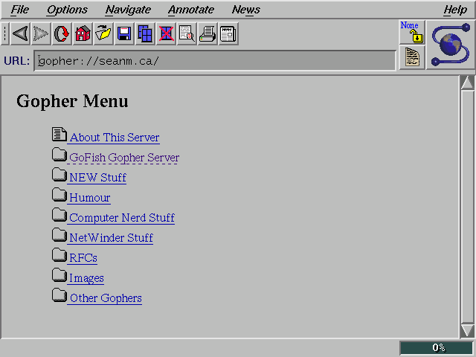
http://
Web is built on standards

Slide 5

Importance of Web Standards
Ensure durability
Ensure accessibility
Ensure portability
D
A
P

Slide 6
HTML
HTML 4.01
  Last revision of HTML specification
  Replaced by XHTML
D
I

Slide 7
XHTML
XHTML
  XHTML 1.0 Transitional
  XHTML 1.0 Strict (requires use of CSS)
  XHTML 1.0 Frameset
  XHTML 2.0 (under development)
P
I

Slide 8
CSS
Level 1 (CSS 1.0)
Level 2 revision 1 (CSS 2.1)
Level 3 (under development)
Mobile Profile
TV Profile
A
I

Slide 9
WAI
Web Accessibility Initiative
Guidelines for:
  Aiding disabled audience
  Aiding agent-type support
A
I

Slide 10
NZ Standards
e-Govt Web Guidelines
  Current version is 2.1, 3.0 under review
  http://www.e.govt.nz/standards/web-guidelines/web-guidelines-v-2-1
e-GIF
D
A
P
G

Slide 11
Other Standards
RSS / ATOM
SiteMaps
OpenSearch
D

Slide 12

Why Standards Compliance makes a difference

Slide 13

Implications of “no standard”
Separate specification class emerges per browser
More expensive delivery
Frustrates users
Hurts adoption

Slide 14

Microsoft and Web Standards
Getting better
IE 7 is a major step forward
IE 8 under development
Working with other organisations

Slide 15
IE 7 Functional Advancements
Support for OpenSearch
Scaling handled by browser
Phishing filter
Tabbed browsing
RSS platform support

Slide 16
IE 7 Rendering Advancements
Fixed more than 50 CSS bugs
Transparent PNG support
Added CSS 2.1 positioning
Added CSS 2.1 selector support

Slide 17

Advancements in Tooling
Validation added to existing tools
CSS Control Adapters for ASP.NET 2.0
Plug-ins for Internet Explorer
Full new product line…

Slide 18

Expression Web
For designers
Standards based
CSS based layout
Strong support for
XML and XSLT
Direct integration with ASP.NET 2.0

Slide 19
Expression Web Designer

Slide 20

Key Benefits
Prevents non-compliant sites
Rich CSS designer support
No OOTB legacy tags
Comprehensive DOCTYPE validation

Slide 21
How to use this stuff...
Get demo of Expression Web
Expression Web not on MSDN
Designer is coming within VS Orcas!
Download:
http://www.microsoft.com/expression

Slide 22
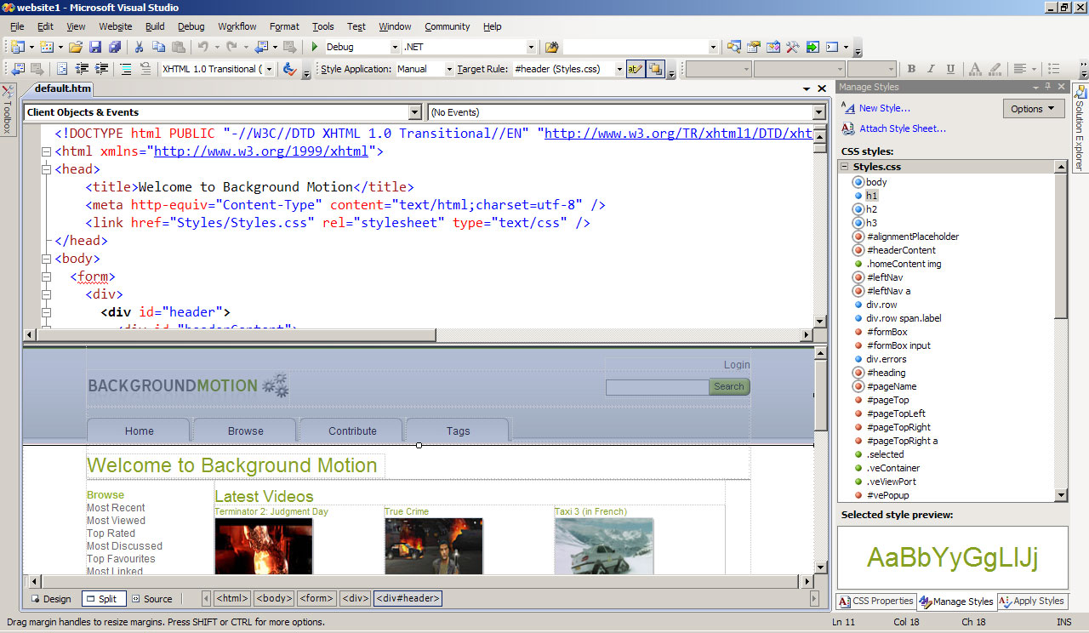
Visual Studio
Richer validation support
Link checking
Tag structure visualization
Web Designer and CSS support baked in Orcas
ASP.NET 2.0

Slide 23
ASP.NET 2.0 CSS Control Adapters

Slide 24

Validating your sites
Validate online with W3C
Validate with applications
Ease validation with browser integration
Download: http://tinyurl.com/dkmm9

Slide 25
Becoming Standards Compliant

Slide 26

Checklist for building your site
Valid HTML
Valid CSS
Page weight
Screen size, font size
Accessibility factors
Cross browser check

Slide 27
Call to Action
Validate your sites
Grab Expression Web Designer
Develop to standards

Slide 28
Questions?
For more info:
Email: jd@mindscape.co.nz
Blogs:
http://blog.bluecog.co.nz
http://www.mindscape.co.nz/

