Slide 2
IT Investment Governance
With EPM Solution
Mike Gruia
Principal Program Manager Lead
Microsoft Corporation

Slide 3
Key Topics:
Why is IT governance important?
The elements of IT Investment governance
The role of portfolio management software
The tale of IT governance at a financial service company
Challenges
Things to remember

Slide 4
Why Is IT Governance Important?
Top management is realizing the significant impact that IT can have on the success of the enterprise
Top management is concerned with the complexity and the high cost of IT
Capital and resources are scarce
An assertive wave of stakeholders is concerned about the sound investment management
Furthermore, regulations establish board responsibilities: SOX, Klinger Cohen Act
Value creation does not depend only on innovation, but also on discipline
The economics of good IT governance are clear

Slide 5
What Is IT Governance?
An operational framework delineating the processes, decision domains and the organizational rights and accountability which will encourage the right behavior to achieve effective and efficient investment in IT.
Key Learning:
The essence of governance is not compliance, but making good decisions.

Slide 6
Achieving Quality Governance Requires Answering Five Questions
What are the investment domains?
What are the decision domains?
What decisions need to be made?
Who is involved in the decision process?
How should these decisions be made?

Slide 7
What Are The Investment Domains?
IT Portfolios
Projects
Applications
Assets
Services
Portfolio characteristics:
  Risk returns
  Common business objectives
  Owned by a organization
  Share common constraints
  The investments are interrelated
Stocks
Bonds
IT Portfolios investments are classified based on Value and Risk properties
Real Estate
Options

Slide 8
What Are The Decision Domains?
Strategy Governance
What should the enterprise focus on?
Enterprise Business Vision
Overall Funding
Infrastructure Investment
Demand Governance
What should IT work on?
Supply Governance How should IT do?
Project Creation
Project Priorities
Resource Allocation
Funding Allocation
Technical Architecture
Applications/hardware rationalization
Project Management Practices
Overall resource funding
Vendor management

Slide 9
Who Should Make These Decisions?
Who: CEO, CXOs, CIO, LOB Managers
Strategy Governance
What should the enterprise focus on?
  Working groups:
    Executive committees
    IT leadership committee
    IT councils with joint business IT membership
    Architecture committee
    Capital approval committee
Demand Governance
What should IT work on?
Supply Governance How should IT do?
Who: Project Manager, Business Manager and IT Managers
Who: CIO, IT Managers
Four perspectives: economic, organizational, legal and audit

Slide 10
What Are The Decision Rights?
Decision Roles
Decision Makers
Determine business priorities and set limits
Allocate resources and the final approval. (C level )
Decision Support
Gather content information, facilitate and analyze and present investment alternatives. (PMO)
Content Experts & Implementers
Provide facts and judgments necessary to understand and size the opportunities. Translate business needs into project opportunities (Architects, project managers, IT experts)

Slide 11
How Should These Decisions Be Made?
Create a governance process
Use the right analytics
Leverage the power of the software to:
  Translate your processes into workflows
  Map your processes using the software
  Enable decision process
  Monitor decision quality

Slide 12
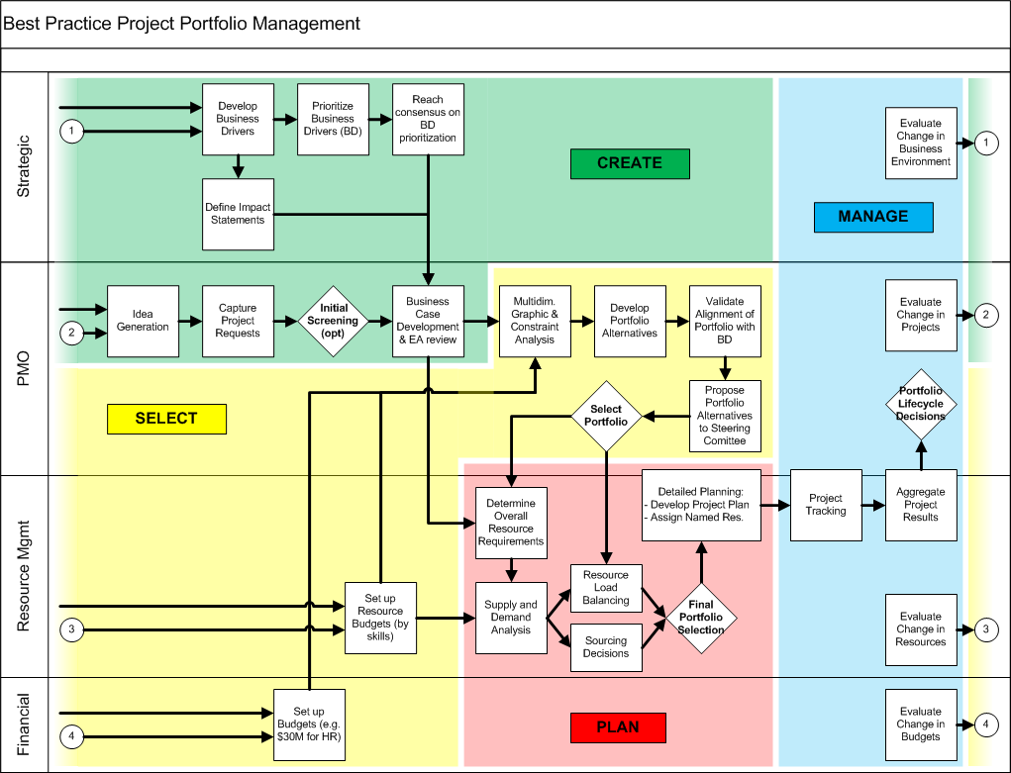
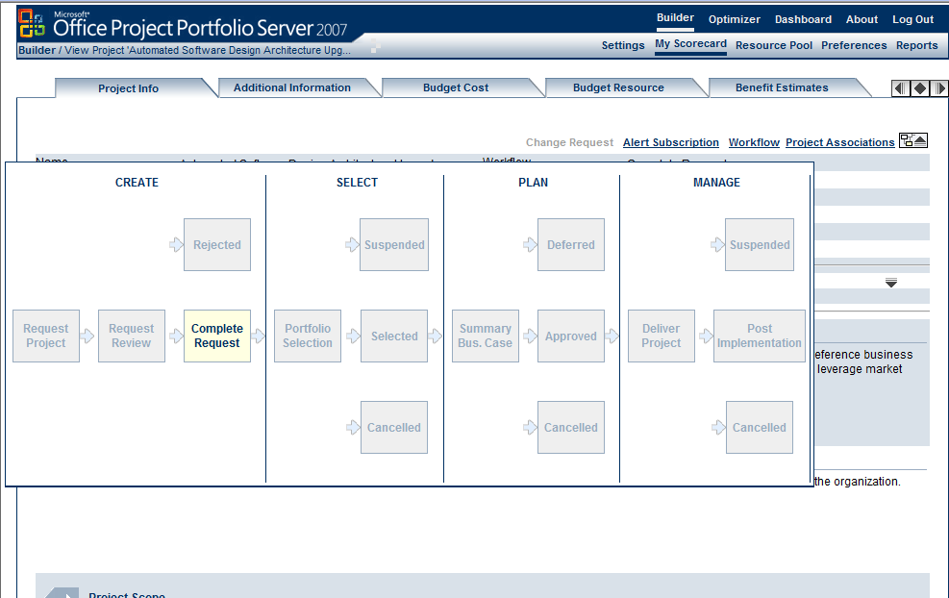
Automate Your Process And Workflow
  Define Governance Phases
  Create a Workflow
  Define Processes
    Verification
    Transition
  Define Notifications
    Define User Groups
    Define Email templates
    Define Notifications
  Create your lifecycle steps
    In a certain Governance Phase
    Add transitions between lifecycle steps

Slide 13
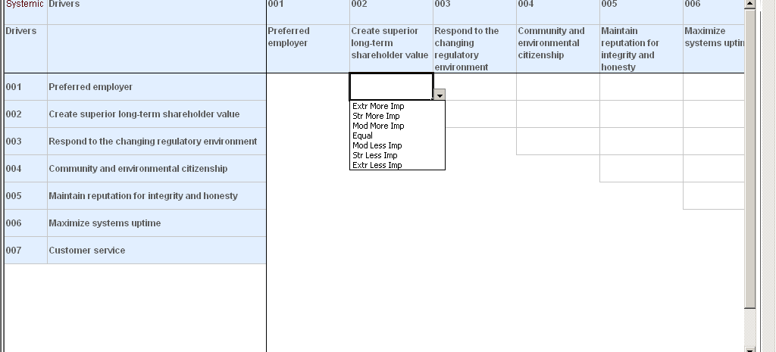
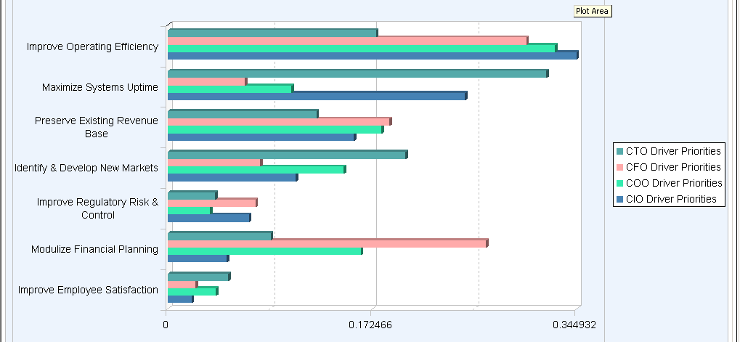
Enable Strategy Governance Decision Process
Agreed enterprise business vision decision process
Influence behavior to reach consensus

Slide 14
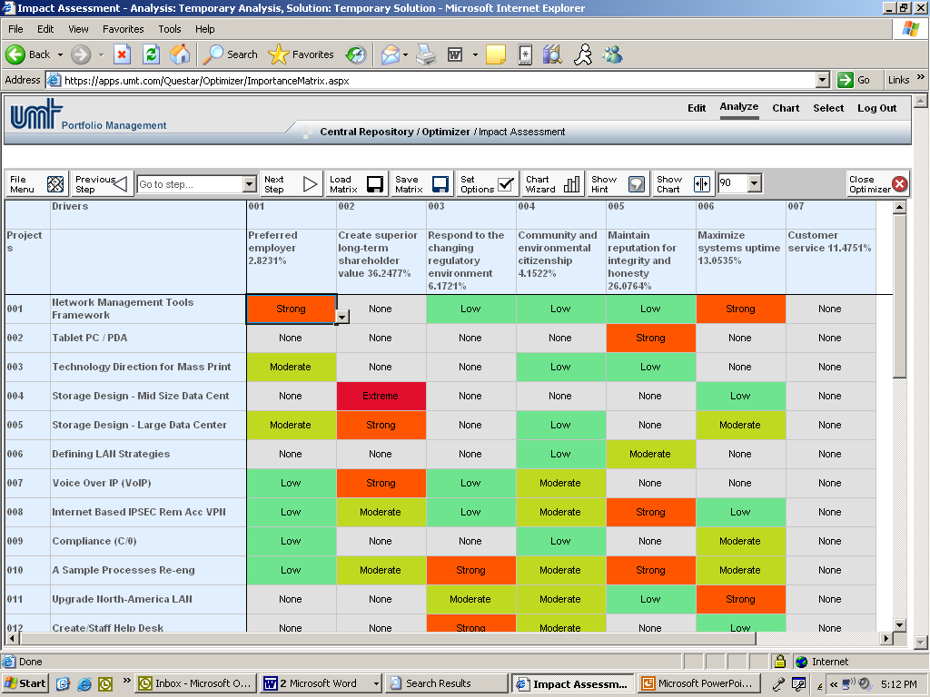
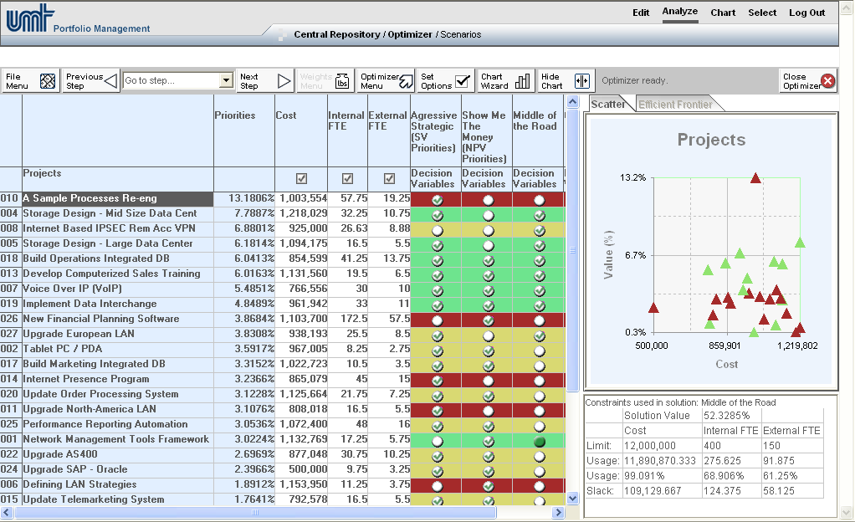
  Enable Demand Governance Decision Process
Clear discipline and consistent valuation rules for
Project creation
Project prioritization
Set organizational boundaries for:
Resource allocation
Funding allocation

Slide 15
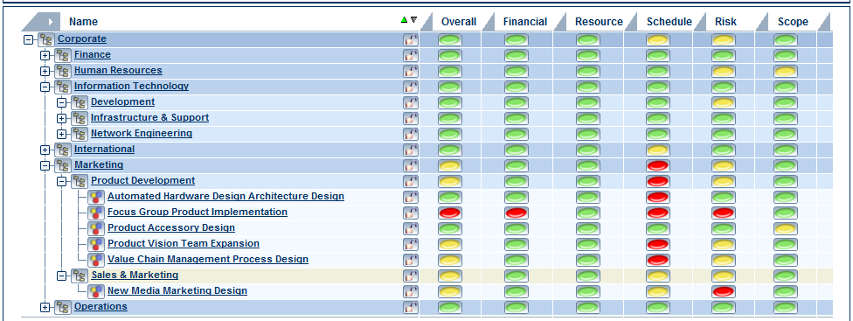
Enable Supply Governance Decision Process
Manage IT workload
Manage investment performance

Slide 16
Which Governance Is Best Suited For My Organization?
It depends on
  Type of business and industry
  Role of IT: Utility, Dependent or Integral
  Maturity of the organization
  Culture
  Geography

Slide 17
The Tale of IT Governance at a Financial Service Company
The business context
The IT context
Mature: effective , well defined process and widely adopted
US geography, focused in NY
IT role: business is dependent on IT performance
Challenge
Striking the right balance between the need for control, autonomy and ability to make decisions in a timely and efficient manner.
Focus on operational excellence and customer responsiveness in a heavily regulated industry

Slide 18
The Tale Of IT Governance At A Financial Service Company
Solution
Form three committees: BU Executive, CIO and BU Executive, IT Governance Committee
Three process streams/workflows: Small projects are approved by BU Executive,
Medium projects by CIO and BU Executive
Large projects by IT Governance Committee.
Analyze and allocate process streams to org structures
How Many Projects to Approve?
28
BU Executive
131
CIO & BU Executive
IT Governance
141
Committee
Who Controls the Budget?
$1.8
BU Executive
$27.0
CIO & BU Executive
$24.0
IT Governance
Committee
Results
  The IT Governance Committee controls 50 % of the cost and is involved on the approval of 10% of the projects
  Increased the portfolio value by more than 25%

Slide 19
Imperfect Rationality Coupled With Conscious Or Unconscious Biases Impact Governance
Inertia
Motivational
Perception
Logical
Group distortions
Communication deficiencies

Slide 20
Summary: Things to Remember
Focus on business purpose
Focus on the right domain and decisions
Redesign the decision process
Optimize decision rights
Software is the translator and the engine
Build the required competencies
Distortions can have significant impact
Time phased implementation with clear success indicators

Slide 21

© 2007 Microsoft Corporation. All rights reserved.
Microsoft, Windows, Windows Vista and other product names are or may be registered trademarks and/or trademarks in the U.S. and/or other countries. The information herein is for informational purposes only and represents the current view of Microsoft Corporation as of the date of this presentation. Because Microsoft must respond to changing market conditions, it should not be interpreted to be a commitment on the part of Microsoft, and Microsoft cannot guarantee the accuracy of any information provided after the date of this presentation.
MICROSOFT MAKES NO WARRANTIES, EXPRESS, IMPLIED OR STATUTORY, AS TO THE INFORMATION IN THIS PRESENTATION.

