Slide 1
Exchange Roadshow: Exchange Server 2010
Annelies bulkens
Unified communications Product Marketing manager
Ilse van criekinge
Technology advisor core Unified Communications

Slide 2
Agenda
Introducing Exchange 2010
Flexible and Reliable Messaging Infrastructure with Exchange 2010
Information Protection and Control
Migration & BPOS

Slide 3

The Office Platform 2010 Timeline
SharePoint
& Office
2010
Beta
Development
and Validation
Customer
Feedback
and Research
Exchange
Beta
Exchange
Server 2010
SharePoint Online
Office
Communications
Server 2007 R2
SharePoint
& Office
2010
Tech Preview
Key Innovation
Areas Locked
SharePoint & Office2010
FAST Search 2010
SharePoint Online
H2
2007
H1
2008
H2
2008
H1
2009
H2
2009
H1
2010
TODAY
Additional products being launched: Project 2010 and Visio 2010
~$1B annual R&D investment across Office, SharePoint and related products

Slide 4

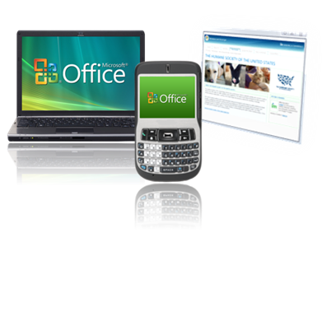
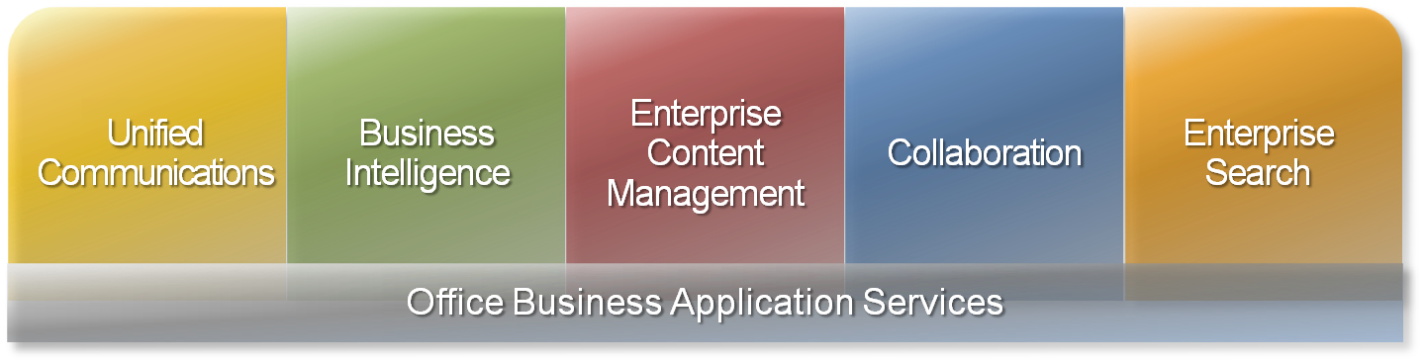
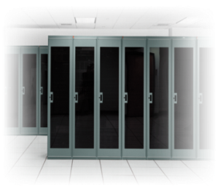


Microsoft BPIO Platform
User Experience
IT Choice and Value
On-Premises
Online Service
Notes:
BPIO is a core advantage overall all competitors & Exchange is core to UC next to OCS
Exchange is ciritical for the following capabilities
- Calendaring & messaging
- messaging
Being able to talk about these areas AND others (Bing, Azure, S+S, SharePoint, etc)

Slide 5











Communications Today
Future of Communications
Instant
Messaging
Video
Conferencing
Web
Conferencing
E-mail and
Calendaring
Audio
Conferencing
Voicemail
Telephony
Telephony and
Voicemail
Instant
Messaging
User
Experience
E-mail/
Calendaring
Unified Conferencing: Audio, Video, Web
User Experience
User
Experience
User Experience
User Experience
User
Experience
User Experience
Unified Inbox
& Presence
Authentication
Administration
Storage
Authentication
Administration
Storage
Authentication
Administration
Storage
Authentication
Administration
Storage
Authentication
Administration
Storage
Authentication
Administration
Storage
Authentication
Administration
Storage
Authentication
Administration
Storage
Compliance
Notes:
Technology has brought us a very long way in terms of how we communicate in the business world. Email, telephones, instant messaging and conference calling enable us to do things today that were unthinkable twenty years ago. But as these technologies have evolved, they have done so independently, in parallel with one another, creating communications silos. These independent silos have led to redundancies and inefficiencies for both the end-user and the administrator. They have become difficult and expensive to maintain and to ensure each is in compliance with business and government regulation.
For most companies today, telephony, e-mail, instant messaging, audio conferencing, video conferencing, Web conferencing and voice mail each live in their own disconnected silo. Each has evolved separate operating platforms – often with proprietary third-party technology – separate authentication, separate administration, and separate storage and compliance. This comes at a huge price tag and an equally enormous headache for the end-user, who has to remember separate phone numbers, account names and passwords. Those end-users run up against limited communication with each device – for example not being able to make audio calls from their computer. Ultimately, their communication is disconnected, and their collaboration and innovation is ultimately hindered.
Unified communications reduces complexity by putting people at the center of the communications experience. Our goal is to integrate all of the ways we contact each other in a single environment, using a single identity and presence

Slide 6

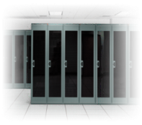


Flexible and Reliable
Anywhere Access
Protection and Compliance
Continuous Availability
Simplify Administration
Deployment Flexibility
Manage Inbox Overload
Enhance Voice Mail
Collaborate Effectively
E-mail Archiving
Protect Communications
Advanced Security
Optimize for
Software + Services
Notes:
Our main focus for Exchange Server 2010 is to offer a solution that helps you achieve new levels of reliability and performance, by delivering features that help simplify your administration, protect your communications, and delight your users by enabling you to deliver experiences that can meet your users’ demand for greater business mobility
These benefits of Exchange 2010 are best represented by our three core product tenets:
Flexible and Reliable Exchange 2010 offers you the flexibility to tailor your deployment based on your unique needs and a simplified way to help keep e-mail continuously available for your users.
Anywhere Access Exchange 2010 expands on the investments we made in Exchange 2007 through innovations that help enable greater workforce productivity, by giving users the freedom to securely access their business communications -- including e-mail, voice mail, and instant messaging -- as well as collaborate effectively from virtually any platform, web-browser, or device.
And lastly Protection and Compliance. Exchange 2010 again expands on the messaging security and compliance advancements we made in Exchange 2007 by helping you simplify and automate the process of protecting your company’s communications and meeting regulatory requirements.
It’s also worth noting that Exchange 2010 was designed, developed, and tested from the ground up with a keen focus on our software plus services strategy. Let’s take a closer look at these areas.

Slide 7
Licensing & product packaging

Slide 8
Pricing and Licensing Basic Constructs
Exchange Server 2010 is licensed in the Server / Client Access License (CAL) model in exactly the same way as Exchange 2007.
Server Licenses
A license must be assigned for each instance of the server software that is being run. The Exchange Server is sold in two Server editions:
  Standard Server
  Enterprise Server
Client Access Licenses (CALs)
Exchange requires a CAL for each user or device that accesses the server software. There are two types of CALs for Exchange:
  Standard CAL
  Enterprise CAL
The Enterprise CAL is sold as an add-on to the Standard CAL. Both CALs work with either Server Edition.
External Connector Licenses
An External Connector permits an unlimited number of clients to access an Exchange Server in scenarios where the number of CALs is uncertain.
  Access via the External Connector is limited to non-employees such as partners, suppliers, customers and retirees.
  The number of External Connector licenses required corresponds to the number of servers in the organization’s Exchange environment.

Slide 9

Key Takeaways for Exchange Server 2010 Licensing & Pricing
Unchanged from Exchange 2007, Exchange 2010 will continue to be sold using the same licensing model, with significant feature improvements across all SKUs.
The Exchange Enterprise CAL is increasing in price by 20% to reflect the value of both net-new features such as Archiving and enhancements to existing features like Voicemail.
The high availability feature “Mailbox Resiliency” is included in the Standard Server in Exchange 2010. In Exchange 2007 high availability was split into LCR/SCR in Standard Server and CCR in the Enterprise Server.
Choices with
Exchange 2003
Choices with
Exchange 2007
Choices with
Exchange 2010
Exchange 2003
Exchange 2007
Exchange 2010
Standard Server
Standard Server
Standard Server
Servers
Enterprise Server
Enterprise Server
Enterprise Server
Exchange CAL
Standard CAL
Standard CAL
CALs
Enterprise CAL
Enterprise CAL

Slide 10
CAL Licensing & Pricing Updates
Exchange 2007 CALs
The Enterprise CAL is differentiated based on additional workloads (UM & AV/AS) and advanced features (compliance, mobile management)
Ex. 2007 CAL | Description | Features |  | Suites
Std. CAL | For organizations that need a premium, feature-rich messaging environment with mobile device access. |  |  | Core CAL SBS EBS
Ent. CAL | For users that need: Unified Messaging Multi-tier AV/AS protection Advanced Compliance Advance mobile management |  |  | E-Cal
Ex. 2007 SP1
E-mail & Contacts
Calendar & Tasks
ActiveSync Mobility
Improved Anti-spam
Per-DB Journaling
Managed Default Folders
Unified Messaging
Forefront for Exchange
Exchange Hosted Filtering
Per-user Journaling
Managed Custom Folders
Advanced Mobile Mngt.
Exchange 2010 CALs
Standard CAL includes improvements to the end-user experience and lowers costs through user self-service
Enterprise CAL includes improvements to unified messaging, along with net-new archiving functionality and compliance tools
Ex. 2010 CAL | Description | Exchange 2010 Features
Std. CAL | Enable your users to be more productive from virtually any platform, browser, or mobile device, with new features that help manage communications overload and lower helpdesk costs. |  | $58
Ent. CAL | Reduce the costs and complexity of compliance with new integrated archiving functionality, while also cutting costs by replacing your legacy voice mail systems. |  | +$35
Exchange 2007 Features: E-mail, Calendar, Tasks, Contacts, Mobility, etc.
Conversation View
Calendar Sharing
Universal Inbox
(Mail, SMS, IM)
Mobile & Browser Improvements
Per-DB Journaling
Mailtips
Message Tracking
Default Retention Policies
IRM in OWA*
Exchange 2007 Features: UM, AV/AS Protection etc.
Custom Retention Policies
Personal Archive
Advanced Mobile Policies
Speech to Text Voicemail
Info. Leakage Protection*
Cross-Mailbox Search
Legal Hold
Per-User /DL Journaling
*Takes a dependency on Windows Server RMS L = $37

Slide 11
Server Licensing & Pricing Updates
Exchange 2007 Servers
The Enterprise Server is differentiated based on mailbox database scalability (>5) and clustering for high availability
Ex.07 Server | Description | Features |  | Suites
Std. Server | Orgs with fewer users and/or smaller mailboxes |  |  | SBS Centro
Ent. Server | Orgs that require mailbox scalability and high availability |  |  | None
Ex. 2007 SP1
5 mailbox database limit
Local Continuous Replication (LCR)
Standby Continuous Replication (SCR)
50 mailbox database limit
Clustering
Exchange 2010 Servers
The Standard Server is designed to lower storage costs and improve user uptime, and will include the high availability feature “Mailbox Resiliency”.
The Enterprise Server will offer an increased 100 mailbox database limit
Prices are unchanged from Exchange 2007
Ex. 2010 Server | Description | Exchange 2010 Features
Std. Server | Simplify your approach to high availability and disaster recovery & Lower the cost and improve the performance of your messaging infrastructure with new low-cost storage options, user self-service features, and maintenance tools that help limit user disruptions.
Ent. Server | All the functionality of the Standard Server plus an increased database limit. | All Standard Features Plus:
5 Mailbox database limit
Remote Powershell
Transport Resiliency
Local Continuous Replication (LCR)
Roles Based Access Control
Online Move Mailbox
Web-based Administration
Mailbox Resiliency*
100 Mailbox database limit

Slide 12
Key Messaging

Slide 13
Flexible and Reliable
Anywhere Access
Protection and Compliance
Continuous Availability
Simplify Administration
Deployment Flexibility
Manage Inbox Overload
Enhance Voice Mail
Collaborate Effectively
E-mail Archiving
Protect Communications
Advanced Security
Optimize for
Software + Services
Notes:
Our main focus for Exchange Server 2010 is to offer a solution that helps you achieve new levels of reliability and performance, by delivering features that help simplify your administration, protect your communications, and delight your users by enabling you to deliver experiences that can meet your users’ demand for greater business mobility
These benefits of Exchange 2010 are best represented by our three core product tenets:
Flexible and Reliable Exchange 2010 offers you the flexibility to tailor your deployment based on your unique needs and a simplified way to help keep e-mail continuously available for your users.
Anywhere Access Exchange 2010 expands on the investments we made in Exchange 2007 through innovations that help enable greater workforce productivity, by giving users the freedom to securely access their business communications -- including e-mail, voice mail, and instant messaging -- as well as collaborate effectively from virtually any platform, web-browser, or device.
And lastly Protection and Compliance. Exchange 2010 again expands on the messaging security and compliance advancements we made in Exchange 2007 by helping you simplify and automate the process of protecting your company’s communications and meeting regulatory requirements.
It’s also worth noting that Exchange 2010 was designed, developed, and tested from the ground up with a keen focus on our software plus services strategy. Let’s take a closer look at these areas.

Slide 14
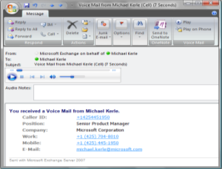
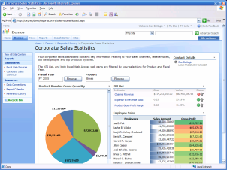

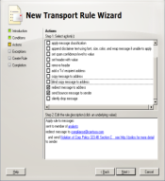
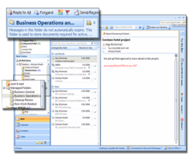





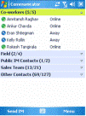
Strategic Business Challenges
“Our Sales teams need to connect with the right customers and systems while on the road ”
- VP of Sales
“I need to deliver secure and compliant communications tools to support a highly distributed workforce.”
- CIO/Technology Director
“I need to reduce hardware costs and operational overhead.”
- IT Manager, Messaging Infrastructure
Notes:
It should come as no surprise that companies of any size are faced with a number of strategic business challenges as these organizations seek to compete in this new world of work.
This includes: giving your people the ability to connect and access the information they want, whenever they need it, wherever they are.
All while managing the industry regulations that place scrutiny on how you control and manage the access your highly distributed workforce has…to this information.
And, transforming IT into a strategic and competitive asset by driving down the costs and operational overhead of your critical infrastructure investments.

Slide 15










Balancing Needs in a Changing Workplace
Communication overload
Globally distributed users and partners
High cost of communications
Increasing security and compliance
Notes:
These trends and insights helped drive how we designed and developed Exchange Server 2010.
We recognize that you are attempting to balance a number of evolving workplace demands and needs, including:
Dealing with the communications overload your users are facing as they attempt to navigate and prioritize the ever increasing amount of information they consume
Helping keep your increasingly distributed and highly mobile workforce, partners, and customers connected without headaches
Lowering the high costs that can be associated with maintaining such a critical business asset as e-mail, voice mail, instant messaging, and more
And, meeting the growing requirements, and regulations around securing and protecting important business information

Slide 16
Flexible and Reliable
Anywhere Access
Protection and Compliance
Continuous Availability
Simplify Administration
Deployment Flexibility
Manage Inbox Overload
Enhance Voice Mail
Collaborate Effectively
E-mail Archiving
Protect Communications
Advanced Security
Optimize for
Software + Services
Notes:
Our main focus for Exchange Server 2010 is to offer a solution that helps you achieve new levels of reliability and performance, by delivering features that help simplify your administration, protect your communications, and delight your users by enabling you to deliver experiences that can meet your users’ demand for greater business mobility
These benefits of Exchange 2010 are best represented by our three core product tenets:
Flexible and Reliable Exchange 2010 offers you the flexibility to tailor your deployment based on your unique needs and a simplified way to help keep e-mail continuously available for your users.
Anywhere Access Exchange 2010 expands on the investments we made in Exchange 2007 through innovations that help enable greater workforce productivity, by giving users the freedom to securely access their business communications -- including e-mail, voice mail, and instant messaging -- as well as collaborate effectively from virtually any platform, web-browser, or device.
And lastly Protection and Compliance. Exchange 2010 again expands on the messaging security and compliance advancements we made in Exchange 2007 by helping you simplify and automate the process of protecting your company’s communications and meeting regulatory requirements.
It’s also worth noting that Exchange 2010 was designed, developed, and tested from the ground up with a keen focus on our software plus services strategy. Let’s take a closer look at these areas.

Slide 17
What does this mean functionally?
A highly available solution with only 2 servers
Cheaper storage
Easier management with archives & RBAC
Great new user interfacing
Enhanced accessibility

Slide 18
What does this mean bottom-line?
Critical messaging becomes affordable
TCO goes down
Usability & efficiency go UP

Slide 19
5 Actions speak louder than words
A small demo you can do too
What do you need ?
What will you show ?
  User interface
    Mailtips
    Quicksteps
    Conversation view
  Anywhere access
    Cross platform UC
  Improved manageability
    Self service

Slide 20

Business Value of Exchange 2010
Reducing costs and complexity of managing the messaging infrastructure while improving business outcomes
Potential
Annual Savings
Flexible
and
Reliable
  Offer larger mailbox at lower storage costs
  Lower administration and support costs
  Flexible high availability and disaster recovery
23%
  Lower costs of providing rich mobile access
  Eliminate legacy voice mail maintenance costs
  Increase user uptime by reducing inbox overload
Anywhere Access
78%
Protection and Compliance
  Lower compliance and e-discovery costs
  Lower costs of safeguarding communications
  Simplify archiving and retentions
27%
Potential TCO reduction of up to 40% over Exchange 2003
*Source: Internal study for 10,000 user organization scenario

