Slide 2
BizTalk Server 2009性能优化以及Hyper-V 虚拟化架构下的最佳实践
BAP303
姓名 马燕
职务 软件开发测试工程师
公司 微软（中国）有限公司

Slide 3
微软中国研发集团服务器与开发工具事业部
商用平台
开发工具
管理与服务
Windows Server解决方案
协议工程
商业在线服务
团队博客：
  http://blogs.msdn.com/stbcblog/
我们关注的论坛
  http://social.microsoft.com/Forums/zh-CN/categories/

Slide 4





















我们的精彩五年

Slide 5
主要内容
BizTalk Server 介绍
BizTalk Server 2009 性能优化的最佳实践
Hyper-V 架构下的性能比较和优化实践

Slide 6

BizTalk Server 的历史
V6
BizTalk
Server 2009
V5
BizTalk
Server 2006
R2
V4
BizTalk
Server 2006
V3
BizTalk
Server 2004
V2
BizTalk Server 2002
V1
BizTalk Server 2000
ALM Support
ESB(2.0)
BPM
Extend B2B
BAM+
RFID Mobile and Std Pack
New Adapters
Update Swift
SOA/ESB
Adapters
in Box
Host
Integration
SOA/ESB
BPM
Extend B2B (+EDI/AS2)
RFID
EAI (partner adapters)
Vertical B2B
BPM
Partner Adapters
XML B2B
500
Customers
2,000
Customers
4,000
Customers
7,000
Customers
8500
Customers

Slide 7
BizTalk Server 2009 的能力
Management and Operations
Business Rule Framework
Business to Business Integration
Business Activity Monitoring
Orchestration
Messaging
Tools
RFID Platform

Slide 8



消息引擎
消息请求
BizTalk组
消息响应
BizTalk主机
BizTalk主机
XLANG
BizTalk主机
1
6
接收端口
业务流程
发送端口
发送适配器
接收适配器
接收管道
发送管道
组件
组件
映射
Message Agent
映射
3
4
Message Agent
Message Agent
2
MessageBox
TDDS
5
Management DB
Tracking DB
BAM

Slide 9
性能评估的背景介绍
一般情况
  产品性能是保证产品应用成功的重要环节
  性能评估是最容易被牺牲或者忽略的一部分
可能的问题
  BizTalk被应用在Business Critical的环境中，对下线时间要求非常严格
  不完备的测试会带来项目应用的风险
  产品的漏洞会导致严重的技术甚至政治问题
  实验室数据显示平台优化能带来成倍的性能增长

Slide 10
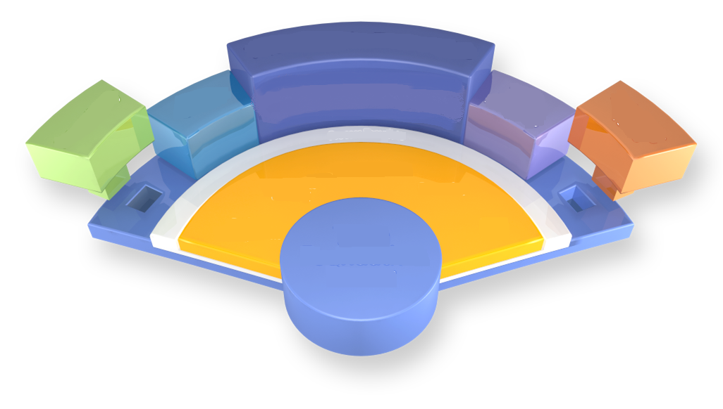
影响BizTalk Server 2009性能的
因素
BizTalk Server 2009
Visual Studio
SQL Server
Messaging
Orchestration
Business Rule
BAM
SharePoint
第三方软件
.Net Framework
WCF
IIS
MSDTC
处理器
内存
磁盘
网络
操作系统
MMC

Slide 11
BizTalk Server 2009 性能
优化的最佳实践
BizTalk优化实践
  BizTalk在64位平台上的优化
  BizTalk应用设计的优化
平台优化实践
  磁盘配置优化
  操作系统配置优化
  SQL Server配置优化
第三方软件优化实践
  高压下的TimeOut事件

Slide 12
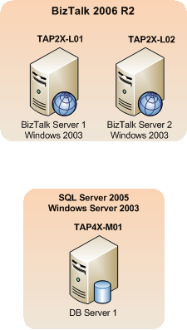
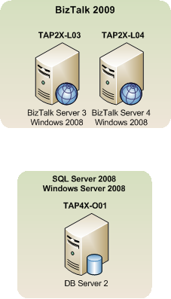
BizTalk Server性能评估环境的比较
Vs.
Name | Model | CPU Type | # of CPUs | # of Cores/CPU | Architecture | RAM | Min Local Disks | OS | Software
TAP2X-L04 | DL380 G5 | Intel Xeon | 2 x 2.33 Ghz | 4 | x64 | 8 GB | 3 x 72gb 10k SAS | Win2k8 EE 64bit | BizTalk 2009
TAP2X-L03 | DL380 G5 | Intel Xeon | 2 x 2.33 Ghz | 4 | x64 | 8 GB | 3 x 72gb 10k SAS | Win2k8 EE 64bit | BizTalk 2009
TAP2X-L02 | DL380 G5 | Intel Xeon | 2 x 2.33 Ghz | 4 | x64 | 8 GB | 3 x 72gb 10k SAS | Win2k3 R2 SP2 EE 64bit | BizTalk 2006 R2
TAP2X-L01 | DL380 G5 | Intel Xeon | 2 x 2.33 Ghz | 4 | x64 | 8 GB | 3 x 72gb 10k SAS | Win2k3 R2 SP2 EE 64bit | BizTalk 2006 R2
TAP4x-M01 | BL680 | Intel Xeon | 4 Proc (2.4 Ghz) | 4 | x64 | 32GB | 3 x 72gb 10k SAS | Win2k3 R2 SP2 EE 64bit | SQL Server 2005
TAP4x-O01 | BL680 | Intel Xeon | 4 Proc (2.4 Ghz ) | 4 | x64 | 32GB | 3 x 72gb 10k SAS | Win2k8 EE 64bit | SQL Server 2008
1
2
3

Slide 13
计算请求
<CalculatorRequest xmlns="http://Microsoft.BizTalk.CAT.Samples.Schemas.CalculatorRequest"> <Method>XmlDocumentOrchestration</Method> <Operations> <Operation> <Operator>+</Operator> <Operand1>82</Operand1> <Operand2>18</Operand2> </Operation> <Operation> <Operator>-</Operator> <Operand1>30</Operand1> <Operand2>12</Operand2> </Operation> <Operation> <Operator>*</Operator> <Operand1>25</Operand1> <Operand2>8</Operand2> </Operation> <Operation> <Operator>\</Operator> <Operand1>100</Operand1> <Operand2>25</Operand2> </Operation> <Operation> <Operator>+</Operator> <Operand1>100</Operand1> <Operand2>32</Operand2> </Operation> </Operations> </CalculatorRequest>
<Operation>
<Operator>+</Operator>
<Operand1>82</Operand1>
<Operand2>18</Operand2>
</Operation>

Slide 14
计算结果
<CalculatorResponse xmlns="http://Microsoft.BizTalk.CAT.Samples.Schemas.CalculatorResponse"> <Status>Ok</Status> <Results> <Result> <Value>100</Value> <Error>None</Error> </Result> <Result> <Value>18</Value> <Error>None</Error> </Result> <Result> <Value>200</Value> <Error>None</Error> </Result> <Result> <Value>4</Value> <Error>None</Error> </Result> <Result> <Value>132</Value> <Error>None</Error> </Result> </Results> </CalculatorResponse>
<Result>
<Value>100</Value>
<Error>None</Error>
</Result>

Slide 15
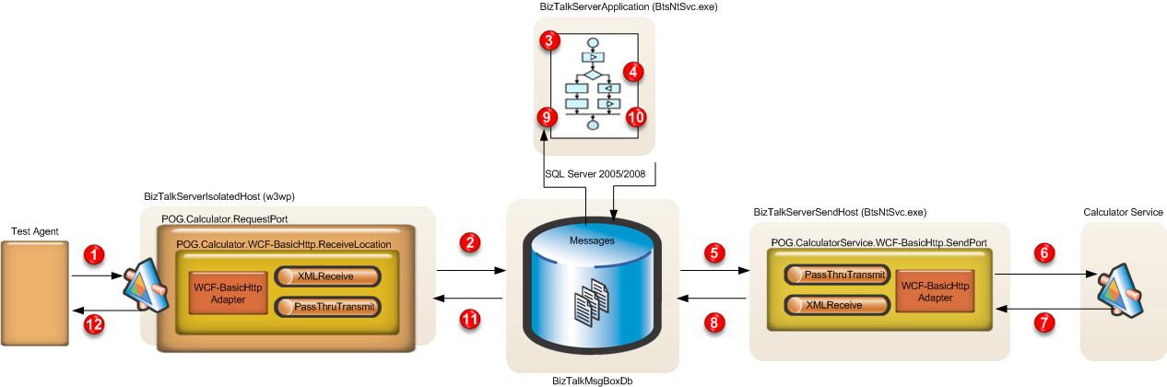
用例介绍1
用例1
  逻辑发送端口

Slide 16
有趣的数据
测试用例 | Concurrent Test Client Users | Messages Per Second | Avg Response (s) | % < 3 seconds | Messages Per Day | Test Length
逻辑发送端口用例 默认配置
R2 – 32 Bit Orch | 100 | 45.4 | 2.24 | 94.36 | ~1,309,000 | 10 minutes
2009 - 64 bit Orch | 100 | 34.3 | 2.89 | 75.45 | ~987,000 | 10 minutes
1
2
逻辑发送端口用例 优化配置
R2 64 bit Orch | 100 | 58.06 | 1.69 | 97.5 | ~1,672,000 | 10 minutes
2009* 64 Bit Orch | 100 | 60.64 | 1.61 | 97.97 | ~1,746,000 | 10 minutes
BizTalk Server 2006 R2 吞吐量增长27%
BizTalk Server 2009 吞吐量增长70%
BizTalk Server 2006 R2响应时间减少25%
BizTalk Server 2009 响应时间减少45%

Slide 17
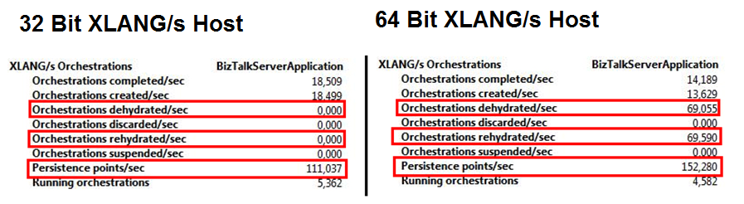
调查冻结的业务流程实例
性能参数：
  Process\Virtual Bytes VirtualMemoryThrottlingCriteria
  Process\Private Bytes PrivateMemoryThrottlingCriteria
1
2
Setting | Original (MB) | Optimization Applied (MB)
Virtual Memory | 900 | 6000
Private Memory | 50 | 700

Slide 18
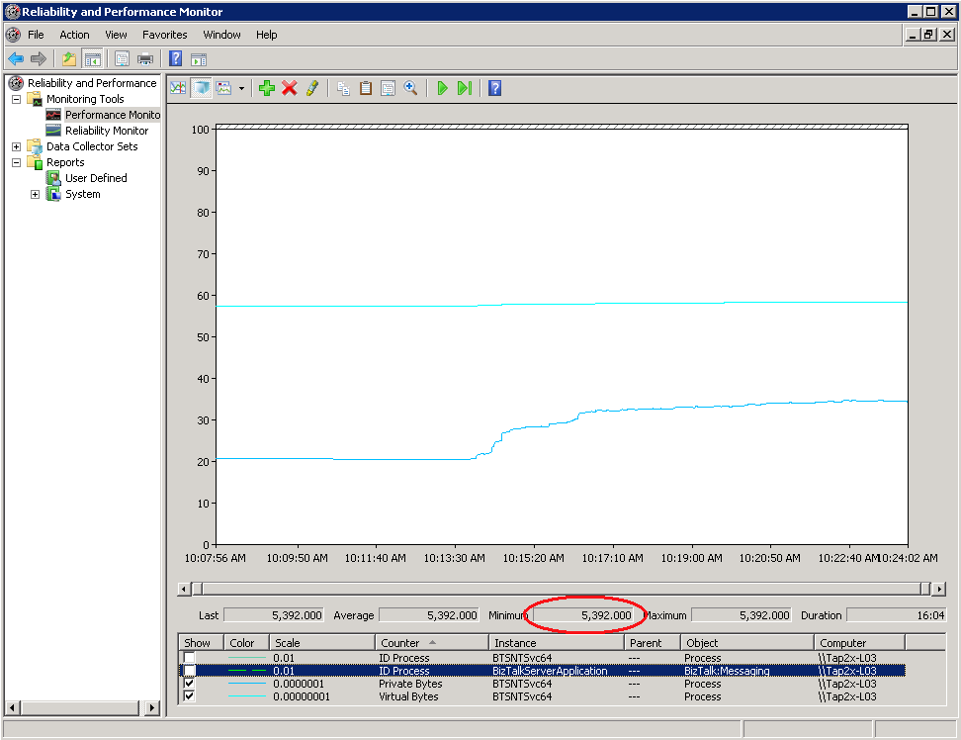
使用Perfmon确定Dehydration值
1
Virtual Bytes ~ 5.4 GB
Private Bytes 持续增长，最大值接近 ~600MB
2

Slide 19
BizTalk在64位平台上的配置优化
默认配置
优化配置
<xlangs>
<Configuration MaxThreshold="1800" MinThreshold="1" ConstantThreshold="-1">
<Dehydration>
<VirtualMemoryThrottlingCriteria OptimalUsage=“900" MaximalUsage=“1300" IsActive=“true" />
<PrivateMemoryThrottlingCriteria OptimalUsage=“50" MaximalUsage=“350" IsActive="true" />
<PhysicalMemoryThrottlingCriteria OptimalUsage="700" MaximalUsage="1000" IsActive="false" /> </Dehydration>
</Configuration>
</xlangs>
<xlangs>
<Configuration MaxThreshold="1800" MinThreshold="1" ConstantThreshold="-1”>
<Dehydration>
<VirtualMemoryThrottlingCriteria OptimalUsage="6000" MaximalUsage="6300" IsActive="true" />
<PrivateMemoryThrottlingCriteria OptimalUsage="700" MaximalUsage="1000" IsActive="true" />
<PhysicalMemoryThrottlingCriteria OptimalUsage="700" MaximalUsage="1000" IsActive="false" /> </Dehydration>
</Configuration>
</xlangs>
1
2
Setting | Counter To Use
VirtualMemoryThrottlingCriteria | Process\Virtual Bytes
PrivateMemoryThrottlingCriteria | Process\Private Bytes
配置文件地址：BizTalk_Installation_Root\BTSNTSvc64.exe.config

Slide 20
BizTalk Server优化配置带来的性能增长
测试用例 | Concurrent Test Client Users | Messages Per Second | Avg Response (seconds) | % < 3 seconds | Messages Per Day | Test Length
32位 业务流程主机 默认配置
R2 | 100 | 55.82 | 1.75 | 95.57 | ~1,607,000 | 10 minutes
2009 | 100 | 56.25 | 1.74 | 95.31 | ~1,620,000 | 10 minutes
64位 业务流程主机 默认配置
R2 | 100 | 45.63 | 2.15 | 95.85 | ~1,314,000 | 10 minutes
2009 | 100 | 45.49 | 2.16 | 88.95 | ~1,310,000 | 10 minutes
64位 业务流程主机 优化配置
R2 | 100 | 58.06 | 1.69 | 97.5 | ~1,672,000 | 10 minutes
2009 | 100 | 60.64 | 1.61 | 97.97 | ~1,746,000 | 10 minutes
1
2
3
4
5
6
Notes:
Highlihgt the final improvements.

Slide 21
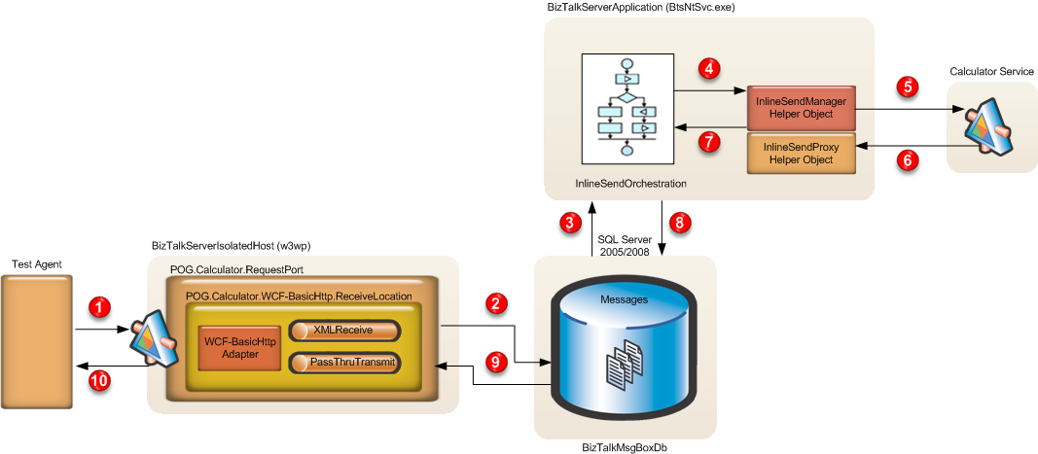
用例介绍2
用例1
  逻辑发送端口
用例2
  内联发送

Slide 22
演 示
用例设计及使用
Inline Sends vs. Logical Ports
Notes:
Perfmon utillity: general performance monitor: CPU %, memory, memory
BizTalk provides sets of performance counters.
Build issues

Slide 23
内联发送端口带来的性能增长
恒定输入
测试用例 | Concurrent Test Client Users | Messages Per Second | Avg Response (sec) | % < 3 seconds | Messages Per Day | Test Length
逻辑发送端口 – 恒定输入
2009 | 100 | 60.64 | 1.61 | 97.97 | ~1,746,000 | 10 minutes
内联发送 – 恒定输入
2009 | 100 | 236.96 | 0.24 | 99.98 | ~6,824,000 | 10 minutes
1
2
3
4
阶梯状输入
测试用例 | Concurrent Test Client Users | Messages Per Second | Avg Response (sec) | % < 3 seconds | Messages Per Day | Test Length
逻辑发送端口 – 阶梯状输入
2009 | 100-800 | 64.9 | 6.51 | 18.43 | ~1,869,000 | 30 minutes
内联发送 – 阶梯状输入
2009 | 100-800 | 148.15 | 0.23 | 99.98 | ~4,262,000 | 30 minutes
恒定输入下，吞吐量产生4倍增长
响应时间成倍缩短

Slide 24
BizTalk Server 2009 性能
优化的最佳实践
BizTalk优化实践
  BizTalk在64位平台上的优化
  BizTalk应用设计的优化
平台优化实践
  磁盘配置优化
  操作系统配置优化
  SQL Server配置优化
第三方软件优化实践
  高压下的TimeOut事件

Slide 25
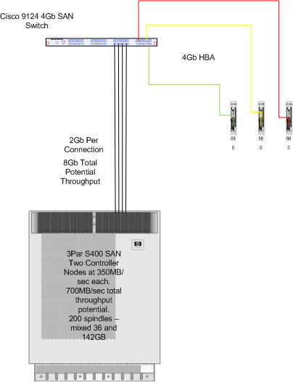
磁盘配置优化 - SAN
3
2
1

Slide 26
Windows 配置优化
阻止防病毒软件对BizTalk运行文件和输出文件的实时扫描
定期整理磁盘碎片
多机环境中MSDTC的必要配置
设置MSDTC日志文件配置到专用磁盘
停止不必要的Windows服务
优化Windows PAGEFILE
多机环境中服务器时间同步
http://msdn.microsoft.com/en-us/library/ee377064(BTS.10).aspx

Slide 27
SQL Server 配置优化
预分配数据和日志的存储空间
确认 SQL Server Agent 服务正常运行
定期清除和保存 Tracking 数据
分隔 MessageBox 和 Tracking 数据库
优化BizTalk数据库所使用的 文件和文件组
http://msdn.microsoft.com/en-us/library/ee377069(BTS.10).aspx

Slide 28
BizTalk Server 2009 性能优化的最佳实践
BizTalk优化实践
  BizTalk在64位平台上的优化
  BizTalk应用设计的优化
平台优化实践
  磁盘配置优化
  操作系统配置优化
  SQL Server配置优化
第三方软件优化实践
  高压下的TimeOut事件

Slide 29
    高压下的Timeout事件
后台WCF应用的web.config
  maxConcurrentThreadsPerCPU: 1000;
  maxConcurrentRequestsPerCPU:5000;
WCF服务的配置
  %windir%\Microsoft.NET\Framework64\v3.0\Windows Communication Foundation\SMSvcHost.exe.config
  <net.tcp listenBacklog="100" maxPendingConnections="200" maxPendingAccepts="2" receiveTimeout="00:10:00" teredoEnabled="false">

Slide 30
Hyper-V架构下的性能比较和优化实践
Hyper-V 体系结构
虚拟机的分配
物理机与虚拟机的比较
BizTalk Server 虚拟化
SQL Server 虚拟化
小结

Slide 31
Hyper-V体系结构
1
Root Partition
3
Child Partition
Child Partition
VHD
提供Pass-Through 磁盘
Server
Server
VSPs
2
VSPs
I/O
Stack
I/O
Stack
I/O
Stack
OS Kernel Enlightenments (WS08+)
Drivers
4
VSCs
VSCs
VMBus
Shared Memory
VMBus
VMBus
5
Hypervisor
Devices
Processors
Memory
Notes:
虚拟化的背景
TCO, Green，Maintenance
Hyper-v 的优势 支持多处理器 high effect

Slide 32
虚拟机的分配
1 to 1 Mapping
Overload Scenario
1
2
BizTalk Server
BizTalk Server
BizTalk Server
BizTalk Server
Virtual Processors
Virtual Processors
Virtual Processors
Virtual Processors
0
0
0
1
0
1
BizTalk Server
BizTalk Server
BizTalk Server
BizTalk Server
Virtual Processors
Virtual Processors
Virtual Processors
Virtual Processors
0
0
0
1
0
1
Logical Processors
Logical Processors
0
1
2
3
0
1
2
3
Notes:
虚拟机的好处：省电，省空间，省钱。。。但是我们可以预期虚拟化是要有代价的。
那么怎样设计虚拟机的分配?
Hyper-v是支持多处理器的，什么是逻辑处理器，什么是虚拟处理器

Slide 33
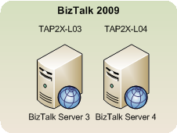
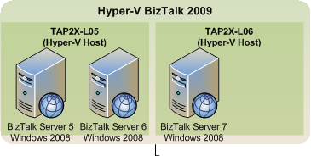
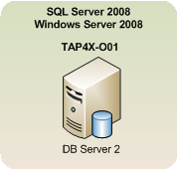
物理机与虚拟机的比较
1
2
Vs.
3
Name | Model | CPU Type | # of CPUs | # of Cores/CPU | Architecture | RAM | Min Local Disks | OS | Software
TAP2X-L06 | DL380 G5 | Intel Xeon | 2 x 2.33 Ghz | 4 | x64 | 8 GB | 3 x 72gb 10k SAS | Win2k8 EE 64bit | BizTalk 2009 Hyper-V Images
TAP2X-L05 | DL380 G5 | Intel Xeon | 2 x 2.33 Ghz | 4 | x64 | 8 GB | 3 x 72gb 10k SAS | Win2k8 EE 64bit | BizTalk 2009 Hyper-V Images
TAP2X-L04 | DL380 G5 | Intel Xeon | 2 x 2.33 Ghz | 4 | x64 | 8 GB | 3 x 72gb 10k SAS | Win2k8 EE 64bit | BizTalk 2009
TAP2X-L03 | DL380 G5 | Intel Xeon | 2 x 2.33 Ghz | 4 | x64 | 8 GB | 3 x 72gb 10k SAS | Win2k8 EE 64bit | BizTalk 2009
TAP4X-O01 | BL680 | Intel Xeon | 4 Proc (Ghz TBC) | 4 | x64 | 32GB | 3 x 72gb 10k SAS | Win2k8 EE 64bit | SQL Server 2008

Slide 34
BizTalk Server 虚拟化
Test | Concurrent Test Client Users | Messages Per Second | Avg Response (s) | % < 3 seconds | Messages Per 8-hour Day | Test Length
Logical Ports 在 优化平台上的结果
2009 | 100 | 60.64 | 1.61 | 97.97 | ~1,746,000 | 10 minutes
2009 on Hyper-V | 100 | 52.96 | 1.86 | 94.8 | ~1,520,000 | 10 minutes
Inline Sends在 优化平台上的结果
2009 | 100 | 236.96 | 0.24 | 99.98 | ~6,824,000 | 10 minutes
2009 on Hyper-V | 100 | 223.54 | 0.28 | 99.87 | ~6,438,000 | 10 minutes
虚拟机提供 ~87% 吞吐量*
虚拟机提供 ~115% 反应时间*
1
2
3
4
5
6
7
8

Slide 35
BizTalk Server 虚拟化小结
1
2
3
4
Notes:
94%, 79.8%, 60%

Slide 36
处理器性能评估
衡量客户机处理器:
  \Hyper-V Hypervisor Virtual Processor(*)\% Guest Run Time
  \Hyper-V Hypervisor Virtual Processor(*)\% Total Run Time
衡量物理处理器:
  \Hyper-V Hypervisor Logical Processor(*)\% Total Run Time
衡量宿主机处理器:
  \Hyper-V Hypervisor Root Virtual Processor(*)\% Total Run Time
Notes:
Virtual processor, logical processor

Slide 37
磁盘性能评估
使用VHD磁盘:
  <RootPartition>\Logical Disk(*)\Avg. sec/Read
  <RootPartition>\Logical Disk(*)\Avg. sec/Write
  <Guest>\Logical Disk(*)\Avg. sec/Read
  <Guest>\Logical Disk(*)\Avg. sec/Write
使用Pass-Through磁盘:
  “Hyper-V Virtual Storage Device” counters
Notes:
What is pass-throug disk
xPerf Tool http://perftools

Slide 38
Pass-Through磁盘性能分析
Measurement | Physical SQL Physical Disk | Virtual SQL Pass-through Disk | Difference
Transfers/Sec | 269.73 | 250.47 | 7%*
* Other factors such as SAN performance could have been a factor
Notes:
VHD disk的差异 ？%

Slide 39
磁盘性能优化方案
在磁盘性能要求高的环境中使用Pass-Through磁盘:
  BizTalk MessageBox Database
  BizTalk Tracking Database
  BizTalk 文件适配器
  如果BizTalk以流的方式处理大文件时，需要将%temp% 文件夹指定到Pass-Through磁盘

Slide 40
疑问和解答
Notes:
Recapture the contents….
把握时间

Slide 41
参考资源
BizTalk Server 2006: Managing a Successful Performance Lab
  http://msdn2.microsoft.com/en-us/library/aa972201.aspx
Scaling Your Solutions
  http://msdn2.microsoft.com/en-us/library/aa561567.aspx
Configuration Parameters that Affect Adapter Performance
  http://msdn2.microsoft.com/en-us/library/aa561380.aspx
Persistence and the Orchestration Engine
  http://msdn2.microsoft.com/en-us/library/aa547090.aspx
Troubleshooting MessageBox Latency Issues
  http://msdn2.microsoft.com/en-us/library/aa561709.aspx
Performance Tips and Tricks
  http://msdn2.microsoft.com/en-us/library/aa560694.aspx
Rule Engine Configuration and Tuning Parameters
  http://technet.microsoft.com/en-us/library/aa548008.aspx
Performance Considerations When Using the Rule Engine
  http://msdn2.microsoft.com/en-us/library/aa952929.aspx

Slide 42
参考资源
BizTalk BPA
PerfMon
LoadGen
BizUnit
Log Man
Relog
Log Parser
PAL
SQLIO
BizTalk Orchestration Profiler
Notes:
注释

Slide 43
























附件 - BizTalk的企业用户
Notes:
Shoprite – The largest food-retailer in Africa. Use for integration of POS and back-end systems
Tesco – The largest food-retailer in the UK. Use for integration of POS and back-end systems. Part of standardized roll-out of new stores.
Siemens – One of the worlds largest electronics and engineering companies. Use BizTalk to create a SOA across the organization. The result cut project development time by 50%.
Samsung – Customer self-service solution. Samsung's customers can identify exact production planning and supply schedules in real time, reducing management cost and maximizing business efficiency.
ChungHwa – The largest telco operator in Taiwan uses BizTalk Server as part of their micro-payment infrastructure. This system requires substantial scaling and allows them to take advantage of new revenue opportunities.
T-Com – Deutsche Telecom’s broadband arm, uses BizTalk with their SOA to build a new automated provisioning system that is able to handle 10 times more customers than the previous system and has reduced provisioning costs by 10-15 percent. T-Com also can bring new services to market 40 percent faster than before.
Pershing (an affiliate of the Bank of New York) – Uses BizTalk to meet the increase in trading volumes that resulted from building an institutional businesses.
Monte Dei Pashi Di Siena – World’s Oldest Bank, offers modern systems with a multi-channel banking system for its retail customers. This means that customers can interact with managers using instant messaging and video calls

Slide 44
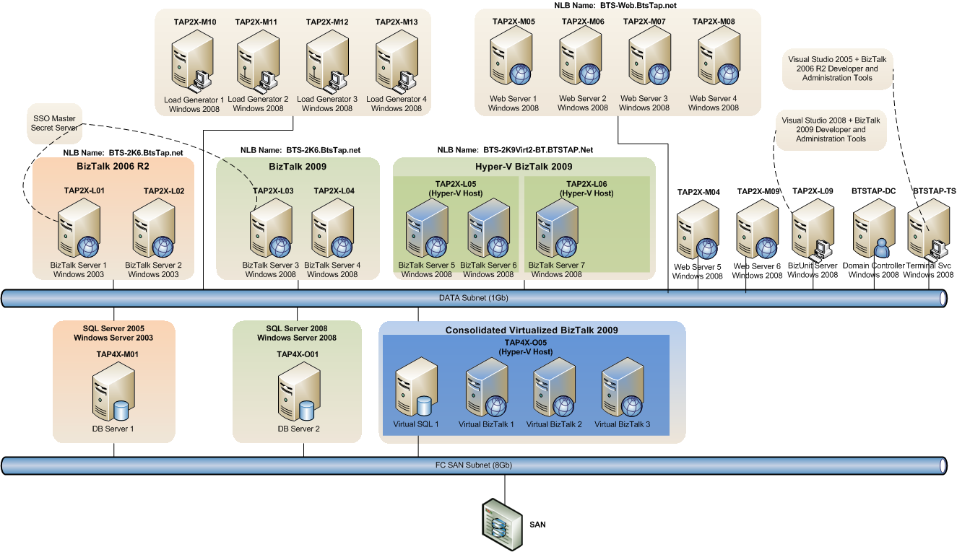
附件 - 性能实验室设备一览

Slide 45
SQL Server 虚拟化小结
Notes:
translation

Slide 46
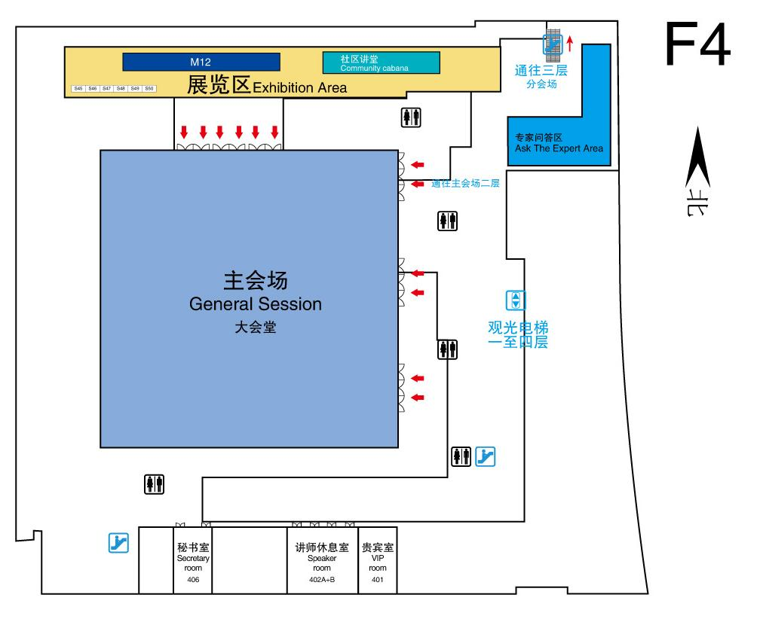
专家问答区 (F4)
本课程结束后，我将在接下来的70分钟内于4层专家问答区与您交流答疑

