Slide 1
Driving Business Value
with Windows 7
Ruth Morton
IT Pro Advisor, Microsoft Canada

Slide 2
What was the world like 8 years ago?

Slide 3


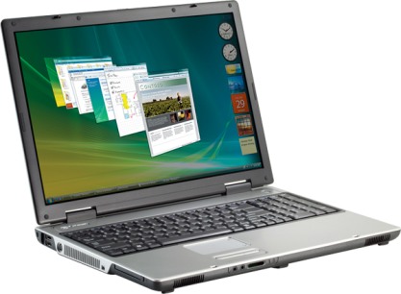
What If?…
New airline rules

Slide 4





What If?…
Extreme weather

Slide 5



Business End Users Need Agility
and Flexibility
IT Needs Control
Notes:
5

Slide 6



Windows 7
Make People
Productive
Manage Risks
Reduce Costs
...anywhere
...through enhanced
security & control
...by streamlining
PC management

Slide 7








Windows Optimized Desktop
Core PC Platform
Unique Value with SA+MDOP

Slide 8

How can my users be productive anywhere?
End-Users
IT
Hard for remote users to connect to resources
Hard to find information across PCs & data portals
Hard to ensure secure connectivity for remote users
Hard to manage mobile PCs and keep them up-to date
Hard to provide and manage access to information

Slide 9



























Making People Productive Anywhere
DirectAccess
BranchCache™
Search Federation
Office
Home

Slide 10


Branch Office File Copy
Situation Today
Windows 7 Solution
Windows
Server 2008
Windows Server 2008 R2
Slow WAN Link
Slow WAN Link
Subsequent access from the same client is satisfied from the transparent cache (local machine access)
Client 1
Client 2
Client 1
Client 2
Vista SP1 Clients
Windows 7 Clients

Slide 11
How can I protect data and maintain compliance?
End-Users
IT
Need to store data locally to use offline as they travel
Need to share data on removable devices as they collaborate
Need to install multiple applications to do work
Need to protect data on mobile PCs and USB drives
Need to protect user systems from unauthorized stuff
Need to ensure compliance

Slide 12












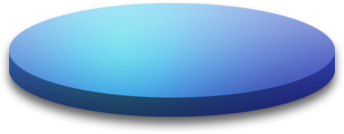


Managing Risks Through Security & Compliance
BitLocker To Go™
Fundamentally Secure Platform
AppLocker™
+

Slide 13
How do I simplify PC management & drive down costs?
End-Users
IT
Need PCs that just work, easy problem resolution when needed
Need applications to work
Want minimal disruption when upgrading
Challenging to ensure PCs “just work”
Concerned if apps will work on new OS
Difficult to deploy new OS and migrate users

Slide 14









Reducing Costs by Streamlining Management
Windows Troubleshooting Platform
Deployment and App
Compatibility Tools
PowerShell 2.0
VDI Enhancements

Slide 15



User data & settings
Applications
OS
Notes:
15

Slide 16
User data & settings
Applications
OS
Notes:
16

Slide 17







User data & settings
Streamlined
Management
Applications
OS
Notes:
17

Slide 18












Application Compatibility Resources
INVENTORY
EVALUATE
REMEDIATE
Application Compatibility Toolkit
Microsoft Assessment and Planning
System Center Family
Application Quality Cookbook
Windows Compatibility Center
Application Verifier
Application Virtualization
Virtual Legacy Windows OS

Slide 19










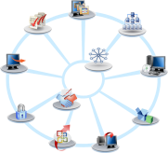







Windows 7 Deployment
IMAGING
DELIVERY
MIGRATION
Deployment Image Servicing and Management
Windows Deployment Services
User State Migration Tool
INTEGRATED SOLUTIONS CONTINUE
Microsoft Assessment and Planning
Application Compatibility Toolkit
Microsoft Deployment Toolkit

Slide 20
Demo
Application Compatibility Toolkit
Microsoft Enterprise Desktop Virtualization (MED-V)
Problem Step Recorder

Slide 21








Impact of the Optimized Desktop
Reduce Risk, Improve
Productivity
Reduce Costs
Manage Complexity,
Achieve Agility
People Process Technology
Basic
Standardized
Rationalized
Dynamic
IT is a cost center
IT is an efficient cost center
IT is a business center
IT is a strategic asset

Slide 22


Session 2 Summary
Desktop Optimization
Reduce complexity
Increase control
Work securely anywhere
Connect people with information

Slide 23
Call to Action
Download ACT from www.microsoft.com/downloads and start collecting inventory information and evaluating your applications
Invite your IT team to learn more about Windows 7 through the Springboard site www.microsoft.ca/springboard

