Slide 1

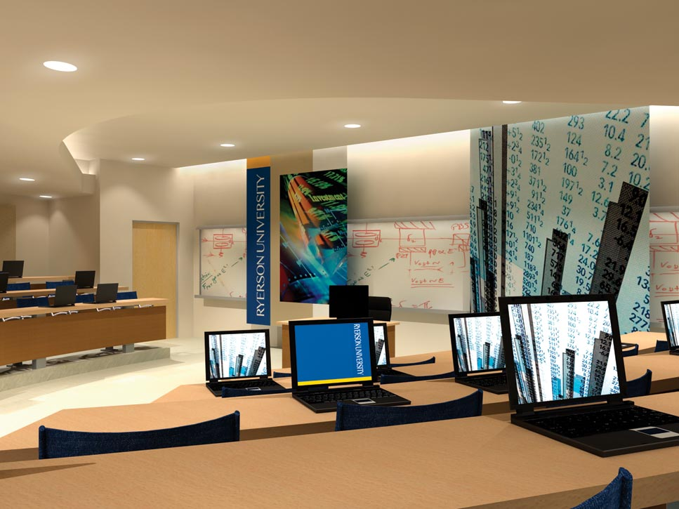
Canadian Advanced Technology Alliance, Women In Technology Project (CATA-WIT) Wendy Cukier, MA, MBA, PhD, DU (hon) LLD(hon) M.S.C. Associate Dean, Ted Rogers School of Management Founder, Diversity Institute, Ryerson University www.ryerson.ca/diversity

Slide 2
Agenda
Overall Project Goals
Business Case for Diversity
Ecological Model of Change
Societal Level: Developing the Pipeline
Organizational Level: Barriers and Strategies
Individual Level: Barriers and Strategies
Conclusions
Questions

Slide 3
CATA Women in Technology (CATA-WIT)
Overall Project Goals
Help erode barriers to women moving into senior positions or starting technology companies
Facilitate systemic change in technology companies to implement strategies to attract women and help them advance
Professional development and mentorship
Broad definition of technology: ICT, Energy, Biotech, Aerospace/Defense
Drill down on some regions and sectors

Slide 4
The Business Case for Diversity
The global “war for talent”
Aging population and generation Y
Critical skill shortages in specific sectors and regions
Evolving skill requirements: eg. hybrids in ICT
Growing diversity of markets
Links between diversity and creativity
Risk management: under-representation of women (and other designated groups)

Slide 5
Industry | Representation of women by sector
 | Number of Workers | Female
Total labour force | 17,146,135 | 47.4%
Life Sciences | 57,565 | 43.5%
ICT | 1,713,650 | 40.5%
Electricity | 96,320 | 25.1%
Aerospace | 195,085 | 24.4%
Defence | 105,850 | 23.0%

Slide 6
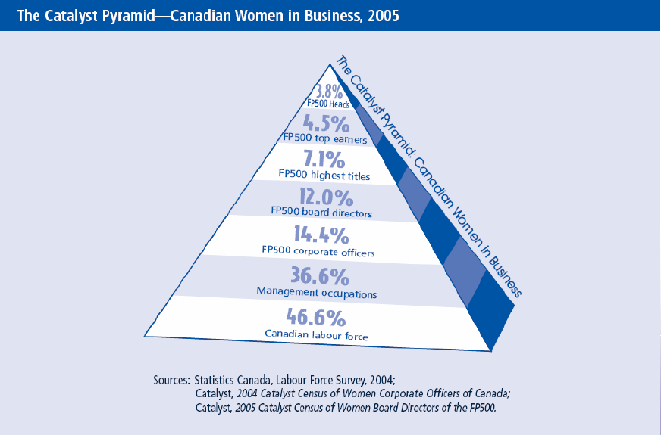
The “Glass Ceiling is Shattered” is a Myth

Slide 7
The Ecological Model of Change
Social
Environment
Individual
Group
Organization
Sector

Slide 8
BARRIERS: Social Environment
Organizations do not exist in a vacuum
Powerful cultural “carriers” reinforce values and stereotypes
Socialization of girls and early education: the pipeline
Representation in the media: eg. seldom “experts”
Limited numbers of female role models: Images of leaders

Slide 9
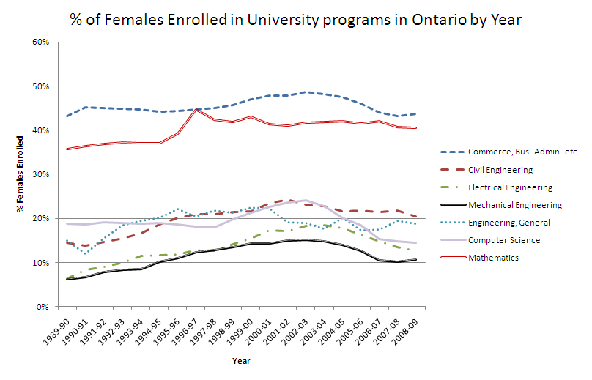

Slide 10
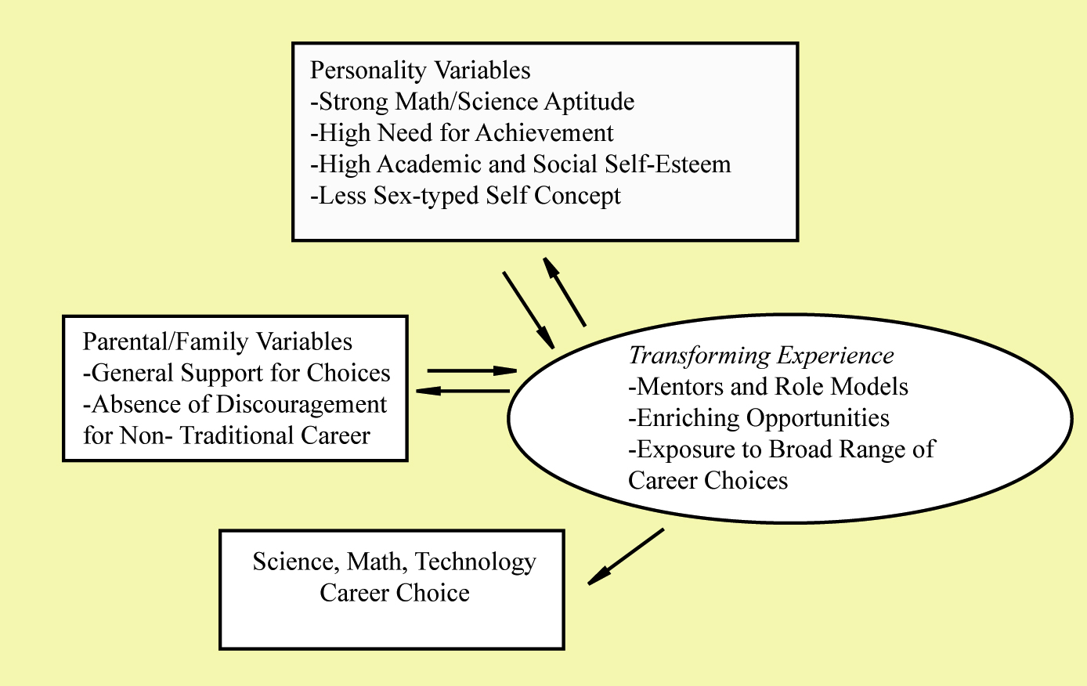
Factors Affecting Choices

Slide 11
Develop the Pipeline: Strategies to influence career choice
Build self efficacy
Encourage new approaches to teaching math, science and technology: female friendly pedagogy
Female role models
Strengthen career and guidance counselling
Challenge that profession is uninteresting, irrelevant and ‘not sexy’: Engineers change the world!
Challenge perception of downturn and instability in industry (post dot.com bust)

Slide 12
BARRIERS: Organizations
Individual
Group
Organization
Sector
Social
Environment
Recruitment and Promotion Practices: reliance on informal networks and processes; mismatch between job task and qualifications
Work/Life Policies: 25% male CEOs have partners working outside the home vs. 75% of female CEOs
“Think Manager, Think Male”: Gendered aspects of management and leadership “style” – the “B” word
Men and women are still evaluated in different ways: “rated as being less competent, less influential, and less likely to have led on the task than men”
Absence of Mentors and Role Models: The “Queen Bee” Syndrome

Slide 13
Perceived Barriers to Advancement | Ranked in top five by Women
I do not promote myself | 49%
The old boys’ network | 46%
Lack of understanding of the invisible rules in your organization | 36%
Not having an influential mentor or sponsor | 36%
Lack of developmental/advancement opportunities in my organization | 35%
Not understanding organizational politics | 33%
Childcare and family obligations | 26%
Lack of informal networking with influential colleagues | 25%

Slide 14
5=Strongly Agree 3= Neither Agree nor Disagree 1= Strongly Disagree
My senior management demonstrates a strong commitment to gender diversity. | 3. 7
I am satisfied with the progress I have made toward meeting my goals for advancement. | 3.7
My senior management demonstrates a strong commitment to promoting women employees. | 3.6
I am satisfied with the progress I have made toward meeting my overall career goals. | 3.5
I am satisfied with the progress I have made toward meeting my goals for income. | 3.5
I feel as if I am held to a higher standard than others in my organization. | 3.3
My organization places too much emphasis on numeric targets for women in senior management positions. | 3.0

Slide 15
Strategies for Advancement
 | Ranked in top five by female
Exceeding performance expectations | 78%
Working on high visibility projects or stretched assignments | 60%
Developing a personal network or advisors to provide career advice | 40%
Get out of my comfort zone | 36%
Informal networking with influential colleagues | 36%
Gaining more experience in my current position | 34%

Slide 16
Effective Practices
 | Ranked in top five by females
Flexible Work Arrangements | 67%
Informal Networking | 63%
Informal Mentoring | 56%
Clear and Bias-free Recruitment | 53%
Formal Performance Appraisal Process | 49%
Formal Talent Identification Process | 41%

Slide 17
The Diversity Curve
Large Financial
Services
Degree of Formalization
- Recognize overt
and systemic
- Integrated policies
- Metrics
SME Manufacturing
- Little recognition of problem
- No policies
- No metrics
% of Women Senior Executives

Slide 18
SMEs versus Large Organizations | Revenues to $10 million | Revenues of $5 billion or more
My senior management demonstrates a strong commitment to gender diversity | 42.3% | 55.0%
My organization strives to create a climate supportive of all individuals | 73.1% | 80.0%
My organization devotes sufficient resources to diversity programs | 34.6% | 50.0%

Slide 19
Leadership and Governance
Does the board consider diversity in identifying and developing candidates?
Do senior executives communicate the importance of diversity?
Do leaders reflect the composition of the workforce?
Is there a diversity council with senior executive participation?
Is there a chief diversity officer at the VP level with lines of authority?
Are there female leaders with profile internally and externally?
Are explicit diversity goals and policies in place and communicated?
Has the business case for diversity been developed & communicated?
Are the policies widely communicated internally and externally?
Are there mechanisms to handle complaints re. harassment and discrimination?
Is compensation for executives tied to meeting diversity targets?

Slide 20
Human Resources
D
Does the board consider diversity in identifying candidates?
Are reviews of vacant positions undertaken to ensure that the qualifications required fit the demands of the job?
Does the organization consider alternative pathways to positions?
Are vacant positions posted?
Do recruiters specifically target women?
Do all internship and co-op programs have diversity targets?
Are selection committees representative?
Are bias-free interviewing processes used?
Is diversity built into performance management systems?

Slide 21
Human Resources (cont.)
D
Does succession planning take into account diversity targets?
Are high potential females given “stretch” assignments?
Are promotional opportunities communicated openly and clearly ?
Are career planning systems in place to support employees?
Are high potential female employees given access to specialized training and professional development?
Is diversity tracked in employee separations ?
Are exit interviews conducted and the results acted upon?
Does succession planning take into account diversity targets?

Slide 22
Training and Development
D
Does orientation for new employees address diversity?
Do all employees receive mandatory training on diversity?
Do managers receive specialized training on diversity?
Is there specialized training in diversity and bias free hiring?
Are high potential female employees given specialized training?
Are there female centric management skills development programs?
Is there intensive technology training for employees from non-technology disciplines?
Are employees kept current during/after parental leave?
Are customized management development programs available ?
Are formal mentoring/coaching programs provided?
Are formal women’s networks supported?

Slide 23
Quality of Life and Workplace Culture
D
Are flexible work arrangements available?
Are family-friendly policies in place (extended parental leave and family emergency days, elder care, support for parents travelling)?
Are on-site day care and emergency day care services available?
Are employee workloads and management expectations managed?
Do employees have access to coaching and counselling to help manage workload and stress?

Slide 24
Measure and Track Diversity
Are there metrics on the participation of women at each management level relative to the available labour force?
Are there explicit diversity targets for participation and for women in management?
Are there regular employee engagement surveys with self reported demographic data?
Are equal pay audits conducted to ensure equal pay for work of equal value?
Is performance benchmarked against others in the industry?
Are these targets tracked and reported with feedback loops for action?

Slide 25
Mainstreaming Diversity
Does the organization consider and communicate the importance of diversity in its marketing and customer service programs?
Is the importance of diversity communicated in all its publications ?
Is diversity considered in designing and developing products?
Is the importance of diversity considered and communicated in philanthropic activities?
Is importance of diversity considered in government relations? For example, advocating for female friendly policies such as national day care and parental leave?
Is the importance of diversity considered and communicated in procurement processes?

Slide 26
Developing the Pipeline
Does outreach stress opportunities for women in technology?
Do outreach activities consider representation?
Does the organization participate with associations and professional organizations in programs to promote women in technology?
Is diverse representation considered in partnerships? (research, executive education, training and development)
Is development of re-entry and transitional programs encouraged?
Are programs to encourage women to enter technology jobs supported? For example hybrid programs; double majors.
Are research and evaluation aimed at promoting effective diversity interventions supported?

Slide 27
BARRIERS: Individuals
Individual
Group
Organization
Sector
Social
Environment
Communication and Negotiation Styles: Women don’t Ask “Women are less likely to negotiate starting salary sacrificing over half a million dollars in earnings over their career” – Babcock & Laschever, 2002
Self-Efficacy
Male tend to attribute their success to skill and effort
Females tend to attribute their success to luck
Males tend to attribute their failure to bad luck
Females tend to attribute their failure to inability
The patterns are evident as early as grade 3!
Women tend to doubt themselves in spite of their abilities

Slide 28
STRATEGIES: Individual action
Individual
Group
Organization
Sector
Social
Environment
Focus on results
Develop and nurture networks
Find a mentor, be a mentor
“Display your excellence”
Make demands! Ask! “Pitch like a girl”
Take risks but judge how far to “push the envelope”
REMEMBER: Even within organizations, functional environments are not homogeneous

Slide 29
CONCLUSIONS
We have made progress – the glass is half full
More is needed – the glass is half empty
In some areas we have hit a plateau
“Change will come not through revolution but through millions of earthworms preparing the soil”
-Ursula Franklin

Slide 30
Thank you! Questions?

