Slide 2
Windows 7 Device Experience
Dennis Flanagan
Group Program Manager
Microsoft Corporation

Slide 3
Purpose of this Session
Discuss challenges and opportunities of the evolving device landscape
Show how Windows 7 addresses these with new experience and platform features
Identify upcoming technical sessions that explore these features in more detail

Slide 4
What Is the Device Experience?
User experience features that define how people discover and use devices that are connected to their PC
System and platform features that define how device makers present their devices and related services in Windows
Installation
Enumeration of Capabilities
Presentation and Configuration
Binding to Applications and Services

Slide 5
Device Experience Evolution
Today Forward
Early 2000s
Mid 1990s
Device/PC Companions
Networked Peripherals
Early 1990s
Plug-and-play Peripherals
Monolithic Components

Slide 6
Devices Evolving Quickly Technology is driving fundamental change
Powerful, multifunction machines
Rapidly growing storage capacity
Wireless connectivity
Integrated with services

Slide 7


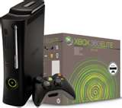
Transition to Multi-Function More capabilities and applications
Printer
Mobile Phone
Gaming System
All-in-one Document Handler:
Printer, Scanner, Email, Fax Machine, card reader, network connected with web services control
Portable
Multifunction Computer: Phone, Email, Internet Browser, Application Platform, Gaming, Camera, Media Player, Address Book
Social and Entertainment Hub:
Gaming System, DVD Player, On-demand Content Provider, Media Player/Extender, Social Networking

Slide 8
Growth in Storage Capacity Content and data everywhere
30 GB
12 GB
8 GB
3 GB
Source: Gartner Dataquest, “USB Flash Drive Market Trends, Worldwide, 2001-2010”
Source: Gartner Dataquest Insight, “Solid-State Drives Emerge in Select Consumer and Enterprise Markets, 2008”

Slide 9
Wireless Connectivity To networks, PC’s and each other
Source: In-Stat, “Consumer Electronics Devices Warming Up to Wi-Fi 10/06”

Slide 10
Windows Experience Today Challenges for users and device makers
Inconsistent views and entry points
Views of functions not devices
Limited brand and function extensibility
Many partners building similar applications for common tasks
No recommended path to on-board and present services

Slide 11
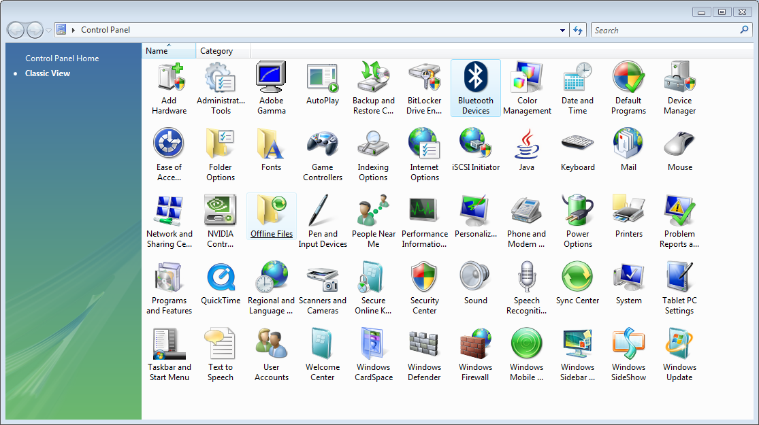
Windows Experience Today No coherent view of devices

Slide 12
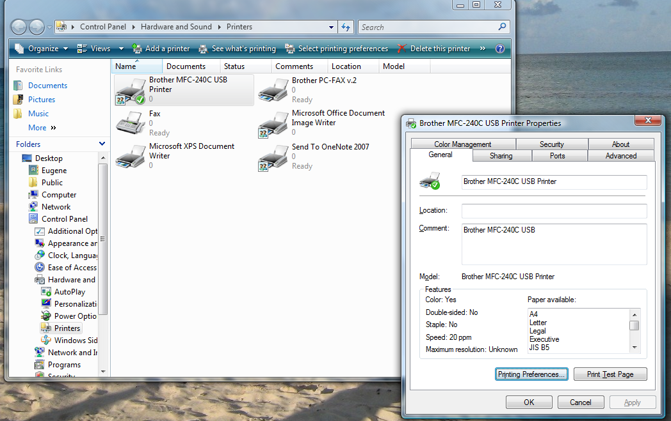
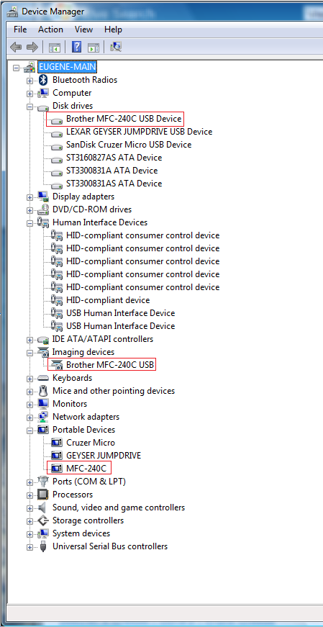
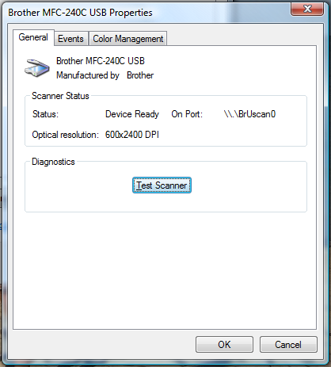
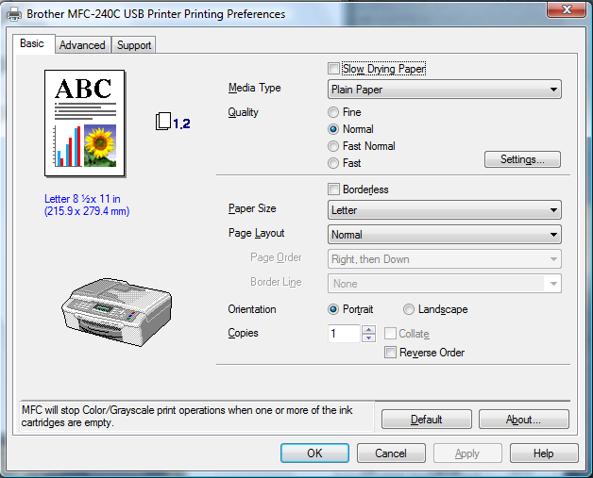
Windows Experience Today Multifunction devices viewed as functions

Slide 13
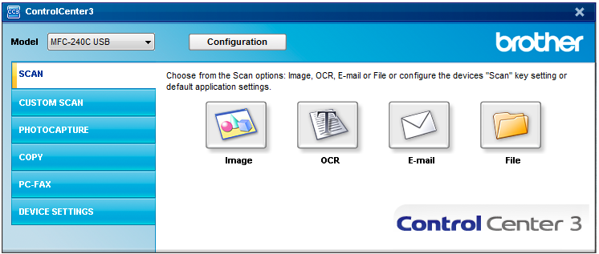
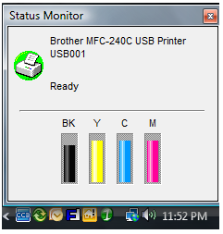
Windows Experience Today Must over-ride or replace Windows UI

Slide 14
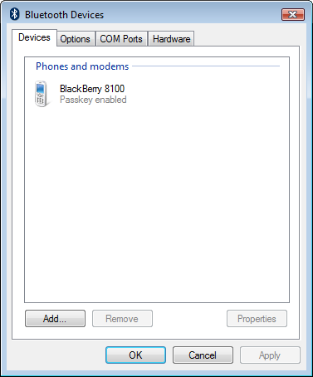
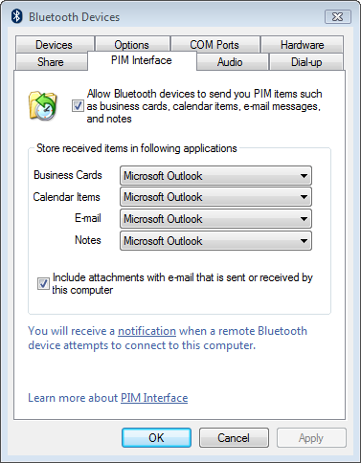
Windows Experience Today Extensibility and branding is limited
Before
After Install

Slide 15
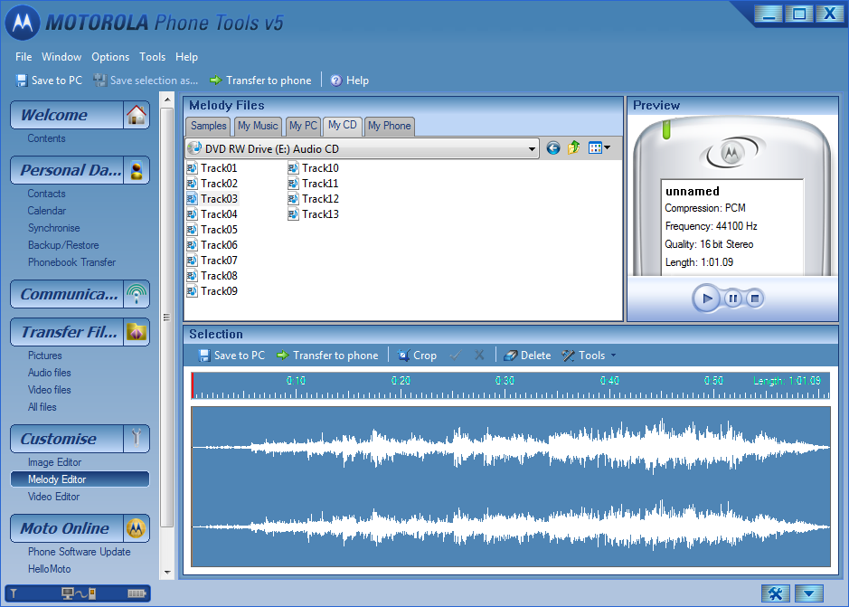
Windows Experience Today Must create unique UI for common tasks

Slide 16

Addressing the Challenges End user and partner needs evolving
Natural Device Experience
Value for Device Partners
Easy to find devices
Easy to discover device capabilities
Easy to find support, services, accessories
Low/No learning curve
Consistent work flow
Simple installation
Clear brand association
Integrated workflow
Prominent placement
Extensible/customizable
Service-enabled
Easy deployment

Slide 17
The Windows 7 Experience Example Demonstrations
Printers and Portable Devices
Home media streaming devices
Wireless audio devices

Slide 18
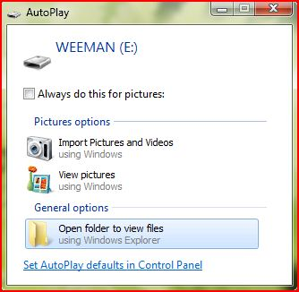
Portable Devices – Vista
Windows Features
Software Applications
WPD API
MTP Driver
WPD Driver
Enumerator (PnP, PnP-X)
Bus Driver
Microsoft
Software
Physical Layer (USB, WiFi)
Partner
Software
Partner
Hardware

Slide 19
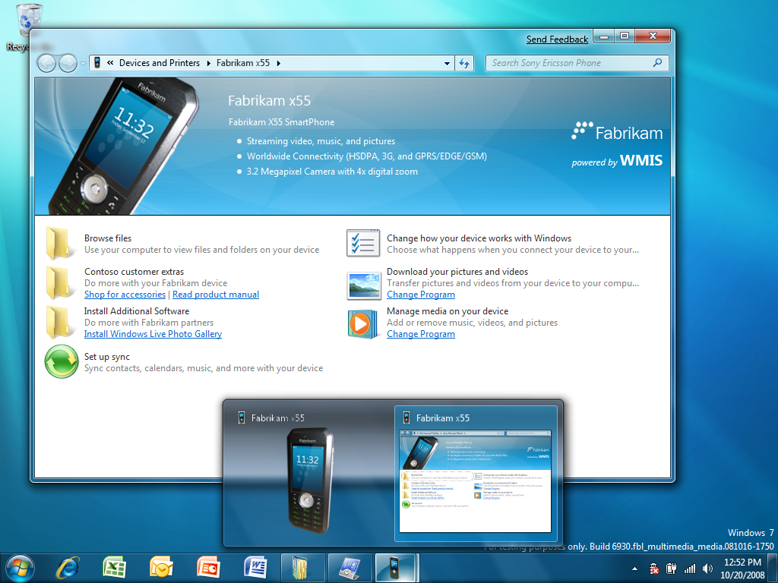
Portable Devices – Windows 7
Windows Features
Software
Applications
Web
Services
Device Experience XML
Device Experience UI (Device Stage)
WPD API
Device Display Object
MTP Driver
WPD Driver
Function
Discovery
Enumerator (PnP, PnP-X)
Microsoft
Software
Bus Driver
Device
Metadata
System
Partner
Software
Physical Layer
(USB, WiFi, Bluetooth, …)
Partner
Hardware

Slide 20
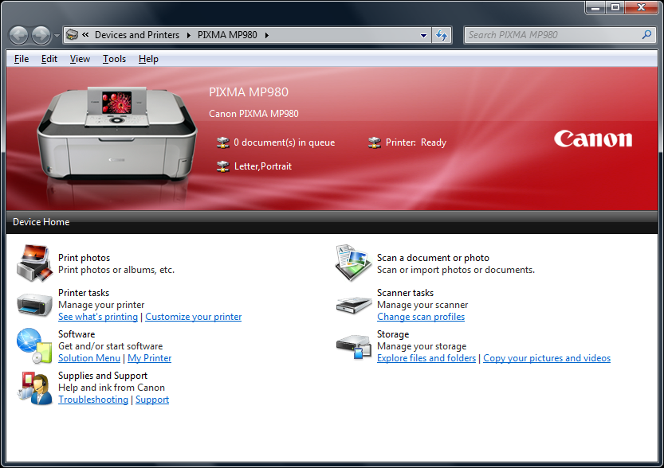
Additional Device Classes
Windows Features
Software
Applications
Web
Services
Device Experience XML
Device Experience UI (Device Stage)
Device Display Object
Portable Device
Printer
*Future Classes*
Scanner
Fax
Function
Discovery
Microsoft
Software
Device
Metadata
System
Partner
Software
Physical Layer
(USB, WiFi, Bluetooth, …)
Partner
Hardware

Slide 21
Device Stage™
demo
Robin Goldstein
Microsoft Corporation

Slide 22
Digital Home – Vista
Networked Media Player
Windows PC
Player/Controller App
DMS
Browse
DMP
DMC
UPnP / IP
Request
UPnP / IP
NIC
Stream
NIC
Microsoft
Software
Partner
Software
Partner
Hardware

Slide 23
Digital Home – Windows 7
Windows PC
Networked Media Player
WMP
WMC
Player/Controller App
DMS
DMC
DMR
Control
DMP/R
DMC
UPnP / IP
Stream
UPnP / IP
NIC
NIC
Control
Control
Microsoft
Software
Stream
“Third Box”
PC or Device
With DMC, DMR, DMS
Stream
Partner
Software
Partner
Hardware

Slide 24
Home Media Streaming
demo
Scott Manchester
Microsoft Corporation

Slide 25
Audio – Vista
Applications
Volume and CPL
Sound APIs (DirectSound, Wave, Win MM, Media Foundation…)
Device Topology Management and Volume Control
Audio Engine
USB Class Driver
HD Audio Driver
Partner
Drivers
Microsoft
Software
Partner
Software
USB Audio
HD
Audio
AC97
Audio
Partner
Hardware

Slide 26
Audio – Windows 7
Communication Streams
Communication Device
Applications
Volume and CPL
Sound APIs (DirectSound, Wave, Win MM, Media Foundation…)
Stream Routing / Attenuation
Device Topology Management and Volume Control
Audio Engine
Communication Device
Bluetooth Class Driver
USB Class Driver
HD Audio Driver
Partner
Drivers
Microsoft
Software
Partner
Software
Bluetooth Audio
USB Audio
HD
Audio
AC97
Audio
Partner
Hardware
Native HDMI Support

Slide 27
Bluetooth & Routing
demo
Jerry Smith
Microsoft Corporation

Slide 28
Device Experience Conclusions
Devices have evolved to become powerful, connected and intelligent
Windows 7 has evolved to become an intelligent companion for devices
Natural experience for end users with portable devices, document devices, home media devices, communications devices, and others
More platform value with branding and commerce opportunities for device makers

Slide 29
Recommendations
Attend Detailed Technical Sessions and Chalk Talks
Document Devices
Portable Devices
Digital Home Devices
Communication Devices
Get Windows 7 builds, documentation and kits and start preparing your devices to take advantage of these new innovations

Slide 30
Additional Resources
Portable Devices
CON-T532 Windows 7 Device Installation Experience
CON-T533 Windows 7 Device Experience Parts 1 and 2
CON-T566 Authoring a Device Experience for Portable Devices
CON-T567 Windows Logo Program for Portable Devices
CON-T568 Windows 7 Device Services for MTP
CON-T569 Windows SideShow: Building Better Devices and PCs
CON-C648 Discussion: Windows Portable Device Enabling Kit
Printing and Document Devices
CON-T531 Windows 7 Device Experience Overview
CON-T532 Windows 7 Device Installation Experience
CON-T533 Windows 7 Device Experience Parts 1 and 2
CON-T570 Windows 7 Distributed Scanning using Web Services
CON-T571 Authoring a Device Experience for MFPs
CON-T572 XPS Printer Driver Development in Windows 7
CON-T573 Printer Installation and Print Driver Management
CON-T608 Print Driver Development Tools and Print Verifier
CON-C650 XPS Rasterization and XPSDrv Performance
CON-C651 Discussion: Distributed Scanning Architecture
CON-T607 Windows 7 Logo Program for Print and Doc Devices
CON-C652 Windows 7 Logo Program for Print, Scan, and Fax
Digital Home
CON-T531 Windows 7 Device Experience Overview
CON-T532 Windows 7 Device Installation Experience
CON-T533 Windows 7 Device Experience Parts 1 and 2
CON-T574 Windows Logo Program for Network Media Devices
CON-T575 Building Digital Picture Frames
CON-T576 Wireless and Network Device Installation
CON-T577 Design Considerations for Windows Home Server
CON-C653 Windows Connect Now for Wireless Devices
CON-C654 Logo for Network Infrastructure Devices
CON-P667 Discussion: Windows Home Server
Communication Devices
CON-T531 Windows 7 Device Experience Overview
CON-T532 Windows 7 Device Installation Experience
CON-T533 Windows 7 Device Experience Parts 1 and 2
CON-T563 Building a Communication Device in Windows 7
CON-T564 Building a Bluetooth Audio Device in Windows 7
CON-T565 Audio Design for Unified Communications
CON-C663 Discussion: Audio Design for Unified Communication
CON-C664 Windows 7 Logo Program for Audio and Communications
Bus Implementation for Devices
CON-T531 Windows 7 Device Experience Overview
CON-T536 Bluetooth and Wireless USB Support in Windows 7
CON-T537 USB Technology Update and Windows Strategy
CON-P578 Panel: Wireless Personal Area Network
CON-C655 Wired USB Strategy and Implementations
CON-C656 Discussion: 1394, Wireless USB, and Bluetooth
Device Setup and Installation
CON-T531 Windows 7 Device Experience Overview
CON-T612 Creating Deployable Driver Packages for Windows
CON-T613 Diagnosing ommon Driver Installation Errors
CON-C649 Discussion: Device Center, Bluewire, and Installation
CON-T615 Device Interfaces Overview

Slide 31



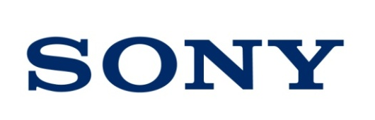





Acknowledgements
Thanks to our development partners who’ve helped us bring these innovations to the Windows platform

Slide 32
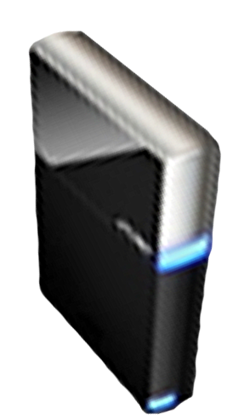


Please Complete A Session Evaluation Form Your input is important!
Visit the WinHEC CommNet and complete a Session Evaluation for this session and be entered to win one of 150 Maxtor® BlackArmor™ 160GB External Hard Drives 50 drives will be given away daily!
http://www.winhec2008.com
BlackArmor Hard Drives provided by:

Slide 33


© 2008 Microsoft Corporation. All rights reserved. Microsoft, Windows, Windows Vista and other product names are or may be registered trademarks and/or trademarks in the U.S. and/or other countries.
The information herein is for informational purposes only and represents the current view of Microsoft Corporation as of the date of this presentation. Because Microsoft must respond to changing market conditions, it should not be interpreted to be a commitment on the part of Microsoft, and Microsoft cannot guarantee the accuracy of any information provided after the date of this presentation. MICROSOFT MAKES NO WARRANTIES, EXPRESS, IMPLIED OR STATUTORY, AS TO THE INFORMATION IN THIS PRESENTATION.

