Slide 1
Windows 7 Device Experience Part 1
Max Morris
Principal Program Manager
Microsoft Corporation
Roland Ayala
Principal Program Manager
Microsoft Corporation

Slide 2
Agenda
Part 1
Device Experience Overview
Demo
Part 2
Multifunction Printer Case Study
Devices and Printers Folder
Device Stage™
Device Experience Components
Simplified Pairing
Extensibility
Portables Devices
Document Devices
Containers
Device Metadata
Distribution System
Special Considerations

Slide 3
What Is the Device Experience?
User experience features that define how people discover and use devices that are connected to
their PC
System and platform features that define how device makers present their devices and related services in Windows
Installation
Enumeration of Capabilities
Presentation and Configuration
Binding to Applications and Services

Slide 4
Addressing The Challenges
Windows 7 evolves for users and partners
Natural Device Experience
Simple installation
Prominent placement
Value for Device Partners
Broad range of business and distribution models
Service-enabled
Easy to deploy
Extensible/customizable
Clear brand association
Consistent work flow
Low/No learning curve
Easy to find support, services, and accessories
Easy to discover device capabilities
Easy to find devices

Slide 5
Addressing The Challenges
Windows evolves as a device companion
A consistent model of a device
  Multi-function nature
  Same behavior across transports and locations
Workflow
  Simplified installation and uniform pairing
  Intelligent actions when devices come and go
  Consistent with applications and the Windows system
Devices participate in Software plus Services
  Provision or update device experiences via services
  Encourage custom service/device interactions

Slide 6
Devices And Printers Folder
demo
Device Stage™

Slide 7
A Device Center For Windows
Windows 7 adds a new “Devices and Printers” folder
One place where users can see all
of their devices
Enables device-centric experiences
in Windows
A “start menu” for devices

Slide 8
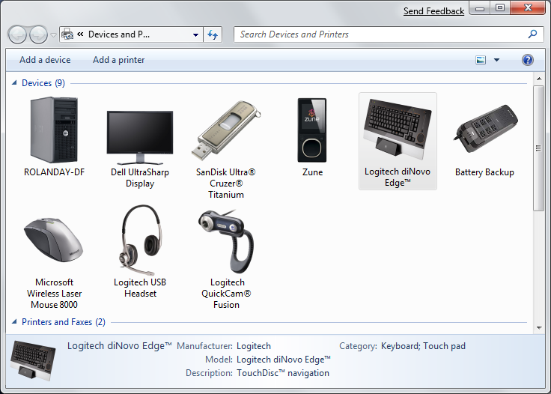
Device And Printers Folder
New folder makes it easier to find and use devices
Simplified pairing for Bluetooth, Wi-Fi, WUSB,
and more
Multifunction devices appear as one device
“Album Art” for devices enriches the user experience

Slide 9
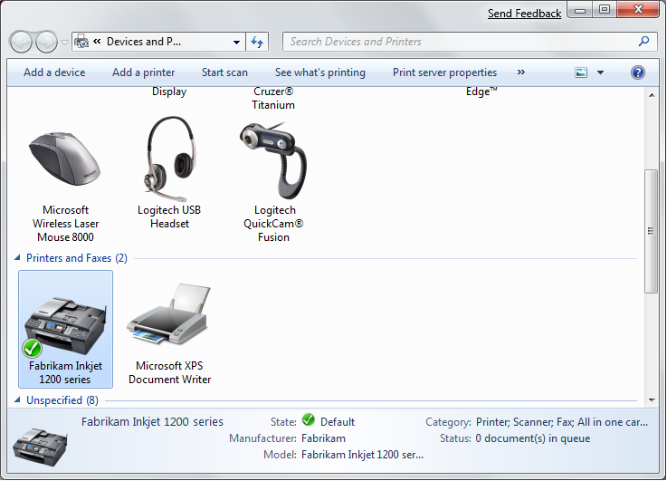
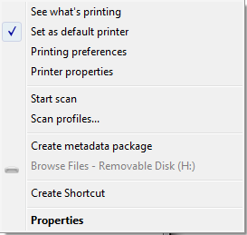
Command Bar And Context Menu
In-box Actions
Configurable Double-click Action
Extensible
Device
Properties

Slide 10
Double-Click Extensibility
Default Action
Custom Action
XML driven
Programmatic
Inbox control panel applications
Depends on supported device class interfaces
Certain supported device classes
AutoPlay replacement for portable devices
New experience for multifunction printers
Target new Windows features
Device Stage
Custom software installation
For devices not using Device Stage
Binding not related to device metadata
Extensible properties page available
Launch contextually

Slide 11
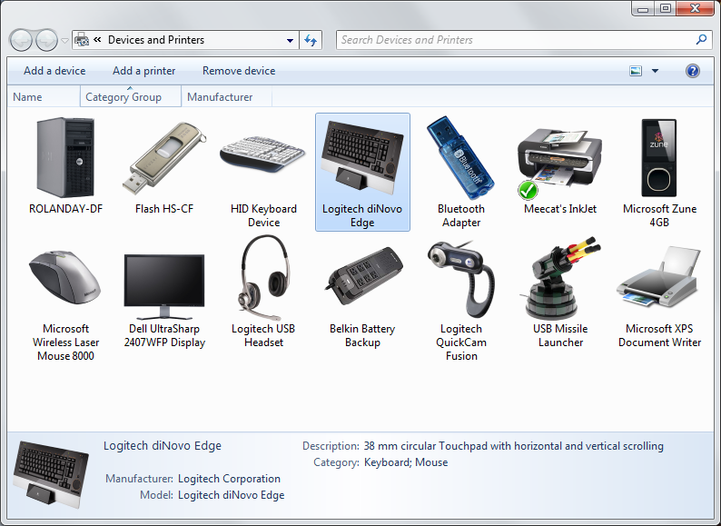
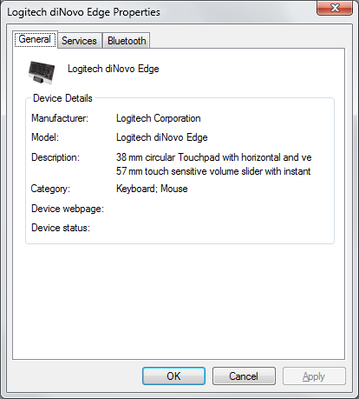
Extensible Device Properties
Additional tabs can be registered here for device management and configuration purposes

Slide 12
Property Pages
Similar registration model as default context menu
  By Model ID
  By Hardware ID
  By device interface class
Implementation
  IShellPropSheetExt

Slide 13
Portable Devices
Design Challenges
Easy out-of-box
Devices integrated with the Windows 7 Desktop
Windows 7 Innovations
One dimensional “AutoPlay”
No experience for
mobile phone
Limited branding
and customization
Limited class extensibility
End user choice
Customizable
experience platform
Mobile phone tasks including PIM sync, Ringtones, Bluetooth
New platform for enabling custom services, device
to Internet

Slide 14
Document Devices
Design Challenges
No coherent user experience
Print/Fax/Scan unified
Windows 7 Innovations
MFPs fragmented into different devices in UI
Limited product differentiation
No framework for service relationship
Difficult to include
additional value
Example: Color profiles versus driver size
One icon equals one
physical device
Differentiation through Device Stage
Branding and presentation
Support, custom
software, supplies
Service-enabling framework
Service relationships plumbed into the experience
Requires custom code

Slide 15
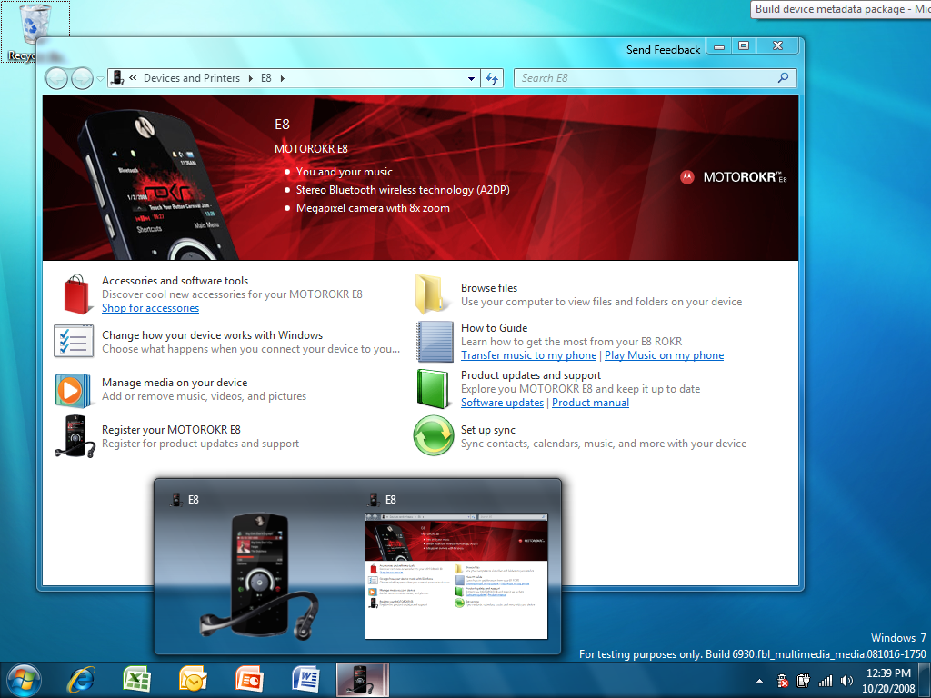
Device Stage
Branding
Tasks
Preview
Shell Icon

Slide 16

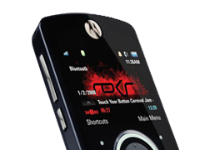


Device Stage Branding
Logo
Overlay
Background
Preview and
Shell Icon
Device Image

Slide 17
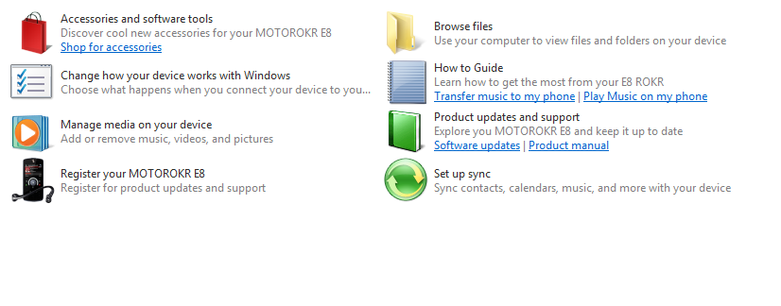
Device Stage Tasks
Tasks

Slide 18
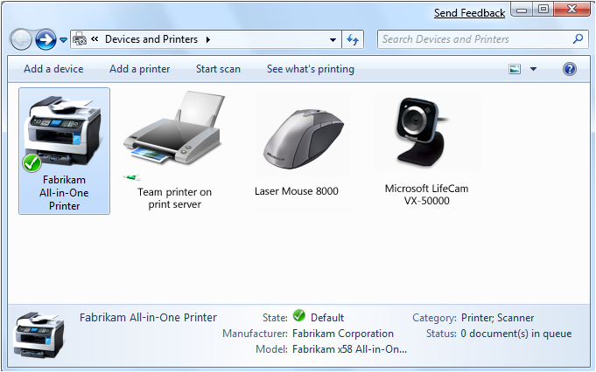
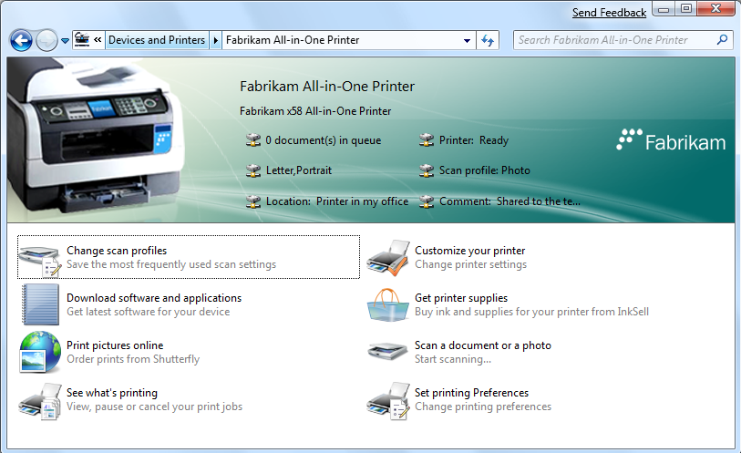
Printer Device Experience
Device Stage
Device and Printers Folder

Slide 19
Agenda For Part 2
Part 1
Device Experience Overview
Demo
Part 2
Multifunction Printer Case Study
Devices and Printers Folder
Device Stage
Device Experience Components
Simplified Pairing
Extensibility
Portables Devices
Document Devices
Containers
Device Metadata
Distribution System
Special Considerations

Slide 20
Windows 7 Device Experience Part 2
Max Morris
Principal Program Manager
Microsoft Corporation
Roland Ayala
Principal Program Manager
Microsoft Corporation

Slide 21
Agenda
Part 1
Device Experience Overview
Demo
Part 2
Multifunction Printer Case Study
Devices and Printers Folder
Device Stage™
Device Experience Components
Simplified Pairing
Extensibility
Portables Devices
Document Devices
Containers
Device Metadata
Distribution System
Special Considerations

Slide 22
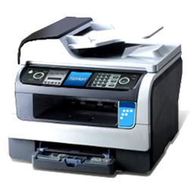
Case Study: Multifunction Printer (MFP)
… as the user sees it
Scanner
Printer
Wireless Connectivity
Fax
Removable Storage
Single "piece of plastic"

Slide 23
Printer Device Experience
Device Stage
Device and Printers Folder

Slide 24
Device Experience Components
Partner
Software
Web
Applications
Windows
Applications
Windows Features
New for
Windows 7
Device Display XML
Device Stage XML
Devices and Printers
Windows
Device Stage
Partner
Hardware
Windows Shell
Device Display Object
Portable Device
Printer
Other classes
FAX
Scanner
Function
Discovery
Device
Metadata
System
Physical Layer
(USB, Wi-Fi, Bluetooth, …)

Slide 25
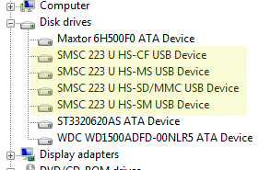
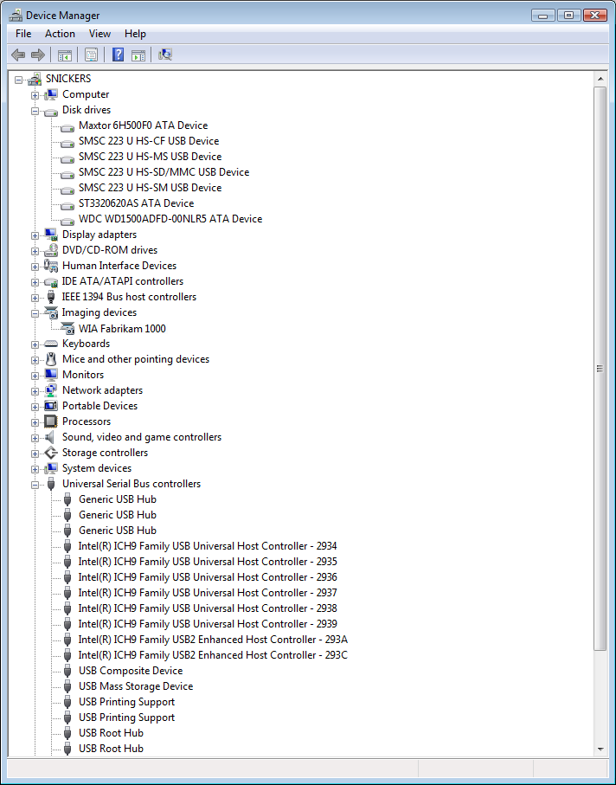
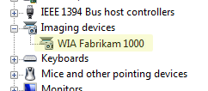

Functional View Of MFP

Slide 26
Device Containers
New PnP device property in Windows 7
Groups device functions together into a container representing the physical device
  Allows Windows to determine how
  functionality is related
  Related functionality can be presented to the user as a device
Preserves existing devnode model while providing a more natural representation
of a physical device

Slide 27
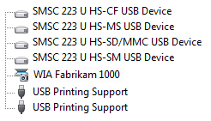
Container View Of MFP
Device Container

Slide 28
Container ID Details
Globally Unique Identifier (GUID) unique
to a physical device
All devnodes belonging to a device container on a given bus share the
same ContainerID
ContainerID is auto-generated by PnP
    Based on devnode topology and DEVICE_CAPABILITIES.Removable capability as reported by the bus driver
  Filter driver or class installer can optionally
  specify container ID

Slide 29


Which Nodes Should Report As Removable?
Declaring that a devnode is Removable indicates to PnP that the devnode is the root of a device container
    Only the root devnode should be reported as Removable
Child devnodes of the root should not be reported as Removable …
    … unless they actually represent physically detachable devices
Non-Removable child devnodes will inherit the ContainerID of their parent
Removable
Device
Root
Function
A
Not Removable
Function
B
Not Removable

Slide 30
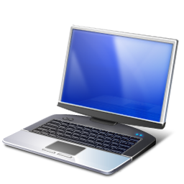
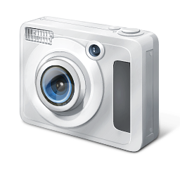
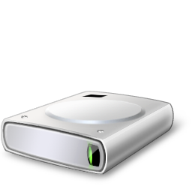
Generating Container IDs
= Non-removable node
{0000-..}
= Removable node
Root
USB Hub
MFP
{5c4d-..}
Print
Scan
USB Hub
WPD
{376a-..}
DISK
{7812..}

Slide 31







Simplified Pairing
Windows
PnP
Codename: Bluewire
Unpaired Realm
Pairing
Process
Paired = PnP Device

Slide 32
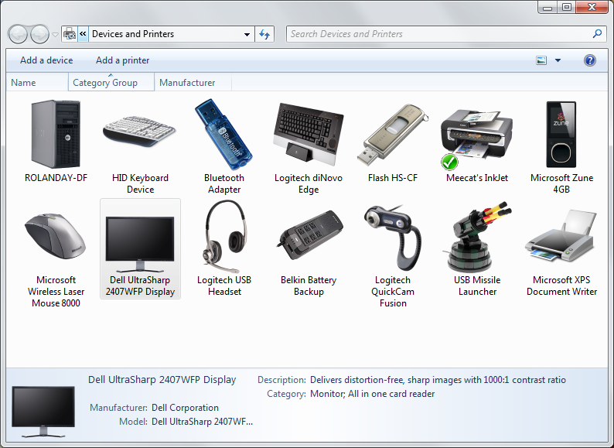
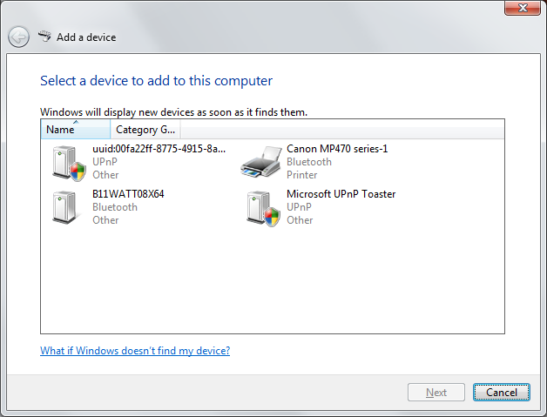
Adding Wireless And IP Devices

Slide 33
Device Metadata
Device metadata enriches how devices
are displayed by and used with Windows
  Device Display XML
    Conceptually similar to album art for music CDs
    Not required for the device to function or to be
    seen by Windows
  Device Experience XML
    Conceptually similar to a simple Web page
    Describes what you can do with the device
    from Windows

Slide 34
Device Metadata Package
PackageInfo.xml
(HWIDs, Model ID, Timestamp, Schemas, Index, and Locale)
Device Information
(DeviceInfo.xml, icon)
Windows Information
(WindowsInfo.xml)
Device Stage
Layout
(behavior.xml,
branding graphics)
Tasks
(task.xml, icons,
and commands)
Localized Resources
(resource.xml)
Localized Resources
(resource.xml)

Slide 35
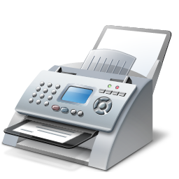
"Album Art" For Devices
Property | Value
ModelName | Fabrikam 1000 Printer
Manufacturer
ModelNumber
Categories | Printer
Description1
Description2
Property | Value
ModelName | Fabrikam 1000 Printer
Manufacturer | Fabrikam Corporation
ModelNumber | XYZ-1234
Categories | Printer, Scanner, Fax, Removable Storage
Description1 | All-in-one Inkjet Printer
Description2 | 29 ppm black and white, 19 ppm color
Without Device Metadata
(display elements)
With Device Metadata
(display elements)

Slide 36
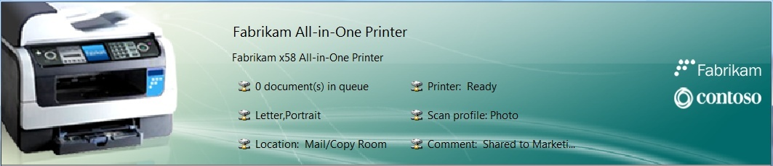
Device Stage Branding
Background and Overlay images
Device status or marketing bullets
Device image
Model name
Logo(s)
<header watermarkAlign="center" backgroundColor="#FFFFFFFF" textColor="#FF000000" backgroundImage="Background.png" watermarkImage="Overlay.png">
<modelInfo image=”Device_image.png“ />
<logos>
<logo image="logo.png" url="http://www.fabrikam.com/" tooltip="1" />
</logos>
</header>

Slide 37
Device Stage Tasks
Task name
Task description
Icon
<task id="{ec7ccfaa-8594-4376-9caf-b60c6cc9a34d}" rank="0" issueTime="2008-09-11T14:51:01Z" requiresElevation="False" name="19" description="20" tooltip="21" icon="print_queue.ico">
<requirements />
<command type="ShellExecute“>
<arguments>
<commandLine xml:space="preserve">rundll32 printui,PrintUIEntry /o /n"</commandLine>
<property fmtid="{656a3bb3-ecc0-43fd-8477-4ae0404a96cd}" pid="12288" level="Device" />
<commandLine>"</commandLine>
</arguments>
</command>
</task>

Slide 38
Associating Metadata To A Device
Metadata can be associated by
  Hardware ID
  Model ID
Use Model ID whenever possible
When using Hardware IDs, be as specific
as possible
  You don’t want your metadata being associated with all keyboards or a complete model line-up!

Slide 39
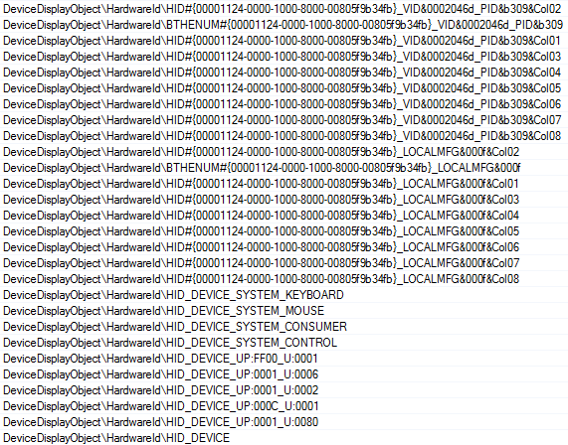
Example: By HardwareID
Choose the HardwareID that most uniquely identifies the device
More
Specific
It’s OK to pick multiple HardwareIDs if needed
Less
Specific
Too Generic

Slide 40
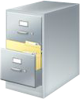




Device Metadata Distribution
Experience Authoring
Windows 7 Rendering
IHV Authors Metadata
Device Center
Device Stage
Device Metadata
Device Display Object
WinQual Submission (if necessary)
Signed Device Metadata
Metadata Distribution
WMIS
Metadata
Cache
IHV metadata on device
Device metadata service
OEM
add-ons
Device
software
installation
Metadata is acquired by PC on device connect

Slide 41
Microsoft Metadata Distribution
WinQual – for authentication
Validation – for quality
Logo required – for Device Stage quality
Signing – tamper resistant
Distribution by IHV or OEM – flexible
Distribution by WMIS
  Global scale
  Lazy caching
  User opt-in

Slide 42
Making Well Behaved Devices
Report device removable capabilities correctly
  If relying on Windows to auto-assign Container IDs
  Your multifunction device should appear as a single device in Devices and Printers
Assign descriptive names in PnP
  Not just for Device Manager anymore
  Metadata not always available
  FriendlyName out-ranks DeviceDesc and Metadata ModelName

Slide 43
What About The PC?
The computer is a device
Windows creates a ContainerID for
the computer
  Removable capability is used to group devnodes into a ContainerID for the computer
There should be only one ContainerID
for the entire PC
  Devices inside the PC need to report themselves as not Removable

Slide 44
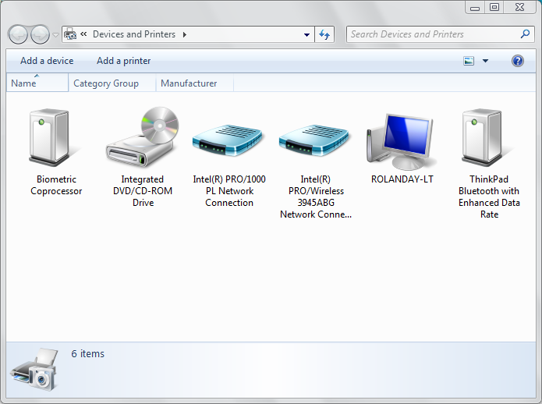
When PCs Don’t Report Removable Correctly
This laptop has nothing connected to it,
so no devices should appear (except for laptop)
These devices should not appear, but they do because they’re reported as removable

Slide 45
Hardware ID For The PC
Windows creates a Hardware ID for the PC using information in SMBIOS
SMBIOS also reports system enclosure type which is used by Windows to assign generic icon when device metadata is not available
Provide accurate information in SMBIOS

Slide 46
Additional Resources
Online Resources
  http://www.microsoft.com/whdc
Related Sessions
  CON-T531 Windows 7 Device Experience Overview
  CON-T532 Windows 7 Device Installation Experience
  CON-T533 Windows 7 Device Experience
  CON-T566 Authoring a Device Experience for Portable Devices
  CON-T567 Windows Logo Program for Portable Devices
  CON-T568 Windows 7 Device Services for Media Transfer Protocol
  CON-C648 Discussion: Windows Portable Device Enabling Kit
  CON-T571 Windows 7 Device Experiences for Multifunction Printers
  CON-T607 Windows 7 Logo Program for Print and Document Devices
  CON-C658 PC and Device IDs in Windows 7: What You Need to Know

Slide 47
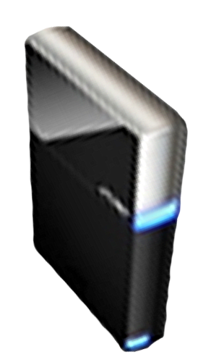


Please Complete A Session Evaluation Form
Your input is important!
Visit the WinHEC CommNet and complete a Session Evaluation for this session and be entered to win one
of 150 Maxtor® BlackArmor™ 160GB External Hard Drives
50 drives will be given away daily!
http://www.winhec2008.com
BlackArmor
Hard Drives provided by:

Slide 48


© 2008 Microsoft Corporation. All rights reserved. Microsoft, Windows, Windows Vista and other product names are or may be registered trademarks and/or trademarks in the U.S. and/or other countries.
The information herein is for informational purposes only and represents the current view of Microsoft Corporation as of the date of this presentation. Because Microsoft must respond to changing market conditions, it should not be interpreted to be a commitment on the part of Microsoft, and Microsoft cannot guarantee the accuracy of any information provided after the date of this presentation.
MICROSOFT MAKES NO WARRANTIES, EXPRESS, IMPLIED OR STATUTORY, AS TO THE INFORMATION IN THIS PRESENTATION.

