Slide 1
Bluetooth and Wireless USB in Windows 7
Kristina Hotz and Zach Little
Program Managers
Microsoft Corporation

Slide 2
Agenda
Wireless Ecosystem Status
Wireless USB update
New to Windows 7
Devices and Printers UX
Bluetooth Profile Support
Bluetooth Device Discovery and Pairing
Partner Expectations and Logo Requirements
Windows Vista
Call to Action

Slide 3


Wireless Ecosystem Status
Bluetooth penetration in the notebook sector was estimated at just over a third in 2006. Penetration
is projected to increase significantly over the next five years passing the 75% mark during 2012.
IMS Research, The Worldwide Market for Bluetooth Technology, September 2007
According to a report by Millward Brown commissioned by the Bluetooth SIG, an average 81 % of consumers
are aware of Bluetooth technology.
Bluetooth SIG press release, March 27, 2007
Bluetooth Wireless Technology is mainstream.
Microsoft’s stack is the most widely deployed Windows Vista stack.

Slide 4
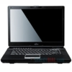
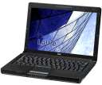
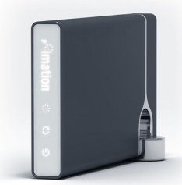
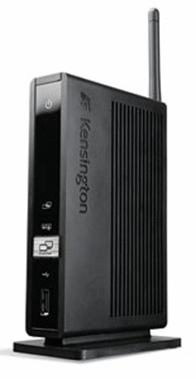
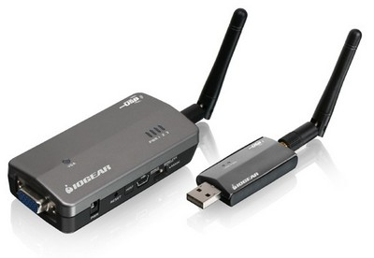
Wireless Ecosystem Status
“A number of the more capable laptop models now include native wireless USB. This represents an important step towards creation of the true wireless home office”
The Wireless Home Office (Finally) Approaches, According to ABI Research, Forbes.com

Slide 5
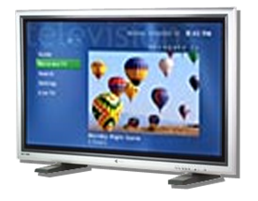
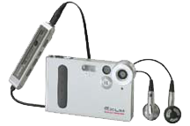
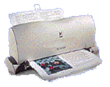

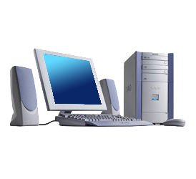

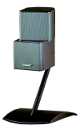

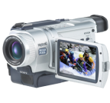



Wireless USB Overview
Up to 127 devices
USB Wire Replacement Technology
Hub-and-spoke connection relationship
Connection model is a wire replacement
Point-to-point connections
Between Certified Wireless USB host and peripheral
Certified Wireless USB Cluster
Certified Wireless USB Host with one or more peripherals (up to 127 addressable devices)
Support for legacy USB Host and Devices
Host scheduled data communications
Dual Role Devices

Slide 6
Wireless USB - Hosts
HWA (Host Wire Adapter)
USB interface to the PC
Enabler for the market
Available from many companies today
Many systems on the market today use this architecture
USB dongle or Express card form factors generally
WHCI (Wireless Host Controller Interface)
PCI interface to the PC
Enables better performance
Required interface for non-removable devices for WLP certification
Better power management
Only host type recommended by Microsoft

Slide 7
Wireless USB Ecosystem Status
First WHCI systems on the market today
Logo requirement goes active June 2009 requiring WHCI for internal system radios*
Market is still predominately HWA
Starting to see an influx of native WUSB devices
VGA-Wireless USB adapters
Docking stations
Native hard drives
What the ecosystems needs to succeed
More WHCI systems
Add-on WHCI cards available
Wide availability of native devices, improved interoperability, better performance, single worldwide SKU
Some great progress since last year’s WinHEC!
DWAs widely available
WHCI solutions available from multiple companies
*Microsoft is interested in hearing feedback on this requirement

Slide 8
WUSB Ecosystem Expectations
Microsoft needs to see shipping Wireless USB solutions
OEMs
Ship systems with WHCI host controllers
Test with Windows 7 early and often– Help us reduce or eliminate need for QFEs!!
IHVs
WHCI add-on cards are needed to help seed market
As host penetration increases, focus on device solutions instead of host-device pairs
Silicon Partners
Ensure your latest hardware (including PHYs) are in Microsoft’s labs
Participate in Wireless USB 1.1 spec development
Make sure your hosts and devices are all compliant with the Windows Logo Program requirements
Regardless of Microsoft shipping a stack, there will still be a Wireless USB logo program

Slide 9
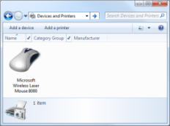


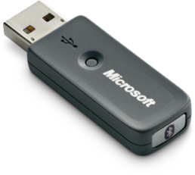
New To Windows 7
Bluetooth Integration into Devices and Printers UX
Windows 7 Device Experience Overview - CON-T531
Windows 7 Device Experience - CON-T533
In-Box support for Bluetooth Audio
Building a Bluetooth Audio Device in Windows 7 - CON-T564
Bluetooth v2.1 Support
Improved Power Management
Bluetooth radio can enter Selective Suspend while connections are in sniff mode
USB Class Match for Bluetooth Dongles
In-box support for 100% of Bluetooth dongles

Slide 10
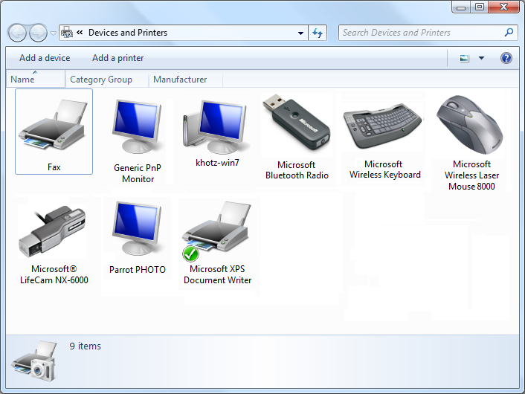
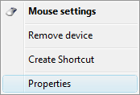
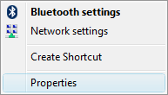
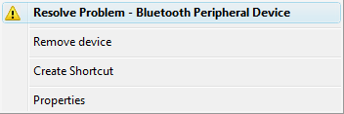
Devices And Printers
Collecting point for all devices
Device Stage for Windows Portable Devices (WPD)
Pairing Wizard Launch Point
Problem resolution entry point
Customizable context menus
Photorealistic icons

Slide 11
Devices And Printers
Collecting point for all devices
Device Stage for Windows Portable Devices (WPD)
Pairing Wizard Launch Point
Problem resolution entry point
Customizable context menus
Photorealistic icons

Slide 12
Inbox Bluetooth Profile Support
A2DP
Handsfree
Windows 7
Headset
AVRCP
HID
Serial Port
OPP
Windows
Vista
PAN
DUN
HCRP

Slide 13
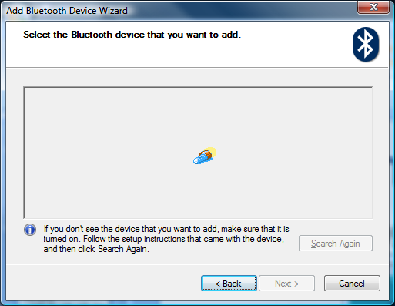
Device Discovery

Slide 14
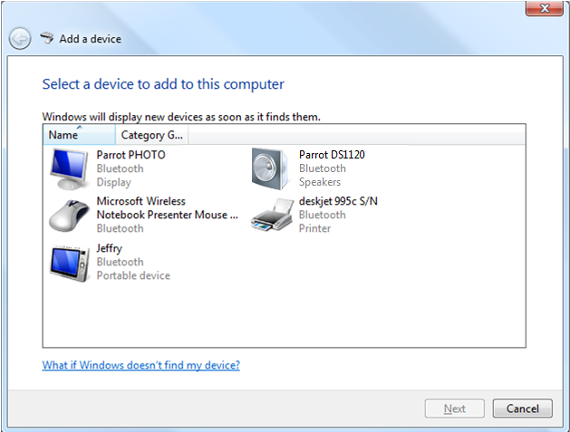
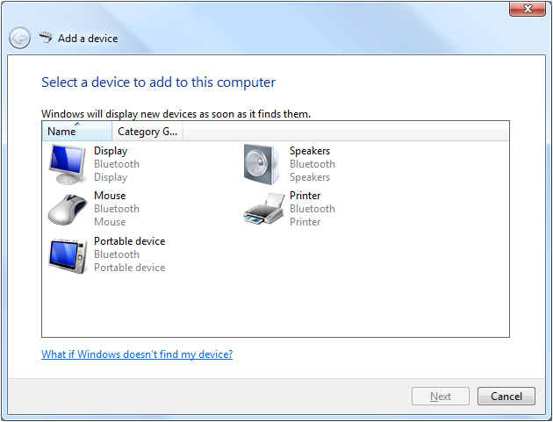
Device Discovery
Step 2: Name Discovery
Step 1: Inquiry

Slide 15
Extended Inquiry Response
Bluetooth v2.1’s Extended Inquiry Response (EIR) can combine steps 1 and 2
EIR Packet can provide, Local Name (Bluetooth Device Name), Service Class UUIDs, TX Power Level, Device ID, or Manufacturer Specific Data
Microsoft Windows uses EIR to supply its Bluetooth Device Name and to fetch Bluetooth Device Names

Slide 16
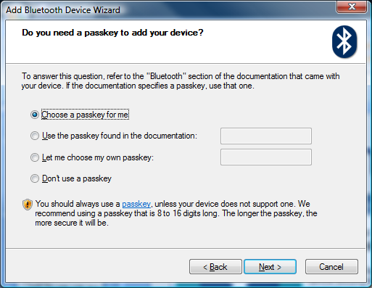
Pairing In Windows Vista SP1

Slide 17
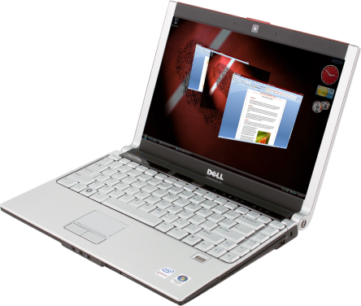
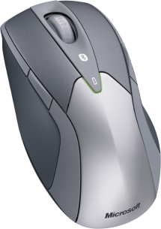
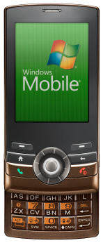
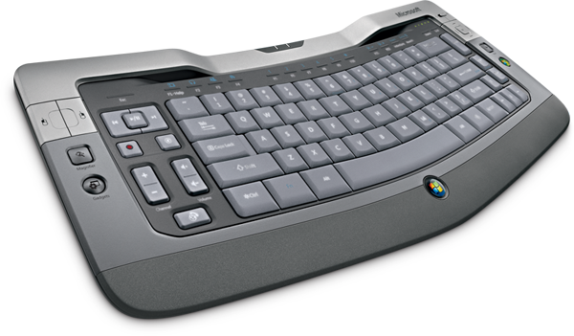
Pairing In Windows 7
What’s the Bluetooth Device Class?
Loudspeaker, Headphones, Headset, etc. 0000
Pointing Device No Passkey
Phone Generated PIN
Computer Generated PIN
Keyboard Generated PIN
Display 0000
What about the exceptions?

Slide 18
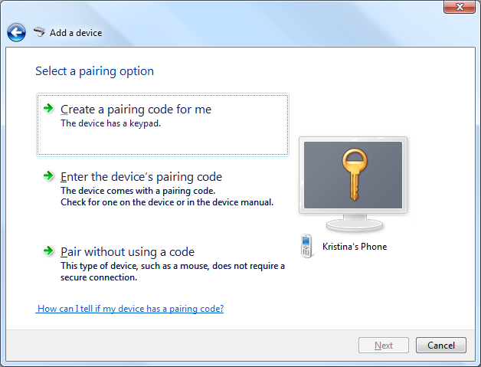
The Exceptions

Slide 19
Pairing With a v2.1 Device
Always Pair
Correctly

Slide 20
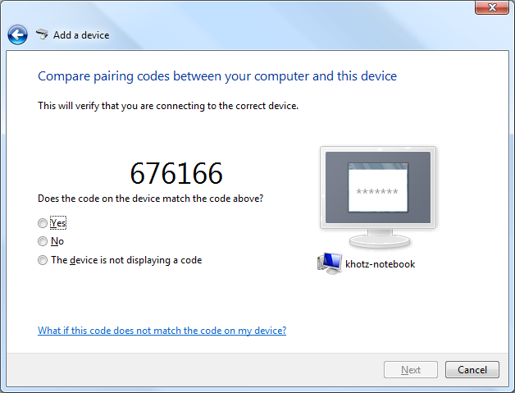
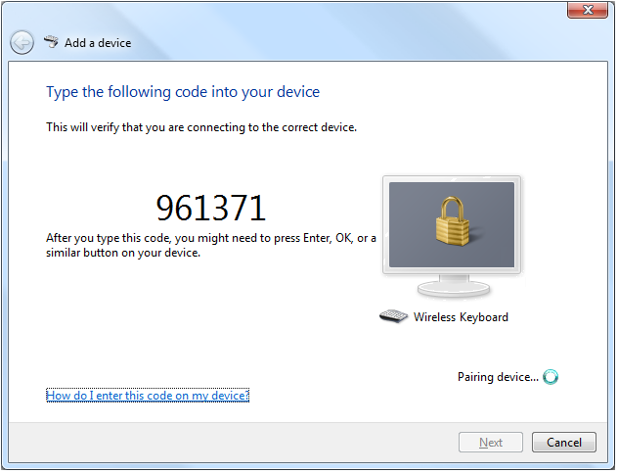
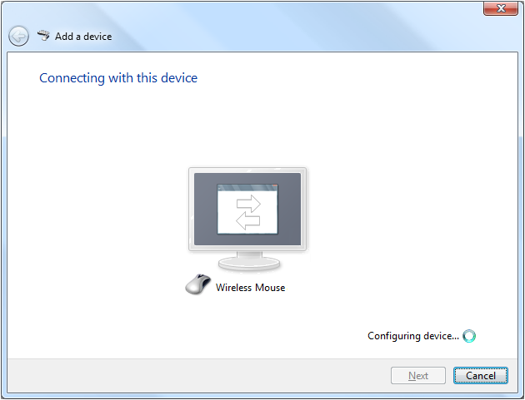
Pairing With A 2.1 Device
Does it have a display?
Does it have a keyboard?
Numeric Compare
Passkey
Just Works
Yes
No
Yes
No

Slide 21
Logo Requirements
Bluetooth v2.1 will be required as of June 2009
Device ID Profile is already required. It enables Microsoft Windows to determine
Vendor ID
Product ID
Version

Slide 22
Down-Level Support For v2.1?
Yes!

Slide 23
Windows Vista Feature Pack For Wireless
Bluetooth v2.1 Specification
July 2007
Windows Vista Feature Pack for Wireless
July 2008
Windows Vista SP2
Windows 7

Slide 24
Call To Action
Use the Devices and Printers UX
Create a metadata package
For Bluetooth, implement Device ID Profile
Logo your devices
Upgrade your Bluetooth radio to v2.1
Consider adding Wireless USB to your platforms
Ensure your devices and systems meet WLP requirements
Test with us

Slide 25
Additional Resources
Related Sessions
CON-C656 - Discussion: 1394, Wireless USB, and Bluetooth
CON-P578 - Panel: Wireless Personal Area Network
Devices Experience
CON-T531 - Windows 7 Device Experience Overview
CON-T533 - Windows 7 Device Experience
CON-T576 - Unifying the Wireless and Network Device Installation Experience in Windows 7
CON-C658 - PC and Device IDs in Windows 7: What You Need to Know
CON-C649 - Discussion: Device Center, Bluewire, and Device Installation
Audio
CON-T564 - Building a Bluetooth Audio Device in Windows 7
CON-T565 and CON-C663 - Audio Design for Unified Communications
CON-C664 - Windows 7 Logo Program for Audio and Communications

Slide 26
Additional Resources
Web Resources
Specs
http://www.bluetooth.org
http://www.usb.org
Whitepapers
http://www.microsoft.com/whdc/connect/wireless/default.mspx
Other Resources
http://www.microsoft.com/whdc/
http://www.bluetooth.com
Email addresses
Bluetooth:
Wireless USB:
bthfb@microsoft.com
wusbbeta@microsoft.com

Slide 27
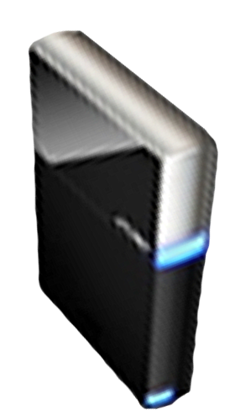


Please Complete A Session Evaluation Form Your input is important!
Visit the WinHEC CommNet and complete a Session Evaluation for this session and be entered to win one of 150 Maxtor® BlackArmor™ 160GB External Hard Drives 50 drives will be given away daily!
http://www.winhec2008.com
BlackArmor Hard Drives provided by:

Slide 28


© 2008 Microsoft Corporation. All rights reserved. Microsoft, Windows, Windows Vista and other product names are or may be registered trademarks and/or trademarks in the U.S. and/or other countries.
The information herein is for informational purposes only and represents the current view of Microsoft Corporation as of the date of this presentation. Because Microsoft must respond to changing market conditions, it should not be interpreted to be a commitment on the part of Microsoft, and Microsoft cannot guarantee the accuracy of any information provided after the date of this presentation. MICROSOFT MAKES NO WARRANTIES, EXPRESS, IMPLIED OR STATUTORY, AS TO THE INFORMATION IN THIS PRESENTATION.

