Slide 1
USB Technology
Update And Windows Connectivity Strategy
Lars A. Giusti
Senior Program Manager
Microsoft Corporation
Jeff Ravencraft
President and Chairman
USB-Implementers Forum

Slide 2
Agenda
USB As A Bus Technology
Windows 7 USB Key Investments
USB Windows Logo Kit Changes
Hi-Speed USB (USB 2.0) EHCI Extensions
SuperSpeed USB (USB 3.0) xHCI
Windows Planning For SuperSpeed USB
USB 3.0 Considerations In Windows Support By OS
A Word From Our Partner: USB-IF Inc.
  USB Yesterday, Today, and Tomorrow
Call To Action

Slide 3
USB As A Bus Technology
Universal Serial Bus is the most pervasive and
successful bus technology ever!
  Available on all PCs today
  Standard connectivity interface for most devices
  Covers a large variety of classes of devices
Users love Universal Serial Bus
  Easy to use
  Hot pluggable
  Wide range of supported Windows inbox class drivers
  Durable and reliable connectors\recepticles
  Simple and low cost

Slide 4
USB In Windows 7

Slide 5
Continuing To Build On USB
Windows 7 Key Investments
Event Tracing For Windows
  First time for instrumentation\logging of USB events and
  error states in ETW
  Solves the issue of complexity in diagnosing USB problems
  Caveat: Capture and ordering of events is subject to change
Minidumps
  New minidumps make debugging a crash more efficient
  We use minidumps to improve the stability of the USB
  stack in Windows

Slide 6
Windows 7 Selective Suspend With USB ETW Events
Device A
active
active
suspended
suspended
0
10
20
30
40
50
60
time
Rundown Events
Tracing Stops
Device B
active
0
10
20
30
40
50
60
time
Start ETW tracing, enable USB ETW events
Monitor USB ETW events for some amount of time (e.g., 60 seconds)
Rundown event includes initial device suspend state
Real-time events include suspend state change information
Analysis can detect
  Percentage of time a device was suspended
  If a device never suspended

Slide 7
Windows 7 Key USB Investments
Timer coalescing
I/O transfer performance optimizations
Improvements to overall system stability
Selective Suspend (SS) fine tuning
  Vista suspends of ALL hubs behind a HC at the same time
  New in Windows 7
    Individually suspend hubs

Slide 8
USB Inbox Class Drivers That Support Selective Suspend
USB DEVICE CLASS | SS SUPPORT IN XP | SS SUPPORT IN VISTA | SS SUPPORT IN WIN7
USB HID Class | YES | YES | YES
USB Audio Class | NO | NO | YES
USB Video Class | NO | YES | YES
USB MTP Class | NO | NO | YES
USB Smart Card Class | NO | NO | YES
WPAN: Bluetooth Radio Class | NO | YES | YES
USB Scanner Class | NO | NO | YES
WinUSB | NO | YES | YES
USB Biometric Class | NO | NO | YES
USB Sideshow | NO | YES | YES
USBHUB | NO | YES | YES
USBCCGP | NO | YES | YES

Slide 9
Gathering Windows 7 USB Data Using C.E.I.P.
Customer Experience Improvement Program
  If users choose to participate we will collect data
    Power Management settings and capabilities
    Hardware configuration and trends
    USB registry settings used
Windows product group gets answers to many of our top USB business questions (for example)
  What USB devices are on the system?
  What are the speeds of those USB devices on the system?
  What are the most common USB device classes and models?
  What USB devices support selective suspend?

Slide 10
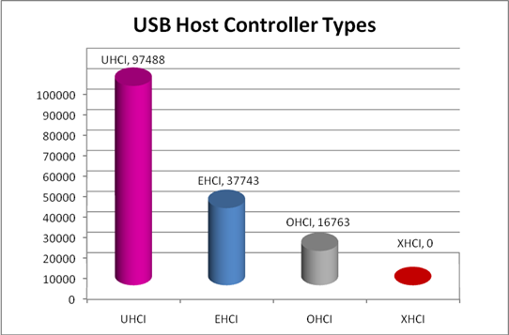
Sample USB Windows 7 CEIP Report
Collection of Windows 7 USB allows us to spot hardware trends early on
CEIP is completely voluntary
and anonymous
SAMPLE DATA ONLY

Slide 11
USB In Windows
Logo Kit Version 1.3

Slide 12
New USB Requirements For WLK 1.3
3 new tests for devices and systems
  System Power State Test
    Loops through all system-supported power states and checks that all host controllers and devices are present after resume
  USB Host Controller Disable Enable Test
    Disables all USB host controllers and connected USB devices on the system
    and then re-enables each host controller and its attached devices, individually checking that all devices that were initially present are still present
  USB Host Controller Selective Suspend Test
    Validates that the device supports IDLE in its driver
1 (if-implemented) device requirement for the new Container ID descriptor in Microsoft OS descriptor
    Will be part of the Microsoft OS Descriptor Test in the USB Descriptor Test
    All 4 new requirements are effective June 1, 2009

Slide 13
WLK 1.3 USB Changes
USB Device tests are now part of the system kit
  Tests will now run as part of system certification
USB device tests are now run as part of
the Unclassified program

Slide 14
WLK And USB-IF Logo Compliance
USB-IF Logo Compliance
  In the past, Windows Logo kit replicated USB-IF CV tests (USB-IF logo compliance was implied)
  All USB devices have to meet
  USB-IF compliance
  USB-IF specification will be referenced in our WLK .CHM and online help documents
  Requirement effective June 1, 2010

Slide 15
Hi-Speed USB (USB 2.0)
Enhanced Host Controller Interface (EHCI)

Slide 16
USB 2.0 EHCI Extensions
Intel has released EHCI version 1.1 Extensions
  Link Power Management
  Per Port Change Events
  Shorter Periodic Frame List
  Hardware Prefetching
There is no planned support for these Intel
ECN’s for EHCI in Windows 7
Reference
  http://download.intel.com/technology/usb/EHCIv1-1_Addendum.pdf

Slide 17
SuperSpeed USB (USB 3.0) And Extensible Host Controller Interface (xHCI)

Slide 18
SuperSpeed USB (USB 3.0)
Microsoft intends to deliver Windows support for hardware that is compliant with the xHCI specification; this is a huge step forward in enabling the industry and our customers to easily connect SuperSpeed USB devices to their PCs for exciting new functionality and usages
Extensible Host Controller Interface (xHCI) provides a standardized method for USB 3.0 host controllers to communicate with the USB 3.0 Windows driver stack
Intel’s xHCI draft specification supports compatibility among various implementations of USB devices and will make it easier to develop software support for the industry
Microsoft has developed driver support for the USB industry standard since its inception and is committed to supporting the latest hardware technologies on the Windows platform

Slide 19
Windows SuperSpeed USB (USB 3.0) Planning
Windows SuperSpeed USB Support
The USB 3.0 specification has not been ratified yet
by the USB 3.0 Promoters Group
There is no SuperSpeed USB hardware available to test and develop on
Microsoft is targeting this support in a post
Windows 7 deliverable
Windows SuperSpeed USB Dependencies
  Sign off of the specification
  Hardware availability
  Time to develop the new driver stack

Slide 20

USB 3.0 Industry Timelines And Milestones
2007
2008
2009
2010
USB 3.0 Specification
Sign Off
Broad Industry
Deployment
and Availability
Forming
Promoters
Group
Standards
Development
Product
Development
Initial
Deployment
Broad
Deployment
Prototyping
Feature Development
Feature Deployment
Necessary Software Timeline
SUBJECT TO CHANGE

Slide 21
Considering USB 3.0 Support In Windows (By OS)
We are currently looking at which Operating Systems we want to support
this technology on
Input from our partners indicates you would like us to consider supporting it on Windows Vista and newer
After the USB 3.0 specification is signed off we will provide you with a list of supported Windows Operating Systems

Slide 22
SuperSpeed USB (USB 3.0) Key Messages
SPEED
  Delivers over 10x performance increase
  PHY signal rate of 5 Gbps
POWER MANAGEMENT
  Eliminates the polling from a host
  controller perspective
  SuperSpeed USB protocol will allow device
  initiated transfers for power efficiency
COMPATABILITY
  Backwards compatibility with Hi-Speed USB (USB 2.0)

Slide 23
USB-Implementers Forum
partner
Jeff Ravencraft
President And Chairman, USB-IF

Slide 24

USB Historical Perspective
USB is the most successful peripheral interface in the history of PC
USB has migrated into CE and Mobile market segments
Device charging over USB has become a major consumer benefit/feature
The USB Installed base is over 6 billion units and growing at 2+ billion units a year
Adoption virtually 100% in most PC and peripheral categories

Slide 25


Slide 26
The Need For SuperSpeed USB
Flash-based peripherals will require much higher data rates
  Digital cameras and camcorders
  Flash memory drives (USB thumb sticks, and cards)
  Flash-based digital MP3 and video players
  PC, Mobile, Handheld PCs and smart phones (SSD’s)
User wait time requirement, 1½ minutes to synchronize
Interface performance sets the requirement
  Your connectivity is only as fast as your memory
 | Song / Pic | 256 Flash | USB Flash | SD-Movie | USB Flash | HD-Movie
 | 4 MB | 256 MB | 1 GB | 6 GB | 16 GB | 25 GB
USB 1.0 | 5.3 sec | 5.7 min | 22 min | 2.2 hr | 5.9 hr | 9.3 hr
USB 2.0 | 0.1 sec | 8.5 sec | 33 sec | 3.3 min | 8.9 min | 13.9 min
USB 3.0 | 0.01 sec | 0.8 sec | 3.3 sec | 20 sec | 53.3 sec | 70 sec
Source: USB-IF

Slide 27
SuperSpeed USB (USB 3.0)
Industry Engagement Update
USB 3.0 Promoter Group formed September 2007
USB 3.0 Promoters issued call for Contributors November 2007
  To date 200+ Companies have joined as USB 3.0 Contributors
  USB 3.0 Contributor participation
  level is closed
USB 3.0 Adoption level begins when final specification is released
  ETA on Final 1.0 is estimated to be Q4’08
  Legally joined with Promoters/Contributors with an adopter agreement
USB-IF manages logos, compliance testing, marketing and promotion

Slide 28







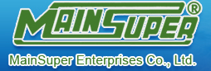














































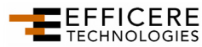















































































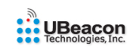























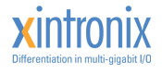



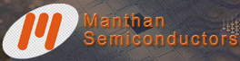


USB 3.0 Promoters and Contributors
Nanoforti
SigmaTel, Inc.
USBest Technology Inc.
Wuxi AlphaScale IC Systems, Inc.

Slide 29
SuperSpeed USB Summary
SuperSpeed USB – The next advancement in Ubiquitous Technology
SuperSpeed USB Industry Engagement is well underway
Attend the First SuperSpeed USB Developers conference November 17 and 18 in San Jose, CA info at www.usb.org

Slide 30
Call To Action
Test your USB devices and systems w\Windows 7
Give us feedback on USB functionality or performance
on Windows 7
Test USB and evaluate new USB test using Windows Logo Kit Version 1.3
Share your USB product plans with our team,
schedule time with us
Submit and pass your devices with USB-IF and
Windows Logo tests
Build your PCs with only USB devices that pass USB-IF
and Windows Logo tests

Slide 31
Additional Resources
USB additional resources and information
Web resources
  USB-IF: http://www.usb.org/home
  CEIP: http://www.microsoft.com/products/ceip/EN-US/default.mspx
  General: http://www.microsoft.com/whdc/connect/usb/usbfaq_intro.mspx
  USB 2.0 and Windows: http://www.microsoft.com/whdc/connect/usb/usb2support.mspx
  Windows USB Driver Stack: http://www.microsoft.com/whdc/connect/usb/usb2support.mspx#EUB
  USB and Windows Device Connectivity
    http://www.microsoft.com/whdc/connect/usb/default.mspx
  EHCI Intel
    http://download.intel.com/technology/usb/EHCIv1-1_Addendum.pdf
  xHCI Intel
    http://www.intel.com/technology/usb/xhcispec.htm
Related sessions
  Improving Platform Energy Efficiency (Sharif Farag)
Email address for questions
  USBCORE@MICROSOFT.COM

Slide 32
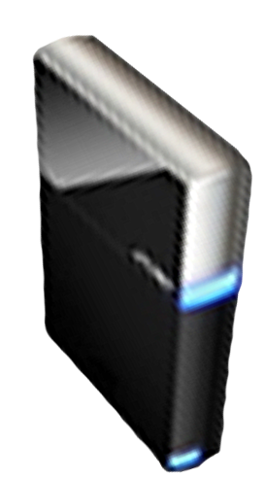


Please Complete A Session Evaluation Form
Your input is important!
Visit the WinHEC CommNet and complete a Session Evaluation for this session and be entered to win one
of 150 Maxtor® BlackArmor™ 160GB External Hard Drives
50 drives will be given away daily!
http://www.winhec2008.com
BlackArmor
Hard Drives provided by:

Slide 33


© 2008 Microsoft Corporation. All rights reserved. Microsoft, Windows, Windows Vista and other product names are or may be registered trademarks and/or trademarks in the U.S. and/or other countries.
The information herein is for informational purposes only and represents the current view of Microsoft Corporation as of the date of this presentation. Because Microsoft must respond to changing market conditions, it should not be interpreted to be a commitment on the part of Microsoft, and Microsoft cannot guarantee the accuracy of any information provided after the date of this presentation.
MICROSOFT MAKES NO WARRANTIES, EXPRESS, IMPLIED OR STATUTORY, AS TO THE INFORMATION IN THIS PRESENTATION.

