Slide 1
Building Great Communications Devices in Windows 7
Rian W. Chung
Program Manager
Microsoft Corporation

Slide 2
Agenda
Overview of Windows 7
Sound Improvements
  Building devices for the communication role
  Multiple device experience
Logo Improvements

Slide 3
Sound Improvements In Windows 7
Communications
  Device Roles
  Stream Routing
  Automatic Stream Attenuation
  Lower latency audio engine
  Bluetooth audio support
Multiple devices
  HID control update
  UX Control

Slide 4
Sound Improvements In Windows 7
Communications
  Device Roles
  Stream Routing
  Automatic Stream Attenuation
  Lower latency audio engine
  Bluetooth audio support
Multiple devices
  HID control update
  UX Control

Slide 5
Device Roles
Device Roles
  Communications
  Non-Communications
Specifying a Role
  INF
  Device Form Factor

Slide 6
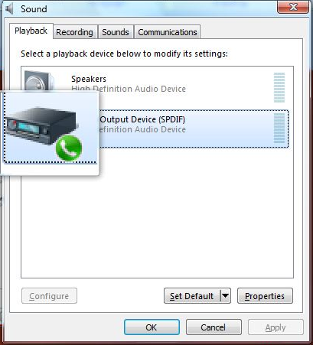
Device Endpoints

Slide 7
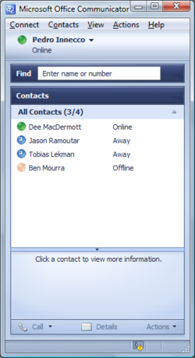

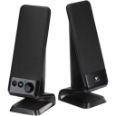


Application asks for preferred communication device
System Communication Default Device

Slide 8
How To Become The
Default Communications Device
Using an INF
Device form factor
Communication device order
  User
  Inf
  OEM
  System

Slide 9
Sound Improvements In Windows 7
Communications
  Device Roles
  Stream Routing
  Stream Attenuation
  Lower latency audio engine
  Bluetooth audio support
Multiple devices
  HID control update
  UX Control

Slide 10
Stream Routing
Audio streams follow the default endpoint (and default communications endpoint)
How does this interact with my device?

Slide 11
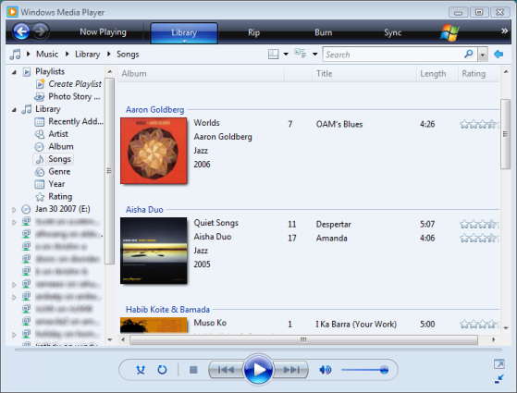

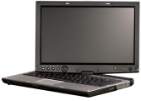

System Default Device
Dynamic Stream Management
Wave API
Dsound API/Dshow API
Media Foundation API
Integrated HD Audio Class Driver
Bluetooth Audio Class Driver
Rank 2
Rank 1

Slide 12
System Default Device
Dynamic Stream Management
Wave API
Dsound API/Dshow API
Media Foundation API
User connects Bluetooth Headset
Integrated HD Audio Class Driver
Bluetooth Audio Class Driver
Rank 2
Rank 1

Slide 13
Sound Improvements In Windows 7
Communications
  Device Roles
  Stream Routing
  Automatic Stream Attenuation
  Lower latency APIs
Multiple devices
  HID control update
  UX Control

Slide 14
Automatic Stream Attenuation/Ducking
What is ducking
What do I need to know about ducking

Slide 15
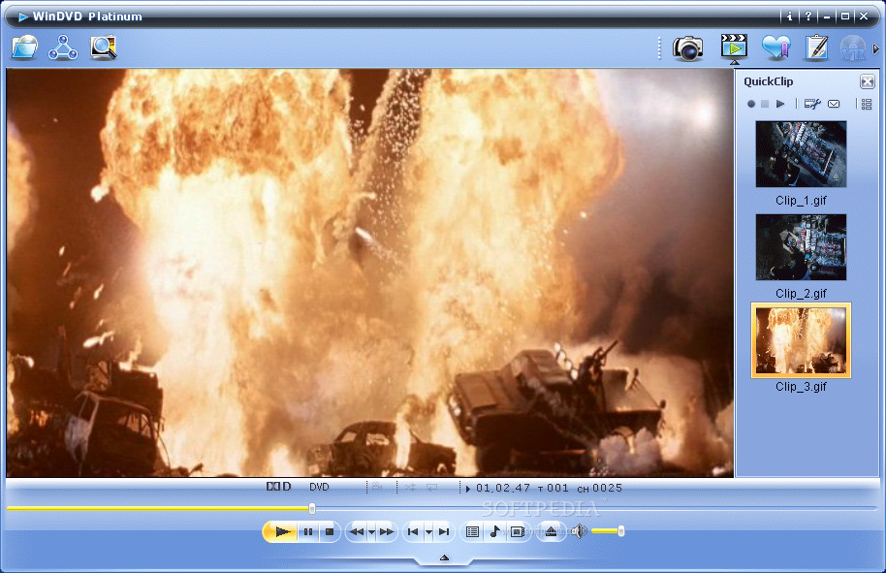
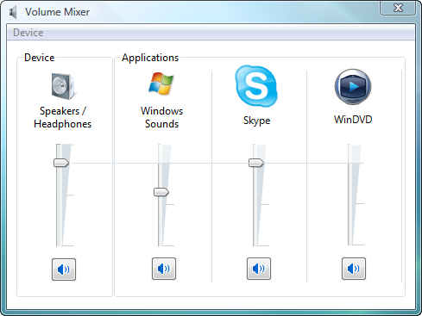
Watching a movie

Slide 16

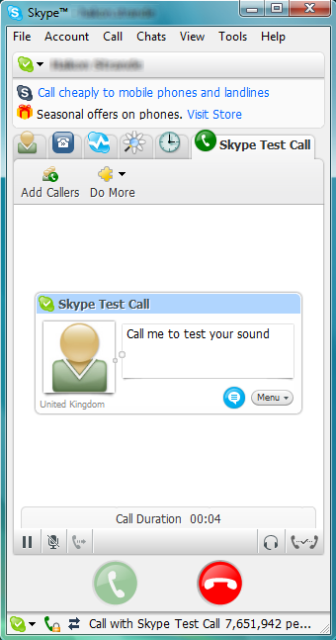
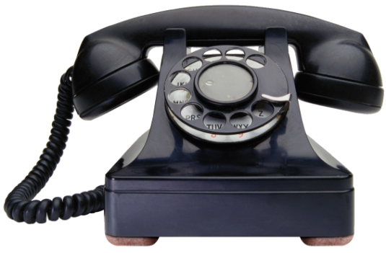
The volume of the movie soundtrack automatically lowers…

Slide 17
Sound Improvements In Windows 7
Communications
  Device Roles
  Stream Routing
  Automatic Stream Attenuation
  Lower latency audio engine
Multiple devices
  HID control update
  UX Control

Slide 18
Lower Latency Sound
Device drivers can enable
pull mode audio engine
OEMs may set periodicity
for improved latency or power

Slide 19
OEM Periodicity INF Entry
Specify PKEY_AudioEngine_OEMPeriod for a custom periodicity
The value is specified as VT_BLOB
Must in the range 50000-90000 (5-9ms) on even 10000 HNSTIME unit boundaries (i.e. 50000, 60000, 70000, 80000 or 90000)
PKEY_AudioEngine_OEMPeriod = "{E4870E26-3CC5-4CD2-BA46-CA0A9A70ED04},6"

Slide 20
Sound Improvements In Windows 7
Communications
  Device Roles
  Stream Routing
  Stream Attenuation
  Lower latency audio engine
  Bluetooth Audio Support
Multiple devices
  HID control update
  UX Control

Slide 21
Bluetooth Audio Support
Windows 7 support
Bluetooth audio natively
Please attend “Designing Bluetooth
Audio Devices for Windows 7”
for more information

Slide 22
Multiple Devices In Win7
Improved Device control
  HID volume controls are
  now associated to the device
  Unassociated volume controls
  control the default device
Improved UI
  Volume Fly-out

Slide 23
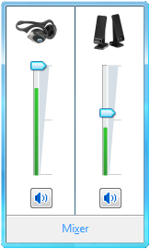
Volume Control UI

Slide 24
Logo Improvements
What is the communications device logo
For more logo information please
attend the chalk talk

Slide 25
Call To Action
Choose a role for your device
Include pull-mode support
in your device and drivers
Think about the logo

Slide 26
Additional Resources
Sessions
  Building Bluetooth audio
  devices for Windows 7
  Audio design for unified communications
Chalk Talks
  Logo improvements for sound devices
  Audio design for unified communications

Slide 27
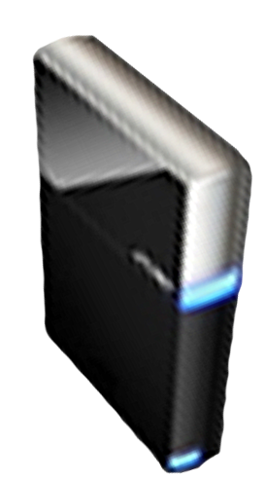


Please Complete A Session Evaluation Form
Your input is important!
Visit the WinHEC CommNet and complete a Session Evaluation for this session and be entered to win one
of 150 Maxtor® BlackArmor™ 160GB External Hard Drives
50 drives will be given away daily!
http://www.winhec2008.com
BlackArmor
Hard Drives provided by:

Slide 28

© 2008 Microsoft Corporation. All rights reserved. Microsoft, Windows, Windows Vista and other product names are or may be registered trademarks and/or trademarks in the U.S. and/or other countries.
The information herein is for informational purposes only and represents the current view of Microsoft Corporation as of the date of this presentation. Because Microsoft must respond to changing market conditions, it should not be interpreted to be a commitment on the part of Microsoft, and Microsoft cannot guarantee the accuracy of any information provided after the date of this presentation.
MICROSOFT MAKES NO WARRANTIES, EXPRESS, IMPLIED OR STATUTORY, AS TO THE INFORMATION IN THIS PRESENTATION.

