Slide 1
Building a Bluetooth Audio Device In Windows 7
Jerry D. Smith
Senior Program Manager
Microsoft Corporation

Slide 2
Agenda
Introduction
Features
  Audio Profiles
  Controls
Architecture
Design/Logo Considerations
Call to Action

Slide 3
Introduction
This year
  1 billion Bluetooth enabled products
  35% of laptops will be Bluetooth enabled
  120 million headsets/stereo headphones
Segment | 2006 | 2007 | 2008 | 2009 | 2010 | 2011 | 2012 | CAGR
Total Mobile PCs | 84,100 | 114,850 | 132,538 | 162,958 | 202,746 | 234,612 | 257,942 | 17.6%
% w/ Bluetooth | 37.2% | 32.1% | 34.8% | 37.5% | 38.9% | 40.1% | 40.5%
Bluetooth PCs | 31,300 | 36,900 | 46,123 | 61,109 | 78,868 | 94,079 | 104,467 | 23.1%
Growth % | 41.0% | 17.9% | 25.0% | 32.5% | 29.1% | 19.3% | 19.9%
Bluetooth Mono/Stereo Headsets | 54,260 | 91,476 | 118,826 | 148,209 | 174,991 | 189,176 | 200,083 | 18.0%
Growth % | 52.1% | 68.7% | 30.4% | 27.4% | 19.1% | 8.6% | 6.3%
Source: In-Stat, 7/08

Slide 4

Bluetooth Audio Support
Bluetooth audio drivers are being
added to the Universal Audio
Architecture (UAA) in Windows 7
  Provide a class driver experience
  for Bluetooth audio peripherals
  Join HD Audio and USB Audio
  as class options for UAA

Slide 5
Key Goals
Make Bluetooth audio devices first class participants in Windows audio scenarios
  Support audio playback and recording
  Support call and AV transport controls
  Participate in new audio scenarios
    Automatically route audio streams as devices arrive and depart
    Automatically duck music to handle VoIP communications
      CON-T563: Building a Communication Device in Windows 7

Slide 6
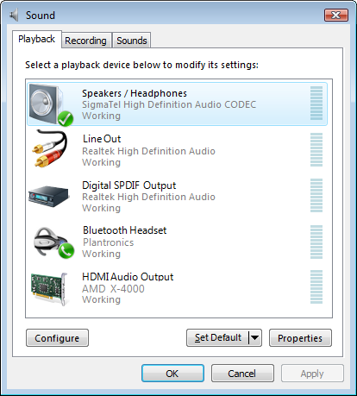
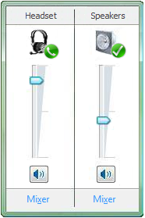


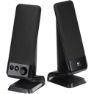
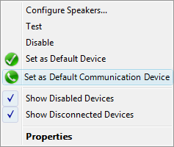
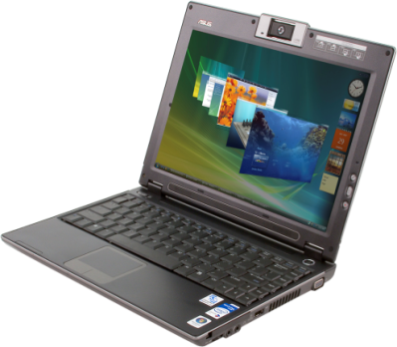


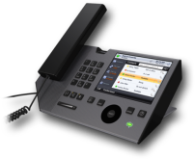
Audio & Communications
Windows 7 supports two types of default audio devices
  Default ( )
  Default Communication ( )

Slide 7
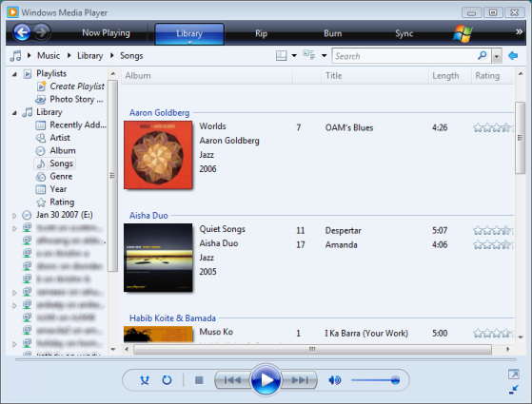

Stream Routing
Default Audio devices are automatically switched when devices arrive or depart

Slide 8

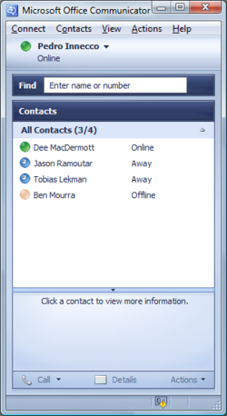
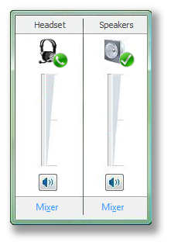
Communications
Communication applications can automatically turn down audio for voice

Slide 9
Features
Supported Audio Profiles
  Hands-Free/Headset (HF/HS)
  Advanced Audio
  Distribution Profile (A2DP)
  Audio/Video Remote
  Control Profile (AVRCP)

Slide 10
Features (cont'd)
HF and AVRCP controls are mapped to Human Interface Device (HID) controls
Device Form Factor Identification
Automatic Profile Reconnection

Slide 11
HF/HS Profile
8 kHz/16 bit/mono
Synchronous Connection Oriented (SCO)
  Full Duplex Audio
HF profile preferred over HS
  HS profile is disabled at device install time
HF Volume Control

Slide 12
A2DP
44.1 kHz/16 bit/stereo
Subband Codec (SBC)

Slide 13
AVRCP
Target categories supported
  Category 1: Player/Recorder
  Category 2: Monitor/Amplifier
Commands
  Play/Pause/Stop
  Volume Up/Volume Down/Mute
  Forward/Backward
  Fast Forward/Rewind

Slide 14
AVRCP HID Mapping
AVRCP Controls are mapped to Human Interface Device (HID) API
AVRCP Operation | TG Category 1 requirement | TG Category 2 requirement | HID usage
Volume up | X | C2 | Volume Increment
Volume down | X | C2 | Volume Decrement
Mute | X | O | Mute
Play | C1 | X | Play
Stop | C1 | X | Stop
Pause | O | X | Pause
Rewind | O | X | Rewind
Fast Forward | O | X | Fast Forward
Forward | O | X | Scan Next Track
Backward | O | X | Scan Previous Track

Slide 15
HF Volume Control
If supported by device, volume controls will synchronize between device and PC
Specific HF specification sections
  Audio Volume Control
    Sync device to PC
  Volume Level Synchronization
    Sync PC to device

Slide 16
HF Audio Gateway (AG) Support
Hands-Free 1.5 Profile Supported Features
Connection management
Phone status information
Audio Connection handling
Accept an incoming voice call
Reject an incoming voice call (optional)
Terminate a call
Audio Connection transfer during an ongoing call
Place a call with a phone number supplied by the HF
Place a call using memory dialing
Place a call to the last number dialed
Call waiting notification
Calling Line Identification (CLI)
Ability to transmit DTMF codes
Remote Audio Volume Control (optional)
Subscriber Number Information
Enhanced Call Status

Slide 17
HID Call Control Access
HF Call Controls are also mapped to HID
HF Call Control Requirement | HID Control
Transfer of Call, Call Setup and Held Call Status | Line/Ring
Answer an Incoming Call | Send
Change the In-Band Ring Tone Setting | Ringer
Reject an Incoming Call | Drop
Terminate a Call Process | Drop
Audio Connection Transfer Towards the HF | Transfer
Audio Connection Transfer Towards the AG | Transfer
Place a Call With the Phone Number Supplied by HF | Dial Number
Memory Dialing from the HF | Dial Memory
Last Number Re-Dial from the HF | Redial
Transmit DTMF Codes | Telephony Keypad

Slide 18

Device Form Factors
Device | Form Factor Description | Playback |  | Recording
 |  | Icon | Text | Icon | Text
Bluetooth Earpiece | This is a mono-headset with built in microphone. Generally used only for communications |  | Bluetooth Communication Device |  | Bluetooth Communication Device
Bluetooth Headphones | This is a stereo only headset (A2DP). Generally used for Music playback. |  | Bluetooth Stereo Headphones |  | Bluetooth Communication Device
Bluetooth Headphones with Mic | This includes both A2DP and HS/HF profiles allowing for stereo playback as well as communications |  | Bluetooth Communications Device (for HS/HF Entry) Bluetooth Stereo Headphones (For A2DP entry) |  | Bluetooth Communications Device
Bluetooth Desktop Speakers | A2DP profile stereo speakers generally used for Music Playback. |  | Bluetooth Stereo Speakers |  | Bluetooth Communication Device
Bluetooth Desktop Speakers with Mic | A2DP and HS/HF profile support. Used for both Music playback and VOIP communications. |  | Bluetooth Stereo Speakers |  | Bluetooth Communication Device

Slide 19
HF/HS Output CoD Form Factors
Class of device minor code | Output | Form
COD_AUDIO_MINOR_UNCLASSIFIED | KSNODETYPE_COMMUNICATION_SPEAKER | Speakers
COD_AUDIO_MINOR_HEADSET | KSNODETYPE_HEADSET | Headset
COD_AUDIO_MINOR_HANDS_FREE | KSNODETYPE_HEADSET | Headset
COD_AUDIO_MINOR_HEADSET_HANDS_FREE | KSNODETYPE_HEADSET | Headset
COD_AUDIO_MINOR_MICROPHONE | KSNODETYPE_COMMUNICATION_SPEAKER | Speakers
COD_AUDIO_MINOR_LOUDSPEAKER | KSNODETYPE_COMMUNICATION_SPEAKER | Speakers
COD_AUDIO_MINOR_HEADPHONES | KSNODETYPE_HEADPHONES | Headphones
COD_AUDIO_MINOR_PORTABLE_AUDIO | KSNODETYPE_COMMUNICATION_SPEAKER | Speakers
COD_AUDIO_MINOR_CAR_AUDIO | KSNODETYPE_COMMUNICATION_SPEAKER | Speakers
COD_AUDIO_MINOR_SET_TOP_BOX | KSNODETYPE_TV_TUNER_AUDIO | LineLevel
COD_AUDIO_MINOR_HIFI_AUDIO | KSNODETYPE_COMMUNICATION_SPEAKER | Speakers
COD_AUDIO_MINOR_VCR | KSNODETYPE_VCR_AUDIO | LineLevel
COD_AUDIO_MINOR_VIDEO_CAMERA | KSNODETYPE_COMMUNICATION_SPEAKER | Speakers
COD_AUDIO_MINOR_CAMCORDER | KSNODETYPE_COMMUNICATION_SPEAKER | Speakers
COD_AUDIO_MINOR_VIDEO_MONITOR | KSNODETYPE_HEAD_MOUNTED_DISPLAY_AUDIO | Speakers
COD_AUDIO_MINOR_VIDEO_DISPLAY_LOUDSPEAKER | KSNODETYPE_HEAD_MOUNTED_DISPLAY_AUDIO | Speakers
COD_AUDIO_MINOR_VIDEO_DISPLAY_CONFERENCING | KSNODETYPE_HEAD_MOUNTED_DISPLAY_AUDIO | Speakers
COD_AUDIO_MINOR_RESERVED | KSNODETYPE_COMMUNICATION_SPEAKER | Speakers
COD_AUDIO_MINOR_GAMING_TOY | KSNODETYPE_COMMUNICATION_SPEAKER | Speakers
Other | KSNODETYPE_HEADSET | Headset

Slide 20
HF/HS Input CoD Form Factors
Class of device minor code | Output | Form
COD_AUDIO_MINOR_UNCLASSIFIED | KSNODETYPE_HEADSET_MICROPHONE | Headset
COD_AUDIO_MINOR_HEADSET | KSNODETYPE_HEADSET | Headset
COD_AUDIO_MINOR_HANDS_FREE | KSNODETYPE_HEADSET | Headset
COD_AUDIO_MINOR_HEADSET_HANDS_FREE | KSNODETYPE_HEADSET | Headset
COD_AUDIO_MINOR_MICROPHONE | KSNODETYPE_MICROPHONE | Microphone
COD_AUDIO_MINOR_LOUDSPEAKER | KSNODETYPE_MICROPHONE | Microphone
COD_AUDIO_MINOR_HEADPHONES | KSNODETYPE_MICROPHONE | Microphone
COD_AUDIO_MINOR_PORTABLE_AUDIO | KSNODETYPE_HEADSET_MICROPHONE | Headset
COD_AUDIO_MINOR_CAR_AUDIO | KSNODETYPE_HEADSET_MICROPHONE | Headset
COD_AUDIO_MINOR_SET_TOP_BOX | KSNODETYPE_TV_TUNER_AUDIO | LineLevel
COD_AUDIO_MINOR_HIFI_AUDIO | KSNODETYPE_HEADSET_MICROPHONE | Headset
COD_AUDIO_MINOR_VCR | KSNODETYPE_VCR_AUDIO | LineLevel
COD_AUDIO_MINOR_VIDEO_CAMERA | KSNODETYPE_HEADSET_MICROPHONE | Headset
COD_AUDIO_MINOR_CAMCORDER | KSNODETYPE_HEADSET_MICROPHONE | Headset
COD_AUDIO_MINOR_VIDEO_MONITOR | KSNODETYPE_HEAD_MOUNTED_DISPLAY_AUDIO | Microphone
COD_AUDIO_MINOR_VIDEO_DISPLAY_LOUDSPEAKER | KSNODETYPE_HEAD_MOUNTED_DISPLAY_AUDIO | Microphone
COD_AUDIO_MINOR_VIDEO_DISPLAY_CONFERENCING | KSNODETYPE_HEAD_MOUNTED_DISPLAY_AUDIO | Microphone
COD_AUDIO_MINOR_RESERVED | KSNODETYPE_HEADSET_MICROPHONE | Headset
COD_AUDIO_MINOR_GAMING_TOY | KSNODETYPE_HEADSET_MICROPHONE | Headset
Other | KSNODETYPE_HEADSET | Headset

Slide 21
A2DP Output CoD Form Factors
Class of device minor code | Output | Form
COD_AUDIO_MINOR_UNCLASSIFIED | KSNODETYPE_SPEAKER | Speakers
COD_AUDIO_MINOR_HEADSET | KSNODETYPE_HEADPHONES | Headphones
COD_AUDIO_MINOR_HANDS_FREE | KSNODETYPE_HEADPHONES | Headphones
COD_AUDIO_MINOR_HEADSET_HANDS_FREE | KSNODETYPE_HEADPHONES | Headphones
COD_AUDIO_MINOR_MICROPHONE | KSNODETYPE_MICROPHONE | Speakers
COD_AUDIO_MINOR_LOUDSPEAKER | KSNODETYPE_ROOM_SPEAKER | Speakers
COD_AUDIO_MINOR_HEADPHONES | KSNODETYPE_HEADPHONES | Headphones
COD_AUDIO_MINOR_PORTABLE_AUDIO | KSNODETYPE_SPEAKER | Speakers
COD_AUDIO_MINOR_CAR_AUDIO | KSNODETYPE_SPEAKER | Speakers
COD_AUDIO_MINOR_SET_TOP_BOX | KSNODETYPE_TV_TUNER_AUDIO | LineLevel
COD_AUDIO_MINOR_HIFI_AUDIO | KSNODETYPE_SPEAKER | Speakers
COD_AUDIO_MINOR_VCR | KSNODETYPE_VCR_AUDIO | LineLevel
COD_AUDIO_MINOR_VIDEO_CAMERA | KSNODETYPE_SPEAKER | Speakers
COD_AUDIO_MINOR_CAMCORDER | KSNODETYPE_SPEAKER | Speakers
COD_AUDIO_MINOR_VIDEO_MONITOR | KSNODETYPE_HEAD_MOUNTED_DISPLAY_AUDIO | Speakers
COD_AUDIO_MINOR_VIDEO_DISPLAY_LOUDSPEAKER | KSNODETYPE_HEAD_MOUNTED_DISPLAY_AUDIO | Speakers
COD_AUDIO_MINOR_VIDEO_DISPLAY_CONFERENCING | KSNODETYPE_HEAD_MOUNTED_DISPLAY_AUDIO | Speakers
COD_AUDIO_MINOR_RESERVED | KSNODETYPE_SPEAKER | Speakers
COD_AUDIO_MINOR_GAMING_TOY | KSNODETYPE_SPEAKER | Speakers
Other | KSNODETYPE_SPEAKER | Speakers

Slide 22
Automatic Profile Reconnection
Periodically attempts to initiate connection with any paired audio device
  That has powered off
  That has gone out of range
Uses a two level timeout based on
power profile and current power status
(line or battery)
Preferred: Device initiates reconnection when powered on or back in range

Slide 23
Architecture
Audio & Communications Applications
Provided by:
User
Microsoft BT
HF
Service
Audio Service
(WASAPI API)
HID API
Microsoft
ISV
RFCOMM
A2DP
HF Audio
HF HID
AVRCP
IHV
OEM
HF Enumerator
Kernel
Bluetooth Core
L2CAP
SCO
Device
Bluetooth Device (Headset, Headphones, Speakers)

Slide 24
Architecture Notes
Separate drivers for each profile
  Audio Profiles
    HF/HS
    A2DP
  Control Profiles
    HF Call Control
    AVRCP

Slide 25
Architecture Notes
HF Enumerator is the function
driver for HF Profile
  Enumerates two children
    One for HID call control (HF HID)
    One for audio IO (HF Audio)
BT Service and RFCOMM
  BT Service exists to provide user
  mode access to BT RFCOMM Protocol
  Supports HF and HS call control
  related messages via Winsock

Slide 26
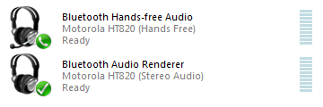
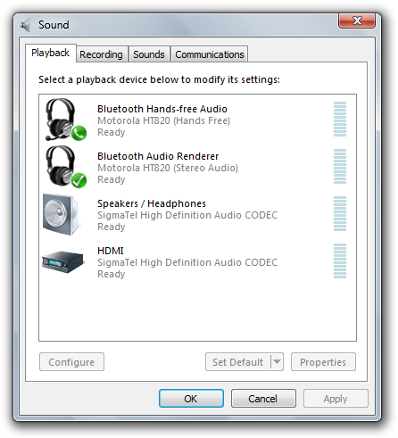
Audio Endpoints
One endpoint for each audio profile

Slide 27
Driver Installation
Bluetooth audio driver
installation priorities
  Device ID
  Class Profile
Custom drivers
  Must install using device ID
  to post on Windows Update

Slide 28
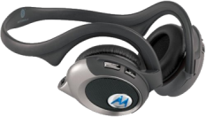
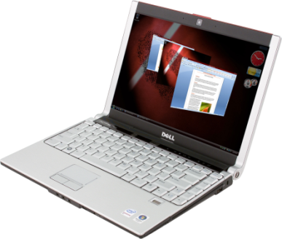
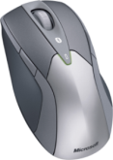
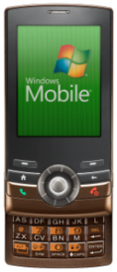
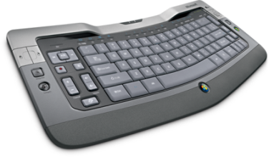
Simple Pairing
CON-T536: Bluetooth and Wireless
USB Support in Windows 7
What’s the Bluetooth Device Class?
Loudspeaker, Headphones, Headset, etc.
0000
Pointing Device
No Passkey
Phone
Generated PIN
Computer
Generated PIN
Keyboard
Generated PIN
Display
0000

Slide 29
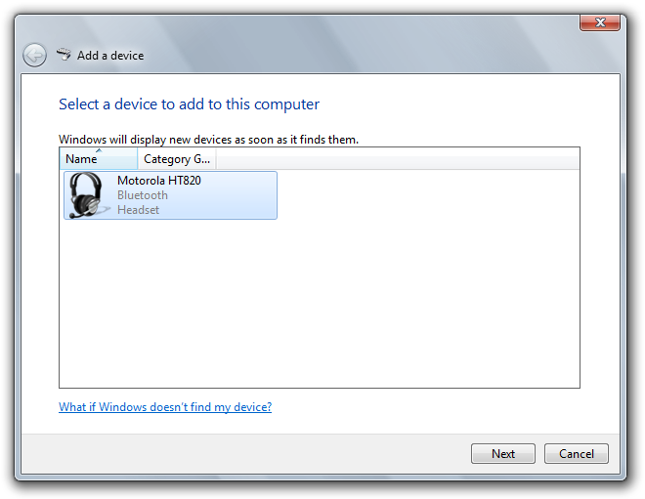
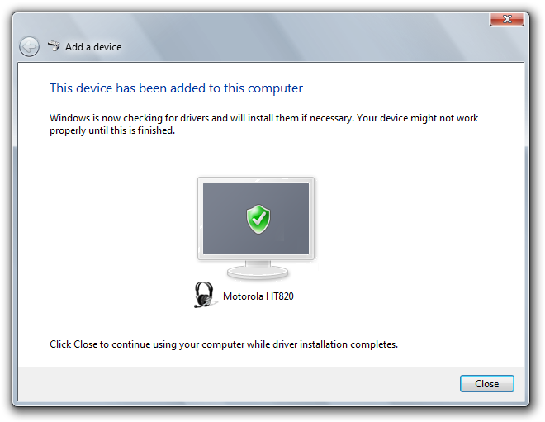
Simple Pairing (cont'd)
Simplifies many pairing
experiences to just this

Slide 30
Other Audio Improvements
Capture Monitor
Public Endpoints and Multiple Remote Endpoints
Shared Mode Latency Improvements
HDMI Audio
Audio Communication Device User Experience
Stream Management
Volume User Experience
Low-Power Audio Enhancements
System Wide Attenuation

Slide 31
Call To Action
Meet Audio Bluetooth Logo Requirements
Take credit by submitting for logo approval
Logo ID | Title
AUDIO-0057 | Bluetooth audio devices to expose Major/Minor Class of Device identifier and accurately reflect form factor/primary usage.
AUDIO-0058 | Bluetooth audio devices paired with a PC will automatically attempt to reconnect to the PC after they are powered up or come back into range.
AUDIO-0060 | Bluetooth Audio Device needs to support at least one of the below profiles (HS, HF, A2DP, AVRCP)
AUDIO-0061 | Bluetooth Audio Devices must complete an HCIDisconnect before powering down
AUDIO-0087 | Bluetooth Audio Device Driver Requirements (Device ID Install)
CONNECT-0006 | Devices which support Bluetooth must implement the DeviceID profile, version 1.2

Slide 32
Additional Resources
White Papers
  UAA Hardware Design
  http://www.microsoft.com/whdc/device/audio/uaa.mspx
  Bluetooth Call Control for Applications
  http://msdn.microsoft.com/en-us/windowsmedia/default.aspx
  Communications Applications and Ducking
  http://go.microsoft.com/fwlink/?LinkId=131247
Related Sessions
  CON-T536: Bluetooth and Wireless USB Support in Windows 7
  CON-T563: Building a Communication Device in Windows 7
  CON-T565: Audio Design for Unified Communications
Chalk Talks
  CON-C663: Audio Design for Unified Communications
  CON-C664: Windows 7 Logo Program for Audio and Communication
Email Questions:
uaa@microsoft.com

Slide 33
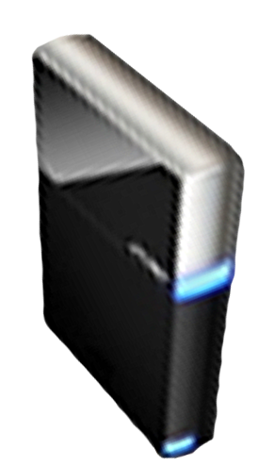


Please Complete A Session Evaluation Form
Your input is important!
Visit the WinHEC CommNet and complete a Session Evaluation for this session and be entered to win one
of 150 Maxtor® BlackArmor™ 160GB External Hard Drives
50 drives will be given away daily!
http://www.winhec2008.com
BlackArmor
Hard Drives provided by:

Slide 34


© 2008 Microsoft Corporation. All rights reserved. Microsoft, Windows, Windows Vista and other product names are or may be registered trademarks and/or trademarks in the U.S. and/or other countries.
The information herein is for informational purposes only and represents the current view of Microsoft Corporation as of the date of this presentation. Because Microsoft must respond to changing market conditions, it should not be interpreted to be a commitment on the part of Microsoft, and Microsoft cannot guarantee the accuracy of any information provided after the date of this presentation.
MICROSOFT MAKES NO WARRANTIES, EXPRESS, IMPLIED OR STATUTORY, AS TO THE INFORMATION IN THIS PRESENTATION.

